Slide 1




English(es) on the Move
What we can learn about language change from variation in amplifier use
Martin Schweinberger
m.schweinberger@uq.edu.au
Slides available at https://github.com/MartinSchweinberger/EngLingInnsbruck2023

Slide 2
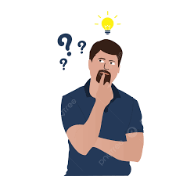
Motivation: what should I present?
A corpus-based acoustic analysis of vowel production by learners and L1-speakers of English
Large scale, acoustic analyses of vowels among Japanese and Chinese English learners
Innovative, future-oriented: will continue becoming a bigger topic (Ulrike Jessner-Schmid)
Utterance-final or as a face-saving strategy in Australian English
Corpus-based pragmatic analysis of utterance final or in spoken Australian English based on 4 AusE corpora (Anna Islentyeva | Monika Kirner-Ludwig)
Combination of computation and qualitative, interpretative work
Vulgarity and swearing on social media
Computational, quantitative analysis of large social media data sets
Timely, skill-exhibition, relevant for the research area Kulturelle Begegnungen – Kulturelle Konflikte (Monika Kirner-Ludwig | Reinhard Heuberger)

Slide 3

English(es) on the Move: what we can learn about language change from variation in amplifier use
Timeline | Table of Contents
Background
Research Gaps | Research Questions
Methodology (Data and Analysis)
Results
Discussion and Outlook

Slide 4

Background What is adjective amplification?
Intensification is a linguistic category that is related to the semantic category of degree and ranges from low (downtoning) to high (amplifiers) (Quirk et al. 1985: 589–590)
Amplifiers
Boosters, e.g. very
Maximizers, e.g. completely
Downtoners
Approximators, e.g. almost
Compromisers, e.g. more or less
Diminishers, e.g. partly
Minimizers, e.g. hardly

Slide 5
Background What is adjective amplification?
Adjective amplification is a common subtype of intensification where the meaning of an adjective is scaled up (amplified or boosted) through linguistic means (Quirk et al. 1985: 589–590)
Prefixation (e.g., ubergood is an amplified version of the base form good)
Suffixation (e.g., -ass as in coldass )
Suprasegmental phonological features such as prosody or stress
Stylistic means, e.g., hyperbole, litotes (e.g., not bad), and rhetorical questions (see Bolinger 1972)
Lexical via degree adverbs that scale upwards such as really, very, or so

Slide 6
Background What is adjective amplification?
Two syntactic functions (positions)
Predicative (1) I think he ’s really nice (ICE-PHI:S1A-083#222:1:C) (2) It ’s so bad (ICE-PHI:S1A-013#204:1:A)
Attributive (3) It is a very good training (ICE-HK:S1A-022#433:1:A) (4) But it’s a completely different story (ICE-IND:S1A-073#48:1:A)

Slide 7
Background Why study adjective amplification?
Adjective amplification is…
major area of grammatical change (cf. Brinton and Arnovick 2006: 441): found to be a site of “fevered invention and competition that would be hard to come by elsewhere” (Bolinger 1972: 18)
crucial for “social and emotional expression of speakers” (Ito and Tagliamonte 2003: 258)
linguistic subsystem which allows precise circumscription of a variable context (Labov 1972, 1966: 49)
Adjective amplification represents an ideal case for
testing mechanisms underlying language change!

Slide 8
Background What do we know about adjective amplification?
Substantial amount of corpus-based research on intensification (e.g Aijmer 2011, 2018; Fuchs 2016, 2017; Núñez Pertejo and Palacios 2014; Palacios and Núñez Pertejo 2012) but mostly either focused on individual intensifiers or without regard to the intensified adjectives
Analyses have investigated amplifier use in different languages (e.g., Stratton & Sundquist 2022 for Norwegian, Stratton 2020b for German, Roles & Enghels 2020 for Spanish, or Zellermayer 1991 for Hebrew), across regional varieties (see next slide), in learner language (e.g., Schweinberger 2020a, 2020b; Czerwionka & Olson 2020), and over time as well as in different periods (Stratton 2022; Méndez-Naya 2003)
Over the last 5 or so years, the role that adjectives play in amplification has come more into focus (e.g. Schweinberger 2017; Wagner 2017a,b)
Amplification (and particularly the use of innovative variants such as so and really) are associated with teenage talk and young(ish) (female) speakers (Bauer and Bauer 2002; D’Arcy 2015; Macaulay 2006; Tagliamonte 2006, 2008) -

Slide 9
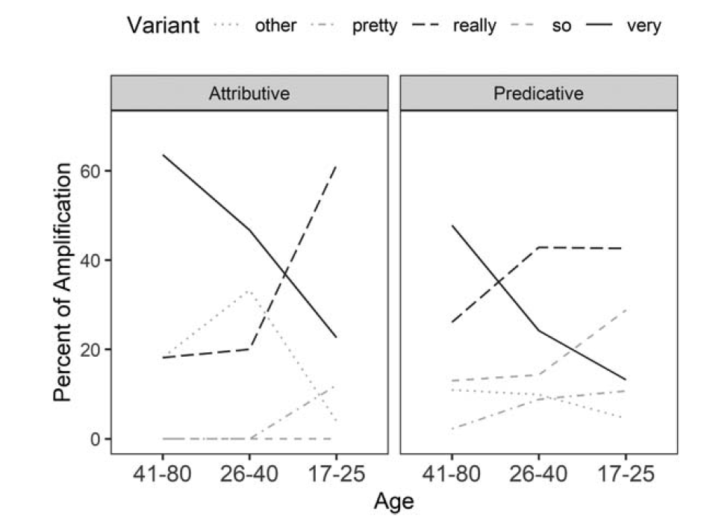
Background What do we know about adjective amplification?
Figure 1:
Amplifier use across apparent time in Australian English (Schweinberger 2021:14)
Most consistent finding in L1 varieties really replaces very as the dominant amplifier (lexical replacement) in various speech communities (see D’Arcy [2015] for New Zealand English; Schweinberger [2021] for Australian English; Ito & Tagliamonte [2003], Xiao & Tao [2007], and Barnfield & Buchstaller [2010] for (north-east) British English; Tagliamonte [2008] and Tagliamonte & Denis [2014] for Canadian English; Macaulay [2002] and [2006] for Scottish English, Schweinberger [2022} for Irish English.

Slide 10
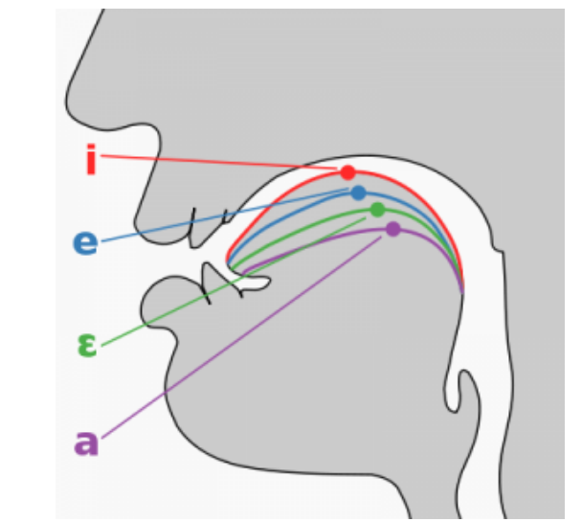
Research Gaps | Research Questions
Problems and gaps in previous research
Very little research on amplifier use in Asian Englishes (notable exceptions are Fuchs & Gut 2016, Fuchs 2022, and Funke & Bernaisch 2022)
We do not know if the amplifier systems in Asian Englishes are undergoing change
More generally though, we lack an understanding of what factors are at play during different stages of change!
Current study
Multivariate, variationist analysis of amplification in Hong Kong English (HKE), Philippine English (PhiE), and Indian English (IndE) that considers various intra- and extra-linguistics factors
RQ1: What is the structure of the amplifier systems in HKE, IndE, and PhiE?
RQ2: Are the amplifier systems in these varieties undergoing change?

Slide 11

Methodology (Data | Analysis)
Data
International Corpus English (ICE) (Greenbaum 1991)
Components: Hong Kong, India, Philippines
Consistent design and annotation (comparability!) plus informal conversation
Accompanied by biodata of speakers (extremely interesting resource for variationist analyses)
Final data set
Variety | Speakers | Adjectives | other (N) | really (N) | so (N) | very (N)
HKE | 162 | 1,562 | 4.5% (N=71) | 10.9% (N=170) | 15.3% (N=239) | 69.3% (N=1082)
IndE | 196 | 916 | 8.5% (N=78) | 4% (N=37) | 14.3% (N=131) | 73.1% (N=670)
PhiE | 168 | 818 | 4.6% (N=38) | 21.9% (N=179) | 37.7% (N=308) | 35.8% (N=293)
Total | 526 | 3,296 | 5.7% (N=187) | 11.7% (N=386) | 20.6% (N=678) | 62% (N=2045)
Table 1: Overview of the final data set.

Slide 12
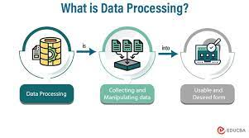
Methodology (Data | Analysis)
Data Processing (all in R 4.2.2, R Core team [2022] in RStudio [Posit Team 2023])
Part–of-speech tagged (udpipe package) spoken private dialogue section of each component
Retrieved all adjectives (PoS–tag JJ) and determined whether an adjective had been amplified (member of a predefined set of amplifiers)
Sentiment Analysis of adjectives (negative, neutral, positive) using the crowd-sourced word-emotion association dictionary (see Mohammad &Turney 2013)
Priming: determined if the same amplifier type had been used to amplify the preceding adjective
Removed. . .
negated adjectives
comparative and superlative forms
adjectives that were preceded by downtoners
strange forms (e.g. much, many)

Slide 13
Methodology (Data | Analysis)
Data Processing (all in R 4.2.2, R Core team [2022] in RStudio [Posit Team 2023])
Determined the syntactic context of the adjective (attributive: the nice man | predicative: The man is nice.)
Determined the token frequency of all adjective types (Tagliamonte and Roberts 2005)
Gradability: likelihood of the occurrence in comparative contexts against occurrence in non-comparative contexts (pregnant, Chinese: not gradable | nice, tall: gradable)
Semantic type of adjective (simplified version of Dixon 1977): evaluative (e.g., good, little, difficult), descriptive (e.g., old, young, simple), relational (e.g., first, new, next), membership (e.g., local, national, british), dimension (e.g., small, large, long), other (unclassifiable adjectives such as illiterate, unavailable, heterogeneous).
Manual cross–evaluation of automated categorisation
Added metadata and speaker information (variety, age, gender)

Slide 14
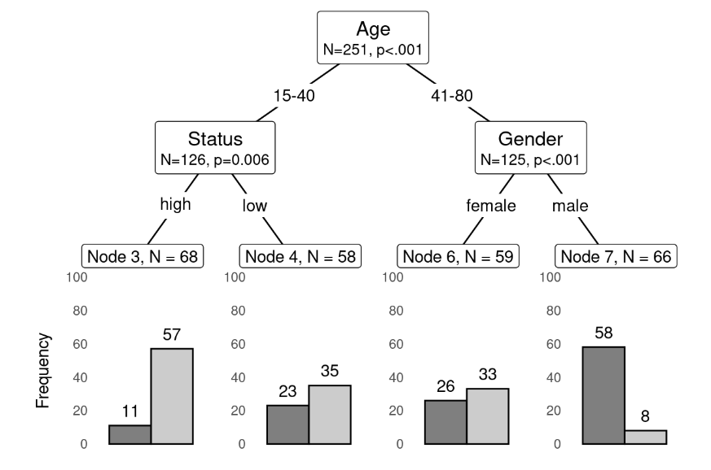
Methodology (Data | Analysis)
Statistical Analysis
Conditional Inference Trees (CIT) (see Schweinberger 2023, Hothorn & Zeileis 2015)
Advantages
Multivariate statistical method
Easy to implement and interpret
Works particularly well for
Complex unbalanced data sets
Higer-order interactions (effects depend on the presence of other factors)
Problems
Not as well-known as (mixed-effects) regressions
Overfitting (generalisability can be limited)

Slide 15
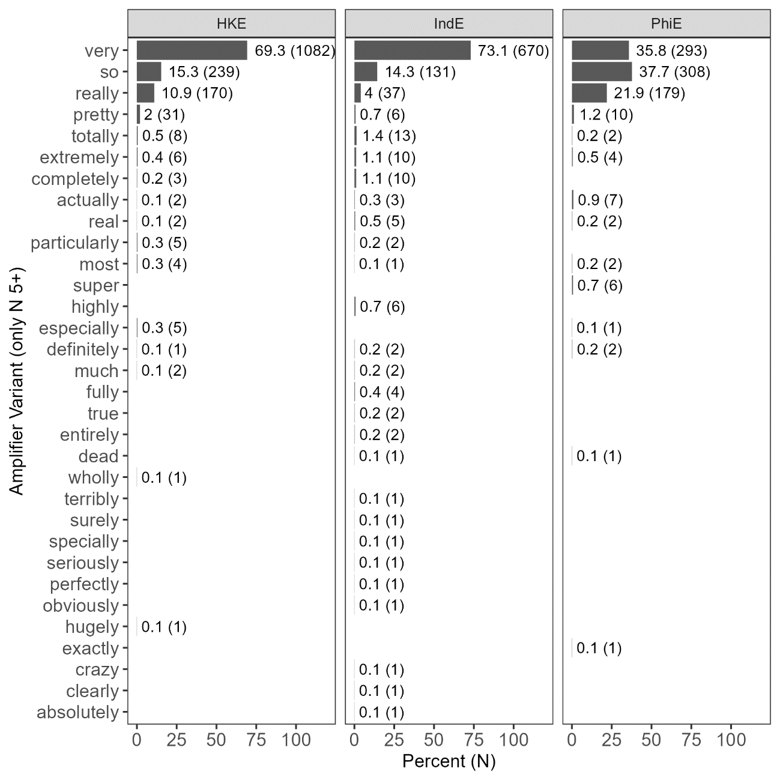
Results
Descriptives: amplifiers across varieties
The broadest range of amplifier use is attested for IndE
very, so, and really are clearly the most frequent (dominating) amplifiers in all varieties.
very is dominating the amplifiers systems of HKE and IndE.
In PhiE, very is less frequent than so and really is about half as frequent as so (other amplifies are notably rare).

Slide 16
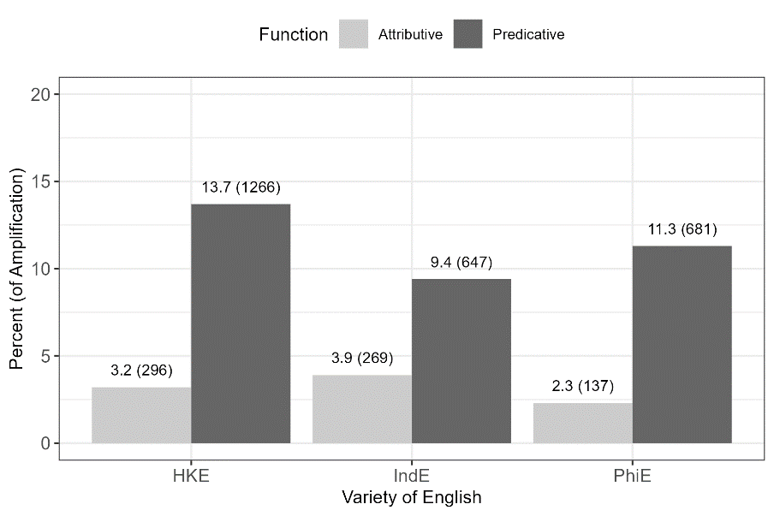
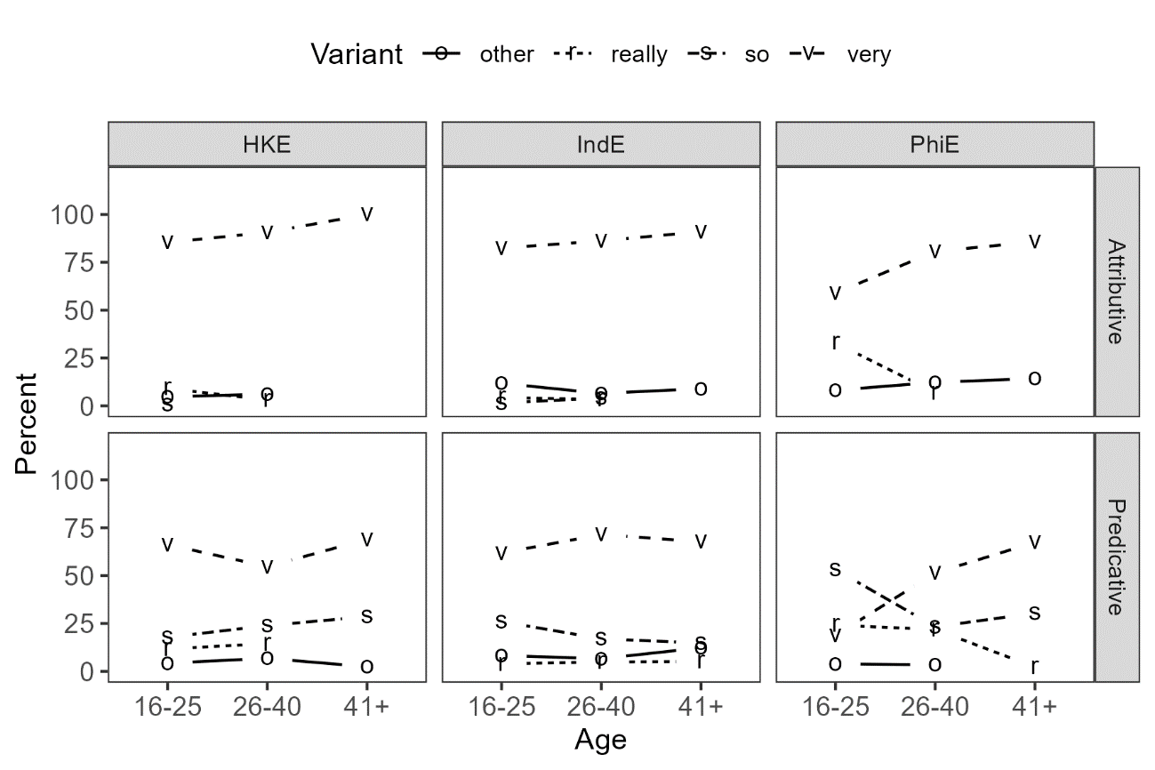
Results
Right: Amplifiers are more common in predicative contexts in all varieties under investigation
Descriptives: amplifiers across varieties
Amplification is more common in predicative contexts (He is very nice.)
very is clearly the dominant amplifier in HKE and IndE
The amplifier system of PhiE is undergoing change in apparent time with really challenging very in attributive contexts and so dominating the system among younger speaker in predicative contexts.
No or few signs of apparent time change in the amplifier systems of HKE and IndE.

Slide 17
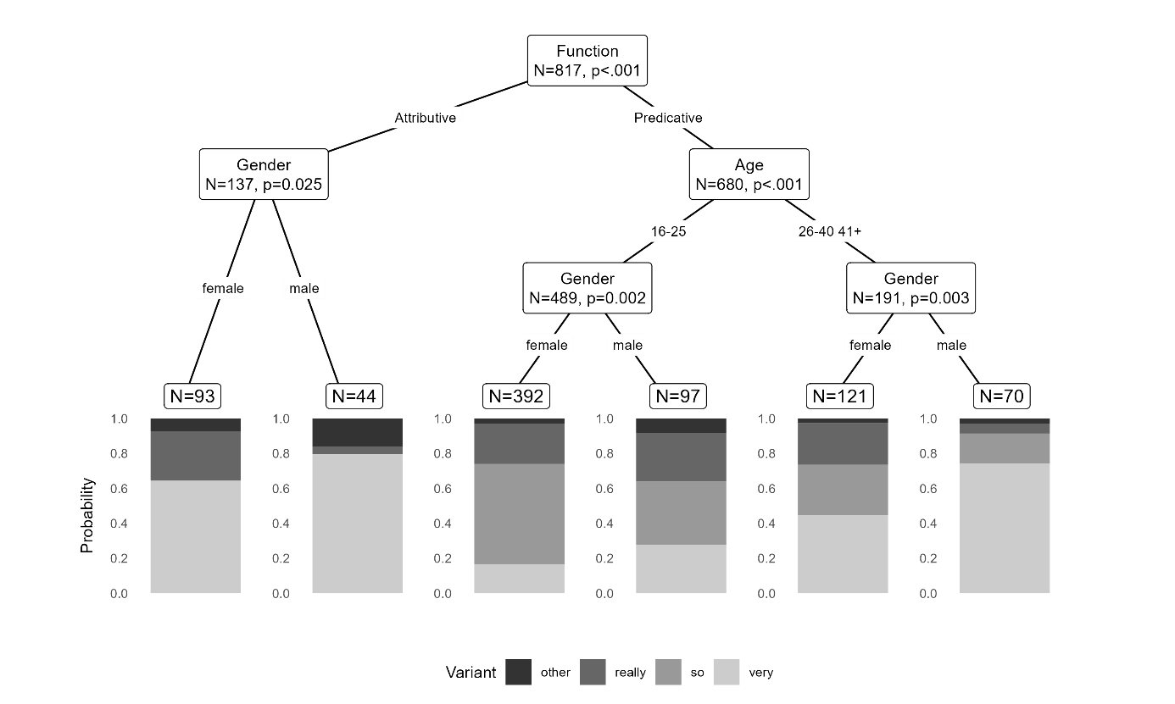
Results
Philippine English
Function most important predictor (unsurprising as so almost exclusively occurs in predicative contexts)
Significant stratification along social dimensions! (extra-linguistic factors dominate)
No significant impact of intra-linguistic factors
very dominant only in attributive contexts and among older males.
Substantive use of really and so.

Slide 18
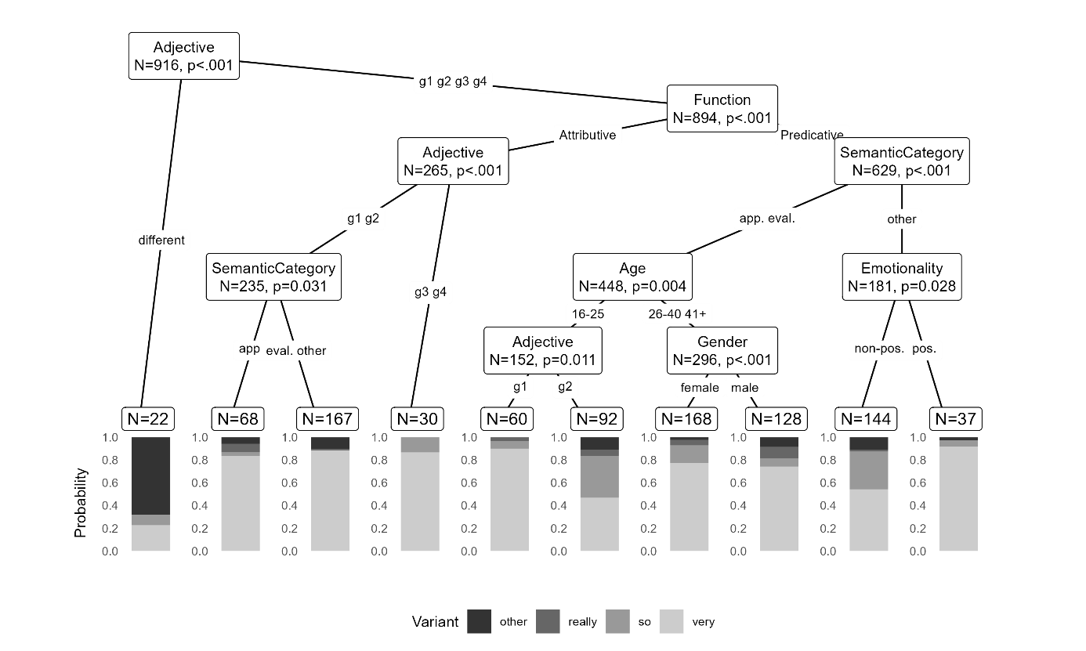
Results
Indian English
More complex than PhiE
Adjective most important predictor (due to quite different)
Intra-linguistic factors associated with the semantics of the adjective dominate
Extra-linguistic factors only relevant for very specific subgroups
Notable dominance of very (with only 3 subgroups showing dominance of innovative variants)
Use of really and so is comparatively rare.

Slide 19
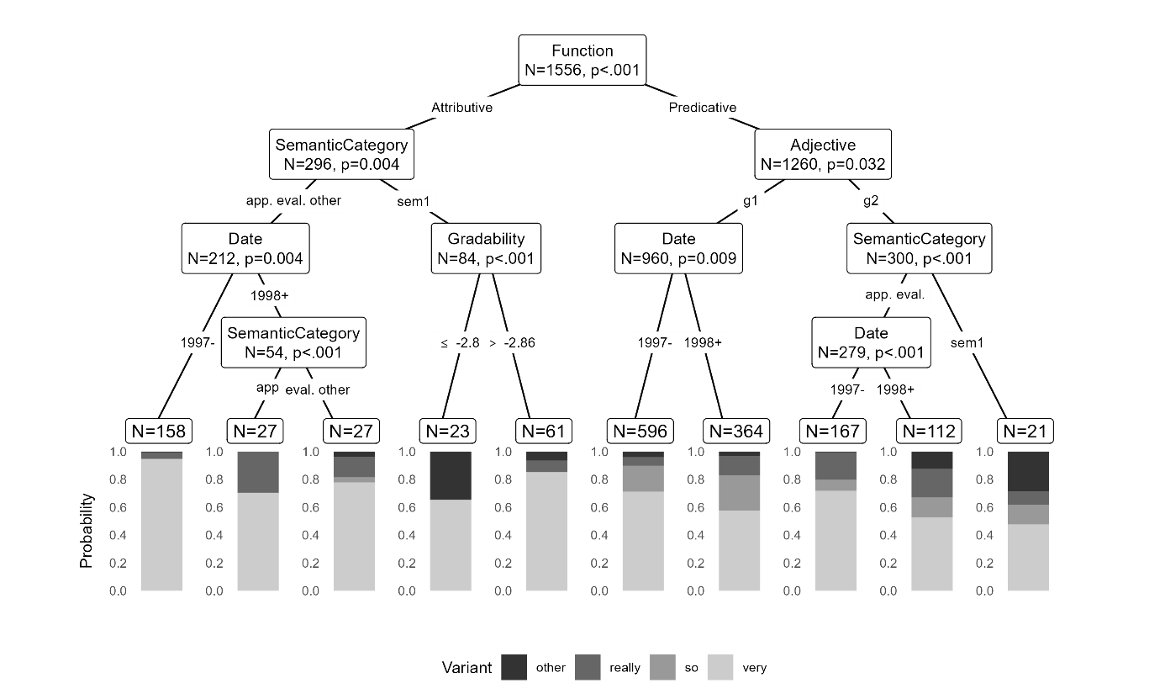
Results
Hong Kong English
In-between IndE and PhiE
Function again most important factor
Intra-linguistic factors associated with the semantics of the adjective dominate
Signs of real-time change (date is an important factor indicating that the system has changed between data collection phases)
Very is dominant but use of really and so is relatively common across subgroups
Lack of social stratification (age and gender do not affect amplifier use)

Slide 20
Summary and Discussion
Main take aways
Main amplifiers: very, so, really (others notably rare)
IndE: no ongoing change: use is determined by language-internal factors!
PhiE: apparent-time change and social stratification
HKE: real-time change but use is determined intra-linguistically
What does this mean?

Slide 21
Discussion
What is the bigger picture here?
Variationist Sociolinguistics
Language is not homogeneous: variation is ubiquitous (see e.g. Labov [1994), 2001, 2011], Tagliamonte [2011])
Social factors |  | Language use
Social stratification |  | Linguistic differentiation
Linguistic variation not random systematic correlation between certain social factors (age, gender, class, ethnicity, etc.) and language use

Slide 22
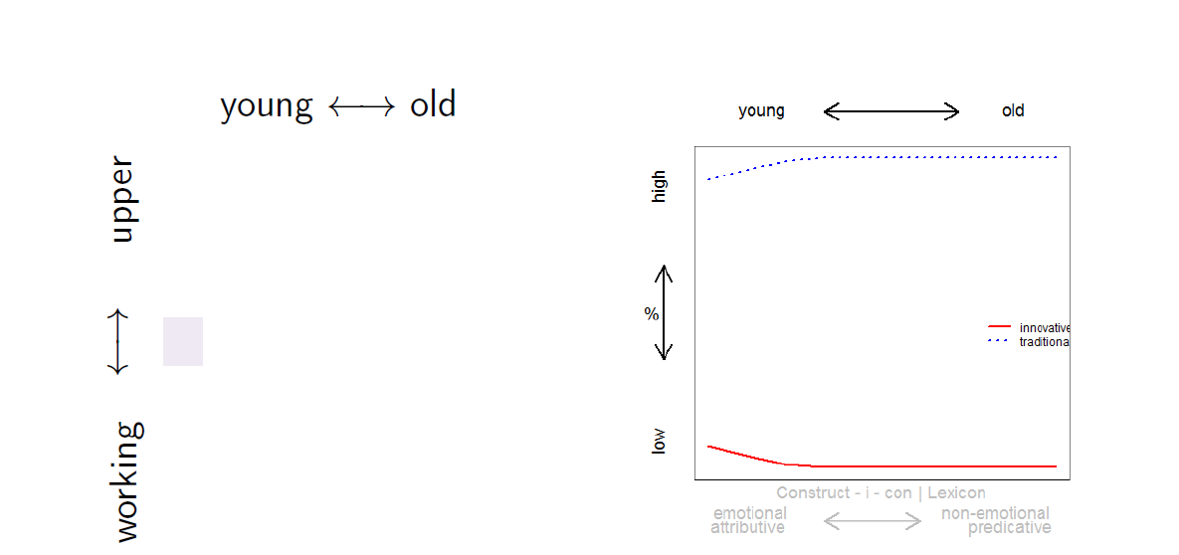
Summary and Discussion
What is the bigger picture here?
Diffusion of Innovations (key concept in Variationist Sociolinguistics)

Slide 23
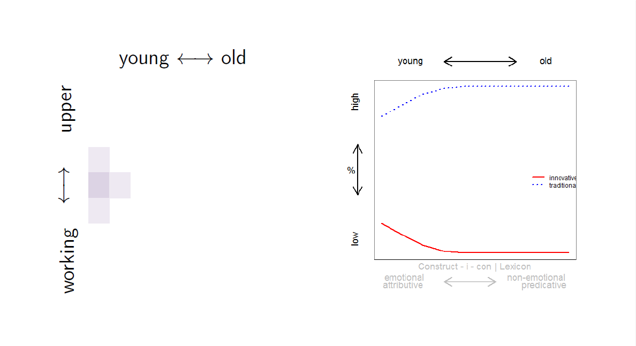
Summary and Discussion
What is the bigger picture here?
Diffusion of Innovations (key concept in Variationist Sociolinguistics)

Slide 24
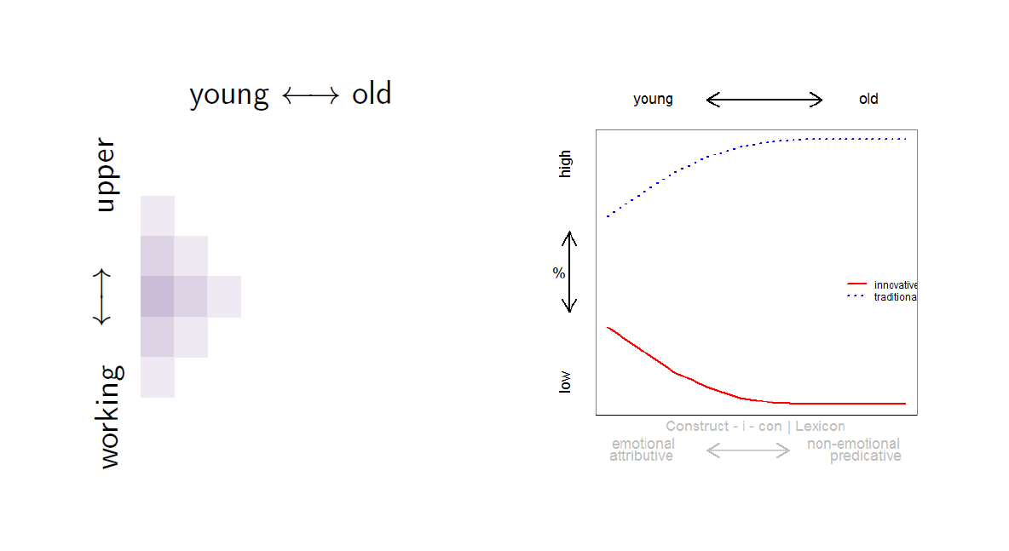
Summary and Discussion
What is the bigger picture here?
Diffusion of Innovations (key concept in Variationist Sociolinguistics)

Slide 25
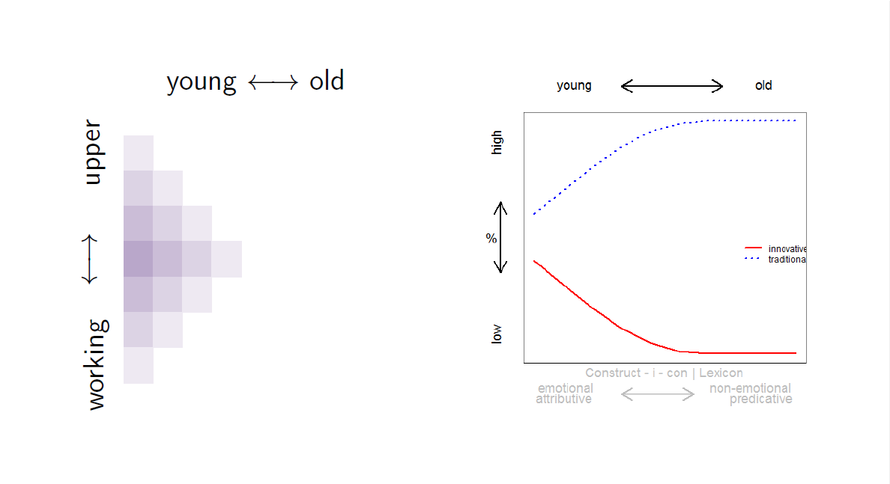
Summary and Discussion
What is the bigger picture here?
Diffusion of Innovations (key concept in Variationist Sociolinguistics)

Slide 26
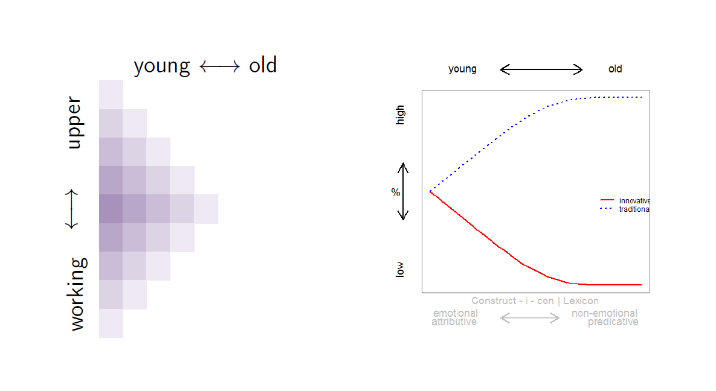
Summary and Discussion
What is the bigger picture here?
Diffusion of Innovations (key concept in Variationist Sociolinguistics)

Slide 27
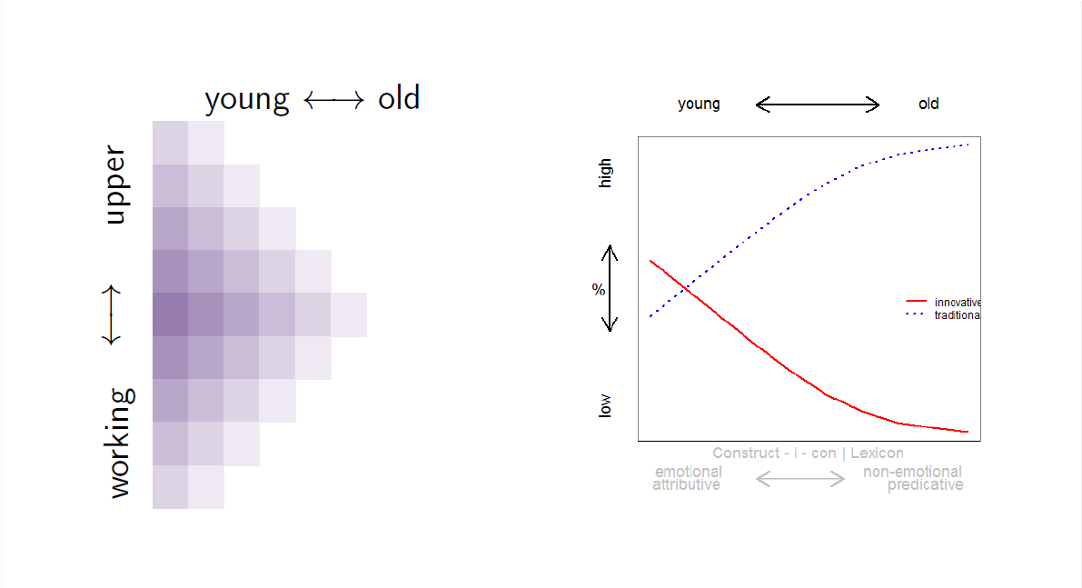
Summary and Discussion
What is the bigger picture here?
Diffusion of Innovations (key concept in Variationist Sociolinguistics)

Slide 28
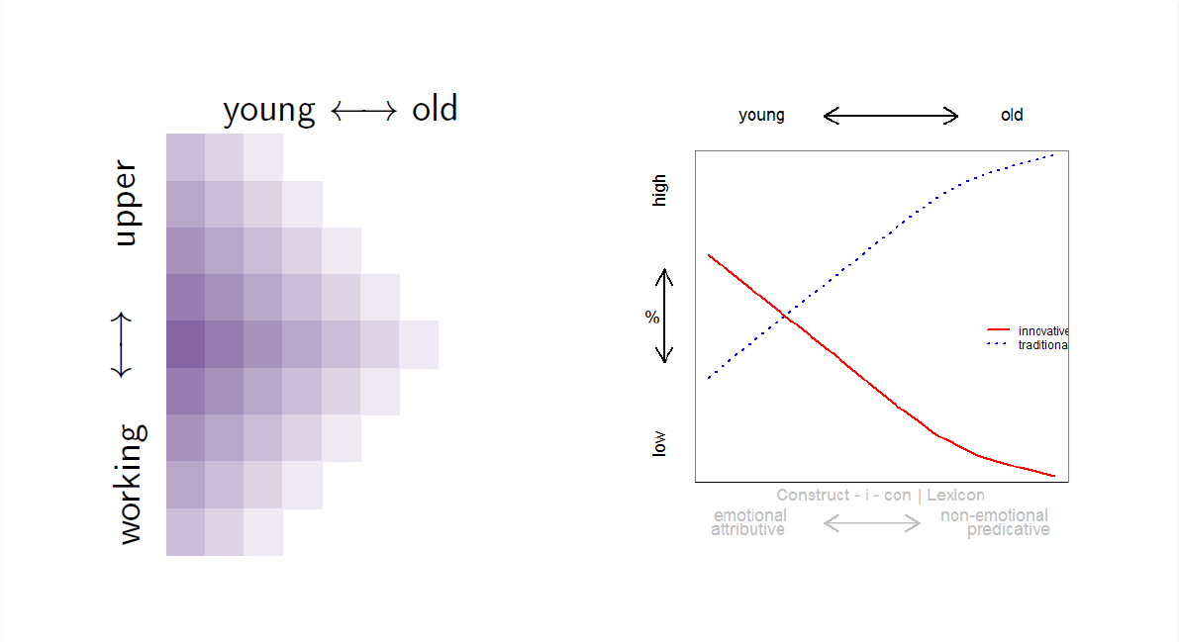
Summary and Discussion
What is the bigger picture here?
Diffusion of Innovations (key concept in Variationist Sociolinguistics)

Slide 29
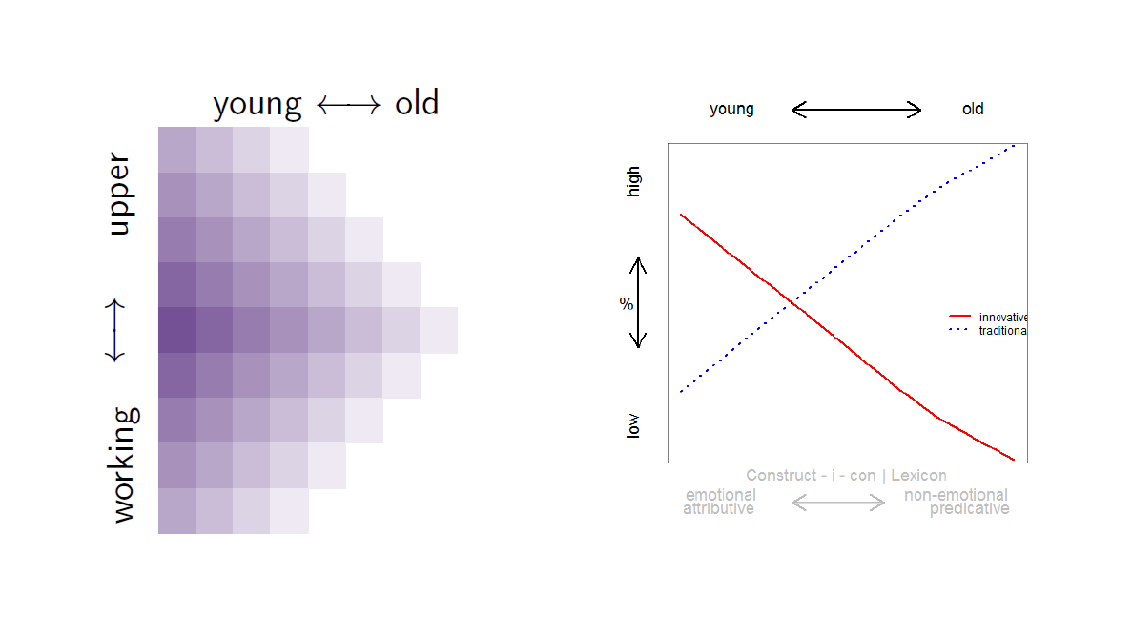
Summary and Discussion
What is the bigger picture here?
Diffusion of Innovations (key concept in Variationist Sociolinguistics)

Slide 30
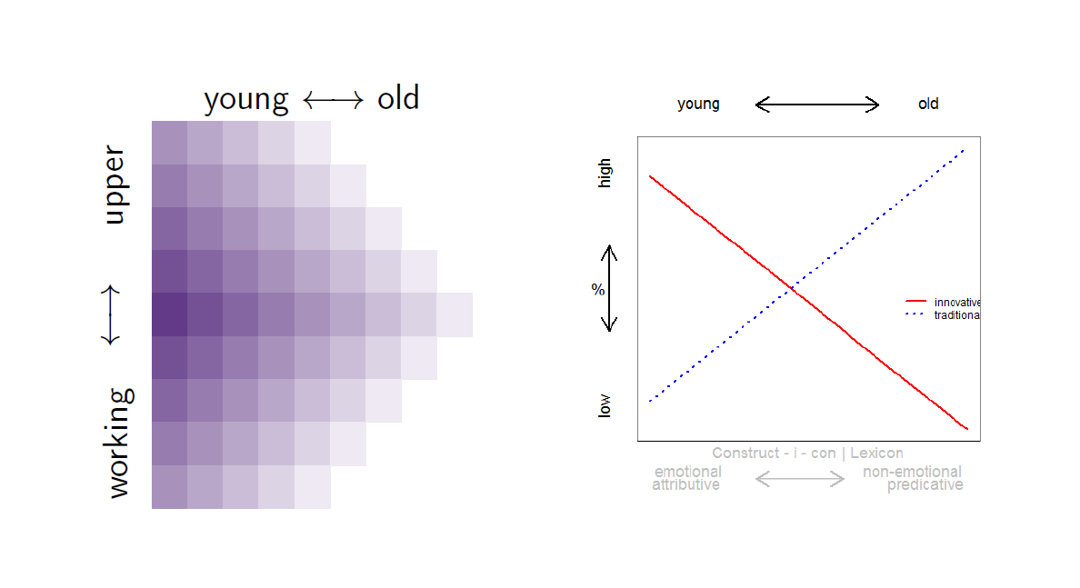
Summary and Discussion
What is the bigger picture here?
Diffusion of Innovations (key concept in Variationist Sociolinguistics)

Slide 31
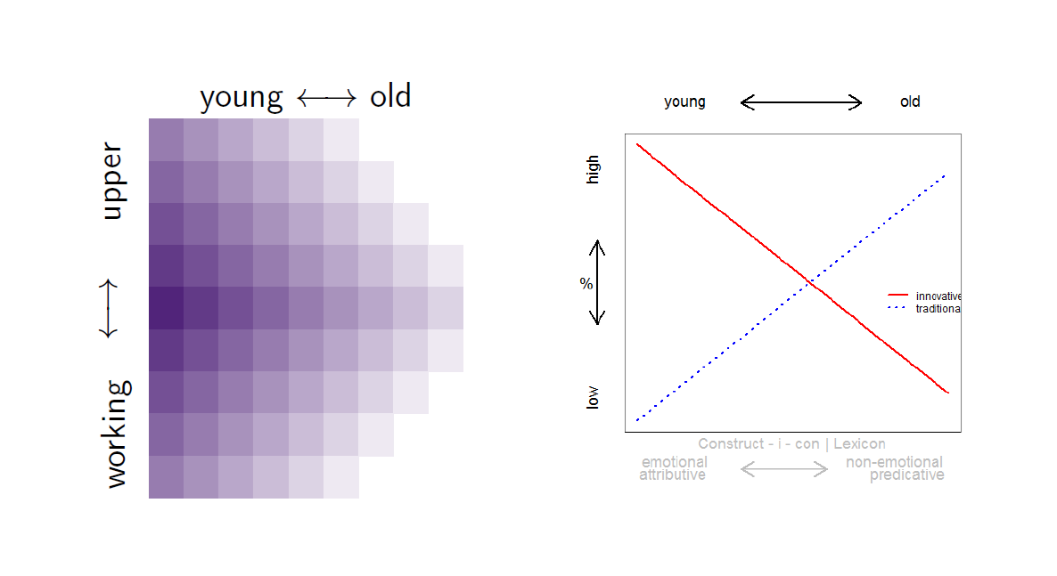
Summary and Discussion
What is the bigger picture here?
Diffusion of Innovations (key concept in Variationist Sociolinguistics)

Slide 32
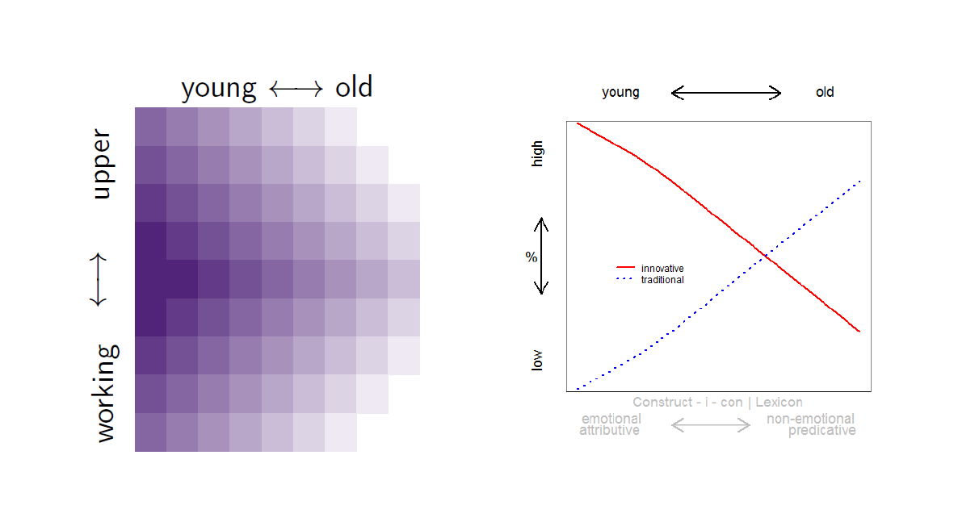
Summary and Discussion
What is the bigger picture here?
Diffusion of Innovations (key concept in Variationist Sociolinguistics)

Slide 33
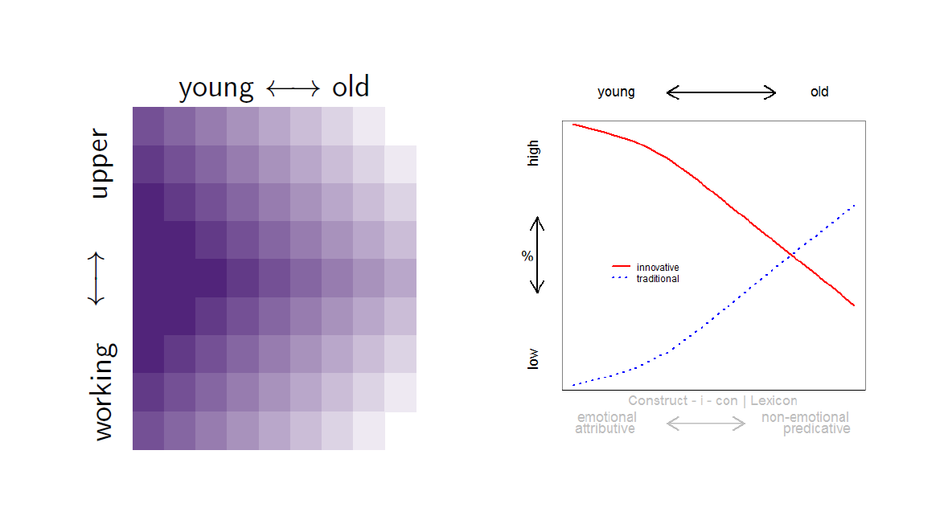
Summary and Discussion
What is the bigger picture here?
Diffusion of Innovations (key concept in Variationist Sociolinguistics)

Slide 34
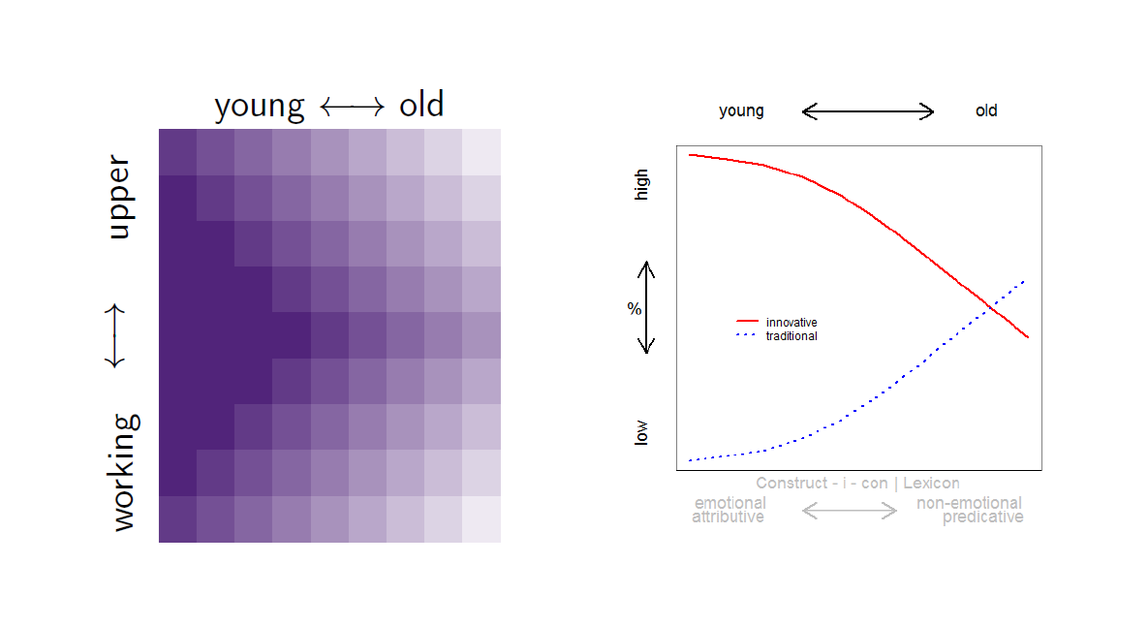
Summary and Discussion
What is the bigger picture here?
Diffusion of Innovations (key concept in Variationist Sociolinguistics)

Slide 35
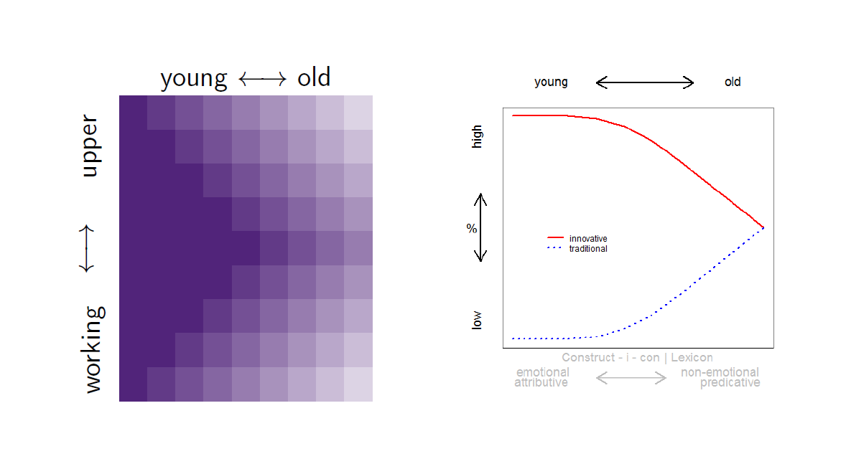
Summary and Discussion
What is the bigger picture here?
Diffusion of Innovations (key concept in Variationist Sociolinguistics)

Slide 36
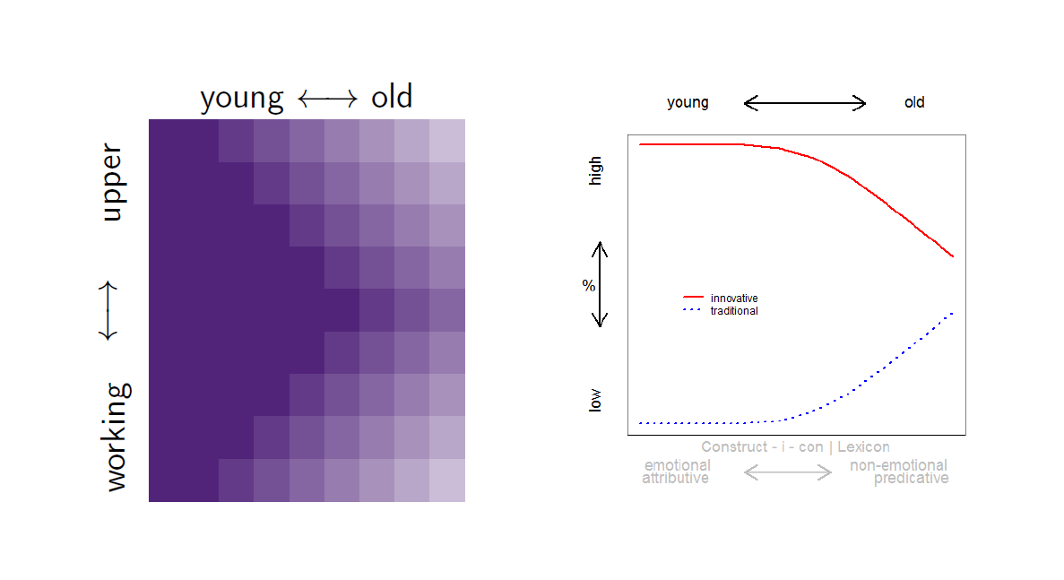
Summary and Discussion
What is the bigger picture here?
Diffusion of Innovations (key concept in Variationist Sociolinguistics)

Slide 37
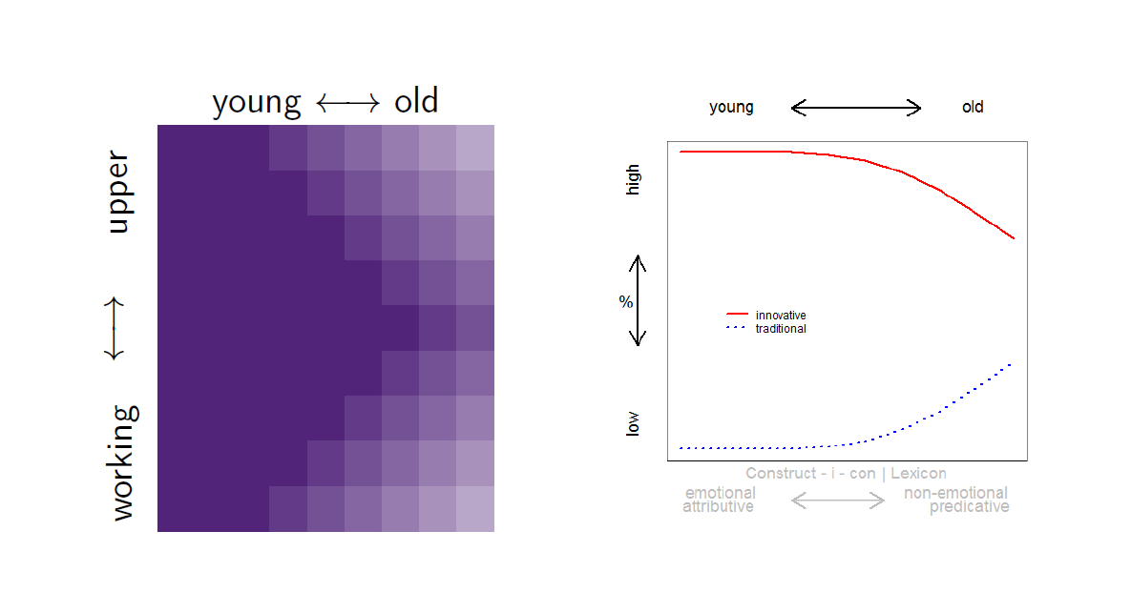
Summary and Discussion
What is the bigger picture here?
Diffusion of Innovations (key concept in Variationist Sociolinguistics)

Slide 38
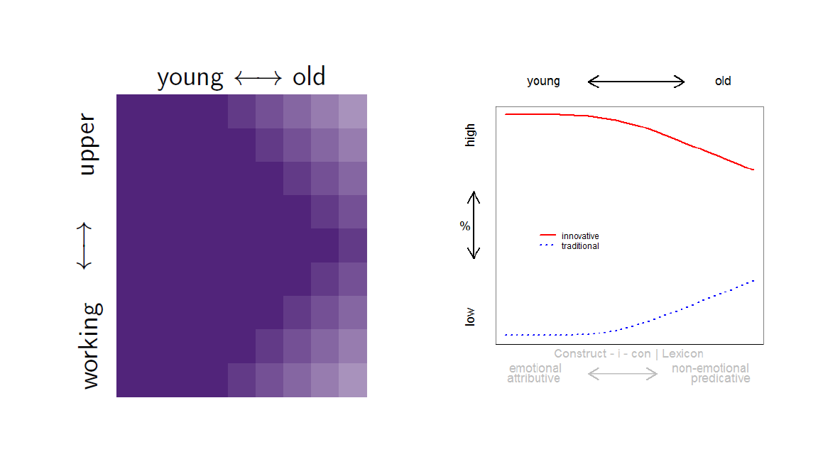
Summary and Discussion
What is the bigger picture here?
Diffusion of Innovations (key concept in Variationist Sociolinguistics)

Slide 39
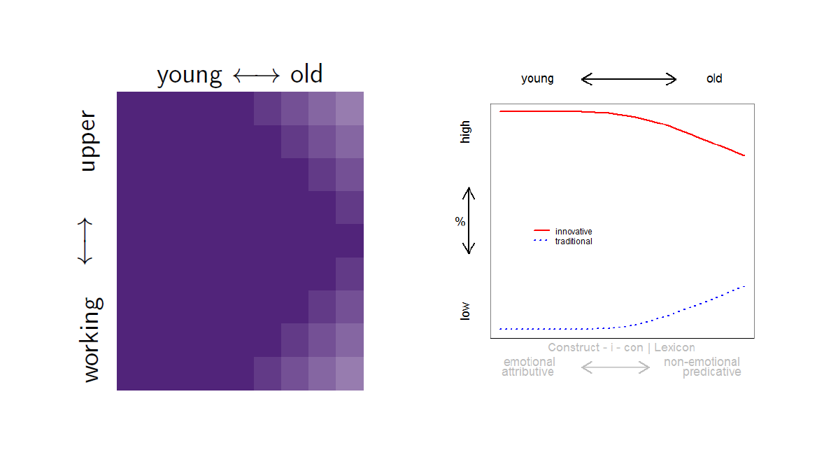
Summary and Discussion
What is the bigger picture here?
Diffusion of Innovations (key concept in Variationist Sociolinguistics)

Slide 40
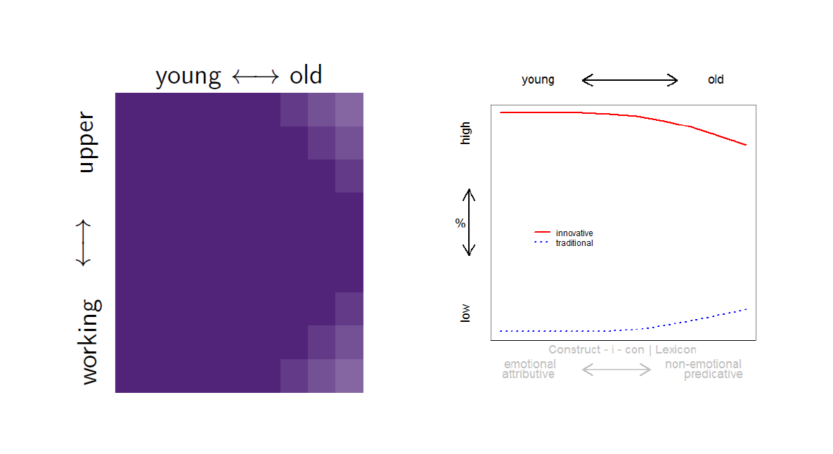
Summary and Discussion
What is the bigger picture here?
Diffusion of Innovations (key concept in Variationist Sociolinguistics)

Slide 41
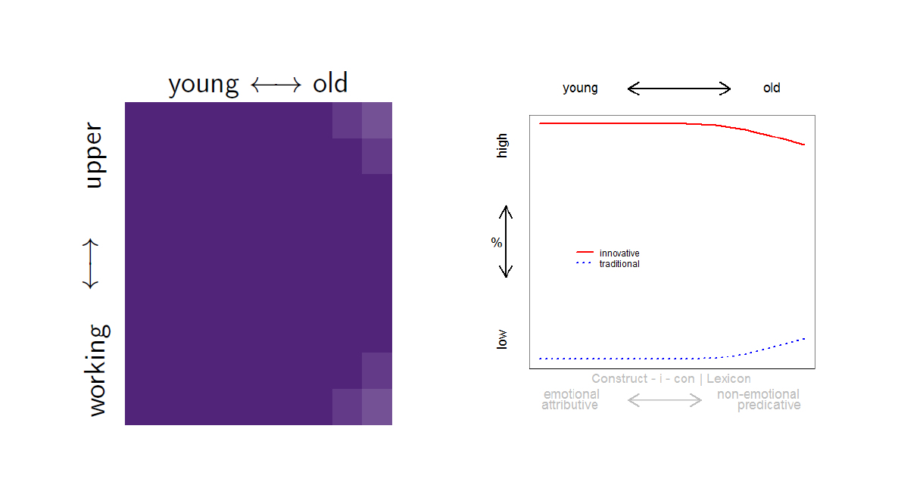
Summary and Discussion
What is the bigger picture here?
Diffusion of Innovations (key concept in Variationist Sociolinguistics)

Slide 42
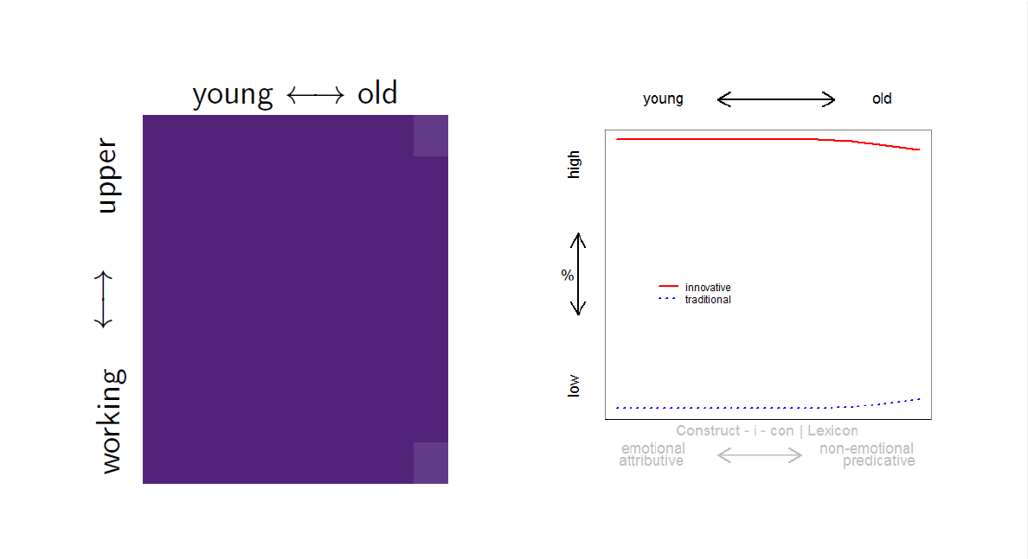
Summary and Discussion
What is the bigger picture here?
Diffusion of Innovations (key concept in Variationist Sociolinguistics)

Slide 43
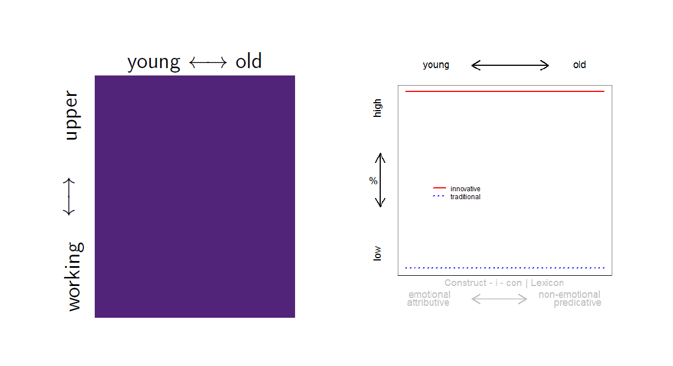
Summary and Discussion
What is the bigger picture here?
Diffusion of Innovations (key concept in Variationist Sociolinguistics)

Slide 44
Discussion
What does this mean?
Changes only progress to finalisation if variants attract a social meaning (actuation problem)
Support for Labov’s (2002) hypothesis that change represents an “opportunistic process that reinforces social distinctions by associating them with particular linguistic variants”
What is new about the present study is the tie between different stages of change and the importance of intra- and extra-linguistic factors:
During stasis and initial stages of change, language-internal factors could represent determining factors of variation, but language-external social factors (social meaning) becomes important when the change progresses to mid-range (and probably beyond).
This means that the study
On the one hand confirms hypotheses about the underlying mechanisms of language change
On the other, it generates hypotheses that can be tested in future research

Slide 45

Potential Applications
Significance
One of the first corpus-based studies that
focus on adjective amplification in Asian Englishes
address the issue of what factors are at play during different stages of change.
Prototype (proof-of-concept)
Extend study to other phenomena and other varieties of English (does this trend hold more generally: could it be a principle of language change?)
Possible Applications
Follow-up: PhD | MA theses that investigate this in other varieties and for other phenomena where we know that there is ongoing change (e.g., discourse markers, quotative systems, t/d-deletion, relativization)

Slide 46
Thank you really very much!
Martin Schweinberger
m.schweinberger@uq.edu.au

Slide 47

References
Aijmer, Karin. 2018. Intensification with very, really and so in selected varieties of English. In Sebastian Hoffmann, Andrea Sand, Sabine Arndt-Lappe, and Lisa Marie Dillmann (eds.), Corpora and lexis, 106-139. Leiden: Brill
Barnfield, Katie, & Isabelle Buchstaller. 2010. Intensifiers on Tyneside: Longitudinal developments and new trends. English World-Wide 31(3): 252-287.
Bolinger, Dwight. 1972. Degree words. The Hague: Mouton.
Czerwionka, Lori, & Daniel J. Olson. 2020. Pragmatic development during study abroad: L2 intensifiers in spoken Spanish. International Journal of Learner Corpus Research 6(2): 125-162.
D’Arcy, Alexandra F. 2015. Stability, stasis and change - the longue duree of intensification. Diachronica 32(4): 449–493.
Dixon, R. M. W. 1977. Where have all the adjectives gone? Studies in Language 1: 19–80.
Fuchs, Robert & Ulrike Gut. 2016. Register variation in intensifier usage across Asian Englishes. In Heike Pichler (ed.), Discourse-pragmatic variation and change: Insights from English, 185-210. Cambridge: Cambridge University Press.
Fuchs, Robert. 2017. Do women (still) use more intensifiers than men?. International Journal of Corpus Linguistics 22(3): 345–374.
Fuchs, Robert. 2022. Sociolinguistic Variation in Intensifier Usage in Indian and British English. Gender and Language in the Inner and Outer Circle. In Tobias Bernaisch (ed.), Gender in World Englishes, 47-68. Cambridge: Cambridge University Press.
Funke, Nina, & Tobias Bernaisch. 2022. Intensifying and downtoning in South Asian Englishes: Empirical perspectives. English World-Wide 43(1): 33-65.
Greenbaum, Sidney. 1991. ICE: The international corpus of English. English Today 7(4): 3-7.
Hothorn Torsten & Achim Zeileis. 2015. partykit: A Modular Toolkit for Recursive Partytioning in R. Journal of Machine Learning Research 16: 3905-3909. url: https://jmlr.org/papers/v16/hothorn15a.html.

Slide 48
References
Ito, Rika & Sali Tagliamonte. 2003. Well weird, right dodgy, very strange, really cool: Layering and recycling in English intensifiers. Language in Society 32(2): 257-279.
Labov, William. 2002. Driving forces in linguistic change. Paper presented at the International Conference on Korean Linguistics.
Lenker, Ursula. 2008. Booster prefixes in Old English – An alternative view of the roots of ME forsooth. English Language & Linguistics 12(2): 245–265.
Macaulay, Ronald. 2002. Extremely interesting, very interesting, or only quite interesting? Adverbs and social class. Journal of Sociolinguistics 6(3): 398–417.
Macaulay, Ronald. 2006. Pure grammaticalization: The development of a teenage intensifier. Language Variation and Change 18: 267–283.
Méndez-Naya, Belén. 2003. On intensifiers and grammaticalization: The case of swiþe. English Studies 84(4): 372-391.
Méndez-Naya, Belén (ed). 2008. Special issue on English intensifiers. English Language and Linguistics 12(2): 213-219.
Mohammad, Saif M, & Peter D. Turney. 2013. Crowdsourcing a Word-Emotion Association Lexicon. Computational Intelligence 29(3): 436–65.
Posit team. 2023. RStudio: Integrated Development Environment for R. Posit Software, PBC, Boston, MA. url: http://www.posit.co/.
Quirk, Randolph, Sydney Greenbaum, Geoffrey Leech, & Jan Svartvik. 1985. A comprehensive English grammar. London and New York: Longman.
R Core Team. 2022. R: A language and environment for statistical computing. R Foundation for Statistical Computing, Vienna, Austria. url: https://www.R-project.org/.
Schweinberger, Martin. 2020a. A corpus-based analysis of adjective amplification among native speakers and learners of English. International Journal of Learner Corpus Research 6(2): 163-192.
Schweinberger, Martin. 2020b. How Learner Corpus-Research can inform language learning and teaching: An analysis of adjective amplification among L1 and L2 English speakers. Australian Review of Applied Linguistics 43(2): 195-217.

Slide 49
References
Schweinberger, Martin. 2021. Ongoing change in the Australian English amplifier system. Australian Journal of Linguistics 41(2): 166-194.
Schweinberger, Martin. 2022. Absolutely fantastic and really, really good – Language Variation and Change in Irish English. In Carolina Amador-Moreno & Stephen Lucek (eds.), Expanding the Landscapes of Irish English: Research in Honour of Jeffrey Kallen, 129-142. Routledge.
Schweinberger, Martin. 2023. Tree-Based Models in R. Brisbane: The University of Queensland. url: https://slcladal.github.io/tree.html (Version 2023.04.05).
Stratton, James M. 2020a. Adjective intensifiers in German. Journal of Germanic Linguistics 32(2): 183-215.
Stratton, James M. 2020b. A diachronic analysis of the adjective intensifier well from Early Modern English to Present Day English. Canadian Journal of Linguistics/Revue canadienne de linguistique 65(2): 216-245.
Stratton, James. 2021. ‘That’s proper cool’. The emerging intensifier proper in British English. English Today 37(4): 206–213.
Stratton, James. M. 2022. Old English intensifiers: The beginnings of the English intensifier system. Journal of Historical Linguistics 12(1): 31-69.
Stratton, James M. & John Sundquist. 2022. A variationist sociolinguistic analysis of intensifiers in Oslo Norwegian. Journal of Germanic Linguistics 34(4): 385-419.
Tagliamonte, Sali. 2008. So different and pretty cool! Recycling intensifiers in Toronto, Canada. English Language and Linguistics 12(2): 361–394.
Tagliamonte, Sali. A. & Derek Denis. 2014. Expanding the transmission/diffusion dichotomy: Evidence from Canada. Language 90(1): 90–136.
Tagliamonte, Sali & Chris Roberts. 2005. So weird; so cool; so innovative: The use of intensifiers in the television series Friends. American Speech 80(3): 280-300.
Wijffels, Jan. 2023. udpipe: Tokenization, Parts of Speech Tagging, Lemmatization and Dependency Parsing with the UDPipe NLP Toolkit. R package version 0.8.11. url: https://CRAN.R-project.org/package=udpipe.
Xiao, Richard, and Hongyin Tao. 2007. A corpus-based sociolinguistic study of amplifiers in British English. Sociolinguistic Studies 1(2): 241-273.

Slide 50
English(es) on the Move
What we can learn about language change from variation in amplifier use
Martin Schweinberger
m.schweinberger@uq.edu.au
Slides available at https://github.com/MartinSchweinberger/EngLingInnsbruck2023

