Slide 1
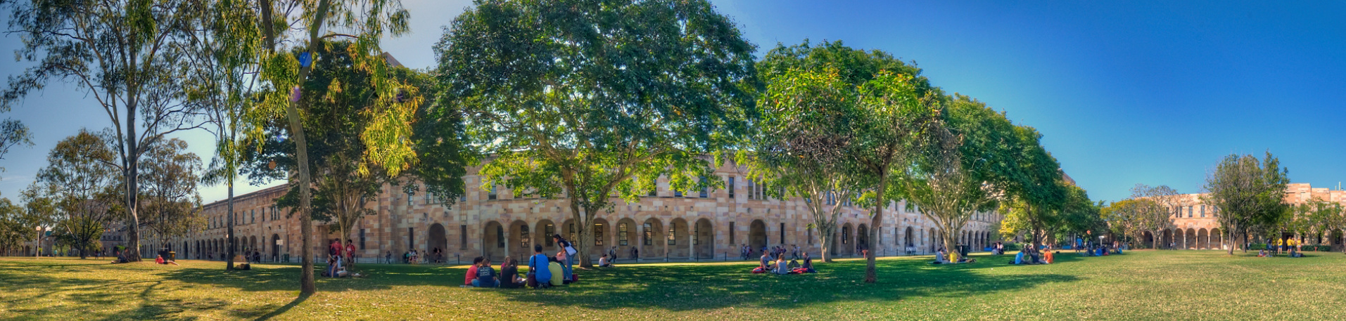
A Corpus-Based Analysis of General Extenders in Irish English Martin Schweinberger https://github.com/MartinSchweinberger/GenExIrE
NPIE 7, Cork, June 8-10, 2022

Slide 2
What are General Extenders?
(1) Adjunctive general extenders
She 's her bag packed and <,> washed out and <,> her pencil case filled and so on (ICE-Ire: S1A-001$B)
But because it 's a real Protestant thing they were never treated with the right respect and all this sort of stuff (ICE-Ire: S1A-005$A)
Sure people 're bringing in fruit for people and stuff (ICE-Ire: S1A-005$A)
(2) Disjunctive general extenders
You 'd think it was hot or something <&> laughter </&> (ICE-Ire: S1A-003$B)
I don't know what he was writing whether it was the cars or whatever you know (ICE-Ire: S1A-012$A)
Common pattern Connector (and | or) + [quantifier (all | some) +] generic NP (thing | that stuff) [+ comparative PP (like this | like that)]
Martin Schweinberger General Extenders in Irish English NPIE7 (Cork)

Slide 3
What are General Extenders?
Also referred to “coordination tags” (Biber et al. 1999: 115–116), “set marking tags” (Dines 1980), “vague category identifiers” (Channell 1994), “extension particles” (Dubois 1992), and “approximation markers” (Erman 1995:136)
Grammatically optional + little propositional meaning (→ pragmatic marker)
GEs have been found to
have genre-specific use
be social stratified along gender, age and socioeconomic dimensions in BrE (Cheshire 2007), AusE (Dines 1980) , NZE (Stubbe & Holmes 1995), and Montreal French (Dubois 1992)
In Toronto English: stuff lexically replacing other NP elements (Tagliamonte & Denis 2010)
In BrE, GEs are undergoing grammaticalization (bleaching of morphosyntactic properties and loss of agreement with host noun) (Cheshire 2007)
Martin Schweinberger General Extenders in Irish English NPIE7 (Cork)

Slide 4
Research Questions
What forms of GEs and how frequently are GEs used in IrE?
Is the IrE GE system currently undergoing change (are GEs stratified)?
What factors impact GE use in IrE?
Martin Schweinberger General Extenders in Irish English NPIE7 (Cork)

Slide 5
Data and Data Processing

Slide 6
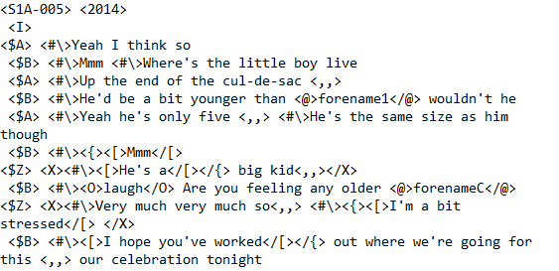
Data
Spoken data from the Irish component of the International Corpus of English (ICE-Ire)
100 conversations
app. 200,000 words
167 speakers
507 GEs (after processing, 971 GEs across spoken text types)
Martin Schweinberger General Extenders in Irish English NPIE7 (Cork)

Slide 7
Data processing
Loading the spoken section of the corpus
Split data into utterances
Retrieved all GEs using a regular expression* (see below)
Combine data with speaker and text information
* "(sort|sorts) of (stuff|shit)|(\\betc\bb|etcetera etcetera|etcetera|et cetera)|(and|or) (this|that){0,4} {0,1}(whatever|so on|so forth|all|something|everything|thing|things|stuff|shit) {0,1}(else|like){0,4} {0,1}(this|that|these|those){0,5}"
Martin Schweinberger General Extenders in Irish English NPIE7 (Cork)

Slide 8
Variable coding
Dependent Variable(s)
Variant | categorical | and stuff | or something | and things like that | etc.
Independent Variables
Speaker | categorical | Speaker ids
Age | categorical | 19-25 | 26-33 | 34-49 | 50+
Gender (Sex) | nominal | Female | male
Region | categorical | RoI | NI | Mixed
AudienceSize | nominal | Dyad | Multiple
ConversationType | nominal | Same | Mixed
Martin Schweinberger General Extenders in Irish English NPIE7 (Cork)

Slide 9
Analysis
Boruta (finding sig. predictors)
What predictors have any kind of statistically significant impact on the use of general extenders?
Conditional Inference Tree (partitioning of the data)
What factor combinations lead to statistically different general extender usage profiles.
Configural Frequency Analysis (types- and antitypes)
What general extender types are over- and underused by social strata??
Martin Schweinberger General Extenders in Irish English NPIE7 (Cork)

Slide 10
Results | Findings

Slide 11
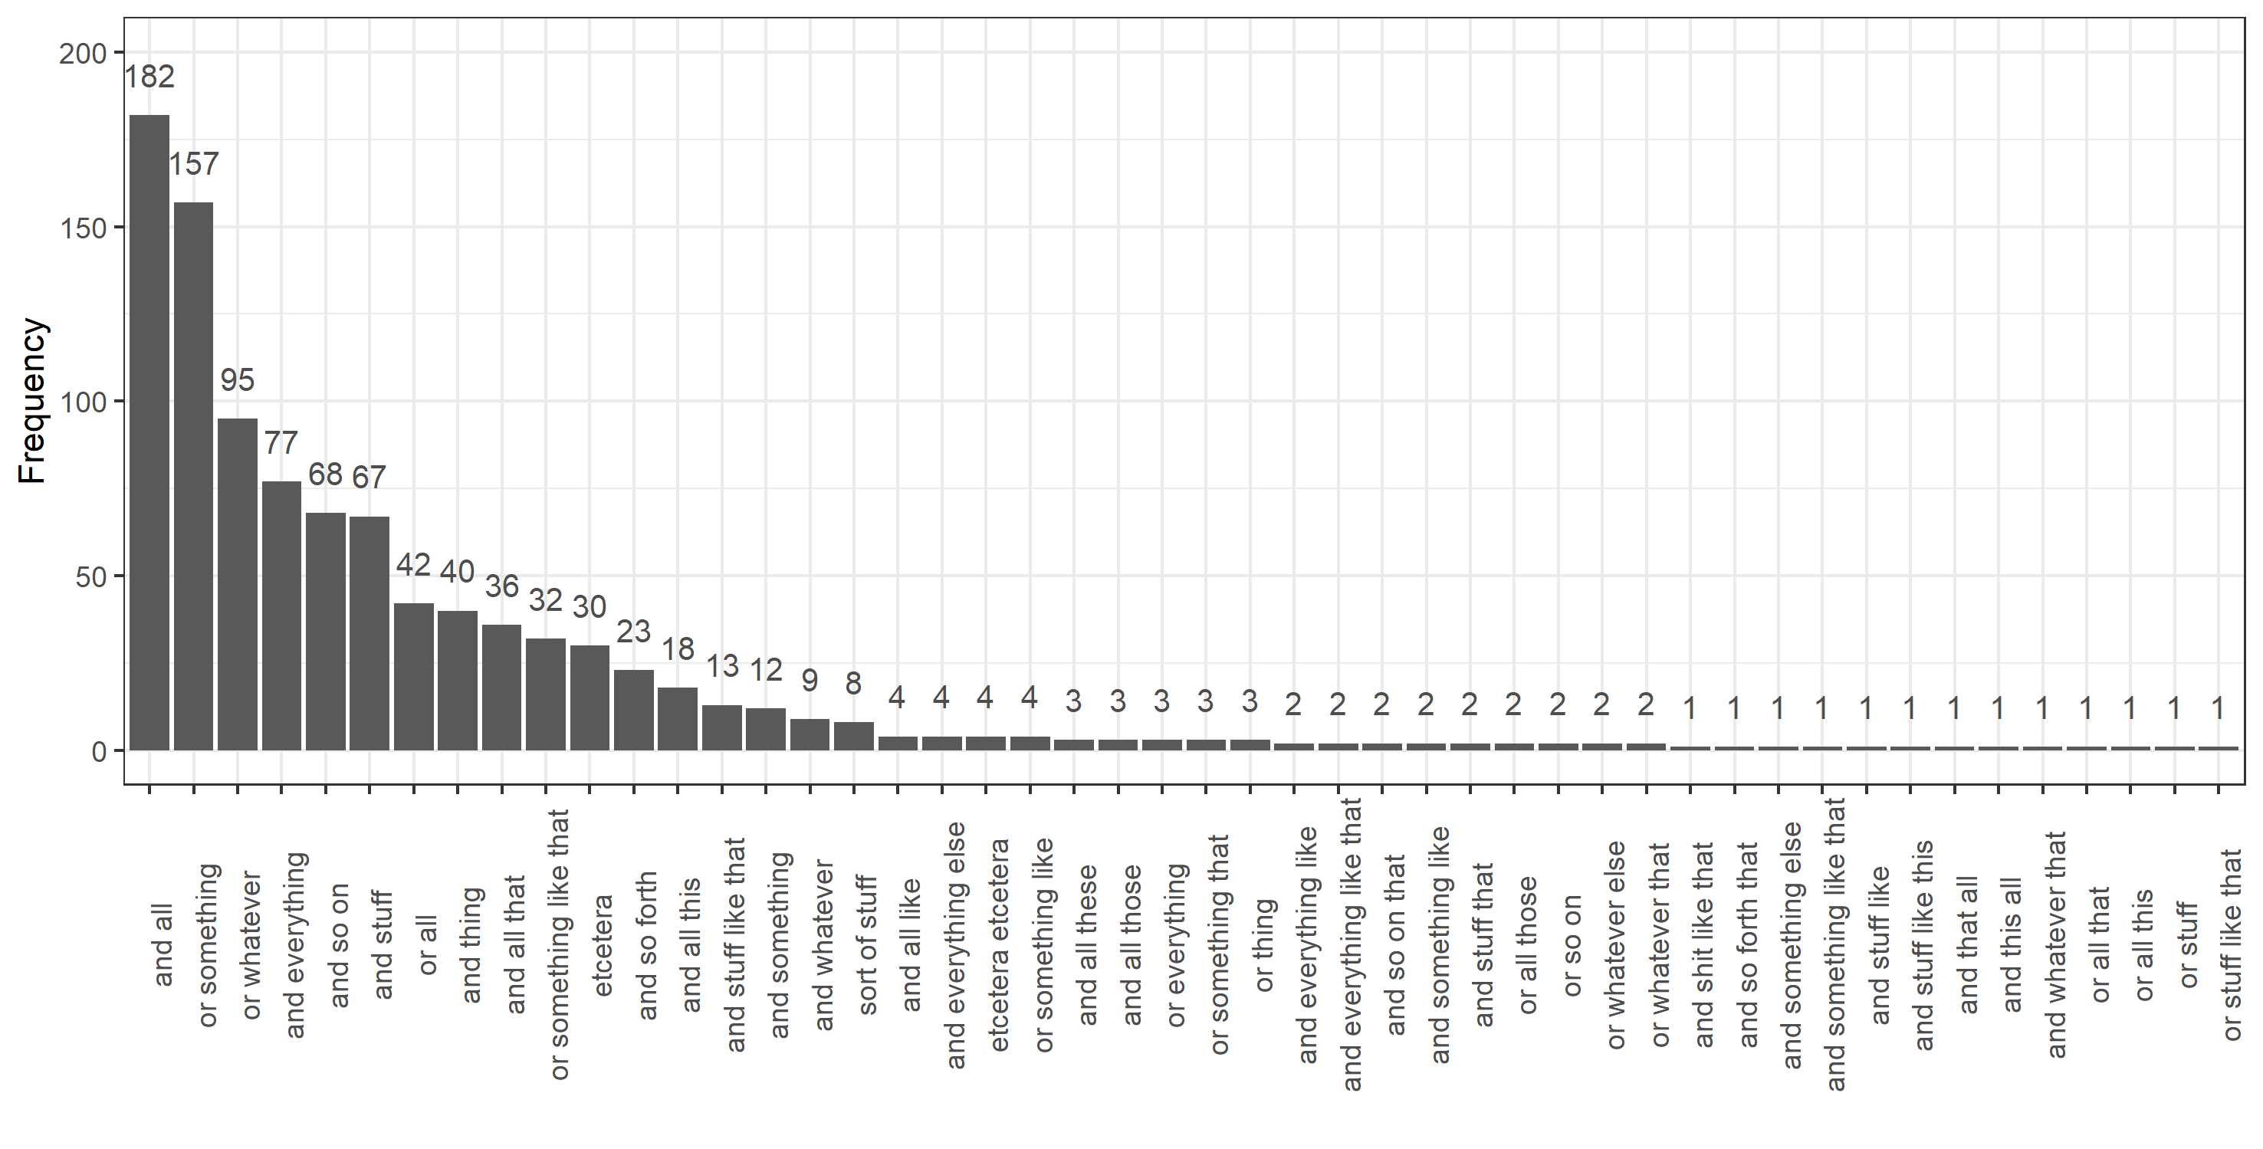
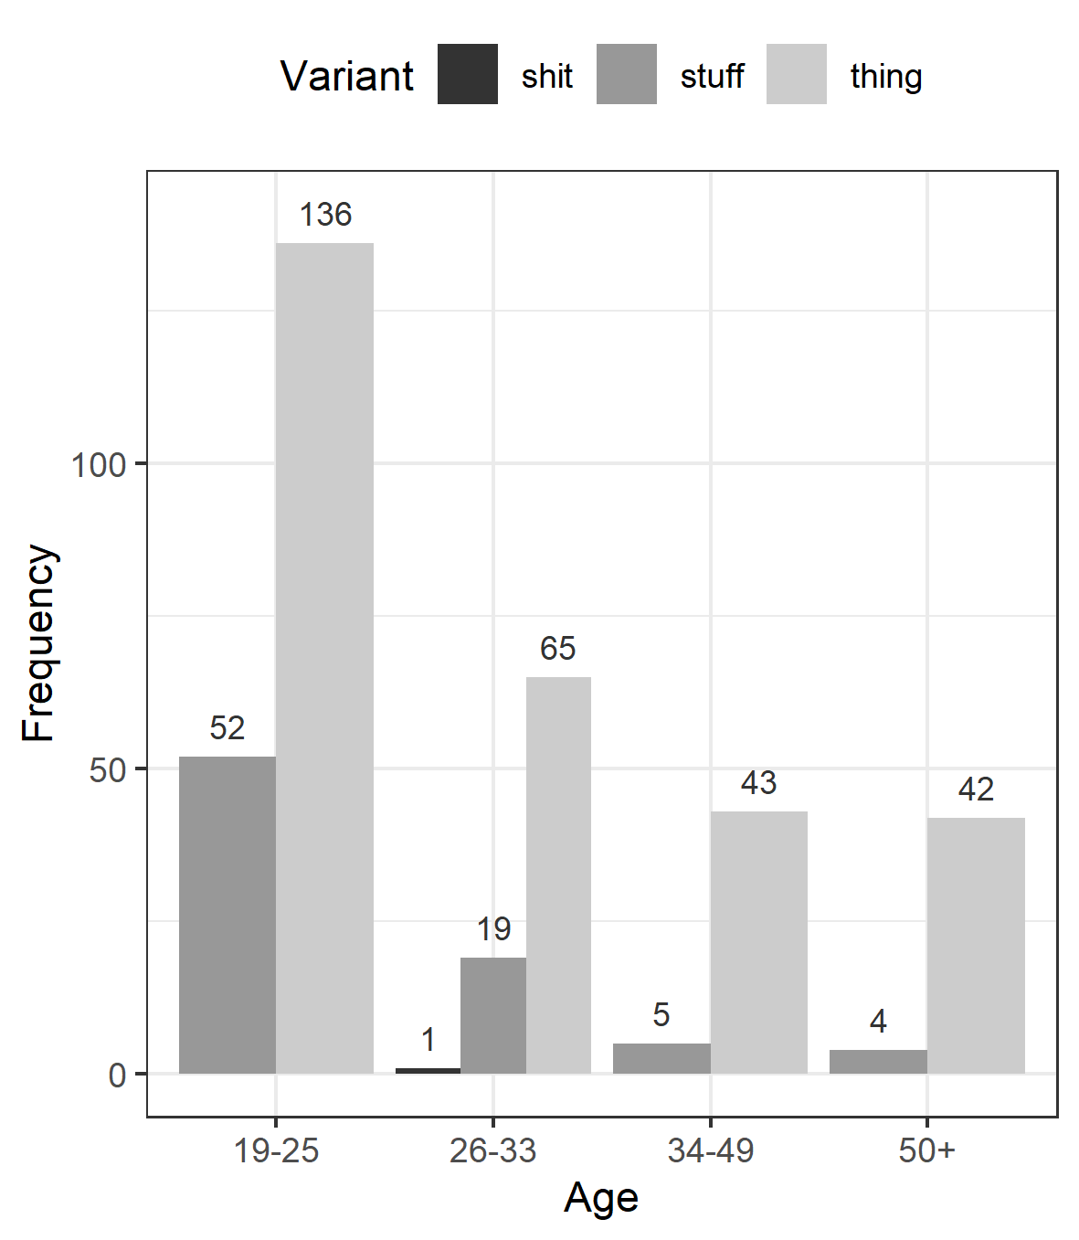

Slide 12
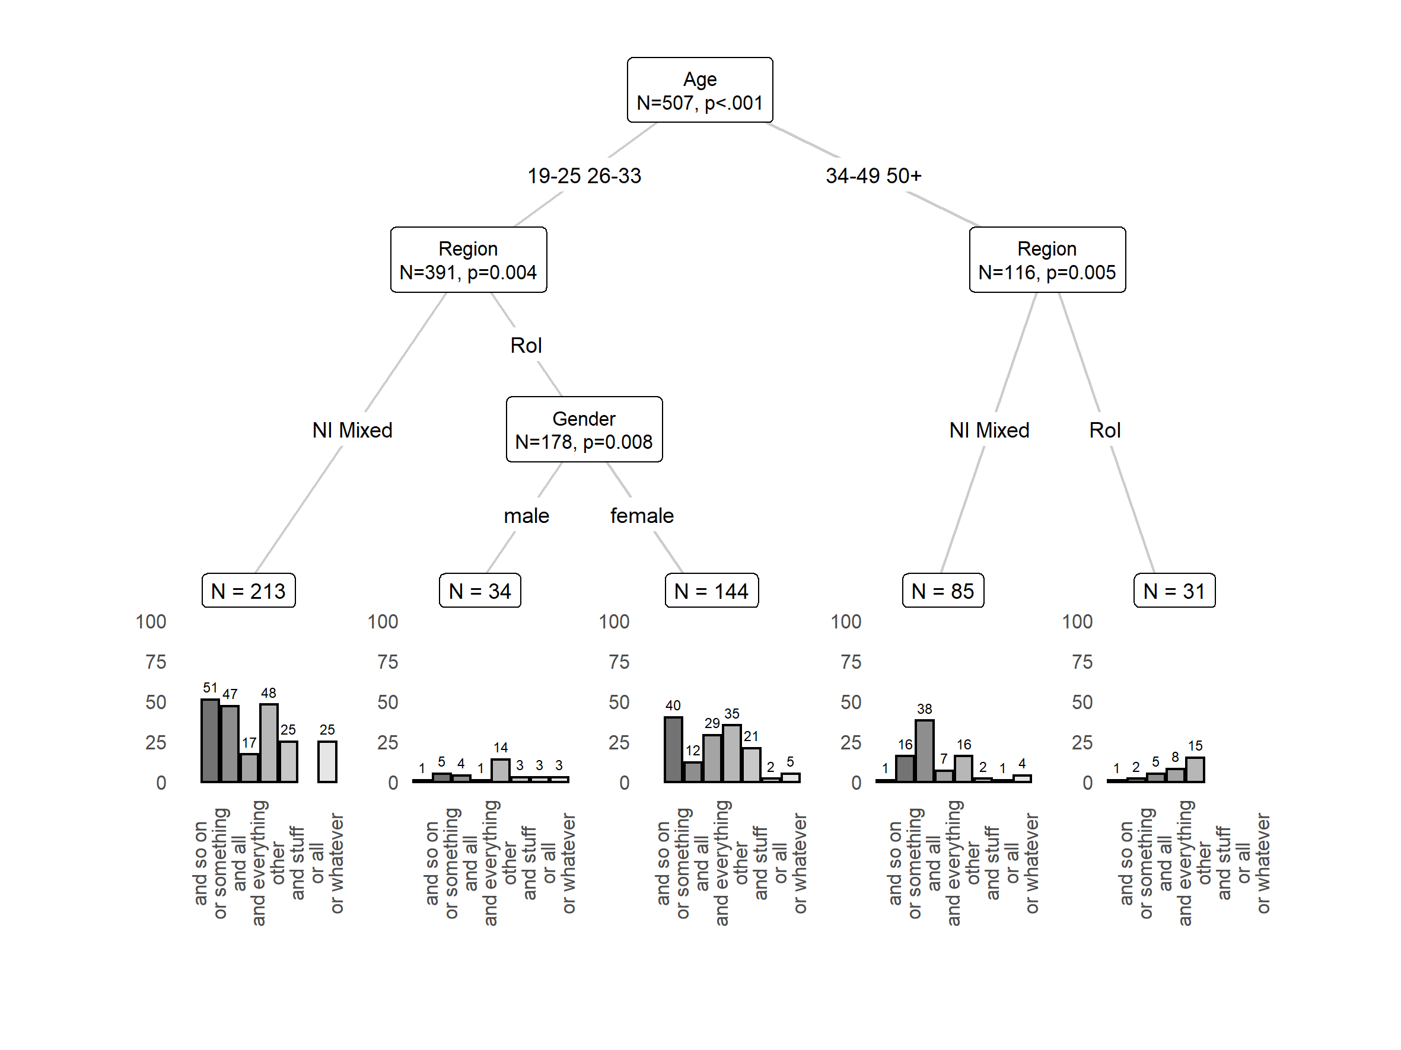
Results
Conditional Inference Tree (partitioning of the data)

Slide 13
Results
Configural Frequency Analysis (CFA) (over- and underuse)
Configuration | Frequency (obs.) | Frequency (exp.) | Q | χ² | z | p-value (z)
RoI male or all | 3 | 0.6 | 0 | 10.74 | 3.28 | 0.0005***
RoI male and so on | 2 | 0.3 | 0 | 10.66 | 3.27 | 0.0005***
Mixed female or whatever | 8 | 2.8 | 0.01 | 9.46 | 3.08 | 0.0011**
RoI female and all | 16 | 33.9 | 0.04 | 9.43 | 3.07 | 0.0011**
Martin Schweinberger General Extenders in Irish English NPIE7 (Cork)

Slide 14
Discussion and Outlook

Slide 15
Summary
Findings
General extenders are stratified along social (not linguistic) dimensions: Age (young vs old), Region (RoI vs NI + Mixed), Gender (Men vs Women) (shows that general extenders have social meaning)
Forms
and all as well as or something are the dominant general extenders in IrE
Variants with thing dominant over variants with stuff | shit
Configurations
Men from the republic underuse or all as well as and so on.
Women from the republic underuse and all.
Women that have ties to both the republic and Northern Ireland overuse or whatever.
Study shows that variability in the use of general extenders is socially motivated.
Martin Schweinberger General Extenders in Irish English NPIE7 (Cork)

Slide 16
Discussion
Corpus-based analyses allow us to investigate a wide variety of linguistic phenomena both within and across varieties of English
General extenders allow us to inspect mechanisms of ongoing change due to their interchangeability and variability as well as lack of overt social stigmatization (exceptions are, of course, general extenders which contain taboo words such as shit).
Multivariate statistics allow us to determine the effects (or the impact) of various predictors simultaneously (at the same time) which is a major advantage because this safeguards from confounding (and thus wrong |inaccurate) results.
Martin Schweinberger General Extenders in Irish English NPIE7 (Cork)

Slide 17
Outlook
Limitations
Although ICE Ireland has the advantage that it is accompanied by detailed information about speakers, it is comparatively moderate in size which renders analyses of innovative variants and ongoing change among non-pervasive features difficult.
Semantic features of the host element and discourse variables were not considered in this study.
Future directions
Apply analysis to GloWbE to analyse patterns of use across a range of varieties of English but social characteristics of users are difficult to ascertain.
Future research will extend this study by adding information on semantic features of the host phrase.
Martin Schweinberger General Extenders in Irish English NPIE7 (Cork)

Slide 18
References
Biber, Douglas, Stig Johansson, Geoffrey Leech, Susan Conrad, Eric Finegan, & Randolph Quirk (1999). Longman Grammar of Spoken and Written English. London: Longman.
Channell, Joanna (1994). Vague Language. Oxford: Oxford University Press.
Cheshire, Jenny (2007). Discourse variation, grammaticalisation and stuff like that. Journal of Sociolinguistics 11(2): 155-193.
Dines, Elizabeth R. (1980). Variation in discourse – and stuff like that. Language in Society 9(1): 13-31.
Dubois, Sylvie. (1992). Extension particles etc. Language Variation and Change 4: 179–204.
Kallen, Jeffrey C., and John Kirk (2007). ICE-Ireland: Local variations on global standards. In Joan Beal, Karen Corrigan, and Hermann Moisl (eds.), Creating and Digitizing Language Corpora, 121-162. London: Palgrave Macmillan.
Stubbe, Maria and Janet Holmes (1995). You know and other exasperating expressions: An analysis of social and stylistic variation in the use of pragmatic devices in a sample of New Zealand English. Language and Communication 15: 63–88.
Tagliamonte, Sali A. and Derek Denis (2010). The stuff of change: General extenders in Toronto, Canada. Journal of English Linguistics 38(4): 335-368.
Martin Schweinberger General Extenders in Irish English NPIE7 (Cork)

Slide 19
Thanks a lot and stuff! A Corpus-Based Analysis of General Extenders in Irish English Martin Schweinberger (m.schweinberger@uq.edu.au)
NPIE 7, Cork, June 8-10, 2022

Slide 20





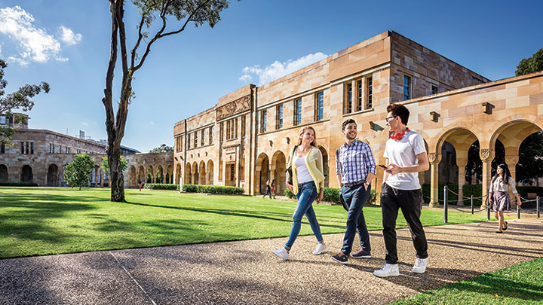

Contact
Martin Schweinberger
T: +61 7 3365 6374 E: m.schweinberger@uq.edu.au H: martinschweinberger.de
School of Languages and Cultures Gordon Greenwood Building The University of Queensland St Lucia Qld 4072 Australia

