Slide 1




A corpus-based acoustic analysis of vowel production by L1-Japanese learners and native speakers of English
Yuki Komiya Martin Schweinberger
y.komiya@uq.edu.au
m.Schweinberger@uq.edu.au

Slide 2

A corpus-based acoustic analysis of vowel production by L1-Japanese learners and native speakers of English
Timeline | Table of Contents
Background and Motivation
Research Gaps | Research Questions
Methodology (Data and Analysis)
Results
Discussion, Outlook, and potential Applications

Slide 3

Background and Motivation
Pronunciation is a challenge for L2 English learners
Problem
Pronunciation is most immediate and direct
Everybody automatically and subconsciously categorizes and infers judgements based on pronunciation (gender, age, cultural background, nativeness, socio-economics, education, etc.)
Pronunciation is crucial for intelligibility
Pronunciation is affecting real-life opportunities (jobs, partner choice, etc.)
Pronunciation is important for learners as well as teachers of English!

Slide 4

Background and Motivation
Why is pronunciation a challenge for L2 English learners?
Languages interact in the minds of multilingual speakers
Speech Learning Model (SLM) (Flege 1995)
L1 and L2 sound systems exist in a shared phonetic space in the bilingual mind
As a result, the L2 sound system is affected by the L1 system (and vice versa)
Languages are not independent but affect each other
L1
L2

Slide 5
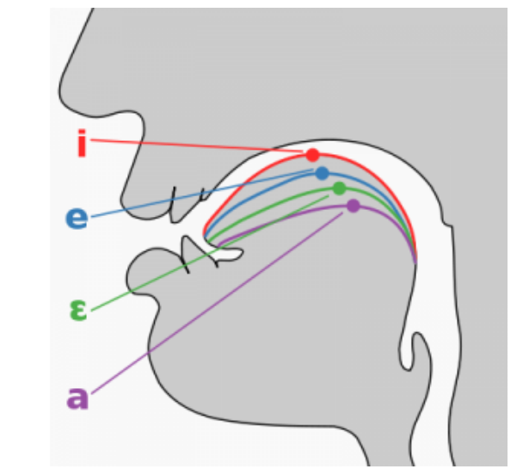
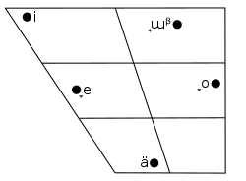
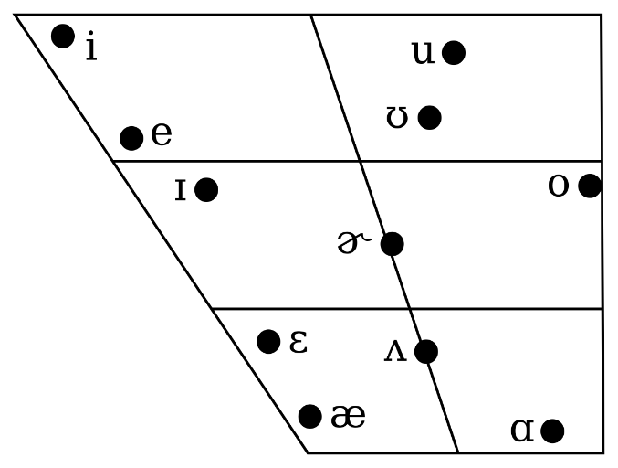
Background and Motivation
English vowels are particularly challenging for Japanese-L1 learners (Franklin & Stoel-Gammon 2014)
Differences in inventory size (JPN: 5 vowels* vs. ENS: app.** 11 vowels) (Homma 1992)
Differences in how vowels are differentiated (ENS: formants + duration | JPN: duration)
Vowel chart of southern Californian Engl.
Japanese vowel chart
* Monophthingal vowels, i.e., vowels with a fixed tongue position (not vowels with a moving tonue position like /au/ or /ou/.
** Depending on the variety of English.

Slide 6
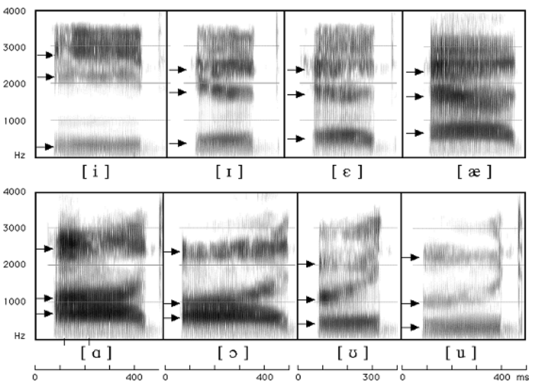
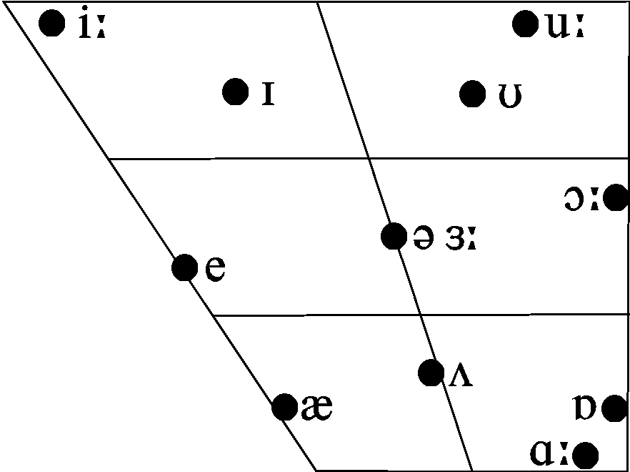
Background and Motivation
What are “formants”? and do they have to do with tongue position?
Formants are concentration of acoustic energy at a certain frequency (Ladefoged & Johnson 2014 )
First formants (F1) and second formants (F2) inversely correspond to the tongue height (F1) and tongue fronting (F2: where it is raised) of each vowel
Left: Vowel chart of Received Pronunciation (RP)
F3
F1 (tongue height)
F2
F1
F2 (tongue fronting)

Slide 7
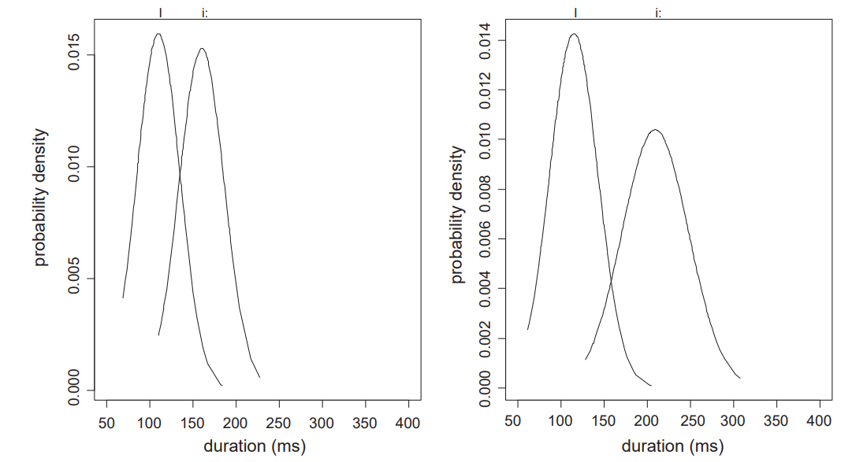
Research Gaps | Research Questions
What has been said about English vowels produced by Japanese learners?
Japanese learners merge spectrally similar vowels (Ingram & Park 1997, Ueyama 2003)
Japanese speakers are very sensitive to vowel duration (Kato et al. 2001) and exaggerate duration to compensate for the relative insensitivity to formant differences (Morrison 2002)
L1 English speaker (ENS)
Japanese learner of English (JPN)
/i/
/ɪ/
/i/
/ɪ/
L1 English speakers
Japanese learners of English
/ɪ/
/ɪ/
/i/
/i/
(Tsukada 2009)

Slide 8
Research Gaps | Research Questions
Problems and gaps in previous research
Investigation mainly done in highly controlled laboratory conditions (scripted word | sentence-reading)
Learner vowel traits in naturalistic speech environments largely unknown
Small subject size (±10 speakers)
Limited generalisability | applicability of the findings
Larger-scale analysis of vowels produced under more spontaneous speech conditions is needed!
RQ1: Do Japanese learners merge /i:/ and /ɪ/ as well as /u:/ and /ʊ/?
RQ2: Do Japanese learners exaggerate the length of vowels to compensate lack of spectral differentiation?

Slide 9

Methodology (Data | Analysis)
Data
International Corpus Network of Asian Learners of English (ICNALE) (Ishikawa 2014)
Speech and text samples from English learners in Asia and L1 English speakers
Spoken monologues: spontaneous speech from 150 Japanese learners and 132 L1 speakers of English
Before processing
After processing (final data set)
Type | Speakers | /ɪ/ | /i:/ | /ʊ/ | /u:/
ENS | 132 | 2,562 | 1,205 | 350 | 1,895
JPN | 150 | 3,696 | 1,203 | 644 | 1,261
Total | 282 | 6,258 | 2,408 | 994 | 3,156
Type | Speakers | /ɪ/ | /i:/ | /ʊ/ | /u:/
ENS | 105 | 693 | 939 | 189 | 395
JPN | 141 | 1,122 | 535 | 188 | 281
Total | 246 | 1,815 | 1,474 | 377 | 676

Slide 10
Methodology (Data | Analysis)
Data Processing (R 4.2, R Core team (2022) in RStudio (RStudio Team 2022))
Aligning speech with audio using Web-MAUS (Schiel 1999) (this produces Praat TextGrids)
Automated extraction of vowel formants and vowel duration from Praat TextGrids (Wickham et al. 2019)
Only monosyllabic words were retained and outliers were removed using Kernel Density Estimation
Statistical Analysis
Mergers → Bhattacharya affinity (Johnson 2015, measure of overlap of scatter clouds, 1 = perfect overlap)
Duration → Mixed-Effects Regression Model (lme4: Bates et al. (2015), sjPlot: Lüdeke (2021))
DV: duration
IVs: type, vowel, gender, age, word type
REs: word, speaker

Slide 11
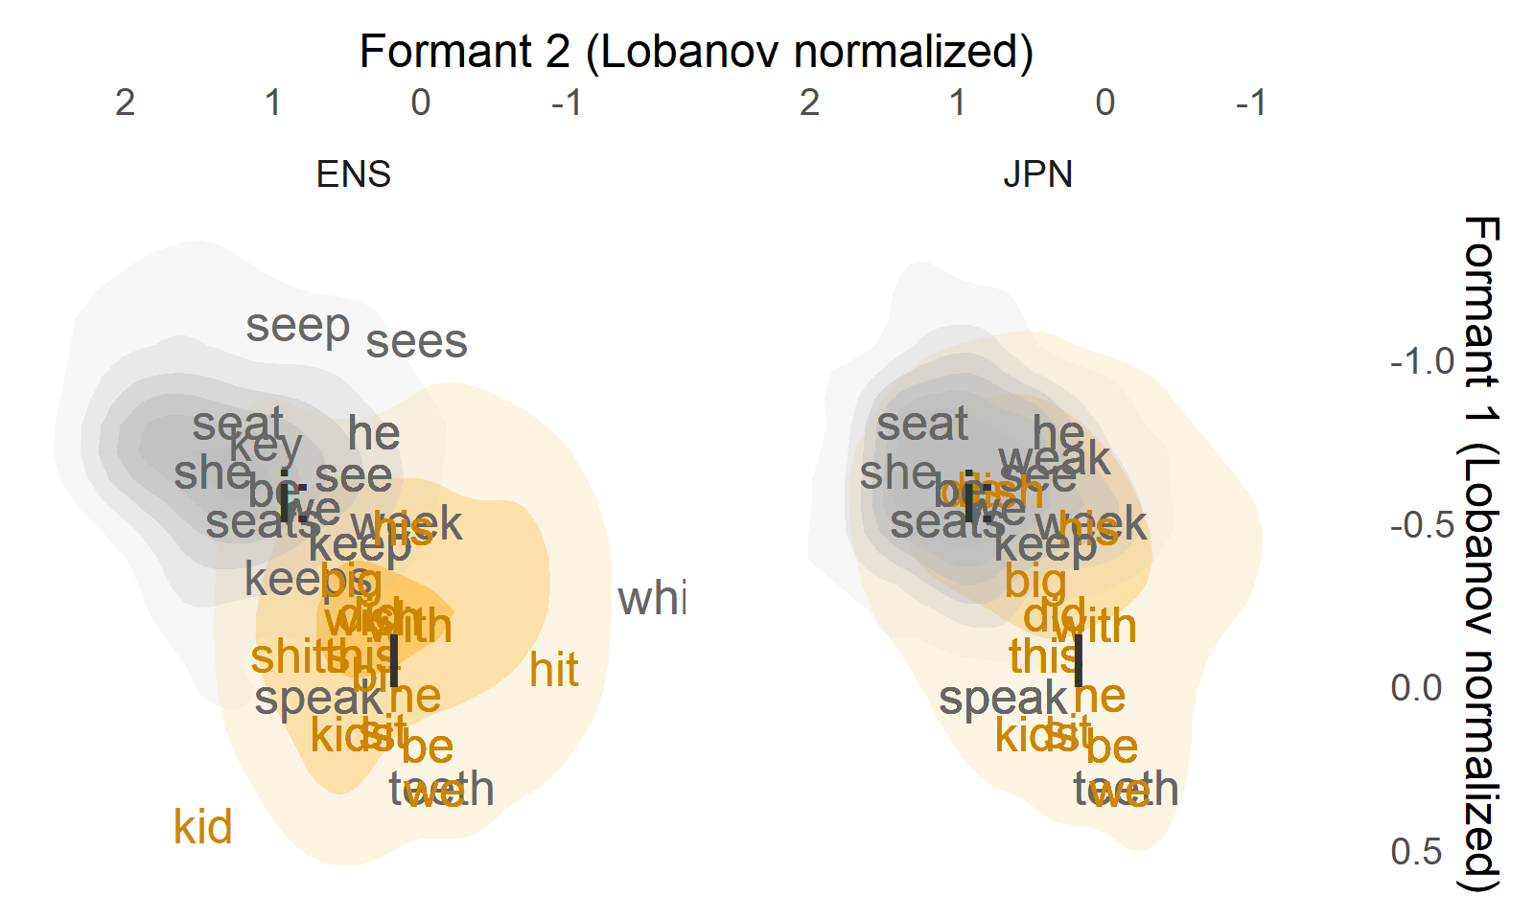
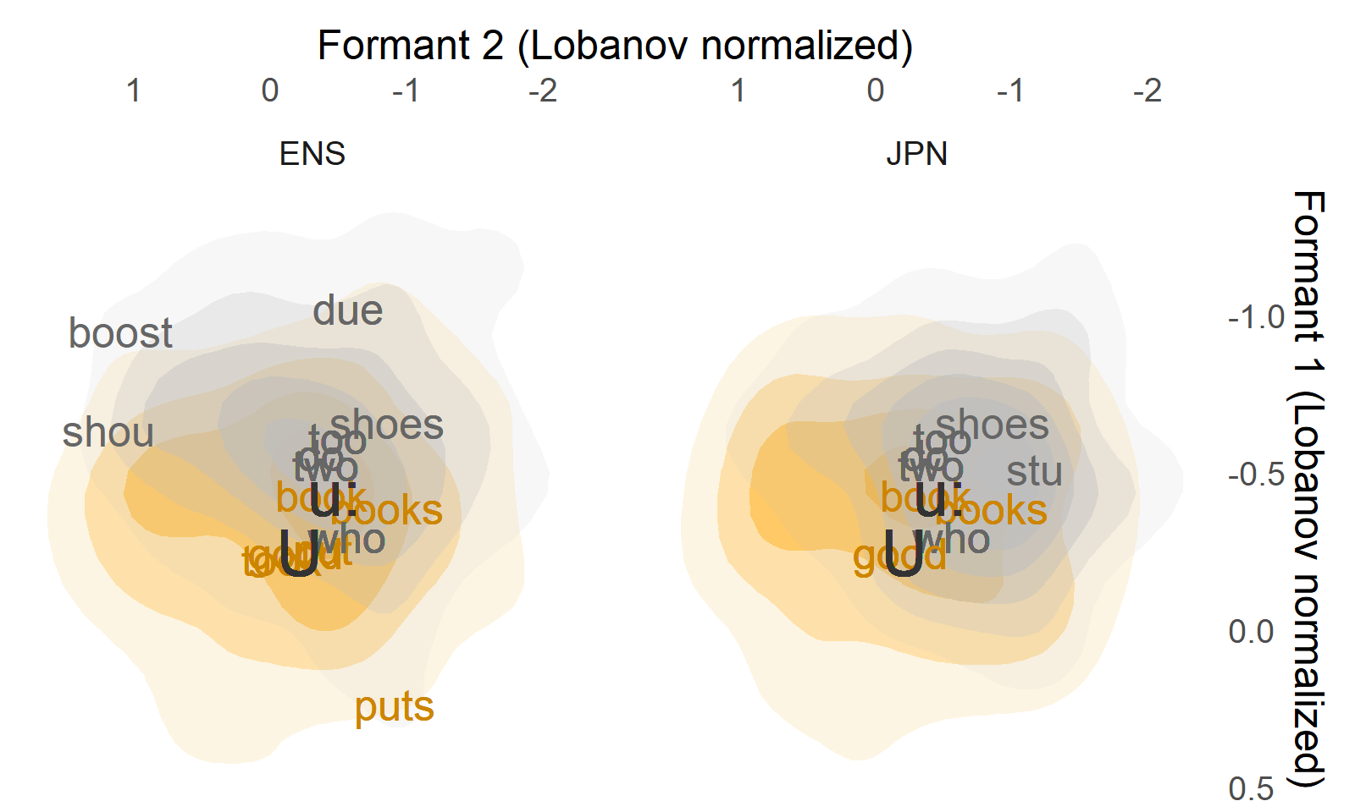
Results
Mergers
/i:/ and /ɪ/
JPN Bhattacharya affinity: .901
ENS Bhattacharya affinity: .757
Substantively more overlap among JPN!
/u:/ and /ʊ/
JPN Bhattacharya affinity: .932
ENS Bhattacharya affinity: .952
Mergers confirmed for spectrally similar vowels (ENS also merge /u:/ and /ʊ/)!

Slide 12
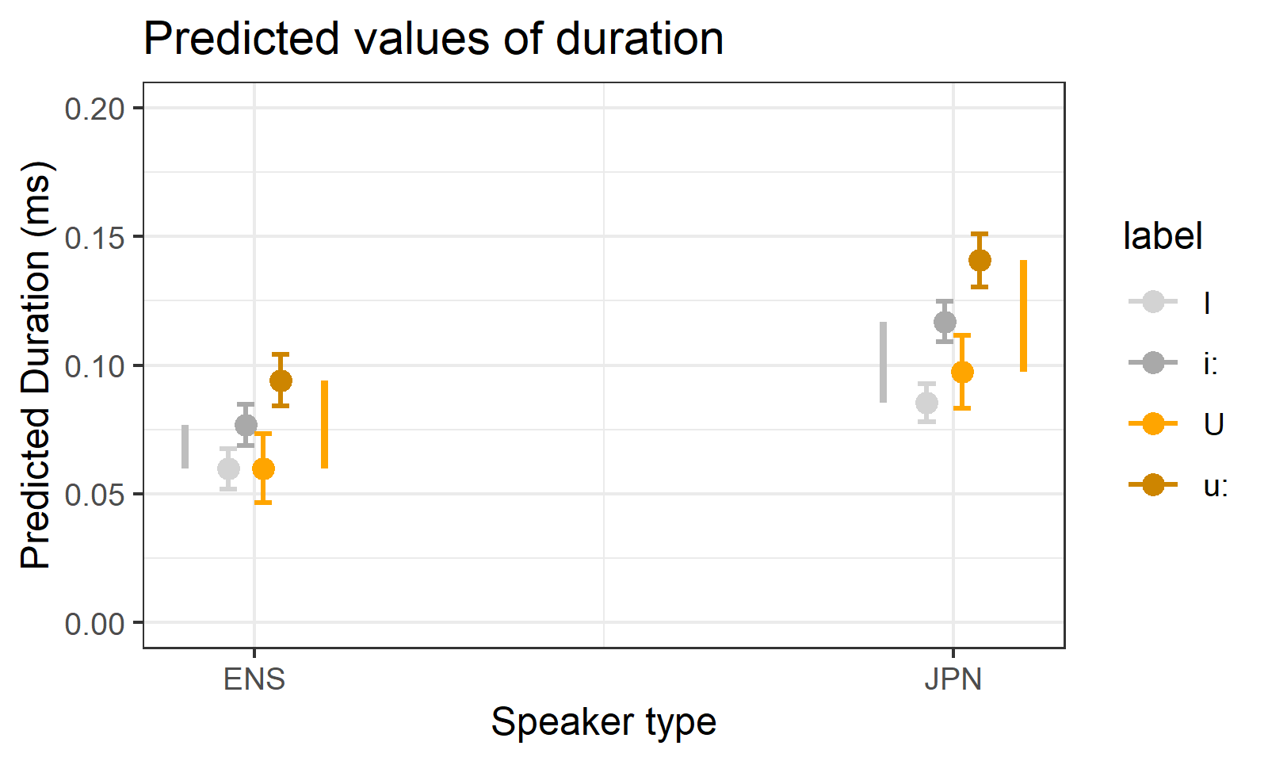
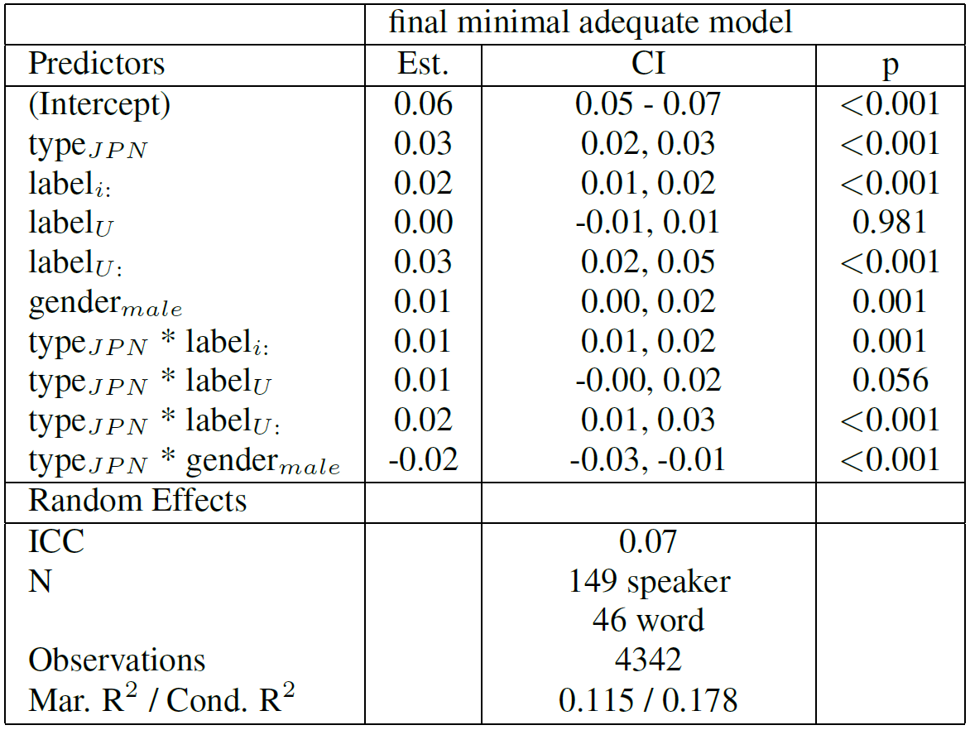
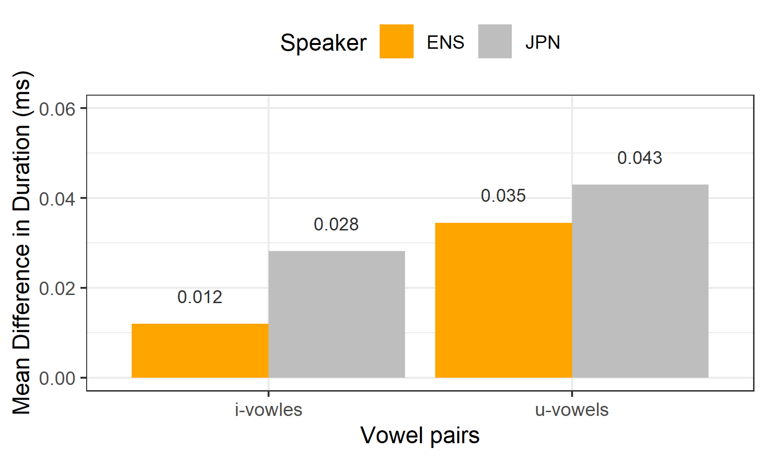
Results

Slide 13
Results
Duration
JPN extend all vowel durations (not just long vowels)! (expectation: short vowels shorter | long vowels longer!)
JPN exaggerate the duration difference of both /i:/ and /ɪ/ as well as /u:/ and /ʊ/
Exaggerated duration difference by JPN speakers confirmed for both /i:/ and /ɪ/ as well as /u:/ and /ʊ/!

Slide 14

Discussion | Outlook
Comparison with previous findings
Confirmation | Substantiation
JPN: mergers of spectrally close vowels (lab settings: Ueyama 2003; Tsukada 2001)
Unique findings | Conflicts
ENS: merger of /u:/ and /ʊ/ in spon. speech
JPN: exaggerated durational contrasts between spectrally similar vowels in nat. settings (lab settings: Tsukada 2009)
Limitations
Quality of recordings is really poor! (minute-long recordings recorded on cell phones)!
Difficult to control semantic | phonological environments (which is important) (see Visceglia et al. 2009)
Significance
Bad quality could | can be compensated using advanced methods (Kernel Density Estimation)
Insights into vowel production by JPN learners in spontaneous speech (underexplored) → natural setting allows to generalise findings to real-life learner speech
Automated corpus-based investigation on larger samples
Apply same method to German learners and learners of other languages (e.g. German)
Determine what factors differentiate ENS and L2 speakers re. vowel production
(potential MA theses!)

Slide 15

Potential Applications
Prototype (proof-of-concept)
Extend study to L1 German learners of English (or learners of other languages)
Significance
First large-scale, corpus-based studies of ESL vowel production in natural speech!
Follow-up: perception → do differences in vowel production correspond to difficulties in intelligibility?
Possible Applications
Creation of targeted classroom materials to improve L1-like vowel production among learners
Convert analysis into a mobile app for MELLT (Mobile-Enhanced Language Learning and Teaching)
BMBF | Volkswagen | ERC grant proposal on Improving Language Production among Language Learners via Direct Digital Feedback (Collaboration with the Phonetics group in the ISFAS at Uni Kiel)

Slide 16
Thank you really very much!
Yuki Komiya Martin Schweinberger
y.komiya@uq.edu.au
m.Schweinberger@uq.edu.au

Slide 17

References
Flege, J. E. (1995). Second-language speech learning: theory, findings, and problems. In W. Strange (ed.), Speech perception and linguistic experience: Issues in cross-linguistic research, 233-277. York Press.
Franklin, A. D., & Stoel-Gammon, C. (2014). Using multiple measures to document change in English vowels produced by Japanese, Korean, and Spanish speakers: The case for goodness and intelligibility. American Journal of Speech-Language Pathology 23(4): 625-640.
Grenon, I., Kubota, M., & Sheppard, C. (2019). The creation of a new vowel category by adult learners after adaptive phonetic training. Journal of Phonetics 72: 17-34.
Homma, Y. (1992). Acoustic phonetics in English & Japanese. Yamaguchi Shoten.
Ingram, J. C. L., & Park, S. G. (1997). Cross-language vowel perception and production by Japanese and Korean learners of English. Journal of Phonetics 25(3): 343-370.
Johnson, D. E. (2015). Quantifying Overlap with Bhattacharyya's affinity and other measures! Paper presented at NWAV15 (https://danielezrajohnson.shinyapps.io/nwav_44/).
Kato, H., Tajima, K., & Akahane-Yamada, R. (2001). Native and non-native perception of phonemic length contrasts in Japanese. The Journal of the Acoustical Society of America 110(5): 2686.
Ladefoged, P., & Johnson, K. (2014). A Course in Phonetics. Cengage.
Morrison, G. S. (2002). Japanese listeners’ use of duration cues in the identification of English high front vowels. In J. Larson. & M. Paster (eds.), Proceedings of the 28th annual meeting of the Berkeley Linguistics Society, 189–200. Berkeley Linguistics Society.

Slide 18
References
Satoi, H., Yoshimura, M., & Yabuuchi, S. (2005). The relationship between English speech rhythm and vowel reduction in production: Comparison between Japanese EFL learners and native English speakers. Language Education & Technology 42: 59-72.
Tsukada, K. (2001). Native vs non-native production of English vowels in spontaneous speech: An acoustic phonetic study. In P. Dalsgaard, B. Lindberg & H. Benner (eds.), Proceedings of the 7th European Conference on Speech Communication and Technology (Eurospeech 2001), 305-308.
Tsukada, K. (2009). Durational characteristics of English vowels produced by Japanese and Thai second language (L2) learners. Australian Journal of Linguistics 29(2): 287-299.
Ueyama, M. (2003). Duration and quality in the production of the vowel length contrast in L2 English and L2 Japanese. In M. J. Solé., D. Recasens., & J. Romero. (eds.), 15th International Congress of Phonetic Sciences, 1509-1512. Universitat Autònoma de Barcelona.
Visceglia, T., Chiu-Yu., T., Kondo, M., Meng, H., & Sagisaka, Y. (2009). Phonetic aspects of content design in AESOP (Asian English Speech cOrpus Project). Oriental COCOSDA International Conference on Speech Database and Assessments, 60-65.
Yamaguchi, T., & Chiew. P. S. (2020). Is there conflation? An acoustic analysis of vowels in Japanese English. Asian Englishes 22(1): 35-51.

Slide 19

Data & Software
Data
Ishikawa, S. (2014). Design of the ICNALE Spoken: A new database for multi-modal contrastive interlanguage analysis. Learner Corpus Studies in Asia and the World 2: 63-76.
Software
R Core Team (2022). R: A language and environment for statistical computing. R Foundation for Statistical Computing, Vienna, Austria. (https://www.R-project.org)
RStudio Team (2022). RStudio: Integrated Development Environment for R. RStudio, PBC: Boston, MA (http://www.rstudio.com)
Bates, D., Maechler, M., Bolker, B., & Walker, S. (2015). Fitting Linear Mixed-Effects Models Using lme4. Journal of Statistical Software 67(1), 1-48.
Lüdecke D. (2021). sjPlot: Data Visualization for Statistics in Social Science. R package. Version 2.8.10 (https://CRAN.R-project.org/package=sjPlot).
Schiel, F. (1999). Automatic Phonetic Transcription of Non-Prompted Speech, Proceedings of the ICPhS 1999. San Francisco, August 1999, 607-610.
Wickham et al., (2019). Welcome to the tidyverse. Journal of Open Source Software 4(43): 1686.

Slide 20
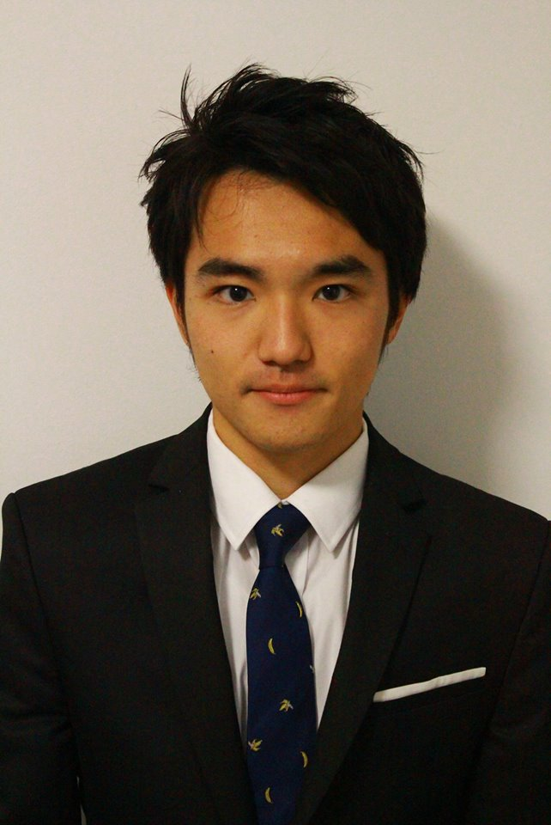


Acknowledgements
The study is part of a project that Yuki Komiya and Martin Schweinberger worked on at the University of Queensland.
This paper has been submitted to SST2022 - The 18th Australasian International Conference on Speech Science and Technology.
Yuki Komiya y.komiya@uq.edu.au
https://www.linkedin.com/in/yuki-komiya-117004200/
Martin Schweinberger
m.schweinberger@uq.edu.au martin.schweinberger@uit.no
https://github.com/MartinSchweinberger

Slide 21
A corpus-based acoustic analysis of vowel production by L1-Japanese learners and native speakers of English
Yuki Komiya Martin Schweinberger
y.komiya@uq.edu.au
m.Schweinberger@uq.edu.au

