Slide 1


Industry panel: What can linguists bring to AI and NLP work?
Thursday 28 July
15:30 – 16:45 (BST)

Slide 2
Main idea
What linguists can bring to work/products in tech companies?
Why linguists should be interested in tech companies!
Especially if linguists do not have a strong quantitative/NLP/programming background
What transferable skills acquired in linguistics research could be useful for these careers.

Slide 3
Timeline
15:30 – 15:35 General Introduction (Martin Schweinberger)
15:35 – 15:50 Speakers introduce themselves (app. 3 mins each)
15:50 – 16:10 Questions to the panel
16:10 – 16:40 Questions from the floor
16:40 – 16:45 Closing and outro

Slide 4
SPEAKERS
Tamara Polajnar - SenseStreet Chief Science (on)
Christos Christodoulopoulos - Senior Research Scientist at Amazon (Alexa) (on)
Hadas Kotek - Apple Hadas Kotek (hkotek.com) Senior NL annotation lead (off)
Ekaterina Kochmar - Lecturer at Bath University and founder and Chief Science Officer at Home (korbit.ai) (off)
Sandy Ritchie - Google Research (off)

Slide 5
SPEAKERS
Tamara Polajnar - SenseStreet Chief Science (on)
Christos Christodoulopoulos - Senior Research Scientist at Amazon (Alexa) (on)
Hadas Kotek - Apple Hadas Kotek (hkotek.com) Senior NL annotation lead (off)
Ekaterina Kochmar - Lecturer at Bath University and founder and Chief Science Officer at Home (korbit.ai) (off)
Sandy Ritchie - Google Research (off)

Slide 6



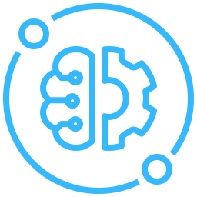
Tamara Polajnar
CHIEF SCIENCE OFFICER
Sense Street
From unstructured market conversations to a fine-grained understanding of liquidity in capital markets.
BSc Computer Science University of Northern British Columbia
MSc NLP and Cognitive Science University of Edinburgh
Our natural language models understand the complex jargon used in capital markets enabling extraction of information from across the life cycle of a trade.
PhD Bioinformatics University of Glasgow
Researching computational representations of semantics at University of Sheffield, NUI Galway, University of Cambridge, Royal Society of Chemistry
SCIENCE TEAM
2 LINGUISTS (3 more starting soon)
4 ML SCIENTISTS (1 more starting soon)
Notes:
In summary, chat is messy and subtle, and to successfully extract the correct information, we need models that can cope with the challenges I described.
However, the State of the art models are unsuccesful

Slide 7
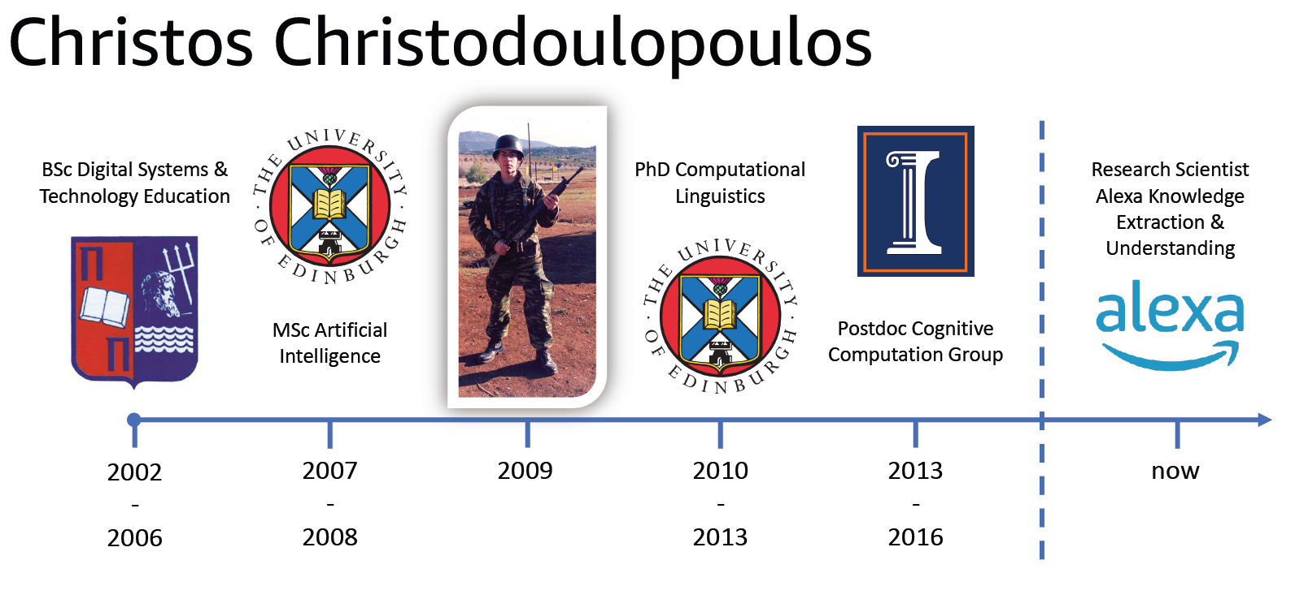

Slide 8
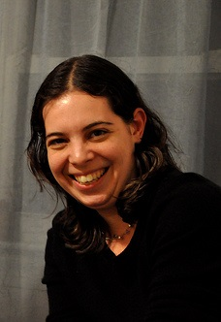







Hadas Kotek
Education: PhD in Linguistics (MIT, 2014)
Interests in formal syntax and semantics + experimental approaches
Basic coding in R, statistics, data visualization, experiment design
Academic employment: McGill, NYU, Yale (2014-2019)
Alt-Ac employment: Apple – Siri and Language Technologies, Natural Language, Data Science team (2019– ):
Role involves (a) data science (b) project management (c) annotation (guidelines, training, etc) (d) knowledge engineering (aka ontology)
Currently also a Research Affiliate with MIT Linguistics (not salaried)
Other areas of engagement
Chair of LSA COGEL, the committee on gender equity in linguistics
Mentoring (see PUMP initiative)
“how-to-industry” for linguists full semester workshop at MIT
LinkedIn: https://www.linkedin.com/in/hadas-kotek-phd/
Personal website: https://hkotek.com/
Twitter: @HadasKotek

Slide 9



Ekaterina Kochmar: Short bio
Co-founder of Korbit Technologies, building an AI-powered dialogue-based ITS
Lecturer at the University of Bath, focusing on applications of NLP, ML, and AI in Education
Previously, postdoc at the University of Cambridge, building Read & Improve – a readability platform for non-native readers

Slide 10

Sandy Ritchie
Background
PhD in Linguistics @ SOAS (2016)
Thesis and publications on possessive constructions in Chimane (Bolivia)
Fieldwork with the Chimane community (2012-14)
Linguist in the Automatic Speech Recognition (ASR) team at Google since 2018
Developing end-to-end ASR systems for currently unsupported languages
Advising on data collection methodologies and evaluating data sets
Providing linguistic expertise on various areas including language grouping
Other areas of interest
Outreach and community engagement work
Documentation of open source linguistic resources and data
Language maps

Slide 11
Questions
Why should tech companies be interested in hiring linguists?
Why should linguists be interested in joining tech companies?
What can linguists add to tech companies and their products?
How important are methodological (computational or quantitative) skills and how important are more qualitative, transferable, and language focused skills?

Slide 12
EVER MORE Questions
Can you give examples of where your companies have hired linguists?
Are you currently looking for linguists?
How different is working in companies compared to working in academia? What are your experiences and what do others that have made the switch say?
How do you think the filed will develop?
What would tech companies like universities to do? Stronger focus on skills?

Slide 13
Industry panel: What can linguists bring to AI and NLP work?
THANK YOU
TO THE SPEAKERs
To the Audience
To the organizers
To the Sponsors

