Slide 1




A corpus-based acoustic analysis of vowel production by L1-Chinese learners and native speakers of English
Martin Schweinberger
Ruihua Yin
m.schweinberger@uq.edu.au ruihua.yin@uq.edu.au
All materials (except data) available at https://github.com/MartinSchweinberger/ICAME44

Slide 2

A corpus-based acoustic analysis of vowel production by L1-Chinese learners and native speakers of English
Timeline | Table of Contents
Background and Motivation
Research Gaps | Research Questions
Methodology (Data and Analysis)
Results
Discussion and Outlook

Slide 3

Background and Motivation
Pronunciation is a challenge for L2 English learners
Problem
Pronunciation is most immediate and direct
Everybody automatically and subconsciously categorizes and infers judgements based on pronunciation (gender, age, cultural background, nativeness, socio-economics, education, etc.)
Pronunciation is crucial for intelligibility
Pronunciation is affecting real-life opportunities (jobs, partner choice, etc.)
Production and perception of speech sounds are crucial for mutual intelligibility in daily converation!

Slide 4

Background and Motivation
Why is pronunciation a challenge for L2 English learners?
Languages interact in the minds of multilingual speakers
Speech Learning Model (SLM) (Flege 1995)
L1 and L2 sound systems exist in a shared phonetic space in the bilingual mind
As a result, the L2 sound system is affected by the L1 system (and vice versa)
Language transfer (Odlin, 1989)
The influence resulting from similarities and differences between the target language and any other language that has been previously acquired.
L1
L2

Slide 5
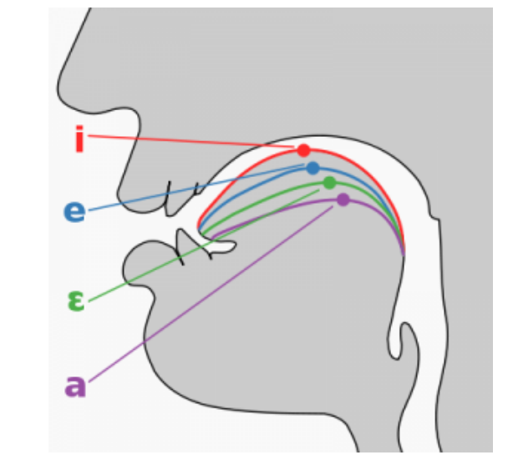
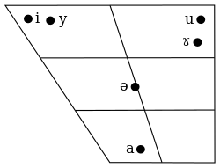
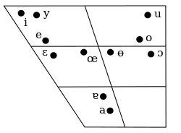
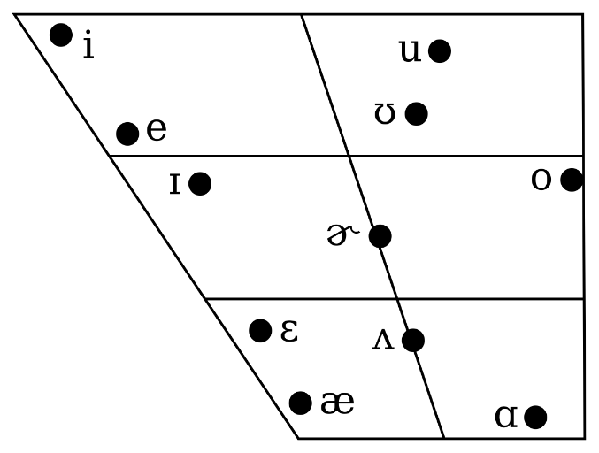
Background and Motivation
Prior research reports that Chinese learners struggle with English vowels, in particular:
Problems differentiating between
/i:/ and /ɪ/ (see, e.g., Zhang & Yin, 2009)
/e/ and /æ/ (Wang, 2008; Zhang & Lu, 2012; Jiang & Zhang 2019)
Reasons
Differences in inventory size (CHN: Mandarin 6 vowels* vs. ENS: app.** 11 vowels) (Wang & Sun, 2015)
Differences in how vowels are differentiated (ENS: formants + duration | CHN: formants + tone)
Monophthongal vowels in southern Californian Engl.
Mandarin monophthongal vowels
Cantonese monophthongal vowels
* Cantonese has 11 monophthongal vowels, i.e., vowels with a fixed tongue position (no moving tonue position like /au/ or /ou/.
** Depending on the variety of English.

Slide 6
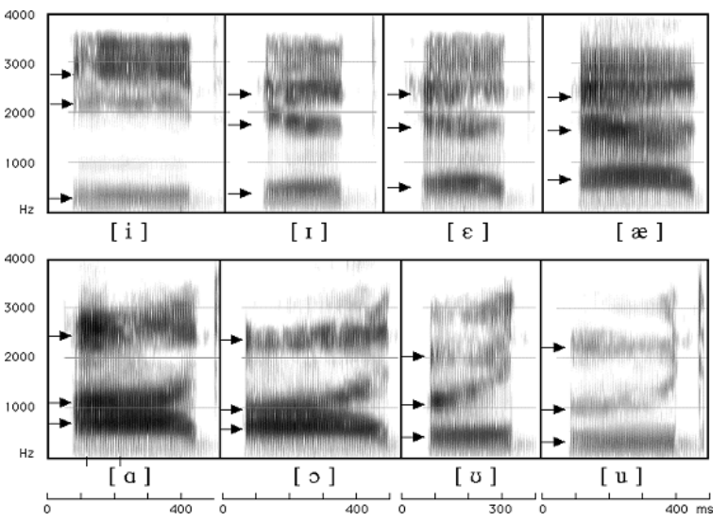
Background and Motivation
What are “formants”? and do they have to do with tongue position?
Formants are concentration of acoustic energy at a certain frequency (Ladefoged & Johnson 2014 )
First formants (F1) inversely correspond to the tongue height
Second formants (F2) and inversely correspond to tongue fronting
Left: Vowel chart of southern Californian Engl.
F3
F1 (tongue height)
F2
F1
F2 (tongue fronting)

Slide 7
Research Gaps | Research Questions
Problems and gaps in previous research
Very little research
Existing research very impressionistic (few systematic empirical research despite Chinese learners of English being one of the largest learner groups globally!)
Learner vowel traits in naturalistic speech environments largely unknown
Limited generalisability | applicability of the findings
Current Study
Larger-scale analysis of Chinese learners of English vowels
produced under more spontaneous speech conditions is needed!
RQ1: Do Chinese learners merge /i:/ and /ɪ/ as well as /e/ and /æ/?
RQ2: Do Chinese learners show significant deviations from L1 speakers in terms of vowel duration for /u:/ and /ʊ/ as well as /i:/ and /ɪ/?

Slide 8
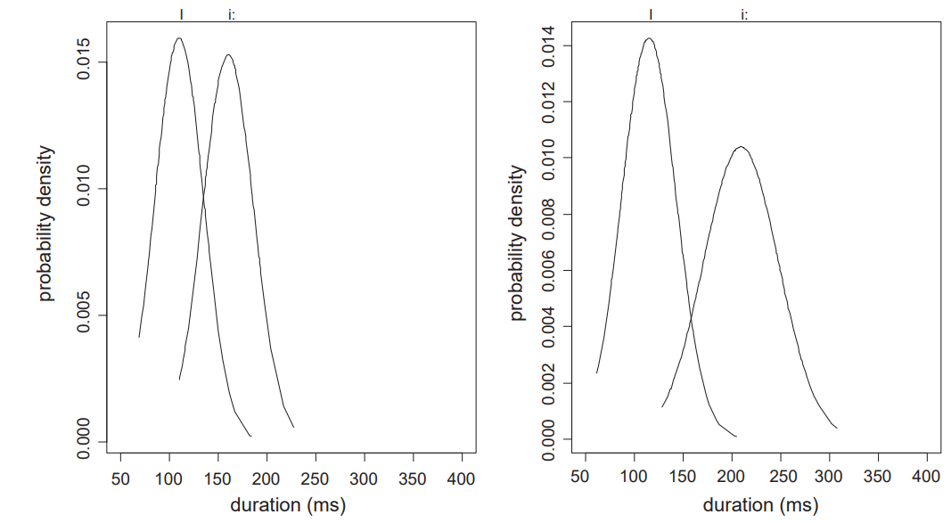
Research Gaps | Research Questions
State of the art
Japanese learners merge /i:/ and /ɪ/ (Zhang & Yin, 2009) and do not differentiate between /e/ and /æ/ (Wang, 2008; Zhang & Lu, 2012; Jiang & Zhang 2019)
Hypothesis
Chinese speakers will show mergers for /i:/ and /ɪ/ and /e/ and /æ/
Chinese speakers will show significant deviations in durations of vowels compared to L1 English speakers (similar to Japanese learners of English where Japanese also lack phonemic duration contrasts and thus exaggerate contrasts compared to L1 English speakers (Schweinberger & Komiya 2022).
L1 English speaker (ENS)
Chinese learner of English (CHN)
/i/
/i/
/ɪ/
/ɪ/
Japanese learners of English
L1 English speakers
/ɪ/
/ɪ/
/i/
/i/
(Tsukada 2009)

Slide 9

Methodology (Data | Analysis)
Data
International Corpus Network of Asian Learners of English (ICNALE) (Ishikawa 2014)
Speech and text samples from English learners in Asia and L1 English speakers
Spoken monologues: spontaneous speech from 148 Chinese learners and 87 L1 speakers of English
Final data set
Type | Speakers | /æ/ | /ɛ/ | /i/ | /ɪ/ | /u/ | /ʊ/ | Total
CHN | 148 | 514 | 228 | 723 | 795 | 278 | 219 | 2,757
ENS | 87 | 869 | 340 | 660 | 443 | 255 | 110 | 2,677
Total | 235 | 1,383 | 568 | 1,383 | 1,238 | 533 | 329 | 5,434
Gender | A2 | B1 | B2 | Total
female | 9 | 70 | 7 | 86
male | 5 | 55 | 2 | 62
Total | 14 | 125 | 9 | 148
Right: Gender and proficiency levels of CHN

Slide 10
Methodology (Data | Analysis)
Data Processing (R 4.2.2, R Core team (2022) in RStudio (RStudio Team 2022))
Aligning speech with audio using Web-MAUS (Schiel 1999) (this produces Praat TextGrids)
Automated extraction of vowel formants and vowel duration from Praat TextGrids (Wickham et al. 2019)
Only monosyllabic words were retained and outliers were removed using Kernel Density Estimation
Statistical Analysis
Mergers → Bhattacharya affinity (Johnson 2015, measure of overlap of scatter clouds, 1 = perfect overlap)
Duration → Mixed-Effects Regression Model (lme4: Bates et al. (2015), sjPlot: Lüdeke (2021))
DV: duration
IVs: type, vowel, gender, age, word type
REs: word, speaker

Slide 11
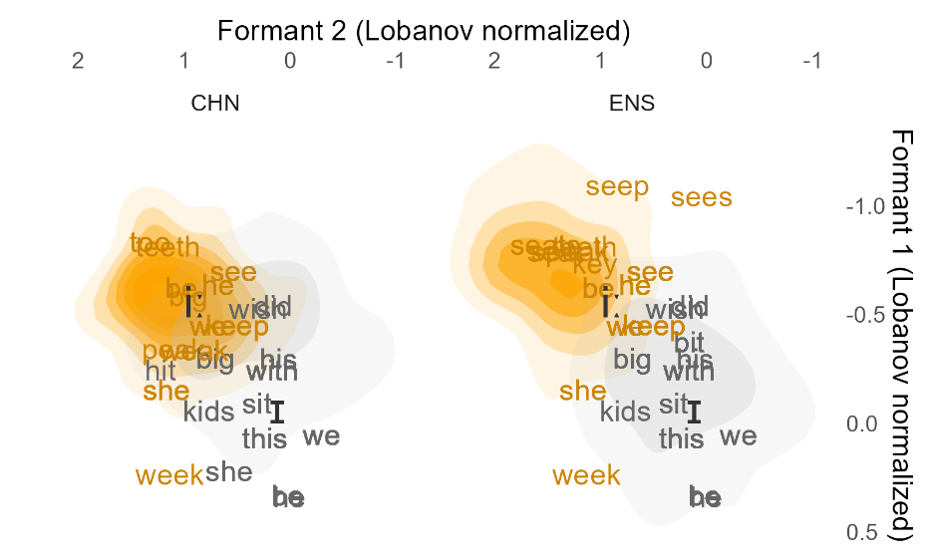
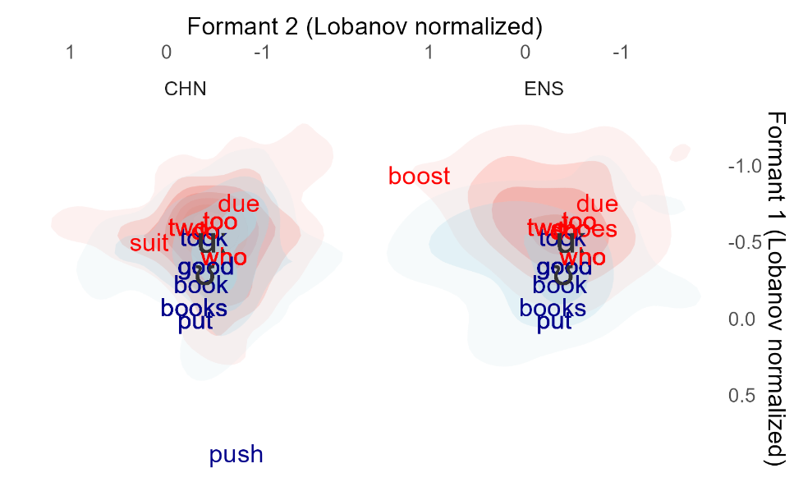
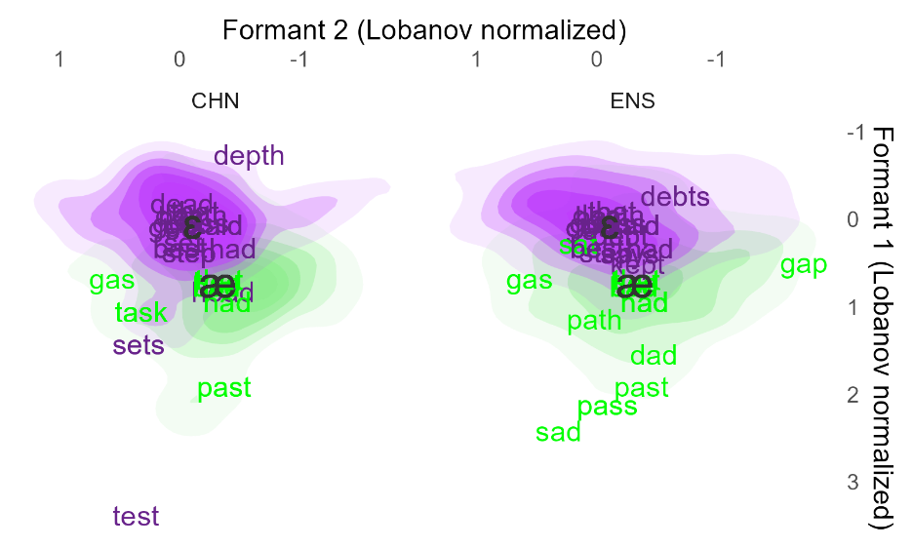
Results
Mergers
/i:/ and /ɪ/
CHN Bhattacharya affinity: .833
ENS Bhattacharya affinity: .692
Substantively more overlap among CHN!
/u:/ and /ʊ/
CHN Bhattacharya affinity: .939
ENS Bhattacharya affinity: .956
Substantive overlap among both groups
/æ/ and /ɛ/
CHN Bhattacharya affinity: .797
ENS Bhattacharya affinity: .816
Overlap among both groups

Slide 12
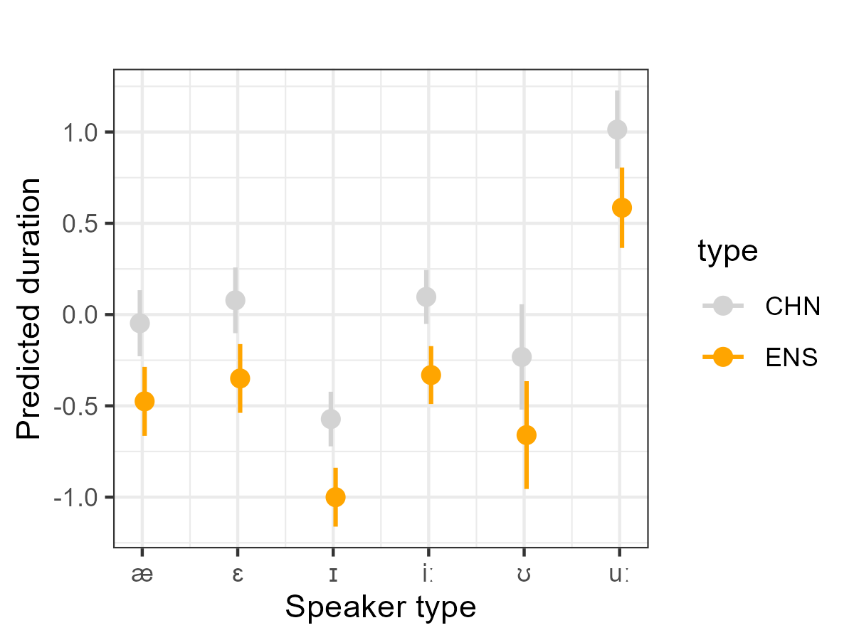
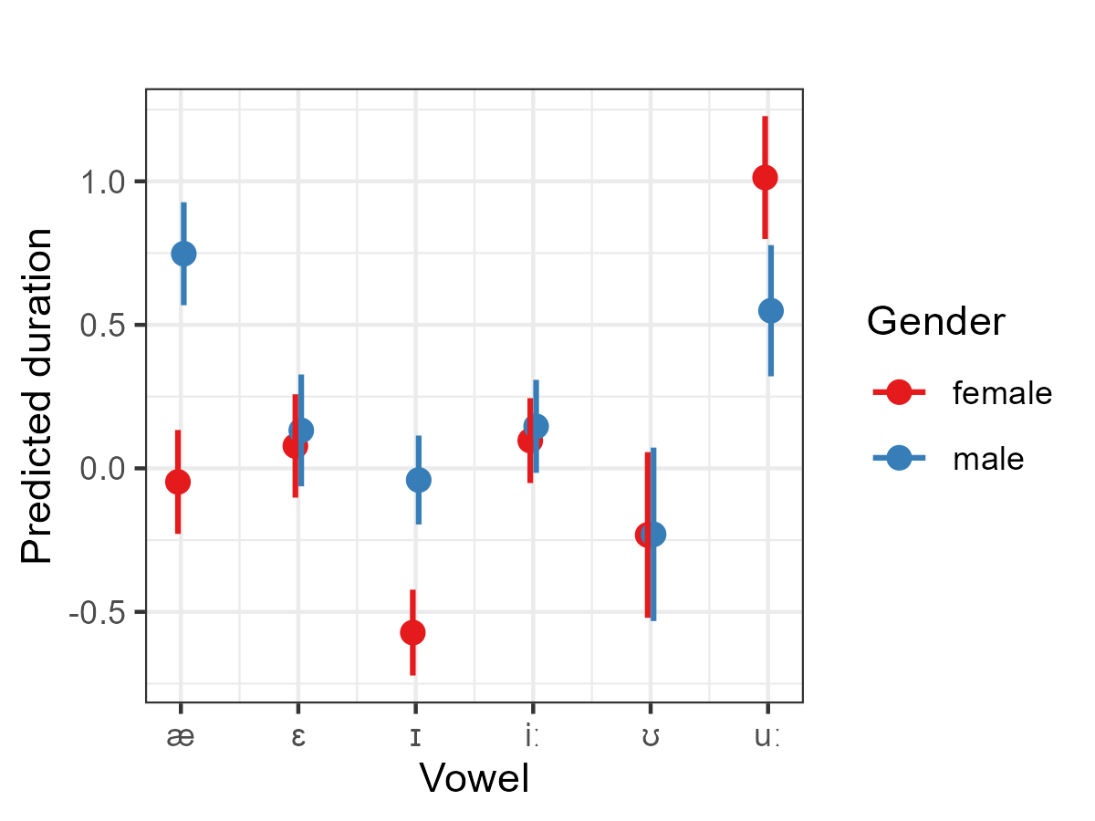
Results
Final minal adequate model (N = 5,434)
Predictors | Estimates | Estimates | CI | p
(Intercept) | -0.05 | -0.05 | -0.23 – 0.13 | 0.608
type [ENS] | -0.43 | -0.43 | -0.51 – -0.34 | <0.001
WordClass [lexical] | 0.25 | 0.25 | 0.08 – 0.42 | 0.003
Vowel [ɛ] | 0.13 | 0.13 | -0.02 – 0.27 | 0.082
Vowel [ɪ] | -0.52 | -0.52 | -0.73 – -0.32 | <0.001
Vowel [iː] | 0.14 | 0.14 | -0.06 – 0.35 | 0.163
Vowel [ʊ] | -0.18 | -0.18 | -0.48 – 0.11 | 0.227
Vowel [uː] | 1.06 | 1.06 | 0.80 – 1.32 | <0.001
Gender [male] | 0.8 | 0.8 | 0.68 – 0.92 | <0.001
Vowel [ɛ] × Gender [male] | -0.74 | -0.74 | -0.92 – -0.56 | <0.001
Vowel [ɪ] × Gender [male] | -0.26 | -0.26 | -0.41 – -0.12 | <0.001
Vowel [iː] × Gender [male] | -0.75 | -0.75 | -0.89 – -0.60 | <0.001
Vowel [ʊ] × Gender [male] | -0.79 | -0.79 | -1.02 – -0.57 | <0.001
Vowel [uː] × Gender [male] | -1.26 | -1.26 | -1.45 – -1.07 | <0.001
Random Effects / Model statistics
τ00 Speaker (N) |  | 0.06 (235)
τ00 Word (N) |  | 0.03 (37)
Marginal R² / Conditional R² |  | 0.179 / 0.263 (baseline 0.229)

Slide 13

Discussion | Outlook
Comparison with previous findings
Confirmation | Substantiation
CHN: mergers of /i:/ and /ɪ/ (Zhang & Yin, 2009) as well as /e/ and /æ/ (Wang, 2008; Zhang & Lu, 2012; Jiang & Zhang 2019) (RQ1)
ENS: merger of /u:/ and /ʊ/ (Schweinberger & Komiya, 2022)
Unique findings | Conflicts
CHN: merger also for /u:/ and /ʊ/ (RQ1)
CHN: produce all vowels shorter than ENS (RQ2)
CHN: do not exaggerate duration contrasts like Japanese learners of English (Schweinberger & Komiya, 2022; Tsukada 2009)
ENS: merger of /e/ and /æ/ in spon. speech
Limitations
Did not substrate of CHN into account (Mandarin vs Cantonese vs etc.)
Did not check for vowels in CHN substrate.
Quality of recordings is really poor! (minute-long recordings recorded on cell phones)!
Significance
Bad quality could | can be compensated using advanced methods (Kernel Density Estimation)
Insights into vowel production by JPN learners in spontaneous speech (underexplored) → natural setting allows to generalise findings to real-life learner speech
Automated corpus-based investigation on larger samples

Slide 14
Potential Applications
Prototype (proof-of-concept)
Extend study to other learners of English (especially learners with L1’s whose vowel system differs from English)
Significance
One of the first large-scale, corpus-based studies of ESL vowel production in natural speech!
Follow-up: perception → do differences in vowel production correspond to difficulties in intelligibility?
Possible Applications
Creation of targeted classroom materials to improve L1-like vowel production among learners

Slide 15
Thank you really very much!
Ruihua Yin Martin Schweinberger
ruihua.yin@uq.edu.au
m.schweinberger@uq.edu.au

Slide 16

References
Flege, J. E. (1995). Second-language speech learning: theory, findings, and problems. In W. Strange (ed.), Speech perception and linguistic experience: Issues in cross-linguistic research, 233-277. York Press.
Grenon, I., Kubota, M., & Sheppard, C. (2019). The creation of a new vowel category by adult learners after adaptive phonetic training. Journal of Phonetics 72: 17-34.
Jiang, L., & Zhang, Y. (2019). Perception and production of English vowels by Chinese learners. Journal of Second Language Pronunciation, 5(1), 1-20.
Johnson, D. E. (2015). Quantifying Overlap with Bhattacharyya's affinity and other measures! Paper presented at NWAV15 (https://danielezrajohnson.shinyapps.io/nwav_44/).
Ladefoged, P., & Johnson, K. (2014). A Course in Phonetics. Cengage.
Schweinberger, M., & Komiya, Y. (2022). A corpus-based computational analysis of high-front and -back vowel production of L1-Japanese learners of English and L1-English speakers. In Rosey Billington (ed.), Proceedings of the Eighteenth Australasian International Conference on Speech Science and Technology, 196-200. Australasian Speech Science and Technology Association.
Tsukada, K. (2001). Native vs non-native production of English vowels in spontaneous speech: An acoustic phonetic study. In P. Dalsgaard, B. Lindberg & H. Benner (eds.), Proceedings of the 7th European Conference on Speech Communication and Technology (Eurospeech 2001), 305-308.
Wang, X. (2008). Pronunciation problems of Chinese students learning English: Interference and instruction. US-China Education Review, 5(9), 16-22.
Wang, W. S., & Sun, C. (2015). The Oxford handbook of Chinese linguistics. Oxford University Press.
Zhang, F. & Yin, P. (2009). A Study of Pronunciation Problems of English Learners in China. Asian Social Science, 5(6), 141-146.
Zhang, Y., & Lu, Y. (2012). A study on pronunciation problems of English learners from China. English Language Teaching, 5(12), 156-162.

Slide 17

Data & Software
Data
Ishikawa, S. (2014). Design of the ICNALE Spoken: A new database for multi-modal contrastive interlanguage analysis. Learner Corpus Studies in Asia and the World 2: 63-76.
Software
R Core Team (2022). R: A language and environment for statistical computing. R Foundation for Statistical Computing, Vienna, Austria. (https://www.R-project.org)
RStudio Team (2022). RStudio: Integrated Development Environment for R. RStudio, PBC: Boston, MA (http://www.rstudio.com)
Bates, D., Maechler, M., Bolker, B., & Walker, S. (2015). Fitting Linear Mixed-Effects Models Using lme4. Journal of Statistical Software 67(1), 1-48.
Lüdecke D. (2021). sjPlot: Data Visualization for Statistics in Social Science. R package. Version 2.8.10 (https://CRAN.R-project.org/package=sjPlot).
Schiel, F. (1999). Automatic Phonetic Transcription of Non-Prompted Speech, Proceedings of the ICPhS 1999. San Francisco, August 1999, 607-610.
Wickham et al., (2019). Welcome to the tidyverse. Journal of Open Source Software 4(43): 1686.
https://github.com/MartinSchweinberger/ICAME44

Slide 18
A corpus-based acoustic analysis of vowel production by L1-Chinese learners and native speakers of English
Martin Schweinberger
Ruihua Yin
m.schweinberger@uq.edu.au ruihua.yin@uq.edu.au
All materials (except data) available at https://github.com/MartinSchweinberger/ICAME44

