Slide 1
UQ School of Languages and Cultures Professional Development Panel Getting Started with Your Academic Career Peter Crosthwaite, Kayoko Hashimoto, Ilana Mushin, Greg Hainge, Martin Schweinberger

Slide 2


Slide 3
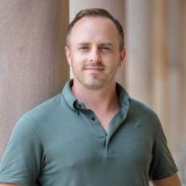
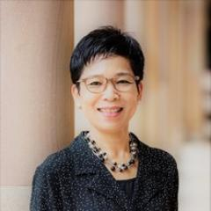
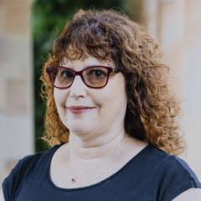
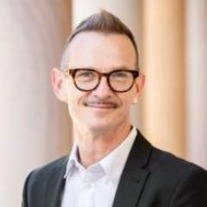
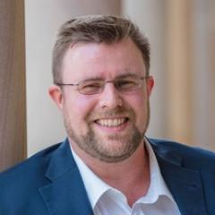
Run-of-show
2:00–2:05 — Welcome, framing, format (Martin)
2:05–2:10 — Panellist intros (~1 minute each)
2:10–2:25 — Block A: Publishing and visibility (lead: Peter)
2:25–2:40 — Block B: Networks and community (lead: Kayoko)
2:40–2:55 — Block C: Grants, awards, and career planning (lead: Ilana)
2:55–3:10 — Block D: The hiring panel view (lead: Greg)
3:10–3:30 — Open Q&A and closing thoughts

Slide 4
Q&A

Slide 5
Thanks so much!
Keypoints will be circulated
Open questions and feedback to slc.dor@uq.edu.au

