Slide 1
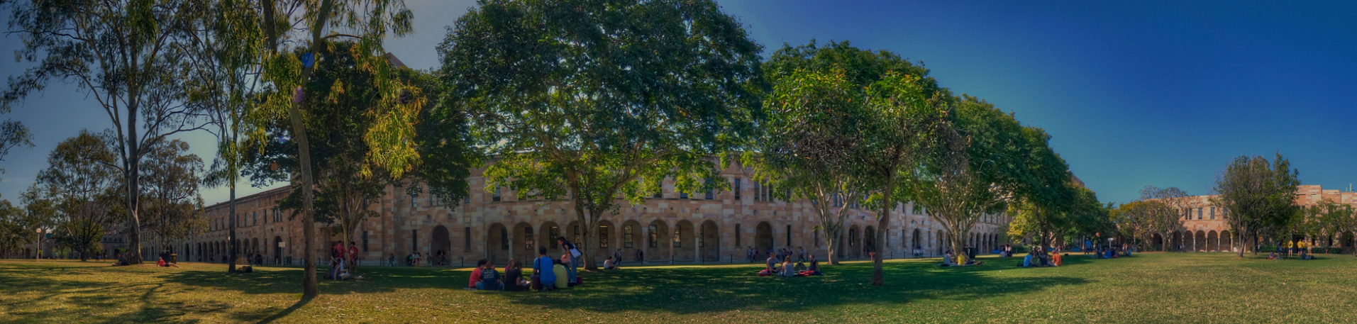
Indigenous Australian Languages Linguistic Features, Revitalization Efforts, and Research Infrastructure for Archiving and Accessibility
Martin Schweinberger
m.schweinberger@uq.edu.au
The University of Queensland

Slide 2

About
Martin Schweinberger is a Lecturer in Applied Linguistics at the University of Queensland (UQ) and co-director of LADAL – the Language Technology and Data Analysis Laboratory (ladal.edu.au).
Before taking on his current position, Martin worked at the University of Hamburg where he got his PhD in 2014, at the Arctic University of Norway in Tromsø where we worked as Associate Professor and Principal Data Science Advisor, as well as several German universities (FU Berlin, Leuphana Lüneburg, Kassel, Greifswald).
As quantitative corpus linguist, he specializes in computational analyses of text and speech. Martin is a Chief Investigator of the Language Data Commons of Australia (LDaCA) and Vice-President Profession of the International Society for the Linguistics of English (ISLE). He also serves as a board member of the International Computer Archive of Medieval and Modern English (ICAME).
His research spans language variation, discourse markers, L1/L2 acquisition, computational modelling, and text analytics as well as reproducibility and linguistic research infrastructures.
Contact: m.schweinberger@uq.edu.au Home: martinschweinberger.de

Slide 3
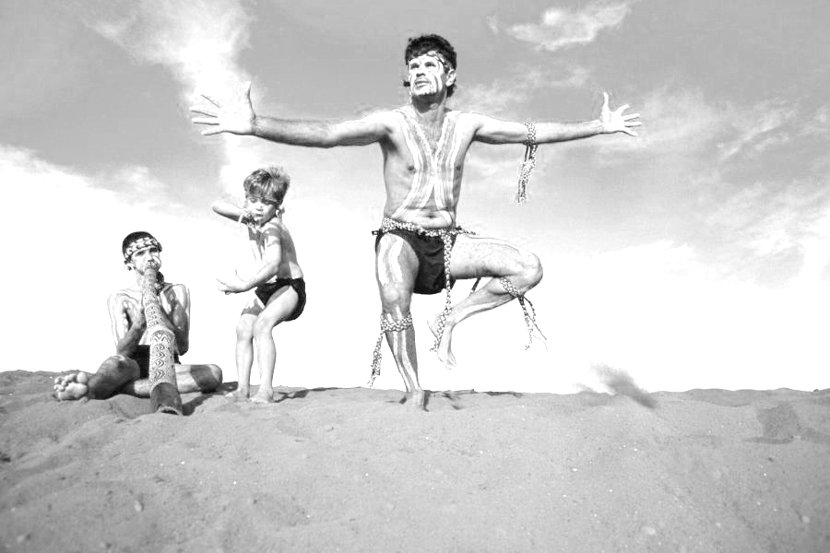
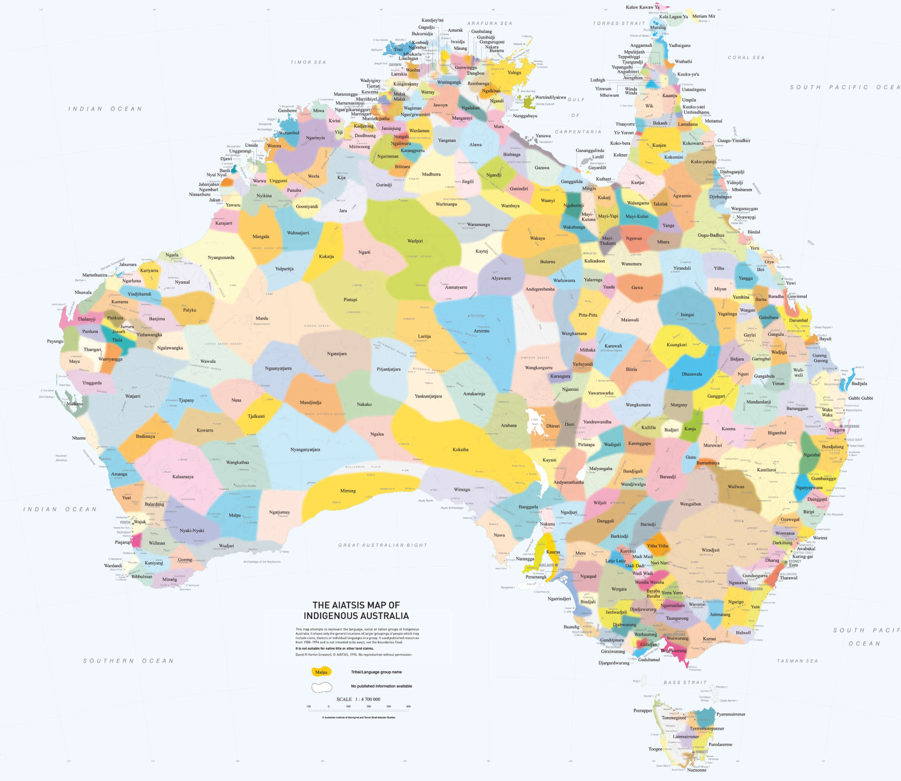
Timeline
Languages of Australia
Background, Basics, History, and Features
What can we learn from indigenous Australian languages?
Indigenous Language Documentation and Revitalization
Ongoing Language Revitalization Efforts in Australia
Language Infrastructure Projects
What are Language Infrastructure Projects?
Language Preservation, Archiving, and Access: LDaCA
The above map is based upon the Horton Indigenous Map of Australia © Aboriginal Studies Press, AIATSIS, and Auslig/Sinclair, Knight, Merz, 1996. The full map is available on the AIATSIS website.

Slide 4

Languages of Australia

Slide 5
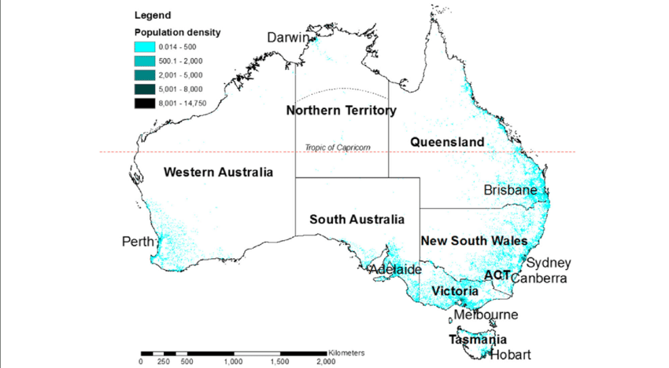
Factsheet Australia
Population: ~26 million (2024).
Geography and Population Density
Area: 7.7 million km² (6th largest country in the world).
Population density: ~3.4 people per km² (one of the lowest globally).
Major Cities
Sydney: ~5.7 million.
Melbourne: ~5.3 million.
Brisbane: ~2.7 million.
Perth: ~2.3 million.
Adelaide: ~1.4 million (Canberra: 400K, Cairns: Hobart: 60K, 155K, Darwin: 125K)
App. 70% of Australian live in cities and most Australians live along the eastern and southeastern coasts due to arid interior regions.
Information based on:
The Australian Bureau of Statistics (for population and demographics)
CIA World Factbook (for geographical data)
Australian government websites or tourism boards (for population and major cities)
Population density Australia

Slide 6
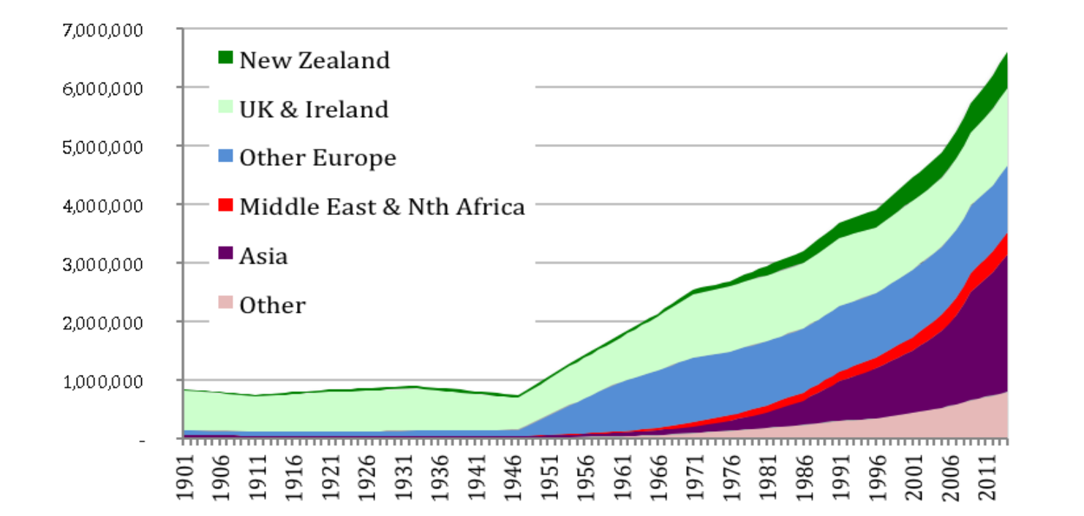
Australia’s Population
Migration Patterns and Population Diversity
Historical Migration Patterns
Indigenous Australians: ~65,000 years ago.
European settlement: Began in 1788.
Post-WWII: Large-scale migration from Europe (e.g., UK, Italy, Greece).
Late 20th century: Increased migration from Asia and the Middle East.
Current Population Composition (2024)
~30% born overseas.
Largest migrant groups: UK, India, China, New Zealand, and Philippines.
21% speak a language other than English at home.
Australia is a superdiverse, multicultural nation shaped by waves of migration, making it one of the most diverse populations in the world.
Overseas-born population, 1901 to 2014, by region of birth

Slide 7
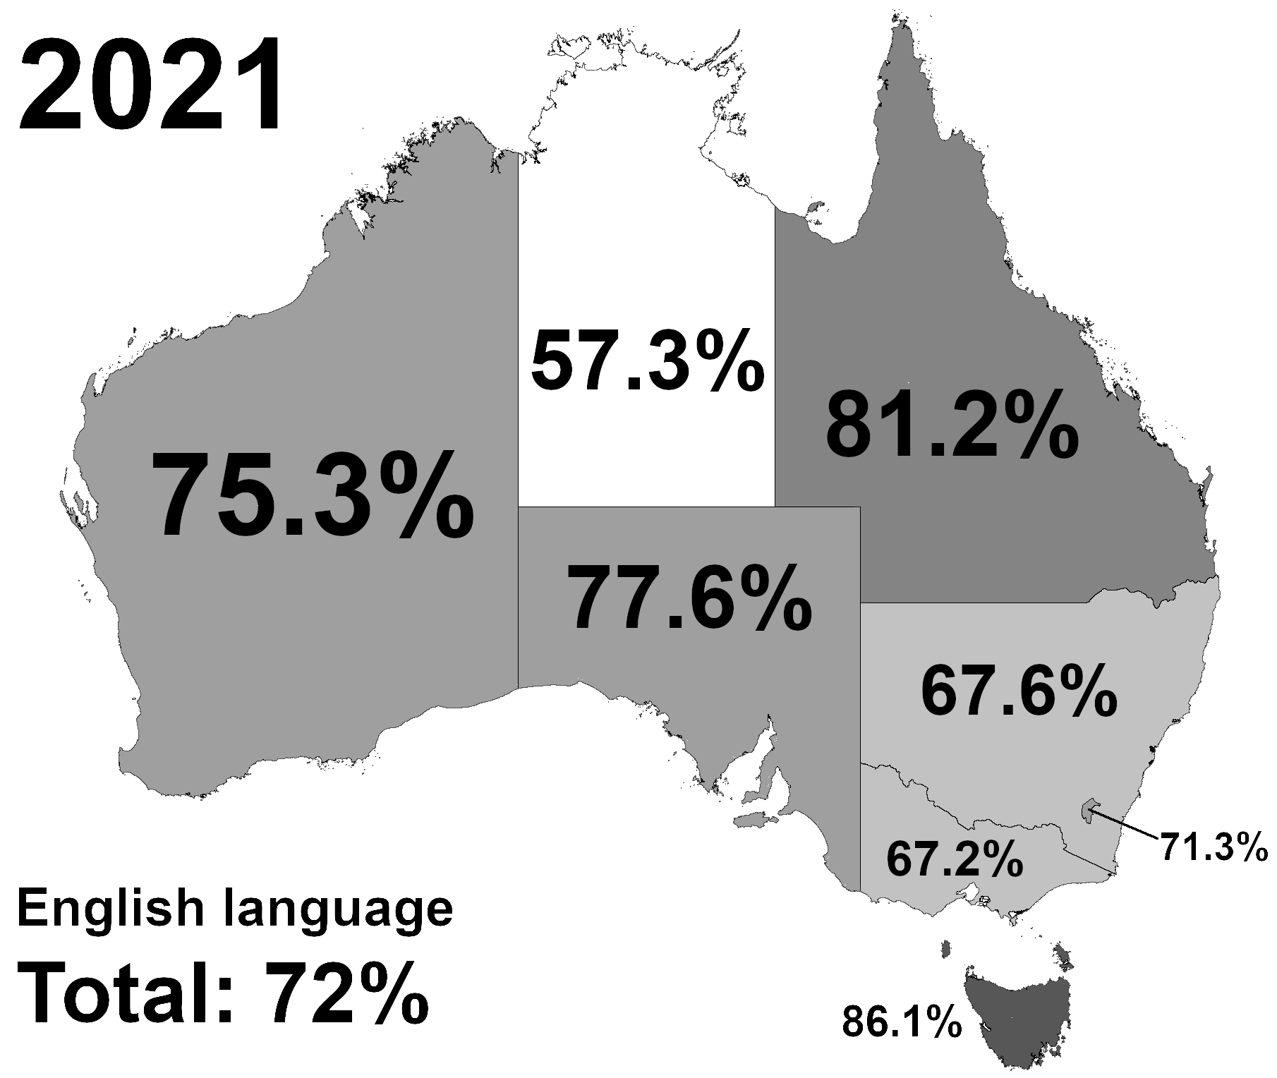
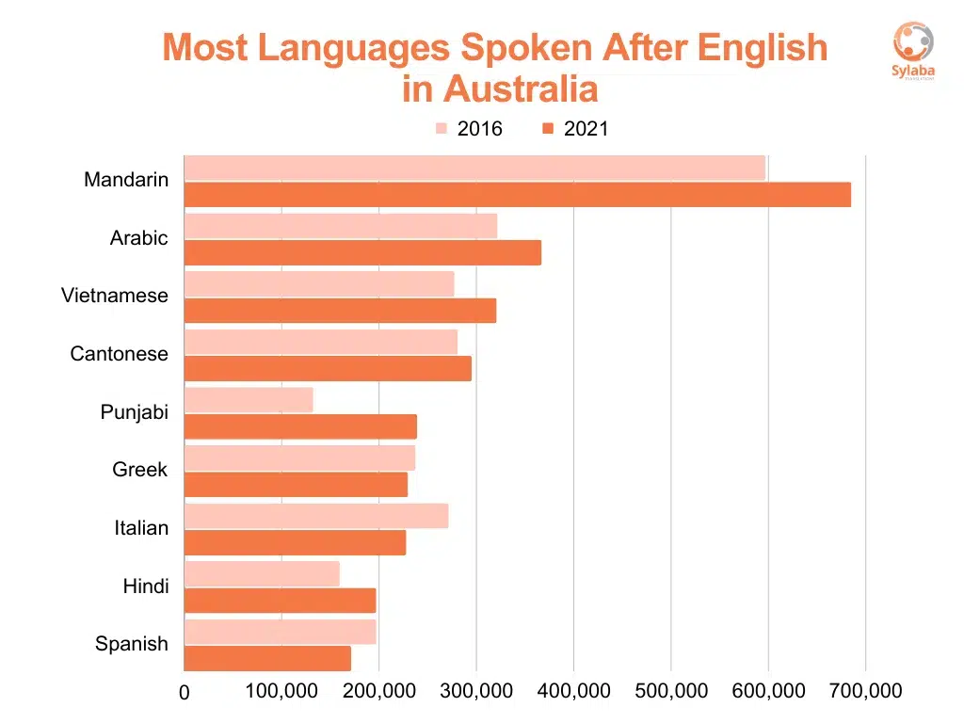
Australia’s Linguistic Landscape
Number of Languages
~250 Indigenous languages spoken pre-colonization.
~120 Indigenous languages still spoken today, but many critically endangered.
Non-Indigenous Languages
Australia is home to speakers of over 300 languages due to migration.
Most common languages after English: Mandarin, Arabic, Cantonese, Vietnamese, Italian
Australia’s linguistic diversity reflects both its Indigenous heritage and multicultural society.
Key Statistic (2024): ~21% of Australians speak a language other than English at home.
Population who speaks only English at home in 2021

Slide 8
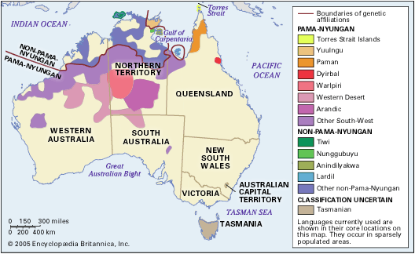
Language Policy and Multilingualism
Supporting Linguistic Diversity
Official Language: English (de facto official language).
Multicultural Society
Policies support cultural and linguistic diversity.
Languages Other Than English (LOTE) in schools.
Translation services for non-English speakers.
Challenges
Indigenous languages at risk of extinction.
Balancing linguistic preservation with English dominance.
Australia is a linguistically superdiverse country, with efforts undertaken to preserve both Indigenous and migrant languages.
Overview of prevalence of indigenous Australian languages

Slide 9
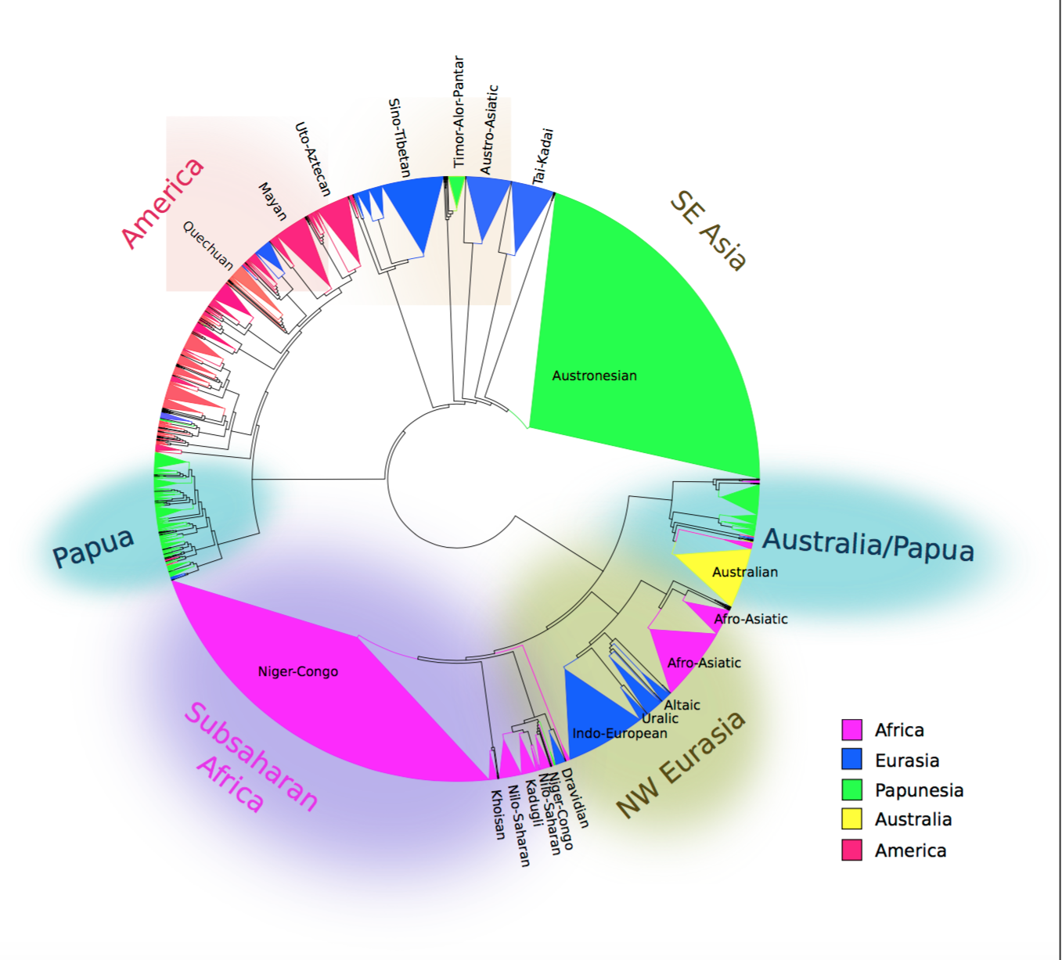
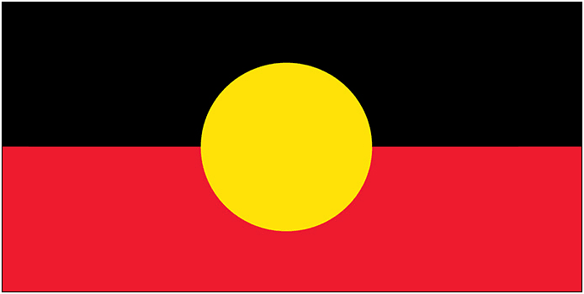
Diversity and Distribution of Aboriginal Languages
From Collins (2016).
Language Families
250+ Aboriginal languages divided into 25+ language families.
Europe has a similar number of languages, but most belong to only 3 major families.
Unique Relation: Aboriginal languages are related to one another but not to any other world languages.
Pama-Nyungan Family (largest family)
Covers 90% of Australia’s landmass.
Includes 150+ languages (e.g., Tiwi, Walmatjari, Warlpiri, Aranda).
Smaller Language Families
Non-Pama-Nyugan and isolates like Tasmanian (consist of just 1–2 languages)
Nearly all have <1,000 speakers and face extinction threats.

Slide 10
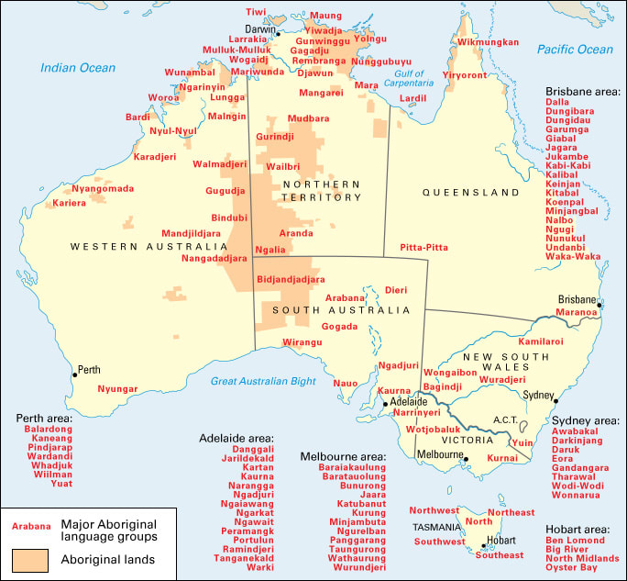
Historical Impact of Colonization
Language Decline and Endangerment
Impact of Colonization
Forced displacement and assimilation policies disrupted transmission of indigenous languages.
Many communities lost access to their traditional lands.
Suppression of language use in schools and institutions.
Current Status:
~120 languages still spoken, but only 13 are considered strong (learned by children).
Many languages have only a few elderly speakers.

Slide 11
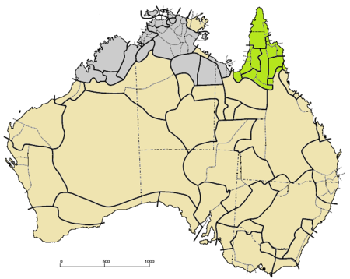
Introduction to Indigenous Australian Languages
Indigenous Australian Languages: A Rich Linguistic Heritage
Origins and Diversity
Indigenous languages are among the oldest continuous languages, with roots stretching back ~65,000 years.
Estimated 250–300 distinct languages spoken pre-European settlement (1788).
Includes ~700 dialects, reflecting Australia’s vast geographical diversity.
Geographic Distribution
Languages often tied to specific territories or Country.
Regions of high linguistic diversity in northern and central Australia.
Map of languages in Australia (green = Paman languages (subfamily of Pama-Nyugan), beige = other Pama–Nyungan,
gray = non-Pama-Nyugan) https://en.wikipedia.org/wiki/Paman_languages

Slide 12
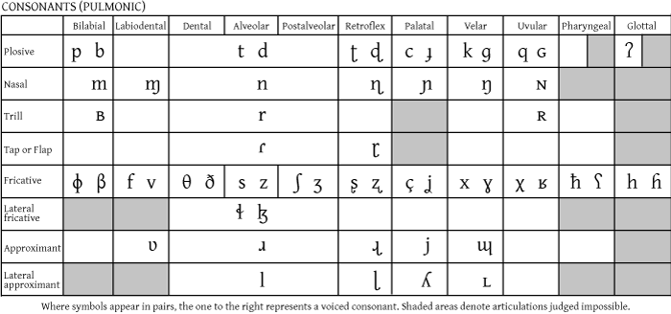
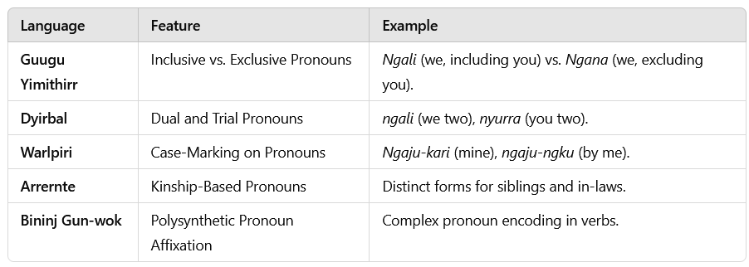
Key Features of Indigenous Australian Languages
Phonetics and Phonology
Small phoneme inventories (e.g., few vowel contrasts).
Extensive use of stops and nasals; retroflex and lateral sounds are common.
Grammar
Free word order but often ergative-absolutive alignment.
Rich inflectional morphology for verbs and nouns.
Pronoun systems encode social relationships and kinship (see table at the bottom right)
(see Dixon 2011 for details)
Examples of information encoded in pronoun systems in Australian languages.

Slide 13
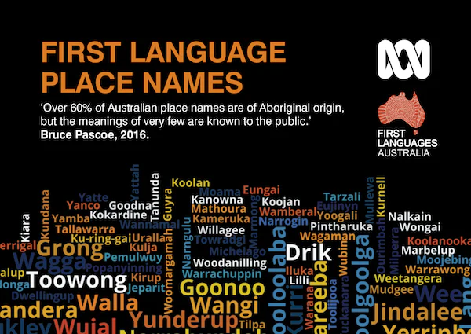
Key Features of Indigenous Australian Languages
Vocabulary and Concepts
Rich and complex vocabulary, with everyday vocabularies of ~10,000 words.
Strong connection to environment (flora, fauna, landmarks).
Specific terms for kinship, reflecting complex social systems.
Flora and Fauna
Kangaroo (Guugu Yimithirr), Koala (Dharug), Wallaby (Dharug), Dingo (Dharug), Wombat (Dharug)
Place Names
Canberra (Ngunnawal: "Meeting place.„), Wagga Wagga (Wiradjuri: "Place of many crows.„), Katoomba (Dharug: "Place of many waterfalls.„), Yarra (Woiwurrung): "Flowing water").
Cultural Terms
Boomerang (Dharug), Didgeridoo (likely Yidaki in Yolŋu Matha), Billabong (Wiradjuri),Tucker (Dharug): Food, Yakka (Yagara): Hard work ("hard yakka").
How would you pronounce Canberra Indooroopilly Mooloolaba

Slide 14
Key Features of Indigenous Australian Languages
Ergative-Absolutive Alignment
Treats subjects of intransitive verbs (S) and objects of transitive verbs (O) the same (absolutive), while marking transitive subjects (A) differently (ergative). In contrast, nominative-accusative alignment (e.g., in English and German) treats subjects of both transitive and intransitive verbs the same (nominative) and marks objects differently (accusative).
Fictitious example: Imagine if English or German worked like an ergative-absolutive language
Intransitive verb: Her sleeps. (Sie schläft.) – “Her" (absolutive) = subject of the intransitive verb.
Transitive verb: She sees her. (Sie sieht sie.) - "She" (ergative) = subject of the transitive verb and "Her" (absolutive) = object of the transitive verb.
Real Example from an Ergative-Absolutive Language (Dyirbal)
Intransitive verb: ŋuma banaga-nyu: "Father (absolutive) returned."
Transitive verb: ŋuma-ŋgu yabu bura-n: "Father (ergative) saw mother (absolutive)."

Slide 15
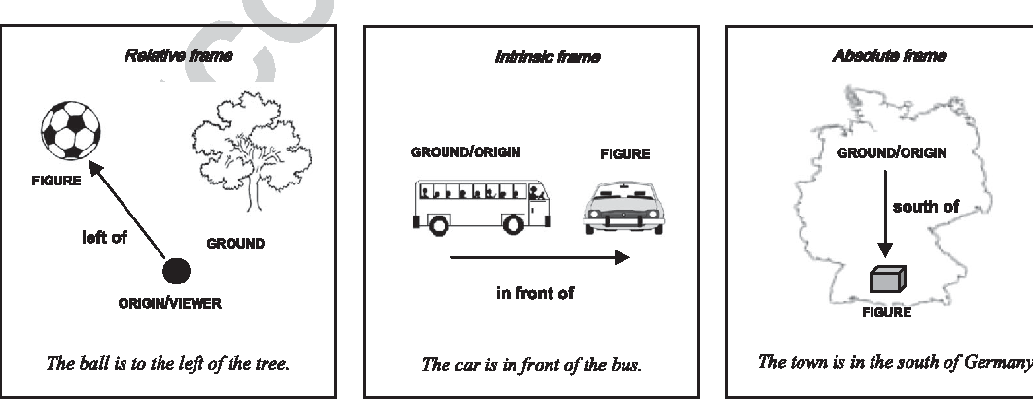
Key Features of Indigenous Australian Languages
Unique Spatial Reference Systems
Australian languages often use absolute reference systems rather than relative ones.
Spatial terms are based on cardinal directions (e.g., north, south, east, west) rather than body-based orientations (e.g., left, right).
Examples:
Kuuk Thaayorre (Paman language): Instead of "turn left," one would say "turn to the north."
Guugu Yimithirr: Phrases like "the cup is north of the plate" are common.
Speakers constantly track their orientation relative to cardinal directions, enhancing spatial awareness.

Slide 16
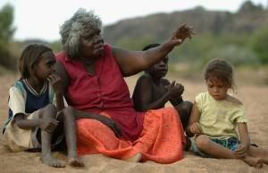
Testing Absolute Reference Systems
1. Orientation and Navigation Tasks
Researchers presented participants with tasks requiring orientation and navigation in real-world or experimental settings. For example: Speakers of Guugu Yimithirr were asked to describe the locations of objects in a room. Instead of left or right, participants used cardinal directions (e.g., north, south). (see Haviland, 1998)
Observation: Speakers consistently used absolute terms regardless of their orientation.
2. Tabletop Spatial Arrangement Tasks
Objects were initially laid out in a specific pattern relative to cardinal directions. Participants were then asked to replicate the layout on a new table after being rotated (see Haun et al., 2011)
Findings: Speakers of absolute-system languages oriented objects based on cardinal directions, while speakers of relative-system languages (e.g., English) used left and right.

Slide 17
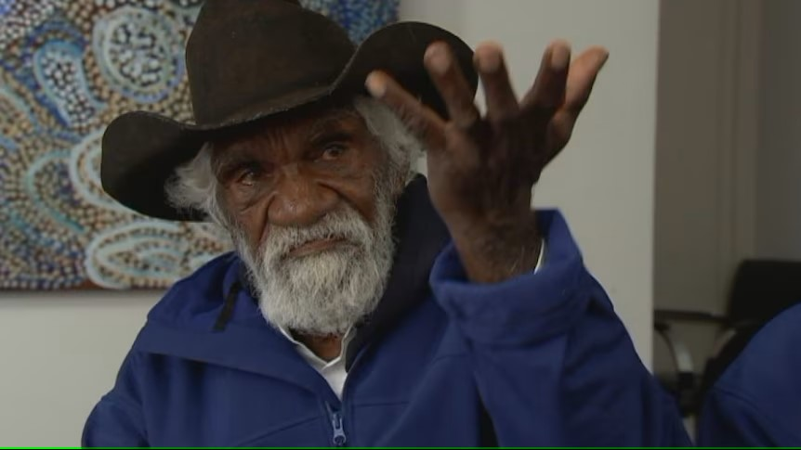
Testing Absolute Reference Systems
3. Recall and Memory Experiments
Participants were shown an arrangement of items and asked to describe or recreate it later. Absolute-system speakers accurately recalled layouts using cardinal terms, even when moved to new locations or faced different directions (see Pederson et al., 1998)
4. Storytelling and Route Description
Kuuk Thaayorre speakers were prompted to describe a journey. The participants consistently encoded directions using absolute references, highlighting their strong reliance on environmental cues like the sun (see Gaby, 2012)
Significance of These Tests
These experiments demonstrate that absolute reference systems influence not just language use but also cognitive processes like spatial awareness, memory, and problem-solving. How can speakers of these languages do this?

Slide 18

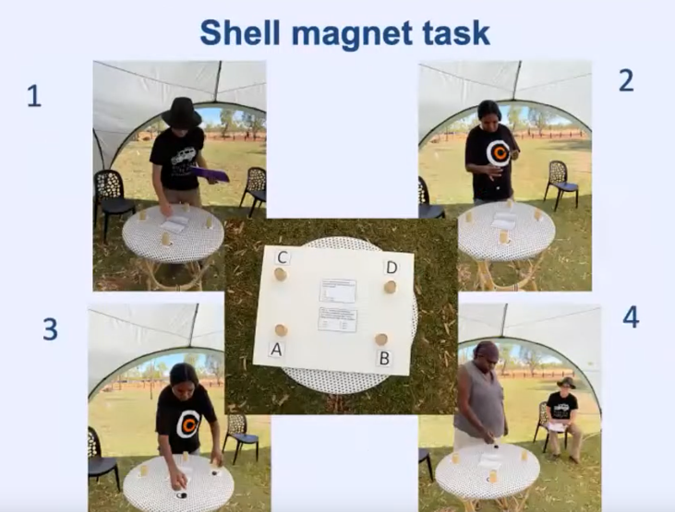
Absolute Reference Systems: Neurological Insights
Meakins, Felicity (to appear) Geocentric languages and the perception of the earth’s magnetic field. Cognitive Processing.
Gurindji speakers rely on cardinal directions (e.g., "north of the vegemite") instead of left/right terms for spatial relations. This geocentric system anchors their mental map of the world to the sun's trajectory, functioning effortlessly day and night.
Recent research (Wang et al., 2019) reveals that human brains respond to Earth's magnetic field via EEG alpha-wave drops, though participants (English speakers) were unaware of these shifts.
Shell magnet task (in Faraday cage) tested if subjects could detect a magnet under a shell. The precision of Gurindji participants was significantly better than English-speaking control group subjects.
Gurindji people's precise spatial orientation suggests they may consciously perceive geomagnetic cues, potentially uncovering a "human sixth sense“ (check out this talk for details: https://www.youtube.com/watch?v=SeLFOdHLYkg)

Slide 19
Indigenous Language Documentation and Revitalization

Slide 20
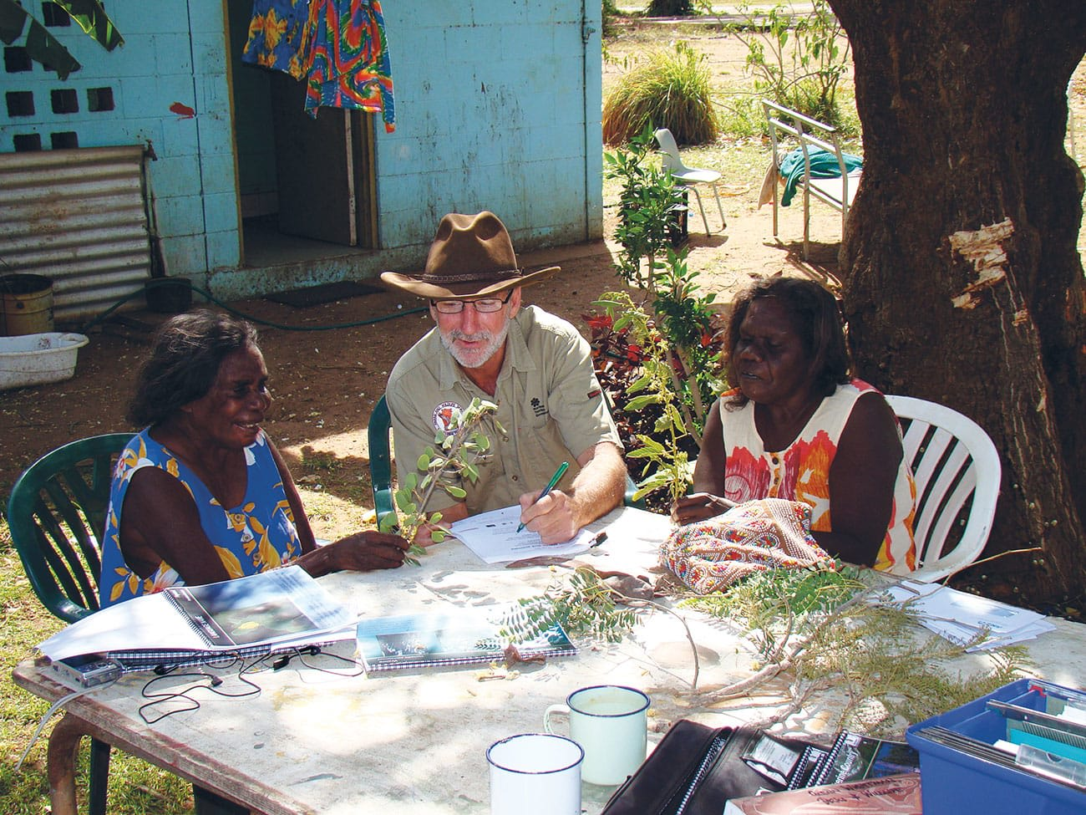
Efforts in Language Documentation and Revitalization
Preserving Cultural and Linguistic Heritage
Language Documentation
Recordings to capture pronunciation, grammar, and vocabulary.
Documenting oral traditions, such as Dreamtime stories, songs, and ceremonial practices.
Ensuring accessibility for future generations through archiving and digitalization.
Language Revitalization
Community-led initiatives for reintroducing languages in daily life.
Establishment of language nests: immersion programs for children supported by fluent speakers.
Innovative technology: Mobile apps, AI transcription tools, and VR-based learning experiences.
Collaborative Approach
Partnerships with Elders, linguists, and educators to respect and honour cultural protocols.
Funding and support through government grants and NGOs like First Languages Australia.
Recording session: Aboriginal Elders and Glenn Wightman

Slide 21
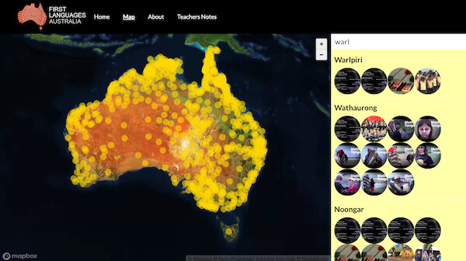
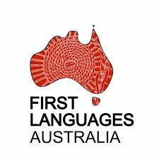
First Languages Australia
National organization working to
Promote and preserve Australia’s Indigenous languages.
Advocate for language rights and resources.
Support communities in developing and sharing resources.
Example project: Gambay - The Languages Map
A collaborative online tool showcasing over 120 languages.
Audio recordings of native speakers.
Detailed information on each language's history, speakers, and revitalization efforts.
Community-submitted updates to maintain accuracy.
Key Achievements
Built a platform for celebrating linguistic diversity in Australia.
Facilitated connections between language workers, teachers, and community members.
"Our languages are our stories, our past, and our future.“ Elder

Slide 22
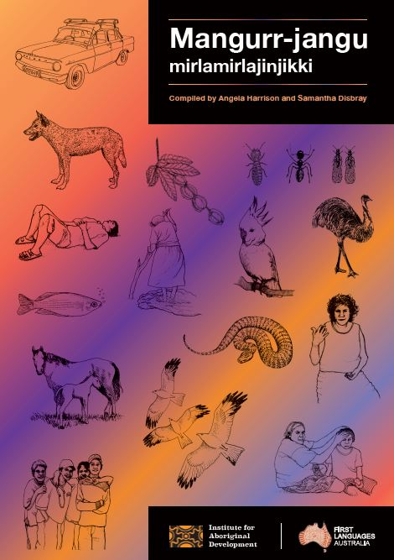

Example project: Pictures and Pedagogies (Samantha Disbray)
Project that investigates how children acquire and maintain Indigenous languages in multilingual environments and that examines the role of family and community in fostering language transmission.
Aims of the project
Creation of interactive storybooks featuring Indigenous languages, co-developed with community members.
Promote language learning at home and school and development of educational resources tailored for teachers in remote communities.
Incorporate local stories to ensure cultural relevance and interest.
Collaboration with parents and Elders to reinforce intergenerational language learning.
Impact
Empowers children and families to reclaim their linguistic heritage and contributes to reviving endangered languages while strengthening cultural ties.

Slide 23
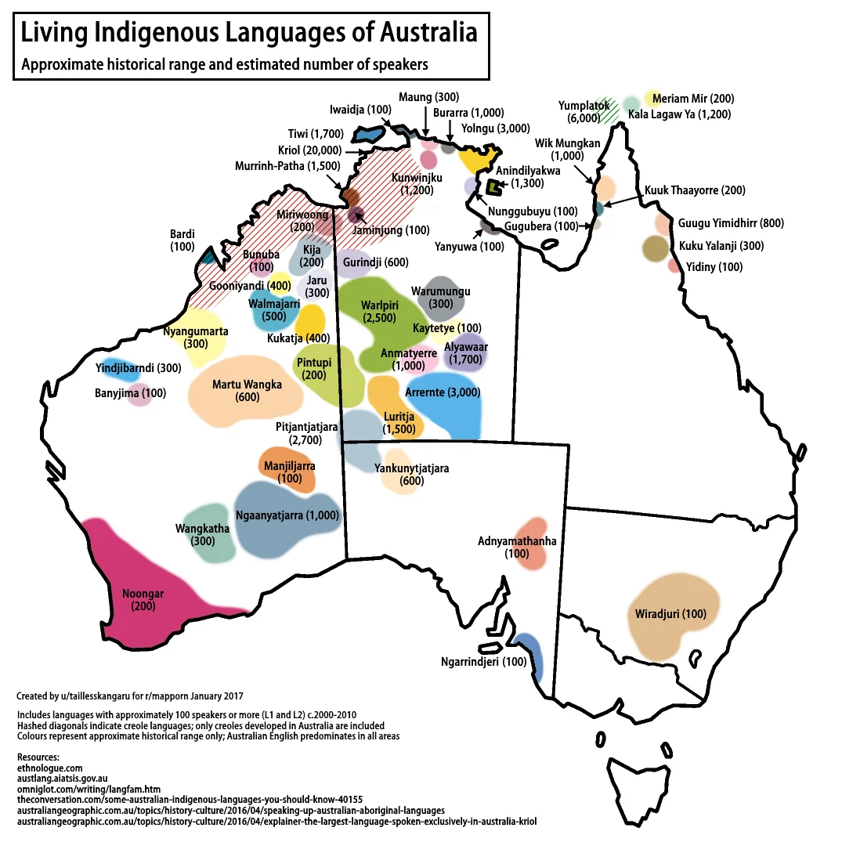
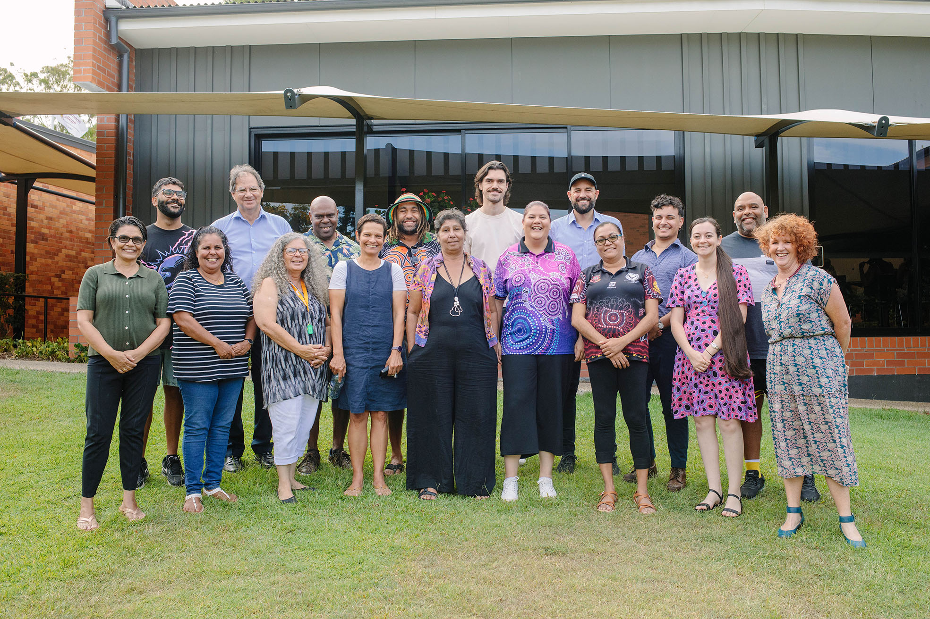
Challenges in Language Revitalization
Generational Gaps
Few fluent speakers remain, most of whom are elderly.
Need for effective tools to bridge language gaps between generations.
Educational Barriers
Limited integration of Indigenous languages in schools.
Lack of trained teachers and educational resources.
Funding and Policy Support
Insufficient financial resources for long-term projects.
Inconsistent government policies impacting community efforts.
Ongoing Efforts
Advocating for language policies at local, state, and federal levels.
Training programs to create a new generation of Indigenous language educators.

Slide 24
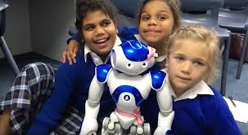
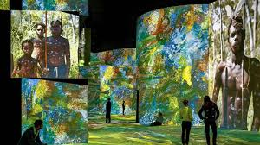
Vision for the Future: Empowering Communities through Innovation
Integration of technology (AI, VR, and gamified learning tools) to make learning engaging: Pink – the language learning robot (UQ ITEE)
Establishing language hubs: community centres focused on teaching, documenting, and celebrating languages.
Inspiring Change
Showcasing successful programs to build momentum for revitalization.
Encouraging younger generations to take pride in their linguistic heritage.
The Role of Linguists
Continue building collaborative relationships with Indigenous communities.
Prioritize ethical practices in documentation and research.
Call to Action
Support Indigenous language projects as part of a broader effort to respect and preserve cultural heritage – e.g., LDaCA.

Slide 25
Language Infrastructure Projects

Slide 26
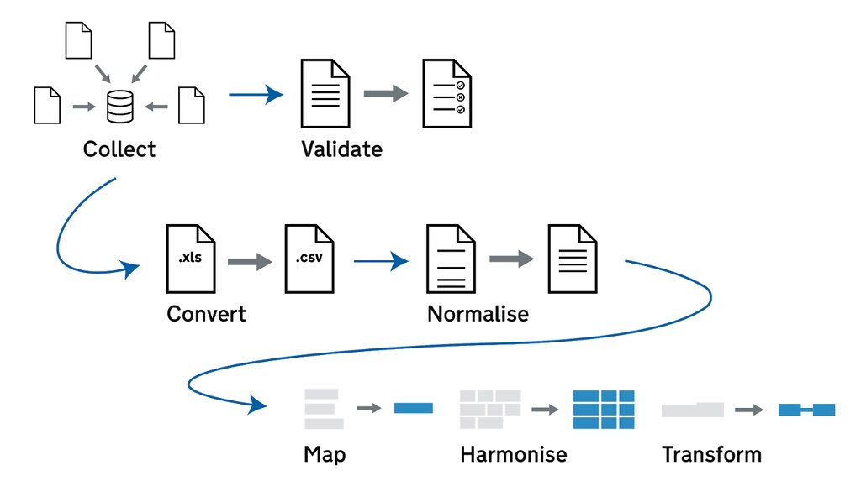
What is Language Research Infrastructure
Building Bridges for Language Research
Language research infrastructure refers to tools, platforms, and frameworks designed to:
Support the collection, storage, and analysis of linguistic data.
Facilitate collaboration among researchers, communities, and institutions.
Enable access to data for teaching, research, and revitalization efforts.
Examples of Components
Digital corpora (e.g., recorded texts, annotated datasets).
Tools for transcription, analysis, and visualization.
Repositories ensuring long-term preservation of linguistic data.

Slide 27
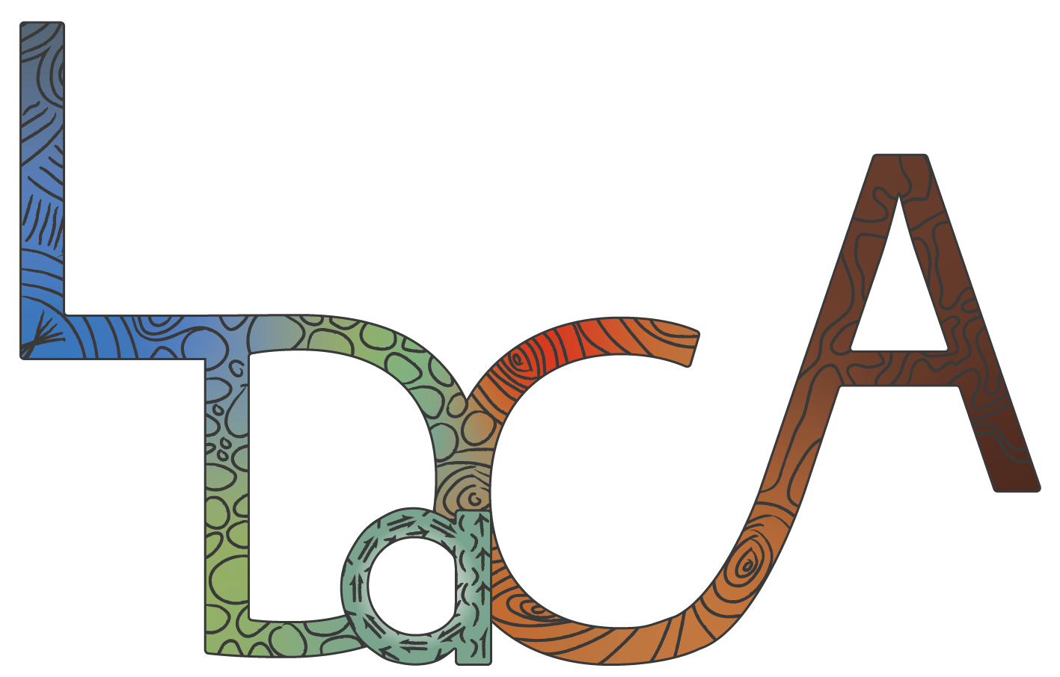
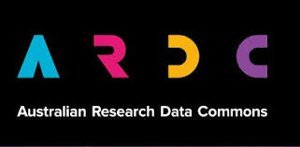
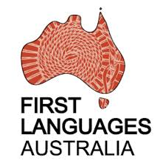
The Language Data Commons of Australia
A National Effort for Language Preservation and Research
LDaCA is a groundbreaking project aimed at creating a national infrastructure for documenting, preserving, and analyzing language data.
Australia lacks a national infrastructure for language data (like CLARIN in Europe)
Existence of highly relevant culturally important data sources (e.g., HANSARD or Trove)
Data and collections are often inaccessible, stored inadequately, not adhering to standards, and at risk of being lost
LDaCA is Australia’s best funded humanities initiative. It receives investment from the Australian Research Data Commons (ARDC) through its HASS and Indigenous Research Data Commons program.
Partner Institutions and Chief Investigators
University of Queensland, Australian National University, University of Melbourne, University of Sydney, University of Western Australia, Queensland University of Technology (QUT) Digital Observatory, AARNet, First Languages Australia

Slide 28
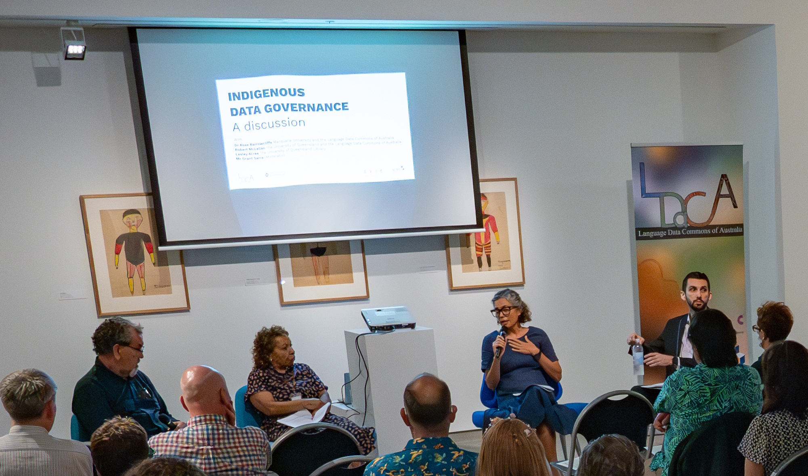
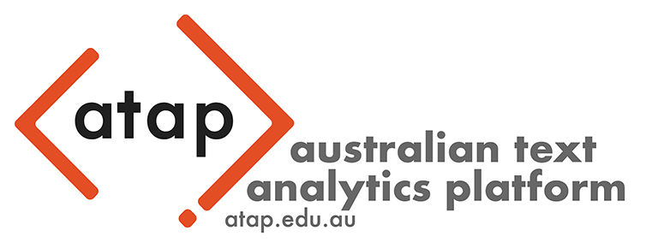
The Language Data Commons of Australia
Goals
Preservation: Archiving linguistic data (special attention is paid to endangered Indigenous languages)
Access: Providing researchers and communities with easy option to stored and access curated data.
Support: Developing software and offering training and education through digital resources.
Key Features
Centralized repository for language data, accessible to academics, educators, and community members.
Cutting-edge tools for linguistic analysis and visualization.
Collaboration between linguists, Indigenous communities, and technologists.
Training hub for collecting, handling, storing, visualising, and analysing language data.

Slide 29
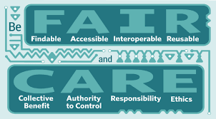
The Language Data Commons of Australia
Bridging the Gap Between Research and Communities
Documentation
Enables the collection and systematic annotation of linguistic data.
Standardized formats ensure the data is interoperable and reusable.
Preservation
Long-term archiving ensures that future generations can access these linguistic resources.
Revitalization
Offers tools and resources for Indigenous communities to revitalize their languages.
Supports language education programs and the development of culturally relevant materials.
Impact
Strengthening linguistic heritage by connecting data with community-driven efforts.
Empowering Indigenous communities to reclaim and maintain their linguistic identities.

Slide 30
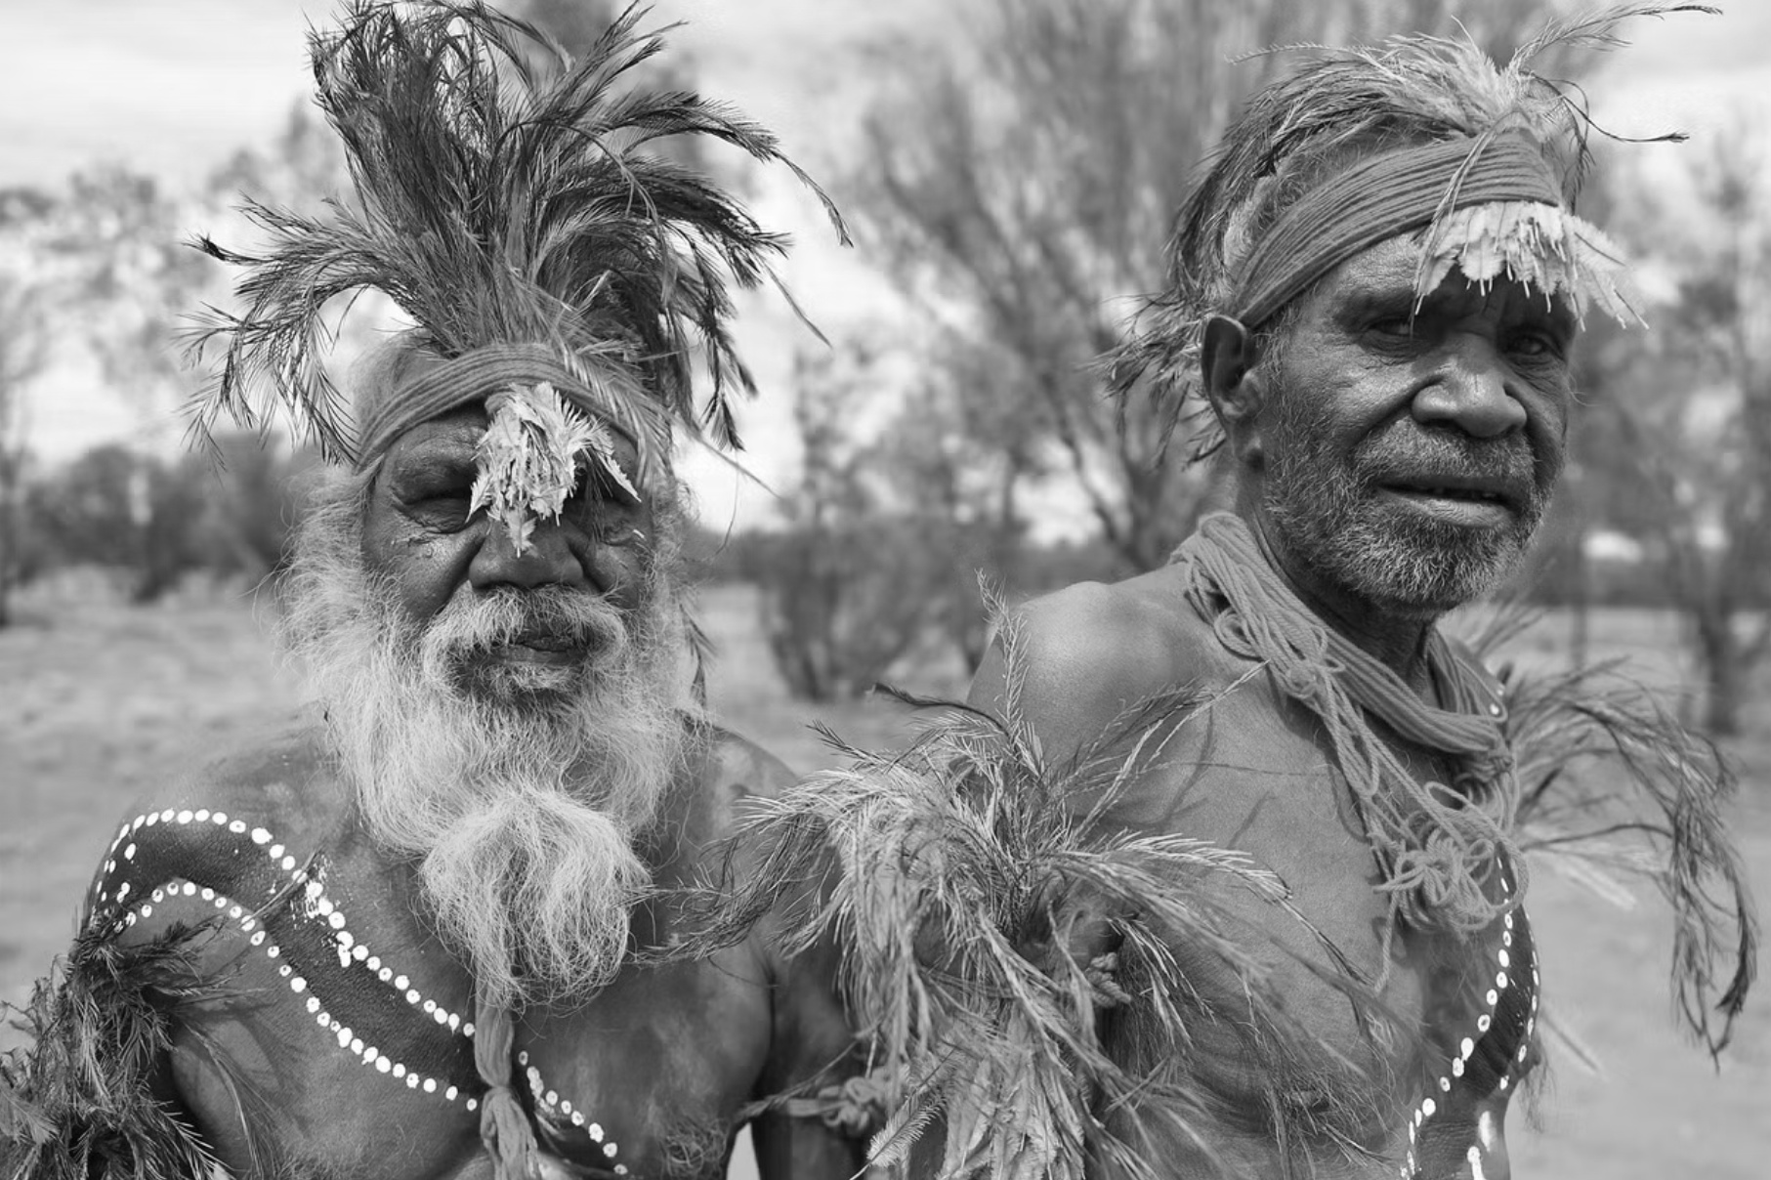
Thanks so much for having me and have a great week!

Slide 31
Indigenous Australian Languages Linguistic Features, Revitalization Efforts, and Research Infrastructure for Archiving and Accessibility
Martin Schweinberger
m.schweinberger@uq.edu.au
The University of Queensland

Slide 32
References
Australian Bureau of Statistics (2024). Australian Bureau of Statistics. Retrieved (20 January 2024) from http://www.abs.gov.au
Central Intelligence Agency. (2020). The CIA World Factbook 2020-2021. Simon and Schuster.
Collins, J. (2016, July 9). A global tree of languages. Humans Who Read Grammars. http://humans-who-read-grammars.blogspot.com/2016/07/a-global-tree-of-languages.html
Dixon, R. M. (2011). The languages of Australia. Cambridge University Press.
Gaby, A. (2012). The Thaayorre think of time like they talk of space. Frontiers in Psychology, 3, 300.
Haun, D. B., Rapold, C. J., Janzen, G., & Levinson, S. C. (2011). Plasticity of human spatial cognition: Spatial language and cognition covary across cultures. Cognition, 119(1), 70-80.
Haviland, J. B. (1998). Guugu Yimithirr cardinal directions. Ethos, 26(1), 25-47.
Meakins, F. (2024). Geocentric languages and the perception of the earth's magnetic field. Cognitive Processing, 25, 13-13.
Pederson, E., Danziger, E., Wilkins, D., Levinson, S., Kita, S., & Senft, G. (1998). Semantic typology and spatial conceptualization. Language, 74(3), 557-589.

