Slide 1
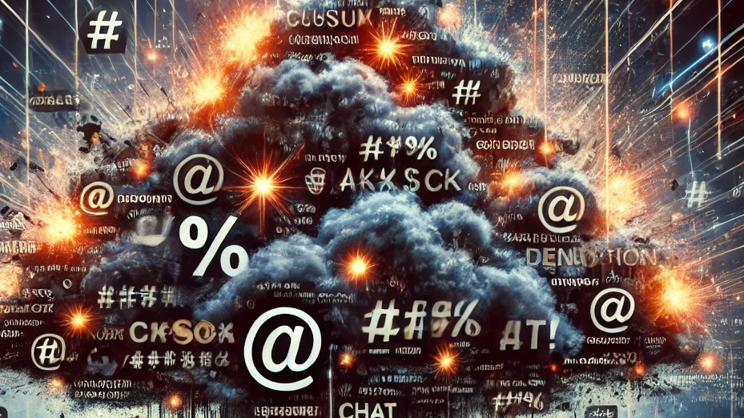

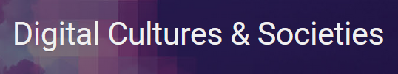


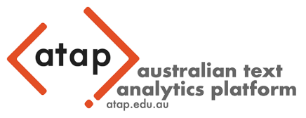
Vulgarity in Online Discourse around the English-Speaking World
Martin Schweinberger, Masoud Fatemi, Sam Hames, Michael Haugh, Mikko Laitinen, Paula Rautionaho & Marissa Takahashi
University of Queensland | University of Eastern Finland | Queensland University of Technology

Slide 2


About
Martin Schweinberger (martinschweinberger.de) works as a Lecturer in Applied Linguistics at the University of Queensland (UQ) in Brisbane, Australia.
Martin studied English Philology, Philosophy and Psychology at the University of Kassel and the National University of Ireland in Galway.
After obtaining his PhD in English linguistics at University of Hamburg (2011) he has worked at several German universities before taking on a postdoc at UQ and worked as an Associate Professor at the Arctic University of Norway in Tromsø.
He is now Chef Investigator for the Australian Text Analytics Platform and the Language Data Commons of Australia. He is board member of the International Computer Archive of Modern and Medieval English (ICAME) and Vice-President Profession of the International Society for the Linguistics of English (ISLE).
In his research and as quantitative corpus linguist / language data scientist, Martin bridges computational linguistics and corpus linguistics and he has specialised on understanding language variability and reproducibility in the humanities.

Slide 3
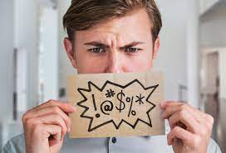
Background and Motivation
First findings from a collaborative research project (Fucking Twitter, funded by the Digital Cultures and Societies Hub at the University of Queensland)
Collaboration: University of Queensland, the Australian Digital Observatory, & FIN-CLARIAH
Why talk about vulgarity? (and not learner speech)
Vulgarity is a powerful linguistic tool and its analysis is relevant for several social domains and various contemporary discussions as well as pragmatic competence and thus for language learning and teaching.

Slide 4
Vulgarity in Online Discourse around the English-Speaking World
Timeline | Table of Contents
Background and Motivation
Study 1: Vulgarity on X/Twitter
Study 2: Vulgarity online across English-speaking regions
Discussion, Outlook, and potential Applications

Slide 5
Background and Motivation
Substantive interest in vulgar or “bad language”
Corpus Linguistics (language use)
Psychology (physical and psychological effects)
Social Science (motivation and behaviour)
Communication and Media Studies (hate speech)
Research Gap
Comparative Studies across varieties of English in online discourse
This talk
Study 1: Who Swears Most Vulgarity on X/Twitter among users from the Unites States, the United Kingdom, and Australia
Study 2: Variability in Vulgarity Vulgarity across 20 different English-speaking regions based on the GloWbE corpus

Slide 6
Aims of the talk
In this talk we want to show that …
address the existing gap in comparative studies in the use of bad language by analysing vulgarity on X/Twitter and in online discourse across different regional varieties of English
vulgarity is an extremely interesting phenomenon that is complex and versatile, and well-worthy of scholarly attention
combining computational data science with quantitative corpus linguistics can inform our understanding of discourse on social media

Slide 7

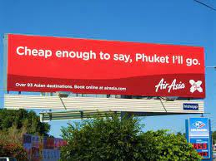
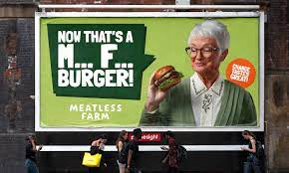
Vulgarity as a linguistic phenomenon
Why is vulgarity better than its reputation?
Vulgar language is popular but generally viewed unfavourably.
Using vulgarity appropriately requires substantive pragmatic proficiency and linguistic awareness
Functions of vulgarity
Social swearing: positively charged (social bonding, banter) Vulgarity as part of humour (see George Carlin, Seizer 2011)
Annoyance swearing: negatively charged (emotional relief, catharsis) e.g., cussing at other drivers in traffic
Linguistically motivated use of vulgarity e.g. intensification, e.g., fucking as an adjective amplifier (Martínez & Pertejo 2012)

Slide 8
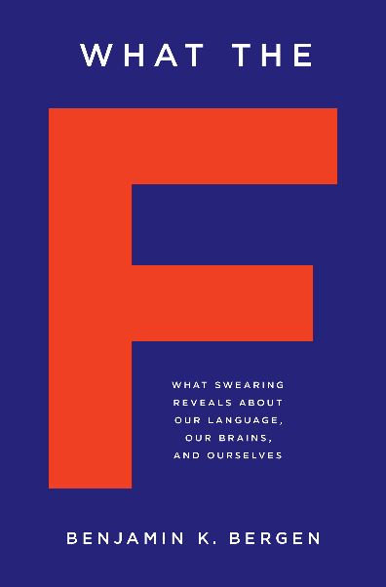
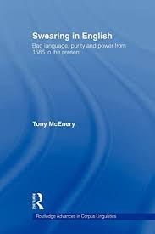
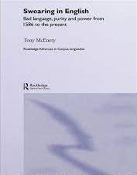
Previous Research
Substantive research on vulgarity (swearing | impoliteness)
Sociolinguistic and pragmatic perspectives (mostly using corpus linguistic and discourse | conversation analysis approaches) (cf. McEnery 2006)
Age: most common among adolescent (McEnery 2006) to middle-aged male speakers (Schweinberger 2018)
Gender: Men swear more than women and they use “stronger” bad language words (BLWs) (Love 2021, McEnery 2006, Schweinberger 2018, Stenström 2006, McEnery and Xiao 2004) – contradicting studies show no gender difference (Drummond 2020) or that female speakers use fucking as an intensifier more than males “to mark their linguistic independence” (Aijmer 2018: 91)
Time: Swearing has decreased(?) in informal British English between 1994 and 2014 (Love 2014)
Social class : findings do not show a consistent patterning (see Stenström 2006 for an overview)

Slide 9
STUDY 1
Who Swears Most Vulgarity on X/Twitter among users from the Unites States, the United Kingdom, and Australia

Slide 10
What counts as vulgar?
Difficulty of defining vulgarity
Problem: unclear what counts as swearing | bad language | cussing
Terminology (impoliteness vs swearing vs taboo language)
Problematic examples
taboo language? If it were taboo, it would not be such a common and systematic phenomenon
literal vs metaphoric John fucked Jane (not considered swearing when used literally (by some))
offensive terms / insults: pedophile, nazi, fascist, etc.
Our approach (resulted in a list of 281 candidates)
Focus on vulgarity! (not insults, swearing, etc.)
Start: word lists based on previous research (781 items)
Criteria
does the word have a less vulgar synonymous counterpart?
fuck | shag vs make love | sleep with, etc.
ass | arse vs behind | bottom, etc.
Is the term marked as vulgar in the OED
pedophile, idiot (can be insults but not vulgar)
English only (not considered: bastardo, arschloch, etc.)
Spelling variation: phuk, fak, fuuuuck, etc. → fuck (lemma)

Slide 11
Research Gaps
Research gaps
Very little research on vulgarity on social media (from a linguistically informed perspective)
Almost no comparative analyses across genres or varieties of English (almost all analyses focus on informal spoken British English – predominantly the speech of adolescents – notable exceptions are Schweinberger 2019 who focused on Irish English and Drange et al. 2014 who analysed Norwegian, Spanish and British youth)
Inconsistencies in the definition of the phenomenon (vague definitions on what counts as swearing | bad language | cussing | vulgarity)
No studies of topics | discourses that are prone to facilitate the use of vulgarity

Slide 12
Research Questions
RQ 1: What forms of vulgarity are used on Twitter in the US, Great Britain, and Australia?
RQ 2: What topics are associated with vulgarity on Twitter in the US, Great Britain, and Australia?
RQ 3: What factors correlate with vulgarity on Twitter?

Slide 13
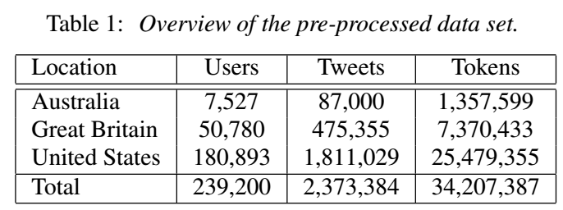
Data
Tweets collected on June 21, 2022 by users self-identifying as being Australian, British, and US American who then served as seed users to collect 3 data sets by collaborators at FIN-CLARIAH and UQ
Data contained information about
the tweet (location, when created, reply, retweet)
the user (followers, following, verified)
text of the tweet
Removed: Spanish tweets | function words

Slide 14
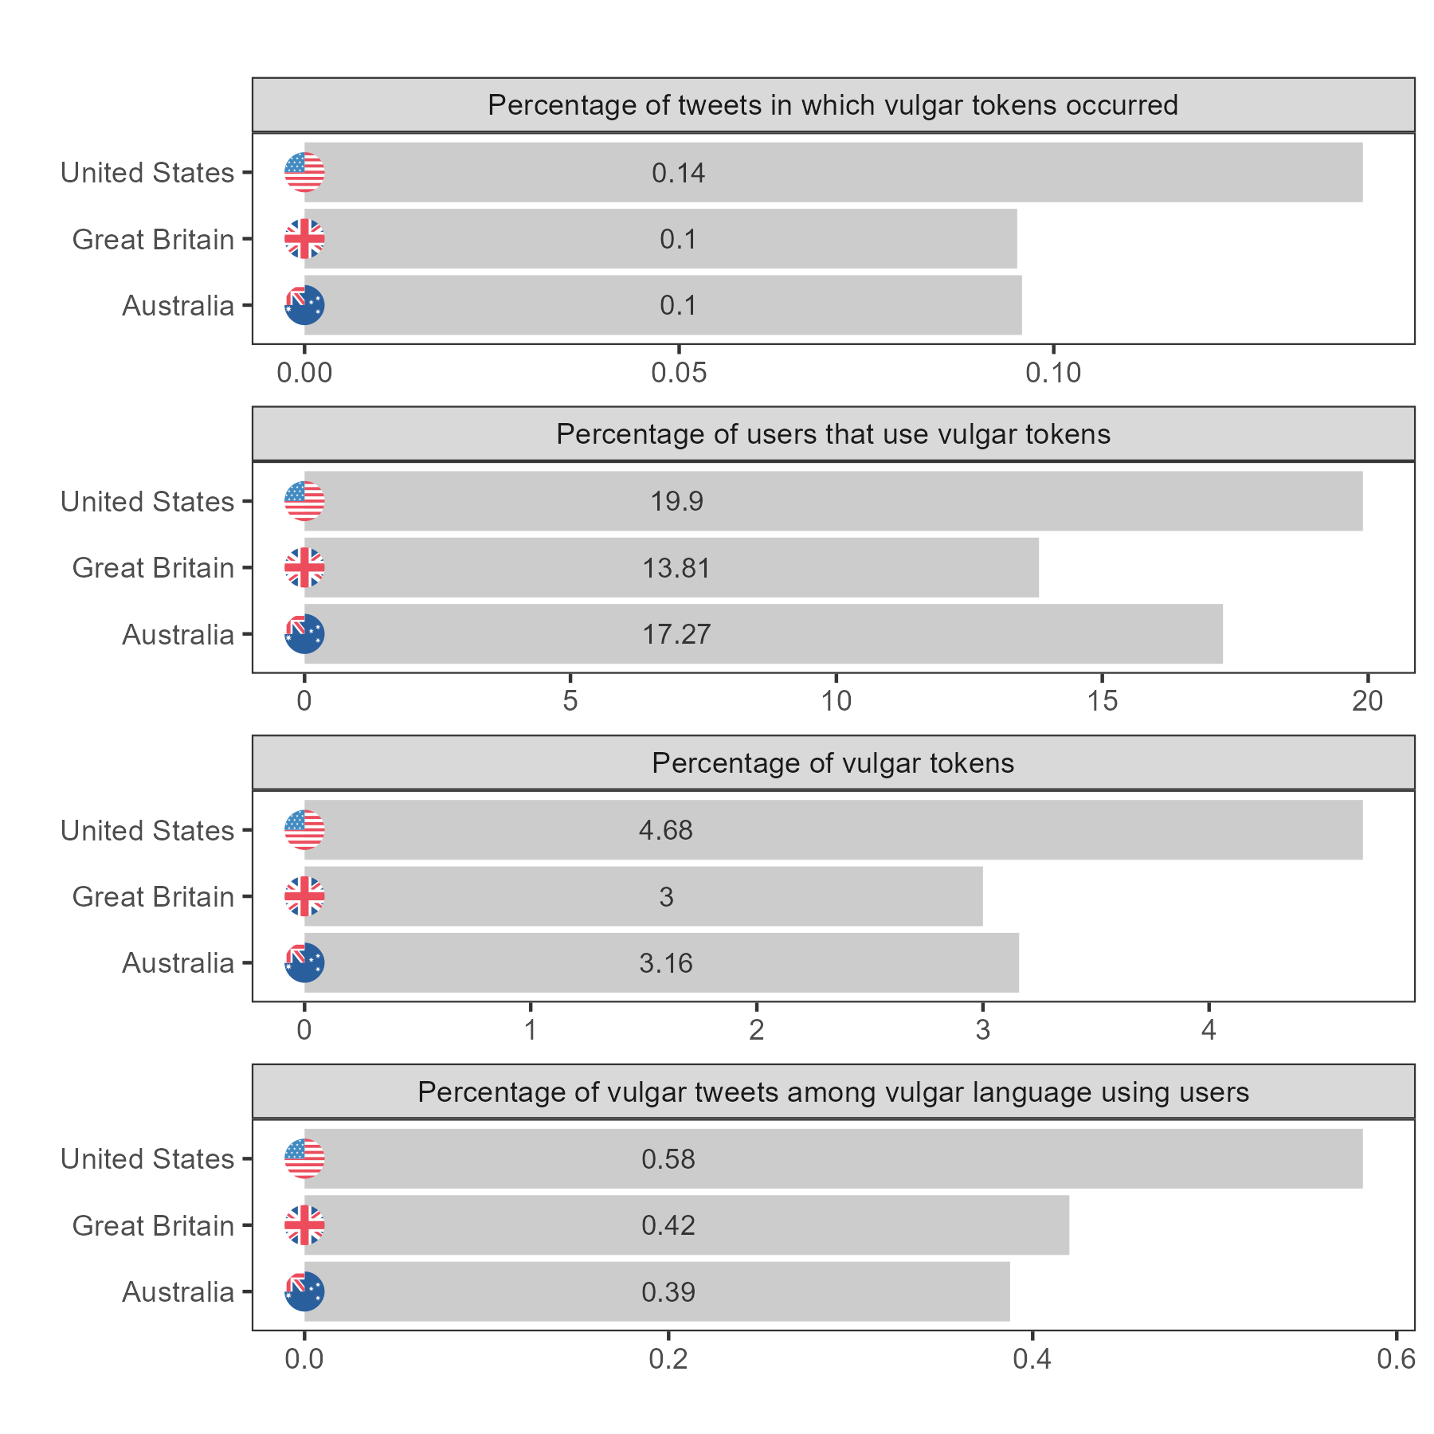
Overview of frequencies across location

Slide 15
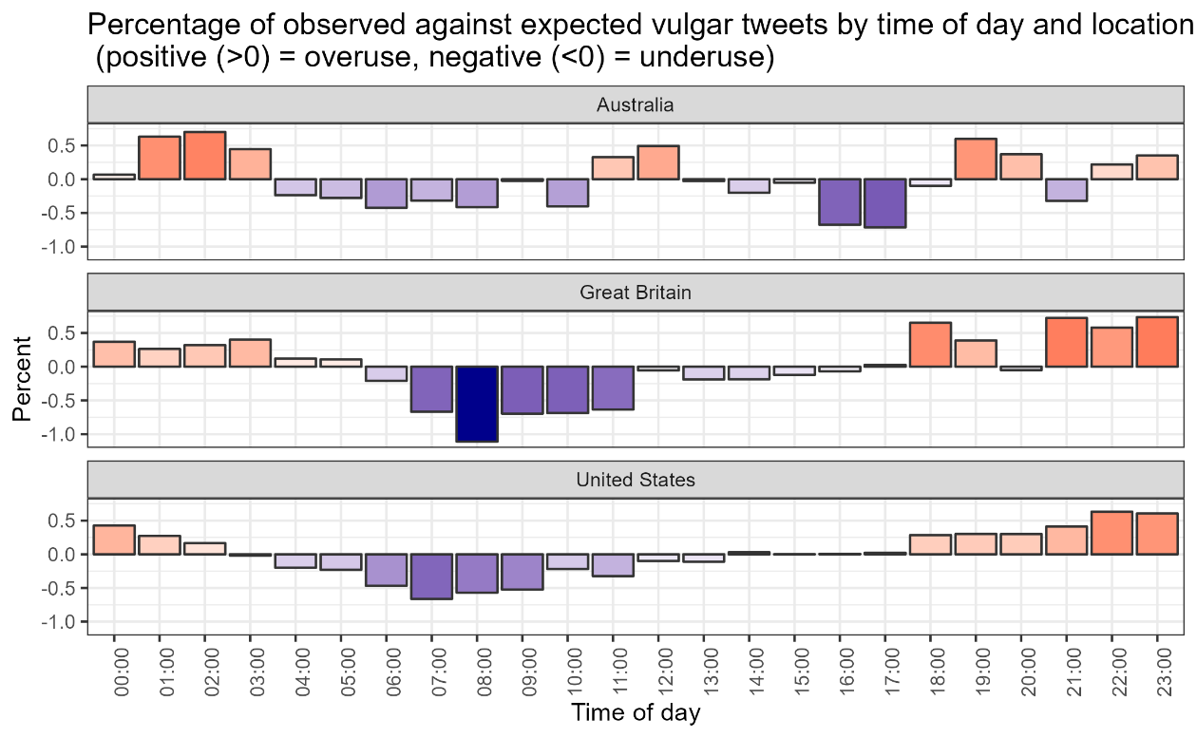
Overview of frequencies across time of day

Slide 16

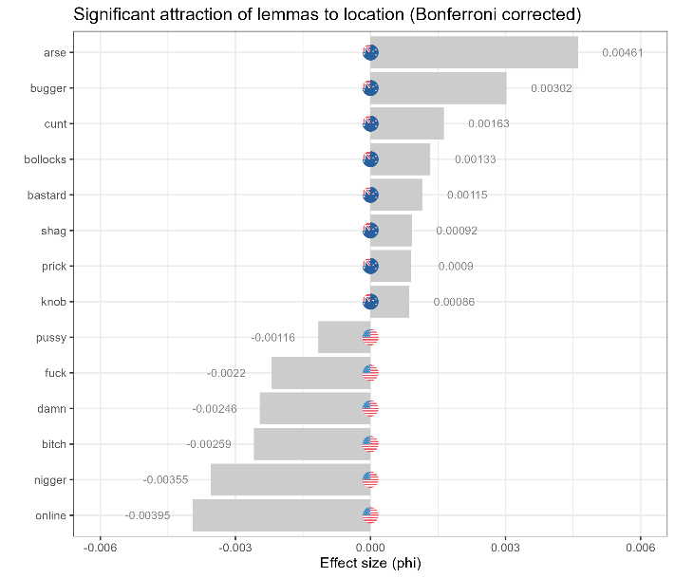
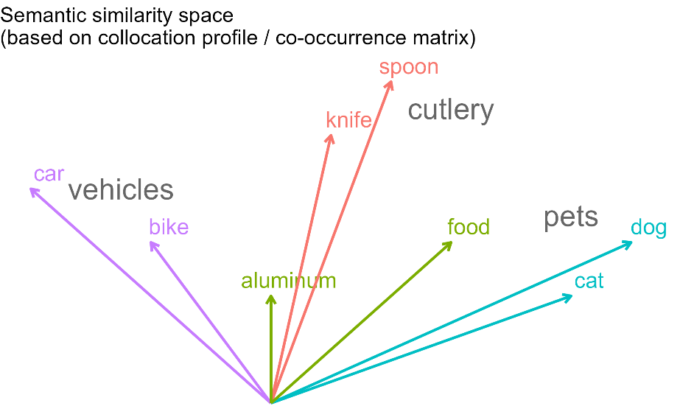
Statistical analysis
Data Processing
Twitter data extracted using the Twitter API (starting with individual users as seeds)
From start to finish the entire analysis is performed in R/RStudio (guarantees reproducibility and flexibility in the analysis)
Statistical methods
Frequency and Collostructional Analysis (RQ1: forms of vulgarity) to determine significant preferences within and across locations (e.g., if users in the US use wft more than users in Great Britain or Australia)
Topic modelling (RQ2: topics for vulgarity) to determine the topics of tweets (e.g. whether a tweet was about sport, politics, or family)

Slide 17
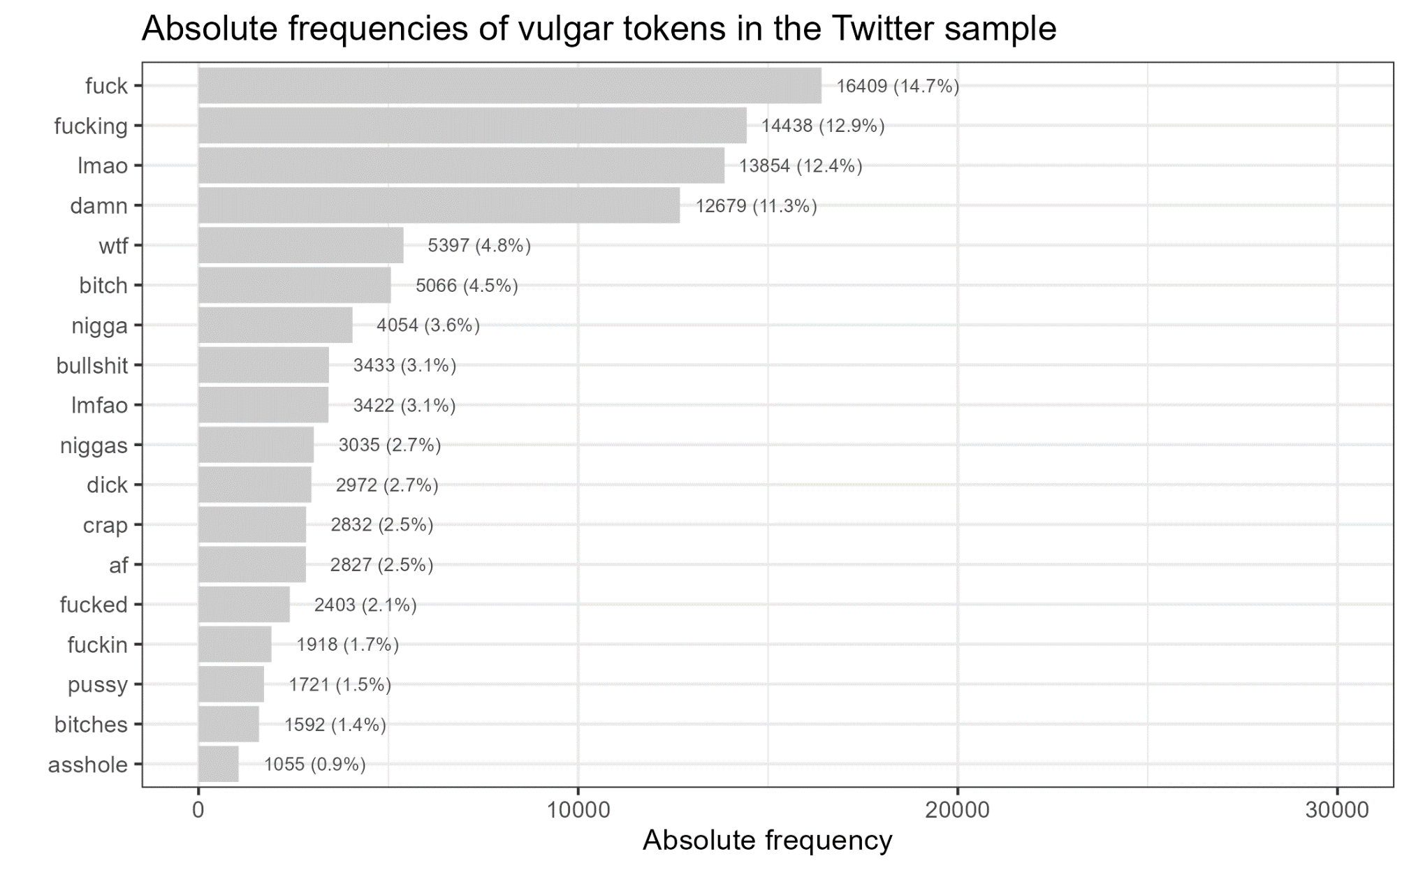
Forms of Vulgarity (RQ1)
Vulgar tokens were identified based on a list of candidates (281 elements, 22 lemmas)
111,919 vulgar tokens (180 types)
Selected examples
I fucking love disco too (us: 1539071912848110000)
@Mahj___ Wtfffffffff😭😭😭😭 (us: 1539071926584360000)
OMG #BREAKMYSOUL IS A BOP LMFAO WTFFFFFF https://t.co/3TFVP3vC4Y (us: 1539071886226660000)
@JTTH0R yea ok LMFAOOO (us: 1539072061305410000)
Anne is a lame bitch .. I know Rollie whooped that ass lol (us: 1539112482454790000)

Slide 18
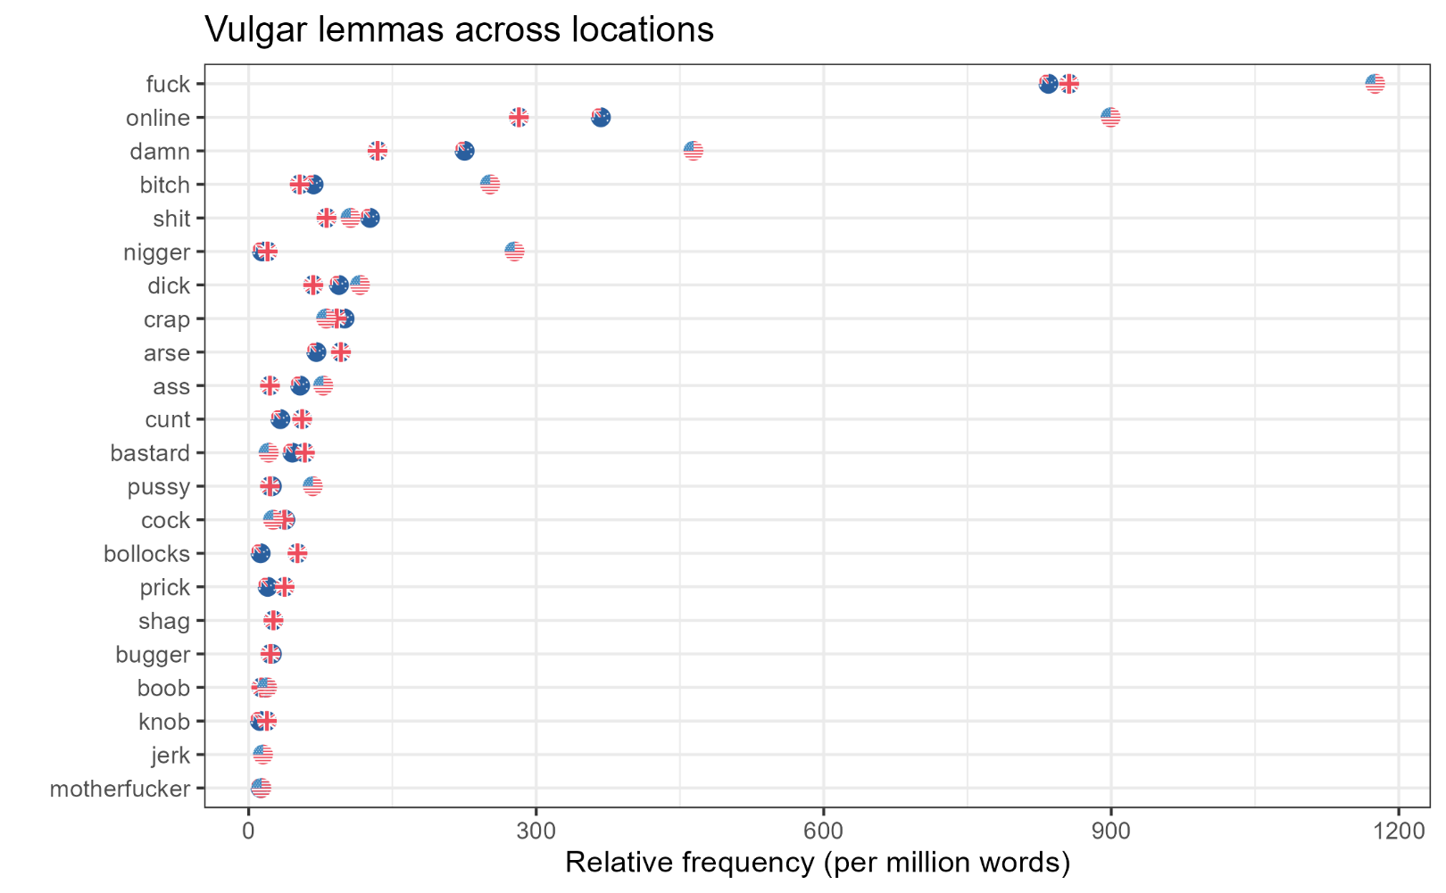
Forms of Vulgarity (RQ1)
Vulgar tokens were identified based on a list of candidates (281 elements, 22 lemmas)
111,919 vulgar tokens (180 types)
Selected examples
SO. FUCKING. ANGRY. (us: 1539329043472030000)
Quite frankly, I fucking adore the rude-ass little bitch that is Byakuya Togami (us: 1539329027932030000)
Chelsea na mumu club for that Lukaku shit 🤣🤣🤣 (us: 1539320606411340000)
It’s hella shit going on 😂 (us: 1539322226557610000)

Slide 19
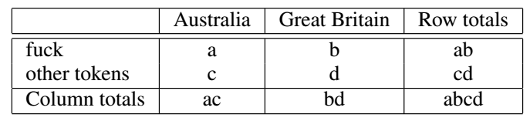
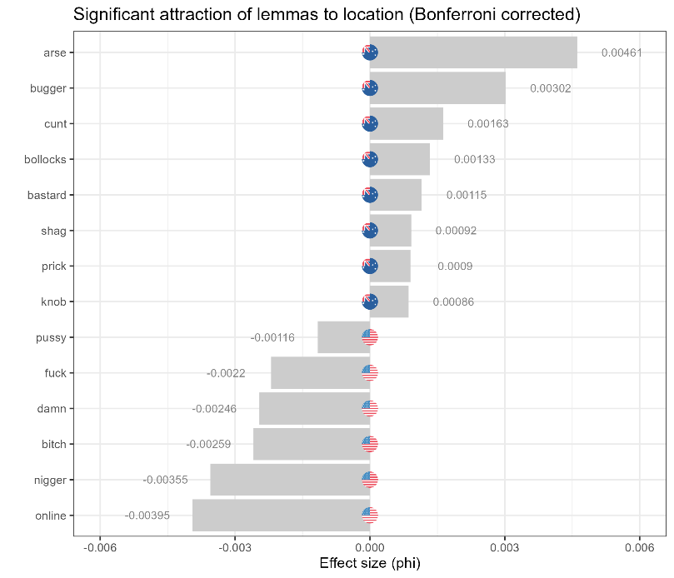
Forms of Vulgarity by Location (RQ1)
Collostructional Analysis
to determine significant preferences and association strengths across locations
e.g., if users in the Australian use fuck (or lmfao) more than users in Great Britain or the United States
based on repeated Fisher’s Exact tests for all vulgar elements across locations (Bonferroni corrections to avoid α-errors)
effect size measures: φ (phi) and LogLikelihood
Comparisons
Australia vs United States
Great Britain vs United States
Australia vs Great Britain

Slide 20
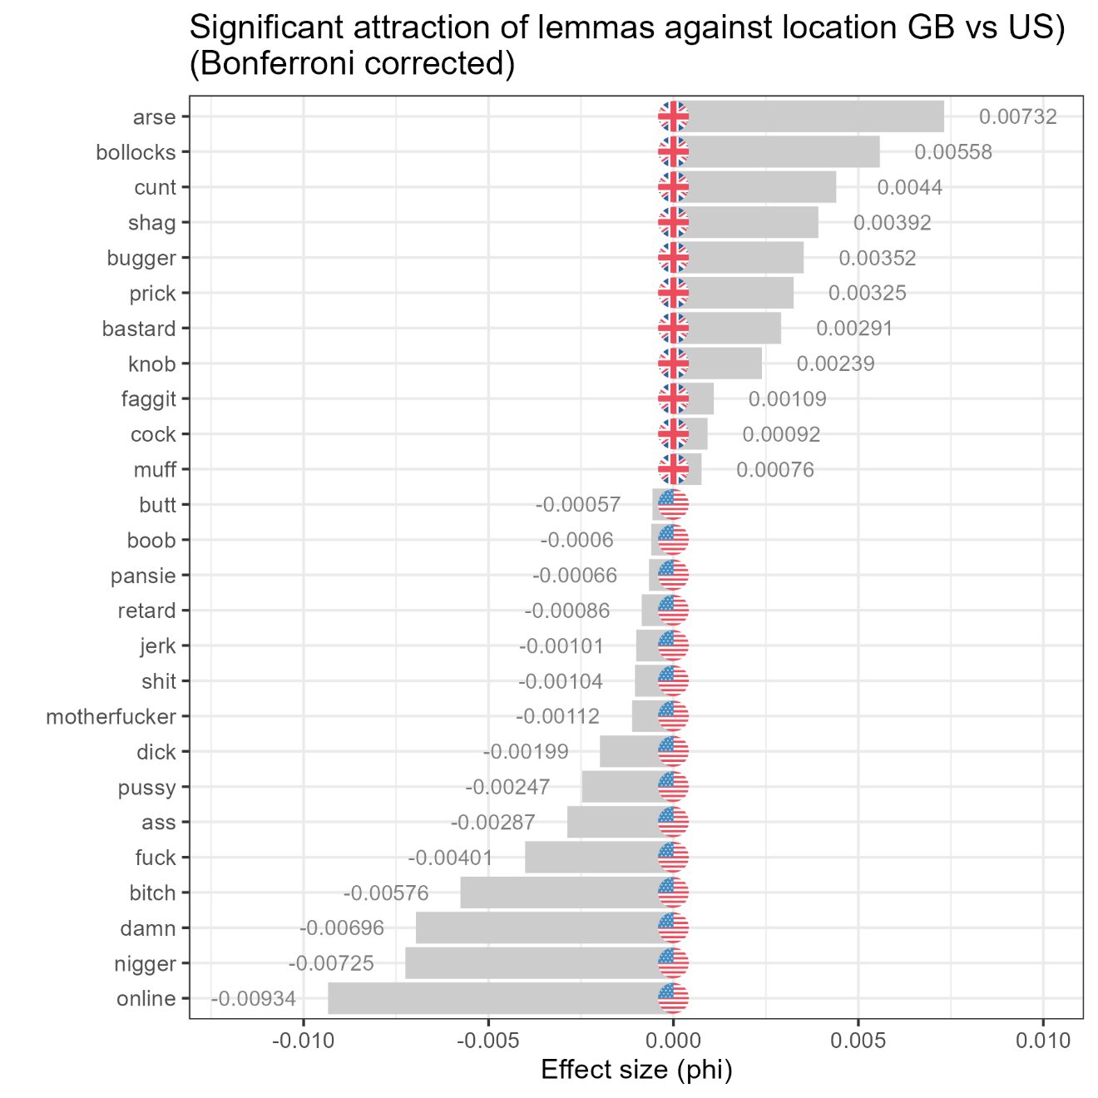
Forms of Vulgarity by Location (RQ1)
Great Britain vs United States
British users also use vulgarity items that are prototypically associated with British English (arse, bollocks, cunt, shag) significantly more than US users
US users use vulgarity items associated with
online discourse (lmao, lmfao, wtf) a
racial slurs* (nigger, nigga)
female sexual behaviour (bitch)
general items (fuck, damn)
significantly more frequently than British users
Important: very(!) similar to Australia vs United States!
* could also be ingroup markers!

Slide 21
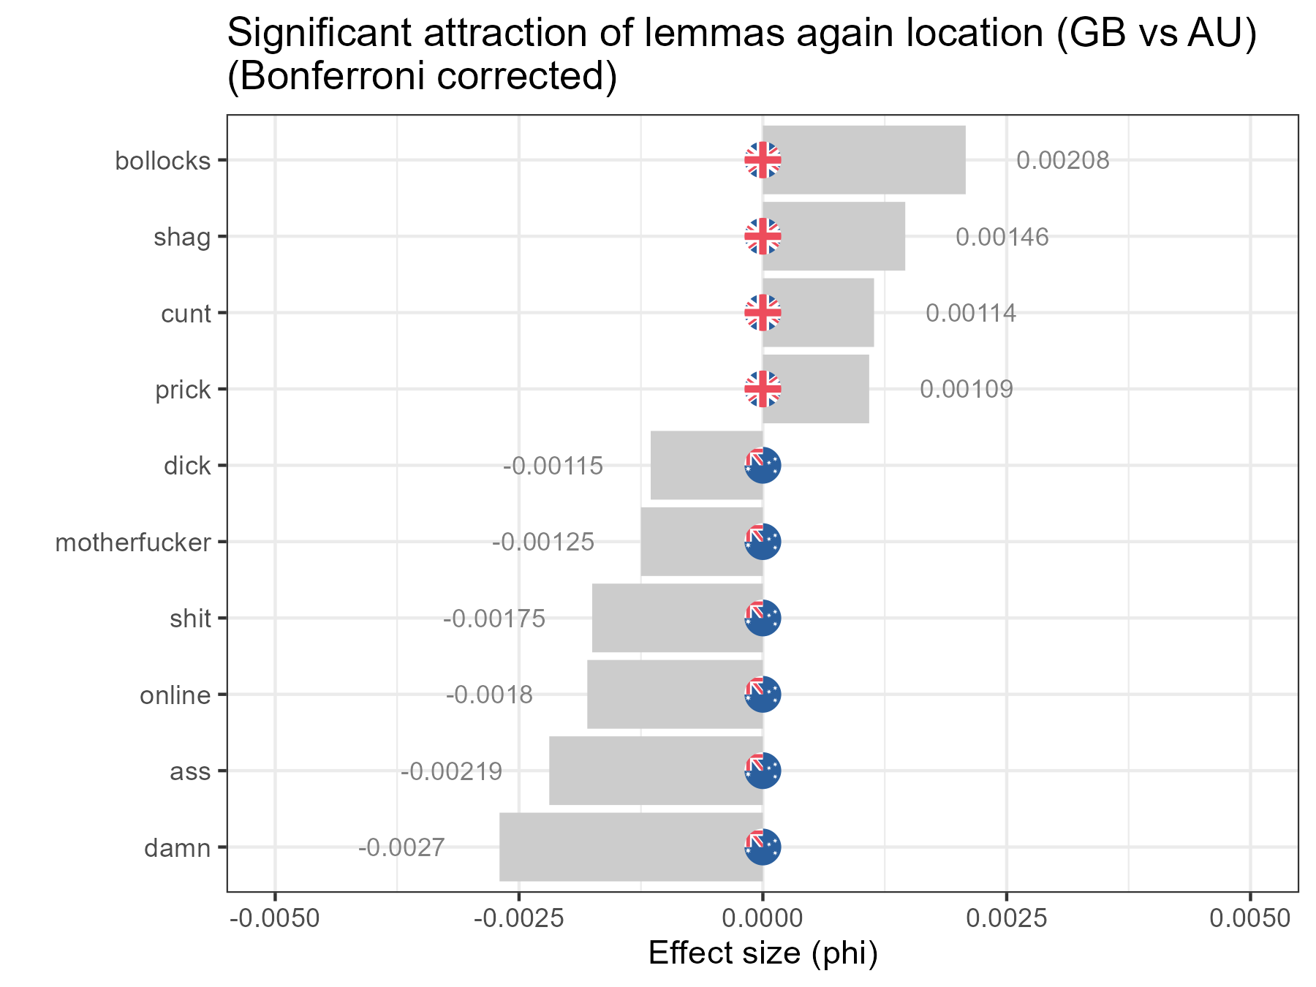
Forms of Vulgarity by Location (RQ1)
Great Britain vs Australia
Overall few significant differences
British users, again, overuse vulgarity items that are prototypically associated with British English (shag, bollocks, cunt, prick) significantly more than Australian users
Australian users use vulgarity items associated with US English (damn, ass, lmao, wtf, shit, motherfucker)
Important: Australian is British when compared to the US but US-like when compared to GB!

Slide 22
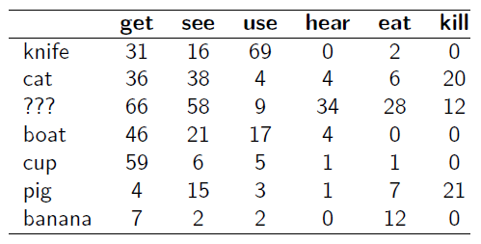

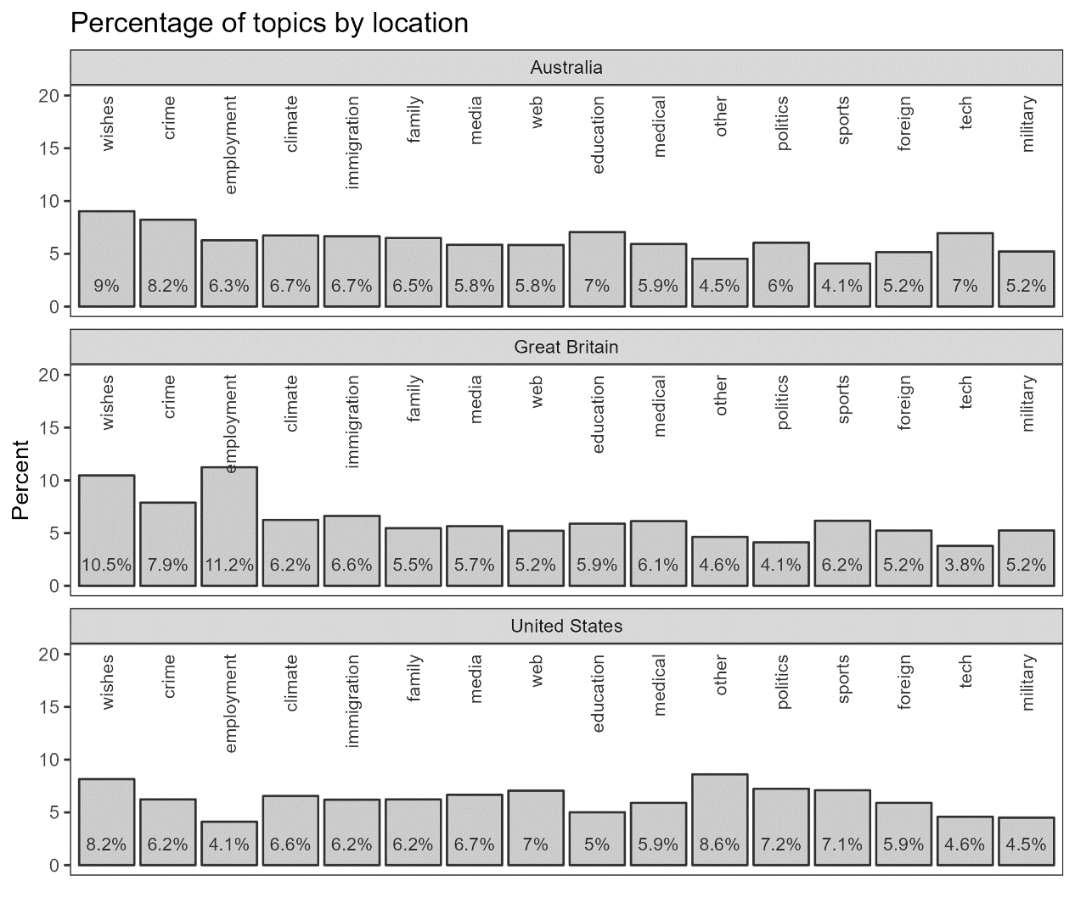
Topic facilitating Vulgarity (RQ2)
What topics attract vulgarity in Oz, GB, and the US?
Topic modelling
Finds words that correlate with seed terms (e.g.: topic = sports: match, game, play, season, players;
topic = employment: pay, wage, money, work, job)
Assesses correlations of semantic similarity based on collocational profiles of types.
Topics: employment, politics, climate, sports, medical, education, foreign, immigration, crime, tech, media, military, family, web, wishes, spanish, other)

Slide 23
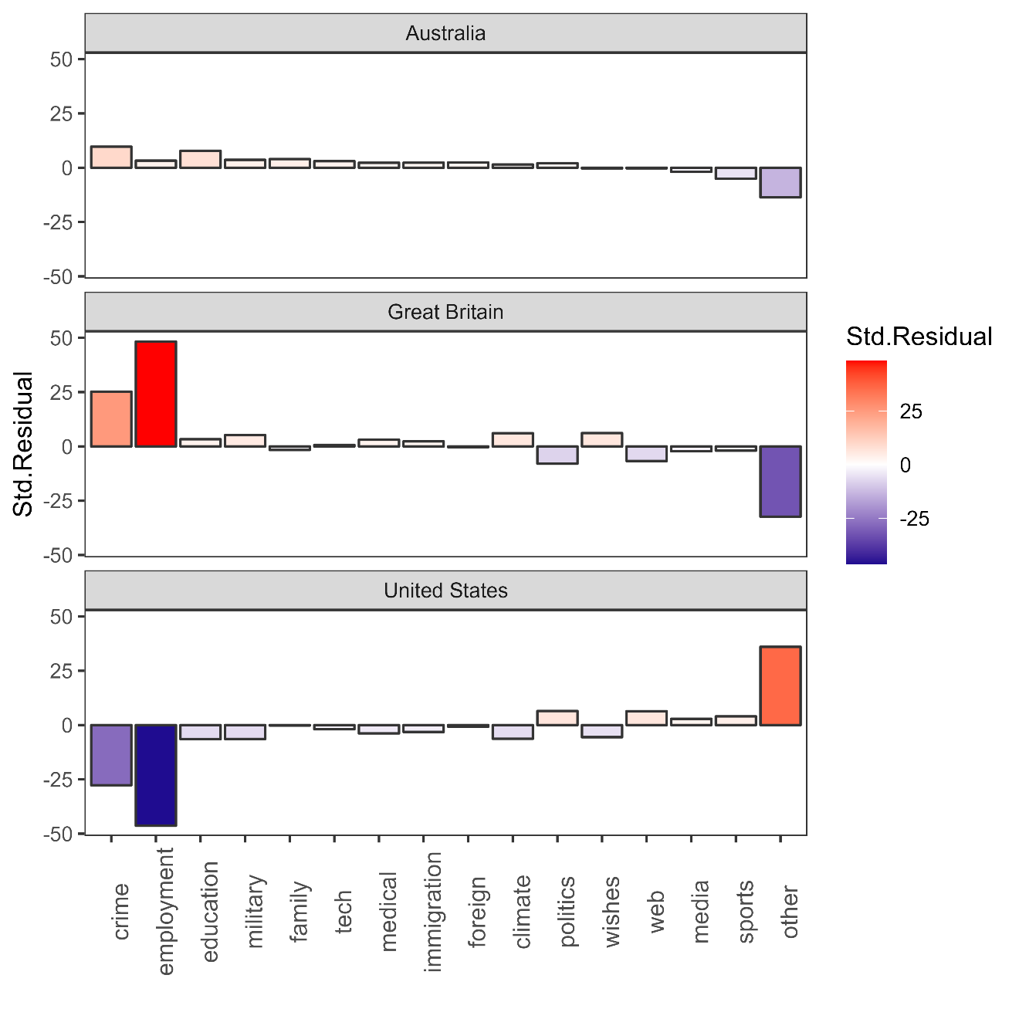
Topic facilitating Vulgarity (RQ2)
What topics attract vulgarity in Oz, GB, and the US?
Crime attracts vulgarity in Australia and Great Britain but vulgarity is dispreferred in tweets about crime in the US data.
Employment-related tweets strongly facilitate vulgar language in Great Britain but not so in Australia and it is decidedly non-vulgar in the US data.
The other category strongly attracts vulgarity in the US but not in Australia and it is decidedly non-vulgar in Great Britain. (keywords other category: bro, shit, get, man, fuck, got, ass, im, fucking, lmao) → naughty web talk
→ In the US, vulgarity is register-constrained whereas, in Britain, it is topic constrained.

Slide 24
Topic facilitating Vulgarity (RQ2)
Examples
Crime
ok so this person is actually fucking deranged https://t.co/nONQyzScdJ (gb: 1539127156449710000)
Employment
@Deborahfrankier @Tinman07382139 @NavyLookout Shit wages but you stand with Boris? If you give me £50 I'll kick you in the bollcks but only if you ask nice (gb: 1539036748390570000)
Other (Web)
Lmfaoooo nah Eddie was funny asf on that’s so raven. Orlando brown really was funny asf. (us: 1539072377027490000)
What topics attract vulgarity in Oz, GB, and the US?
Crime attracts vulgarity in Australia and Great Britain but vulgarity is dispreferred in tweets about crime in the US data.
Employment-related tweets strongly facilitate vulgar language in Great Britain but not so in Australia and it is decidedly non-vulgar in the US data.
The other category strongly attracts vulgarity in the US but not in Australia and it is decidedly non-vulgar in Great Britain. (keywords other category: bro, shit, get, man, fuck, got, ass, im, fucking, lmao) → naughty web talk
→ In the US, vulgarity is register-constrained whereas, in Britain, it is topic constrained.
What topics attract vulgarity in Oz, GB, and the US?
Crime attracts vulgarity in Australia and Great Britain but vulgarity is dispreferred in tweets about crime in the US data.
Employment-related tweets strongly facilitate vulgar language in Great Britain but not so in Australia and it is decidedly non-vulgar in the US data.
The other category strongly attracts vulgarity in the US but not in Australia and it is decidedly non-vulgar in Great Britain. (keywords other category: bro, shit, get, man, fuck, got, ass, im, fucking, lmao) → naughty web talk
→ In the US, vulgarity is register-constrained whereas, in Britain, it is topic constrained.

Slide 25
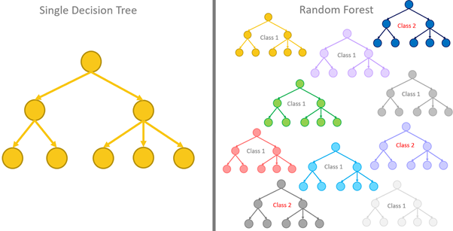
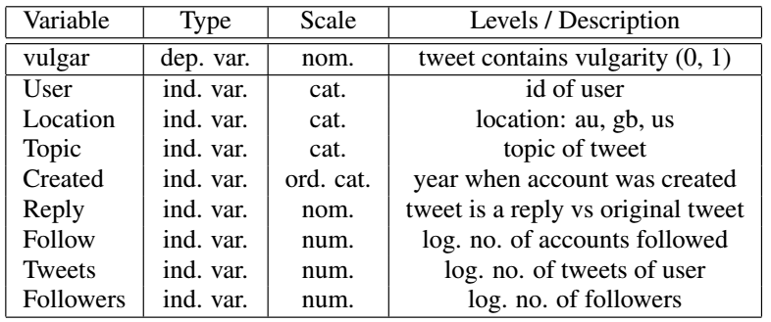
Factors correlating with Vulgarity (RQ3)
based on a sample of 15,000 tweets (5,000 random tweets from each location)
Boruta Model
Tree-based method (extension of conditional inference trees and random forests)
Multivariate machine-learning method: assesses the impact of a factor while controlling for the effects of all other factors (confounding)
Used here to determine which factors impact vulgarity (and how strong that influence is)

Slide 26
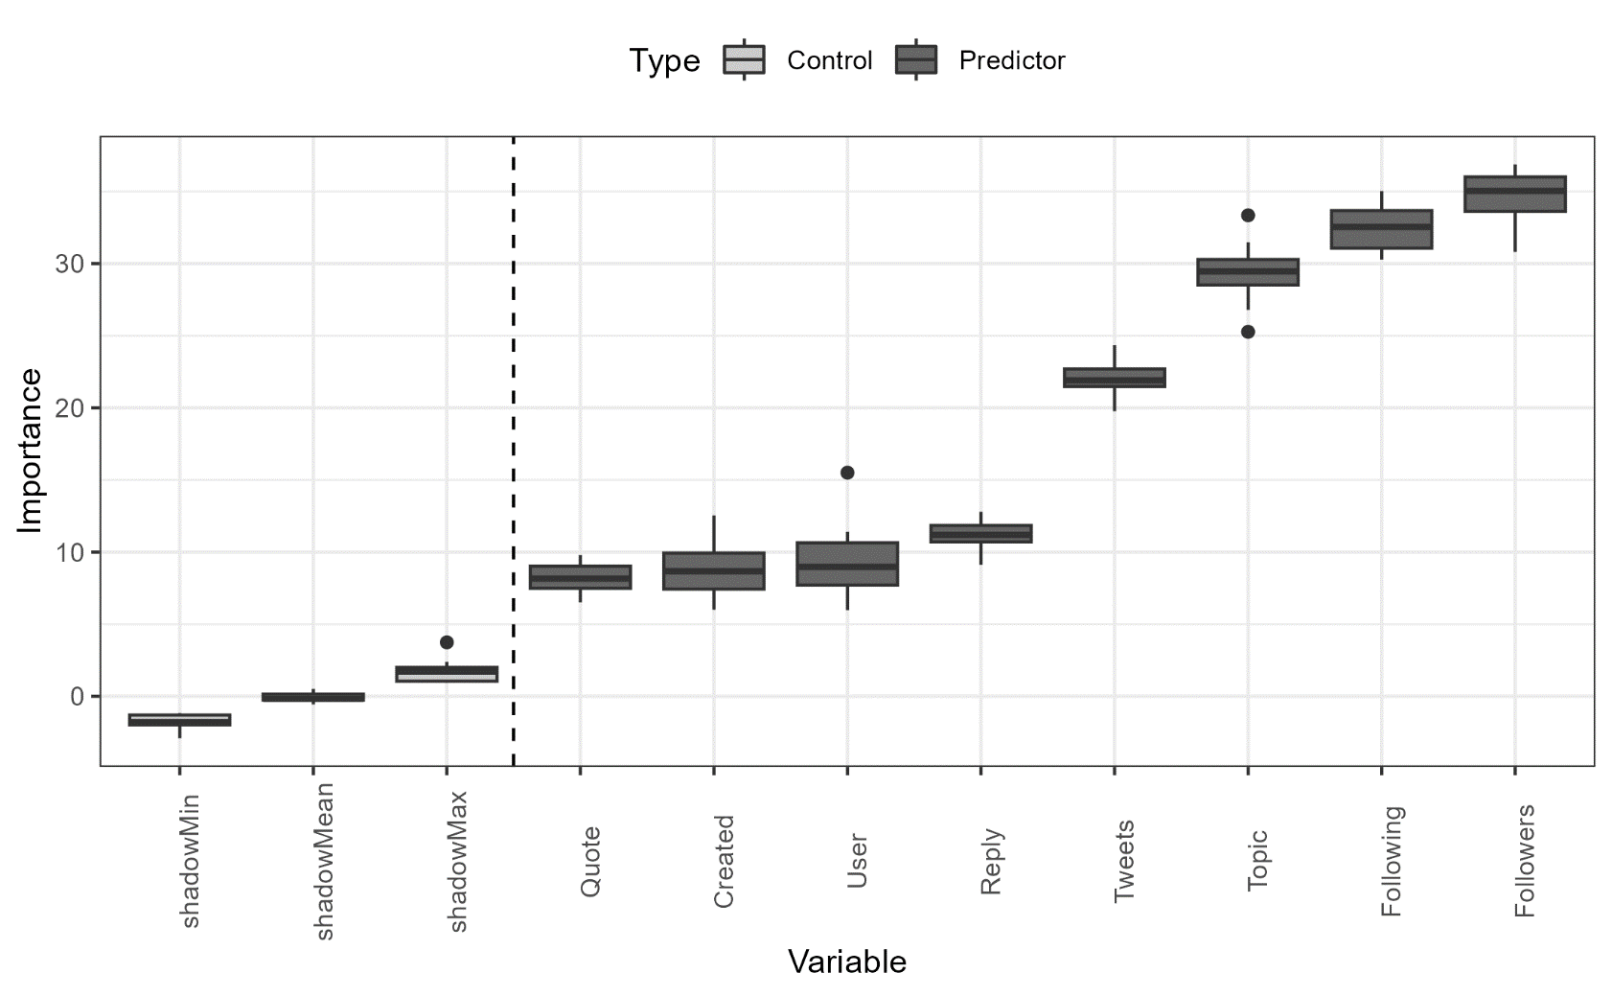
Factors correlating with Vulgarity (RQ3)
Location is NOT significant when we use a multivariate approach!
Topic | Register is a very important predictor for vulgarity
Vulgarity is affected by whether users
have a large following
follow many other users
tweet a lot
have been on Twitter for a long time
Also, if the tweet is a reply or a quote it affects the probability that a tweet contains vulgarity

Slide 27
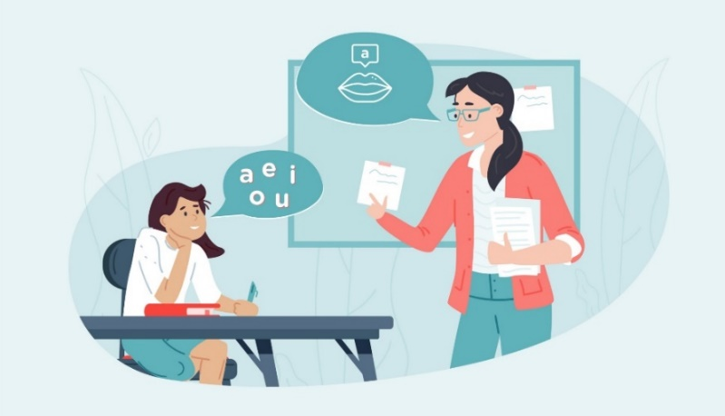
Discussion | Outlook
Comparison with previous findings
Confirmation | Substantiation
Swearing is a common linguistic phenomenon (McEnery 2006, Love 2021)
Almost half of the users use vulgarity but in less than 1 percent of tweets
Australian English combines features of AmE and BrE
Unique findings | Conflicts
Vulgarity is topic specific in Britain but register specific in the US Twitter data
Variety differences become less important once other conditioning factors are included
Significance
First large-scale, comparative, corpus-based (and linguistically informed) study of vulgarity on social media
Limitations
More socio-demographic information needed: gender, age, socio-economic status) (see Beers Fägersten 2012)
Multimodality not considered! (graphics and emojis were ignored)

Slide 28
STUDY 2
Variability in Vulgarity Vulgarity across 20 different English-speaking regions based on the GloWbE corpus

Slide 29
Research Questions
RQ 1: How frequent is vulgarity in online discourse across different English-speaking regions?
RQ 2: What region specific uses can we detect across English- speaking regions?
RQ 3: Do English-speaking regions differ with respect to their creativity in using vulgarity?

Slide 30
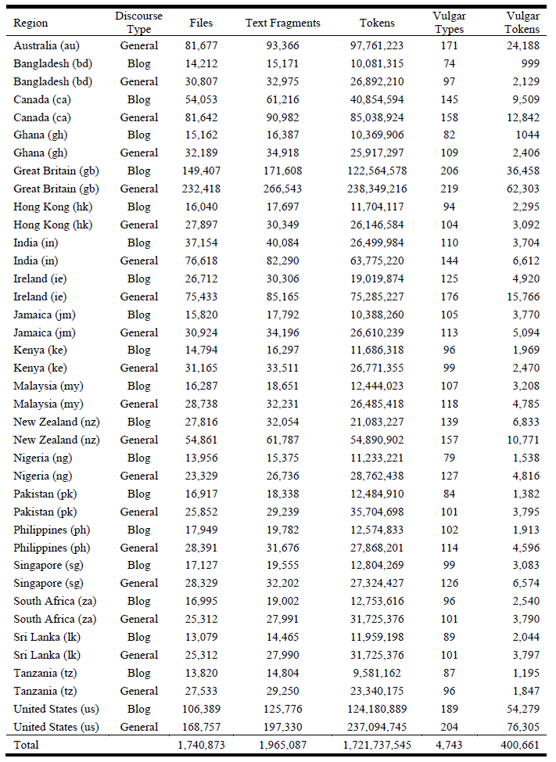
Data
Global Web-Based English Corpus (GloWbE, Davies & Fuchs, 2015)
1.7 billion words across 20 regional components
informal blog content (app. 60 %) and a wide range of other web-based materials, genres, and text types (app.40 %)
6 inner circle Australia, Canada, Great Britain, Ireland, New Zealand, and United States
14 outer circle varieties of English or English-speaking regions Bangladesh, Ghana, Hong Kong, India, Jamaica, Kenya, Malaysia, Nigeria, Pakistan, Philippines, Singapore, South Africa, Sri Lanka, and Tanzania
For copyright reasons, every 200 words, 10 words are replaced with a @ symbol

Slide 31
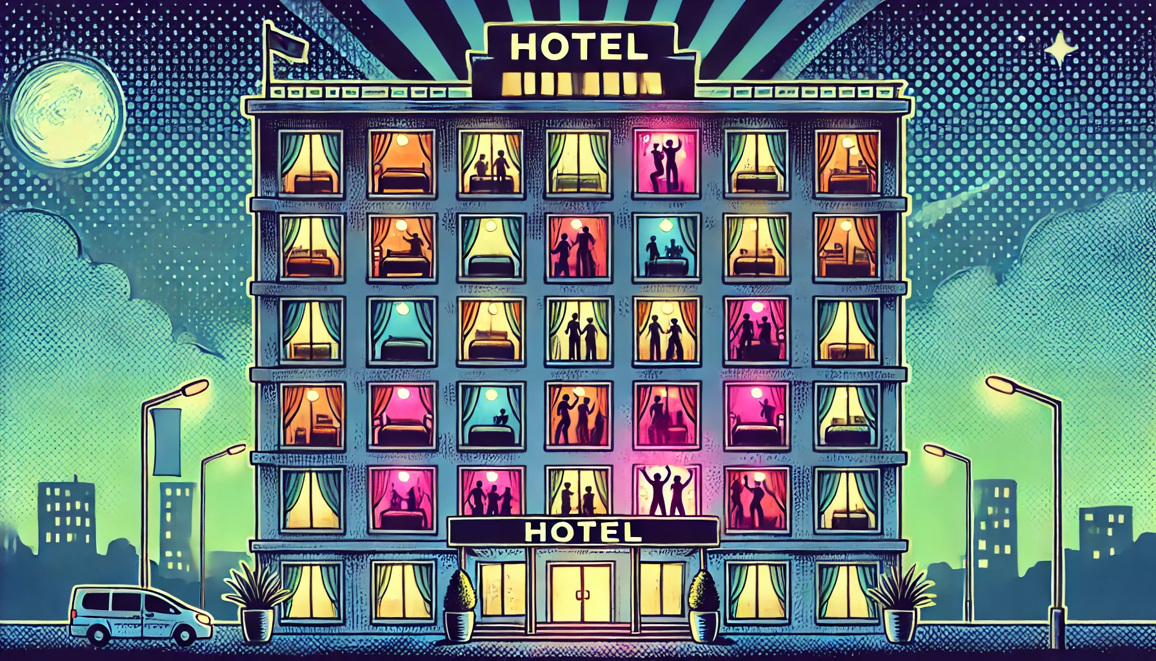

Methodology
Frequency Analysis
Visualisation of normalised frequencies (token/types per million words)
Configural Frequency Analysis (CFA, Bortz et al., 2008; Lienert & Krauth, 1975)
Variety/form-based over- and underuse
Extension of a χ²-test (2 by 2 table analysis)
Allows to test what cell(s) significantly differ from chance.
Corrected Type-Token Ratio (Variability/Creativity)
Higher degree of variability is considered a proxy for higher creativity
Lower CTTR = less variability (10 different forms per 100 instances = 0.1)
Higher CTTR = more variability (20 different forms per 100 instances = 0.2)

Slide 32
What counts as vulgar?
555 vulgar types (classified into 75 vulgar lemmas): arse, ass, asshole, ballsack, bastard, bellend, bint, bitch, bloody, bollocks, boner, bonk, boob, bugger, bukkake, butt, chink, cock, coon, cornhole, cracker, crap, cum, cunt, damn, darkie, dick, dildo, dyke, fagit, fanny, feck, frigg, fuck, git, hag, hoe, hooker, idiot, jab, jap, jerk, jizz, juggs, knob, lesbo, libtard, masturbate, minger, moron, muff, nigger, nonce, nympho, online, paki, pecker, penis, pig, piss, poofter, prick, pussy, shag, shit, sissy, skank, slag, slut, spastic, tits, tosser, twat, wank, whore).
For example, the types of the lemma fuck included the 81 types fuck, fucking, fucked, eff, fuckin, effing, fucks, fk, fac, effie, motherfucker, fcuk, clusterfuck, mofo, fuk, effin, fck, motherfuckers, fuckedup, fucken, effed, fuckup, phuc, effi, fke, fcking, fkn, fking, fukien, fks, fak, phukan, fuckups, fack, phuck, fukin, fuckoff, facc, fuckyou, effs, fuckall, fuking, fka, fukk, fcks, fkin, f, fucka, mofos, mindfuck, fukang, fuka, fuckn, fckn, effies, fuks, fuke, fki, effyou, effe, phucking, fukn, fked, fkd, effedup, headfuck, fuked, fuckton, fucki, fkz, fckin, fcked, effen, phucas, muhfuck, fuuuuuck, fukkk, fuki, fuecks, fuckiing, and effend.
Approach combining word lists and regular expressions (and word embeddings)
English List-of-Dirty-Naughty-Obscene-and-Otherwise-Bad-Words (LDNOOBW) (widely used for detection of swearwords and inappropriate language)
Enhanced using regular expressions and word embeddings
Example: the expression \\bf[ou\\W]{1,}[c]{0,}[k\\W]{1,}(s|a|er|ers|ed|ing){0,}\\b stands for:
A word boundary (\\b), followed by the letter f.
The next part of the word must contain o, u, or any non-alphanumeric character ([ou\\W]).
This is followed by an optional c and either a k or another non-alphanumeric character.
The final part is optional and can include s, a, er, ers, ed, or ing.
This patter will retrieve words like: fuck, fuuuk, fock, fukers, fukkkking, f@#%#$ etc.

Slide 33
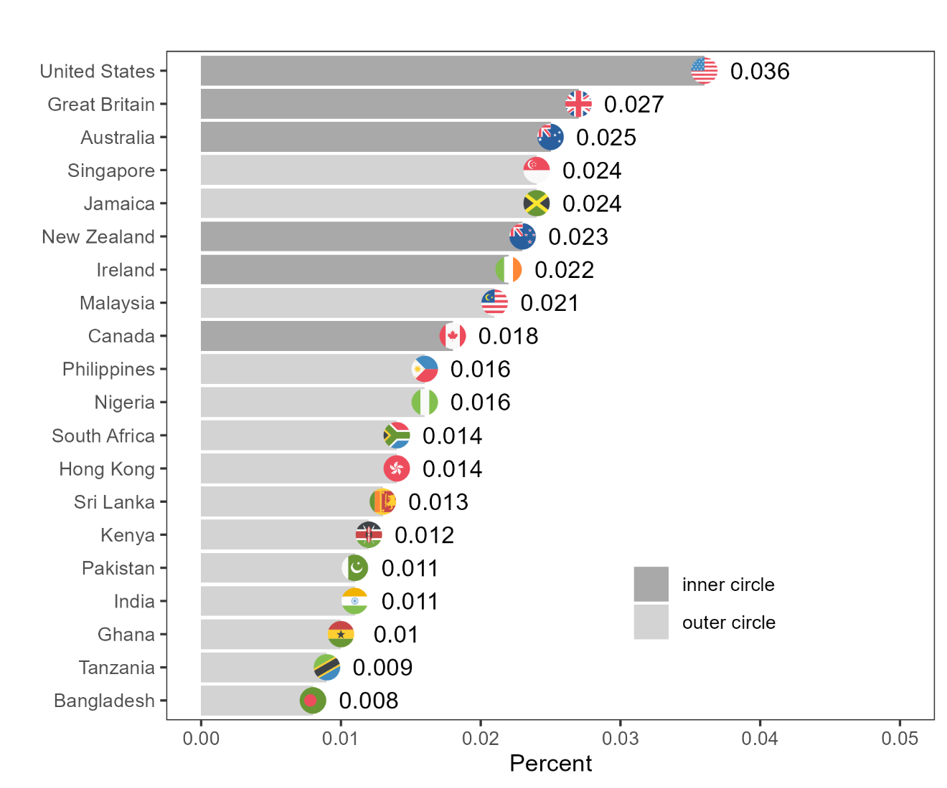
Overview of frequencies across location

Slide 34
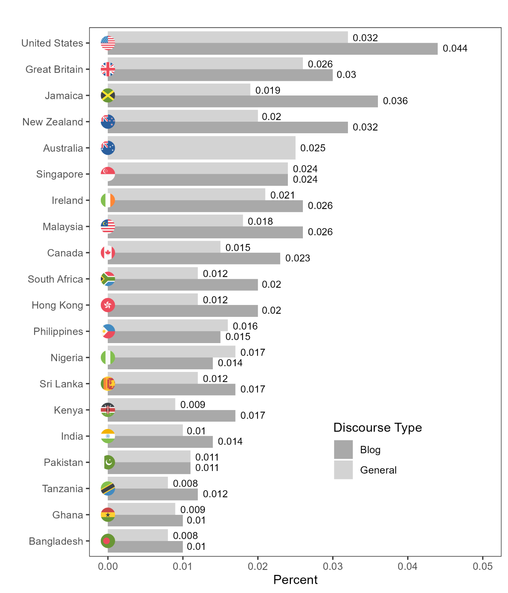
Overview of vulgar elements by location and discourse type
Percentage of vulgar elements (vulgar tokens) in GloWbE across English-speaking regions and discourse types.

Slide 35
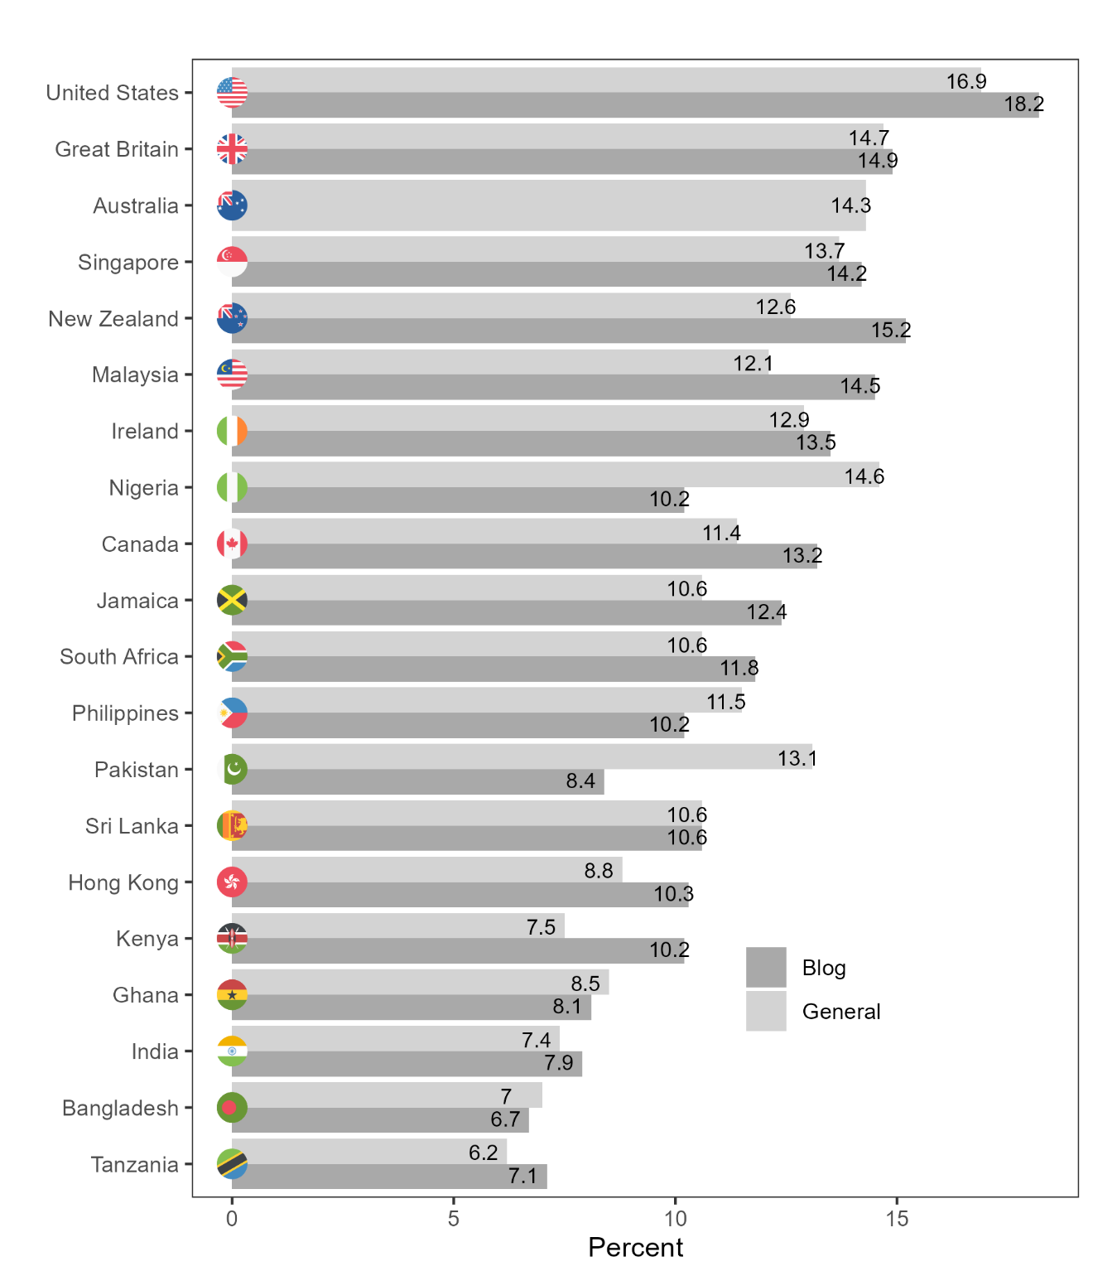
Overview of files containing vulgar elements by location and discourse type
Percentage of files containing vulgar elements in GloWbE across English-speaking regions and discourse types.

Slide 36
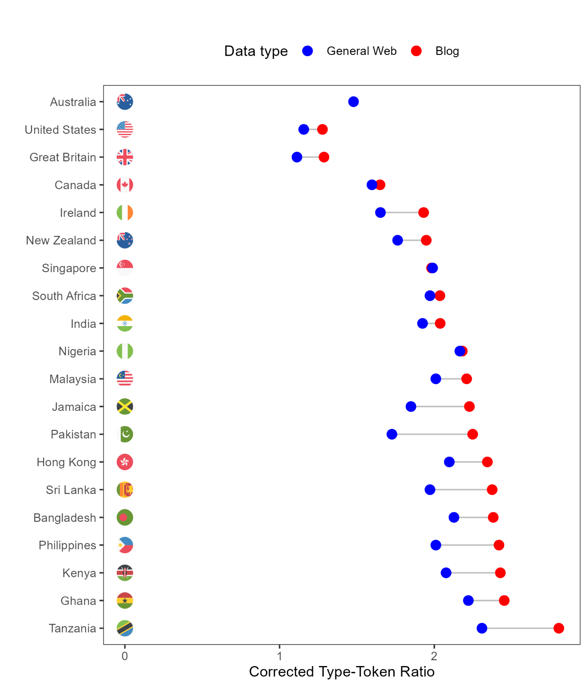
Overview of variability in the use of vulgar elements by location and discourse type
Corrected Type-Token Ratio of Vulgar Types and Tokens in GloWbE across English-speaking regions and discourse types.

Slide 37
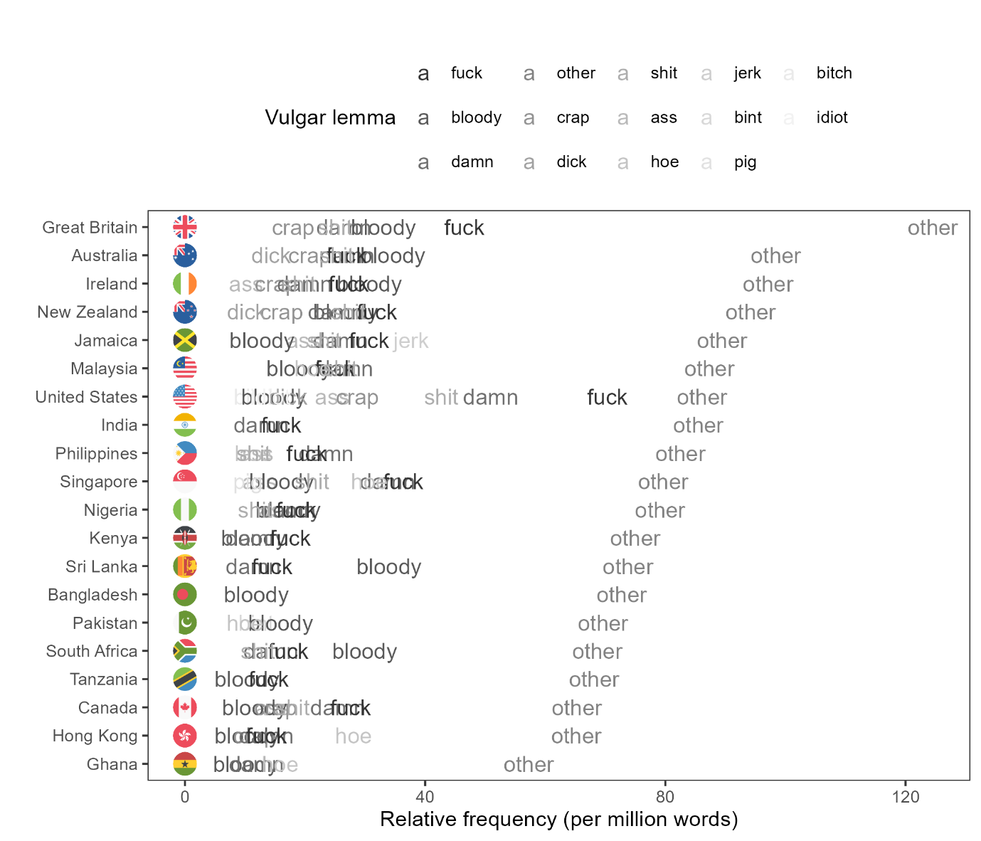
Overview of types of vulgar elements by location
Relative frequency (per million words) of vulgar lemmas in GloWbE across English-speaking regions (with lemmas having a relative frequency lower than 10 per million being collapsed into a single bin category, other).

Slide 38
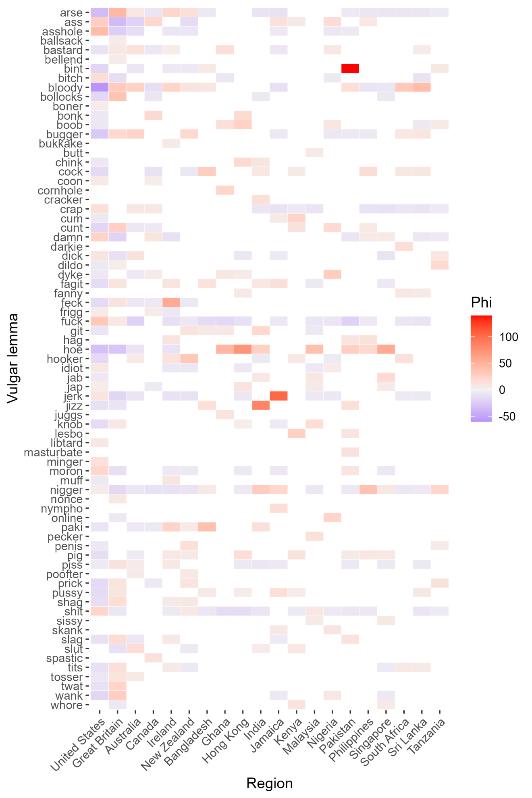
Overview of over- and underuse of vulgar elements by location
Association plot showing preferred and dispreferred vulgar lemmas across regions based on the phi-value (red = preferred, blue = dispreferred, grey = no trend, white = absent). Colouring only shown if the phi-value is greater than 5 or smaller than -5.

Slide 39
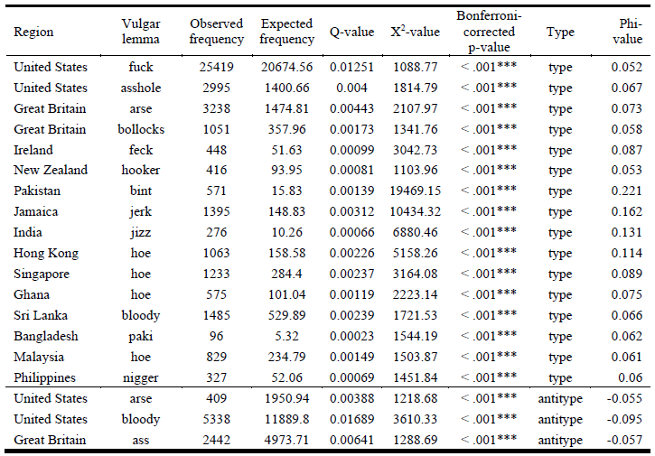
Overview of over- and underuse of vulgar elements by location
Results of the CFA analysing significant preferences (types) for and avoidance (antitypes) of vulgar lemmas across English-speaking regions.

Slide 40
Discussion | Outlook
Key points
Swearing is a common but at the same time rare linguistic phenomenon in online discourse
Between 6.2 and 18.2 percent of files (online texts) contain vulgar elements.
Overall frequency very low (between 0.008 and 0.044 percent of all tokens are vulgar).
Vulgarity more common in blogs compared to general web content.
Inner circle varieties use more vulgarity compared with outer circle varieties
Inner circle varieties show higher variability (creativity) in the use of vulgar language.
Further analyses of spelling variability and local preferences as well as specific conversational contexts and strategies of vulgarity needed.
Current project: Special Issue of Lingua on Bad Language and Vulgarity in Public and Online Discourse (Eds. Martin Schweinberger, Paula Rautionaho, & Kate Burridge)

Slide 41
Summary and Outlook

Slide 42
Summary | Outlook
Key findings
Swearing is a common (many speakers use it) but rare in terms of frequency)
Especially in L1/ inner circle varieties use vulgarity as a functional linguistic resource
Inner circle speakers more creative than outer circle variety speakers (degree of creativity and avoidance strategies need to be studied to get a more precise and detailed picture)
The use of vulgar language differs across location:
Forms (types) as well as topics (cultural constraints), and frequency.
Significance
First large-scale, comparative, corpus-based (and linguistically informed) study of vulgarity on social media and online discourse
Limitations
Little socio-demographic information
Context and multimodality not considered in this study (graphics and emojis were ignored)
Variability and context require further analysis
Vulgarity a functional pragmatic aspect of language use that is not taught in ESL/EFL classrooms – how can vulgarity be included in teaching materials?
How can awareness of culturally distinct forms and uses be taught appropriately?

Slide 43
Thank you very much!

Slide 44

References
Andersson, L. & Trudgill, P. (1992). Bad language. London: Penguin.
Andersson, L. & Trudgill, P. (2007). Swearing. In Leila Monaghan, Jane Goodman & Jennifer Robinson (eds.), A cultural approach to interpersonal communication, 195–199. Oxford: Blackwell.
Bergen, B. K. (2016). What the F: What swearing reveals about our language, our brains, and ourselves. Hachette UK.
Beers Fägersten, K. (2012). Who’s swearing now? The social aspects of conversational swearing. Newcastle-upon-Tyne: Cambridge Scholars Publishing.
Culpeper, J. (2011). Impoliteness: Using language to cause offence. Cambridge University Press.
Drange, E. M. D., Hasund, I. K., & Stenström, A. B. (2014). " Your mum!" Teenagers’ swearing by mother in English, Spanish and Norwegian. International Journal of Corpus Linguistics, 19(1), 29-59.
Drummond, R. (2020). Teenage swearing in the UK. English World-Wide 41(1). 59–88.
Hughes, G. (1991). Swearing: A social history of foul language, oaths and profanity in English. London: Blackwell.
Martínez, I. M. P., & Pertejo, P. N. (2012). He's absolutely massive. It's a super day. Madonna, she is a wicked singer. Youth language and intensification: a corpus-based study. Text & Talk, 32(6), 773-796.
McEnery, T. (2006). Swearing in English: Bad language, purity and power from 1586 to the present. New York: Routledge.
Love, R. (2021). Swearing in informal spoken English: 1990s–2010s. Text & Talk 41(5-6): 739-762.
Schweinberger, M. (2018). Swearing in Irish English -- A corpus-based quantitative analysis of the sociolinguistics of swearing. Lingua 209. 1–20.
Seizer, S. (2011). On the uses of obscenity in live stand-up comedy. Anthropological Quarterly, 209-234.
Stapleton, K. (2010). Swearing. In Miriam A. Locher & Sage L. Graham (eds.), Interpersonal pragmatics, 289–306. Berlin: De Gruyter Mouton.

Slide 45

Software
Software
R Core Team (2022). R: A language and environment for statistical computing. R Foundation for Statistical Computing, Vienna, Austria. (https://www.R-project.org)
RStudio Team (2022). RStudio: Integrated Development Environment for R. RStudio, PBC: Boston, MA (http://www.rstudio.com)
Benoit K, Watanabe K, Wang H, Nulty P, Obeng A, Müller S, Matsuo A (2018). quanteda: An R package for the quantitative analysis of textual data. Journal of Open Source Software 3(30): 774.
Kursa, M. B. & Rudnicki, W. R. (2010). Feature Selection with the Boruta Package. Journal of Statistical Software 36(11): 1-13.
Wickham et al., (2019). Welcome to the tidyverse. Journal of Open Source Software 4(43): 1686.

Slide 46
Acknowledgements
The study is part of a collaborative project (Fucking Twitter) that has received seed funding from the UQ Digital Cultures and Societies Hub. The project involves researchers at the University of Queensland (Michel Haugh and Sam Hames) the Australian Digital Observatory (Marissa Takahashi) at the Queensland University of Technology and researchers of FIN-CLARIAH at the University of Eastern Finland (Mikko Laitinen and Paula Rautionaho).

Slide 47
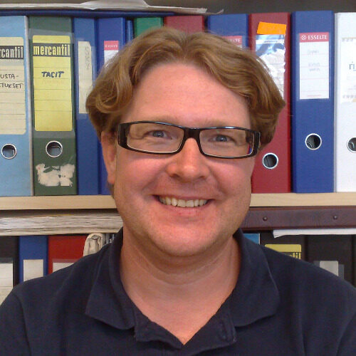


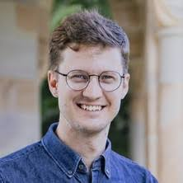


Contact
Dr. Martin Schweinberger (CI)
m.schweinberger@uq.edu.au
Prof. Mikko Laitinen
mikko.laitinen@uef.fi
Masoud Fatemi
masoud.fatemi@uef.fi
Dr. Paula Rautionaho
paula.rautionaho@uef.fi
Sam Hames
sam.hames@uq.edu.au
Marissa Takahashi
marissa.takahashi@qut.edu.au
Prof. Michael Haugh
michael.haugh@uq.edu.au

Slide 48
Vulgarity in Online Discourse around the English-Speaking World
Martin Schweinberger, Masoud Fatemi, Sam Hames, Michael Haugh, Mikko Laitinen, Paula Rautionaho & Marissa Takahashi
University of Queensland | University of Eastern Finland | Queensland University of Technology

