Slide 1

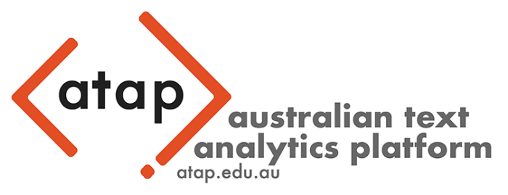


F%$# Twitter
A corpus-based analysis of vulgar language on Twitter
Assoc. Prof. Dr. Martin Schweinberger
University of Queensland | Arctic University of Norway, Tromsø

Slide 2
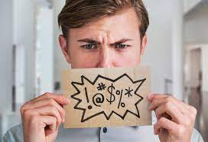
Background and Motivation
first findings from a collaborative research project under my lead (Fucking Twitter)
collaboration: University of Queensland, the Australian Digital Observatory, & FIN-CLARIAH
forthc. in Big Data & Society early next year
Why talk about vulgarity? (and not learner speech)
Vulgarity is a powerful linguistic tool and its analysis is relevant for several social domains and various contemporary discussions around hate speech, power relations, social change, and democratization.

Slide 3
Aims of the talk
In this talk I want to show that …
vulgarity is an extremely interesting phenomenon
vulgarity is complex and versatile, and well-worthy of scholarly attention
combining computational data science with quantitative corpus linguistics can inform our understanding of discourse on social media

Slide 4

F%$# Twitter
A corpus-based analysis of vulgar language on Twitter
Timeline | Table of Contents
Vulgarity as a linguistic phenomenon
Research Gaps | Research Questions
Methodology (Data and Analysis)
Results
Discussion, Outlook, and potential Applications

Slide 5

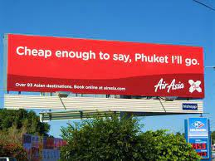
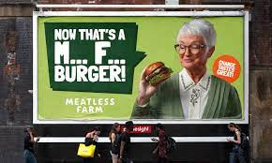
Vulgarity as a linguistic phenomenon
Why is vulgarity better than its reputation?
Vulgar language is popular but generally viewed unfavourably.
Using vulgarity appropriately requires substantive pragmatic proficiency and linguistic awareness
Functions of vulgarity
Social swearing: positively charged (social bonding, banter) Vulgarity as part of humour (see George Carlin, Seizer 2011)
Annoyance swearing: negatively charged (emotional relief, catharsis) e.g., cussing at other drivers in traffic
Linguistically motivated use of vulgarity e.g. intensification, e.g., fucking as an adjective amplifier (Martínez & Pertejo 2012)

Slide 6
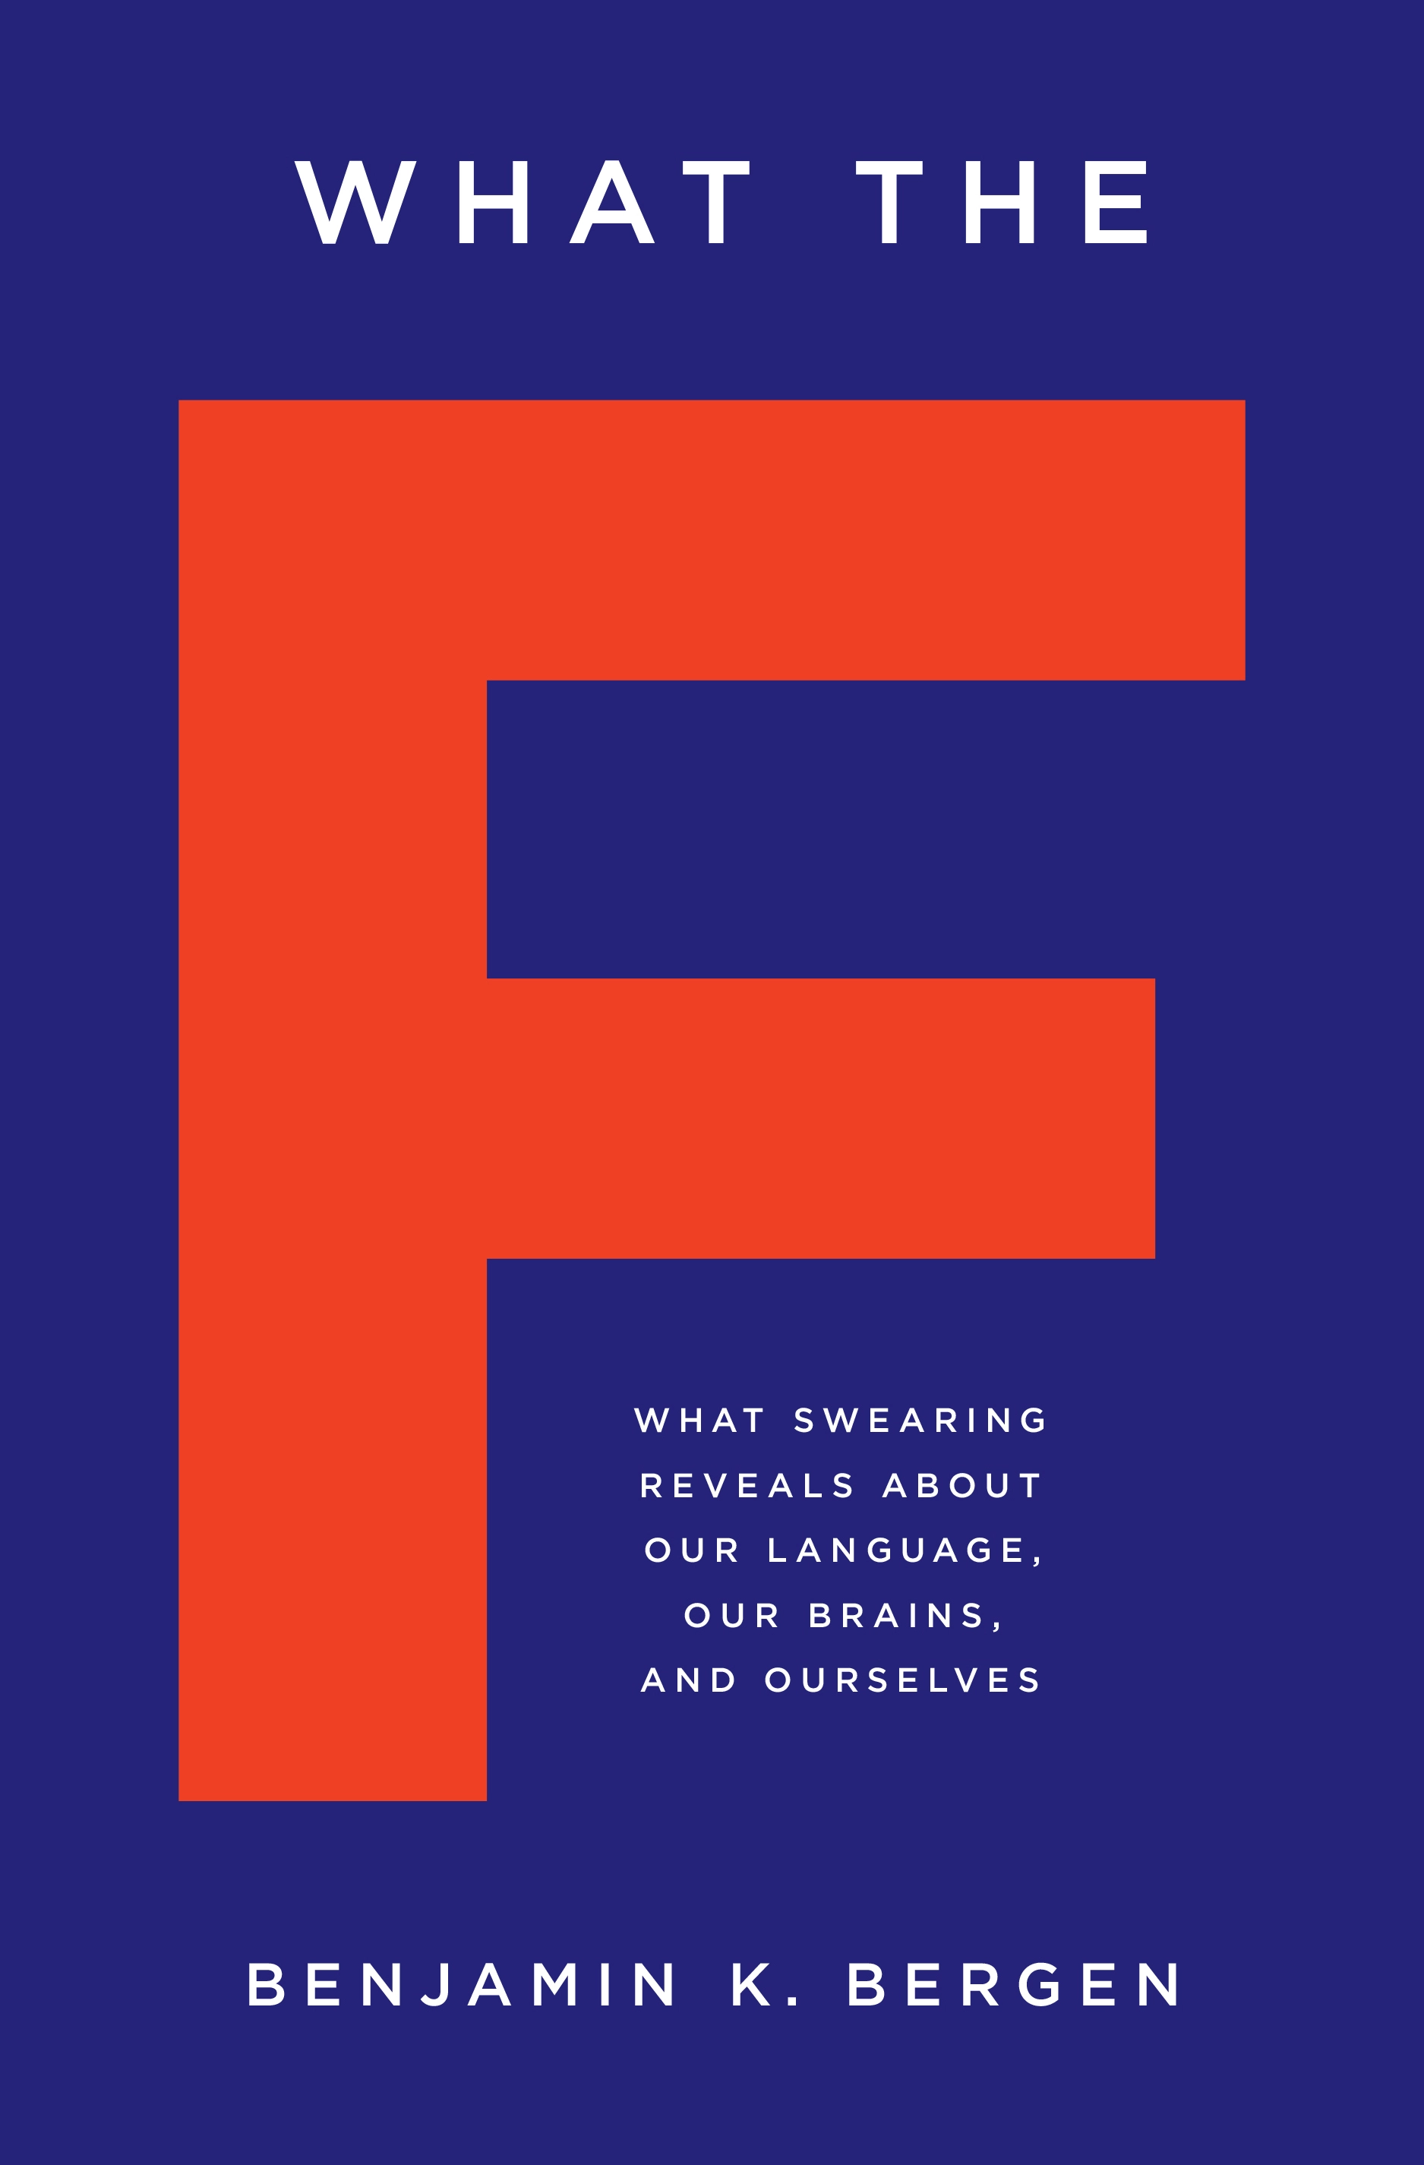

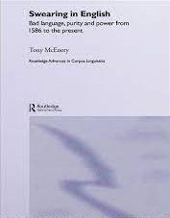
Previous Research
Substantive research on vulgarity (swearing | impoliteness)
Sociolinguistic and pragmatic perspectives (mostly using corpus linguistic and discourse | conversation analysis approaches) (cf. McEnery 2006)
Age: most common among adolescent (McEnery 2006) to middle-aged male speakers (Schweinberger 2018)
Gender: Men swear more than women and they use “stronger” bad language words (BLWs) (Love 2021, McEnery 2006, Schweinberger 2018, Stenström 2006, McEnery and Xiao 2004) – contradicting studies show no gender difference (Drummond 2020) or that female speakers use fucking as an intensifier more than males “to mark their linguistic independence” (Aijmer 2018: 91)
Time: Swearing has decreased(?) in informal British English between 1994 and 2014 (Love 2014)
Social class : findings do not show a consistent patterning (see Stenström 2006 for an overview)

Slide 7
What counts as vulgar?
Difficulty of defining vulgarity
Problem: unclear what counts as swearing | bad language | cussing
Terminology (impoliteness vs swearing vs taboo language)
Problematic examples
taboo language? If it were taboo, it would not be such a common and systematic phenomeon
literal vs metaphoric John fucked Jane (not considered swearing when used literally (by some))
offensive terms / insults: pedophile, nazi, fascist, etc.
Our approach (resulted in a list of 281 candidates)
Focus on vulgarity! (not insults, swearing, etc.)
Start: word lists based on pervious research (781 items)
Criteria
does the word have a less vulgar synonymous counterpart?
fuck | shag vs make love | sleep with, etc.
ass | arse vs behind | bottom, etc.
Is the term marked as vulgar in the OED
pedophile, idiot (can be insults but not vulgar)
English only (not considered: bastardo, arschloch, etc.)
Spelling variation: phuk, fak, fuuuuck, etc. → fuck (lemma)

Slide 8
Research Gaps
Research gaps
Very little research on vulgarity on social media (from a linguistically informed perspective)
Almost no comparative analyses across genres or varieties of English (almost all analyses focus on informal spoken British English – predominantly the speech of adolescents – notable exceptions are Schweinberger 2019 who focused on Irish English and Drange et al. 2014 who analysed Norwegian, Spanish and British youth)
Inconsistencies in the definition of the phenomenon (vague definitions on what counts as swearing | bad language | cussing | vulgarity)
No studies of topics | discourses that are prone to facilitate the use of vulgarity

Slide 9
Research Questions
RQ 1: What forms of vulgarity are used on Twitter in the US, Great Britain, and Australia?
RQ 2: What topics are associated with vulgarity on Twitter in the US, Great Britain, and Australia?
RQ 3: What factors correlate with vulgarity on Twitter?

Slide 10
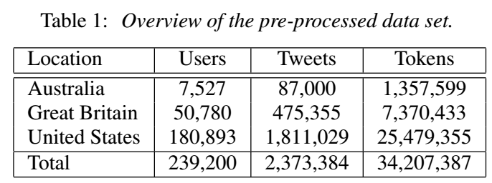
Data
Tweets collected on June 21, 2022 by a selection of Australian, British, and US American users collected by collaborators at FIN-CLARIAH and UQ
Data contained information about
the tweet (location, when created, reply, retweet)
the user (followers, following, verified)
text of the tweet
Removed: Spanish tweets | function words

Slide 11
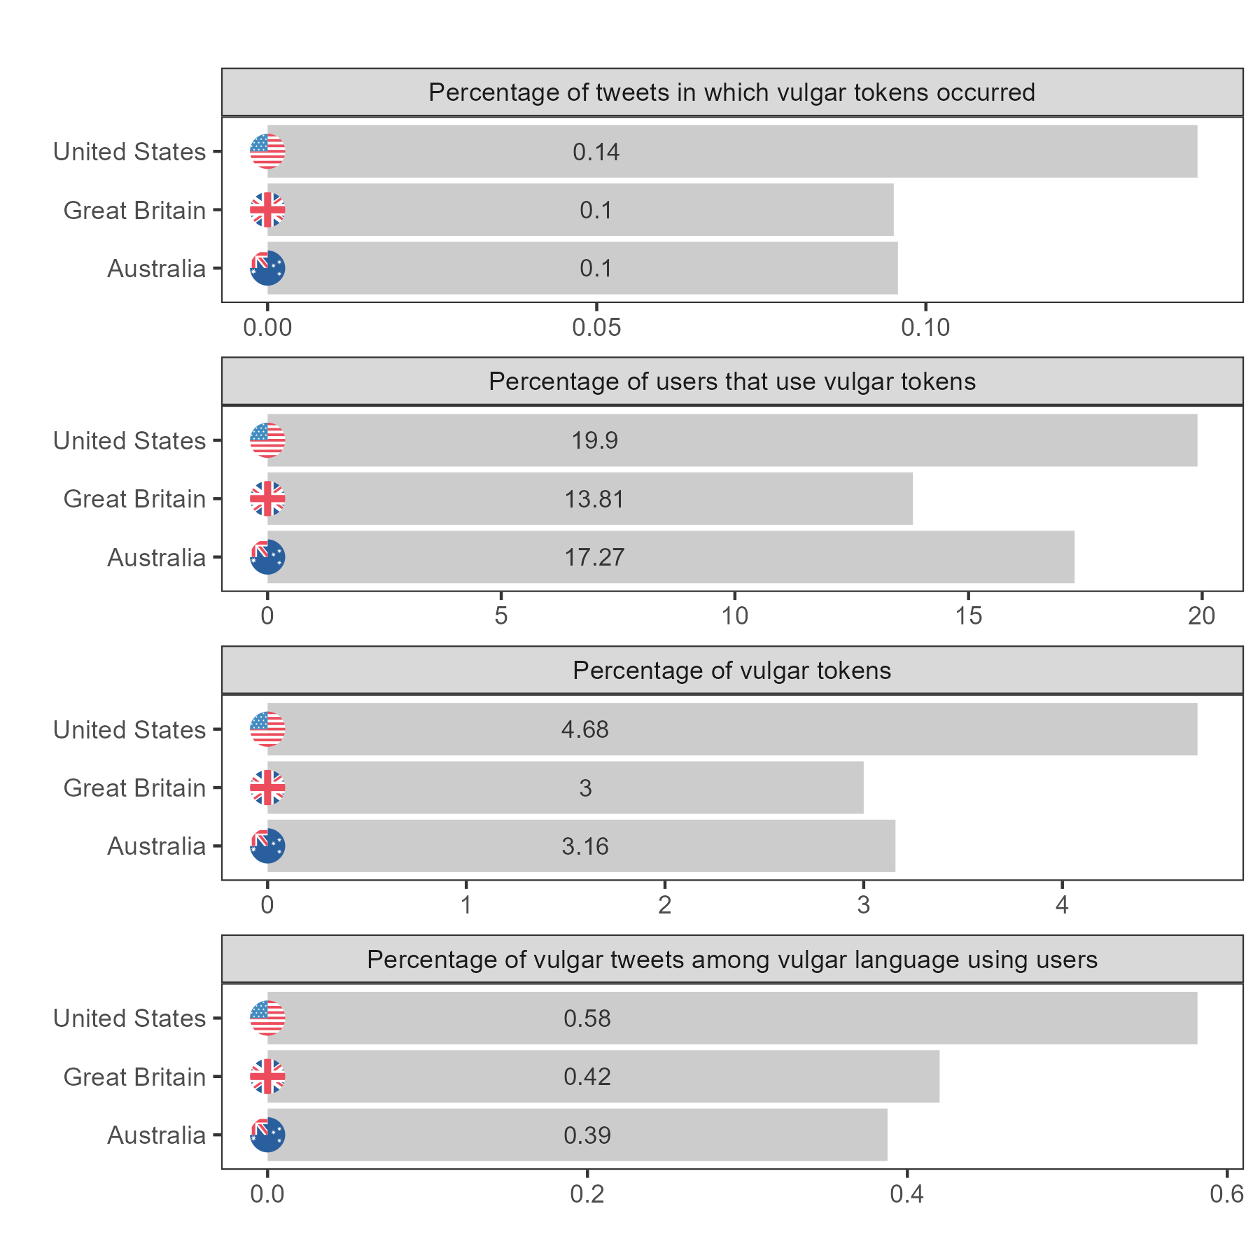
Overview of frequencies across location

Slide 12
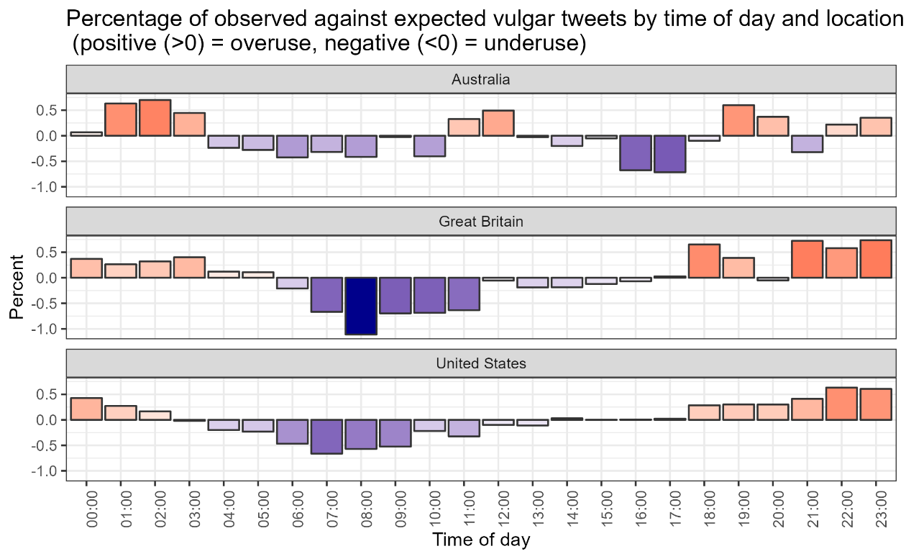
Overview of frequencies across time of day

Slide 13

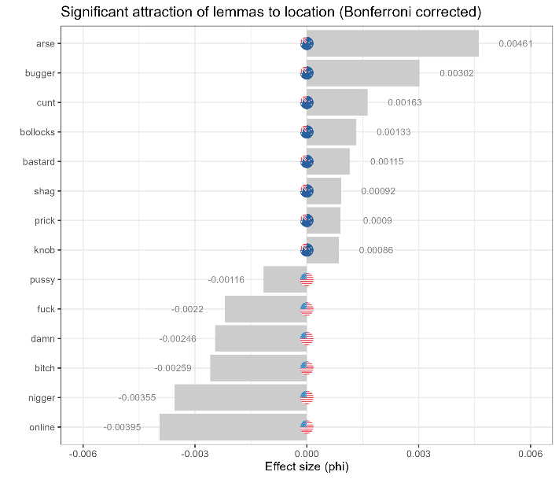
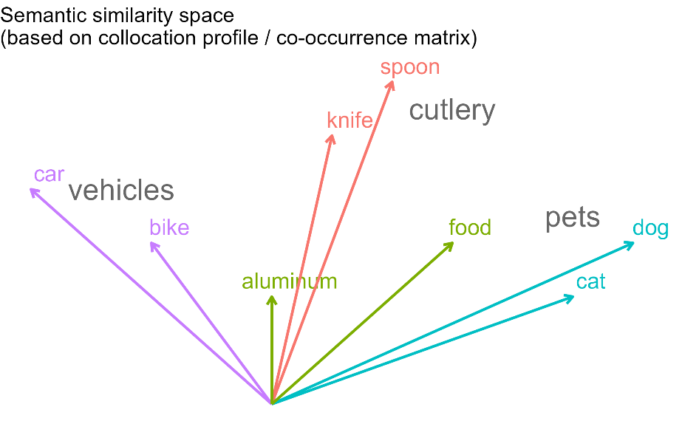
Statistical analysis
Data Processing
Twitter data extracted using the Twitter API (starting with individual users as seeds)
From start to finish the entire analysis is performed in R/RStudio (guarantees reproducibility and flexibility in the analysis)
Statistical methods
Frequency and Collostructional Analysis (RQ1: forms of vulgarity) to determine significant preferences within and across locations (e.g., if users in the US use wft more than users in Great Britain or Australia)
Topic modelling (RQ2: topics for vulgarity) to determine the topics of tweets (e.g. whether a tweet was about sport, politics, or family)

Slide 14
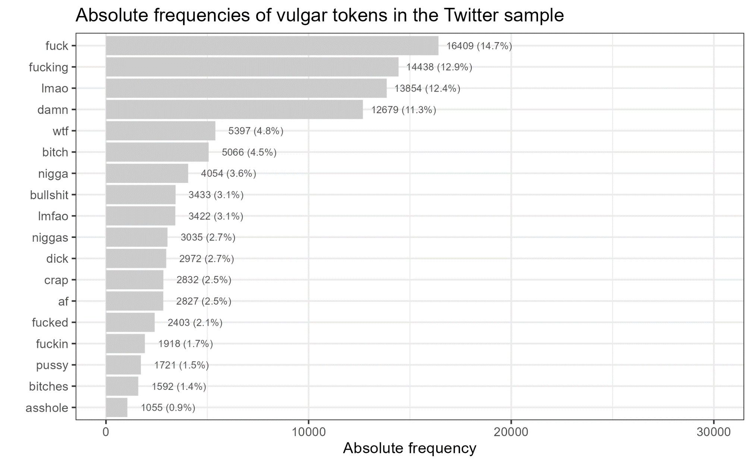
Forms of Vulgarity (RQ1)
Vulgar tokens were identified based on a list of candidates (281 elements, 22 lemmas)
111,919 vulgar tokens (180 types)
Selected examples
I fucking love disco too (us: 1539071912848110000)
@Mahj___ Wtfffffffff😭😭😭😭 (us: 1539071926584360000)
OMG #BREAKMYSOUL IS A BOP LMFAO WTFFFFFF https://t.co/3TFVP3vC4Y (us: 1539071886226660000)
@JTTH0R yea ok LMFAOOO (us: 1539072061305410000)
Anne is a lame bitch .. I know Rollie whooped that ass lol (us: 1539112482454790000)

Slide 15
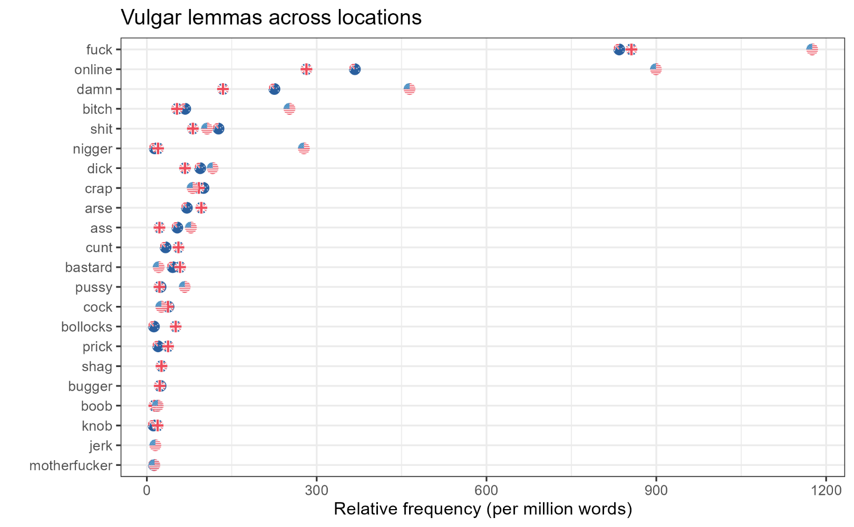
Forms of Vulgarity (RQ1)
Vulgar tokens were identified based on a list of candidates (281 elements, 22 lemmas)
111,919 vulgar tokens (180 types)
Selected examples
SO. FUCKING. ANGRY. (us: 1539329043472030000)
Quite frankly, I fucking adore the rude-ass little bitch that is Byakuya Togami (us: 1539329027932030000)
Chelsea na mumu club for that Lukaku shit 🤣🤣🤣 (us: 1539320606411340000)
It’s hella shit going on 😂 (us: 1539322226557610000)

Slide 16
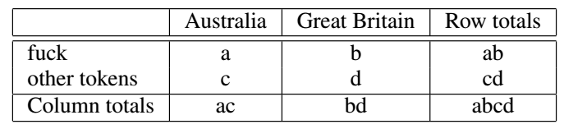
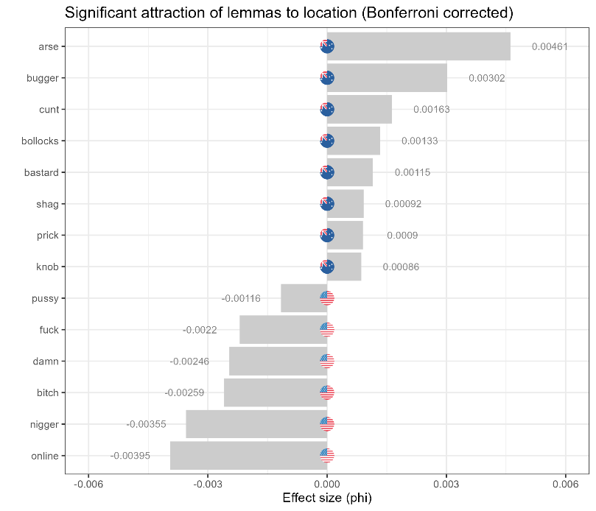
Forms of Vulgarity by Location (RQ1)
Collostructional Analysis
to determine significant preferences and association strengths across locations
e.g., if users in the Australian use fuck (or lmfao) more than users in Great Britain or the United States
based on repeated Fisher’s Exact tests for all vulgar elements across locations (Bonferroni corrections to avoid α-errors)
effect size measures: φ (phi) and LogLikelihood
Comparisons
Australia vs United States
Great Britain vs United States
Australia vs Great Britain

Slide 17
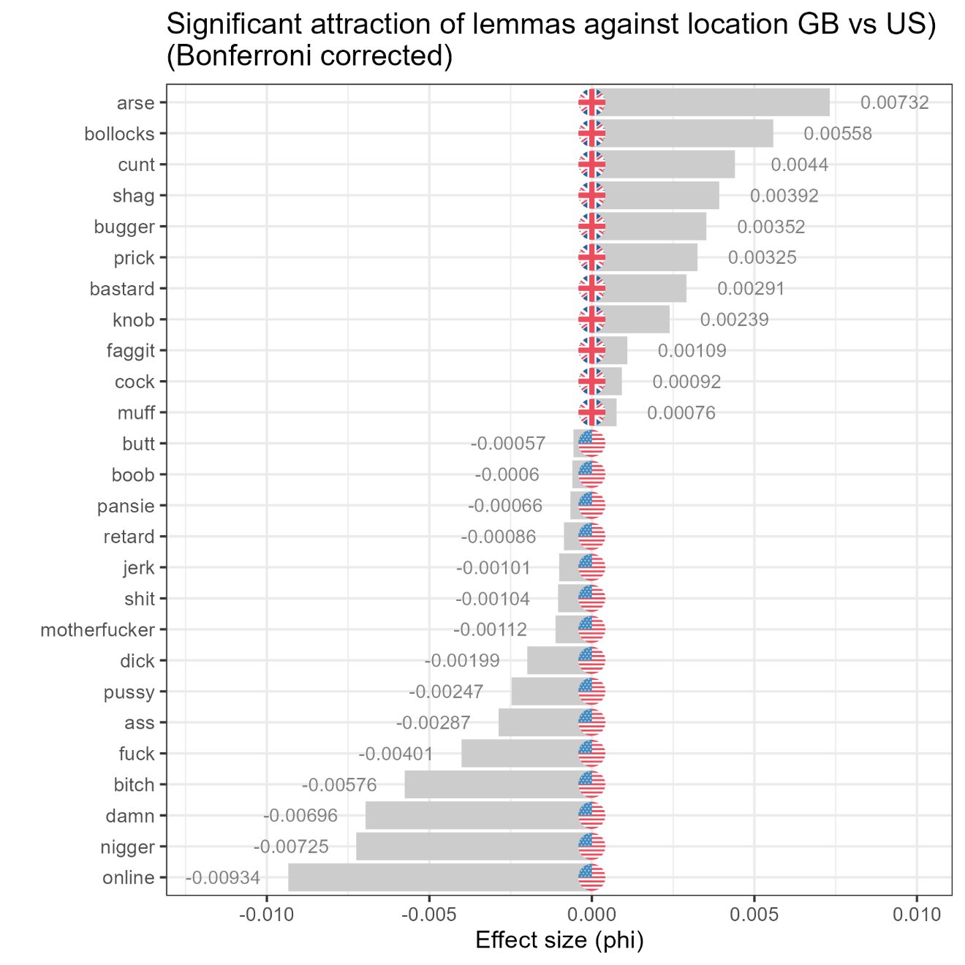
Forms of Vulgarity by Location (RQ1)
Great Britain vs United States
British users also use vulgarity items that are prototypically associated with British English (arse, bollocks, cunt, shag) significantly more than US users
US users use vulgarity items associated with
online discourse (lmao, lmfao, wtf) a
racial slurs* (nigger, nigga)
female sexual behaviour (bitch)
general items (fuck, damn)
significantly more frequently than British users
Important: very(!) similar to Australia vs United States!
* could also be ingroup markers!

Slide 18
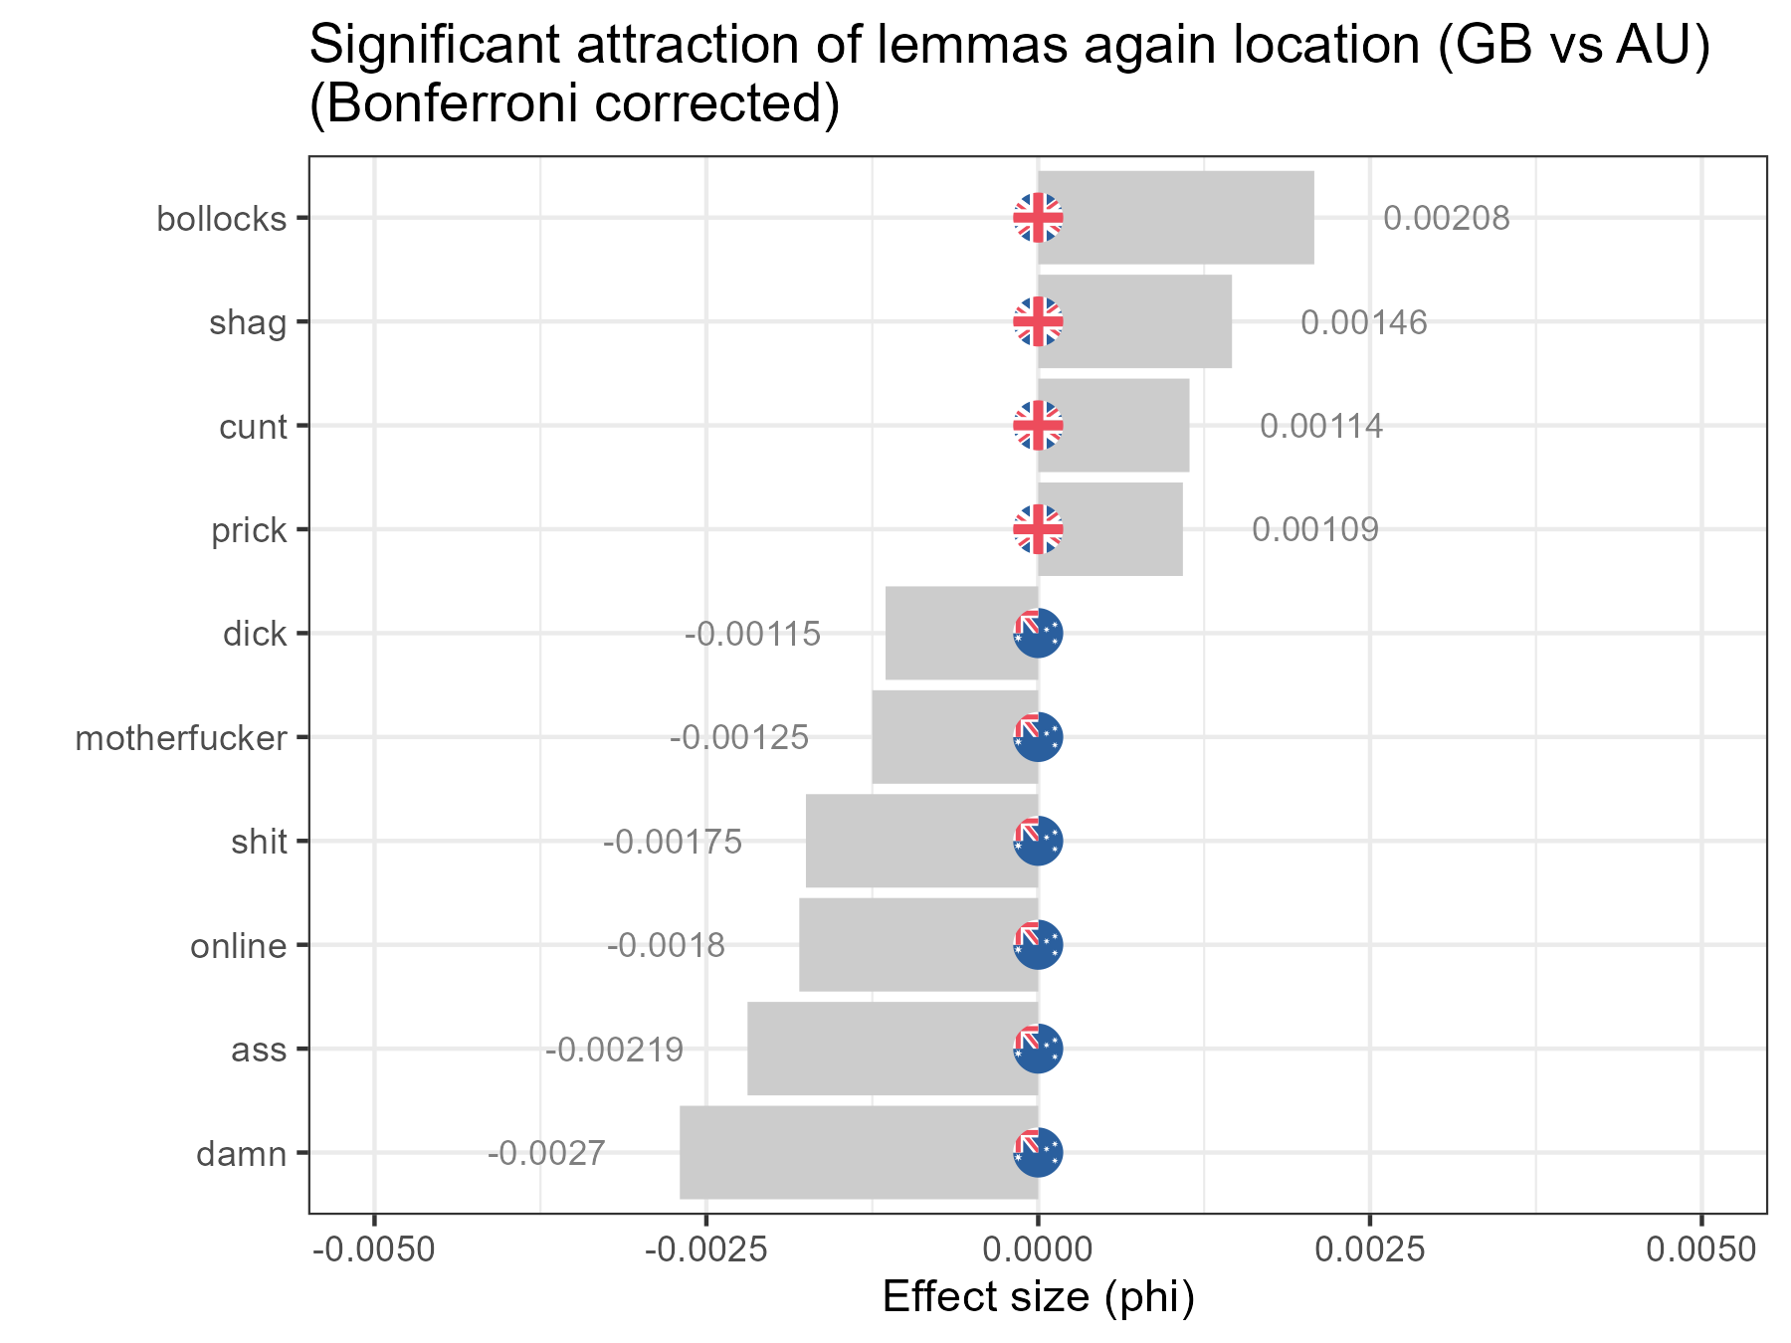
Forms of Vulgarity by Location (RQ1)
Great Britain vs Australia
Overall few significant differences
British users, again, overuse vulgarity items that are prototypically associated with British English (shag, bollocks, cunt, prick) significantly more than Australian users
Australian users use vulgarity items associated with US English (damn, ass, lmao, wtf, shit, motherfucker)
Important: Australian is British when compared to the US but US-like when compared to GB!

Slide 19
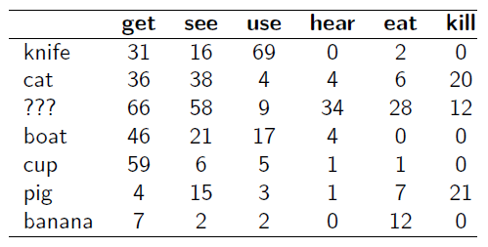

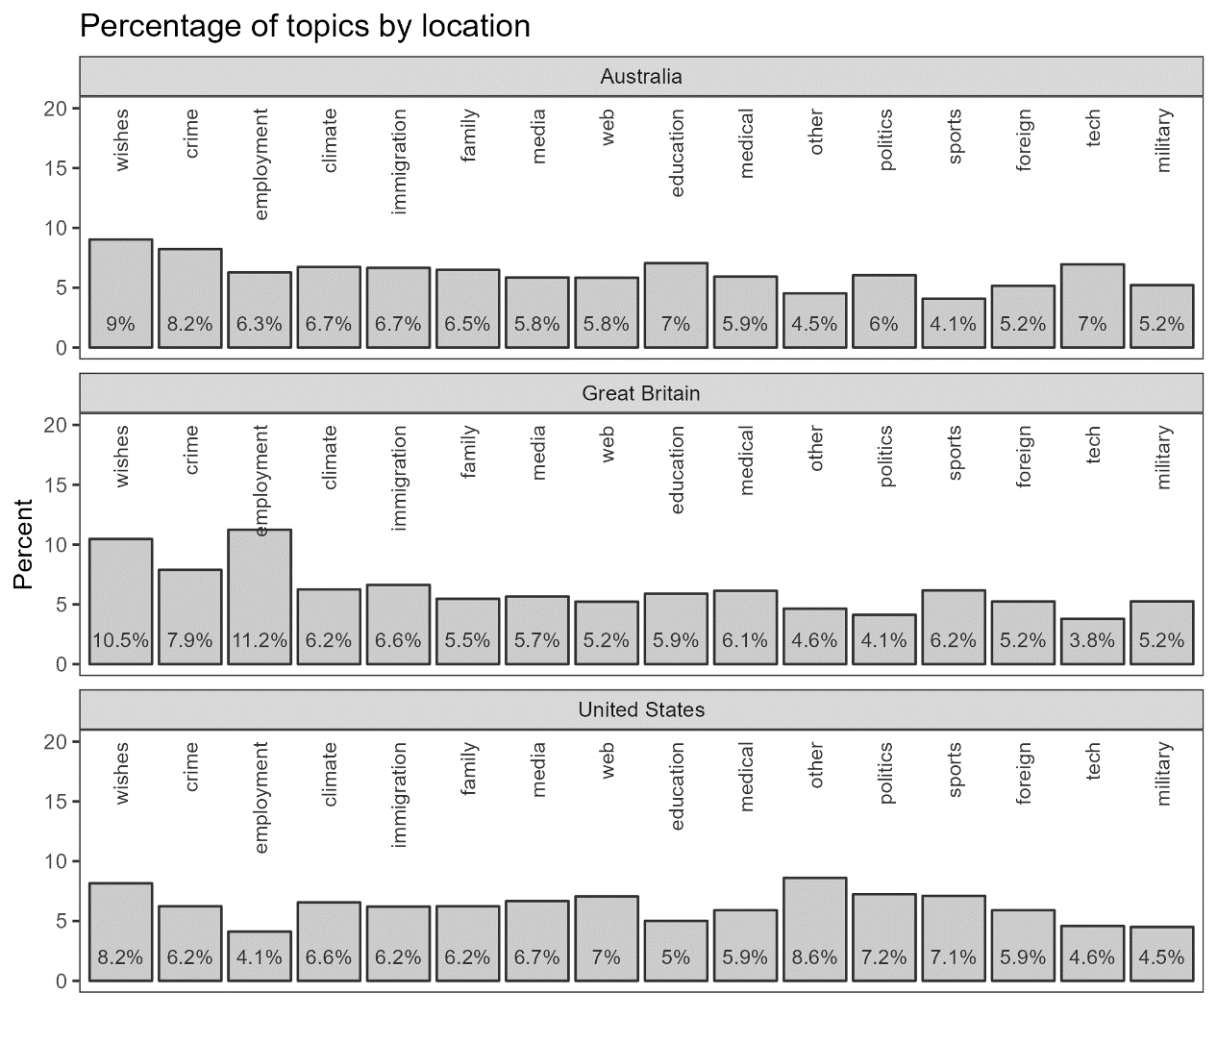
Topic facilitating Vulgarity (RQ2)
What topics attract vulgarity in Oz, GB, and the US?
Topic modelling
Finds words that correlate with seed terms (e.g.: topic = sports: match, game, play, season, players;
topic = employment: pay, wage, money, work, job)
Assesses correlations of semantic similarity based on collocational profiles of types.
Topics: employment, politics, climate, sports, medical, education, foreign, immigration, crime, tech, media, military, family, web, wishes, spanish, other)

Slide 20
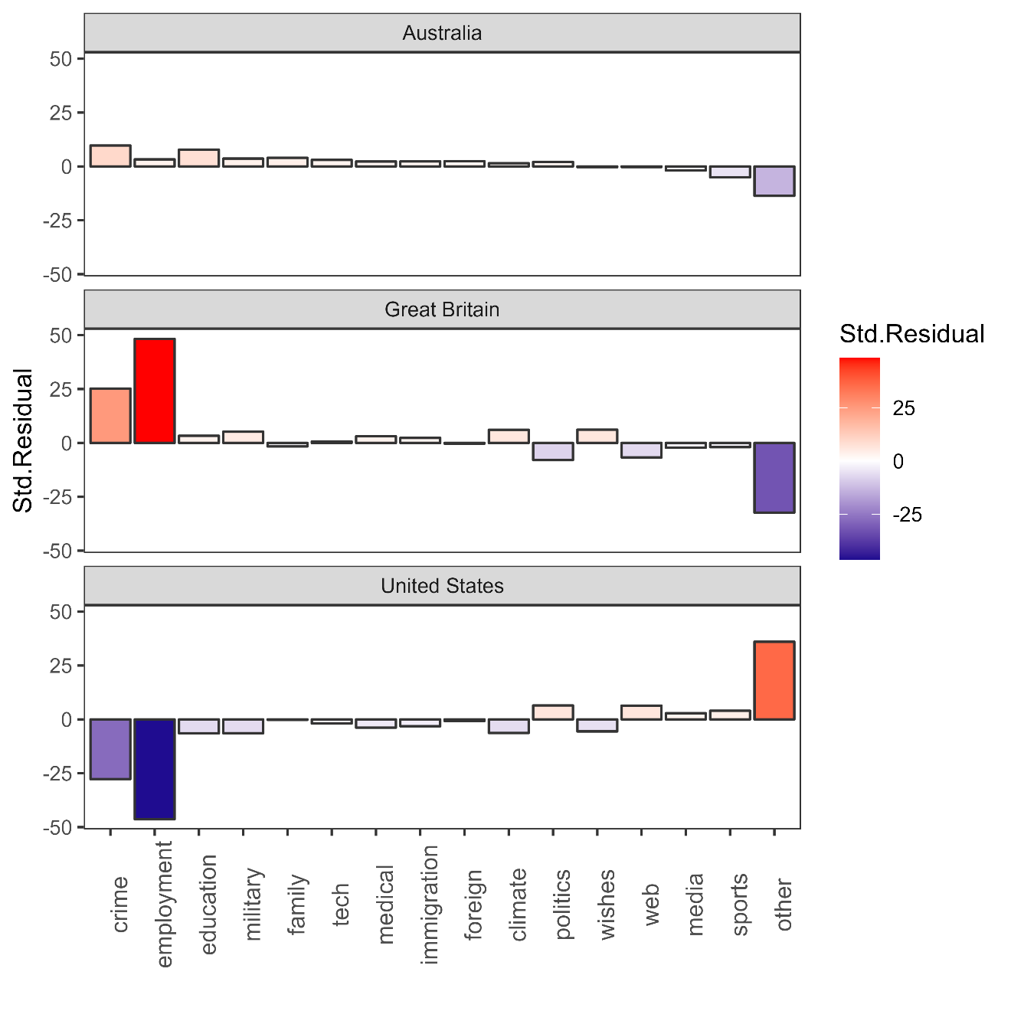
Topic facilitating Vulgarity (RQ2)
What topics attract vulgarity in Oz, GB, and the US?
Crime attracts vulgarity in Australia and Great Britain but vulgarity is dispreferred in tweets about crime in the US data.
Employment-related tweets strongly facilitate vulgar language in Great Britain but not so in Australia and it is decidedly non-vulgar in the US data.
The other category strongly attracts vulgarity in the US but not in Australia and it is decidedly non-vulgar in Great Britain. (keywords other category: bro, shit, get, man, fuck, got, ass, im, fucking, lmao) → naughty web talk
→ In the US, vulgarity is register-constrained whereas, in Britain, it is topic constrained.

Slide 21
Topic facilitating Vulgarity (RQ2)
Examples
Crime
ok so this person is actually fucking deranged https://t.co/nONQyzScdJ (gb: 1539127156449710000)
Employment
@Deborahfrankier @Tinman07382139 @NavyLookout Shit wages but you stand with Boris? If you give me £50 I'll kick you in the bollcks but only if you ask nice (gb: 1539036748390570000)
Other (Web)
Lmfaoooo nah Eddie was funny asf on that’s so raven. Orlando brown really was funny asf. (us: 1539072377027490000)
What topics attract vulgarity in Oz, GB, and the US?
Crime attracts vulgarity in Australia and Great Britain but vulgarity is dispreferred in tweets about crime in the US data.
Employment-related tweets strongly facilitate vulgar language in Great Britain but not so in Australia and it is decidedly non-vulgar in the US data.
The other category strongly attracts vulgarity in the US but not in Australia and it is decidedly non-vulgar in Great Britain. (keywords other category: bro, shit, get, man, fuck, got, ass, im, fucking, lmao) → naughty web talk
→ In the US, vulgarity is register-constrained whereas, in Britain, it is topic constrained.
What topics attract vulgarity in Oz, GB, and the US?
Crime attracts vulgarity in Australia and Great Britain but vulgarity is dispreferred in tweets about crime in the US data.
Employment-related tweets strongly facilitate vulgar language in Great Britain but not so in Australia and it is decidedly non-vulgar in the US data.
The other category strongly attracts vulgarity in the US but not in Australia and it is decidedly non-vulgar in Great Britain. (keywords other category: bro, shit, get, man, fuck, got, ass, im, fucking, lmao) → naughty web talk
→ In the US, vulgarity is register-constrained whereas, in Britain, it is topic constrained.

Slide 22
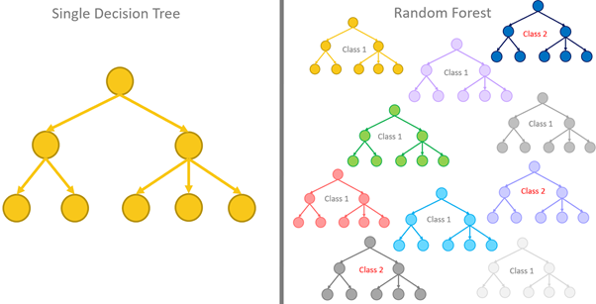
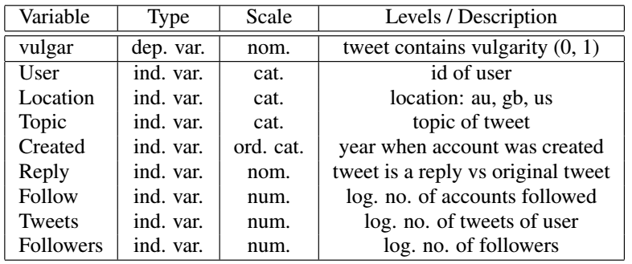
Factors correlating with Vulgarity (RQ3)
based on a sample of 15,000 tweets (5,000 random tweets from each location)
Boruta Model
Tree-based method (extension of conditional inference trees and random forests)
Multivariate machine-learning method: assesses the impact of a factor while controlling for the effects of all other factors (confounding)
Used here to determine which factors impact vulgarity (and how strong that influence is)

Slide 23
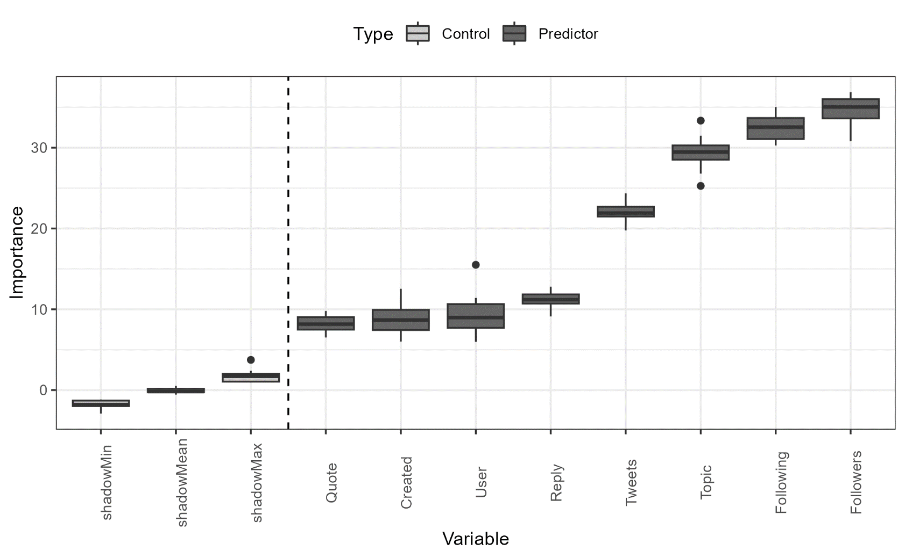
Factors correlating with Vulgarity (RQ3)
Location is NOT significant when we use a multivariate approach!
Topic | Register is a very important predictor for vulgarity
Vulgarity is affected by whether users
have a large following
follow many other users
tweet a lot
have been on Twitter for a long time
Also, if the tweet is a reply or a quote it affects the probability that a tweet contains vulgarity

Slide 24
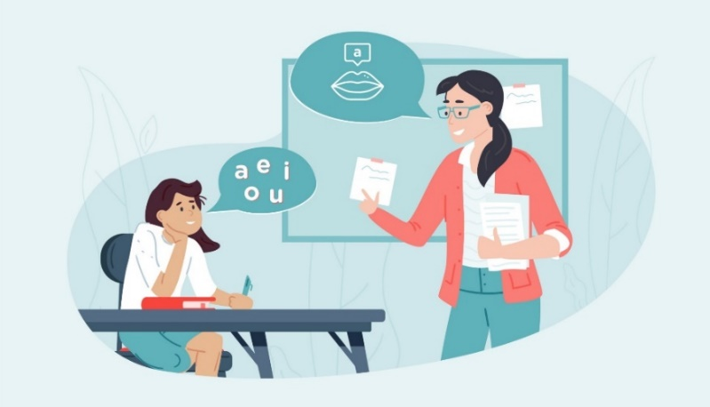
Discussion | Outlook
Comparison with previous findings
Confirmation | Substantiation
Swearing is a common linguistic phenomenon (McEnery 2006, Love 2021)
Almost half of the users use vulgarity but in less than 1 percent of tweets
Australian English combines features of AmE and BrE
Unique findings | Conflicts
Vulgarity is topic specific in Britain but register specific in the US Twitter data
Variety differences become less important once other conditioning factors are included
Significance
First large-scale, comparative, corpus-based (and linguistically informed) study of vulgarity on social media
Limitations
More socio-demographic information needed: gender, age, socio-economic status) (see Beers Fägersten 2012)
Further analyse specific conversational contexts and strategies of vulgarity (also possible for German) (potential MA theses!)

Slide 25

Potential Applications
Prototype (proof-of-concept)
Extend study to
political discourse (party affiliation)
diachronic analyses of the use of vulgarity (democratization)
Outlook and possible applications
Currently working on an ARC proposal on Hate Speech and Polarization of Discourses on Social Media (planned collaboration with research group Democratization and Power Structures here in Bonn, currently a TRA4 project)

Slide 26
Thank you very much!
Assoc. Prof. Dr. Martin Schweinberger

Slide 27

References
Andersson, L. & Trudgill, P. (1992). Bad language. London: Penguin.
Andersson, L. & Trudgill, P. (2007). Swearing. In Leila Monaghan, Jane Goodman & Jennifer Robinson (eds.), A cultural approach to interpersonal communication, 195–199. Oxford: Blackwell.
Beers Fägersten, K. (2012). Who’s swearing now? The social aspects of conversational swearing. Newcastle-upon-Tyne: Cambridge Scholars Publishing.
Culpeper, J. (2011). Impoliteness: Using language to cause offence. Cambridge University Press.
Drange, E. M. D., Hasund, I. K., & Stenström, A. B. (2014). " Your mum!" Teenagers’ swearing by mother in English, Spanish and Norwegian. International Journal of Corpus Linguistics, 19(1), 29-59.
Drummond, R. (2020). Teenage swearing in the UK. English World-Wide 41(1). 59–88.
Hughes, G. (1991). Swearing: A social history of foul language, oaths and profanity in English. London: Blackwell.
Martínez, I. M. P., & Pertejo, P. N. (2012). He's absolutely massive. It's a super day. Madonna, she is a wicked singer. Youth language and intensification: a corpus-based study. Text & Talk, 32(6), 773-796.
McEnery, T. (2006). Swearing in English: Bad language, purity and power from 1586 to the present. New York: Routledge.
Love, R. (2021). Swearing in informal spoken English: 1990s–2010s. Text & Talk 41(5-6): 739-762.
Schweinberger, M. (2018). Swearing in Irish English -- A corpus-based quantitative analysis of the sociolinguistics of swearing. Lingua 209. 1–20.
Seizer, S. (2011). On the uses of obscenity in live stand-up comedy. Anthropological Quarterly, 209-234.
Stapleton, K. (2010). Swearing. In Miriam A. Locher & Sage L. Graham (eds.), Interpersonal pragmatics, 289–306. Berlin: De Gruyter Mouton.

Slide 28

Software
Software
R Core Team (2022). R: A language and environment for statistical computing. R Foundation for Statistical Computing, Vienna, Austria. (https://www.R-project.org)
RStudio Team (2022). RStudio: Integrated Development Environment for R. RStudio, PBC: Boston, MA (http://www.rstudio.com)
Benoit K, Watanabe K, Wang H, Nulty P, Obeng A, Müller S, Matsuo A (2018). quanteda: An R package for the quantitative analysis of textual data. Journal of Open Source Software 3(30): 774.
Kursa, M. B. & Rudnicki, W. R. (2010). Feature Selection with the Boruta Package. Journal of Statistical Software 36(11): 1-13.
Wickham et al., (2019). Welcome to the tidyverse. Journal of Open Source Software 4(43): 1686.

Slide 29

Acknowledgements
The study is part of a collaborative project (Fucking Twitter) that has received seed funding from the UQ Digital Cultures and Societies Hub under my lead. The project which involves researchers at the University of Queensland (Michel Haugh and Sam Hames) the Australian Digital Observatory (Marissa Takahashi) at the Queensland University of Technology and researchers of FIN-CLARIAH at the University of Eastern Finland (Mikko Laitinen and Paula Rautionaho).
The resulting paper will be submitted Big Data & Society.
Assoc. Prof. Dr. Martin Schweinberger
m.schweinberger@uq.edu.au martin.schweinberger@uit.no
https://github.com/MartinSchweinberger

Slide 30
F%$# Twitter
A corpus-based analysis of vulgar language on Twitter
Assoc. Prof. Dr. Martin Schweinberger
University of Queensland | Arctic University of Norway, Tromsø

