Slide 1


Text Analytics with Language Technology and Data Analysis Laboratory Resources: an introduction to free, open-source interactive resources for linguists
Martin Schweinberger
Notes:
Thank you very much for the kind introduction and the chance to draw attention this topic.

Slide 2



Aim to develop computational HASS infrastructure
Collation of projects (UQ: LADAL | USyd: SCL) (diversity of audiences, needs, and approaches)
Development of resources (> 30 tutorials, 15 interactive notebooks) (websites, tools, static and interactive notebooks)
Upskilling | engagement (workshops, seminars, trainings)
Continuing support (consultation and 1:1 support)
Generating vectors (educators and fellows)
LADAL: Language Technology and Data Analysis Laboratory
Collaborative, cloud-based workbench environment, bringing together users and providers of data and text analytics tools. It will support researchers transitioning to code-based text analysis, with the resultant benefits of flexibility, reproducibility and reuse.

Slide 3
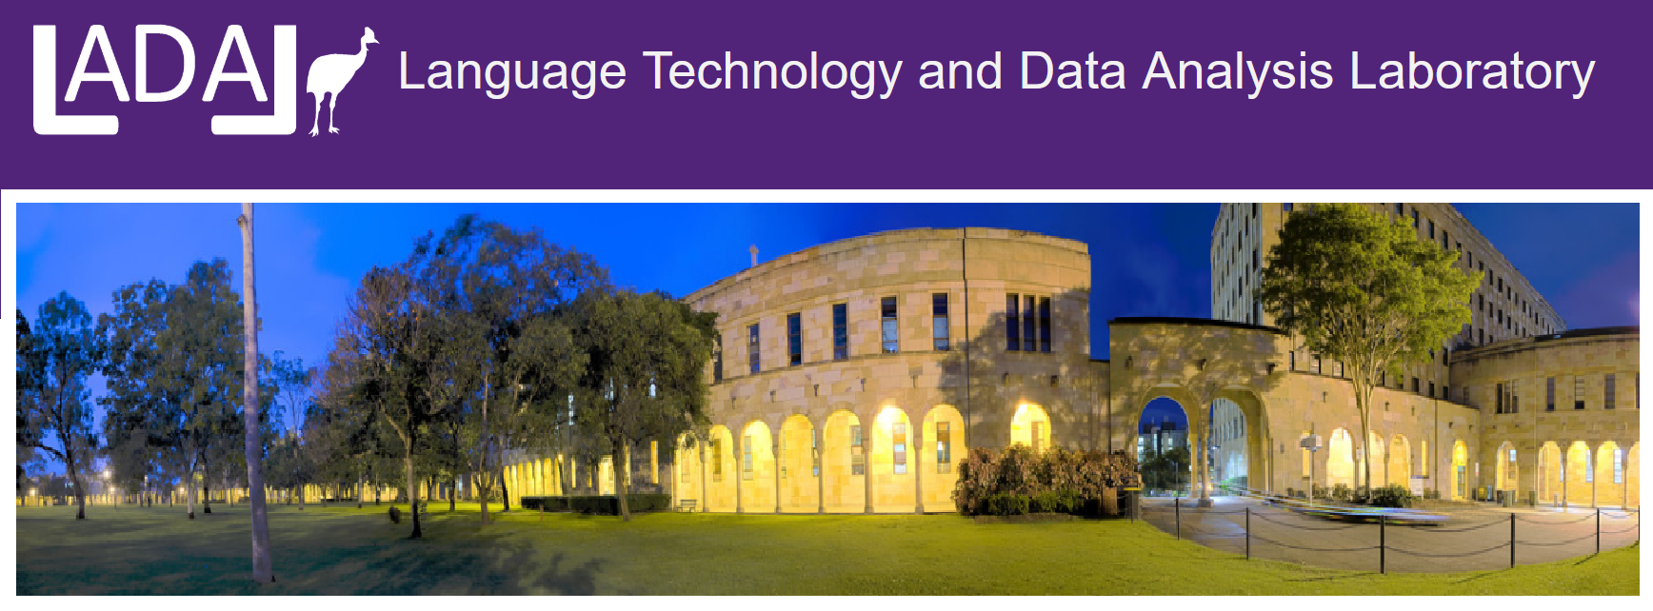
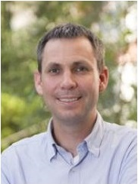
Language Technology and Data Analysis Laboratory (LADAL)
LADAL: https://ladal.edu.au
Free, open-source eResearch support infrastructure for computational HASS in the UQ School of Languages and Cultures
Aim
provide (notebook-based) resources for computational HASS (website tutorials and case studies, interactive notebooks, links, information, etc.)
organize events and community building (webinars, workshops, etc.)
People
Directors: Martin Schweinberger & Michael Haugh
Contributors: Sam Hames, Ben Foley plus various international experts
Michael Haugh (co-director of LADAL)

Slide 4
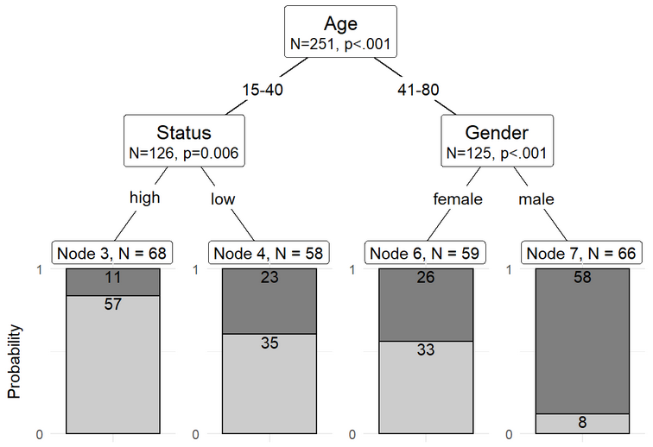
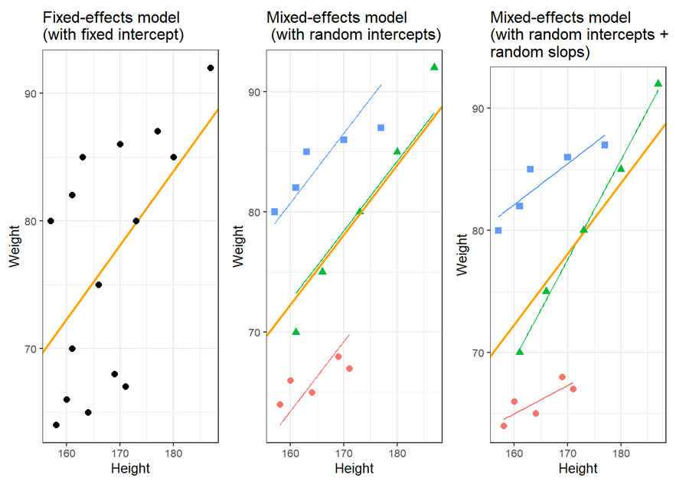
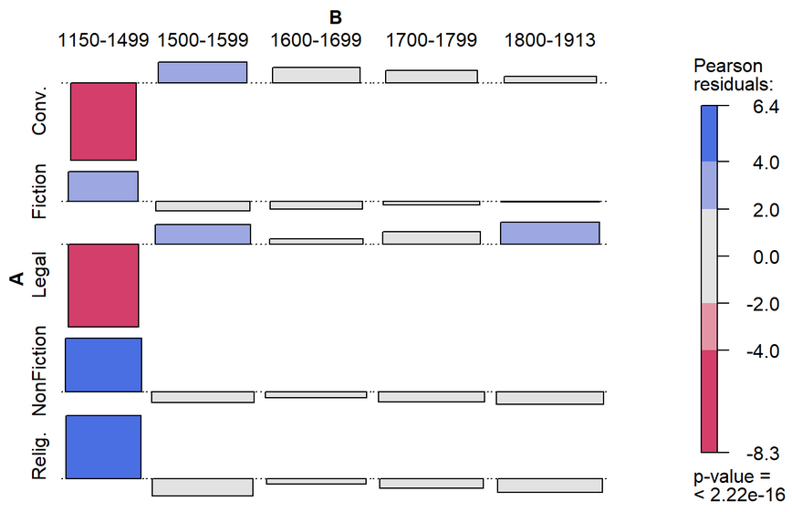
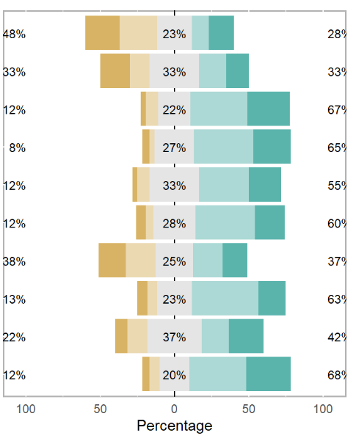
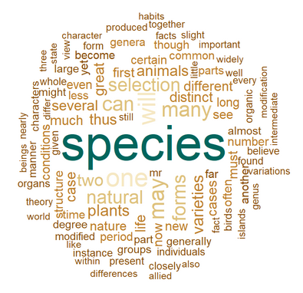
Language Technology and Data Analysis Laboratory (LADAL)
LADAL: https://ladal.edu.au
What does LADAL offer?
Provides free resources (notebooks) on
Digital tools (R | RStudio) and data management
Computational methods and (basic) programming skills
Data extraction / transformation / processing
Data visualization (including geospatial mapping and interactive web apps)
NLP applications and text analytics
Various statistical procedures (including classification and machine learning)

Slide 5
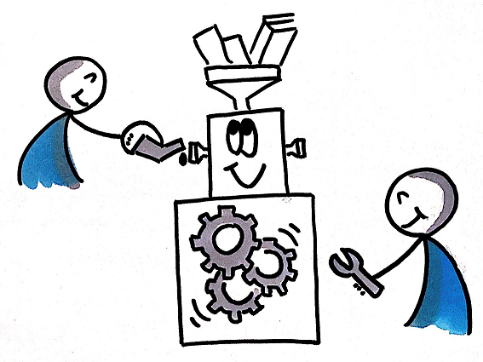

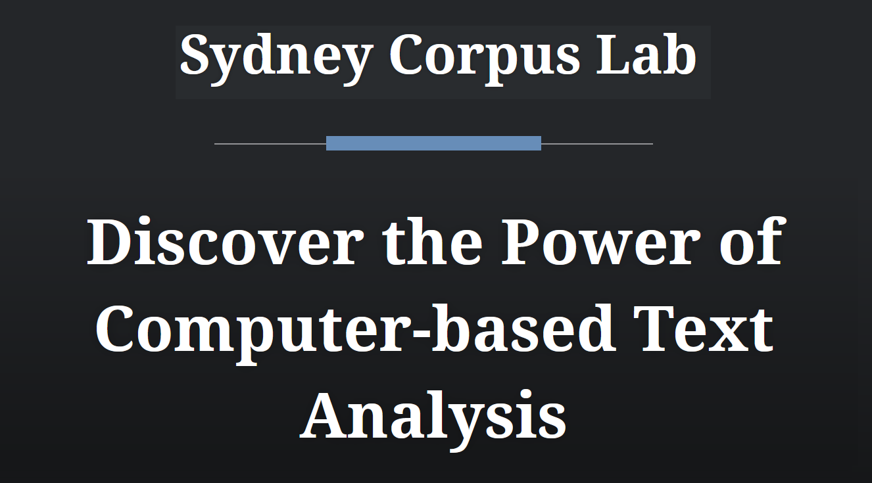

Language Technology and Data Analysis Laboratory (LADAL)
LADAL: https://ladal.edu.au
International Collaborations
Text Crunching Center (TCC) at UZH
Varieng at UHel
Syney Corpus Lab
AcqVA Aurora at UiT
(sharing of resources, reciprocal promotion, and assistance)

Slide 6
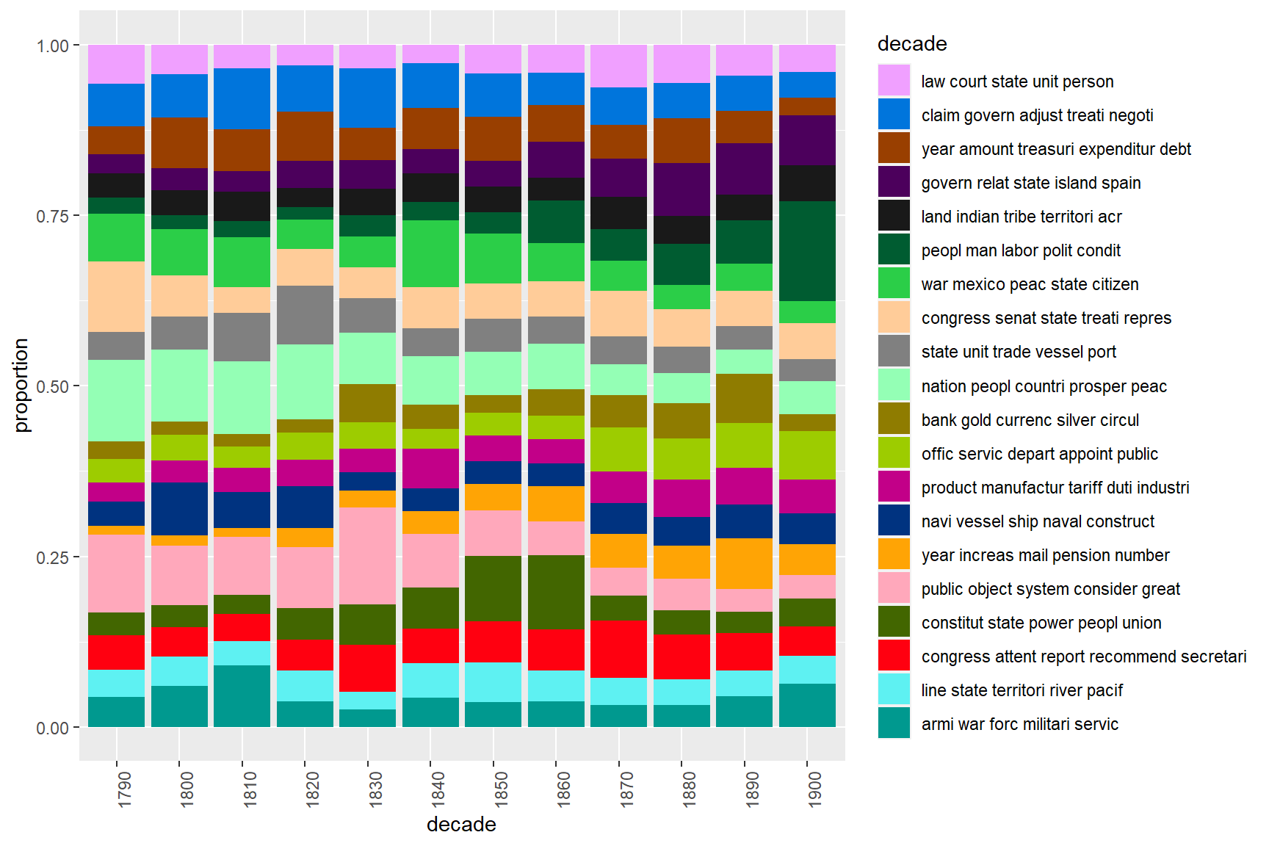
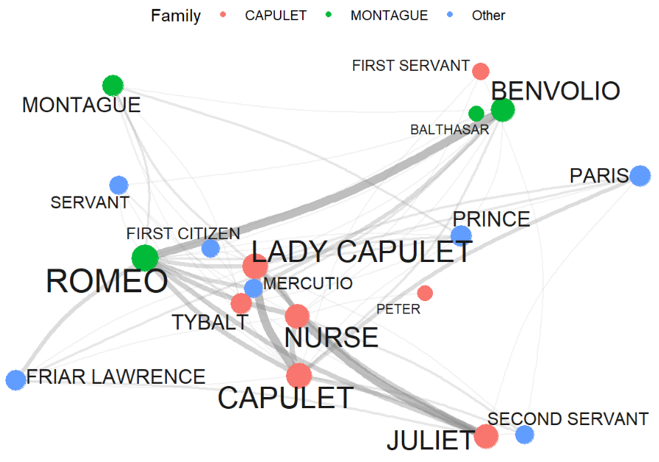
Language Technology and Data Analysis Laboratory (LADAL)
LADAL: https://ladal.edu.au
Distribution of topics in US State of the Union Addresses over time
What we hope to achieve?
Improve transparency and quality by showcasing how to produce reproducible workflows in R/RStudio)
Enable researchers to pursue new pathways by using innovative methods and new types of data
Improve data management, assist in making workflows tidier, more transparent and more efficient.
Provide an infrastructure for acquiring computational skills (relevant for academia | employability for graduates)
Showcase comp. methods can be used across HASS disciplines
Network of persons in Shakespeare’s Romeo and Juliet

Slide 7
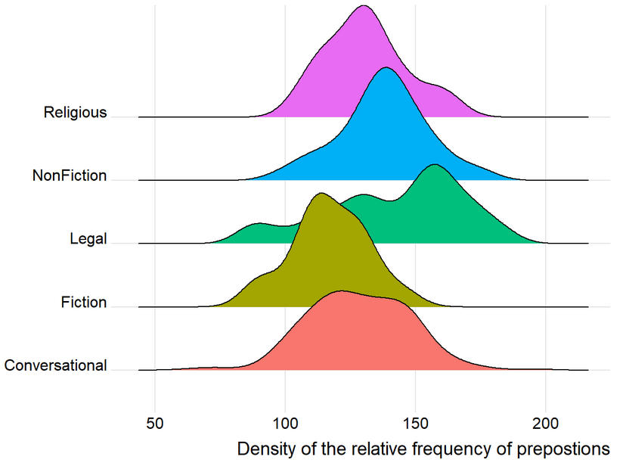
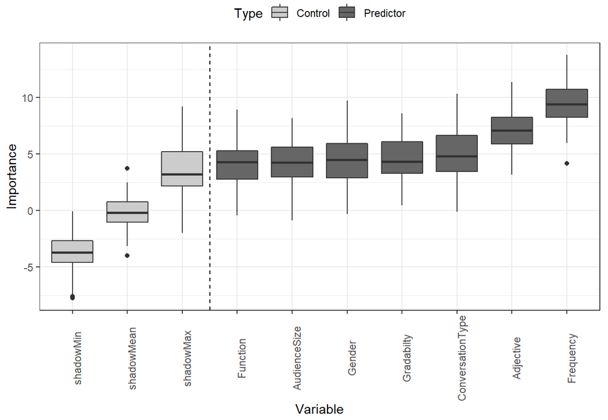
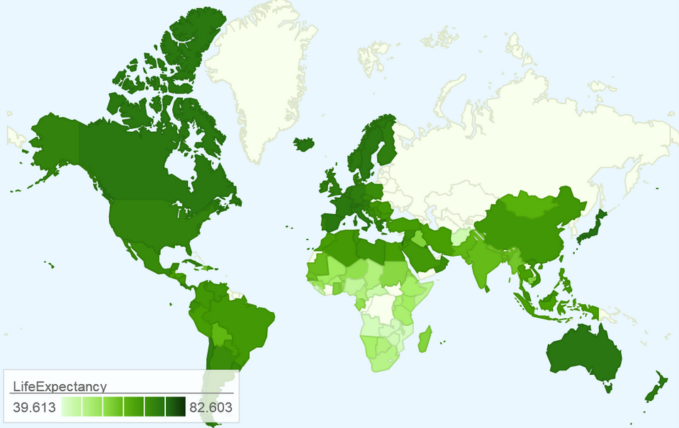
Language Technology and Data Analysis Laboratory (LADAL)
LADAL: https://ladal.edu.au
Key measure so far:
40 tutorials, case studies, and how-tos
15 interactive Jupyter notebooks (on Binder.org and Google Colab)
More than 450,000 page views
More than 250,000 different users
LADAL resources used all around the world (from university courses on quantitative methods in Norway to dashboards for medical school in California) by diverse users from various fields (from linguists to psychologists to artists)

Slide 8
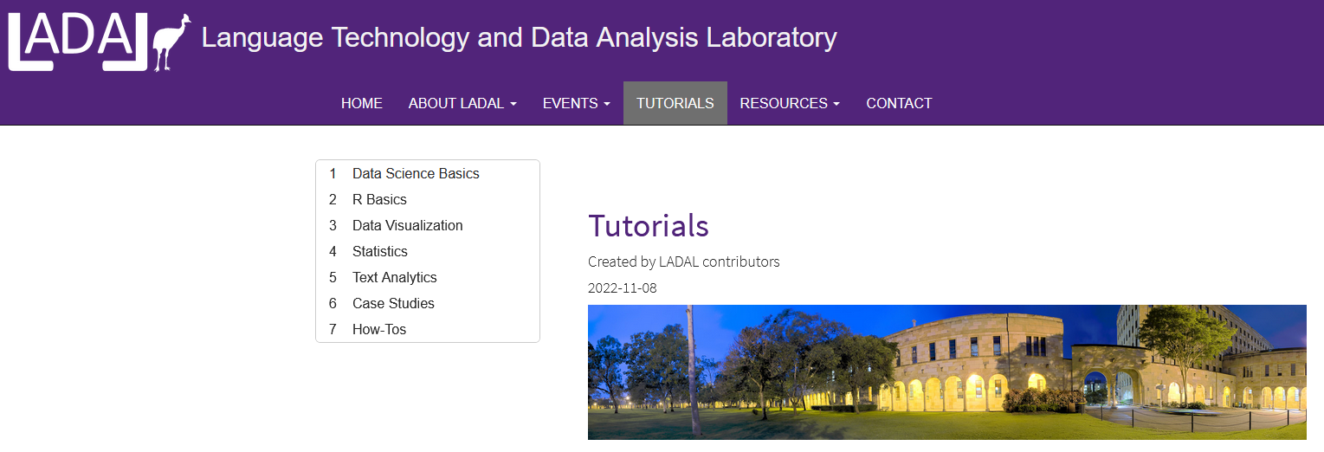
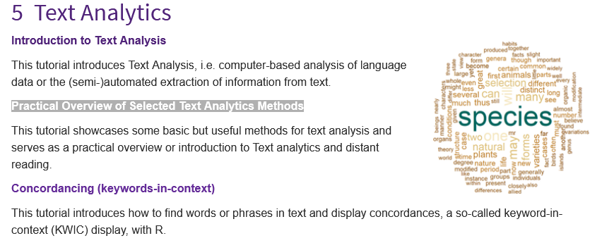
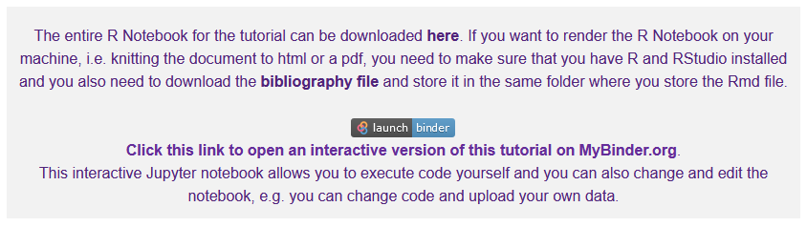
Language Technology and Data Analysis Laboratory (LADAL)
LADAL: https://ladal.edu.au
PRACTICE
Go to ladal.edu.au
Click on the tab TUTORIALS
Go to Text Analysis
Click on Practical Overview of Selected Text Analytics Methods
Click on the Binder.org link

