Slide 1



The Serious Business of “Bad” Language in English Why F%#$ Matters (and So Does “Like”)
Martin Schweinberger m.schweinberger@uq.edu.au materials and slides available at www.martinschweinberger.de
This research was partially funded by the Language Data Commons of Australia (LDaCA). Language Data Commons of Australia (LDaCA) (DOI: 10.3565/kq2v-9g52) is a co-investment partnership with the Australian Research Data Commons (ARDC) through the HASS and Indigenous Research Data Commons. The ARDC is enabled by the Australian Government’s National Collaborative Research Infrastructure Strategy (NCRIS). In addition, this research was partially funded by the Centre for Digital Cultures and Societies at the University of Queensland.

Slide 2
What do these five utterances have in common?
Like they're they're trying to breed […] a forty foot long tube chicken?
(Santa Barbara Corpus:sbc003$Roy)
you're a grubby cunt aren't you
(ICE-NZ: S1A-033$B)
You know big Jane like.
(ICE Ireland:S1A‐024$C)
what the fuck else do do you think I'm doing
(ICE-Aus: S1A-061$B)
That guy like provides the cash.
(ICE‐Canada:S1A‐020$B)
They‘re the words we‘re told to avoid that not considered important | relevant | interesting | proper | good
And they are not taught in scholl yet they are doing some of the heaviest social work in English.
Schweinberger: The Serious Business of “Bad” Language

Slide 3
The argument in one sentence
The “unnecessary” parts of language
are where the real work happens.
IDENTITY | EMOTION | POWER
Who we are, who we belong to | How we feel, how we react | Who‘s up, who‘s down
Schweinberger: The Serious Business of “Bad” Language

Slide 4
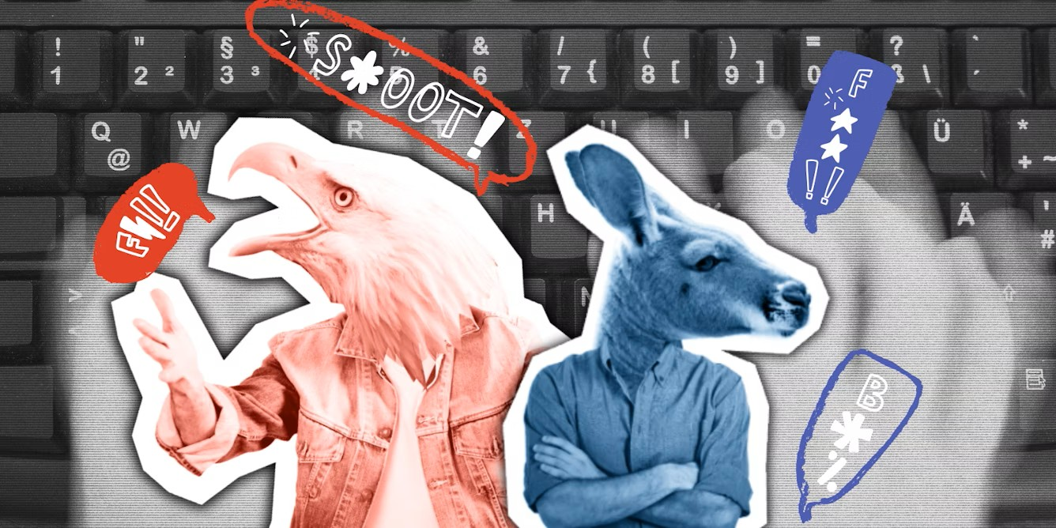
Outline – The Serious Business of “Bad” Language in English
Part 1: Background. Why I‘m interest in language “not taught at school”
Part 2: Small words, big consequences
Study 1: Discourse markers, like, and how listeners hear us (Dailey-O‘Cain, 2000)
Part 3: Vulgarity across contexts
Study 2: Vulgarity on the Web (Schweinberger & Burridge, 2025)
Study 3: Vulgarity in Face-to-Face Conversation (Schweinberger & Burridge, submitted)
Study 4: Vulgarity on Social Media (Schweinberger et al., 2026, in print)
Study 5: Vulgarity in Pop Music (Putensen & Schweinberger, submitted)
Part 4: Bringing it together – What we've learned – and why it matters
Schweinberger: The Serious Business of “Bad” Language

Slide 5
Part 1 Background Why I‘m interest in language “not taught at school”
Schweinberger: The Serious Business of “Bad” Language

Slide 6
Why show an interest in “bad” language?
“Bad” language is widely used, popular — but generally viewed unfavourably. People use it even when they don’t like it or don’t realise they do:
It's usually young females um when every other word is "like" and it drives me insane. I just like I hate it. (TOR/054; woman, Toronto, aged 55; Tagliamonte 2011: 6)
Socially relevant: speech patterns index social, cultural, and regional identity. Consider these excerpts: young or old? Male or female?
I don't know, it's jus' stuff that really annoys me. And I jus' like stare at him and jus' go . . . like, "huh". (YRK98/S014c; Tagliamonte 2006: 7)
It was sort-of just grass steps down and where I dare say it had been flower beds and goodness-knows-what . . . (YRK/v; Tagliamonte 2006: 7)
Schweinberger: The Serious Business of “Bad” Language

Slide 7
Why show an interest in “bad” language?
“Bad” language is widely used, popular — but generally viewed unfavourably. People use it even when they don’t like it or don’t realise they do:
It's usually young females um when every other word is "like" and it drives me insane. I just like I hate it. (TOR/054; woman, Toronto, aged 55; Tagliamonte 2011: 6)
Socially relevant: speech patterns index social, cultural, and regional identity. Consider these excerpts: young or old? Male or female?
I don't know, it's jus' stuff that really annoys me. And I jus' like stare at him and jus' go . . . like, "huh". (YRK98/S014c; Tagliamonte 2006: 7) young woman, aged eighteen
It was sort-of just grass steps down and where I dare say it had been flower beds and goodness-knows-what . . . (YRK/v; Tagliamonte 2006: 7) female, aged seventy-nine
Schweinberger: The Serious Business of “Bad” Language

Slide 8
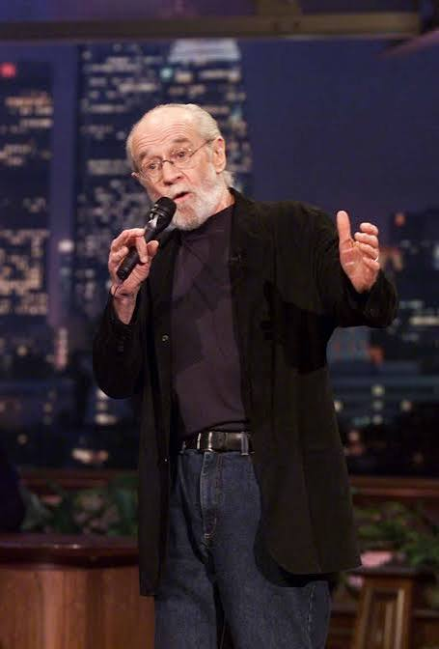
Why show an interest in “bad” language?
Bad language is linguistically functional.
These features do concrete work:
Expressivity: communicating attitude, emotion, evaluation
Stance-taking: positioning oneself relative to what’s being said
Identity marking: signalling age, region, group, alignment
Humour, bonding, and play: George Carlin routines, but also everyday banter
Attention direction: focuser like, discourse-marker you know
Comprehension support: helping interlocutors track new information
“Fitting-in”: the pragmatic skill of matching your register to the room
Schweinberger: The Serious Business of “Bad” Language

Slide 9
Why show an interest in “bad” language?
Using vulgarity appropriately requires substantive pragmatic proficiency and linguistic awareness
Difference between actual, natural language use and what is taught in school
Social and regional differences in how English is spoken
Differing socio-cultural norms across social, cultural, and geographic spaces and settings
Socially relevant: expressivity, stance-taking, identity marking, humour, and “fitting-in”
“Bad language” is better than its reputation!
Discourse markers, vulgarity and swearing are highly (multi-)functional Bad language is linguistically as well as socially and pragmatically rich phenomenon that offers insights into a wide range of communicative, cultural, and cognitive processes
Schweinberger: The Serious Business of “Bad” Language

Slide 10
Part 2 Small words, big consequences Discourse markers, like, and how listeners hear us
Schweinberger: The Serious Business of “Bad” Language

Slide 11
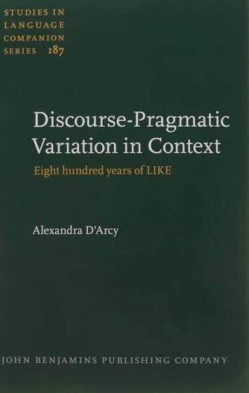
What are discourse particles?
Definition
Optional, meaning-light items with no clear grammatical function — but pragmatically loaded (Schiffrin 1986; Brinton 1996).
Examples in English: like, you know, well, just, sort of, I mean, actually…
Functions include
Initiating, sustaining, or repairing discourse
Marking boundaries or sequential dependence
Signalling new or old information
Managing information flow in informal speech (Brinton 1996: 36–38)
Schweinberger: The Serious Business of “Bad” Language

Slide 12
Study 1: Does “like” change how you are seen? (Dailey-O’Cain, 2000, Journal of Sociolinguistics 4(1): 60-80)
Schweinberger, M., & Burridge, K. (2025). Vulgarity in online discourse around the English-speaking world. Lingua, 321, 103946. https://doi.org/10.1016/j.lingua.2025.103946

Slide 13
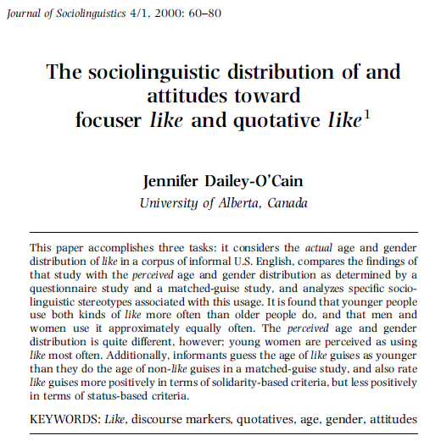
Does “like” change how you are seen?
Study design
Corpus study 30 speakers, informal interviews, middle-class southeastern Michigan. Stratified by age (14–29, 30–49, 50–69) and gender. 671 occurrences of like coded (576 focuser, 95 quotative).
Questionnaire 40 informants asked about perceived age/gender distribution of like and their own use.
Experiment Eight one-minute recordings from four speakers (two age groups, both genders). Each recording in two versions: with like (12–15 tokens per minute) and without (every like digitally removed). 40 listeners rated each recording on nine traits (attractive, cheerful, educated, intelligent, friendly,…). They didn’t know they were listening to the same speaker twice. Innovation: Same speaker, same voice, same content — only like varies.
Schweinberger: The Serious Business of “Bad” Language

Slide 14
Does “like” change how you are seen?
Study design
Corpus study 30 speakers, informal interviews, middle-class southeastern Michigan. Stratified by age (14–29, 30–49, 50–69) and gender. 671 occurrences of like coded (576 focuser, 95 quotative).
Questionnaire 40 informants asked about perceived age/gender distribution of like and their own use.
Experiment Eight one-minute recordings from four speakers (two age groups, both genders). Each recording in two versions: with like (12–15 tokens per minute) and without (every like digitally removed). 40 listeners rated each recording on nine traits (attractive, cheerful, educated, intelligent, friendly,…). They didn't know they were listening to the same speaker twice. Innovation: Same speaker, same voice, same content — only like varies.
Schweinberger: The Serious Business of “Bad” Language

Slide 15
Perception Effects
WITH “like”, speakers were rated MORE
attractive (p < .001)
cheerful (p < .0001)
friendly (p < .0001)
successful (p = .003)
WITH “like”, speakers were rated LESS:
educated (p < .005)
intelligent (n.s.)
interesting (n.s.)
Additional finding older speakers using like are perceived as younger (mean 24.1 vs 29.2 years without like, p < .001 interaction); younger speakers are perceived as young either way.
Schweinberger: The Serious Business of “Bad” Language

Slide 16
Two dimensions of language attitudes
Principal components factor analysis of the trait ratings yielded two factors (Dailey-O'Cain 2000)
Factor 1: STATUS (successful, reliability, responsibility, intelligence, educated)
Factor 2: SOLIDARITY (friendliness, cheerfulness, attractiveness)
These dimensions are found across speech communities studied via matched-guise since Lambert et al. (1960) (see Agheyisi & Fishman 1970 for a review).
The trade-off Using like raises solidarity ratings and lowers status ratings — the same feature does both, simultaneously.
Analogy to vernacular speech more generally Non-standard forms carry negative status connotations but positive solidarity connotations (Labov 1972; Milroy 1987: 181–183). This same trade-off applies to swearing (which is where we go next).
Schweinberger: The Serious Business of “Bad” Language

Slide 17
Part 3 Vulgarity across contexts Vulgarity on the Web, in Face-to-Face Conversation, and on Social Media
Schweinberger: The Serious Business of “Bad” Language

Slide 18
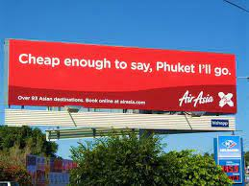
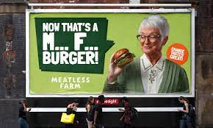

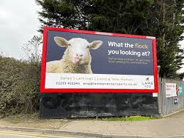
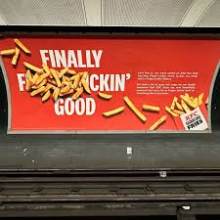
Brief overview of what we know
Categories of Swearing
Social swearing: positively charged (social bonding, banter) Vulgarity as part of humour (see George Carlin, Seizer 2011)
Annoyance swearing: negatively charged (emotional relief, catharsis) e.g., cussing at other drivers in traffic
Linguistically motivated use of vulgarity e.g. intensification, e.g., fucking as an adjective amplifier (Martínez & Pertejo 2012)
Schweinberger: The Serious Business of “Bad” Language

Slide 19
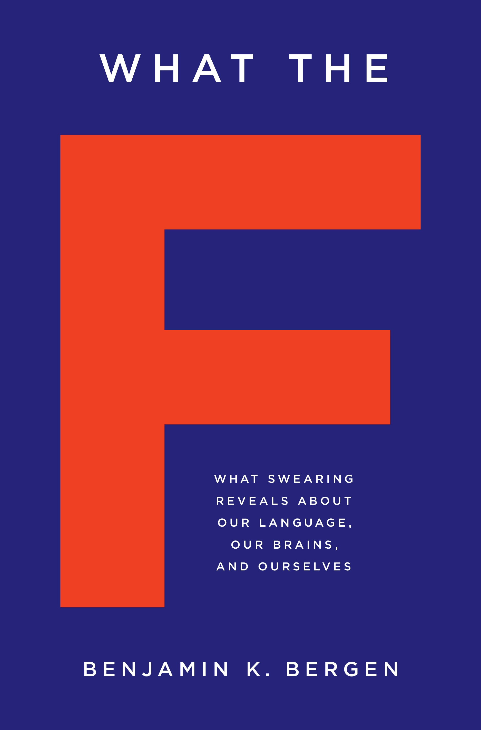
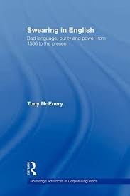
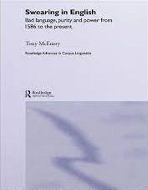
Brief overview of what we know
Social Stratification
Age: most common among adolescent (McEnery 2006) and middle-aged speakers (Schweinberger 2018)
Gender: Men swear more than women and they use “stronger” bad language words (BLWs) (Love 2021, McEnery 2006, Schweinberger 2018, Stenström 2006, McEnery and Xiao 2004) – contradicting studies show no gender difference (Drummond 2020) or that female speakers use fucking as an intensifier more than males “to mark their linguistic independence” (Aijmer 2018: 91)
Time: Swearing has decreased in informal British English between 1994 and 2014 (Love 2014)
Social class : findings do not show a consistent patterning (see Stenström 2006 for an overview)
Schweinberger: The Serious Business of “Bad” Language

Slide 20
What counts as vulgar?
Difficulty of definitions
What counts as swearing | bad language | cussing | impoliteness | offensive | hate speech | taboo language | insult | vulgarity?
Problematic examples
taboo language? If it were taboo, it would not be such a common and systematic phenomenon
literal vs metaphoric John fucked Jane (not considered swearing when used literally (by some))
offensive terms / insults pedophile, nazi, fascist, etc.
Our approach: focus on vulgarity!
Start: word lists based on pervious research and online moderation (781 items)
Criteria does the word have a less vulgar synonymous counterpart?
fuck | shag vs make love | sleep with, etc.
ass | arse vs behind | bottom, etc.
Is the term marked as vulgar in the OED
pedophile, idiot, penis (can be insults but not vulgar)
English only (not considered: bastardo, arschloch, etc.)
Spelling variation: phuk, fak, fuuuuck, etc. → fuck (lemma)

Slide 21
Study 2: Vulgarity on the Web (Schweinberger & Burridge, 2025, Lingua 321, 103946)
Schweinberger, M., & Burridge, K. (2025). Vulgarity in online discourse around the English-speaking world. Lingua, 321, 103946. https://doi.org/10.1016/j.lingua.2025.103946

Slide 22
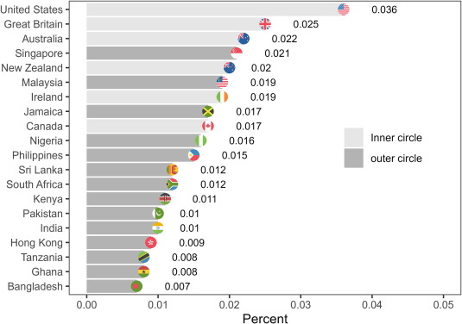
Who is most vulgar online?
Research Questions
How frequent is vulgar language in online discourse across the 20 different English-speaking regions represented in GloWbE?
What vulgar elements are used in the data and are there region-specific differences or preferences?
Is there are difference in the variability (creativity) of vulgar elements that are used?
Data: Global Web-Based Corpus of English (GloWbE) (Davies & Fuchs, 2014)
Consisting of 1.7 billion words across 20 regions
Informal blog content (~ 60%) and a wide range of other web-based materials (~40 %)
Schweinberger: The Serious Business of “Bad” Language

Slide 23
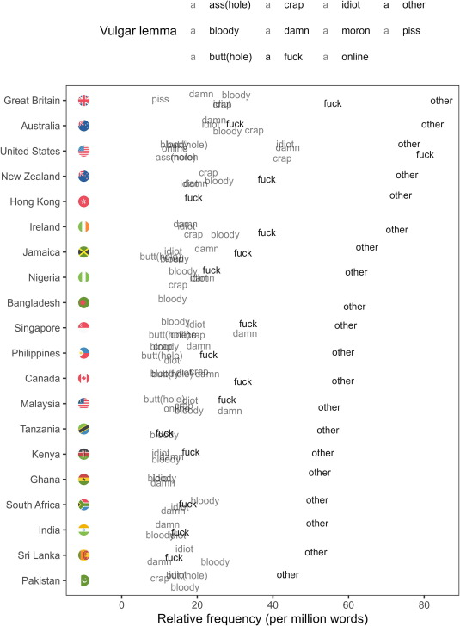
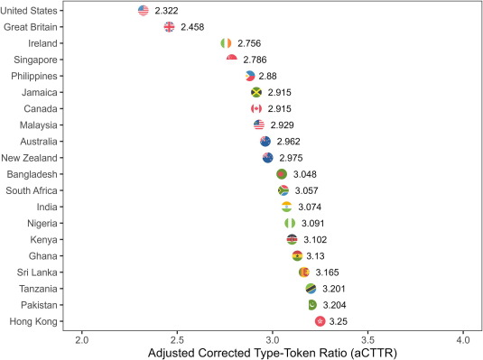
Who is most vulgar online?

Slide 24
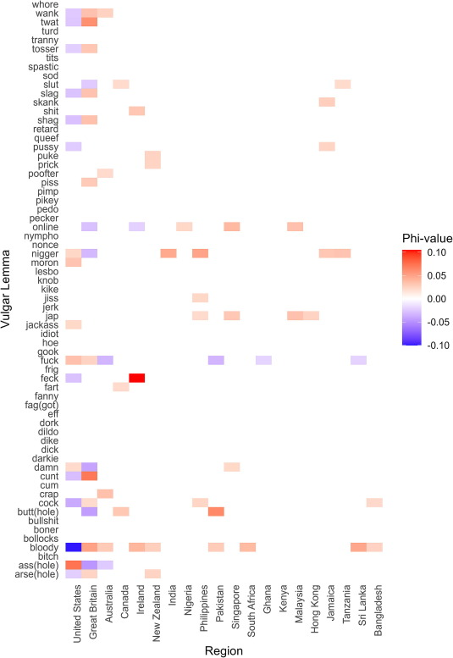
Who is most vulgar online?
Results of the CFA analysing significant preferences (types) for and avoidance (antitypes) of vulgar lemmas across English-speaking regions.
Region | Vulgar lemma | Type | Observed | Exp | X²-value | Q-value | Bonferroni-corrected p | Phi-value
Ireland | feck | Preferred | 546 | 56.6 | 4228.3 | 0.00127 | < 0.001*** | 0.105
United States | ass(hole) | Preferred | 5395 | 2938.1 | 2054.4 | 0.00643 | < 0.001*** | 0.073
Great Britain | cunt | Preferred | 2074 | 817.4 | 1932 | 0.00327 | < 0.001*** | 0.071
Pakistan | butt(hole) | Preferred | 842 | 239.6 | 1514.5 | 0.00157 | < 0.001*** | 0.063
United States | bloody | Avoided | 5205 | 12039.1 | 3879.5 | 0.01832 | < 0.001*** | −0.1

Slide 25
Key Findings
Users in the US lead in terms of use of vulgarity
Vulgarity is notably more frequent in inner-circle varieties – particularly the US, UK, and Australia – than among users from outer circle varieties.
Similarly, users from inner-circle varieties are more creative (show higher variability) in the use of English(!) vulgarity.
Vulgarity is more likely to surface in blog data compared to general web data (probably due to the more personal and less corporate style and content)
There are some regional preferences for specific forms reflecting dialectal language use.
Schweinberger: The Serious Business of “Bad” Language

Slide 26
Problems | Limitations
Corpus related
Corpus quite “noisy” (e.g., includes texts from other regions and literary texts)
General
“True” behavior hard to capture – users are aware that their data is available publicly
There is likely content moderation at play – the extend will likely vary across regions
Outer-circle speakers are likely using non-English forms of vulgarity
Norm around what users feel comfortable with sharing online differ across regions (stylistic rather than behavioral or linguistic difference)
Schweinberger: The Serious Business of “Bad” Language

Slide 27
Study 3: Vulgarity in Spoken Interaction (Schweinberger & Burridge, submitted, Lingua)
Schweinberger, M., & Burridge, K. Vulgarity in spoken interaction across selected varieties of English [Manuscript in preparation]. English World-Wide.

Slide 28
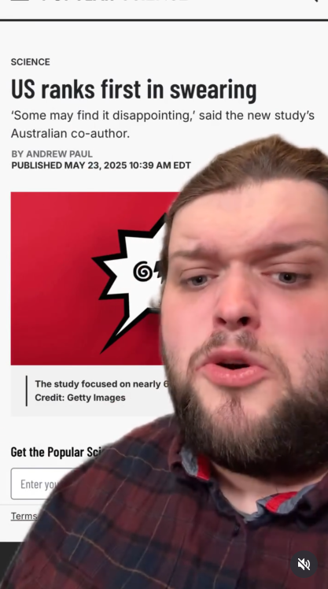
Motivation
When presenting the results on vulgarity online, the most common question was:
Some reactions were quite emotional, and people felt “offended” that their regional variety was not further up in the list!
Data
International Corpus of English (ICE)
Spoken sections of ICE Australia, Canada, East Africa (Kenya & Tanzania), Great Britain, Hong Kong, Ireland, India, Jamaica, New Zealand, Philippines, Sri Lanka, Singapore, and the Santa Barbraa Corpus of Spoken American English
What would results be
if you looked at face-to-face interaction?!
Schweinberger: The Serious Business of “Bad” Language

Slide 29
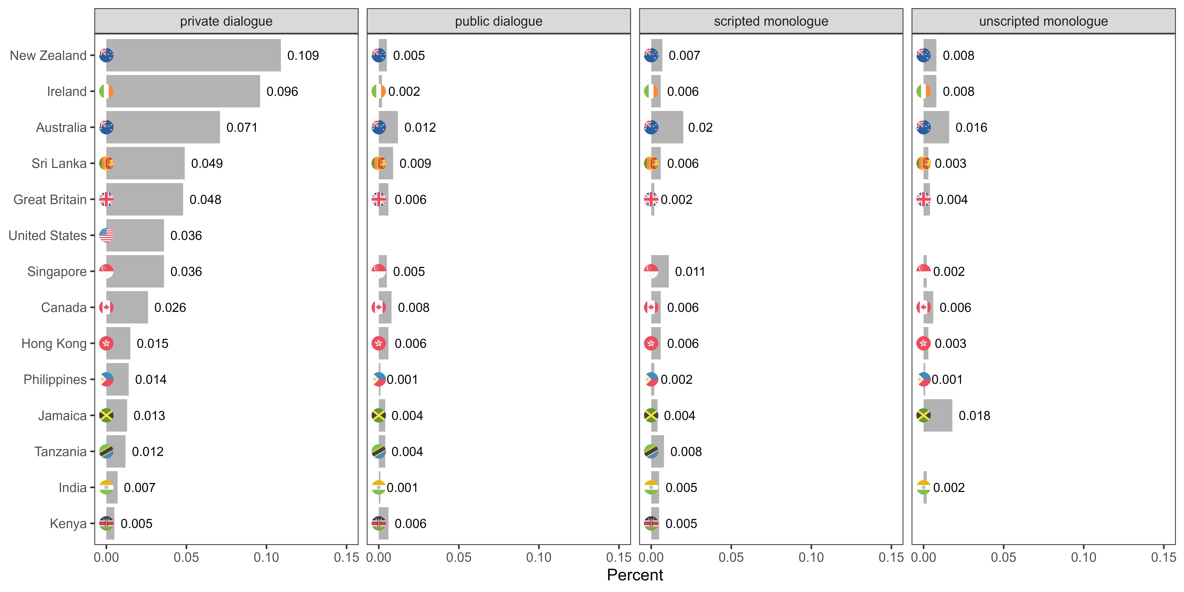
of tokens

Slide 30
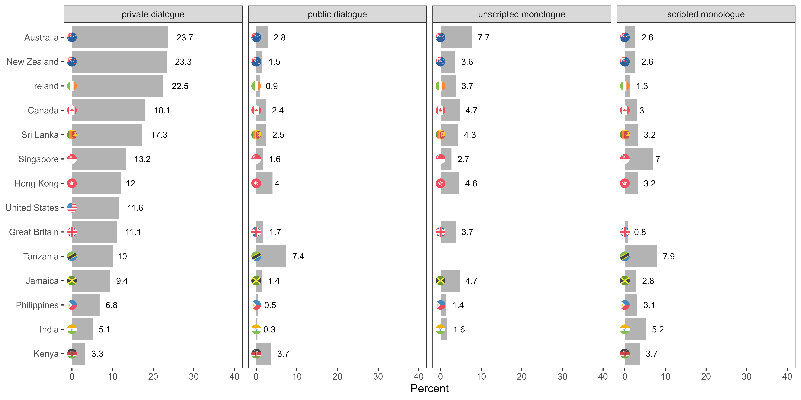
of speakers

Slide 31
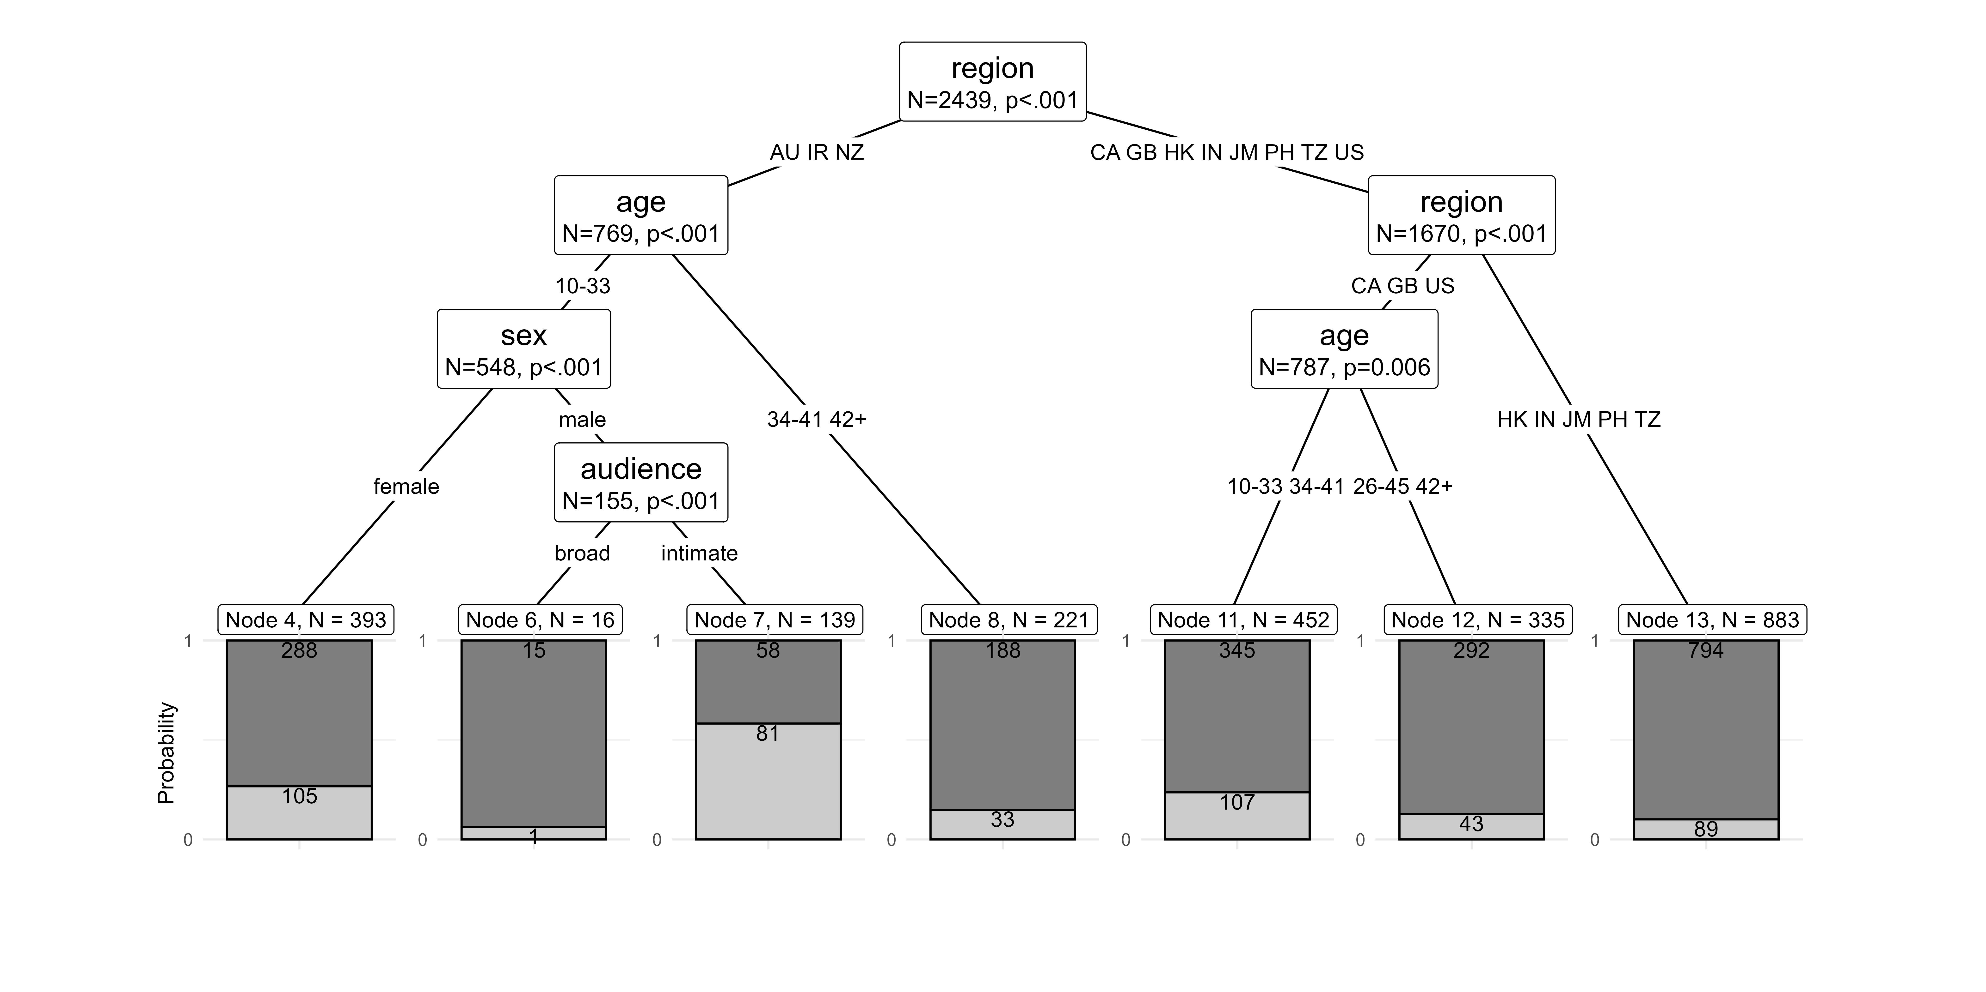
Findings
Schweinberger: Vulgarity in World Englishes

Slide 32
Key Findings
Vulgarity is notably more frequent in informal private dialogues than in public-stage talk or monologues intended for broader audiences.
Speakers from inner circle varieties use more vulgarity in face-to-face conversations than speakers from outer circle varieties.
Unlike online discourse, US speakers are less prominent in face-to-face vulgarity use.
In contrast, nativized post-colonial varieties (Ireland, New Zealand, Australia) show higher frequencies of vulgar expressions.
Australians have the highest share of speakers who use vulgarity in face-to-face settings and are less sensitive to register effects.
Prior research regarding sociolinguistic constraints are supported and expanded: young speakers use more vulgarity. Young women use vulgarity regardless of audience size, young men use vulgarity significantly more in intimate settings rather than with a broad audience.
Schweinberger: The Serious Business of “Bad” Language

Slide 33
Problems | Limitations
Data-related
Despite being intended for cross-cultural comparisons – are quite heterogeneous and inconsistent (structure, transcription convention, coverage, sociodemographic information, etc.).
Focus of ICE on educated speakers – very little data from working class speakers.
Some data quite “old” by now (time of data collection as a confound)
General
“True” behavior hard to capture – speakers are still aware that they are recorded.
How representative are the ICE components?
Schweinberger: The Serious Business of “Bad” Language

Slide 34
Study 4: Vulgarity on Social Media (Schweinberger et al., 2026, Digital Scholarship in the Humanities, Schweinberger et al., fc., Corpora)
Schweinberger, M., Laitinen, M., Haugh, M., Rautionaho, P., Fatemi, M., Hames, S., & Takahashi, M. F%$# Twitter: A corpus-based analysis of vulgar language on Twitter [Manuscript submitted for publication]. Corpora.
Schweinberger, M., Haugh, M., Laitinen, M., Fatemi, M., Hames, S., Rautionaho, P., & Takahashi, M. Swearing online: Exploring dimensions of variability in born-digital data [Manuscript submitted for publication]. Digital Scholarship in the Humanities.

Slide 35
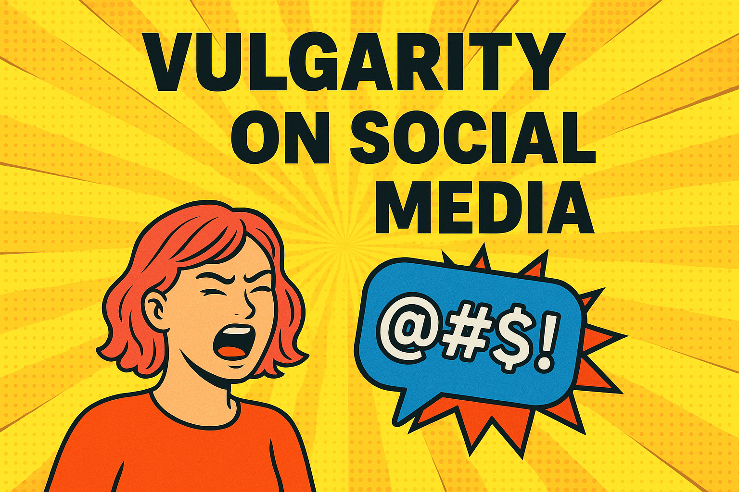
Research Questions
How frequent is vulgarity on Twitter by users from the United States, United Kingdom, and Australia?
What forms of vulgarity are used on Twitter in the United States, United Kingdom, and Australia?
What topics are associated with vulgarity on Twitter and are there regional/cultural differences?
Do we see temporal patterns in the use of vulgarity on Twitter by users from the United States, United Kingdom, and Australia?
What social-media specific factors impact the use of vulgarity on Twitter?
Schweinberger: The Serious Business of “Bad” Language

Slide 36
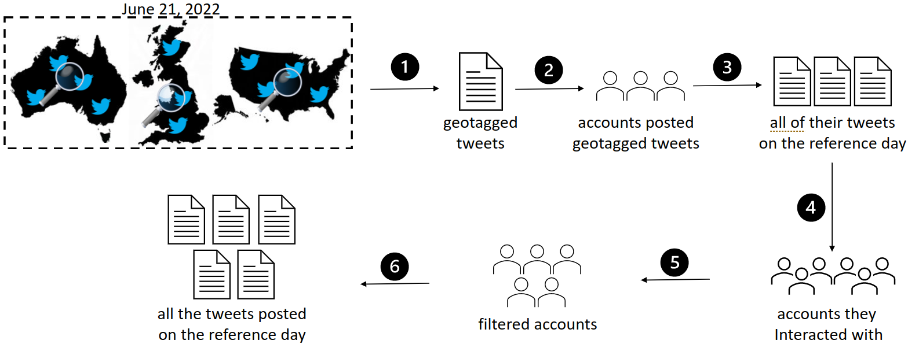
Soical Media Data
Tweets collected on June 21, 2022 by a selection of tweets from Twitter users from the United States, United Kingdom, and Australia collected by the Australian Digital Observatory at QUT as well as collaborators at FIN-CLARIAH and UQ
Information about the tweet (location, when created, reply, retweet)
Information about the user (followers, following, verified)
The text of the tweet
Location of users
Geotagged users served as seed accounts – then crawled their networks, and finally filtered the harvested data for accuracy
Schweinberger: Vulgarity in World Englishes

Slide 37
Final Data Set
 | Tokens (N) | Tweets (N) | Users (N) | Avg. Length Tweet
Australia | 1,449,292 | 99,404 | 7,647 | 14.6
United Kingdom | 7,883,971 | 538,661 | 51,514 | 14.6
United States | 27,398,975 | 2,090,972 | 184,711 | 13.1
Total | 36,732,238 | 2,729,037 | 243,872 | 13.5
Vulgarity Overview
 | Users of vulgarity (%) | Vulgar Tokens N (%) | Vulgar Tweets N (%)
Australia | 46.8 | 3,906 (0.27) | 3,581 (3.60)
United Kingdom | 36.9 | 20,655 (0.26) | 19,005 (3.53)
United States | 52.9 | 108,175 (0.39) | 97,748 (4.67)
Total | 49.3 | 132,736 (0.36) | 120,334 (4.41)
Schweinberger: The Serious Business of “Bad” Language

Slide 38
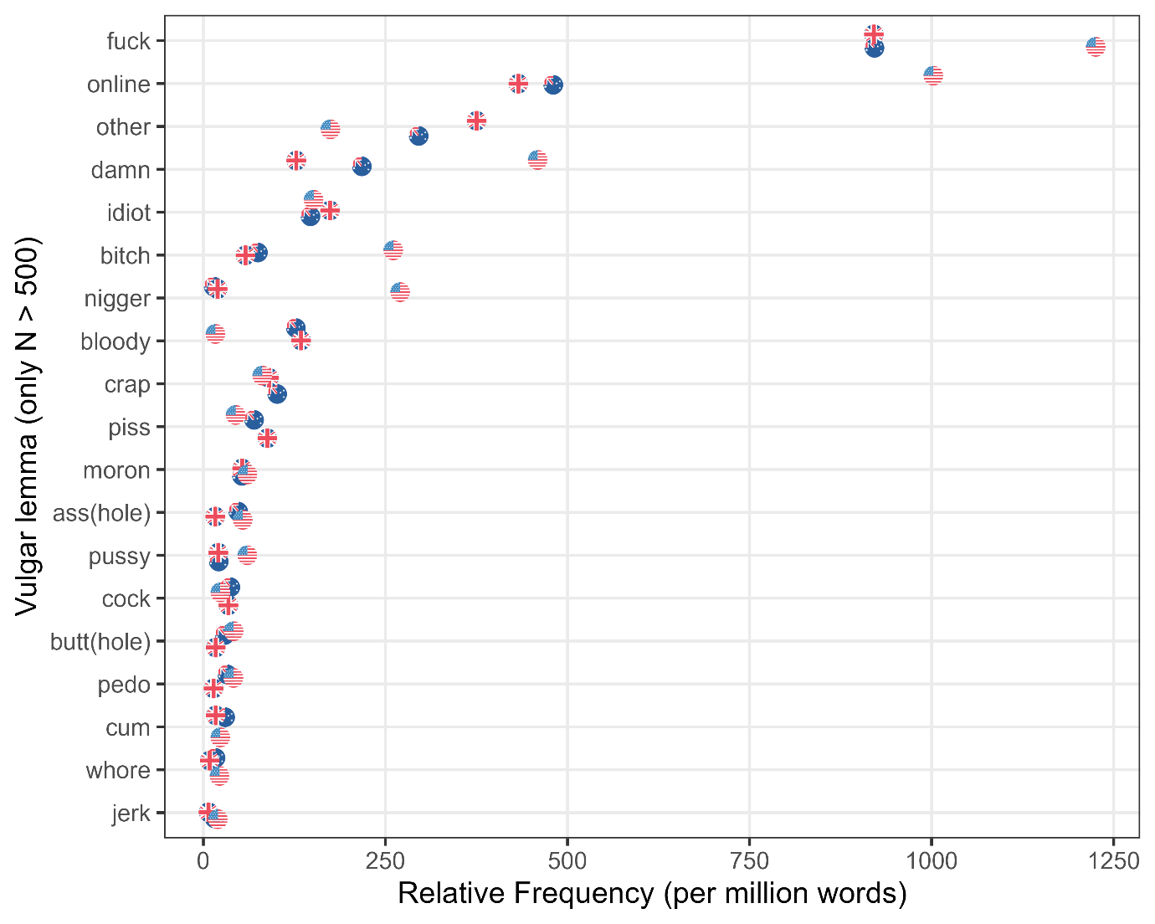
Schweinberger: Vulgarity in World Englishes

Slide 39
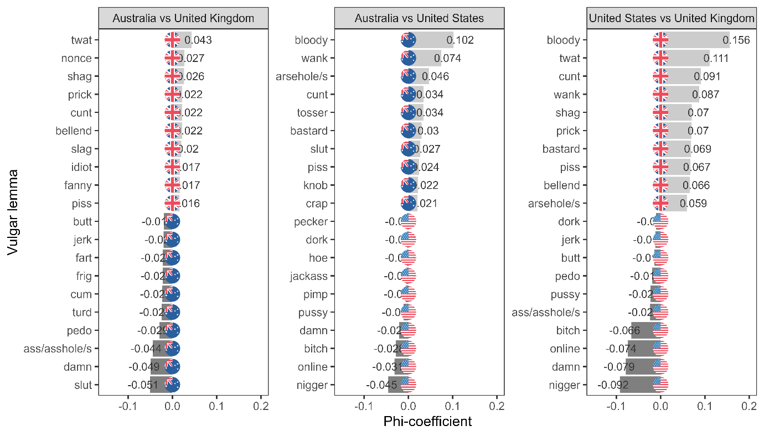
Schweinberger: Vulgarity in World Englishes

Slide 40
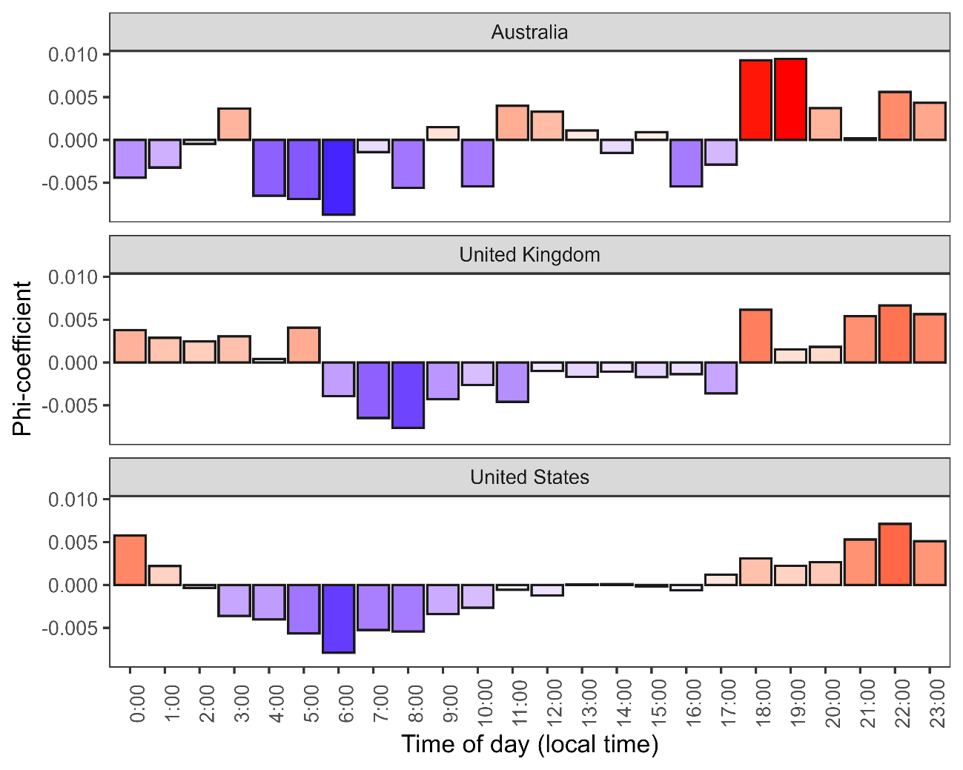
Schweinberger: Vulgarity in World Englishes

Slide 41
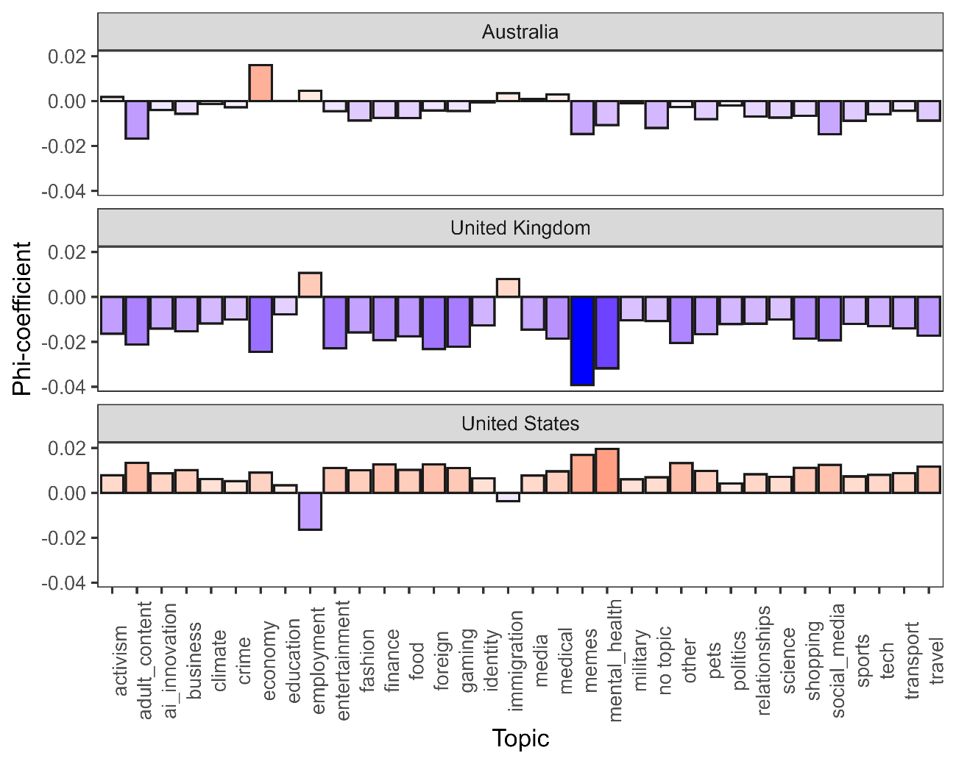
Schweinberger: Vulgarity in World Englishes

Slide 42
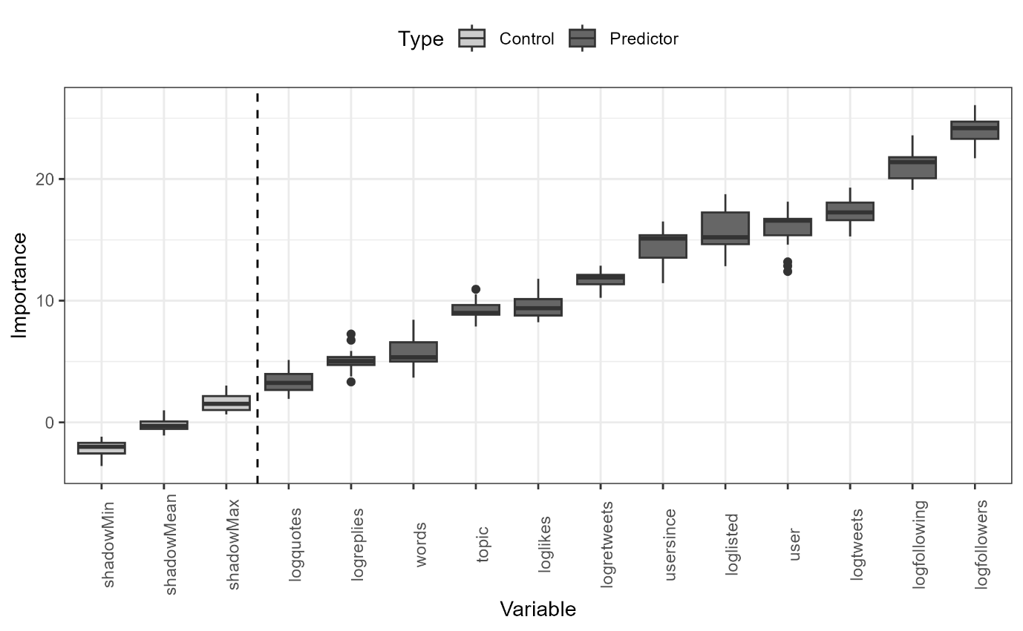
What factors impact the use of vulgarity online?
Combination of Boruta (to identify factors) and Regression (to determine direction and size of effect) effectively identifies factors associated with the use of vulgar language.
Network size effect: Users with larger social networks (more followers/following) are more likely to use vulgar language, whereas tweets with higher engagement (likes, retweets, replies) are slightly less likely to include it.
Topical variation: Vulgarity is most common in informal or expressive topics such as memes, adult content, fashion, pets, science, and employment.
Formal context restraint: Vulgarity is least common in professional, institutional, or policy-focused discussions (e.g., immigration, business, education, military, relationships).
Overall pattern: Vulgar language thrives in playful and socially expressive contexts but is constrained in formal or information-driven domains.
Schweinberger: The Serious Business of “Bad” Language

Slide 43
Key Findings
Social Media offers genuinely new insights into the use of vulgarity
Vulgarity is quite common (0.36 % of tokens & 4.4% of tweets) with users from the United States using most vulgarity
Vulgarity rates drop during working hours and increase towards late evening, except for Australian users where there is a notable peak right after coming home from work.
US users avoid vulgarity in discourse around work and employment, Australian users use vulgarity when tweeting about the work and the economy, UK users overuse vulgarity in the contexts of education and immigration.
Users with larger social networks (more followers/following) are more likely to use vulgar language, whereas tweets with higher engagement (likes, retweets, replies) are slightly less likely to include it.
Schweinberger: The Serious Business of “Bad” Language

Slide 44
Problems | Limitations
Social Media related
We cannot tap into social characteristics of users (age, gender, etc.) although we know(!) that these factors matter
There is automated content moderation which affects the use of vulgarity on social media
Tweets are very short which is sub-optimal for topic modelling (determining discursive topics)
General
Focus on English and neglect of emojis, etc.
Data represents a snapshot while longitudinal data would help reveal trends over time
Schweinberger: The Serious Business of “Bad” Language

Slide 45
Study 5: Vulgarity in Pop Music (Putensen & Schweinberger, submitted, Pop Goes Profanity, Journal of Language and Pop Culture)
Putensen, L. & Schweinberger, M. Pop Goes Profanity: Vulgarity Trends in English Chart Hits From 2000 to 2024 [Manuscript submitted for publication]. Journal of Language and Pop Culture.

Slide 46
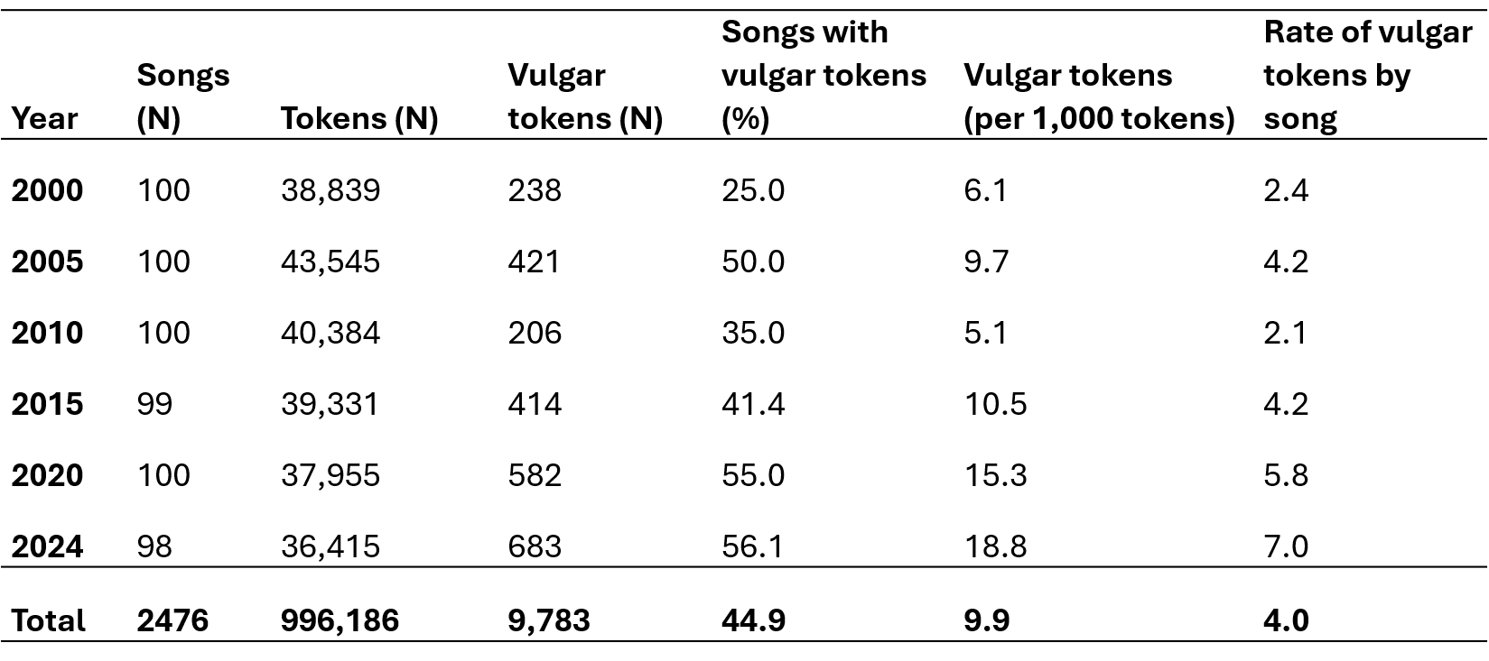
Who is most vulgar in pop music?
Research Questions
How has the frequency of vulgar words in mainstream chart hits evolved over the past 25 years, and which words are most salient?
How do artist demographics – such as gender, nationality, and group status – along with song characteristics (genre and chart performance) influence the occurrence vulgarity?
How do lyrical themes correlate with the presence of vulgar language, and what social meanings emerge from these associations?
Data Corpus of ~2,500 songs* from Billboard Year-End Hot 100 (2000–2024)
Schweinberger: The Serious Business of “Bad” Language

Slide 47
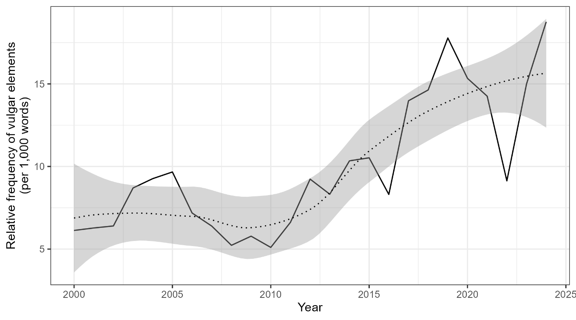
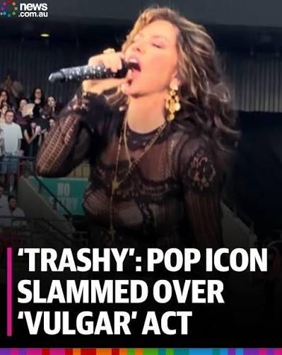
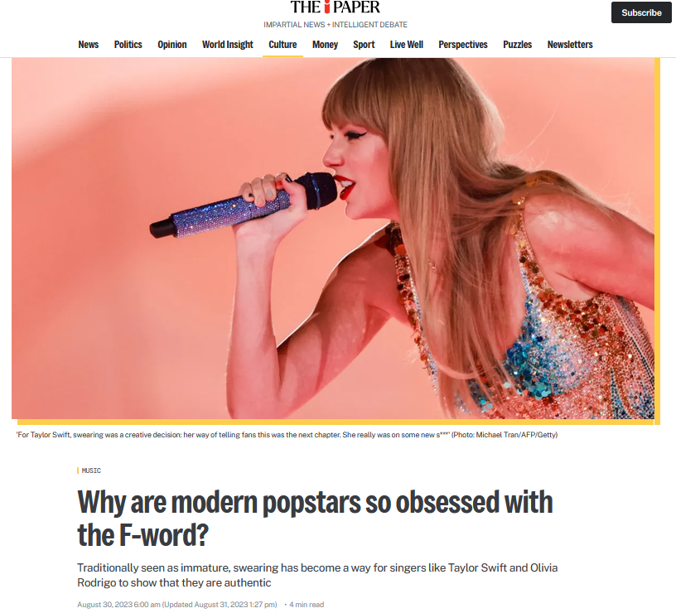
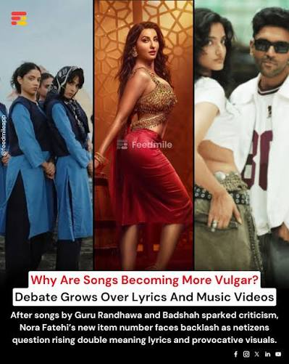
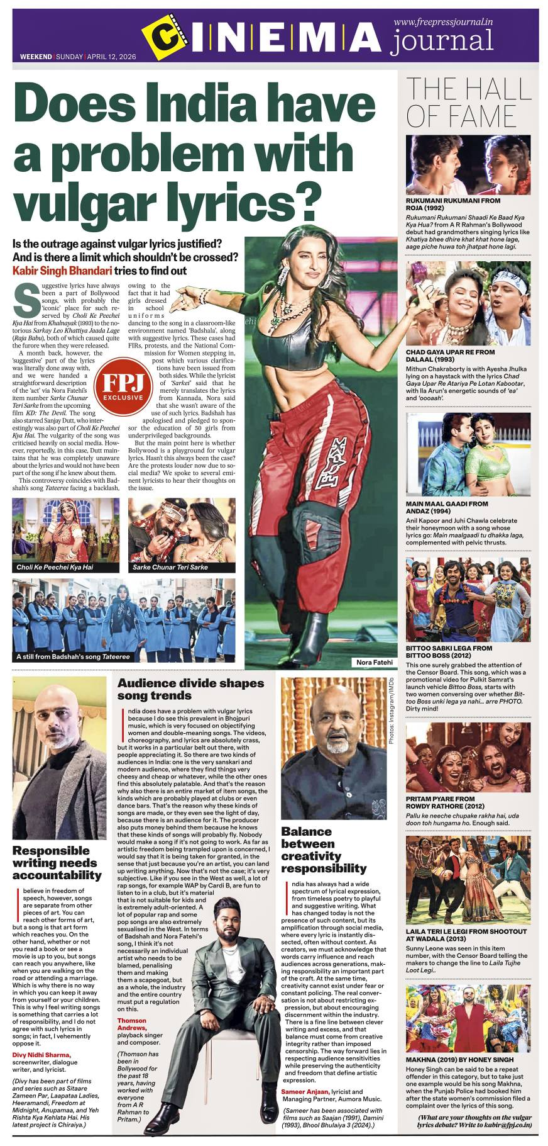
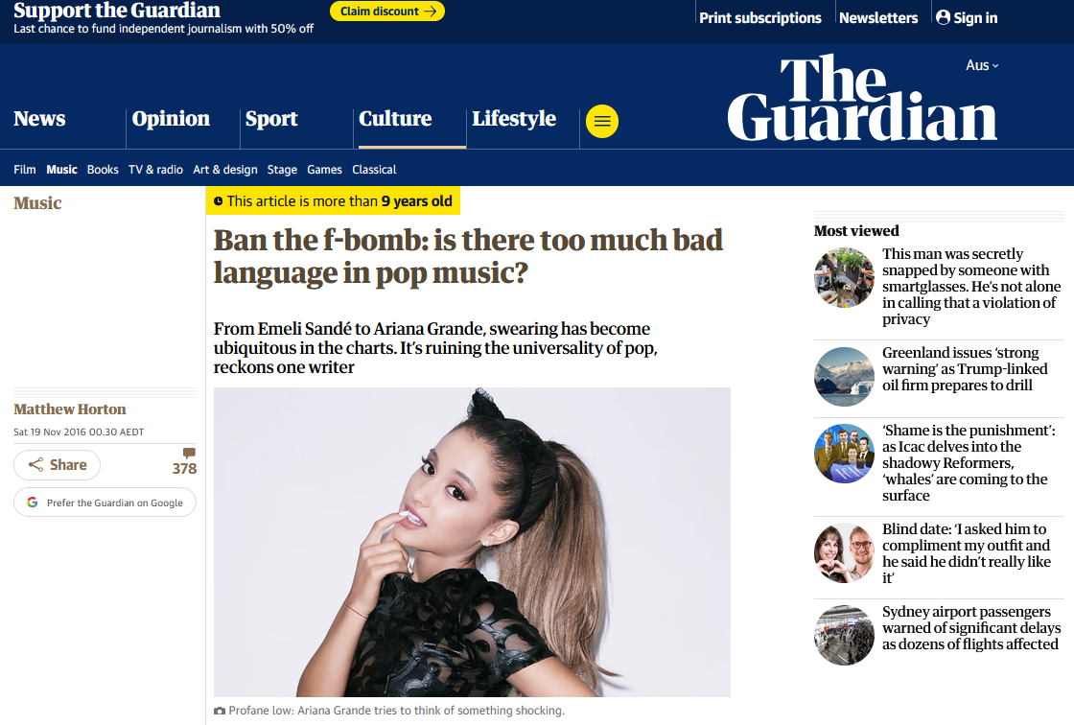
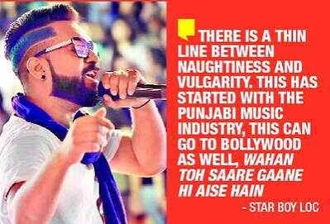
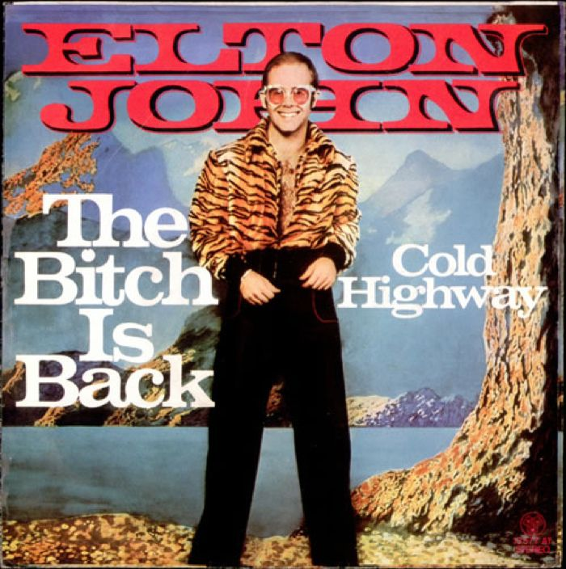
Schweinberger: The Serious Business of “Bad” Language

Slide 48
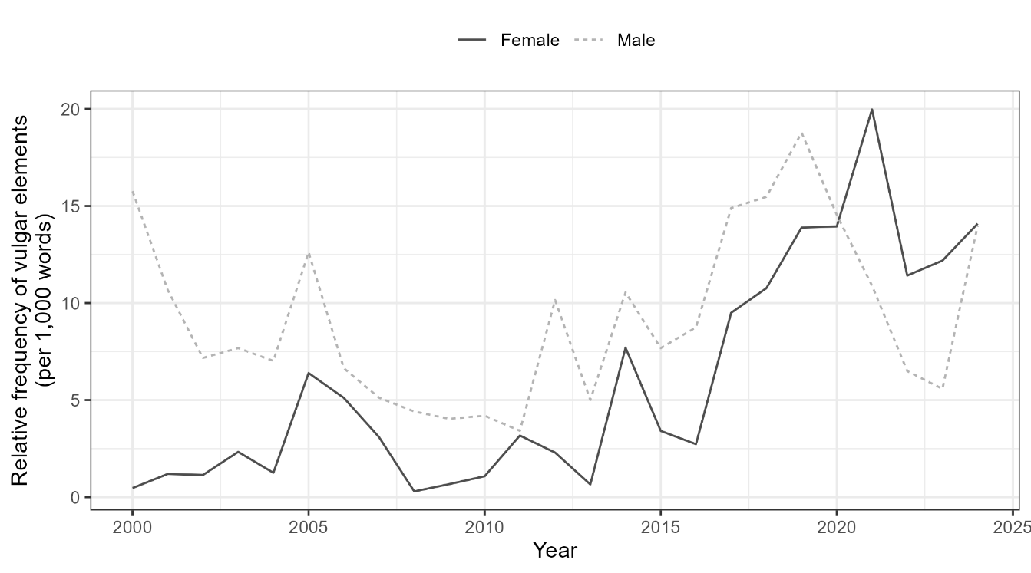
Schweinberger: The Serious Business of “Bad” Language

Slide 49
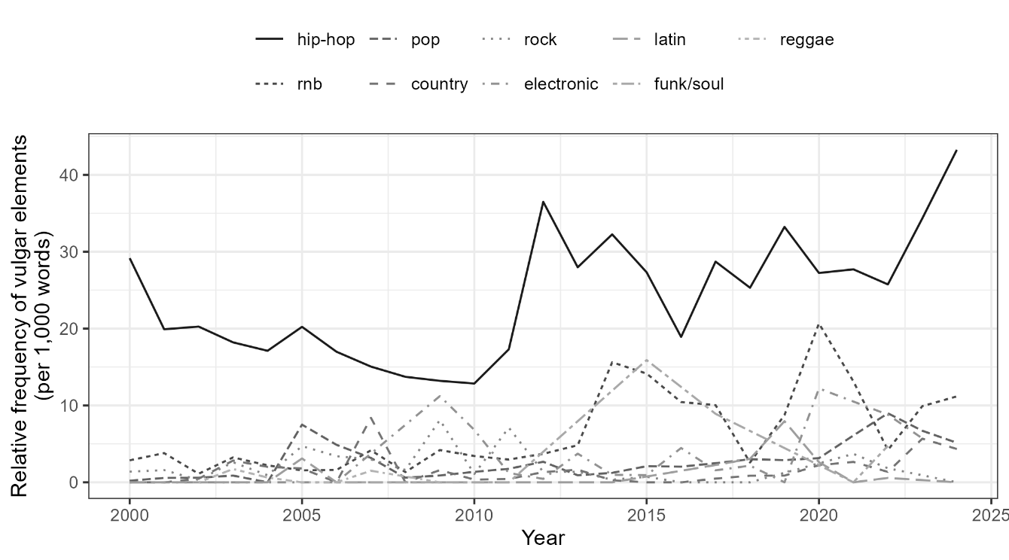
Schweinberger: The Serious Business of “Bad” Language

Slide 50
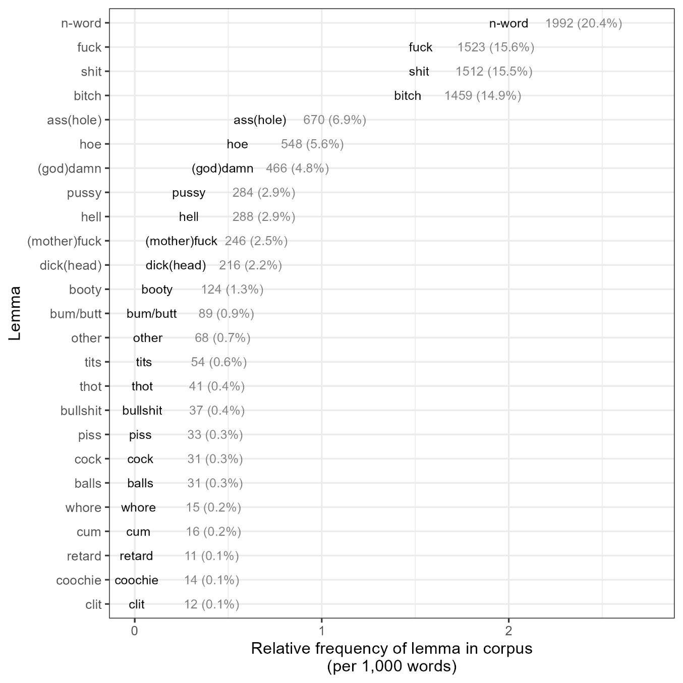
Schweinberger: The Serious Business of “Bad” Language

Slide 51


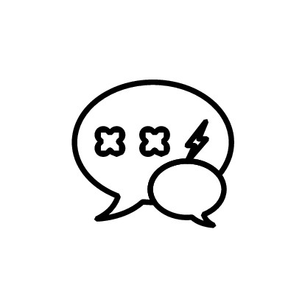
Who is most vulgar in pop music?
Increase over time
Vulgar word usage increases significantly over time. The most common words are nigga, fuck, and shit.
Hip-Hop, closing gender-gap, US
Artist demographics, song performance (not mentioned here), and genre influence the use and frequency to varying degrees:
Genre as strongest predictor with hip-hop peaking in number and intensity;
male artists are overall more vulgar; female artists, however, surpass male acts in terms of vulgarity intensity 2019 onwards (hip-hop);
U.S.-based artists contribute to largest share of vulgar content.
Street life and gang culture
Vulgarity most frequently co-occurs with themes related to violence, gang culture, and aggression.
Schweinberger: The Serious Business of “Bad” Language

Slide 52
Part 4 Part 4: Bringing it together – What we've learned – and why it matters What discourse markers and vulgarity tell us about language, culture, and society
Schweinberger: The Serious Business of “Bad” Language

Slide 53
Key Takeaways
Vulgarity is a global yet locally shaped phenomenon: its use varies across varieties, contexts, and media
Inner-circle varieties (US, UK, Australia) use more English vulgarity and show greater lexical creativity than outer-circle varieties
Face-to-face data show higher vulgarity in informal private dialogues, especially among younger speakers – with Australian English also elevated in more formal contexts
Online and social media data reveal that use of vulgarity is affected by time-of-day and topic: formal/institutional topics (education, business, politics) less vulgar
Social media offers genuinely new insights: network size (bigger → more vulgarity) and engagement (more engagement → less vulgarity)
Discourse particles (Study 1) and vulgarity share a mechanism: same feature, different reads — status ↓, solidarity ↑
Pop music suggests the male–female gap is a change in progress, not a fixed sociolinguistic pattern
Schweinberger: The Serious Business of “Bad” Language

Slide 54
Methodological and conceptual reflections
Corpora and comparability Challenges due to uneven data quality (ICE heterogeneity, register vs stylistic differences, social-media moderation).
Definitional ambiguity “Vulgarity”, “swearing”, and “taboo” overlap but aren’t identical. Our approach was deliberately inclusive but coarse-grained (nuanced operationalisation still required).
Ethical and interpretive challenges Studying and using offensive language demands careful contextualisation and cultural sensitivity. Speakers need pragmatic awareness of when and when not to use vulgarity (highly relevant for learners and (im)migrants)
Functional analysis Future research needs to understand the context to differentiate between pragmatic functions (friendly banter vs vile or offensive hate speech) at scale(!) → AI to help decode linguistic and social context (a fascinating area!)
Schweinberger: The Serious Business of “Bad” Language

Slide 55
Outlook and future directions
Extend analyses to non-English, learner, and migrant contexts to explore cross-cultural norms of vulgarity
In progress: vulgarity in Spanish (with Jhoana Pan Li)
Incorporate longitudinal data to trace diachronic shifts and changing tolerances in online discourse
In progress: vulgarity in late 20th century London (with Yon Visoni)
Combine computational and fine-grained qualitative methods for richer contextual understanding
LLMs4HASS project (with Michael Haugh, Laurence Anthony, Mikko Laitinen & Gerold Schneider et al.): enriching out understanding of vulgarity via annotation of pragmatic functions using LLMs
Overall, vulgarity offers a powerful lens into how language, culture, and technology interact in the digital age.
Schweinberger: The Serious Business of “Bad” Language

Slide 56
Thank you very f*&$ing much!
Schweinberger: The Serious Business of “Bad” Language

Slide 57
References
Allan, K., & Burridge, K. (2006). Forbidden Words: Taboo and the Censoring of Language. Cambridge University Press.
Beers Fägersten, K. (2012). Who’s Swearing Now? The Social Aspects of Conversational Swearing. Cambridge Scholars Publishing.
Burridge, K. (2006). Taboo words and the polite language. English Today, 22(1), 3–9.
Culpeper, J. (2011). Impoliteness: Using Language to Cause Offence. Cambridge University Press.
Dewaele, J.-M. (2016). Self-reported use and perception of swear words across languages by multilinguals. Intercultural Pragmatics, 13(3), 343–369.
Dynel, M. (2012). Swearing methodologically: The (im)politeness of expletives in anonymous commentaries on YouTube. Journal of English Studies, 10, 25–50.
Gries, S. T. (2021). Statistics for linguistics with R: A practical introduction. Walter de Gruyter.
Gries, S. and A Stefanowitsch. 2004. Extending collostructional analysis: a corpus-based perspective on alternations. International Journal of Corpus Linguistics 9(1): 97-129.
Holmes, J. (2013). "Discourse markers." In R. F. Simonsen & P. Mæhlum (Eds.), Pragmatics of Society (pp. 343–364). De Gruyter Mouton.
Jay, T. (2009). The utility and ubiquity of taboo words. Perspectives on Psychological Science, 4(2), 153–161. https://doi.org/10.1111/j.1745-6924.2009.01115.x
Kádár, D. Z., & Haugh, M. (2013). Understanding Politeness. Cambridge University Press.
Kursa, M. and W. Rudnicki. 2010. Feature selection with the Boruta package. Journal of Statistical Software 36(11): 1-13.
Laitinen, M., Rautionaho, P., Fatemi, M., & Halonen, M. (2025). Do we swear more with friends or with acquaintances? F#ck in social networks. Lingua, 320, 103931. https://doi.org/10.1016/j.lingua.2025.103931
Ljung, M. (2011). Swearing: A Cross-Cultural Linguistic Study. Palgrave Macmillan.
Schweinberger: The Serious Business of “Bad” Language

Slide 58
References
McEnery, T., & Xiao, R. (2004). Swearing in Modern British English: The Case of Fuck in the BNC. Language and Literature, 13(3), 235–268.
Pinker, S. (2007). The Stuff of Thought: Language as a Window into Human Nature. Viking.
Posit team (2025). RStudio: Integrated Development Environment for R. Posit Software, PBC, Boston, MA. url: http://www.posit.co/.
R Core Team (2024). R: A Language and Environment for Statistical Computing. R Foundation for Statistical Computing, Vienna, Austria. url: https://www.R-project.org.
Schweinberger, Martin (2018). Swearing in Irish English – A corpus-based quantitative analysis of the sociolinguistics of swearing. Lingua 209: 1-20. https://doi.org/10.1016/j.lingua.2018.03.008
Schweinberger, Martin. 2024. Seeded topic modeling as a more appropriate alternative to unsupervised standard topic models. Discourse Studies 27(4): 675-678 [Commentary on the Discussion Paper ‘Topic modelling in corpus-based discourse analysis: Uses and critiques’ by Monika Bednarek]. https://doi.org/10.1177/14614456241293895
Schweinberger, Martin and Kate Burridge. 2025. Vulgarity in Online Discourse around the English-Speaking World. Lingua, 321: 103946. https://doi.org/10.1016/j.lingua.2025.103946
Schweinberger, M., Laitinen, M., Haugh, M., Rautionaho, P., Fatemi, M., Hames, S., & Takahashi, M. (n.d.). F%$# Twitter: A corpus-based analysis of vulgar language on Twitter [Manuscript submitted for publication]. Corpora.
Schweinberger, M., Haugh, M., Laitinen, M., Fatemi, M., Hames, S., Rautionaho, P., & Takahashi, M. (n.d.). Swearing online: Exploring dimensions of variability in born-digital data [Manuscript submitted for publication]. Digital Scholarship in the Humanities.
Stapleton, K. (2003). Gender and swearing: A community practice. Women and Language, 26(2), 22–33.
Stephens, R., Atkins, J., & Kingston, A. (2009). Swearing as a response to pain. NeuroReport, 20(12), 1056–1060. https://doi.org/10.1097/WNR.0b013e32832e64b1
Wajnryb, R. (2005). Expletive Deleted: A Good Look at Bad Language. Free Press.
Schweinberger: The Serious Business of “Bad” Language

Slide 59
The Serious Business of “Bad” Language in English Why F%#$ Matters (and So Does “Like”)
Martin Schweinberger m.schweinberger@uq.edu.au materials and slides available at www.martinschweinberger.de
This research was partially funded by the Language Data Commons of Australia (LDaCA). Language Data Commons of Australia (LDaCA) (DOI: 10.3565/kq2v-9g52) is a co-investment partnership with the Australian Research Data Commons (ARDC) through the HASS and Indigenous Research Data Commons. The ARDC is enabled by the Australian Government’s National Collaborative Research Infrastructure Strategy (NCRIS). In addition, this research was partially funded by the Centre for Digital Cultures and Societies at the University of Queensland.

Slide 60
 | private dialogue |  |  | public dialogue |  |  | unscripted monologue |  |  | scripted monologue
Region | Vulgar Tokens | Tokens | Percent | Vulgar Tokens | Tokens | Percent | Vulgar Tokens | Tokens | Percent | Vulgar Tokens | Tokens | Percent
Australia | 146 | 206,544 | 0.071 | 19 | 163,595 | 0.012 | 23 | 147,533 | 0.016 | 22 | 109,371 | 0.02
Canada | 72 | 271,984 | 0.026 | 24 | 297,391 | 0.008 | 10 | 181,750 | 0.006 | 18 | 298,530 | 0.006
Great Britain | 126 | 261,576 | 0.048 | 11 | 192,483 | 0.006 | 12 | 294,119 | 0.004 | 3 | 174,120 | 0.002
Hong Kong | 74 | 485,383 | 0.015 | 17 | 293,478 | 0.006 | 8 | 257,041 | 0.003 | 15 | 257,831 | 0.006
India | 16 | 237,108 | 0.007 | 2 | 195,321 | 0.001 | 4 | 164,214 | 0.002 | 7 | 153,340 | 0.005
Ireland | 196 | 205,032 | 0.096 | 4 | 169,785 | 0.002 | 13 | 158,834 | 0.008 | 6 | 108,709 | 0.006
Jamaica | 30 | 236,258 | 0.013 | 8 | 191,304 | 0.004 | 39 | 221,205 | 0.018 | 5 | 137,777 | 0.004
Kenya | 3 | 63,073 | 0.005 | 9 | 151,371 | 0.006 |  |  |  | 6 | 122,646 | 0.005
New Zealand | 246 | 225,457 | 0.109 | 9 | 183,930 | 0.005 | 14 | 171,280 | 0.008 | 9 | 128,076 | 0.007
Philippines | 28 | 204,346 | 0.014 | 2 | 162,356 | 0.001 | 2 | 215,569 | 0.001 | 4 | 184,170 | 0.002
Singapore | 82 | 226,537 | 0.036 | 9 | 181,943 | 0.005 | 3 | 147,228 | 0.002 | 13 | 120,700 | 0.011
Sri Lanka | 108 | 222,615 | 0.049 | 16 | 177,260 | 0.009 | 4 | 156,676 | 0.003 | 7 | 113,641 | 0.006
Tanzania | 1 | 8,625 | 0.012 | 16 | 436,249 | 0.004 |  |  |  | 8 | 102,479 | 0.008
United States | 80 | 221,827 | 0.036
Total | 1,208 | 3,076,365 | 0.039 | 146 | 2,796,466 | 0.005 | 132 | 2,115,449 | 0.006 | 123 | 2,011,390 | 0.006
Schweinberger: The Serious Business of “Bad” Language

