Slide 1
Reproducibility, Transparency, and AI in Language-Based Empirical Research
UNIVERSITY OF BONN 2026
Notes:
Open with a direct question to the room — don't just read the title. Try: "How many of you have read a paper and wanted to know exactly how the author got from their data to their conclusion — and couldn't tell?" Let them respond. Then: "That's what this talk is about."

Slide 2

Martin Schweinberger
Research focus
Corpus linguistics · language variation · language data science Computational methods for text and speech analysis
On reproducibility & open science
Director, Language Technology and Data Analysis Laboratory (LADAL) — ladal.edu.au
Chief Investigator, Language Data Commons of Australia (LDaCA)
Co-editor, Special Issue: Reproducibility, Replication and Robustness in Corpus Linguistics (International Journal of Corpus Linguistics, 2025)
Book series editor: Language, Data Science and Digital Humanities (Bloomsbury)
Background
PhD, Universität Hamburg (magna cum laude)
Native German · near-native English
40+ peer-reviewed publications
90+ conference presentations
Martin Schweinberger
Senior Lecturer in Applied Linguistics
Director of Research, School of Languages and Cultures
The University of Queensland

Slide 3
THE STAKES:
WHY STUDY REPRODUCIBILITY & AI?
Notes:
End this cluster on a constructive note. The tools exist. The platforms exist. What's missing is the habit and the norm. That's something a field can change — and your talk is part of that change.

Slide 4
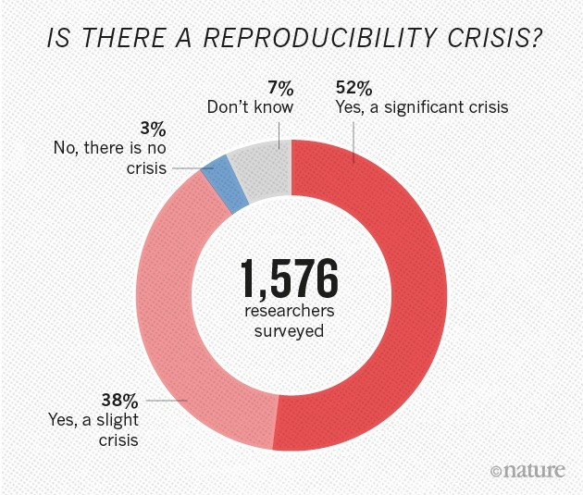
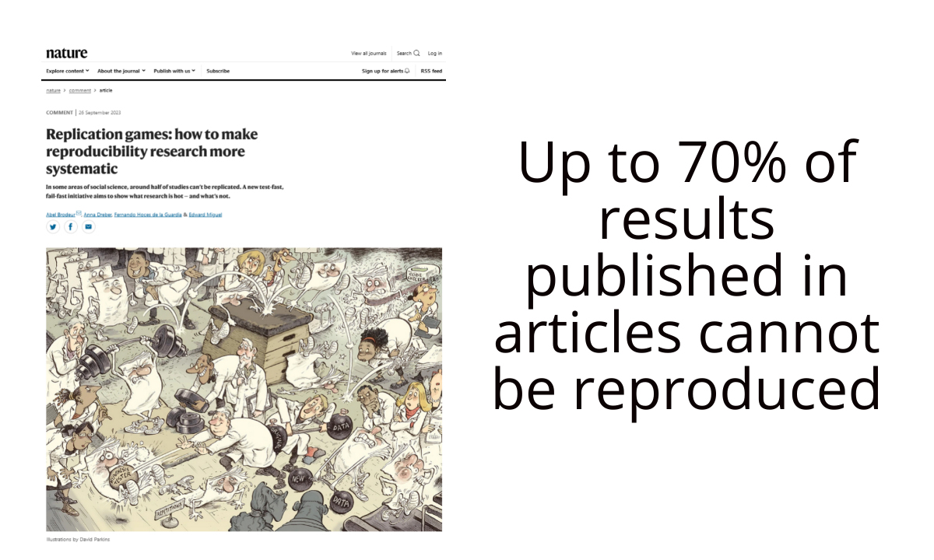
“Most published findings cannot be reproduced”
Psychology (2015) Only 36% of 100 replicated studies held up - down from 97% statistical significance in originals (Open Science Collaboration, 2015)
Cancer biology (2021) An 8-year effort found the majority of key findings could not be replicated (Errington et al., 2021)
Linguistics Not immune - debates about reproducibility have been gaining momentum since the early 2010s (Berez-Kroeker et al., 2018; Sönning & Werner, 2021; Schweinberger & Haugh, 2025)
Notes:
The psychology number is the one that shocked the field — 97% claimed significant results, only 36% survived replication. Pause on that. Then signal that linguistics is catching up to this conversation late. Don't be alarmist — frame it as an opportunity, not a scandal.

Slide 5
This isn't just a problem for psychologists and biologists
Three pressure points for linguistics
Funders now require open data and reproducible methods (NIH, Wellcome Trust, European Commission)
Journals now require data availability statements (Nature, PLOS ONE, Science)
Your readers cannot evaluate what they cannot see — and neither can your reviewers
Notes:
This is where you connect the abstract crisis to the room. For the MA students: "This affects how your thesis will be evaluated." For the professors: "This is already affecting publication decisions at top journals." The funder point lands especially well in Germany given DFG open science requirements.

Slide 6
Reproducibility is not about bureaucracy - it is about trust
“Achieving transparency and reproducibility in corpus linguistic research promotes greater accountability and trust in its quality, enabling others to scrutinise the research, and identify potential problems or errors.” (Schweinberger & Haugh, 2025)
The question is not: “Can someone repeat your study?”
The question is: “Can someone follow your thinking?”
Notes:
This slide makes the philosophical pivot that carries the whole talk. Reproducibility in the strict sense — identical results from identical data — is often impossible and arguably not even the right goal in interpretive research. What we owe each other as scholars is the ability to follow an analysis, to evaluate it, to build on it. That's trust. That's what's at stake.

Slide 7
Getting the terminology right matters
REPRODUCIBILITY Same data + same methods = same results → The strictest standard; often impossible in interpretive work
REPLICABILITY New data + same methods = consistent results → Tests whether findings generalise
ROBUSTNESS Different methods, same data = consistent results → Tests whether findings depend on analytical choices
TRANSPARENCY Can others follow, evaluate, and scrutinise your process? → The right goal for qualitative and interpretive research
Key claim: For interpretive paradigms like corpus pragmatics, transparency matters more than reproducibility (Schweinberger & Haugh, 2025)
Notes:
Don't rush this slide. These terms are used interchangeably in the wild, and the conflation causes real problems. The key move here — which you can defend — is that transparency is not a consolation prize for researchers who can't achieve reproducibility. It is the epistemically appropriate standard for work that is necessarily interpretive. A qualitative analyst making a defensible judgment call is doing something different from a computational pipeline producing a number — and the accountability standard should reflect that.

Slide 8
THE SPECTURUM OF RESEARCH PRACTICES
Notes:
End this cluster on a constructive note. The tools exist. The platforms exist. What's missing is the habit and the norm. That's something a field can change — and your talk is part of that change.

Slide 9
Not all research faces the same reproducibility challenge
EASIER
Quantitative
corpus linguistics
Code-based
Automatable
Results identical if code shared
Mixed-methods
corpus linguistics
Code + annotation
Some manual steps
Partially reproducible
HARDER
Qualitative
Interpretive pragmatics
Close reading
Context-dependent
Multiple valid interpretations
Notes:
The spectrum framing is important because it prevents the audience from thinking this is an all-or-nothing problem. Quantitative corpus work is closer to the natural sciences — share your R script, someone else runs it, they get your table. Interpretive pragmatics is closer to literary criticism in some ways — the analyst's judgment is irreducibly part of the method. But that doesn't mean anything goes. It means transparency becomes the appropriate standard.

Slide 10
Qualitative research has a transparency problem not because it is subjective, but because it is invisible
In quantitative research → The steps are in the code. Share the code, share the method.
In interpretive research → The steps are in the analyst’s head. What did you look at? In what order?
What did you discard?
Why did you code this as X and not Y?
The problem is not validity — it is visibility.
“What might appear to be inherently subjective forms of analysis can be made accessible for scrutiny by other researchers.” (Schweinberger & Haugh, 2025)
Notes:
This is the slide that will resonate most with the qualitative professors. They may have spent years defending qualitative work against accusations of subjectivity. Reframe: the issue is not whether the interpretation is valid — it often is. The issue is that readers cannot see the process well enough to evaluate it. Notebooks are a way to make the invisible visible.

Slide 11
Transparency means your analytical process is visible, evaluable, and auditable
For QUANTITATIVE work, transparency means
✓ Sharing your code (R script, Python script) ✓ Sharing your data (where permitted) ✓ Sharing your notebook (code + output + explanation)
For QUALITATIVE / INTERPRETIVE work, transparency means ✓ Sharing your coding scheme and annotation guide ✓ Showing which examples were included and why ✓ Documenting borderline decisions and how they were resolved ✓ Making your data exploration visible, not just your results
Both: share via GitHub, OSF, or similar platform
Notes:
The bottom items are what most qualitative researchers have never been asked to do — and what notebooks make possible. The annotation guide, the borderline case discussion, the "I considered coding this as X but chose Y because..." — that's transparency in interpretive work. It doesn't require code. It requires documentation.

Slide 12
Researchers face real barriers to transparency
DATA COMPLEXITY Language data is messy, context-dependent, and often cannot be shared due to ethics/copyright
THE NATURE OF INTERPRETIVE WORK Multiple valid readings of the same data are a feature, not a bug — but they complicate reproducibility claims
LACK OF SHARED INFRASTRUCTURE Tools built for quantitative research don't automatically serve interpretive work
LACK OF TRAINING Computational and documentation skills are not standard in humanities research programmes
Notes:
Acknowledge these honestly. Don't minimise them. The audience — especially the professors — will have experienced all four. The point is not that transparency is easy. It's that tools now exist that lower the barrier substantially, and we have a professional obligation to use them.

Slide 13
The infrastructure already exists
The barrier is awareness and habit, not technology
What we need → Notebooks to document analytical processes → Version control (Git/GitHub) to track and share work → Open repositories (OSF, Zenodo, GitHub) to publish materials → A shift in norms: transparency as scholarly expectation, not optional extra
“Increasing research transparency is an ongoing process requiring commitment not only from researchers, but also from institutions, funding bodies, publishers, and editors.” (Schweinberger & Haugh, 2025)
Notes:
End this cluster on a constructive note. The tools exist. The platforms exist. What's missing is the habit and the norm. That's something a field can change — and your talk is part of that change.

Slide 14
THE TOOLKIT
Notes:
End this cluster on a constructive note. The tools exist. The platforms exist. What's missing is the habit and the norm. That's something a field can change — and your talk is part of that change.

Slide 15
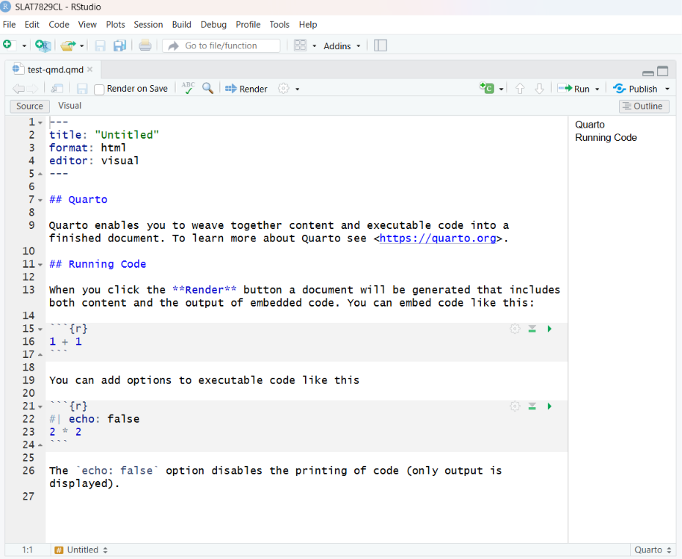
A notebook combines text, code, and output in a single, shareable document
Three formats you'll encounter
R Notebooks / Quarto (.Rmd / .qmd) — popular in linguistics
Jupyter Notebooks (.ipynb) — popular in programming / data science
Observable Notebooks — web-based, interactive
What they all share
→ Prose explanation sits alongside the code that runs it
→ Output (tables, plots, results) is embedded and visible
→ The whole document can be shared, rendered, and re-run
Notes:
End this cluster on a constructive note. The tools exist. The platforms exist. What's missing is the habit and the norm. That's something a field can change — and your talk is part of that change.

Slide 16
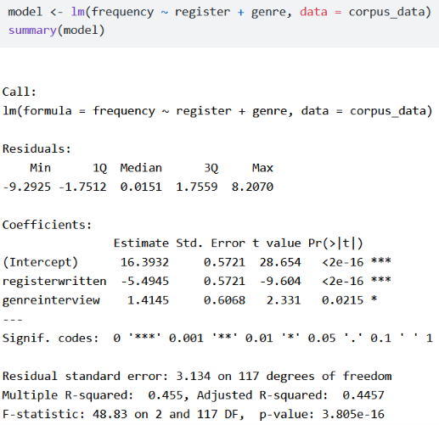
What a Notebook Shows That Code Alone Cannot
Code alone Code tells you what was done.
What a reader cannot tell from this code
Why these predictors were chosen
What the data look like before modelling
Whether assumptions were checked
What the results actually mean
What the next step is
The output exists. The reasoning is invisible.
Notes:
This is the slide that makes notebooks concrete for a non-technical audience. The code is the same. What the notebook adds is the reasoning around the code — which is precisely what peer reviewers and future researchers need to evaluate and build on the work.

Slide 17
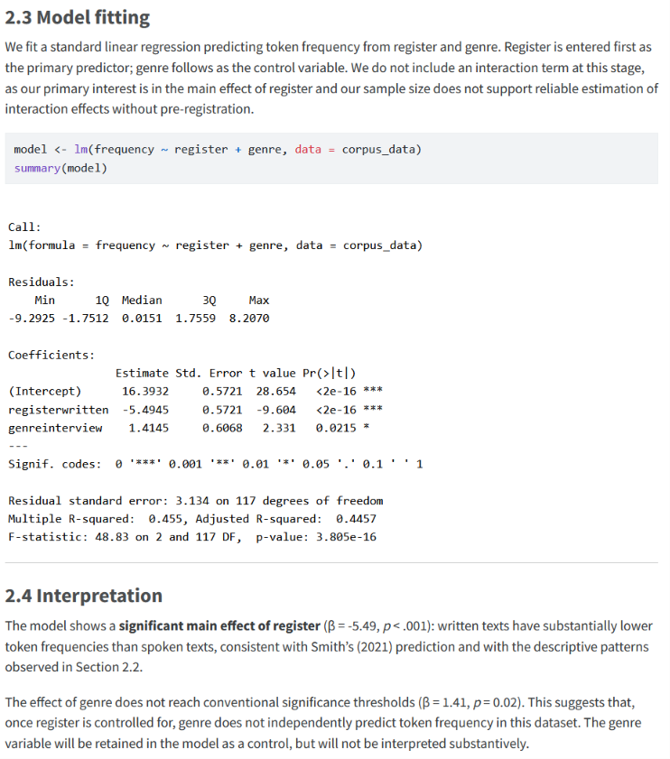
What a Notebook Shows
Notebook (Explanation + Code + Output + Interpretation)
A notebook tells you
What was done
Why it was done
How it was done
What happened.
The interpretation does something a bare summary()call cannot: it connects the coefficient values to the theoretical framework (Smith 2021), explains why the non-significant genre effect does not lead us to drop the variable, and signals the next analytical step. These decisions are part of the analysis — and in a notebook, they are documented alongside the code rather than existing only in the researcher’s head.
Notes:
This is the slide that makes notebooks concrete for a non-technical audience. The code is the same. What the notebook adds is the reasoning around the code — which is precisely what peer reviewers and future researchers need to evaluate and build on the work.

Slide 18
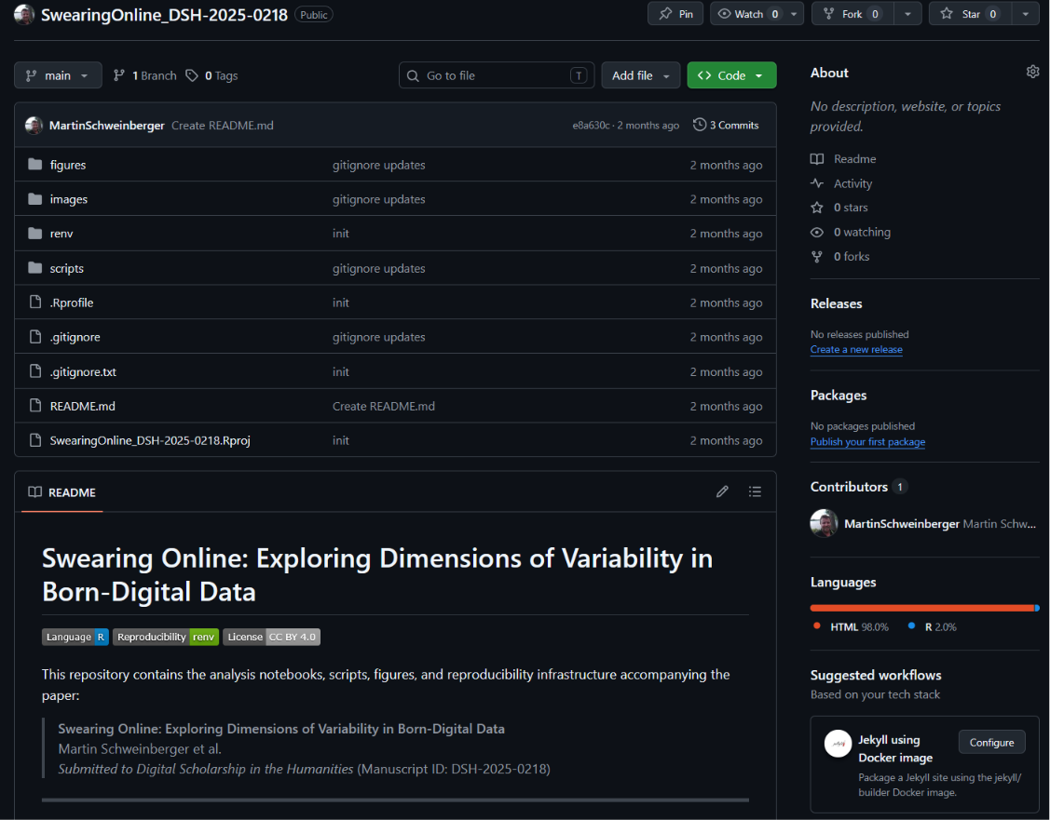
Version Control with Git and GitHub
GitHub is not just for software developers
It is an archive, a collaboration tool, and a publishing platform.
What Git/GitHub gives you:
✓ Every version of your files is saved and recoverable
✓ Collaborators can work on the same project without conflicts
✓ Your materials (notebooks, data, annotation guides) become publicly accessible with a single link
✓ A permanent, citable URL for your research materials
For non-coders: think of it as Google Docs with a complete, searchable history — for your entire research project
Notes:
Many in the room will have heard of GitHub but think of it as something for programmers. Push back on that. Any file — a Word document, a coding scheme, a PDF annotation guide — can be stored and version-controlled on GitHub. The key benefit for interpretive researchers is that it creates a permanent, publicly accessible record of their materials.

Slide 19
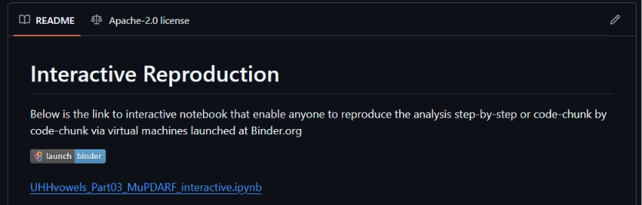
Sharing and Interactivity: OSF and Binder
Sharing a notebook is good.
Sharing a notebook others can run is better.
THE OPEN SCIENCE FRAMEWORK (OSF)
Free repository for data, materials, preregistrations
Assigns a permanent DOI to your project
Connects to GitHub, Zenodo, and other platforms
Used by major journals for data availability requirements
BINDER
Turns a GitHub repository into a live, runnable environment
Anyone can open and interact with your notebook in their browser (no software installation needed)
Bridges theoretical and practical reproducibility: not just “the data is available” but “anyone can run this now”
Notes:
Binder is the underused tool in this stack. The distinction between theoretical and practical reproducibility is worth dwelling on — you make it in your paper and it's genuinely clarifying. Theoretical reproducibility means the materials exist somewhere. Practical reproducibility means someone can actually use them without a PhD in software engineering.

Slide 20
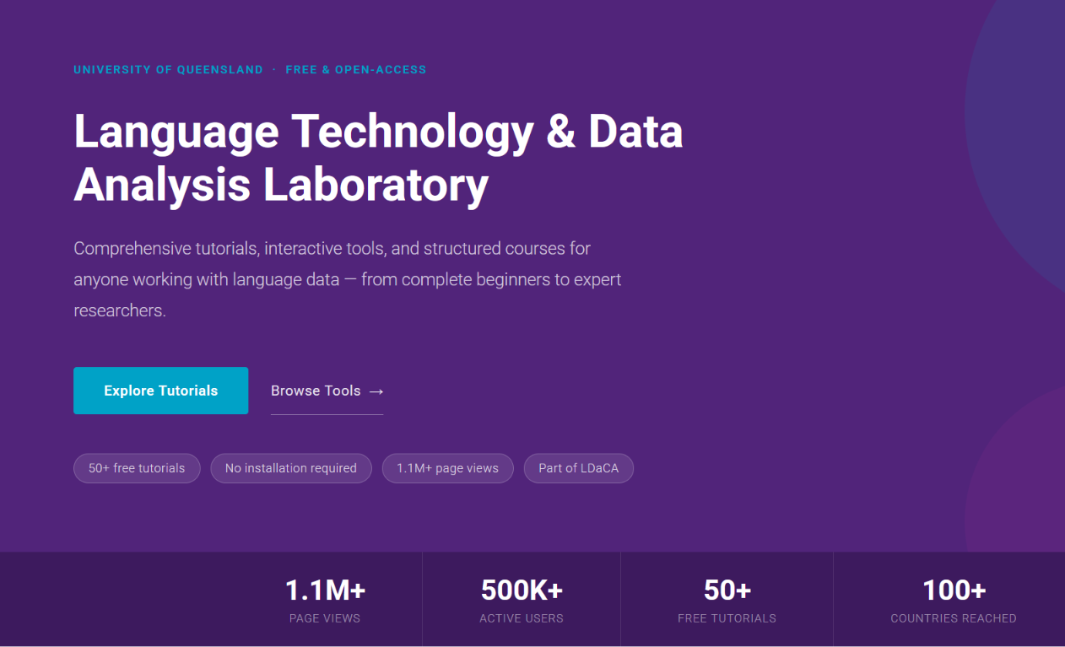
LADAL: A Resource for Linguistics Researcher
LADAL: Language Technology and Data Analysis Laboratory (ladal.edu.au)
Free, open tutorials for corpus and computational linguistics
Covers basic data management, R, text analysis, statistics, and AI tools
Written for researchers without a coding background
All tutorials are themselves published as notebooks (practicing what they preach)
Especially relevant to today’s talk
→ Tutorials on notebooks and reproducible workflows
→ Tutorial: Privacy-Preserving Analysis with Local LLMs (generating synthetic proxy data — more on this later)
Recommended: bookmark and explore after today
Notes:
Keep this brief. LADAL is a resource, not the focus. The key thing for the audience to take away is that the tutorials are written for people exactly like them — linguists who want to do more rigorous, transparent work but don't have a computer science background. The local LLM tutorial gets a fuller treatment later.

Slide 21
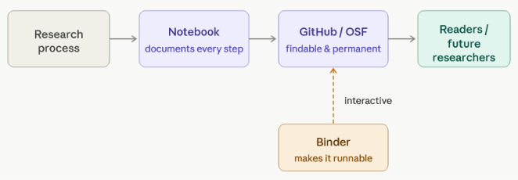
The Full Transparency Stack
Putting it together: a transparent research workflow
The goal: someone who was not in the room when you did your analysis can follow exactly what you did, evaluate every decision, and build on your work.
That is transparency. That is what we owe each other.
Notes:
This diagram is deliberately simple — don't overcomplicate it. The point is that the stack works together: notebooks document, GitHub/OSF preserves and shares, Binder activates. For the qualitative professors: the notebook is the piece that extends to their work most directly. They don't need to run code — they need to document their analytical process in a way that others can follow.

Slide 22
CASE STUDY
Notes:
End this cluster on a constructive note. The tools exist. The platforms exist. What's missing is the habit and the norm. That's something a field can change — and your talk is part of that change.

Slide 23
Case Study
A concrete example making interpretive corpus pragmatics analysis transparent
RQ: How do speakers of Australian English respond to information-seeking questions ending with utterance-final or?
Example: “Do you think I should spray it with something or?”
[Australian Radio Talkback corpus]
Why this example?
→ Inherently interpretive: responses require pragmatic judgment
→ Mixed method: computational extraction + qualitative annotation
→ Full transparency stack implemented: notebook + GitHub + Binder
(Schweinberger & Haugh, 2025, International Journal of Corpus Linguistics)
Notes:
Ground this quickly in something the audience can hear. Play or read the example aloud — "Do you think I should spray it with something or?" — and ask what they notice. It's a truncated question, it invites elaboration, it's pragmatically interesting. Then explain that the research question is about what happens next in the conversation — how do people respond to this?

Slide 24
The Four-Step Pipeline
Each analytical step maps onto a transparency tool
STEP 1: COMPUTATIONAL EXTRACTION
R script searches corpora for utterance-final 'or’
→ 98 candidate cases extracted automatically
Transparency tool: R code shared in notebook
STEP 2: MANUAL ANNOTATION (Round 1)
Each case manually checked: interrogative or declarative?
False positives removed → 63 genuine cases retained
Transparency tool: annotation decisions documented in notebook
STEP 3: MANUAL ANNOTATION (Round 2)
Responses coded: confirming / disconfirming / non-answer?
Elaborated or bare response?
Transparency tool: coding scheme shared; borderline cases discussed
STEP 4: COMPUTATIONAL + INTERPRETIVE ANALYSIS
Distributions computed; deviant cases examined in depth
Transparency tool: full notebook + interactive Binder environment
Notes:
The key point here is that transparency isn't just about the code — steps 2 and 3 involve no code at all, just human judgment. But those decisions are just as important as the R script, and a notebook can document them too. This is the argument for extending transparency practices to qualitative work.

Slide 25
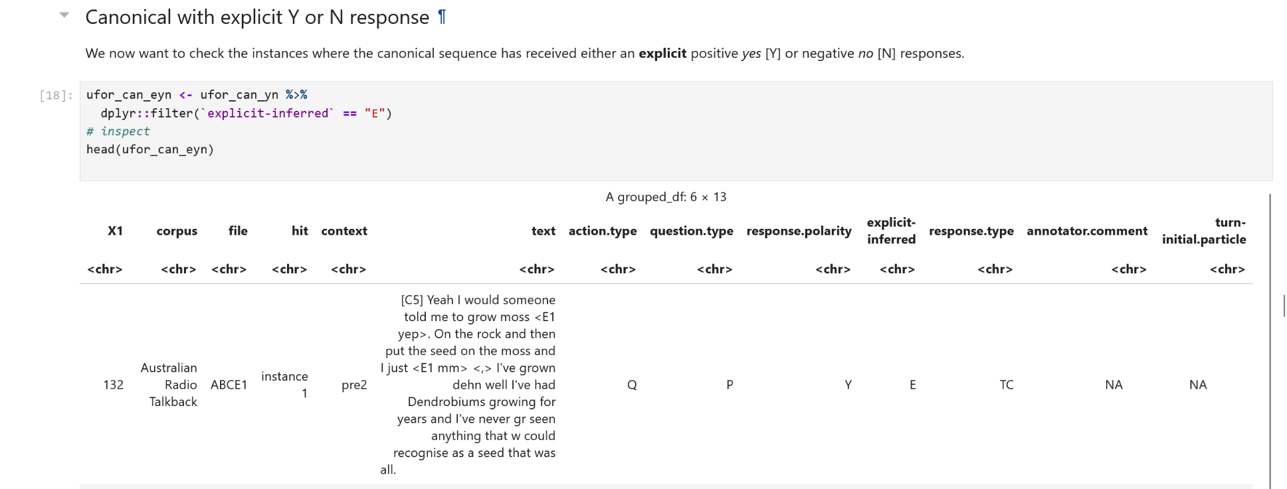
What the Notebook Makes Visible
The notebook shows not just results, but reasoning
Key finding visible in the notebook [github.com/MartinSchweinberger/IJCL_ReproducibilityInCorpusPragmatics]
87.3% of responses treated utterance-final 'or' as a polar question (not an alternative question)
75% of confirming/disconfirming responses included elaboration — bare responses were the exception
Anyone can open the Binder link and inspect the actual examples to verify these interpretations.
Notes:
The Binder link is your strongest demonstration of practical reproducibility. If you can show it on screen — even just the GitHub page — do so. The point is not "look at my finding about or" — the pragmatics audience will have opinions about that. The point is: "look at how every step that led to this finding is visible, inspectable, and interactive."

Slide 26
From Case Study to Principle
The case study demonstrates one core principle
Transparency does not require that every reader agrees with your interpretation.
It requires that every reader can see your interpretation, follow how you reached it, and evaluate whether they find it defensible.
This is what notebooks + GitHub + Binder make possible — even for qualitative, interpretive work.
→ Now: what role can AI play in this workflow?
And what role must it never play?
Notes:
This is your pivot slide. Use it as a hard transition — don't rush it. Let the principle land. Then signal clearly that Part 2 is a different kind of conversation. You might say: "Everything I've shown you so far involves human researchers making decisions and documenting them. Now I want to talk about where AI fits into this picture — and where it absolutely does not."

Slide 27
HOW LLMS WORK – FOR HUMANS
Notes:
End this cluster on a constructive note. The tools exist. The platforms exist. What's missing is the habit and the norm. That's something a field can change — and your talk is part of that change.

Slide 28
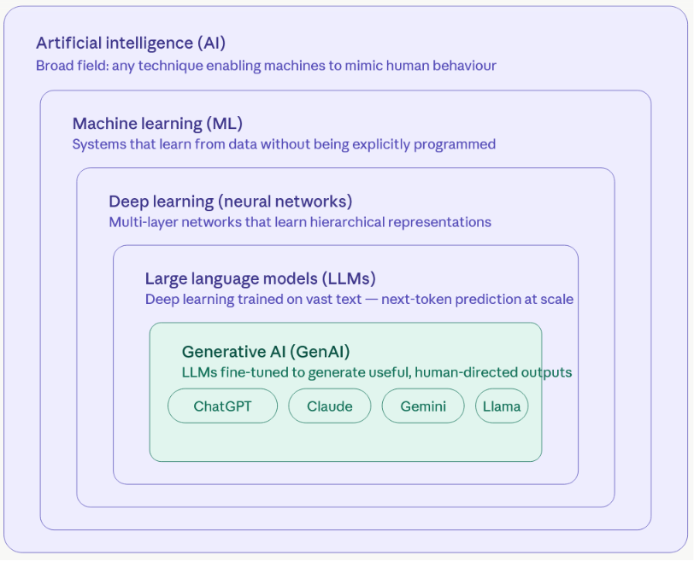
What Is Artificial Intelligence (and What Isn't)
“AI” is a broad term. What we’re talking about today is a specific and recent technology.
What LLMs are NOT
✗ A database being searched
✗ A search engine retrieving documents
✗ A system that "knows" facts the way you know facts
✗ Intelligent in any human sense of the word
What LLMs ARE
✓ Extremely sophisticated pattern-completion systems
✓ Trained on vast amounts of human-generated text
✓ Optimised to produce plausible, coherent language
Notes:
Start by clearing away misconceptions. Many people — including academics — interact with ChatGPT or Claude as if they were talking to a very knowledgeable person. That mental model leads to predictable errors: trusting outputs uncritically, being surprised by hallucinations, using AI for tasks it cannot reliably perform. The correction isn't "AI is dumb" — it's "AI is doing something fundamentally different from what you think it's doing."

Slide 29
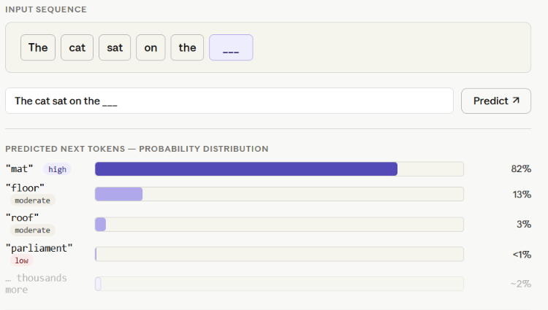
The Prediction Machine: What LLMs Actually Do
At its core, an LLM is a next-word prediction machine — at extraordinary scale
THE BASIC MECHANISM
Given this text: The model predicts:
"The cat sat on the ___" → "mat" (high probability) → "floor" (moderate) → "parliament" (low)
At each position, the model calculates a probability distribution over its entire vocabulary and samples from it.
This happens token by token — thousands of times per response — based on patterns learned from training data.
That is all it is doing.
The outputs feel meaningful because human language is deeply, systematically patterned.
Notes:
This is the most important technical slide in the talk, and it needs to land. The "prediction machine" framing is genuinely clarifying — not reductive. Spend a moment on it. You might ask: "Why does predicting the next word produce something that looks like reasoning, explanation, even creativity?" Because human language encodes enormous amounts of structured knowledge. If you've read enough text about corpus linguistics, you can predict what comes after "the concordance lines were sorted by" — and that prediction looks like knowledge. It partly is — and partly isn't.

Slide 30
Components of LLMs: Step 1 — Tokenization
The model doesn’t read words. It reads pieces.
Before processing any text, an LLM breaks it into “tokens” — units that can be whole words, parts of words, punctuation, or even single characters.
corpus pragmatics → [corpus, prag, matics]
unhappiness → [un, happiness]
GPT-4 → [G, PT, -, 4]
WHY SUBWORDS?
A fixed vocabulary of whole words cannot handle:
New words, names, technical terms
Spelling variants and typos
Words from other languages
Subword tokenization handles anything — at the cost of losing “word” as a natural unit.
WHAT THIS EXPLAINS
→ Why LLMs sometimes mis-split technical terminology
→ Why they struggle with character-level tasks (counting letters, spelling backwards)
→ Why “token limits” ≠ word limits (1 token ≈ 0.75 words on average)
Notes:
The tokenisation step is the one that surprises linguists most — because linguists think in words, and the model fundamentally doesn't. The "corpus pragmatics" example is good for this audience: show them that a term they use every day gets split in ways that seem arbitrary. The practical implication for your talk: token limits matter when uploading long documents to AI tools, and the model's "understanding" of a word is actually built up from subword fragments.

Slide 31
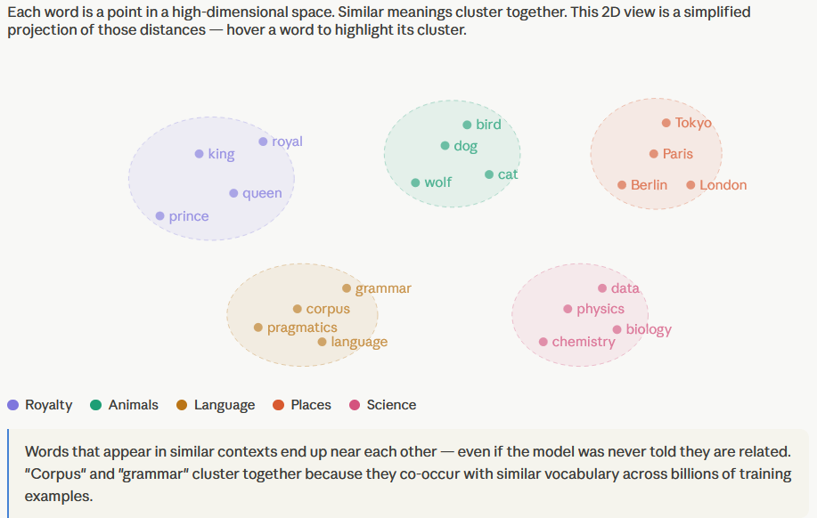
Components of LLMs: Step 2 — Embeddings
Tokens become points in a mathematical space where meaning has geometry
Each token is converted into a list of hundreds or thousands of numbers — a “vector.” These vectors are not arbitrary: similar meanings end up close together in this space.
THE CLASSIC DEMONSTRATION
vector(“king”) − vector(“man”) + vector(“woman”) ≈ vector(“queen”)
Relationships between words become directions in the vector space.
WHAT THE MODEL ACTUALLY “KNOWS“
Not facts. Not rules. Not meaning in any deep sense.
Statistical co-occurrence patterns across billions of words of training text — encoded as distances and directions in a high-dimensional mathematical space.
WHAT THIS EXPLAINS
→ Why LLMs are fluent: similar contexts produce similar vectors, so output “fits”
→ Why LLMs hallucinate: the model moves through a space of plausible associations, not a database of verified facts
→ Why bias in training data becomes bias in model output
Notes:
The king/queen/man/woman example is famous and slightly overused, but it earns its place here because it demonstrates something genuinely surprising: that semantic relationships have algebraic structure in the embedding space. The key point for your audience is the last one — the model doesn't "know" things in any meaningful sense. It has encoded statistical regularities. That is the root cause of hallucination, and it's worth dwelling on.

Slide 32
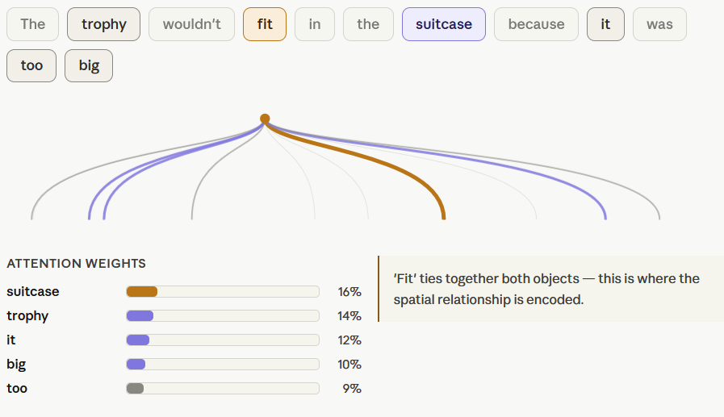
Components of LLMs: Step 3 — Attention
The mechanism that lets the model read context, not just sequences
A model reading word-by-word cannot resolve polysemy (“bank” – river vs “bank” – finance). It needs to weigh the relevance of every word to every other word simultaneously.
WHAT ATTENTION DOES
For each token, the model calculates how much “attention” to pay to every other token in the input when predicting what comes next.
“The trophy wouldn’t fit in the suitcase because it was too big.”
→ What does “it” refer to?
Attention assigns high weight to “trophy” relative to “it” — not because it was told the rule, but because this pattern was learned from millions of similar examples.
WHAT THIS EXPLAINS
→ Why LLMs handle long, complex sentences well
→ Why they can maintain context across a paragraph
→ Why they still fail on very long documents: attention has practical limits
→ Why the same word means different things in different contexts — the model handles this
Notes:
The king/The trophy/suitcase example is from Winograd schemas — a classic test of language understanding that requires real-world knowledge to resolve. It's a good one for a linguistics audience because it is a pragmatics problem: the referent of "it" is determined by context and world knowledge, not syntax. The model gets this right not because it understands physics, but because "the [object] wouldn't fit because it was too [adjective]" appears in enough similar training contexts that the model has learned the pattern.

Slide 33
Components of LLMs: Step 4 — Training
Where the “knowledge” comes from
PRE-TRAINING (self-supervised)
The model reads hundreds of billions of words and learns to predict the next token. No human labels. No explicit rules. The training signal is: were you right or wrong?
Scale: GPT-4 estimated at ~1 trillion tokens = roughly 1,000× all books ever written
FINE-TUNING
The pre-trained model is further trained on curated examples of specific tasks: following instructions, answering questions, holding a conversation.
RLHF — Reinforcement Learning from Human Feedback
Human raters score model outputs: the model learns to produce responses humans rate as helpful, harmless, and honest.
⚠ CRITICAL IMPLICATION
RLHF optimises for human approval — not for truth. A confident, fluent wrong answer scores better than an uncertain right one if human raters aren’t careful. This is why hallucinations are delivered with confidence.
Notes:
The RLHF point is the most important one on this slide for your purposes. The model was explicitly trained to produce outputs that humans find satisfying — which means fluency, confidence, and apparent coherence are rewarded regardless of factual accuracy. This is not a design failure; it's a design choice optimised for user experience. But it means the model's confident tone is not a signal of reliability. This connects directly back to your hallucination slide.

Slide 34
How LLMs Are Trained
LLMs learn from human language — an almost unimaginable amount of it TRAINING (simplified, three stages)
PRE-TRAINING The model reads billions of pages of text (books, websites, academic papers, code, etc.) and learns to predict the next token. This is where most "knowledge" comes from.
FINE-TUNING The model is further trained on curated, high-quality examples of specific tasks (instruction following, question answering, etc.)
REINFORCEMENT LEARNING FROM HUMAN FEEDBACK (RLHF) Human raters evaluate outputs; the model learns to produce responses humans prefer. This is where helpfulness, tone, and safety behaviours come from.
Key implication: the model's "knowledge" has a cutoff date — it cannot know what happened after training.
Notes:
You don't need to go deep on the mathematics here — your audience doesn't need it. The key takeaways are: (1) the model's capabilities come from patterns in training data, not from a knowledge base that's updated; (2) there is a cutoff — events, papers, and developments after training are unknown to the model unless you tell it; (3) RLHF explains why models sound confident and helpful even when they're wrong — they were optimised to produce responses humans rate positively, not responses that are true.

Slide 35
What Generative AI Can and Cannot Do
Generative AI is genuinely remarkable — and genuinely limited — in specific, predictable ways
WHAT GenAI DOES WELL
✓ Generating fluent, well-structured text
✓ Writing, explaining, and annotating code
✓ Summarising and paraphrasing documents
✓ Suggesting structure for a notebook or paper
✓ Answering questions about well-documented topics
✓ Adapting to a specified style or format
WHAT GenAI DOES POORLY OR UNRELIABLY
✗ Stating facts accurately (especially specific ones)
✗ Citing real sources — fabricated references are common
✗ Mathematical reasoning beyond simple arithmetic
✗ Knowing what happened after its training cutoff
✗ “Understanding” language in any deep semantic sense
✗ Making valid interpretive or analytical judgments about novel data it has not seen
Notes:
The asymmetry here is what researchers need to internalise. GenAI is extraordinary at form — producing text that looks right, that is well-structured, grammatical, and plausible. It is unreliable at truth — making accurate factual claims, citing real sources, or making valid inferences from data. For research, this distinction is everything.

Slide 36
Hallucination: The Technical Term for Confident Nonsense
“Hallucination” is not a bug. It is a predictable consequence of how LLMs work.
WHAT HALLUCINATION MEANS
The model generates text that is fluent, confident, and plausible-looking — but factually false.
WHY IT HAPPENS
The model is optimised to produce probable, coherent text — not true text.
It has no mechanism to “know” when it doesn't know.
Uncertainty does not feel different from certainty from the inside.
EXAMPLES IN ACADEMIC CONTEXTS
Fabricated journal articles with real-sounding titles, authors, and DOIs that do not exist
Invented quotations attributed to real scholars
Plausible but incorrect descriptions of studies
Made-up statistics presented with false precision
RULE OF THUMB
Every specific factual claim from an LLM must be independently verified.
Every reference must be checked.
Notes:
This is where you can be concrete and slightly dramatic — it earns the point. You might say: "I have seen papers submitted with references that don't exist. Not because the author was dishonest — because they trusted an AI output they didn't check. The model doesn't lie. It doesn't know it's wrong. It just produces the next most plausible token." The implication for research is severe: you cannot use an LLM to find or verify sources. Period.

Slide 37
The Black Box Problem
We cannot see inside an LLM — and that has direct consequences for reproducibility
THE BLACK BOX
LLMs have billions of parameters (weights)
No human can read or interpret what the model has "learned" or why it produces a given output
The same prompt can produce different outputs at different times (non-deterministic by design)
There is no audit trail: the model cannot tell you why it said what it said
FOR REPRODUCIBILITY, THIS MEANS
✗ An analysis performed by an LLM cannot be reproduced
✗ An LLM-generated interpretation cannot be verified
✗ Results will differ between model versions, between runs, between users
✗ You cannot cite "the model reasoned that..." because the model did not reason — it predicted
Handing your analysis to an LLM does not make research faster. It makes it unreproducible.
Notes:
Connect this directly back to Part 1. Everything you said about transparency — making the analytical process visible, auditable, followable — is destroyed the moment you hand the analysis to a black box. This is the foundational argument against using AI for analysis, and it follows directly from how LLMs work, not from a conservative attitude toward technology.

Slide 38
LLMs and Language: A Note for Linguists
LLMs are language models — but not in the sense linguists mean
WHAT LINGUISTS MEAN BY "LANGUAGE“
A system with structure, meaning, and social function
Tied to cognition, context, and human experience
Something that can be studied empirically
WHAT LLMs MEAN BY “LANGUAGE”
Statistical regularities in sequences of tokens
Patterns learned from text, not from experience
No grounding in the physical or social world
THE PRACTICAL IMPLICATION
LLMs are very good at producing language that looks like it carries meaning.
They are not reliable analysts of what language means in specific contexts — because they have no context beyond the training data and the current prompt.
This makes them particularly unsuitable for pragmatic, discourse, and sociolinguistic analysis, where context is everything.
Notes:
This slide speaks directly to your linguist audience in a way a general AI talk wouldn't. The professors who work on pragmatics and discourse will appreciate this — it connects the technical limitations of LLMs to something they understand deeply: the centrality of context and meaning. An LLM predicting the next token is not doing what a pragmaticist does when they interpret an utterance in context. These are categorically different activities.

Slide 39
WHERE AI HELPS
Notes:
End this cluster on a constructive note. The tools exist. The platforms exist. What's missing is the habit and the norm. That's something a field can change — and your talk is part of that change.

Slide 40
The Right Mental Model: AI as Tool
AI is a tool. A powerful one.
The question is what it is a tool for.
A USEFUL ANALOGY
Computers did not replace researchers — they made certain tasks faster, more accurate, and more scalable.
Word processors did not replace writers — they removed the friction of editing and formatting.
Statistical software did not replace statisticians — it automated calculation so researchers could focus on interpretation.
LLMs are the next step in this sequence
→ They automate the generation of code, text structure, and documentation scaffolding
→ They do not replace the researcher's judgment, domain knowledge, or analytical responsibility
The human must remain in the loop. Especially at the evaluation and interpretation stage.
Notes:
The typewriter analogy is one you've articulated yourself — use it here. Nobody argues we should still use typewriters because computers make editing "too easy." The question was never whether to adopt the tool. It was how to use it well. The same applies to LLMs. The risk is not that AI is too powerful — it's that researchers use it for tasks it cannot reliably perform.

Slide 41
Use Case 1: Code Generation
The strongest legitimate use case: getting code written or fixed quickly
HOW IT WORKS IN PRACTICE
You describe what you want in plain English.
The LLM writes the code.
You read, test, and refine it.
EXAMPLE PROMPT (to Claude or ChatGPT)
“I have a data frame in R called corpus_data with columns ‘speaker’, ‘utterance’, and ‘response_type’. I want to count how many times each response_type appears and create a bar chart showing the distribution. Please write the R code using ggplot2.”
THE LLM PRODUCES
Working R code — often on the first attempt.
YOUR JOB
✓ Read the code before running it
✓ Check it does what you intended
✓ Test it on a small sample first
✓ Understand what each line does (ask the LLM to explain)
✓ Document it in your notebook with your own explanation
Notes:
This is where MA students will see the most immediate value. Learning to write R or Python from scratch takes months. Being able to describe what you want and get working code immediately removes the highest barrier to entry for quantitative methods. But — and this is critical — you must read and understand the code before you use it. Running code you don't understand is not reproducible research; it's outsourcing your methodology to a black box.

Slide 42
Use Case 2: Code Explanation and Annotation
AI can explain code you didn’t write — making inherited or found code transparent
THE PROBLEM
You find an R script online, or inherit code from a supervisor
You need to use it but don't fully understand it
Undocumented code is a transparency problem
THE AI SOLUTION
Paste the code and ask: “Please explain what each section of this code does, in plain English. Flag anything that might produce unexpected results.”
THE OUTPUT
A line-by-line explanation you can paste into your notebook as documentation
WHY THIS MATTERS FOR REPRODUCIBILITY
Code you cannot explain is code you cannot defend. AI-assisted annotation turns inherited black boxes into documented, auditable steps.
Notes:
This use case is underappreciated. A significant proportion of corpus linguistics code is passed between researchers informally, often without documentation. The AI can serve as an instant code reviewer and explainer — turning opaque scripts into documented, understandable steps. This directly serves transparency.

Slide 43
Use Case 3: Designing and Drafting Notebooks
AI can scaffold the structure of a notebook — the writing-up work that researchers often skip
WHAT AI CAN HELP WITH
✓ Suggesting a logical structure for your analytical notebook
✓ Drafting the prose explanation around your code chunks
✓ Writing section introductions that explain the purpose of each analytical step
✓ Generating a README for your GitHub repository
✓ Drafting a data availability statement or methods section for a paper
EXAMPLE PROMPT
“I am writing a Quarto notebook documenting a corpus analysis of hedging in academic writing. The analysis has four steps: data loading, keyword extraction, concordance analysis, and frequency visualisation. Please draft a structure for the notebook with section headings and short introductory paragraphs for each section.”
RESULT
A complete scaffold in minutes — you fill in the substance.
Notes:
The biggest reason researchers don't document their work properly is not laziness — it's that writing up a notebook feels like a second full analysis. AI dramatically reduces that cost. You can generate a first draft of the structure and prose in minutes, then refine it. The researcher provides the domain knowledge and the analytical judgments; the AI provides the writing scaffold. That division of labour is legitimate and productive.

Slide 44
Use Case 4: Setting Up GitHub Repositories
AI can help you set up the infrastructure for transparent research — even if you've never used GitHub
WHAT RESEARCHERS OFTEN SKIP
Writing a clear README (what is this repository for?)
Creating a logical folder structure - Writing a data availability statement
Adding a license file
Documenting dependencies
You add your specific details, links, and citation
WHAT AI CAN GENERATE FOR YOU
“Please write a README for a GitHub repository containing an R notebook analysing hedging in academic writing. The repository includes: the notebook (.qmd), an annotation guide (.pdf), and a data availability note. The associated paper is published in the Journal of Corpus Linguistics.”
OUTCOME
A repository others can actually navigate
Notes:
Many researchers know they should share their materials but don't because setting up a repository feels technically daunting. AI removes almost all of that friction. The technical scaffolding — README, folder structure, license — can be generated in minutes. This is AI lowering the barrier to transparency, which is exactly the right use.

Slide 45
A Live Example: The LADAL Privacy Tutorial
AI-assisted research in practice: a real example of responsible use
LADAL Tutorial: “Privacy-Preserving Analysis with Local LLMs: Generating Synthetic Data Proxies” (Schweinberger, 2026 @ ladal.edu.au)
AI Statement from that tutorial
“This tutorial was developed with the assistance of Claude (claude.ai). Claude was used to help revise the tutorial text, structure the instructional content, generate the R code examples, and write quiz questions. All content was reviewed, edited, and approved by the author, who takes full responsibility for the accuracy and pedagogical appropriateness of the material.”
THREE THINGS TO NOTICE
AI use is disclosed — transparency, not concealment
The human role is specific: review, edit, approve
Responsibility stays with the author — not the AI
Notes:
This is a self-referential moment that gives the talk real credibility. You are not advocating for AI use in the abstract — you are showing your own practice, with full disclosure. The transparency statement model is something the audience can adopt immediately. It costs nothing, takes two sentences, and is increasingly expected by journals and institutions. Encourage the room to use it.

Slide 46
The AI Transparency Statement: A Model
Disclose AI use — always, specifically, and honestly
WHY DISCLOSURE MATTERS
It is a transparency practice, consistent with everything argued in Part 1
It is increasingly required by journals and institutions
It protects you: responsibility stays with the author
It contributes to emerging norms in the field
TEMPLATE
“[Tool] was used to [specific tasks]. All content was reviewed and [edited/approved] by [author], who takes full responsibility for its accuracy.”
WHAT A GOOD TRANSPARENCY STATEMENT INCLUDES
✓ Which AI tool(s) were used
✓ What specific tasks they were used for
✓ What human review and approval was undertaken
✓ Who takes responsibility for the content
WHAT IT IS NOT
✗ A blanket "AI may have been used"
✗ A liability disclaimer
✗ A reason to reduce your own critical engagement
Notes:
Give the audience something they can use today. The template on this slide is ready to copy. Stress that vague disclosure — "AI tools were used in the preparation of this work" — is not enough. Specific disclosure tells readers what was human and what was AI-assisted, which is exactly the information they need to evaluate the work.

Slide 47
WHERE AI FAILS
Notes:
End this cluster on a constructive note. The tools exist. The platforms exist. What's missing is the habit and the norm. That's something a field can change — and your talk is part of that change.

Slide 48
The Line You Must Not Cross
There is a clear line between AI-assisted research and AI-conducted research. Do not cross it.
AI-ASSISTED (legitimate)
AI helps write the code; human runs and interprets it
AI drafts the notebook structure; human fills the substance
AI explains someone else's code; human decides to use it
AI suggests a visualisation approach; human implements it
AI-CONDUCTED (not legitimate)
AI analyses your data and you report its output
AI codes your qualitative data without human verification
AI interprets concordance lines and you accept the reading
AI generates your results section from raw data
The difference: is the human making the analytical decisions, or is the AI?
Notes:
Draw this line clearly and hold it. Some in the room — probably the MA students — may have already experimented with asking ChatGPT to "analyse" their data. The problem is not the experiment; it's accepting the output. When the AI is making the interpretive calls, the research is neither reproducible nor defensible. You cannot publish "the AI found that..." and call it empirical linguistics.

Slide 49
Why AI Must Not Conduct Qualitative Analysis
AI annotation of qualitative data fails for reasons that go to the heart of interpretive research
THE SPECIFIC PROBLEMS
NO GENUINE CONTEXTUAL UNDERSTANDING LLMs work on token sequences, not on the social and interactional context that gives utterances their pragmatic meaning
INCONSISTENCY The same example coded in different sessions may receive different labels — non-deterministic outputs undermine inter-rater reliability
NO AUDIT TRAIL You cannot ask the model why it assigned a code. Its "reasoning" cannot be inspected or defended.
IRREPRODUCIBILITY Another researcher using the same model and prompt will likely get different results. Model updates change outputs silently.
MISALIGNMENT WITH YOUR SCHEME The model applies patterns from training data, not your specific theoretical framework. It will confidently apply the wrong categories.
Notes:
This slide is for the professors who may be wondering whether AI could speed up qualitative coding. The answer is a principled no — and the reasons connect directly to what makes qualitative research valuable in the first place. The analyst's contextual judgment, theoretical framework, and accountability for borderline decisions are not incidental to the method. They are the method. Replacing them with LLM prediction destroys the epistemic basis of the analysis.

Slide 50
Hallucinated References: A Real and Serious Problem
Fabricated references are not rare. They are a predictable output of how LLMs work.
THE MECHANISM
The model has seen millions of academic references. It knows the pattern perfectly: Author (Year). Title. Journal, Volume(Issue), Pages. DOI.
When asked to cite sources, it applies this pattern to produce plausible-looking references — whether or not those sources exist.
WHAT THIS LOOKS LIKE
Real author names attached to papers they never wrote
Real journal names with invented volume/issue/page numbers - Plausible titles for studies that were never conducted
DOIs that return 404 errors — or worse, lead to something completely different
THE ONLY DEFENCE
Check every reference independently.
Use Google Scholar, your library database, or DOI lookup.
Never cite a source you have not read.
This is not new advice — but AI makes it more urgent.
Notes:
If you have a concrete example from your own experience — a hallucinated reference you caught — use it here. The emotional register shifts when it becomes real. If not, you can note that this has been documented extensively and that legal cases have already been filed with AI-fabricated citations. The point is not to alarm but to insist: verify everything. This is a basic scholarly norm that AI makes more urgent, not less.

Slide 51
The Reproducibility Paradox of AI-Generated Analysis
Using AI for analysis creates an irreproducibility problem that no amount of documentation can fix
THE PARADOX
You want transparent, reproducible research. You use AI to conduct your analysis. You document that you used AI.
But
The model version may no longer be available
The same prompt produces different outputs over time
The model weights are proprietary and inaccessible
No one — including the model's creators — can fully explain why it produced a specific output
Your “method” is a black box inside a black box
Documenting that you used ChatGPT-4 to code your data is not a methods section. It is an admission that your method cannot be reproduced or evaluated.
Transparency requires that others can follow your process. A black box, however well documented, cannot be followed.
Notes:
This is the slide where Part 1 and Part 2 snap together explicitly. Bring back the core argument from the transparency cluster: reproducibility and transparency are about making your analytical process followable and evaluable. AI-conducted analysis fails this test structurally — not because AI is bad technology, but because the internal process of an LLM is by definition opaque. This is not an argument against AI in research. It is an argument against using AI as the analyst.

Slide 52
Summary: The Rules
Four rules for responsible AI use in empirical research
RULE 1: AI assists. It does not analyse
Use AI to write code, scaffold documents,
explain methods. Never to interpret data.
RULE 2: You must understand everything AI produces
Code you cannot read is a method you cannot defend.
Ask AI to explain what it wrote. Then document it yourself.
RULE 3: Verify everything factual
References, statistics, descriptions of studies.
Check them independently. Every single one.
RULE 4: Disclose specifically and honestly
What tool. What task. What human review was done.
Who is responsible. (You are. Always.)
The standard has not changed
You are accountable for your research.
AI does not share that accountability.
Notes:
These four rules are a takeaway the audience can actually use. Consider putting them on a handout or a slide they can photograph. The last line is the one to land on: AI cannot be accountable for research outputs. It cannot be a co-author in any meaningful sense. The human researcher remains fully responsible — which means the human researcher must be fully in control of every analytical decision.

Slide 53
THE PRIVACY PROBLEM & LLM SOLUTIONS
Notes:
End this cluster on a constructive note. The tools exist. The platforms exist. What's missing is the habit and the norm. That's something a field can change — and your talk is part of that change.

Slide 54
The Data Privacy Problem
Most language research data cannot legally be uploaded to cloud AI platforms
THE DILEMMA
AI assistants are genuinely useful for writing analysis code — but using them requires uploading your data to external servers.
For most research data, this is not permitted
Ethics approvals restrict data to named researchers and approved institutional environments
GDPR and equivalent regulations prohibit sharing identifiable data with third parties
Participant consent forms do not cover commercial AI platform processing
Institutional data governance policies often explicitly prohibit it
AFFECTED DATA TYPES
Interview and conversation transcripts
Clinical or health-related language data
Data involving minors
Any data where participants are identifiable
Commercially sensitive or legally restricted corpora
Notes:
This problem is more widespread than most researchers realise. If your ethics approval says data is accessible only to the named research team, uploading it to ChatGPT or Claude is a violation — even if you trust the platform. The terms of service of most commercial AI platforms allow the company to use inputs for model training and improvement by default. That is not compatible with most ethics frameworks for language research with human participants.

Slide 55
The Solution: Synthetic Proxy Data via Local LLMs
You can get AI to write your analysis code without exposing a single line of real data
THE CORE INSIGHT
Cloud AI needs to understand your data STRUCTURE to write correct analysis code. It does not need your actual data.
THE FIVE-STEP WORKFLOW (see Schweinberger, 2026 — LADAL Tutorial)
DESCRIBE your real data structure to a LOCAL LLM (running entirely on your own machine — no data leaves)
GENERATE a synthetic dataset that mirrors your real data's format, structure, and statistical properties — but contains no real participants or real content
UPLOAD the synthetic dataset to a cloud AI platform (Claude, ChatGPT, etc.)
ASK the cloud AI to write the analysis code you need
RUN that code locally on your real data At no point does any real participant data leave your machine.
Notes:
This is one of the most practically useful things in the talk, and it's genuinely novel to most researchers. Walk through the five steps slowly. The key insight — which is worth repeating — is that a cloud AI writing R code needs to know what your columns are called and what kind of data they contain. It does not need to see your participants' actual words. A synthetic stand-in that mimics the structure is sufficient.

Slide 56
Local LLMs: What They Are and Why They Matter
Local LLMs run entirely on your own machine. Your data never leaves.
WHAT A LOCAL LLM IS
A large language model installed and running on your own computer — not on a company's server.
HOW TO ACCESS ONE (non-technical)
Ollama: free, open-source, runs on Mac/Windows/Linux
Download a model (e.g. Llama 3.2) once — then offline
Interact via R or Python — or via a simple interface
No account, no upload, no data leaving your machine
WHAT LOCAL LLMS ARE GOOD FOR IN THIS WORKFLOW
✓ Generating synthetic proxy data from a description
✓ Drafting code when you cannot share real data
✓ Sensitive data processing without ethics risk
WHAT THEY ARE NOT (YET)
✗ As capable as the best cloud models (GPT-4, Claude)
✗ Suitable for all tasks — use cloud AI for complex code generation once proxy data is ready
See: LADAL Tutorial — Privacy-Preserving Analysis with Local LLMs (ladal.edu.au)
Notes:
Many researchers will not have heard of Ollama or local LLMs. Keep this practical and non-technical. The key message is: a free, offline tool exists that lets you use AI for data preparation without any privacy risk. For the professors with ethics-constrained datasets — which is most of them — this workflow genuinely solves a real problem.

Slide 57
When to Use Local vs. Cloud AI
The right tool for the right stage
Use LOCAL LLM (Ollama + Llama, Mistral, etc.) for
Generating synthetic proxy data from sensitive datasets
Any task where real data is involved at the prompt stage
Experimenting with prompts before moving to cloud
Working offline or in restricted computing environments
Use CLOUD AI (Claude, ChatGPT, Gemini, etc.) for
Writing and debugging analysis code (using synthetic data, not real data)
Scaffolding notebooks, READMEs, documentation
Explaining existing code
Tasks where no sensitive data is involved
Use STATISTICAL SYNTHESIS (synthpop in R) when
You need a statistically faithful synthetic copy (preserving correlations, distributions, missing data)
Sharing data for external replication
Power analysis on a synthetic stand-in The workflow combines all three — each at the right stage.
Notes:
This slide gives the audience a decision tree they can actually apply. The three-way distinction — local LLM, cloud AI, statistical synthesis — covers the major scenarios researchers face. Point back to the LADAL tutorial for the full worked example. Encourage people to try the workflow on a small, low-stakes dataset before they need it for something important.

Slide 58
PRINCIPLES & TAKE-AWAYS
Notes:
End this cluster on a constructive note. The tools exist. The platforms exist. What's missing is the habit and the norm. That's something a field can change — and your talk is part of that change.

Slide 59
Bringing It Together
Two halves of the same argument
PART 1: TRANSPARENCY
Research accountability requires that others can follow your process.
Notebooks + GitHub + Binder make the analytical process visible.
Transparency applies to quantitative AND qualitative work.
PART 2: AI
AI is a tool, not an analyst It excels at scaffolding, coding, and documentation.
It fails at analysis, interpretation, and citation.
Disclose AI use with the same transparency you apply to all other methods.
THE CONNECTING PRINCIPLE
The researcher is responsible for every decision.
Every decision must be visible and defensible.
AI changes the speed of some tasks.
It does not change the standard.
Notes:
This is your synthesis slide — spend a little time on it. The two halves of the talk share a single underlying principle: scholarly accountability. Transparency practices and responsible AI use are not separate topics. They are expressions of the same commitment: that research decisions must be made by humans, documented by humans, and defended by humans. AI accelerates some of the work. It does not and cannot discharge the responsibility.

Slide 60
What You Can Do This Week
Concrete next steps — for any level of experience
IF YOU ARE NEW TO ALL OF THIS
Browse LADAL (ladal.edu.au) — tutorials written for linguists
Open a free GitHub account
Read one rendered notebook (linked from LADAL or OSF)
Add an AI transparency statement to your next piece of work
IF YOU HAVE SOME EXPERIENCE
Convert one existing analysis to a Quarto notebook
Push a project to GitHub with a README
Try generating analysis code with Claude or ChatGPT using a small, non-sensitive dataset
Try Ollama with a local model for a simple task IF
YOU ARE ALREADY USING THESE TOOLS
Try the full synthetic proxy workflow (LADAL tutorial)
Make a project reproducible end-to-end via Binder
Consider preregistering your next study on OSF
Advocate for transparency norms in your department The field moves when individuals change their practice.
Notes:
Close on action, not abstraction. Different people in the room are at different starting points. The three-tier structure means every person in the audience has something specific and achievable they can do in the next seven days. The final line is for the professors — structural change in a field depends on senior researchers modelling and requiring new norms.

Slide 61
Key Resources
Where to go next
TOOLS & PLATFORMS
LADAL: ladal.edu.au — tutorials for linguists
OSF: osf.io — open science framework
GitHub: github.com — version control and sharing
Binder: mybinder.org — interactive notebooks
Ollama: ollama.com — local LLMs (free, offline)
Quarto: quarto.org — notebook system for R and Python
KEY REFERENCES
Schweinberger & Haugh (2025). Reproducibility and transparency in interpretive corpus pragmatics. International Journal of Corpus Linguistics. [Special Issue: Reproducibility, Replication and Robustness in Corpus Linguistics]
Schweinberger (2026). Privacy-Preserving Analysis with Local LLMs. LADAL Tutorial. ladal.edu.au
Berez-Kroeker et al. (2018). Reproducible research in linguistics. Linguistics, 56(1), 1–18.
Notes:
Leave this slide up during the discussion. The resources list gives people something to photograph immediately. Consider making this slide available as a handout or shared link — it's the most actionable thing you can give the audience. If you have a QR code linking to your GitHub repository or the LADAL tutorial, add it here.

Slide 62
Thank you very much!
Questions?
Notes:
End this cluster on a constructive note. The tools exist. The platforms exist. What's missing is the habit and the norm. That's something a field can change — and your talk is part of that change.

Slide 63
Reproducibility, Transparency, and AI in Language-Based Empirical Research
UNIVERSITY OF BONN 2026
Notes:
Open with a direct question to the room — don't just read the title. Try: "How many of you have read a paper and wanted to know exactly how the author got from their data to their conclusion — and couldn't tell?" Let them respond. Then: "That's what this talk is about."

