Slide 1
Rethinking What Data-Intensive Methods Can Do in Sociolinguistics and Sociopragmatics
Position Statement Martin Schweinberger
Beyond Form:
Pragmatics at Scale and the Potential of Cross-Disciplinary Collaboration
Martin Schweinberger, University of Queensland
APCLC2026, Toyama, Japan

Slide 2
Corpus linguistics works at scale — but stays at form
The discipline has developed powerful methods for describing what is in language data. The harder question is what language is doing.
Corpus Linguistics FORM
Pragmatics|Conversation Analysis FUNCTION
The Gap OPPORTUNITY (AI)
Works at scale — millions of words, thousands of texts
Counts, classifies, and distributes linguistic forms
Frequency, collocation, keyness, concordance
Strength: scale, replicability, statistical rigour
Works at depth — individual interactions, fine-grained interpretation
Asks what speakers are doing with language: how meaning is negotiated
Sequence, context, implicature, face, social action
Strength: functional richness, interpretive validity
Scale without function: we know how often "idiot" appears; we do not know whether it is banter or abuse
Function without scale: we understand the pragmatics of one interaction; we cannot see the population-level pattern
AI makes it possible — for the first time — to ask functional questions at corpus scale. But only if the functional framework is rigorous enough to guide it.
Martin Schweinberger, University of Queensland APCLC2026, Toyama, Japan

Slide 3
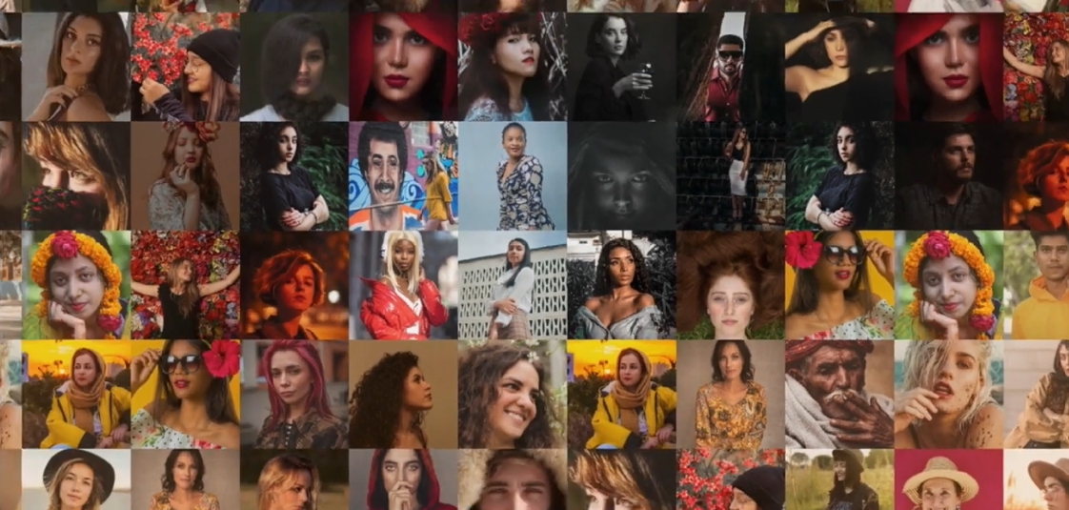
Scale reveals what close reading cannot — Moretti's distant reading
"Instead of concrete works, a more abstract view: models, systems, series. And yes, the great unread." Franco Moretti, Distant Reading (2013)
Close reading sees the tile
Each individual text, interaction, or utterance yields rich interpretation. But the analyst cannot see beyond the cases in front of them.
Distant reading sees the image
Moretti showed that literary genres rise and fall over decades — the Western dominated the first half of the 20th century and then almost disappeared. This pattern is invisible from any individual film or novel.
The same logic applies to pragmatics
How does the line between banter and abuse shift across communities, platforms, and time? Individual cases cannot answer this. A corpus of hundreds of thousands of interactions — annotated for pragmatic function — can.
Martin Schweinberger, University of Queensland APCLC2026, Toyama, Japan

Slide 4
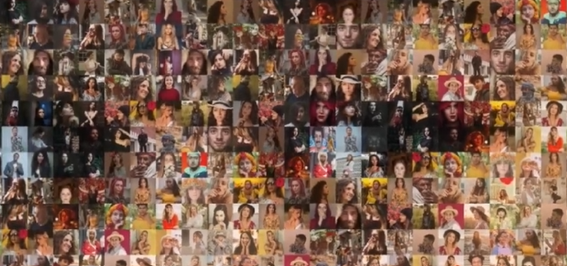
Scale reveals what close reading cannot — Moretti's distant reading
"Instead of concrete works, a more abstract view: models, systems, series. And yes, the great unread." Franco Moretti, Distant Reading (2013)
Close reading sees the tile
Each individual text, interaction, or utterance yields rich interpretation. But the analyst cannot see beyond the cases in front of them.
Distant reading sees the image
Moretti showed that literary genres rise and fall over decades — the Western dominated the first half of the 20th century and then almost disappeared. This pattern is invisible from any individual film or novel.
The same logic applies to pragmatics
How does the line between banter and abuse shift across communities, platforms, and time? Individual cases cannot answer this. A corpus of hundreds of thousands of interactions — annotated for pragmatic function — can.
Martin Schweinberger, University of Queensland APCLC2026, Toyama, Japan

Slide 5
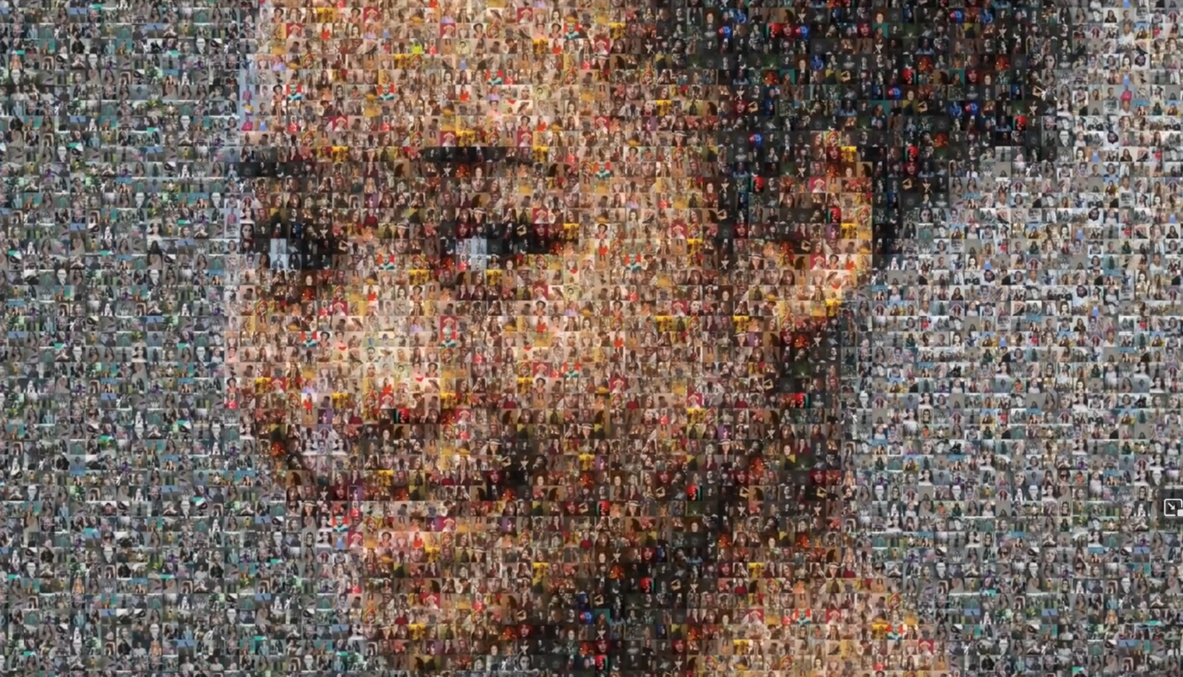
Scale reveals what close reading cannot — Moretti’s distant reading
“Instead of concrete works, a more abstract view: models, systems, series. And yes, the great unread.” Franco Moretti, Distant Reading (2013)
Close reading sees the tile
Each individual text, interaction, or utterance yields rich interpretation. But the analyst cannot see beyond the cases in front of them.
Distant reading sees the image
Moretti showed that literary genres rise and fall over decades — the Western dominated the first half of the 20th century and then almost disappeared. This pattern is invisible from any individual film or novel.
The same logic applies to pragmatics
How does the line between banter and abuse shift across communities, platforms, and time? Individual cases cannot answer this. A corpus of hundreds of thousands of interactions — annotated for pragmatic function — can.
Martin Schweinberger, University of Queensland APCLC2026, Toyama, Japan

Slide 6
Two failure modes — and the tension between them
Cross-disciplinary collaboration fails when either side ignores what the other brings. Both failure modes produce bad research.
Engineering without grounding
Many hate speech detection projects use existing “gold standard” datasets
But the definition of hate speech is poorly specified and culturally parochial
“Where the bloody hell are you?" — offensive in the US, unremarkable in Australia
The model learns the cultural assumptions of the annotators, not the phenomenon
Result: high accuracy on the benchmark, poor performance in the world
Conceptual work without operationalisation
Qualitative pragmatics produces rich frameworks for face, impoliteness, and social action
But concepts like “banter” resist simple operationalisation
When does teasing become bullying? The analyst knows — but can they specify?
Without explicit, measurable criteria, the framework cannot guide a classifier
Result: concepts that are theoretically sophisticated but computationally unusable
The solution is not to pick a side. It is to build the collaboration so that each failure mode corrects the other: pragmatic expertise disciplines the engineering; computational scale tests the concepts.
Martin Schweinberger, University of Queensland APCLC2026, Toyama, Japan

Slide 7
Demonstrating pragmatics at scale: From Banter to Abuse
Same form — different function
"You're an idiot, mate" friends watching sport together → banter, bonding, affiliation
"You're an idiot" directed at a stranger after a political post → potential abuse, face threat
About the idea
Building on a corpus of social media interactions (Bluesky + Twitter) containing both banter and abuse
Develop a pragmatically grounded annotation scheme anchored in Haugh’s jocular mockery / face threat framework
Uses network variables (tie strength, community density) to capture the relational context that determines function
Trains classifiers that generalise across cultural contexts — not locked to one gold standard dataset
Why it matters
Content moderation at scale requires automated classifiers — they currently fail at this distinction
Policy relevance: EU Digital Services Act, eSafety Commissioner — regulators need tools that work
Broader gain: a replicable workflow for studying any phenomenon where form underdetermines function
What scale reveals: how the banter/abuse boundary shifts across communities, platforms, and time
Martin Schweinberger, University of Queensland APCLC2026, Toyama, Japan

Slide 8
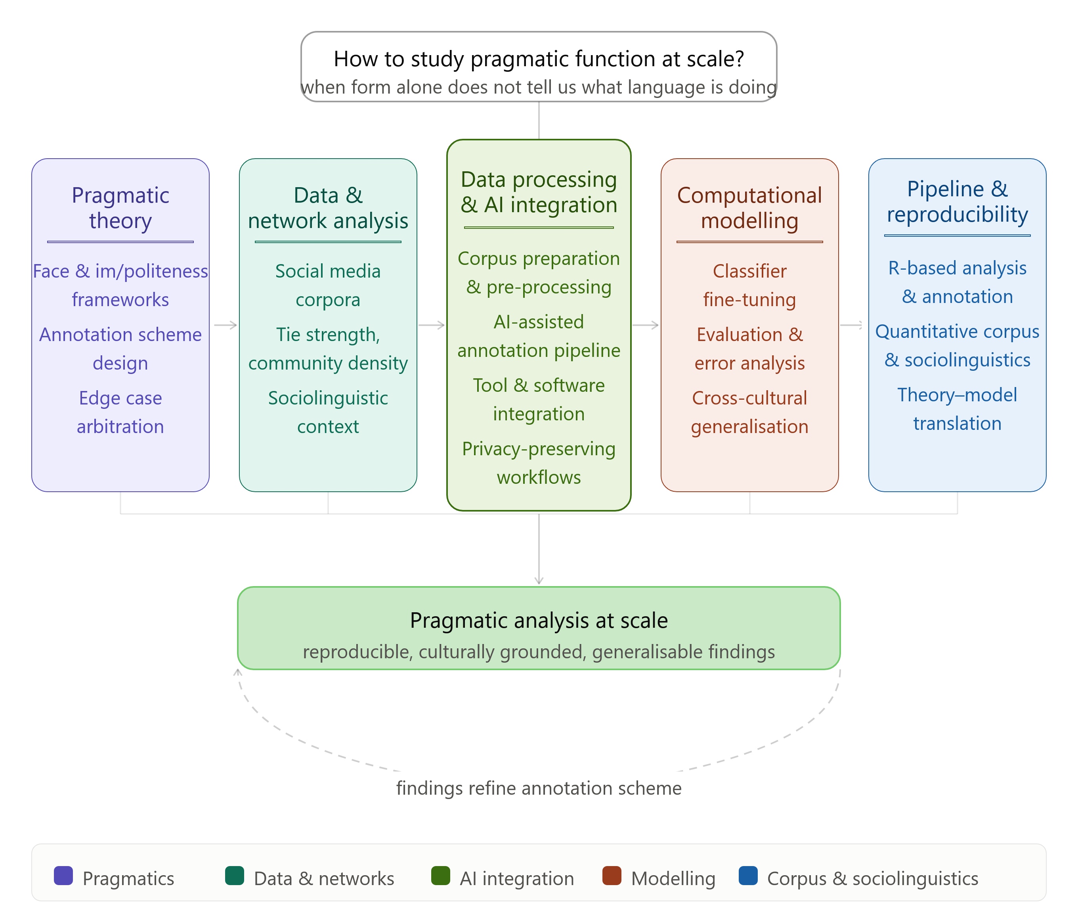
Data-Intensive Methods
allow to go beyond form,
enable seeing patterns invisible in close analyses
perform analyses at scale
Result in computational pipelines (efficient/adaptable)
But…
They require collaboration and/or training.

Slide 9
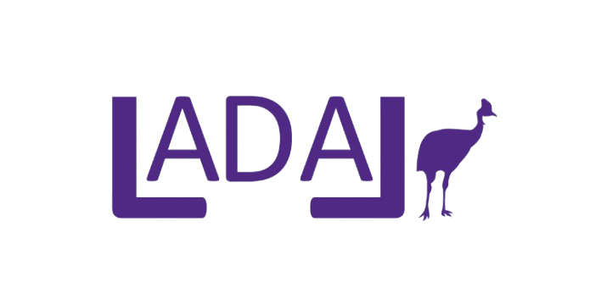
The pipeline is adaptable — and computational basics are free
The banter/abuse project is a proof of concept. The workflow it develops transfers to any phenomenon where form underdetermines function.
What the workflow (hopefully) offers
A pragmatically grounded annotation scheme — not borrowed from another cultural context
An AI-assisted pipeline that scales to corpus-sized data while preserving functional interpretation
Network-aware modelling: the social context is built into the analysis, not treated as noise
Reproducible code and documentation: the next project starts from here, not from scratch
What LADAL provides
Free, open-access tutorials from quantitative reasoning foundations to advanced ML — all CC-BY
Tools for corpus design, annotation, statistical analysis, and AI-assisted pipelines
Infrastructure for privacy-preserving analysis with local LLMs (shown in the showcase today)
A community of practice: ladal.edu.au
If you work on socially relevant discourse or pragmatic phenomena and want to collaborate — or adapt this workflow to your own research — talk to us.
Martin Schweinberger, University of Queensland APCLC2026, Toyama, Japan

