Slide 1
UQ School of Languages and Cultures Professional Development Panel Getting Started with Your Academic Career Peter Crosthwaite, Kayoko Hashimoto, Ilana Mushin, Greg Hainge, Martin Schweinberger

Slide 2


Slide 3

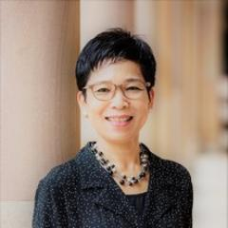
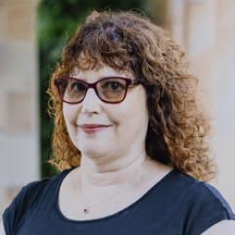


Run-of-show
2:00–2:05 — Welcome, framing, format (Martin)
2:05–2:10 — Panellist intros (~1 minute each)
2:10–2:25 — Block A: Publishing and visibility (lead: Peter)
2:25–2:40 — Block B: Networks and community (lead: Kayoko)
2:40–2:55 — Block C: Grants, awards, and career planning (lead: Ilana)
2:55–3:10 — Block D: The hiring panel view (lead: Greg)
3:10–3:30 — Open Q&A and closing thoughts

Slide 4
Block A — Publishing and visibility
Peter Crosthwaite (Deputy Head of School)
Publication strategy (venues, cadence, single vs. co-authored, book vs. article trajectories)
Presenting at conferences and making the most of them
Online academic presence (Google Scholar, LinkedIn, personal websites, ORCID)
Examples of errors: scattergun publishing without a coherent line; coasting on unrefereed venues; invisible online profile; treating conferences as passive attendance rather than networking.

Slide 5
Block B — Networks and community
Kayoko Hashimoto (Director of Higher Degree Research)
Building research collaborations and professional networks
Approaching supervisors and senior academics for mentoring and collaboration
Involvement in academic societies and professional communities
Examples of errors: transactional networking; over-reliance on supervisor’s network; staying inside a single silo; saying yes to service that doesn’t build a profile.

Slide 6
Block C — Grants, awards, and career planning
Ilana Mushin (Deputy Associate Dean (Research))
Applying for grants, awards, and prizes (including internal and early-career schemes)
General strategies for planning and developing an academic career
Examples of errors: ignoring early-career schemes; chasing prestige over fit; a weak narrative arc across the CV; no plan for gaps between contracts.

Slide 7
Block D — The hiring panel view
Greg Hainge (Head of School)
What recruitment panels actually look for
What separates a shortlisted candidate from a hired one
Red flags on applications and in interviews

Slide 8
Q&A

Slide 9
Thanks so much!
Keypoints will be circulated
Open questions and feedback to slc.dor@uq.edu.au

