Slide 1

Working Safely with Sensitive Research Data Using Local LLMs
AI in Practice: Lunchtime Insights Series
Martin Schweinberger, School of Languages and Cultures

Slide 2



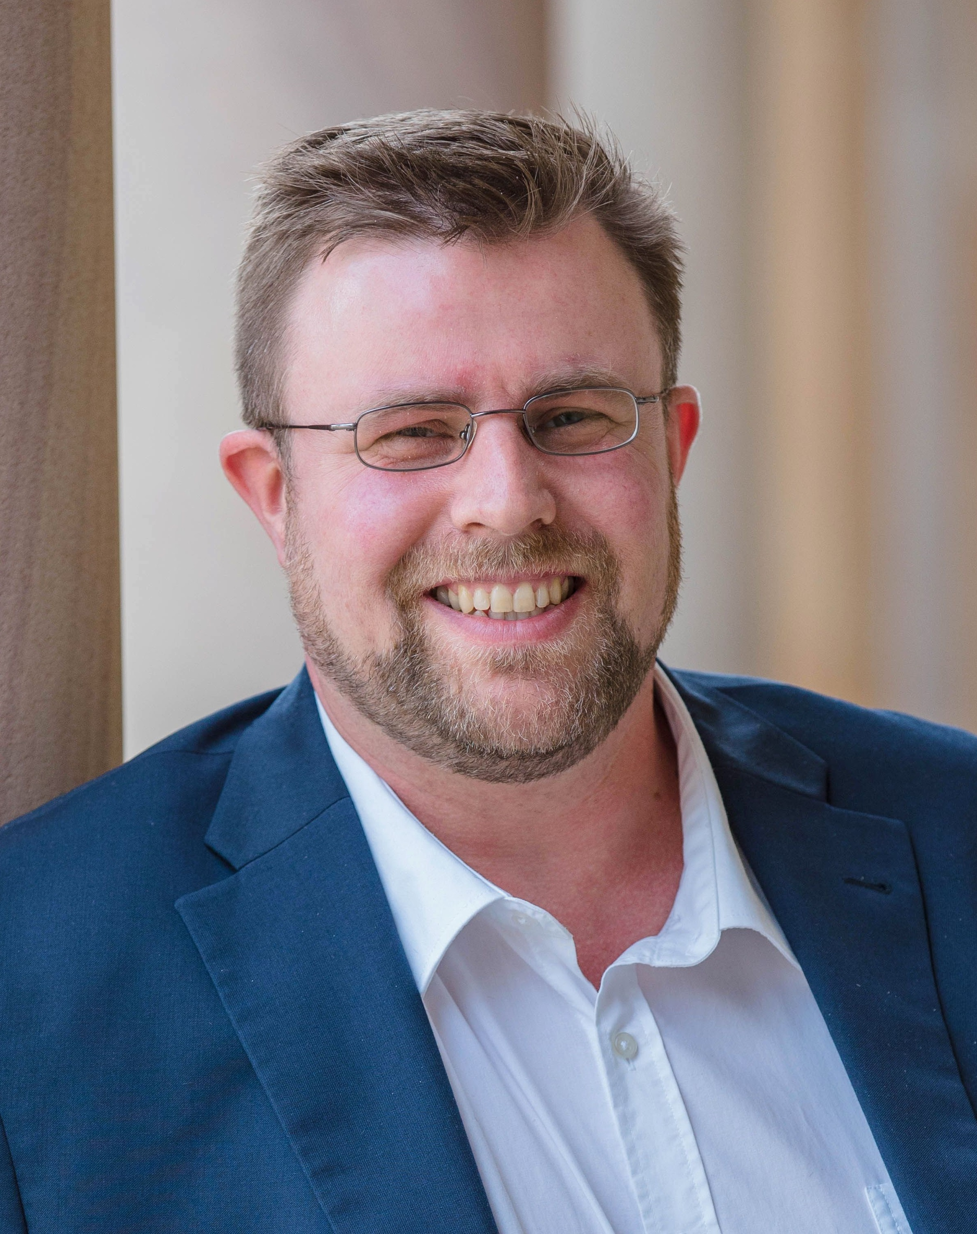
Martin Schweinberger
UQ School of Languages and Cultures Senior Lecturer in Applied Linguistics | Director of Research
Background
English linguistics, Philosophy, Psychology, Computer Science/Language Technology
Research areas
Corpus linguistics; Language data science; quantitative and computational methods
Reproducibility and open science in language research
Vulgarity, and discourse features across varieties of English
Roles
Director of the Language Technology and Data Analysis Laboratory (LADAL) UQ’s open-access hub for computational and quantitative language research, training, and reproducible-methods infrastructure
CI of the Language Data Commons of Australia (LDaCA) Australia’s national research infrastructure for language data funded by ARDC.
Links
www.ladal.edu.au
www.martinschweinberger.de
m.schweinberger@uq.edu.au

Slide 3
The Problem: ChatGPT says upload; Ethics says no.
A researcher collects 80 patient interview transcripts involving people with mild cognitive impairment. The transcripts contain:
Patient names and pseudonyms
Descriptions of cognitive difficulties
Family and healthcare details
Emotionally sensitive disclosures
Ethics approval says
GDPR / Privacy Act No upload to external servers
Participant consent Data used only for approved purposes
Institutional policy No third-party processing without approval
Result: researchers with the most important data are locked out of the most powerful tools.

Slide 4
The cloud AI doesn’t need your data.
It needs to understand your data’s structure.
A synthetic copy that looks like your data is enough to generate working analysis code –
and your real participants never leave your machine.

Slide 5
Same structure. No real participants.
ORIGINAL TRANSCRIPT (ICE-Ireland)
<S1A-021 Provincetown> <I> <S1A-021$A> <#> So Daniel <,> what about Scotland <S1A-021$B> <#> It was really really good <S1A-021$A> <#> Did the weather hold up for you <S1A-021$B> <#> Not too bad <#> It drizzled a few days but I mean that 's expected over there <#> You know <#> It was very relaxing <S1A-021$A> <#> And did you find nice places to stay <S1A-021$B> <#> Actually old sort of taverns and
↑ Real ICE-Ireland markup format, real content
TRANSCRIPT PROXY (ICE-Ireland format)
<S1A-021 Weekend> <I> <S1A-021$A> <#> So what did you get up to at the weekend <,> then <S1A-021$B> <#> Ah sure <,> we went out to Malahide <,,> you know the way <#> lovely spot it was <S1A-021$A> <#> I 've never been actually <#> is it far <S1A-021$B> <#> Not at all <,> maybe forty minutes on the DART <#> grand
↑ Real ICE-Ireland markup format, fictional content

Slide 6
Same structure. No real participants.
TRANSCRIPT PROXY (ICE-Ireland format)
<S1A-021 Weekend> <I> <S1A-021$A> <#> So what did you get up to at the weekend <,> then <S1A-021$B> <#> Ah sure <,> we went out to Malahide <,,> you know the way <#> lovely spot it was <S1A-021$A> <#> I 've never been actually <#> is it far <S1A-021$B> <#> Not at all <,> maybe forty minutes on the DART <#> grand
↑ Real ICE-Ireland markup format, fictional content
TABULAR PROXY (clinical assessment data)
ID | Age | MMSE | Diagnosis | RT(ms)
1042 | 71 | 24 | MCI | 812
1043 | 68 | 27 | Control | 643
1044 | 79 | 18 | AD | 1204
1045 | 74 | 22 | MCI | 934
1046 | 66 | 29 | Control | 591
1047 | 82 | 14 | AD | 1687
1048 | 70 | 25 | MCI | 778
1049 | 73 | 28 | Control | 512
↑ Real variable names and formats, fictional values

Slide 7
The DGUCR Workflow
DESCRIBE
Tell the local LLM
what your data looks like
GENERATE
Local LLM creates a synthetic data proxy
UPLOAD
Send only the synthetic proxy data to cloud AI
CODE
Cloud AI writes your R / Python analysis code
RUN
Execute code locally on your real data
1
2
3
4
5
LOCAL
LOCAL
CLOUD
CLOUD
LOCAL
Real data never leaves your machine · The cloud AI sees only the synthetic proxy

Slide 8
The tools: Free. Local. No specialist hardware needed.
Ollama (or other local LLM platforms)
Runs LLMs on your machine Free desktop app. Downloads and serves open-source language models locally. No GPU required for smaller models. Works on Mac, Windows, Linux
ollama.com
ollamar
R interface to Ollama CRAN package. Clean tidyverse-compatible API. generate() and chat() functions. Works on any machine running Ollama. install.packages("ollamar")
CRAN / GitHub
Cloud AI (ChatGPT, Claude, etc.)
Writes your analysis code Claude, ChatGPT, Gemini – your choice. Receives only the synthetic proxy. Generates R or Python code. Works in any browser.
claude.ai / chatgpt.com
Laptop-friendly · All open source · LADAL tutorial walks through every step

Slide 9
How do you know the data proxy is good enough?
For code generation, you need structural fidelity — not statistical perfection.
✓ Format matches
Same markup, same column names, same file structure
✓ Value ranges match
Variables stay within realistic bounds for your population
✓ Missing values present
If real data has NAs, synthetic data must too
→Statistical distributions
For power analysis or replication → use synthpop instead
Always test the generated code on the synthetic proxy before running on real data.

Slide 10

DIY: Step-by-step tutorial – free and open access
ladal.edu.au – The Language Technology and Data Analysis Laboratory
TUTORIAL 1
Local LLMs in R with Ollama — setup, generate(), chat(), prompt engineering https://ladal.edu.au/tutorials/ollamar/ollamar.html
TUTORIAL 2
Privacy-Preserving Analysis — the full DGUCR workflow with worked examples https://ladal.edu.au/tutorials/llm_privacy/llm_privacy.html
Case Study
ICE-Ireland synthetic proxy validation — R code, metrics, comparison tables
All tutorials: freely available · CC-BY licence · Reproducible R code included

Slide 11
Let’s discuss
What sensitive data are you currently NOT using AI tools for and why?
1
Where is the line between data structure and data content?
2
What would change in your research workflow if synthetic proxy generation became standard practice?
3

Slide 12
Martin Schweinberger
Senior Lecturer in Applied Linguistics
m.schweinberger@uq.edu.au

