Slide 1
Rethinking What Data-Intensive Methods Can Do in Sociolinguistics and Sociopragmatics
Position Statement Martin Schweinberger
Beyond Form:
Pragmatics at Scale and the Potential of Cross-Disciplinary Collaboration
Martin Schweinberger, University of Queensland
APCLC2026, Toyama, Japan

Slide 2
Background
Workshop Morcote
Gerold Schneider (LiRI, UZH), Mikko Laitinen (UEF), Martin Schweinberger (UQ, LADAL)
Responses to “Do you want to have a coffee?” – AI-based inference annotation of responses → AI involved in analysis! Haugh, Michael, Gerold Schneider and Sophia Conrad (in preparation). “Are AI and computational methods relevant to pragmatics?”, Intercultural Pragmatics.
Laurence Anthony Visiting Scholar at UQ
LLMs for HASS Research: Opportunities, Challenges, and a Human-Centred Future (talk at UQ 18/8/2026) → Impact of AI on academia, workflows & training
CUP Element
Data-Intensive Pragmatics: Doing Pragmatics at Scale (Schweinberger in prep)
Martin Schweinberger, University of Queensland APCLC2026, Toyama, Japan

Slide 3
Traditional and Post-AI Data-Intensive Paradigms
Data-intensive methods can enhance sociolinguistic and sociopragmatic research by either improving traditional paradigm of doing research (but more effectively and at scale) BUT it can also go beyond what we where able to do.
Data Intensive Methods in the Traditional Paradigm
Code-based workflows (Transparency, Reproducibility, Efficiency)
Regular expressions (Pattern detection, Big Data)
Annotation and Classification (Rich Data, Machine Learning, beyond language)
Data Intensive Methods in the post AI Paradigm
Improved efficiency via AI (applicable for all traditional workflows)
AI involved in analysis itself!
Going beyond FORM!
Going beyond FORM allows us to do research at scale that was previously restricted to close reading!
Martin Schweinberger, University of Queensland APCLC2026, Toyama, Japan

Slide 4
Corpus linguistics works at scale — but stays at form
The discipline has developed powerful methods for describing what is in language data. The harder question is what language is doing.
Corpus Linguistics FORM
Pragmatics|Conversation Analysis FUNCTION
The Gap OPPORTUNITY (AI)
Works at scale — millions of words, thousands of texts
Counts, classifies, and distributes linguistic forms
Frequency, collocation, keyness, concordance
Strength: scale, replicability, statistical rigour
Works at depth — individual interactions, fine-grained interpretation
Asks what speakers are doing with language: how meaning is negotiated
Sequence, context, implicature, face, social action
Strength: functional richness, interpretive validity
Scale without function: we know how often "idiot" appears; we do not know whether it is banter or abuse
Function without scale: we understand the pragmatics of one interaction; we cannot see the population-level pattern
AI makes it possible — for the first time — to ask functional questions at corpus scale. But only if the functional framework is rigorous enough to guide it.
Martin Schweinberger, University of Queensland APCLC2026, Toyama, Japan

Slide 5
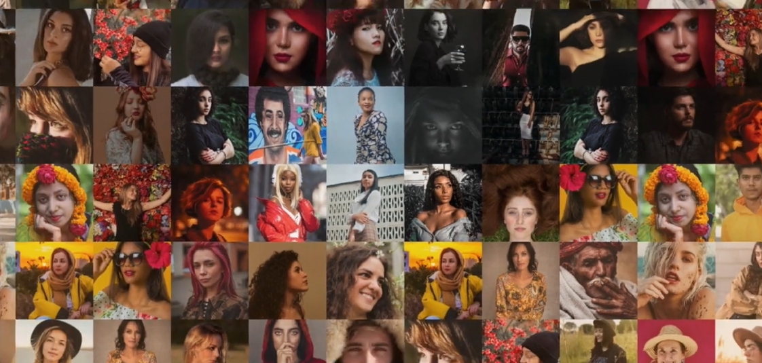
Scale reveals what close reading cannot — Moretti's distant reading
"Instead of concrete works, a more abstract view: models, systems, series. And yes, the great unread." Franco Moretti, Distant Reading (2013)
Close reading sees the tile
Each individual text, interaction, or utterance yields rich interpretation. But the analyst cannot see beyond the cases in front of them.
Distant reading sees the image
Moretti showed that literary genres rise and fall over decades — the Western dominated the first half of the 20th century and then almost disappeared. This pattern is invisible from any individual film or novel.
The same logic applies to pragmatics
How does the line between banter and abuse shift across communities, platforms, and time? Individual cases cannot answer this. A corpus of hundreds of thousands of interactions — annotated for pragmatic function — can.
Martin Schweinberger, University of Queensland APCLC2026, Toyama, Japan

Slide 6
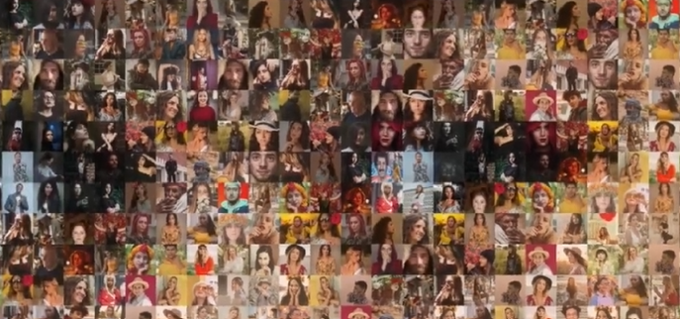
Scale reveals what close reading cannot — Moretti's distant reading
"Instead of concrete works, a more abstract view: models, systems, series. And yes, the great unread." Franco Moretti, Distant Reading (2013)
Close reading sees the tile
Each individual text, interaction, or utterance yields rich interpretation. But the analyst cannot see beyond the cases in front of them.
Distant reading sees the image
Moretti showed that literary genres rise and fall over decades — the Western dominated the first half of the 20th century and then almost disappeared. This pattern is invisible from any individual film or novel.
The same logic applies to pragmatics
How does the line between banter and abuse shift across communities, platforms, and time? Individual cases cannot answer this. A corpus of hundreds of thousands of interactions — annotated for pragmatic function — can.
Martin Schweinberger, University of Queensland APCLC2026, Toyama, Japan

Slide 7
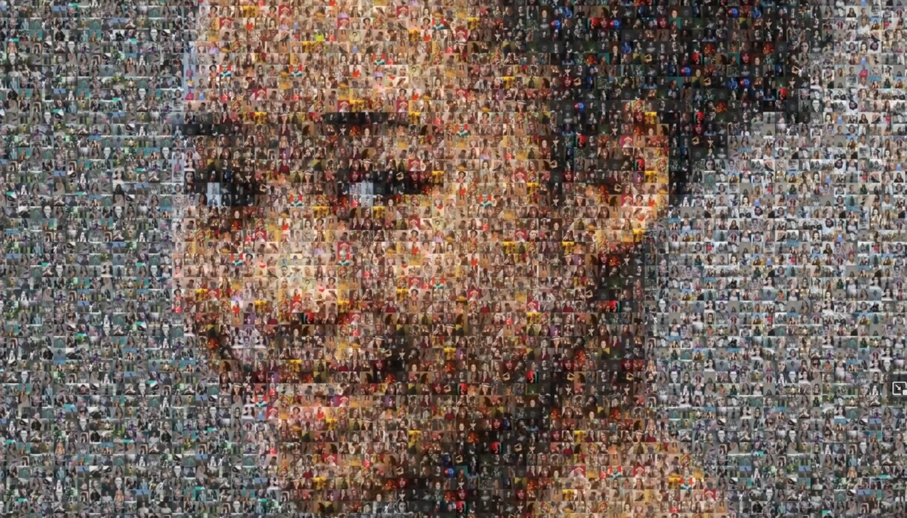
Scale reveals what close reading cannot — Moretti’s distant reading
“Instead of concrete works, a more abstract view: models, systems, series. And yes, the great unread.” Franco Moretti, Distant Reading (2013)
Close reading sees the tile
Each individual text, interaction, or utterance yields rich interpretation. But the analyst cannot see beyond the cases in front of them.
Distant reading sees the image
Moretti showed that literary genres rise and fall over decades — the Western dominated the first half of the 20th century and then almost disappeared. This pattern is invisible from any individual film or novel.
The same logic applies to pragmatics
How does the line between banter and abuse shift across communities, platforms, and time? Individual cases cannot answer this. A corpus of hundreds of thousands of interactions — annotated for pragmatic function — can.
Martin Schweinberger, University of Queensland APCLC2026, Toyama, Japan

Slide 8
Demonstrating pragmatics at scale: From Banter to Abuse
Same form — different function
"You're an idiot, mate" friends watching sport together → banter, bonding, affiliation
"You're an idiot" directed at a stranger after a political post → potential abuse, face threat
About the idea
Building on a corpus of social media interactions (Bluesky) containing both banter and abuse
Develop a pragmatically grounded annotation scheme, e.g., Haugh’s jocular mockery / face threat framework
Uses network variables (tie strength, community density) to capture the relational context that determines function
Generate crowd-sourced culture-specific gold-standard datasets — not locked to one gold standard dataset
Why it matters
Content moderation at scale requires automated classifiers — they currently fail at this distinction
Policy relevance: EU Digital Services Act, eSafety Commissioner — regulators need tools that work
Broader gain: a replicable workflow for studying any phenomenon where form underdetermines function
What scale reveals: how the banter/abuse boundary shifts across communities, platforms, and time
Martin Schweinberger, University of Queensland APCLC2026, Toyama, Japan

Slide 9
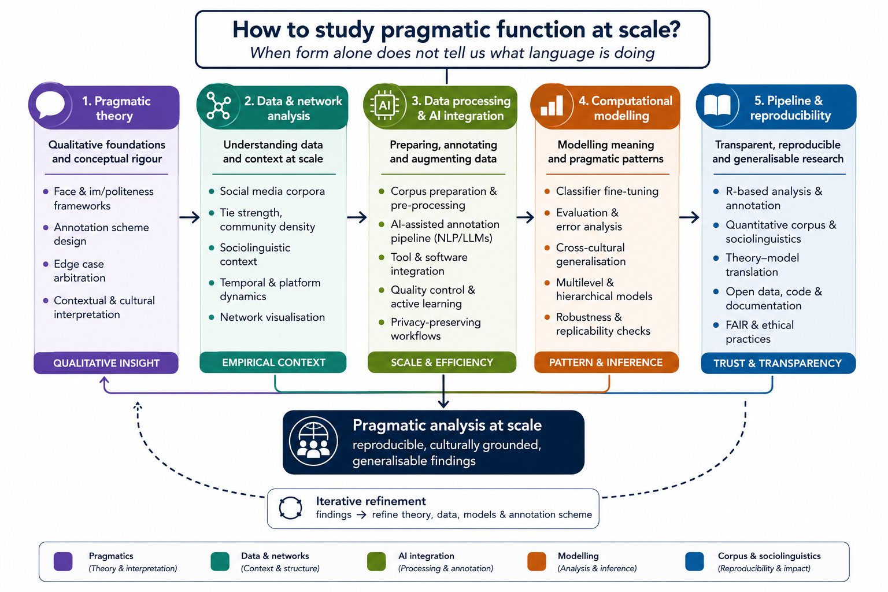
Data-Intensive Methods
Allow going beyond form
Perform analyses at scale
Enable seeing patterns invisible in close analyses
Result in computational pipelines (efficient/adaptable)
But…
They require collaboration and/or training.

Slide 10
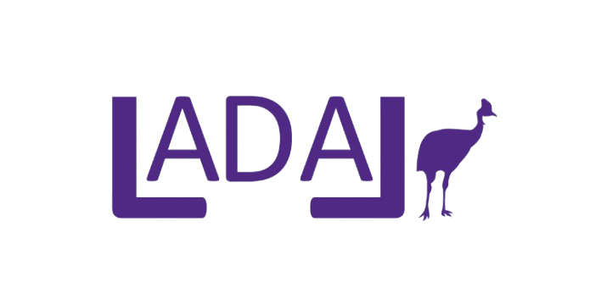
The pipeline is adaptable — and computational basics are free
The banter/abuse project is a proof of concept. The workflow it develops transfers to any phenomenon where form underdetermines function.
What the workflow (hopefully) offers
A pragmatically grounded annotation scheme — not borrowed from another cultural context
An AI-assisted pipeline that scales to corpus-sized data while preserving functional interpretation
Network-aware modelling: the social context is built into the analysis, not treated as noise
Reproducible code and documentation: the next project starts from here, not from scratch
What LADAL provides
Free, open-access tutorials from quantitative reasoning foundations to advanced ML — all CC-BY
Tools for corpus design, annotation, statistical analysis, and AI-assisted pipelines
Infrastructure for privacy-preserving analysis with local LLMs (shown in the showcase today)
A community of practice: ladal.edu.au
If you work on socially relevant discourse or pragmatic phenomena and want to collaborate — or adapt this workflow to your own research — talk to us.
Martin Schweinberger, University of Queensland APCLC2026, Toyama, Japan

