Slide 1
An introduction to conditional inference trees in R
Assoc. Prof. Dr. Martin Schweinberger
University of Queensland | Arctic University of Norway, Tromsø

Slide 2





About me
Quantitative corpus-linguist
Lecturer in Applied linguistics at the University of Queensland (UQ)
Associate Professor II at the Arctic University of Norway in Tromsø (UiT)
Co-Director of the Language Technology and Data Analysis Laboratory (LADAL) at UQ
Principal Data Science Advisor to the AcqVA Aurora Lab at UiT
Projects: Australian Text Analytics Platform (ATAP) | Language Data Commons of Australia (LDaCA)
Studied Philosophy, English Philology and Psychology in Kassel and Galway
PhD in Hamburg, Post docs (or similar positions) at the Linguistic Diversity in Urban Areas Excellence Cluster (LiMA), the FU Berlin, the Universities of Greifswald, Luneburg, and Kassel

Slide 3
About the workshop
Timeline | Table of Contents
Introduction
When to use trees
What are pros and cons?
Case study | Practice
Outro
During practice, we will use a Jupyter notebook and you can
sit back and follow
you can practice using the data provided by me
you can try and use your own data (but I cannot help you in modifying the code)

Slide 4

Introduction: what are tree-based models?
Better than chi-square tests because
it is multivariate
is robust
takes all types of variables.
Tree-based models are a multivariate statistical method used in machine learning and it is now becoming more common in the language sciences. It is non-parametric and thus relies on few distributional requirements, it is easy to use, and it takes any type of dependent and predictor variables. It works by recurrent partitioning (splitting) of the data.

Slide 5
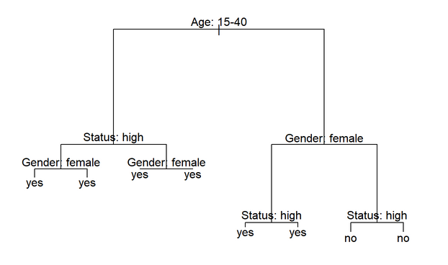
Example
Classification and Regression Trees
Decision tree all possible nodes (outcomes) are shown
Classification and Regression Tree only splits if justified by information measure (e.g., Gini; we will talk about Gini later)
Conditional Inference Tree only splits based on statistical test (splits represent statistical difference)
Basic principle
Take a data set and see if there is a maximally distinct distribution of the dependent variable if we split the data set on a level of any of the independent variables (repeat until the resulting distribution is no longer different)
Think break Let’s assume we have 10,000 adults and we want to split them into men and women: what would be the best variable to split them by (assuming we can only go be looks including height)?

Slide 6
When to use tree-based models
Variable types
Nominal (two levels, e.g. yes, no)
Categorical (more than 2 levels, e.g., nationalities)
Ordinal (ranked or ordered categories, e.g., disagree, neutral, agree)
Numeric
Counts (e.g., 2, 15, 212)
True numeric (e.g., -5.8, 1.4, 113.0)
You have one dependent variable (outcome | response)
You have more than one independent variable (predictor)
You expect there to be interactions between independent variables (effects or not only additive)
You are interested in how predictors impact a response (outcome)
Your categorical variables have less than 54 levels
Effects are non-linear
The most important effect is not an interaction

Slide 7
Pros
Several advantages have been associated with using tree-based models:
Tree-structure models are very useful because they are extremely flexible as they can deal with different types of variables and provide a very good understanding of the structure in the data.
Tree-structure models have been deemed particularly interesting for linguists because they can handle moderate sample sizes and many high-order interactions better then regression models.
Tree-structure models are (supposedly) better at detecting non-linear or non-monotonic relationships between predictors and dependent variables. This also means that they are better at finding and displaying interactions involving many predictors.
Tree-structure models are easy to implement in R and do not require the model selection, validation, and diagnostics associated with regression models.
Tree-structure models can be used as variable-selection procedure which informs about which variables have any sort of significant relationship with the dependent variable and can thereby inform model fitting.

Slide 8
Cons
Despite these potential advantages, a word of warning is in order. For instance,
Simple tree-structure models have been shown to fail in detecting the correct predictors if the variance is solely determined by a single interaction (Gries 2021, chap. 7.3). This failure is caused by the fact that the predictor used in the first split of a tree is selected as the one with the strongest main effect (Boulesteix et al. 2015, 344). This issue can, however, be avoided by hard-coding the interactions as predictors plus using ensemble methods such as random forests rather than individual trees (see Gries 2021, chap. 7.3).
Another shortcoming is that tree-structure models partition the data (rather than “fitting a line” through the data which can lead to more coarse-grained predictions compared to regression models when dealing with numeric dependent variables (again, see Gries 2021, chap. 7.3).
Boulesteix et al. (2015, 341) state that high correlations between predictors can hinder the detection of interactions when using small data sets. However, regression do not fare better here as they are even more strongly affected by (multi-)collinearity (see Gries 2021, chap. 7.3).
Tree-structure models are bad a detecting interactions when the variables have strong main effects which is, unfortunately, common when dealing with linguistic data (Wright, Ziegler, and König 2016).
Tree-structure models cannot handle factorial variables with many levels (more than 53 levels) which is very common in linguistics where individual speakers or items are variables.

Slide 9
Let’s now learn how to implement a conditional inference tree in R
Thank you very much!
Assoc. Prof. Dr. Martin Schweinberger

Slide 10

References
Boulesteix, Anne-Laure, Silke Janitza, Alexander Hapfelmeier, Kristel Van Steen, and Carolin Strobl. 2015. “Letter to the Editor: On the Term ‘Interaction’ and Related Phrases in the Literature on RandomForests.” Briefings in Bioinformatics 16 (2): 338–45. https://academic.oup.com/bib/article/16/2/338/246566.
Gries, Stefan Th. 2021. Statistics for Linguistics Using r: A Practical Introduction. Berlin & New York: Mouton de Gruyter.
Wright, Marvin N., Andreas Ziegler, and Inke R. König. 2016. “Do Little Interactions Get Lost in Dark Random Forests?” 17 (145). https://bmcbioinformatics.biomedcentral.com/articles/10.1186/s12859-016-0995-8.

Slide 11
Let’s now learn how to implement a conditional inference tree in R

Slide 12
An introduction to conditional inference trees in R
Assoc. Prof. Dr. Martin Schweinberger
University of Queensland | Arctic University of Norway, Tromsø

