Slide 1
An acoustic analysis of vowel production by L1-Chinese learners of English
Martin Schweinberger
m.schweinberger@uq.edu.au
All materials (except data) available at https://github.com/MartinSchweinberger/UHHvowels
The study presented here is part of a project I am collaborating on with Dr Ruihua Yin at the University of Queensland.

Slide 2

Introduction
Pronunciation is most immediate and direct
Everybody automatically and subconsciously infers judgements based on pronunciation (gender, age, cultural background, nativeness, socio-economics, education, etc.)
Pronunciation and speech is key in language learning and teaching contexts (LLT)!
Pronunciation affects real-life opportunities(jobs, partner choice, etc.)
Listeners need to understand what is said
Pronunciation is crucial for intelligibility: The more processing effort is taken up by decoding linguistic aspects of a message, the less processing power is left for decoding the meaning → accents impact comprehension and intelligibility! (Munro & Derwing 1995, Jeong, Elgemark, & Thorén 2021)

Slide 3
Introduction
Variety and diversity of spoken language is beautiful, and all accents and varieties are equally valuable as objects of study!
Corpus-based research on spoken language focuses almost exclusively on transcripts
Most corpus tools are designed for text (not speech)
Most corpora do not provide audio data
Analyses of speech (acoustic phonetics) are almost always experimental (not corpus-based)
Small samples (5 – 10 speakers)
Laboratory setting (unnatural environment / speech)
Large-scale empirical analyses of naturally occurring speech are highly relevant but dramatically under-researched!

Slide 4

An acoustic analysis of vowel production by L1-Chinese learners of English
Timeline | Table of Contents
Background and Motivation
Research Gaps | Research Questions
Methodology (Data and Analysis)
Results
Discussion and Outlook

Slide 5

Background and Motivation
Why is pronunciation a challenge for L2 English learners?
Languages interact in the minds of multilingual speakers
Speech Learning Model (SLM) (Flege 1995)
L1 and L2 sound systems exist in a shared phonetic space in the bilingual mind
As a result, the L2 sound system is affected by the L1 system (and vice versa)
Cross Linguistic Transfer (CLI) (Odlin, 1989)
The influence resulting from similarities and differences between the target language and any other language that has been previously acquired.
L1
L2

Slide 6
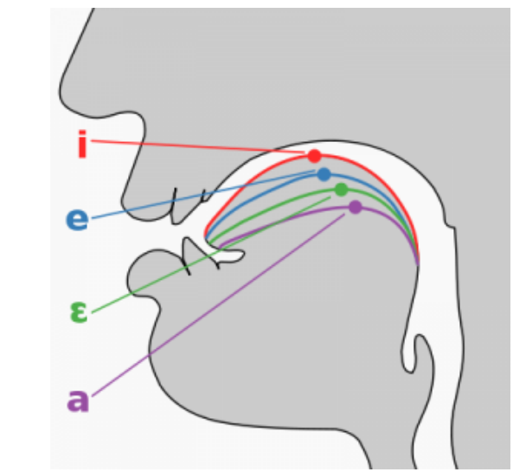
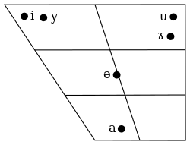
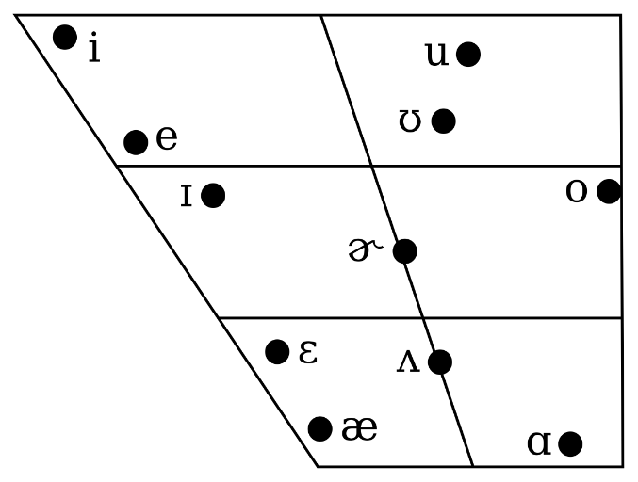
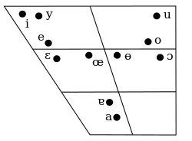
Background and Motivation
Prior research reports that Chinese learners struggle with English vowels, in particular, they have problems differentiating between
/iː/ and /ɪ/ (see, e.g., Zhang & Yin, 2009)
/uː/ and /ʊ/ (Wang & Van Heuven 2006)
/ɛ/ and /æ/ (Wang, 2008; Zhang & Lu, 2012; Jiang & Zhang 2019)
Reasons
Differences in inventory size (CHN: Mandarin 6 vowels* vs. ENS: app.** 11 vowels) (Wang & Sun, 2015)
Differences in how vowels are differentiated (ENS: formants + duration | CHN: formants + tone)
Mandarin monophthongal vowels
Monophthongal vowels in southern Californian English
Cantonese monophthongal vowels
* Cantonese has 11 monophthongal vowels, i.e., vowels with a fixed tongue position (no moving tonue position like /au/ or /ou/.
** Depending on the variety of English.

Slide 7
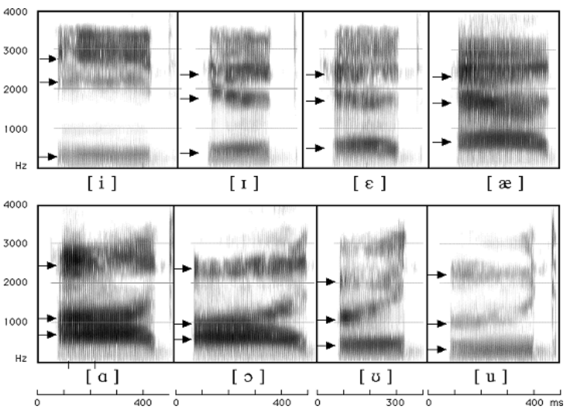
Background and Motivation
What are “formants”? and do they have to do with tongue position?
Formants are concentration of acoustic energy at a certain frequency (Ladefoged & Johnson 2014 )
First formants (F1) inversely correspond to the tongue height
Second formants (F2) and inversely correspond to tongue fronting
Left: Vowel chart of southern Californian Engl.
F3
F1 (tongue height)
F2
F1
F2 (tongue fronting)

Slide 8
Research Gaps | Research Questions
Problems and gaps in previous research
Very little research: existing research very impressionistic (few systematic empirical research despite Chinese learners of English being one of the largest learner groups globally!)
Learner vowel traits in naturalistic speech environments largely unknown
Limited generalisability | applicability of the findings
Current Study
Larger-scale analysis of Chinese learners of English vowels
produced under more spontaneous speech conditions is needed!
RQ: What factors correlate with divergencies in English vowel production among Chinese learners of English?

Slide 9
















Methodology (Data | Analysis)
Data
International Corpus Network of Asian Learners of English (ICNALE) (Ishikawa 2014)
Free for everyone to use
Includes more than 10,000 topic-controlled speeches by college students (English native speakers and speakers from 10 regions in Asia)
Audio data: minute long recordings (recorded on mobile phones) + transcripts
Regions
China Hong Kong Indonesia Japan Korea Pakistan
the Philippines Singapore Malaysia Taiwan Thailand
L1 speakers
USA
Canada
Australia
Britain

Slide 10
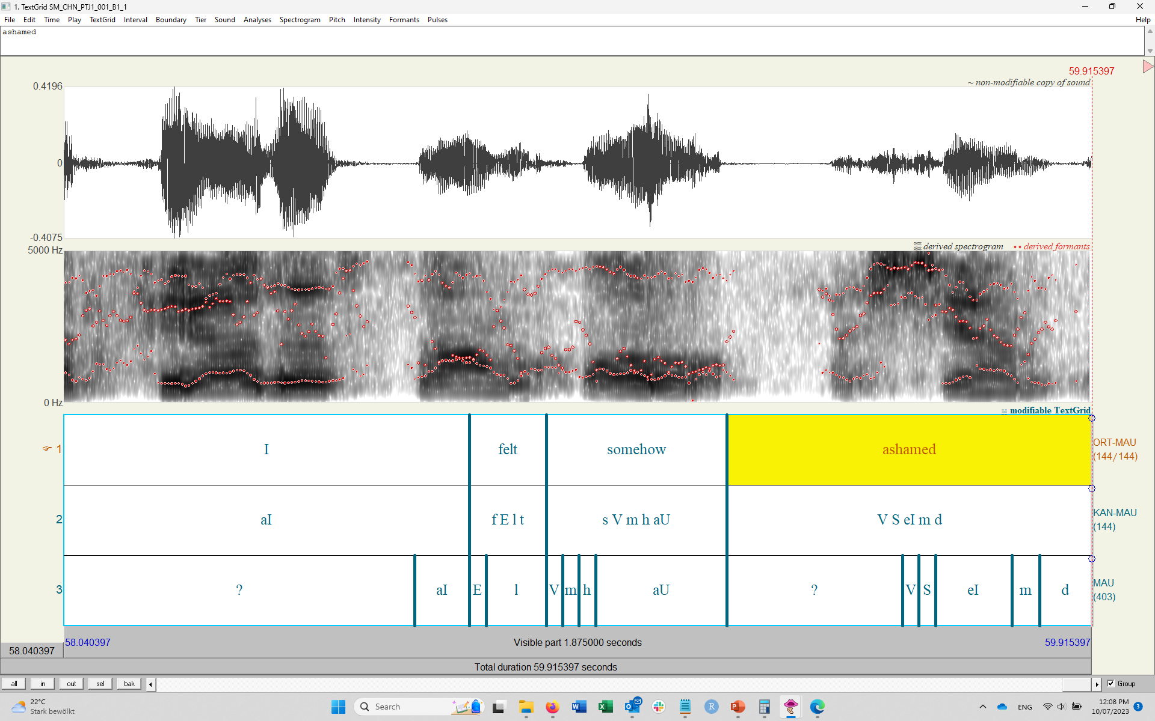

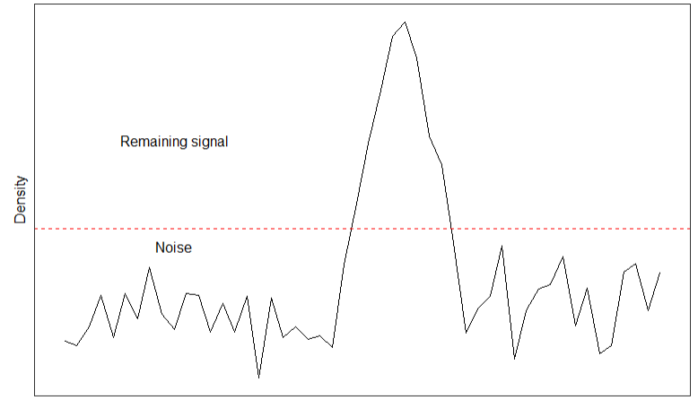
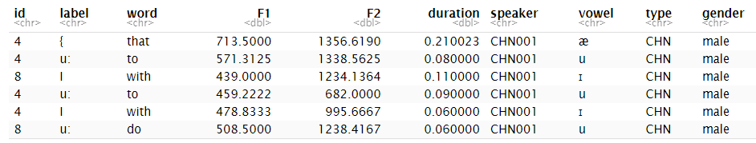
Methodology (Data | Analysis)
Data Processing (R 4.2.2, R Core team (2022) in RStudio (RStudio Team 2022))
Aligning speech with audio using Web-MAUS (Schiel 1999) (this produces Praat TextGrids)
Automated extraction of vowel formants and vowel duration from Praat TextGrids (Wickham et al. 2019)
Multisyllabic words were removed (only monosyllabic words remained)
Noise was removed using Kernel Density Estimation (only strong signal was retained)
Speaker information was added (Age, Gender, Proficiency)
Frequencies of words were added (based on frequency in standard corpora: BROWN + LOB + ACE)
Compared against standard vowels (AmE & BrE) (only best fitting vowels were retained)
Rare vowels were removed (/ɜ ɑ ɔ/)

Slide 11
Methodology (Data | Analysis)
Final data set
Spoken monologues: spontaneous speech from 148 Chinese learners and 87 L1 speakers of English
Final data set
Type | Speakers | /æ/ | /ɛ/ | /i/ | /ɪ/ | /u/ | /ʊ/ | Total
CHN | 148 | 576 | 263 | 847 | 858 | 1,215 | 244 | 4,003
ENS | 87 | 872 | 340 | 662 | 446 | 1,078 | 115 | 3,513
Total | 235 | 1,448 | 603 | 1,509 | 1,304 | 2,293 | 359 | 7,516
Type | Female | Male | Total
female | 86 | 62 | 148
male | 30 | 57 | 87
Total | 116 | 119 | 235
Left: Gender and type of speakers in final data
Gender | A2 | B1 | B2 | Total
female | 9 | 70 | 7 | 86
male | 5 | 55 | 2 | 62
Total | 14 | 125 | 9 | 148
Right: Gender and proficiency levels of CHN

Slide 12
Methodology (Data | Analysis)
Statistical Analysis
Multifactorial Prediction and Deviation Analysis using Random Forest and Regression (MuPDARF) (Heller, Bernaisch, & Gries 2017)
Combination of Machine Learning and Advanced Inferential Statistics
Idea
How would someone act if they were put exactly in the same position as someone else?
This is different from trying to assess what factors impact an outcome or if two groups differ!

Slide 13



Methodology (Data | Analysis)
Training data (ENS)
Statistical Analysis
MuPDARF (Heller, Bernaisch, & Gries 2017)
Split data into ENS and CHN
Fit Random Forest model to ENS data (prediction / dependent var.: Vowel)
Apply model to CHN data and check accuracy of RF model
Create a new variable (NonTargetLike) that shows if the observation is the same as the model prediction (0) or if the observed vowel differs from the predicted vowel (1)
Fit a mixed-effects logistic regression model (Log. GLMER) on the CHN data with NonTargetLike as dependent variable (RE: Speaker, Word) This model evaluates what factors correlate with differences between ENS and CHN production (deviation analysis).
Random Forest Model
Apply to
Comparison
Test data (CHN)
Mixed-model What factors correlate with differences?

Slide 14
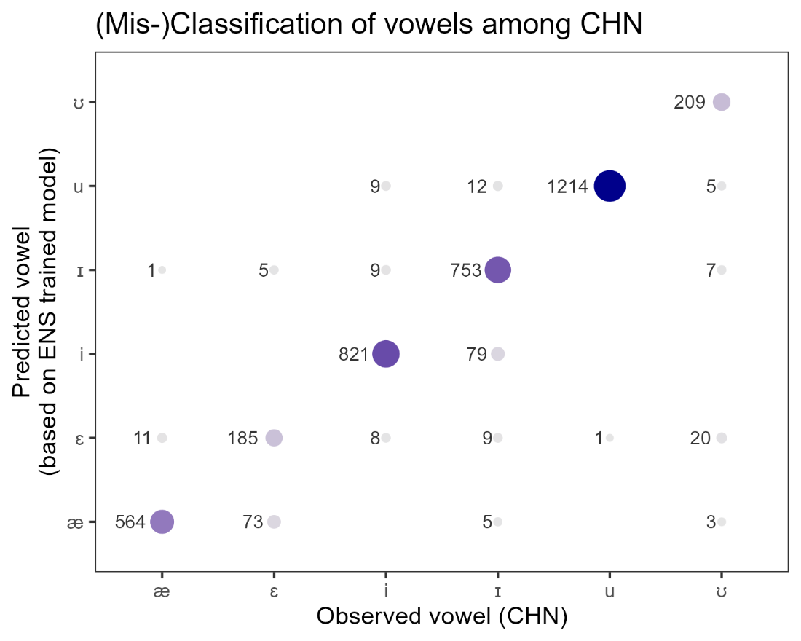
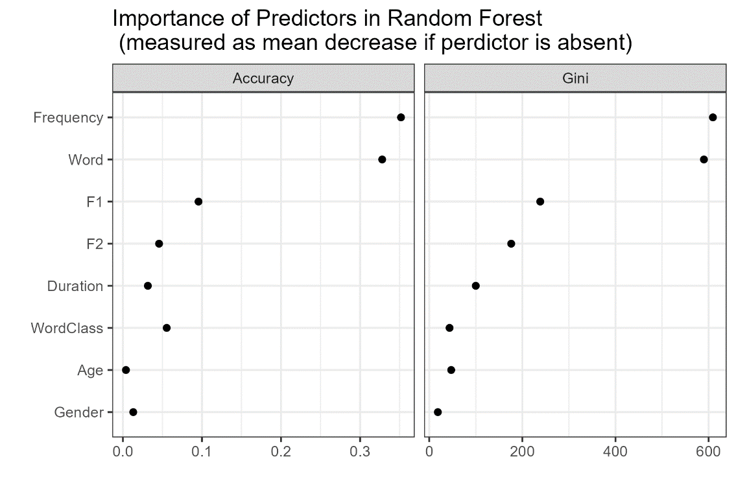
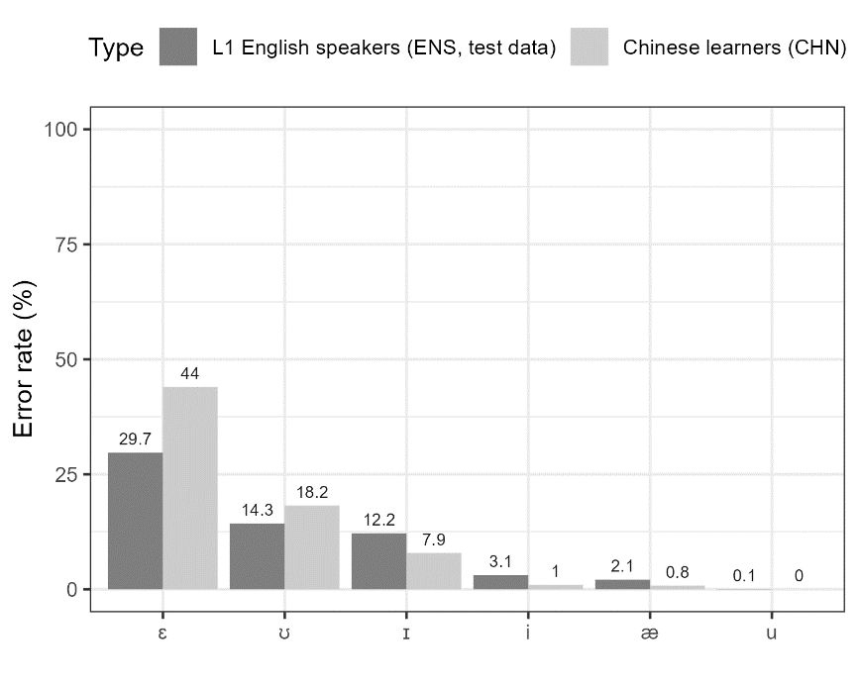
Results
RF (trained on ENS, applied CHN)
Accuracy: 0.936 (93.6 %)
Baseline Accuracy: 0.304 (30.4 %)
→ Accuracy improved by a factor of 3.08 (308 %)
Model works extremely well for both CHN and ENS (94.1 % on holdout)
Misclassifications already suggest that CHN fail to differentiate
between /ɪ/ and /iː/
between /ɛ/ and /æ/

Slide 15
Results
RF (trained on ENS, applied CHN)
Accuracy: 0.936 (93.6 %)
Baseline Accuracy: 0.304 (30.4 %)
→ Accuracy improved by a factor of 3.08 (308 %)
Model works extremely well for both CHN and ENS (94.1 % on holdout)
Misclassifications already suggest that CHN fail to differentiate
between /ɪ/ and /iː/
between /ɛ/ and /æ/

Slide 16
Results
RF (trained on ENS, applied CHN)
Accuracy: 0.936 (93.6 %)
Baseline Accuracy: 0.304 (30.4 %)
→ Accuracy improved by a factor of 3.08 (308 %)
Model works extremely well for both CHN and ENS (94.1 % on holdout)
Misclassifications already suggest that CHN fail to differentiate
between /ɪ/ and /iː/
between /ɛ/ and /æ/

Slide 17
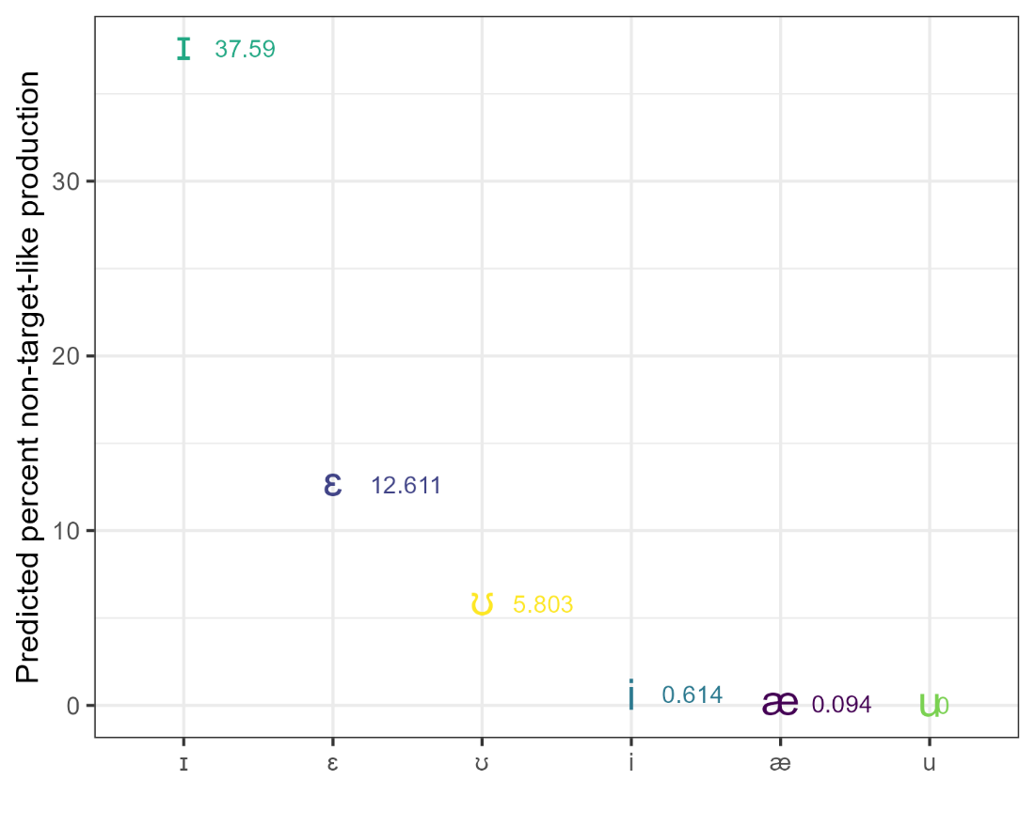
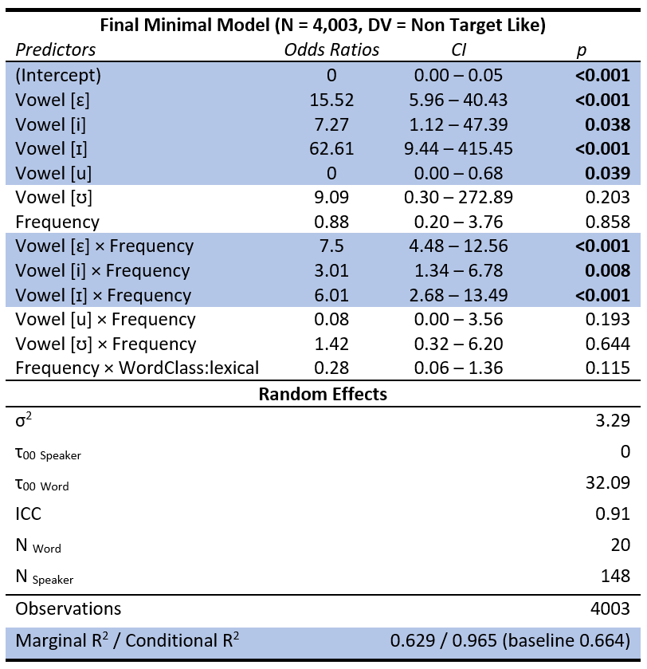
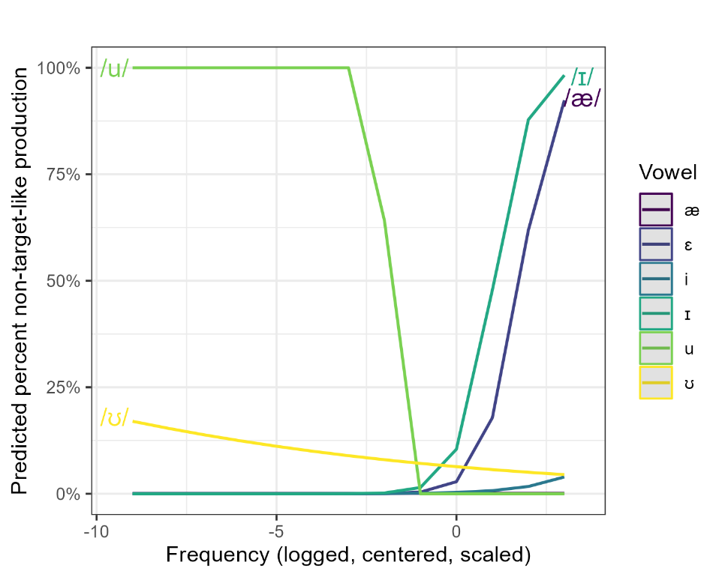
Results
More problems with short vowels!
Problems with u-sounds for low-frequency words
Problems with /ɪ æ/ for high-frequency words

Slide 18
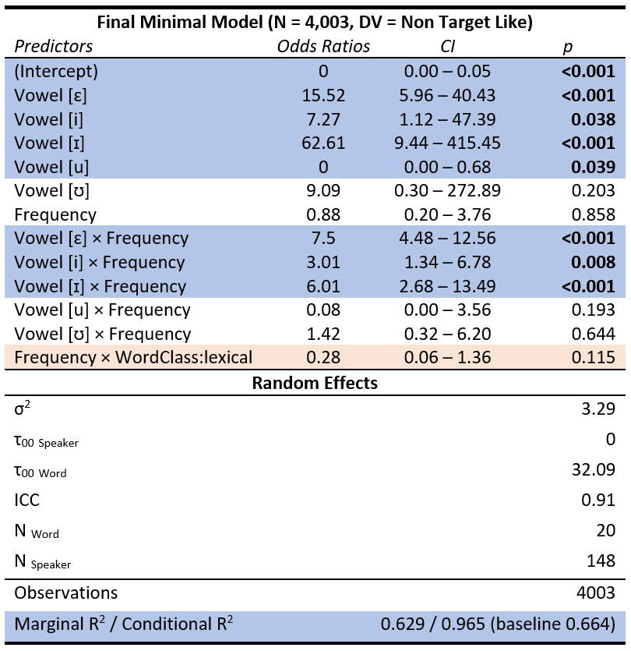
Results
More problems with short vowels!
Problems with u-sounds for low-frequency words
Problems with /ɪ æ/ for high-frequency words

Slide 19
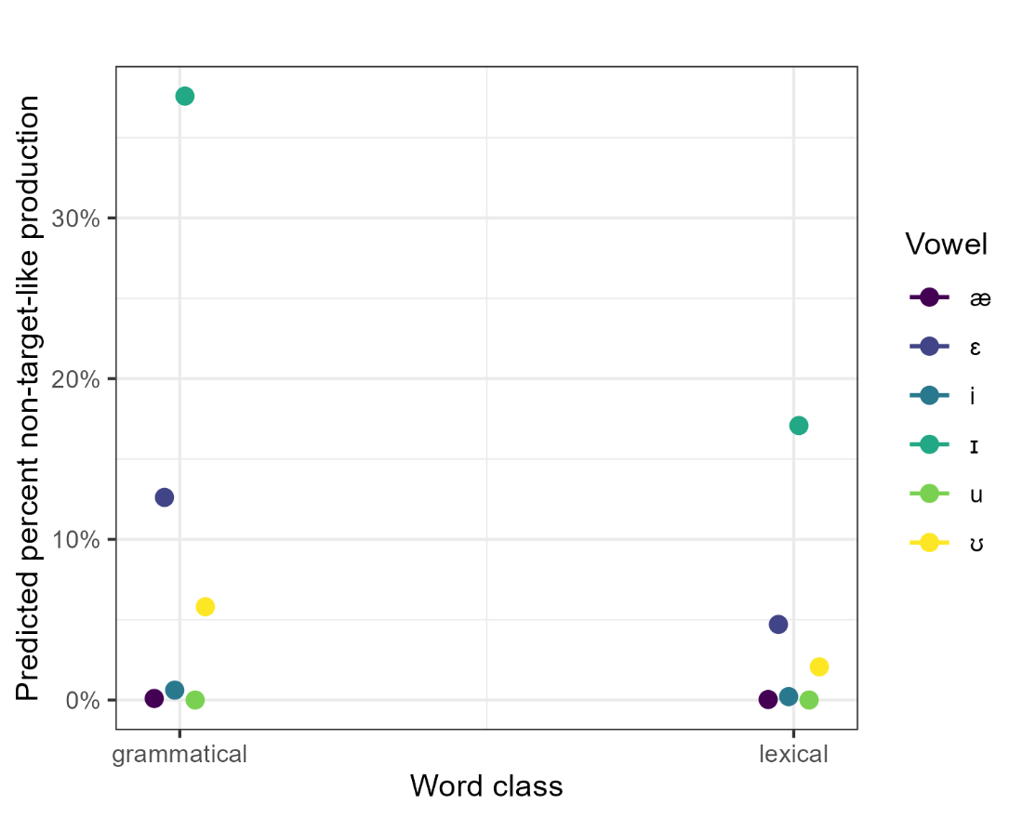
Results
If there are problems, they are more pronounced among grammatical words!
Lack of reduction of vowels in unstressed environments!

Slide 20

Discussion | Outlook
First systematic, large-scale analysis or CHN production of English vowels in natural, spontaneous speech
Main findings
The study suggest that CHN appear to have production difficulties associated with short vowels /ɪ, ʊ, æ/ : short vowels are produced as long vowels (Zhang & Yin, 2009; Wang, 2008; Zhang & Lu, 2012; Jiang & Zhang 2019)
Difficulties associated with:
Reduction in unstressed contexts (grammatical words)
Low frequency of vowels/words in input (/ʊ uː/)
Explanation
Lack of phonemic duration contrasts in L1s
Lack of vowel reduction in L1 : failure to reduce vowels in unstressed environments in target (Ln, English)
Underlying cause
Lack of practice of conversation in classrooms and informal input (low frequency / minimal input → errors producing low frequency items appropriately)
Limitations
Did not take substrate of CHN into account (Mandarin vs Cantonese vs etc.)
Quality of recordings is really poor! (minute-long recordings recorded on cell phones)!
Significance
Bad quality could | can be compensated using advanced methods (Kernel Density Estimation)
Insights into vowel production by CHN learners in spontaneous speech (underexplored) → natural setting allows to generalise findings to real-life learner speech
Automated corpus-based investigation on larger samples

Slide 21

Potential Applications
Prototype (proof-of-concept)
Extend study to L1 German learners of English (or learners of other languages) (especially learners with L1’s whose vowel system differs from English)
Significance
First large-scale, corpus-based studies of ESL vowel production in natural speech!
Follow-up: perception → do differences in vowel production correspond to difficulties in intelligibility?
Possible Applications
Creation of targeted classroom materials to improve L1-like vowel production among learners
Convert analysis into a mobile app for MELLT (Mobile-Enhanced Language Learning and Teaching)
BMBF | Volkswagen on Improving Language Production among Language Learners via Direct Digital Feedback (Collaboration with the UZH)

Slide 22
Thank you really very much!
Martin Schweinberger
m.schweinberger@uq.edu.au

Slide 23

References
Flege, J. E. (1995). Second-language speech learning: theory, findings, and problems. In W. Strange (ed.), Speech perception and linguistic experience: Issues in cross-linguistic research, 233-277. York Press.
Grenon, I., Kubota, M., & Sheppard, C. (2019). The creation of a new vowel category by adult learners after adaptive phonetic training. Journal of Phonetics 72: 17-34.
Heller, B., Bernaisch, T., & Gries, S. T. (2017). Empirical perspectives on two potential epicenters: The genitive alternation in Asian Englishes. ICAME Journal, 41(1), 111-144.
Jeong, H., Elgemark, A., & Thorén, B. (2021). Swedish youths as listeners of global Englishes speakers with diverse accents: Listener intelligibility, listener comprehensibility, accentedness perception, and accentedness acceptance. Frontiers in education 6, 651908.
Jiang, L., & Zhang, Y. (2019). Perception and production of English vowels by Chinese learners. Journal of Second Language Pronunciation, 5(1), 1-20.
Johnson, D. E. (2015). Quantifying Overlap with Bhattacharyya's affinity and other measures! Paper presented at NWAV15 (https://danielezrajohnson.shinyapps.io/nwav_44/).
Ladefoged, P., & Johnson, K. (2014). A Course in Phonetics. Cengage.
Munro, M. J., & Derwing, T. M. (1995). Processing Time, Accent, and Comprehensibility in the Perception of Native and Foreign-Accented Speech. Language and Speech, 38(3), 289–306. https://doi.org/10.1177/002383099503800305
Schweinberger, M., & Komiya, Y. (2022). A corpus-based computational analysis of high-front and -back vowel production of L1-Japanese learners of English and L1-English speakers. In Rosey Billington (ed.), Proceedings of the Eighteenth Australasian International Conference on Speech Science and Technology, 196-200. Australasian Speech Science and Technology Association.
Tsukada, K. (2001). Native vs non-native production of English vowels in spontaneous speech: An acoustic phonetic study. In P. Dalsgaard, B. Lindberg & H. Benner (eds.), Proceedings of the 7th European Conference on Speech Communication and Technology (Eurospeech 2001), 305-308.
Wang, X. (2008). Pronunciation problems of Chinese students learning English: Interference and instruction. US-China Education Review, 5(9), 16-22.
Wang, W. S., & Sun, C. (2015). The Oxford handbook of Chinese linguistics. Oxford University Press.
Zhang, F. & Yin, P. (2009). A Study of Pronunciation Problems of English Learners in China. Asian Social Science, 5(6), 141-146.
Zhang, Y., & Lu, Y. (2012). A study on pronunciation problems of English learners from China. English Language Teaching, 5(12), 156-162.

Slide 24

Data & Software
Data
Ishikawa, S. (2014). Design of the ICNALE Spoken: A new database for multi-modal contrastive interlanguage analysis. Learner Corpus Studies in Asia and the World 2: 63-76.
Software
R Core Team (2022). R: A language and environment for statistical computing. R Foundation for Statistical Computing, Vienna, Austria. (https://www.R-project.org)
RStudio Team (2022). RStudio: Integrated Development Environment for R. RStudio, PBC: Boston, MA (http://www.rstudio.com)
Bates, D., Maechler, M., Bolker, B., & Walker, S. (2015). Fitting Linear Mixed-Effects Models Using lme4. Journal of Statistical Software 67(1), 1-48.
Lüdecke D. (2021). sjPlot: Data Visualization for Statistics in Social Science. R package. Version 2.8.10 (https://CRAN.R-project.org/package=sjPlot).
Schiel, F. (1999). Automatic Phonetic Transcription of Non-Prompted Speech, Proceedings of the ICPhS 1999. San Francisco, August 1999, 607-610.
Wickham et al., (2019). Welcome to the tidyverse. Journal of Open Source Software 4(43): 1686.

Slide 25
An acoustic analysis of vowel production by L1-Chinese learners of English
Martin Schweinberger
m.schweinberger@uq.edu.au
All materials (except data) available at https://github.com/MartinSchweinberger/UHHvowels

