Slide 1


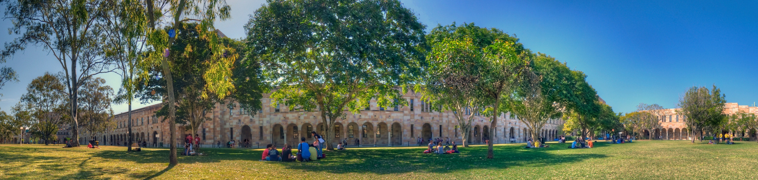
Vulgarity in World Englishes
Martin Schweinberger
m.schweinberger@uq.edu.au materials and slides available at www.martinschweinberger.de
This research was partially funded by the Language Data Commons of Australia (LDaCA). Language Data Commons of Australia (LDaCA) (DOI: 10.3565/kq2v-9g52) is a co-investment partnership with the Australian Research Data Commons (ARDC) through the HASS and Indigenous Research Data Commons. The ARDC is enabled by the Australian Government’s National Collaborative Research Infrastructure Strategy (NCRIS). In addition, this research was partially funded by the Centre for Digital Cultures and Societies at the University of Queensland.

Slide 2
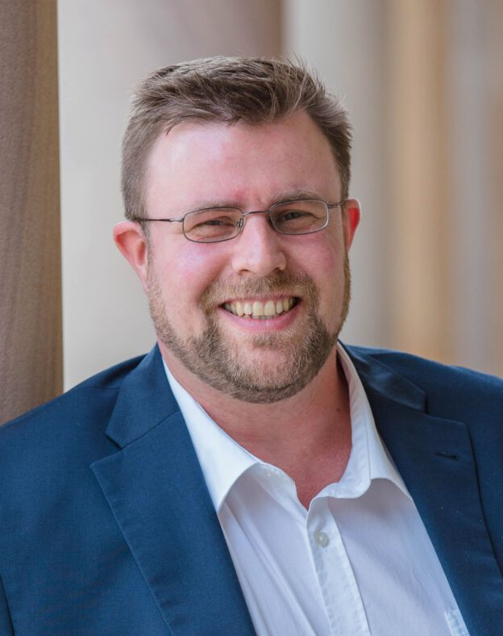
Martin Schweinberger
Lecturer in Applied Linguistics at the University of Queensland (at UQ since 2018)
PhD in English Linguistics at the University of Hamburg (2014)
Quantitative Corpus Linguistics – combining traditional language-based research with modern computational methods
Underlying interest
Methodologically, I‘m interested in statistical modelling of lamnguage data, reproducibility and transparency in language-based research, and in Big Data (not massive data)
Linguistically, I want to improve our understanding language use, linguistic variability, and cultural shifts reflected in language
Underlying theme
I have an interest in asepcts of language that are not thought in school, yet fundamentally improtant for communication
Schweinberger: Vulgarity in World Englishes

Slide 3
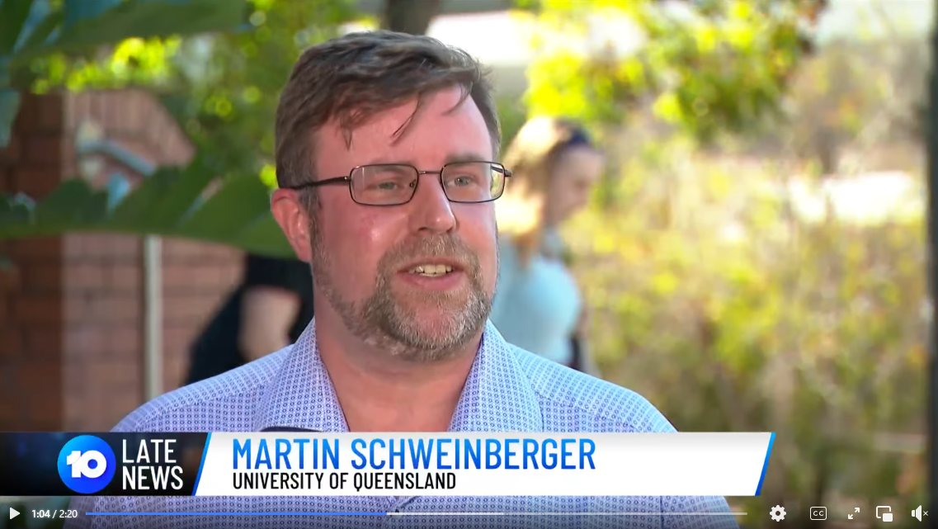
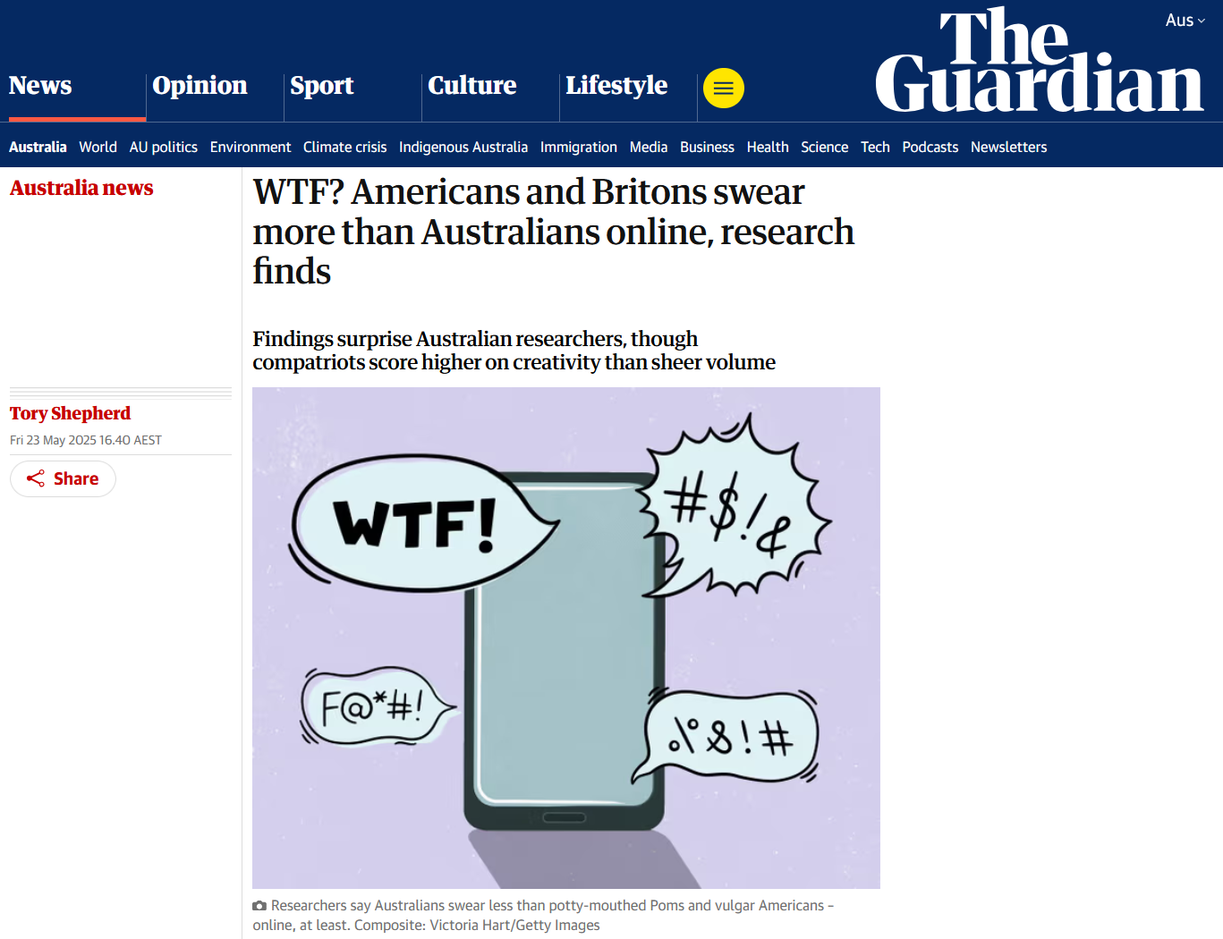
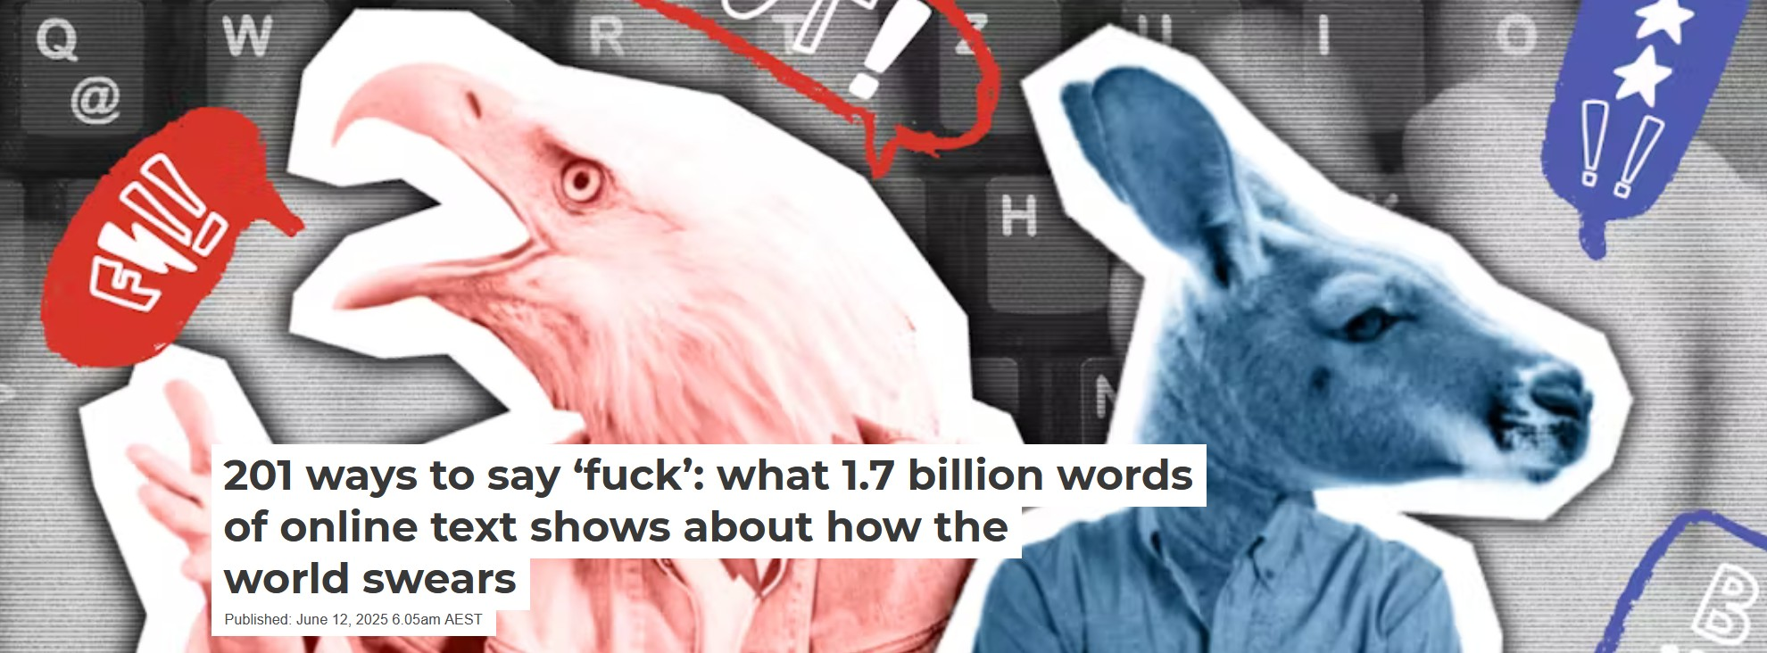
Background
In 2021, together with colleagues from UQ, The Queensland University of Technology, and the University of Eastern Finland, we applied for funding for a project called F%$# Twitter from the UQ Centre for Digital Cultures and Societies.
With additional supportThe results of this project have led to several presentations at international conferences and a Lingua Special Issue Bad Language and Vulgarity Online and in Public Discourse (Eds. Martin Schweinberger, Paula Rautionaho, & Kate Burridge) and submissions to other journals.
Schweinberger & Burridge (2025) Vulgarity in online discourse around the English-speaking world went viral…
Features in the national afternoon and evening news in Australia (Channel 10)
Over 90 newspaper articles including The Guardian, CNN, The Conversation, The Washington Times, etc.
Several live radio interviews (I alone appeared on 5 ABC radio shows)
Schweinberger: Vulgarity in World Englishes

Slide 4
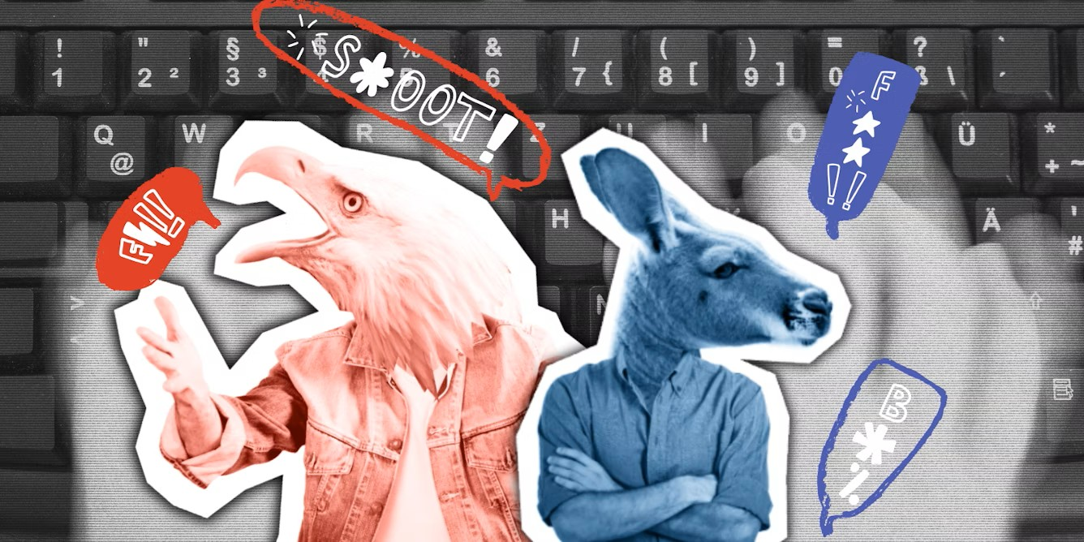
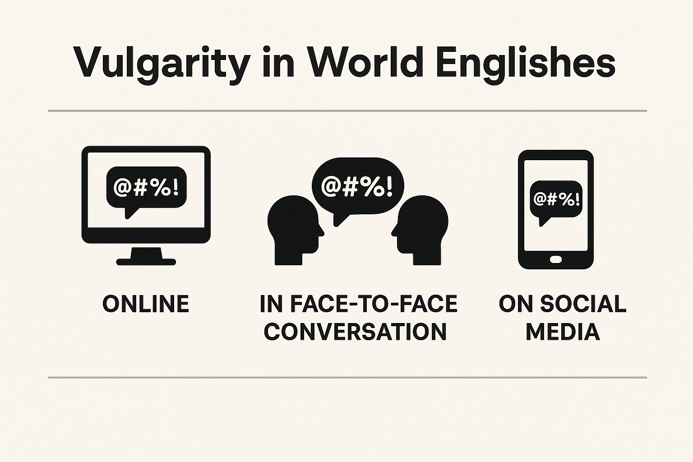
Outline
Introduction to Vulgarity (Research)
Study 1: Vulgarity on the Web
Study 2: Vulgarity in Face-to-Face Conversation
Study 3: Vulgarity on Social Media
Discussion and Outlook
Schweinberger: Vulgarity in World Englishes

Slide 5
Introduction to Vulgarity (Research)
Schweinberger: Vulgarity in World Englishes

Slide 6
Why show an interest in vulgarity?
Vulgar language is popular but generally viewed unfavourably.
Using vulgarity appropriately requires substantive pragmatic proficiency and linguistic awareness
Difference between actual, natural language use and what is taught in school
Social and regional differences in how English is spoken
Differing socio-cultural norms across social, cultural, and geographic spaces and settings
Socially relevant: expressivity, stance-taking, identity marking, humour, and “fitting-in”
Vulgarity is better than its reputation!
Vulgarity and swearing are highly (multi-)functional Vulgarity is linguistically as well as socially and pragmatically rich phenomenon that offers insights
into a wide range of communicative, cultural, and cognitive processes
Schweinberger: Vulgarity in World Englishes

Slide 7
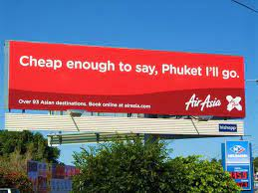
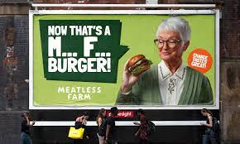
Categories of Swearing
Social swearing: positively charged (social bonding, banter) Vulgarity as part of humour (see George Carlin, Seizer 2011)
Annoyance swearing: negatively charged (emotional relief, catharsis) e.g., cussing at other drivers in traffic
Linguistically motivated use of vulgarity e.g. intensification, e.g., fucking as an adjective amplifier (Martínez & Pertejo 2012)
Schweinberger: Vulgarity in World Englishes

Slide 8

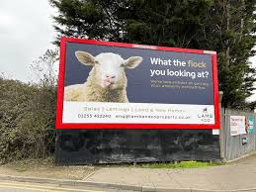
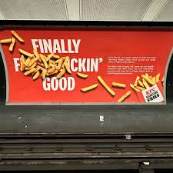
Socio-Cognitive Functions
Indexing Identity/Group Membership: can signal in-group solidarity, shared norms, or cultural/regional identity (social bonding, banter) (Beers Fägersten, 2012)
Establishing|Challenging Social Hierarchies: can assert dominance, express resistance, or subvert social norms (Dynel, 2012; Jay, 2009)
Expressing Emotion & Intensity: used as an emotional intensifier and stress relief (Stephens, Atkins, & Kingston, 2009; Wajnryb, 2005).
Managing Social Distance & Politeness: may reduce social distance or enhance authenticity in informal settings (Culpeper, 2011; Kádár & Haugh, 2013)
Vulgarity as a bonding strategy (bonding humour) (see George Carlin, Seizer 2011)
Schweinberger: Vulgarity in World Englishes

Slide 9
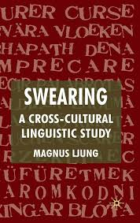
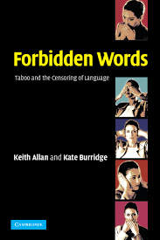
Linguistic Aspects
Lexical Creativity & Innovation: Swearing often involves creative word formation, euphemisms, and taboo-avoidance strategies (Allan & Burridge, 2006; Ljung, 2011).
Pragmatic & Discourse Marking: serves as a discourse strategy to mark stance, topic shifts, or emphasis (Dewaele, 2016; Holmes, 2013)
Sociolinguistic Variation: varies by age, gender, class, and region, making it a rich domain for sociolinguistic study (McEnery & Xiao, 2004; Schweinberger, 2018; Stapleton, 2003)
Language Norms and Taboo: reveals how societies construct and negotiate linguistic taboos (Burridge, 2006; Pinker, 2007).
Schweinberger: Vulgarity in World Englishes

Slide 10
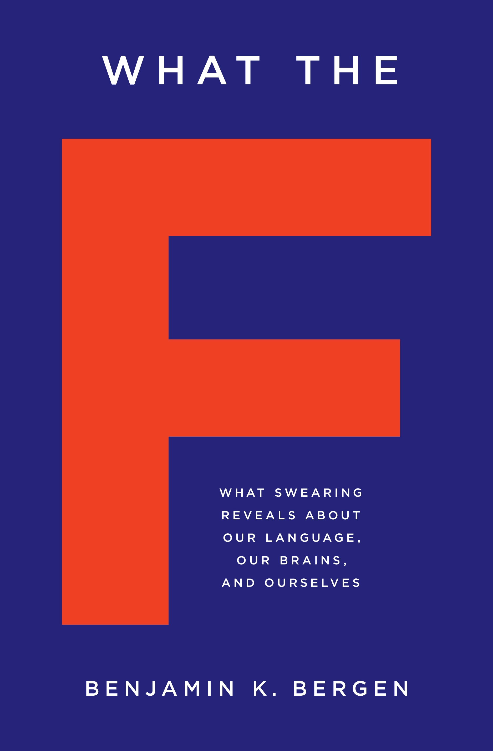
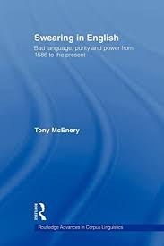
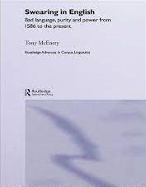
Social Stratification
Substantive sociolinguistic research on vulgarity (swearing)
Mostly using corpus linguistic approaches (cf. McEnery 2006)
Age: most common among adolescent (McEnery 2006) to middle-aged male speakers (Schweinberger 2018)
Gender: Men swear more than women and they use “stronger” bad language words (BLWs) (Love 2021, McEnery 2006, Schweinberger 2018, Stenström 2006, McEnery and Xiao 2004) – contradicting studies show no gender difference (Drummond 2020) or that female speakers use fucking as an intensifier more than males “to mark their linguistic independence” (Aijmer 2018: 91)
Time: Swearing has decreased in informal British English between 1994 and 2014 (Love 2014)
Social class: findings do not show a consistent patterning (see Stenström 2006 for an overview)
Schweinberger: Vulgarity in World Englishes

Slide 11
What counts as vulgar?
Difficulty of defining vulgarity
Problem: unclear what counts as swearing | bad language | cussing
Terminology (impoliteness vs swearing vs taboo language)
Problematic examples
taboo language? If it were taboo, it would not be such a common and systematic phenomeon
literal vs metaphoric John fucked Jane (not considered swearing when used literally (by some))
offensive terms / insults: pedophile, nazi, fascist, etc.
Our approach Focus on vulgarity! (not insults, swearing, etc.)
Start: word lists based on pervious research and online content moderation
Criteria does the word have a less vulgar synonymous counterpart?
fuck | shag vs make love | sleep with, etc.
ass | arse vs behind | bottom, etc.
Is the term marked as vulgar in the OED
pedophile, idiot, penis (can be insults but not vulgar)
English only (not considered: bastardo, arschloch, bomboclaat, etc.)
Spelling variation: phuk, fak, fuuuuck, etc. → fuck (lemma)

Slide 12
Study 1: Vulgarity on the Web
Schweinberger, M., & Burridge, K. (2025). Vulgarity in online discourse around the English-speaking world. Lingua, 321, 103946. https://doi.org/10.1016/j.lingua.2025.103946

Slide 13
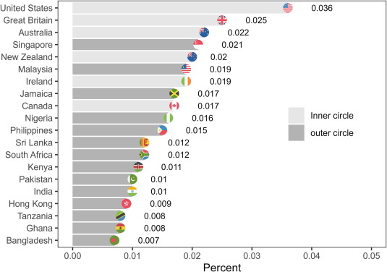
Motivation
Lack of comparative analyses of the use of swearing
The main research question for us thus was:
Substantive public interest in the topic
Top two Lingua articles that received most public attention are both about swearing/vulgarity
Similarly, papers from psychology (e.g., pain tolerance effect of swearing), education (e.g., effects of swearing in front of children), and linguistics (functions and socio-demographics of swearing) received notable attention
For our paper: public interest in the ranking of the use of vulgarity across English-speaking regions online
Who swears most online?
Schweinberger: Vulgarity in World Englishes

Slide 14
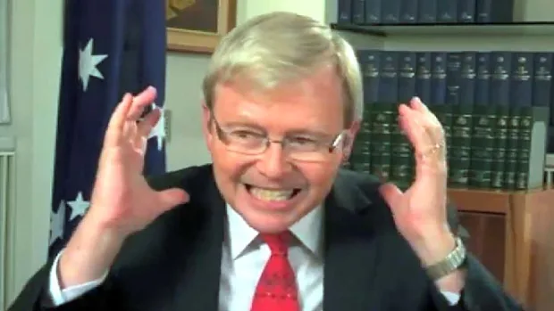
Research questions and hypotheses
Very limited findings from prior research
Research Questions
How frequent is vulgar language in online discourse across the 20 different English-speaking regions represented in GloWbE?
What vulgar elements are used in the data and are there region-specific differences or preferences?
Is there are difference in the variability (creativity) of vulgar elements that are used?
Hypotheses
Based on the use of vulgarity in spoken discourse in public settings (advertisement ads and outbursts of former Prime Ministers on televsion), we assumed that
Australians would exhibit the highest frequencies of vulgarity
Schweinberger: Vulgarity in World Englishes

Slide 15

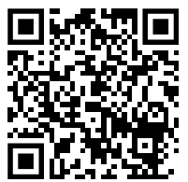
Data and Data Processing
Global Web-Based Corpus of English (GloWbE) (Davies & Fuchs, 2014)
Consisting of 1.7 billion words across 20 regional components representing informal blog content (approximately 60 percent of the total data) and a wide range of other web-based materials, genres, and text types (here referred to as general web content which approximates to 40 percent of the total data)
Data Processing
All in R version 4.4.2 (R Core Team, 2024) via RStudio (Posit team, 2025) (analysis details available at https://github.com/MartinSchweinberger/Vulgarity-Lingua-D-24-00844)
Split into subtexts
Cleaned data (removed emojis, non-English words)
Determined the number of tokens in each text and regional comonent
Schweinberger: Vulgarity in World Englishes

Slide 16
Methodology
Data Extraction
To extract vulgar elements we used a list of regular expressions (Schweinberger & Burrdige, 2025)
Started with lists using in online content modertation, previous research, and what the OED considers „vulgar“. Then manually checked the lists and enhanced them using regular expressions to be able to find vulgarity with non-normalised spellings and other variants (plurals, progressive forms, etc.).
Statistical Methods
Frequency tabulation (normalised by N tokens)
Adjusted Corrected Type-Token Ratios (aCTTR) to investigate variability and creativity in use: the higher the aCTTR, the more different variants the speaker form a region are using.
Configural Frequency Analysis (CFA) to detect significant preferences and avoidence of forms
Schweinberger: Vulgarity in World Englishes

Slide 17
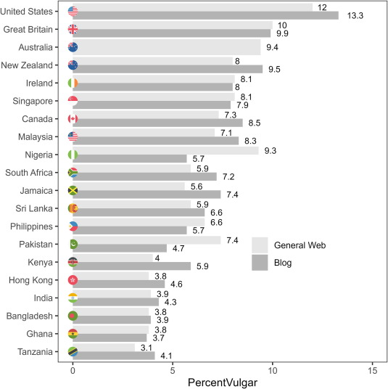

Slide 18
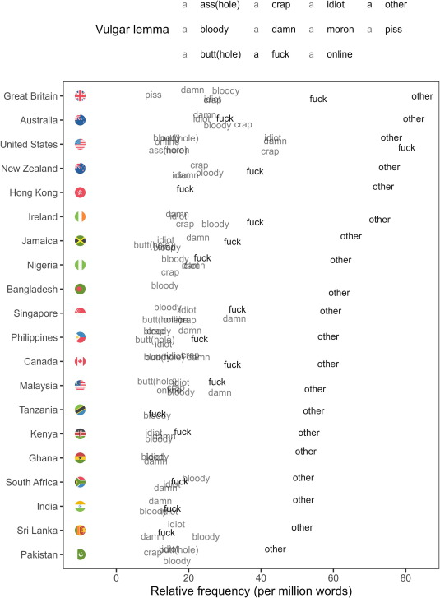
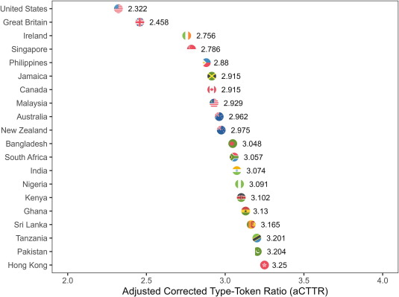

Slide 19
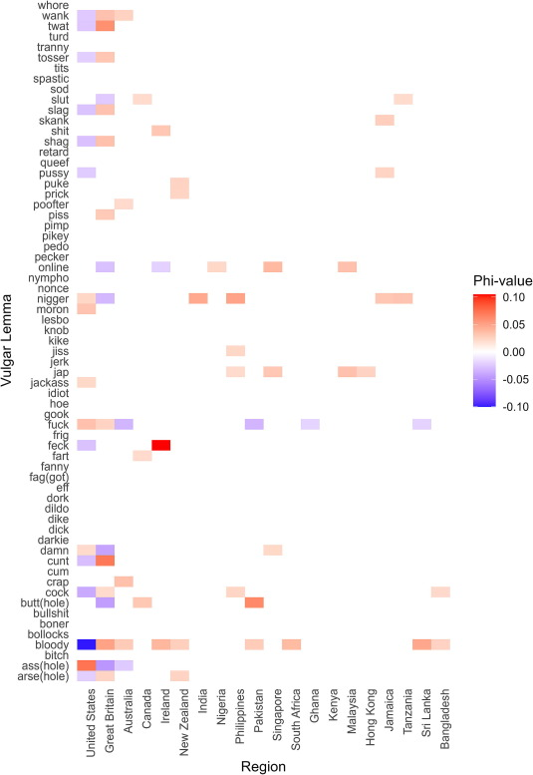
Results of the CFA analysing significant preferences (types) for and avoidance (antitypes) of vulgar lemmas across English-speaking regions.
Region | Vulgar lemma | Type | Observed | Exp | X²-value | Q-value | Bonferroni-corrected p | Phi-value
Ireland | feck | Preferred | 546 | 56.6 | 4228.3 | 0.00127 | < 0.001*** | 0.105
United States | ass(hole) | Preferred | 5395 | 2938.1 | 2054.4 | 0.00643 | < 0.001*** | 0.073
Great Britain | cunt | Preferred | 2074 | 817.4 | 1932 | 0.00327 | < 0.001*** | 0.071
Pakistan | butt(hole) | Preferred | 842 | 239.6 | 1514.5 | 0.00157 | < 0.001*** | 0.063
United States | bloody | Avoided | 5205 | 12039.1 | 3879.5 | 0.01832 | < 0.001*** | −0.1

Slide 20
Key Findings
(English) vulgarity is notably more frequent in inner-circle varieties – particularly the US, UK, and Australia – than among users from outer circle varieties.
Similarly, users from inner-circle varieties are more creative (show higher variability) in the use of English(!) vulgarity.
Vulgarity is more likely to surface in blog data compared to general web data (probably due to the more personal and less corporate style and content)
There are some regional preferences for specific forms reflecting dialectal language use
Schweinberger: Vulgarity in World Englishes

Slide 21
Problems | Limitations
Corpus related
Corpus quite “noisy” (e.g., includes texts from other regions and literary texts)
General
“True” behavior hard to capture – users are aware that their data is available publicly
There is likely content moderation at play – the extend will likely vary across regions
Outer-circle speakers are more likely to use non-English forms of vulgarity (bombaclaat, ect.)
Norm around what users feel comfortable with sharing online differ across regions (stylistic rather than behavioral or linguistic difference)
Schweinberger: Vulgarity in World Englishes

Slide 22
Study 2: Vulgarity in Face-to-Face Conversation
Schweinberger, M., & Burridge, K. Vulgarity in spoken interaction across selected varieties of English [Manuscript in preparation]. English World-Wide.

Slide 23
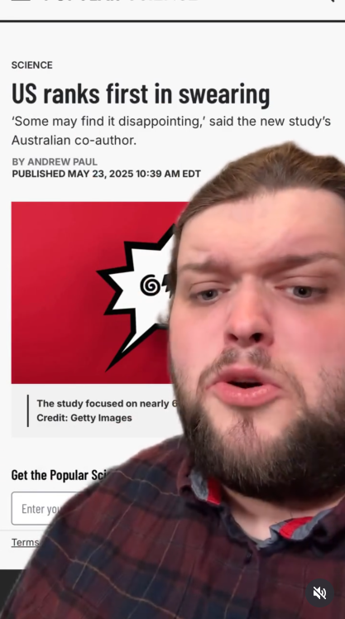
Motivation
When presenting the results on vulgarity online, the most common question was:
Some reactions were quite emotional, and people felt “offended” that their regional variety was not further up in the list!
What would results be
if you looked at face-to-face interaction?!
Schweinberger: Vulgarity in World Englishes

Slide 24
Research questions and hypotheses
Relevant findings from prior research
Younger speakers and young males in particular exhibit higher rates of vulgarity compared with older speakers or female speakers (Schweinberger, 2018)
online, speakers/users from inner circle varieties and espcially speakers from the US use most vulgarity (Laitinen, Rautionaho, Fatemi, & Halonen, 2025; Schweinberger & Burridge, 2025; Schweinberger, Laitinen, Haugh, Rautionaho, Fatemi, Hames, & Takahashi, n.d.; Schweinberger, Haugh, Laitinen, Fatemi, Hames, Rautionaho, & Takahashi, n.d.).
Hypotheses
Based on the use of vulgarity in spoken discourse in public settings (advertisement ads and outbursts of former Prime Miniters on televsion), we assumed that
Australians would exhibit higher frequencies of vulgarity in face-to-face conversations while the use of vulgarity among US speakers would be lower.
Inner circle varieties exhibit a tendency for higher use fo vulgarity compared to outer circle vareities.
Younger speakers, and young males in particular, use more vulgarity than older speakers
Schweinberger: Vulgarity in World Englishes

Slide 25
Data and Data Processing
International Corpus of English (ICE)
Spoken sections of ICE Australia, Canada, East Africa (Kenya & Tanzania), Great Britain, Hong Kong, Ireland, India, Jamaica, New Zealand, Philippines, Sri Lanka, Singapore, and the Santa Barbraa Corpus of Spoken American English
Data Processing
All in R version 4.4.2 (R Core Team, 2024) via RStudio (Posit team, 2025): analysis details will be made available)
Split into untterances
Extracted speaker reference and cleaned utterance
Added speaker information and determined the number of tokens in each utterance
Tabullation and visualisation
Schweinberger: Vulgarity in World Englishes

Slide 26
 | private dialogue |  |  | public dialogue |  |  | unscripted monologue |  |  | scripted monologue
Region | Vulgar Tokens | Tokens | Percent | Vulgar Tokens | Tokens | Percent | Vulgar Tokens | Tokens | Percent | Vulgar Tokens | Tokens | Percent
Australia | 146 | 206,544 | 0.071 | 19 | 163,595 | 0.012 | 23 | 147,533 | 0.016 | 22 | 109,371 | 0.02
Canada | 72 | 271,984 | 0.026 | 24 | 297,391 | 0.008 | 10 | 181,750 | 0.006 | 18 | 298,530 | 0.006
Great Britain | 126 | 261,576 | 0.048 | 11 | 192,483 | 0.006 | 12 | 294,119 | 0.004 | 3 | 174,120 | 0.002
Hong Kong | 74 | 485,383 | 0.015 | 17 | 293,478 | 0.006 | 8 | 257,041 | 0.003 | 15 | 257,831 | 0.006
India | 16 | 237,108 | 0.007 | 2 | 195,321 | 0.001 | 4 | 164,214 | 0.002 | 7 | 153,340 | 0.005
Ireland | 196 | 205,032 | 0.096 | 4 | 169,785 | 0.002 | 13 | 158,834 | 0.008 | 6 | 108,709 | 0.006
Jamaica | 30 | 236,258 | 0.013 | 8 | 191,304 | 0.004 | 39 | 221,205 | 0.018 | 5 | 137,777 | 0.004
Kenya | 3 | 63,073 | 0.005 | 9 | 151,371 | 0.006 |  |  |  | 6 | 122,646 | 0.005
New Zealand | 246 | 225,457 | 0.109 | 9 | 183,930 | 0.005 | 14 | 171,280 | 0.008 | 9 | 128,076 | 0.007
Philippines | 28 | 204,346 | 0.014 | 2 | 162,356 | 0.001 | 2 | 215,569 | 0.001 | 4 | 184,170 | 0.002
Singapore | 82 | 226,537 | 0.036 | 9 | 181,943 | 0.005 | 3 | 147,228 | 0.002 | 13 | 120,700 | 0.011
Sri Lanka | 108 | 222,615 | 0.049 | 16 | 177,260 | 0.009 | 4 | 156,676 | 0.003 | 7 | 113,641 | 0.006
Tanzania | 1 | 8,625 | 0.012 | 16 | 436,249 | 0.004 |  |  |  | 8 | 102,479 | 0.008
United States | 80 | 221,827 | 0.036
Total | 1,208 | 3,076,365 | 0.039 | 146 | 2,796,466 | 0.005 | 132 | 2,115,449 | 0.006 | 123 | 2,011,390 | 0.006
Schweinberger: Vulgarity in World Englishes

Slide 27
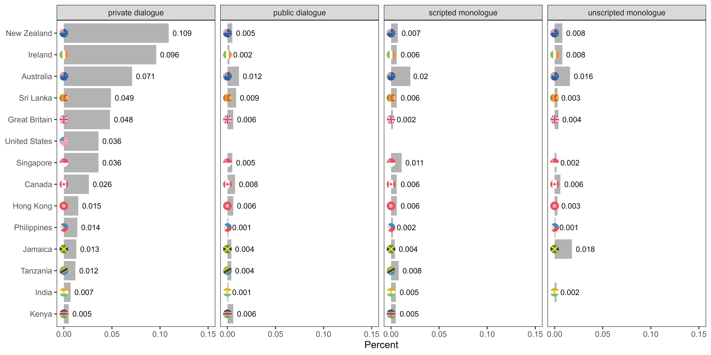
of tokens

Slide 28
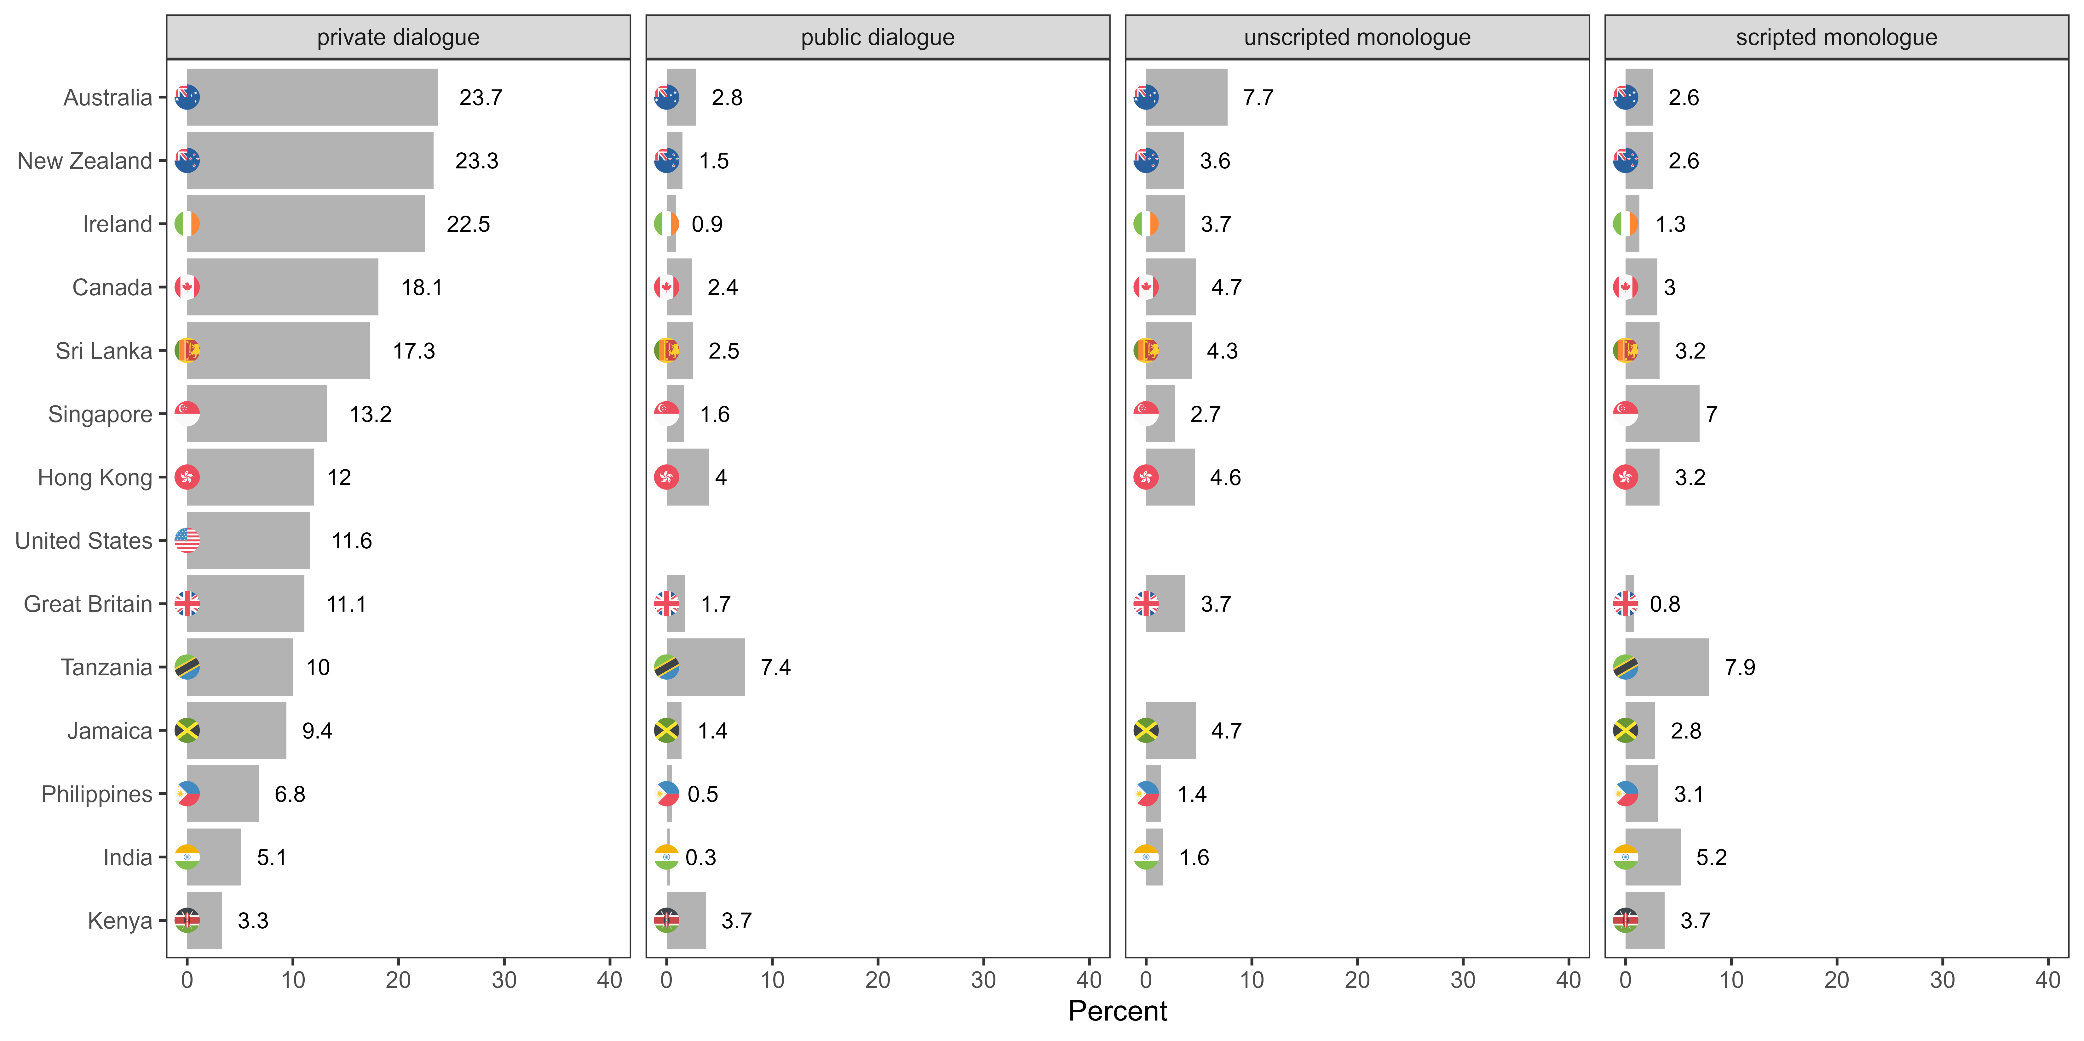
of speakers

Slide 29
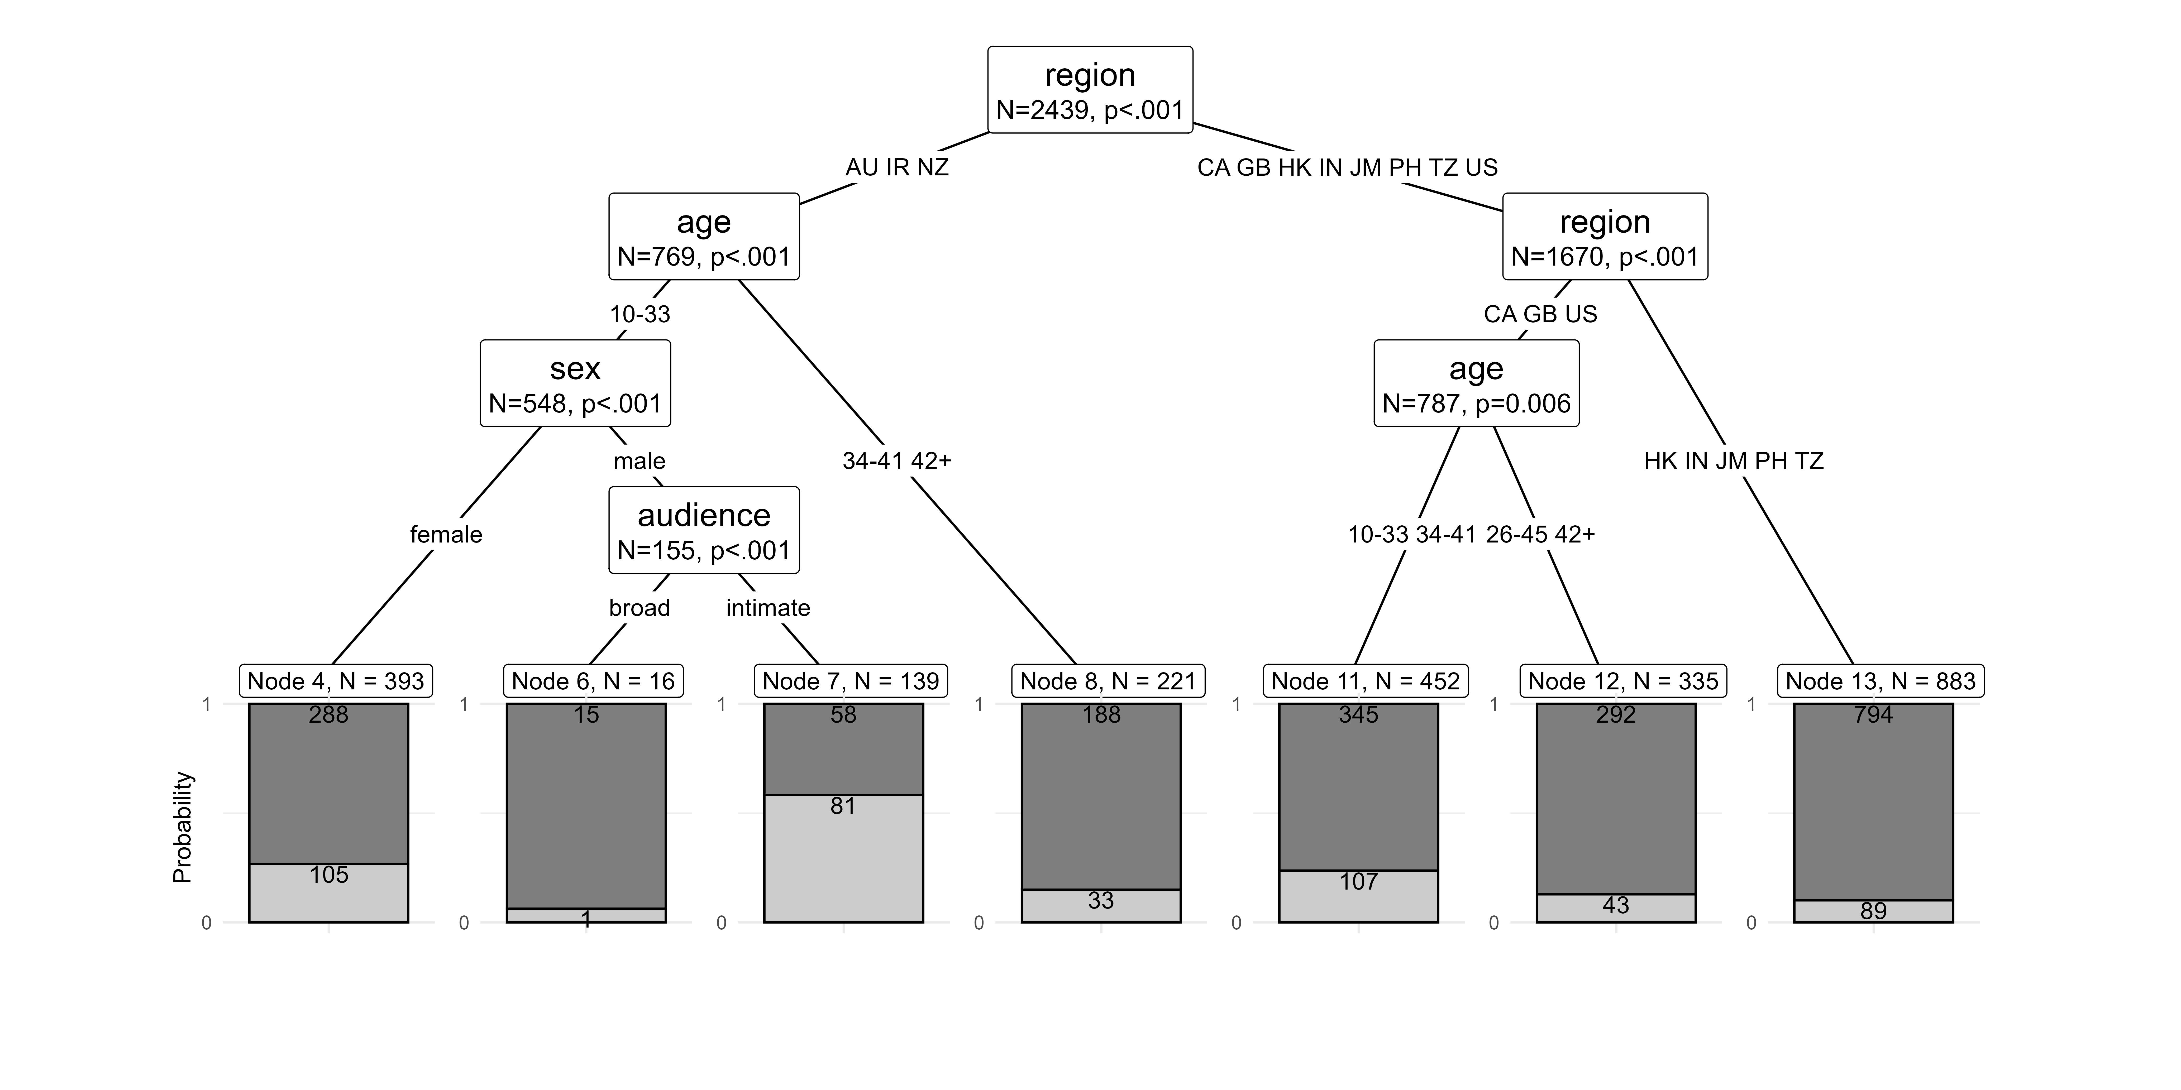
Findings
Schweinberger: Vulgarity in World Englishes

Slide 30
Key Findings
Vulgarity is notably more frequent in informal private dialogues than in public-stage talk or monologues intended for broader audiences.
Speakers from inner circle varieties use more vulgarity than speakers from outer circle varieties in face-to-face conversations.
Unlike online discourse, US speakers are less prominent in face-to-face vulgarity use.
In contrast, nativized post-colonial varieties (Ireland, New Zealand, Australia) show higher frequencies of vulgar expressions.
Australians have the highest share of speakers who use vulgarity in face-to-face settings.
Prior research regarding sociolinguistic constraints are supported and expanded: young speakers use more vulgarity. Young women use vulgarity regardless of audience size, young men use vulgarity significantly more in intimate settings rather than with a broad audience.
Schweinberger: Vulgarity in World Englishes

Slide 31
Problems | Limitations
ICE corpora related
Despite being intended for cross-cultural comparisons – are quite heterogeneous and inconsistent (structure, transcription convention, coverage, sociodemographic information, etc.).
Focus of ICE on educated speakers – very little data from working class speakers.
Some data quite “old” by now…
Regional differences may be confounded by the data of data collection or stylistic norms
General
“True” behavior hard to capture – speakers are still aware that they are recorded.
How representative are the ICE components?
Schweinberger: Vulgarity in World Englishes

Slide 32
Study 3: Vulgarity on Social Media
Schweinberger, M., Laitinen, M., Haugh, M., Rautionaho, P., Fatemi, M., Hames, S., & Takahashi, M. in print. F%$# Twitter: A corpus-based analysis of vulgar language on Twitter. Corpora.
Schweinberger, M., Haugh, M., Laitinen, M., Fatemi, M., Hames, S., Rautionaho, P., & Takahashi, M. Swearing online: Exploring dimensions of variability in born-digital data [under revision]. Digital Scholarship in the Humanities.

Slide 33
Motivation
Very little research on vulgarity on social media (from a linguistically informed perspective!)
Almost no comparative analyses across genres or varieties of English (almost all analyses focus on informal spoken British English – predominantly the speech of adolescents (notable exceptions are Schweinberger 2019 who focused on Irish English and Drange et al. 2014 who analysed Norwegian, Spanish and British youth)
Inconsistencies in the definition of the phenomenon (vague definitions on what counts as swearing | bad language | cussing | vulgarity)
No studies of topics | discourses that are prone to facilitate the use of vulgarity Social Media data does not lend itself to classical sociolinguistic analyses but it allows to test other relevant factors relating to how social networks and discourse topics affect the use of vulgarity
No studies on when users use vulgarity
Schweinberger: Vulgarity in World Englishes

Slide 34
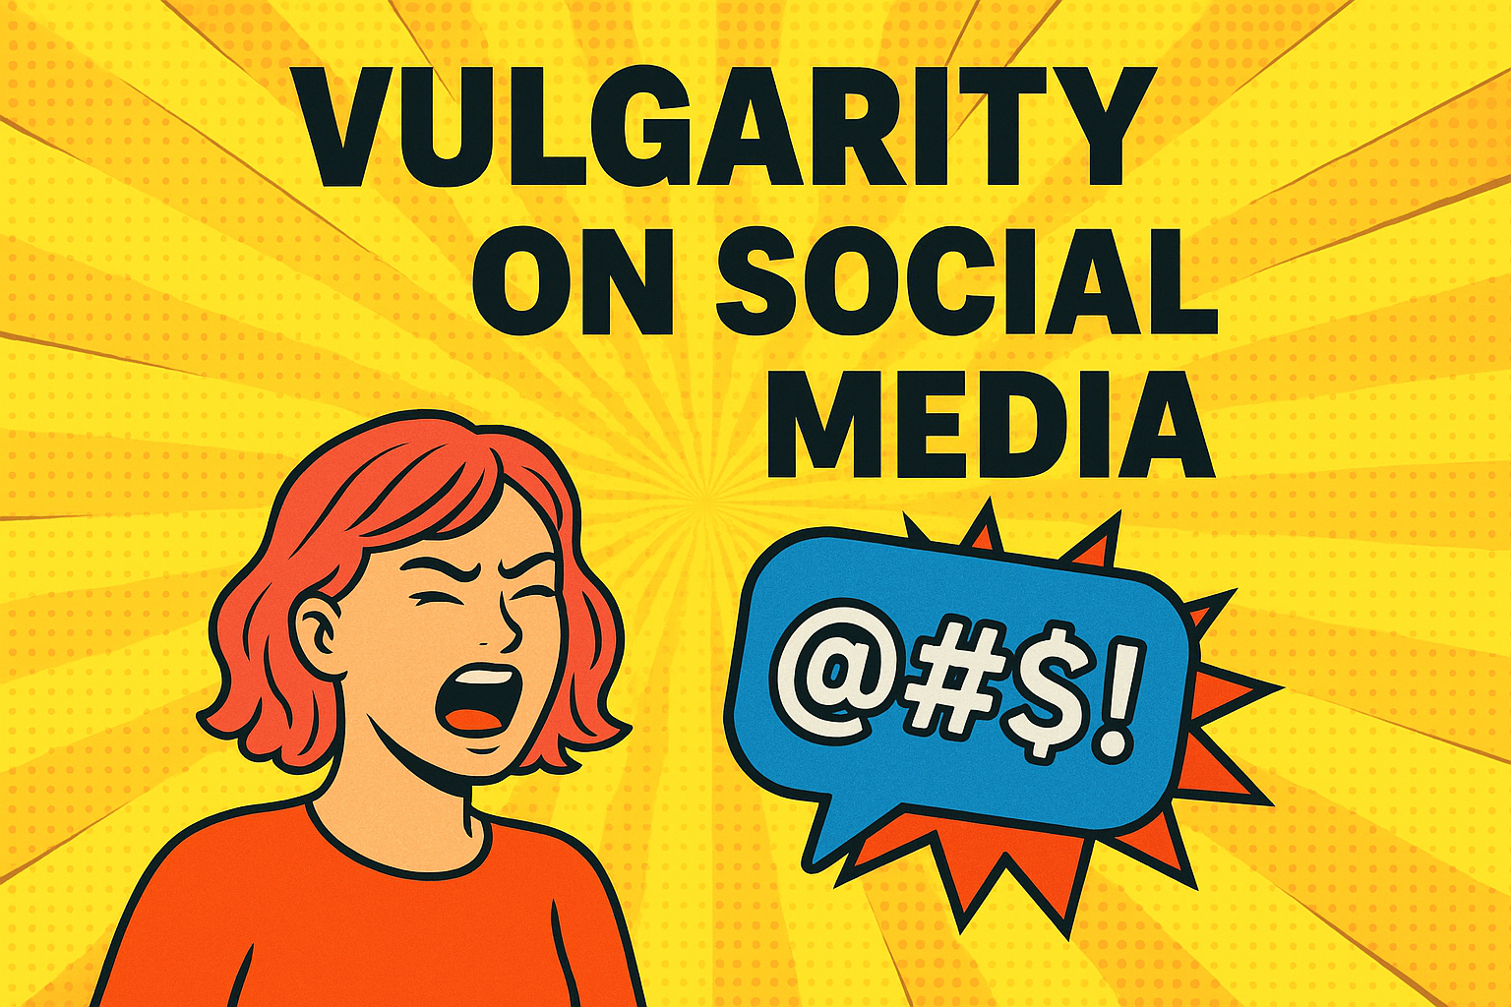
Research Questions
How frequent is vulgarity on Twitter by users from the United States, United Kingdom, and Australia?
What forms of vulgarity are used on Twitter in the United States, United Kingdom, and Australia?
What topics are associated with vulgarity on Twitter and are there regional/cultural differences?
Do we see temporal patterns in the use of vulgarity on Twitter by users from the United States, United Kingdom, and Australia?
What social-media specific factors impact the use of vulgarity on Twitter?
Schweinberger: Vulgarity in World Englishes

Slide 35
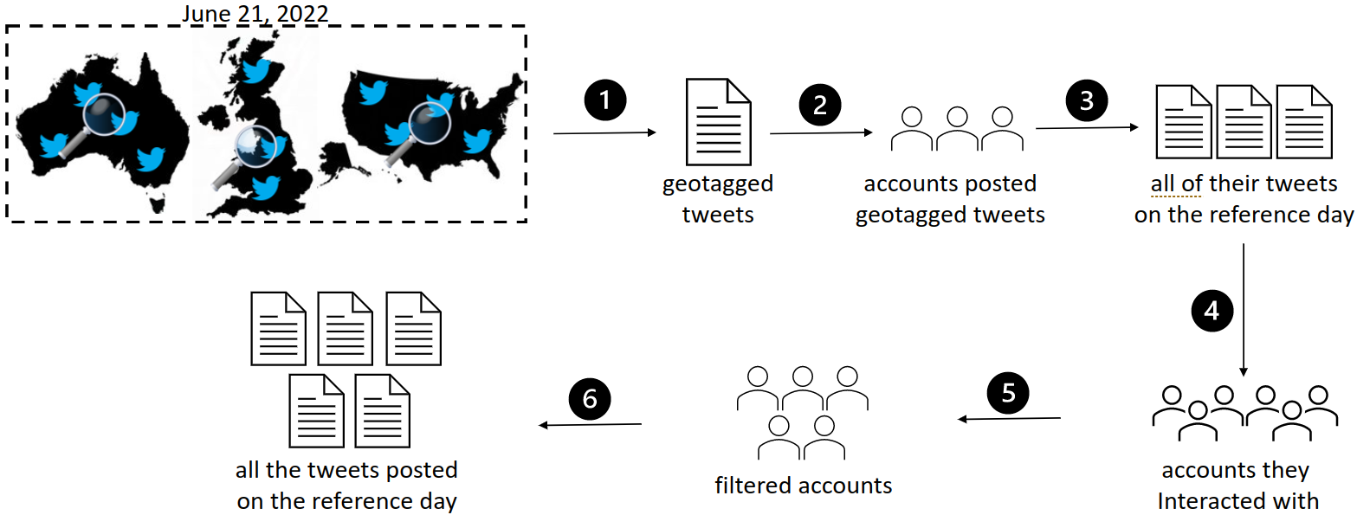
Data
Tweets collected on June 21, 2022 by a selection of tweets from Twitter users from the United States, United Kingdom, and Australia collected by the Australian Digital Observatory at QUT as well as collaborators at FIN-CLARIAH and UQ
Information about the tweet (location, when created, reply, retweet)
Information about the user (followers, following, verified)
The text of the tweet
Location of users
Geotagged users served as seed accounts – then crawled their networks, and finally filtered the harvested data for accuracy
Schweinberger: Vulgarity in World Englishes

Slide 36
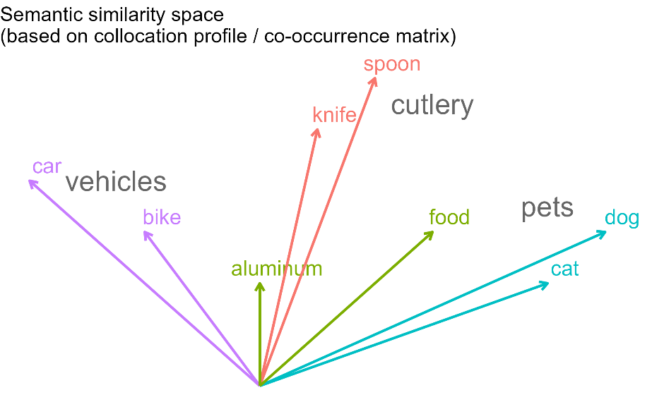
Methodology
Data Extraction
To extract vulgar elements we used the same list of regular expressions as Schweinberger and Burrdige (2025).
Data Processing
All in R version 4.4.2 (R Core Team, 2024) via RStudio (Posit team, 2025) (analysis details available at https://github.com/MartinSchweinberger/Vulgarity-Lingua-D-24-00844)
Determined the number of tokens in each tweet and added metadata
Statistical Methods
Frequency tabulation (normalised by N tokens)
Collostructional Analyses (Gries & Stefanowitsch, 2004) what lemmas are significantly over- and underused across the three locales?
(Seeded/Human-in-the-loop) Topic Modelling (Schweinberger, 2024) to determine if vulagrity is associated with specific topics
Botuta (Variable Selection Method) (Kursa & Rudnicki, 2010) to determine what factors correlate with the use of vulgarity
Regression modelling (Gries, 2021)
To determine the direction and size of the impact of factors that influence the sue of vulgarity
Schweinberger: Vulgarity in World Englishes

Slide 37
Final Data Set
 | Tokens (N) | Tweets (N) | Users (N) | Avg. Length Tweet
Australia | 1,449,292 | 99,404 | 7,647 | 14.6
United Kingdom | 7,883,971 | 538,661 | 51,514 | 14.6
United States | 27,398,975 | 2,090,972 | 184,711 | 13.1
Total | 36,732,238 | 2,729,037 | 243,872 | 13.5
Vulgarity Overview
 | Users of vulgarity (%) | Vulgar Tokens N (%) | Vulgar Tweets N (%)
Australia | 46.8 | 3,906 (0.27) | 3,581 (3.60)
United Kingdom | 36.9 | 20,655 (0.26) | 19,005 (3.53)
United States | 52.9 | 108,175 (0.39) | 97,748 (4.67)
Total | 49.3 | 132,736 (0.36) | 120,334 (4.41)
Schweinberger: Vulgarity in World Englishes

Slide 38
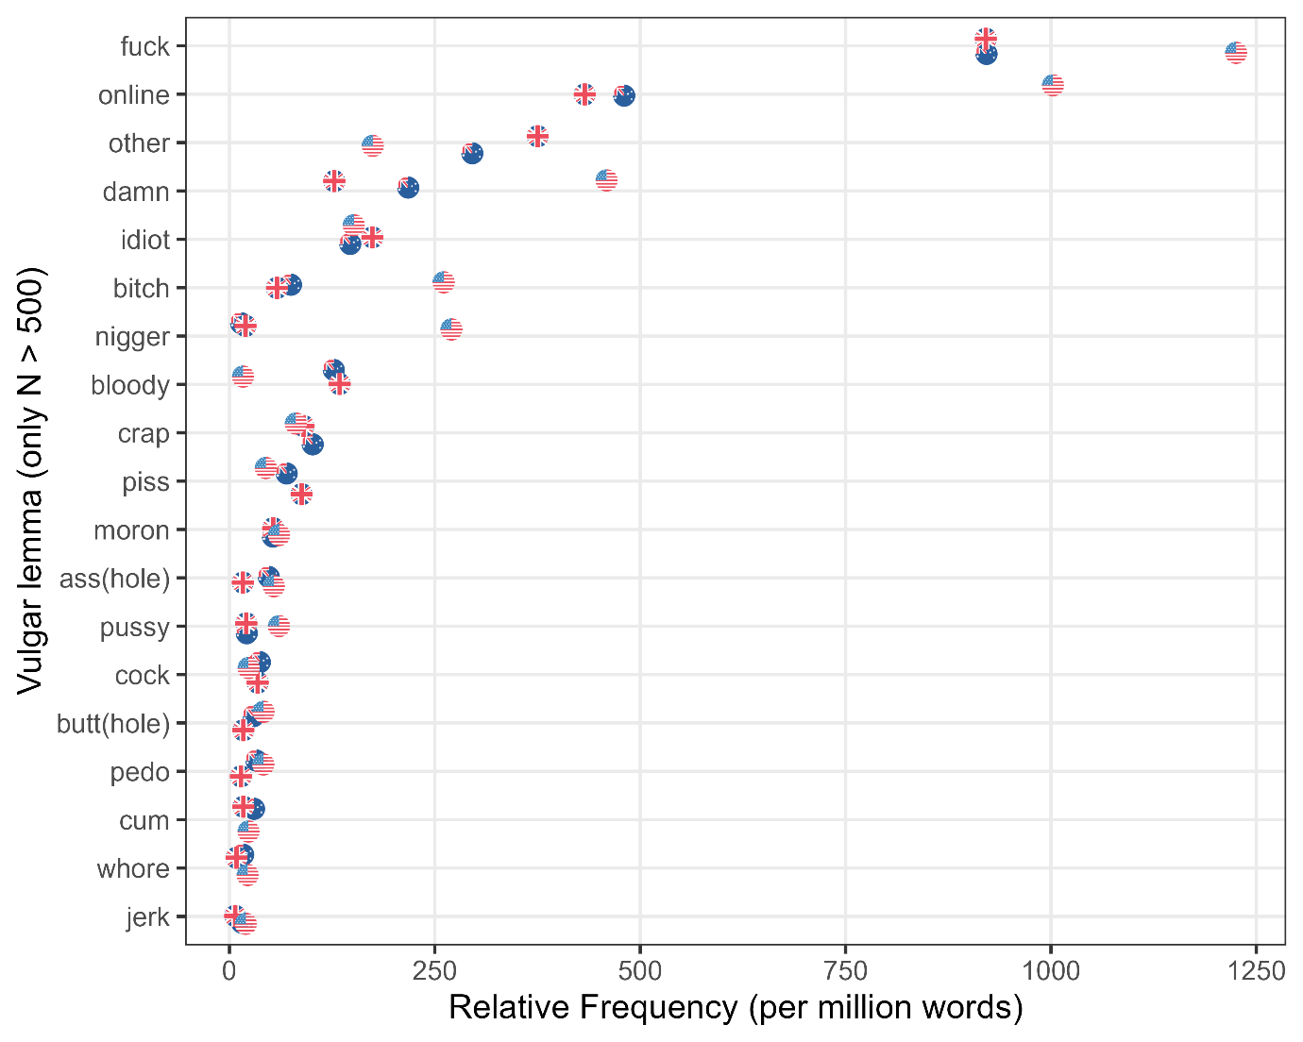
Schweinberger: Vulgarity in World Englishes

Slide 39
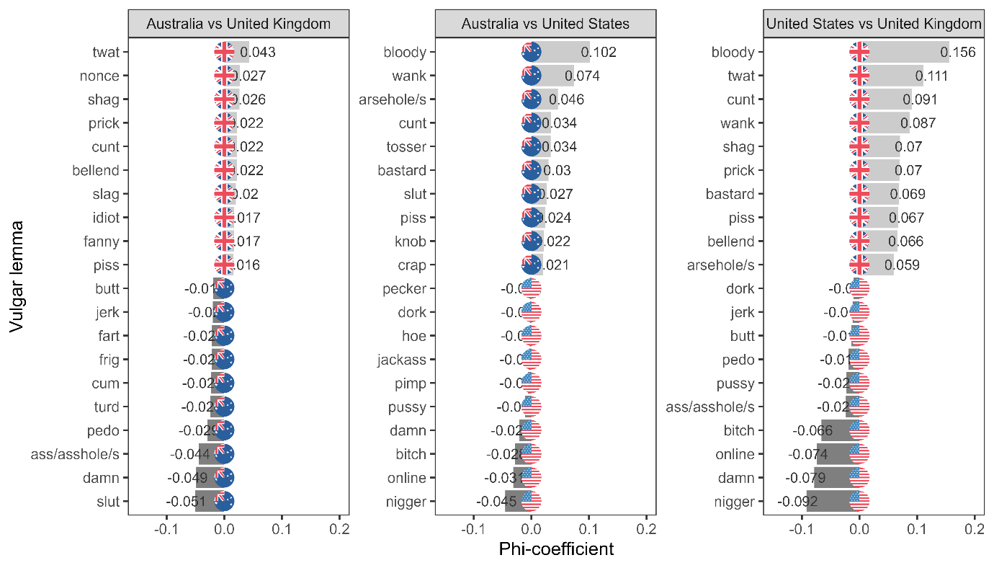
Schweinberger: Vulgarity in World Englishes

Slide 40
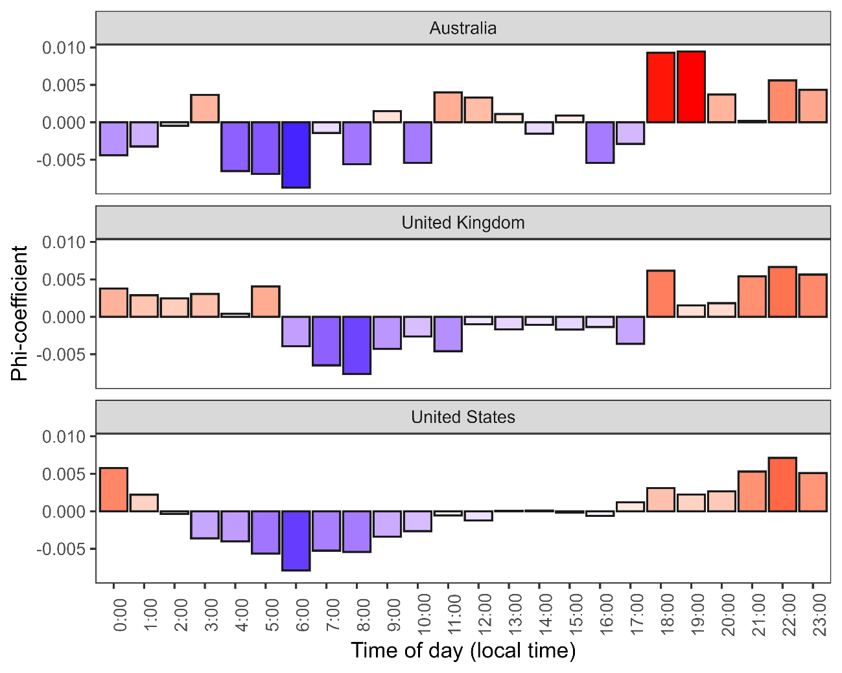
Schweinberger: Vulgarity in World Englishes

Slide 41
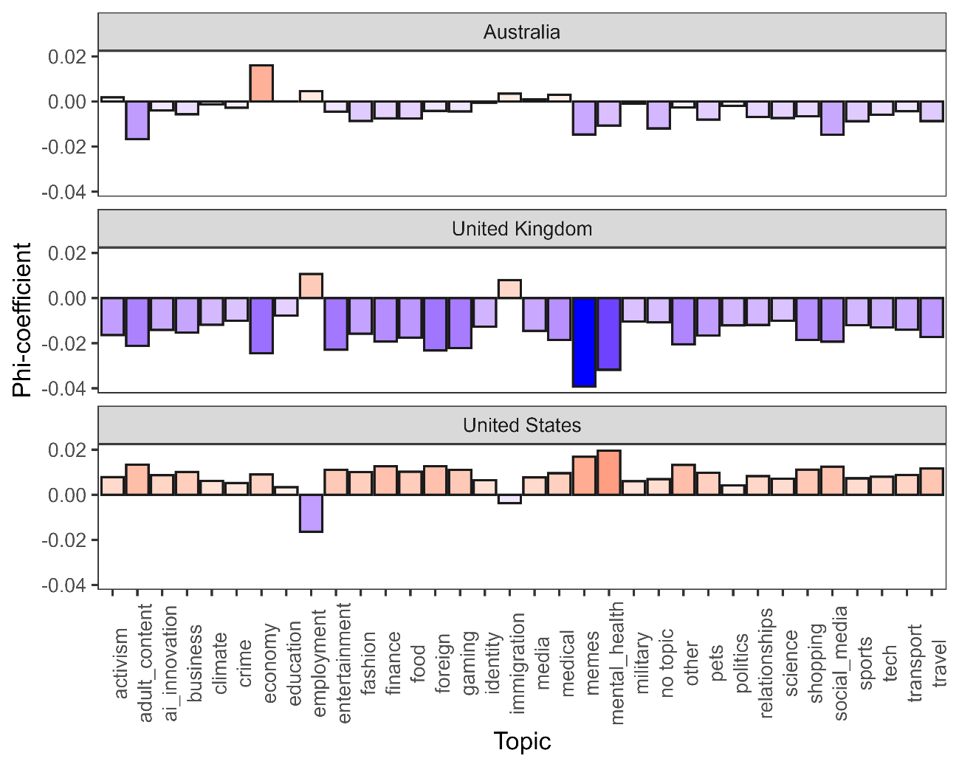
Schweinberger: Vulgarity in World Englishes

Slide 42
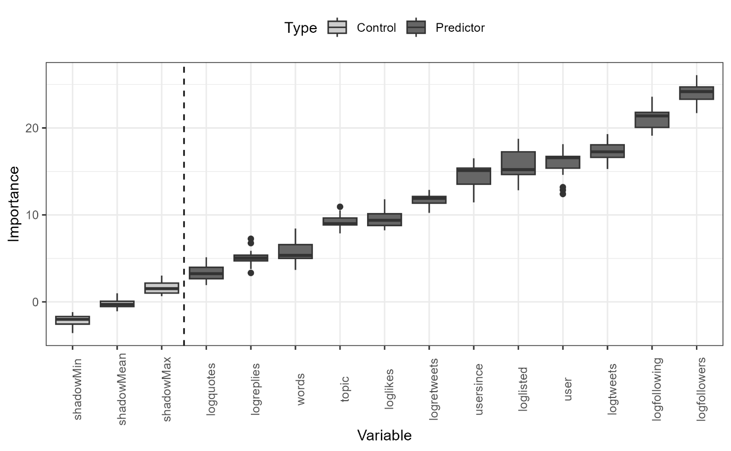
What factors impact the use of vulgarity online?
Combination of Boruta (to identify factors) and Regression (to determine direction and size of effect) effectively identifies factors associated with the use of vulgar language.
Network size effect: Users with larger social networks (more followers/following) are more likely to use vulgar language, whereas tweets with higher engagement (likes, retweets, replies) are slightly less likely to include it.
Topical variation: Vulgarity is most common in informal or expressive topics such as memes, metal health, immigration, crime, and employment.
Formal context restraint: Vulgarity is least common in professional, institutional, or policy-focused discussions (e.g., business, education, military, relationships).
Overall pattern: Vulgar language thrives in playful and socially expressive contexts but is constrained in formal or information-driven domains.
Schweinberger: Vulgarity in World Englishes

Slide 43
Key Findings
Social Media offers genuinely new insights into the use of vulgarity
Vulgarity is quite common (0.36 % of tokens & 4.4% of tweets) with users from the United States using most vulgarity
Vulgarity rates drop during working hours and increase towards late evening, except for Australian users where there is a notable peak right after coming home from work.
US users avoid vulgarity in discourse around work and employment, Australian users use vulgarity when tweeting about the work and the economy, UK users overuse vulgarity in the contexts of education and immigration.
Users with larger social networks (more followers/following) are more likely to use vulgar language, whereas tweets with higher engagement (likes, retweets, replies) are slightly less likely to include it.
Vulgar language thrives in playful and socially expressive contexts but is constrained in formal or information-driven domains. Australians have the highest share of speakers who use vulgarity in face-to-face settings.
Schweinberger: Vulgarity in World Englishes

Slide 44
Problems | Limitations
Social Media related
We cannot tap into social characteristics of users (age, gender, etc.) although we know(!) that these factors matter
There is automated content moderation which affects the use of vulgarity on social media
Tweets are very short which is sub-optimal for topic modelling (determining discursive topics)
General
Focus on English and neglect of emojis, etc.
Data represents a snapshot while longitudinal data would help reveal trends over time
Schweinberger: Vulgarity in World Englishes

Slide 45
Discussion and Outlook
Schweinberger: Vulgarity in World Englishes

Slide 46
Key Takeaways
Vulgarity is a global yet locally shaped phenomenon – its use varies across English varieties, contexts, and media.
Inner-circle varieties (US, UK, Australia) use more (English) vulgarity and display greater lexical creativity than outer-circle varieties.
Face-to-face data show higher vulgarity in informal, private dialogues, especially among younger speakers – speakers of Australian English use more vulgarity in more formal contexts.
Online and social media data reveal that vulgarity thrives in playful, identity-driven, and expressive discourses (e.g., memes, humour).
Formal or institutional topics (education, business, politics) are consistently less likely to feature vulgar expressions.
Social Media data offer genuinely new insights: impact of network size (bigger: more vulgarity) and engagement (more engagement: less vulgarity)
Schweinberger: Vulgarity in World Englishes

Slide 47
Methodological and Conceptual Reflections
Corpora and comparability: Challenges due to uneven data quality (e.g., ICE heterogeneity, register vs stylistic differences, social media moderation).
Definitional ambiguity: “Vulgarity,” “swearing,” and “taboo” overlap but are not identical – requiring thoughtful operationalization. Our approach aimed to be rather inclusive but was coarse-grained.
Ethical and interpretive challenges: Studying AND using offensive language demands careful contextualization and cultural sensitivity. Speakers need to be aware when and when not to use vulgarity (highly relevant for learners and (im-)migrants).
Need for multimodal and multilingual analyses: Future research should include other languages (combining content moderation lists for different languages) and also focus on emojis, images, and non-verbal cues to capture full expressive range. The present studies only focused on language but the use of “vulgar” emojis is fascinating!
Schweinberger: Vulgarity in World Englishes

Slide 48
Outlook and Future Directions
Extend analyses to non-English (Germany?), multilingual, learner, pop music, pop musand immigrant contexts to explore cross-cultural norms of vulgarity.
Incorporate longitudinal data to trace diachronic shifts and changing tolerances in online discourse.
Combine computational and more fine-grained methods for richer contextual understanding.
Investigate AI moderation impacts on language use and cultural variation in “acceptable” speech.
Overall, vulgarity offers a powerful lens into how language, culture, and technology interact in the digital age.
Schweinberger: Vulgarity in World Englishes

Slide 49
Thank you very f*&$ing much!
Schweinberger: Vulgarity in World Englishes

Slide 50
References
Allan, K., & Burridge, K. (2006). Forbidden Words: Taboo and the Censoring of Language. Cambridge University Press.
Beers Fägersten, K. (2012). Who’s Swearing Now? The Social Aspects of Conversational Swearing. Cambridge Scholars Publishing.
Burridge, K. (2006). Taboo words and the polite language. English Today, 22(1), 3–9.
Culpeper, J. (2011). Impoliteness: Using Language to Cause Offence. Cambridge University Press.
Dewaele, J.-M. (2016). Self-reported use and perception of swear words across languages by multilinguals. Intercultural Pragmatics, 13(3), 343–369.
Dynel, M. (2012). Swearing methodologically: The (im)politeness of expletives in anonymous commentaries on YouTube. Journal of English Studies, 10, 25–50.
Gries, S. T. (2021). Statistics for linguistics with R: A practical introduction. Walter de Gruyter.
Gries, S. and A Stefanowitsch. 2004. Extending collostructional analysis: a corpus-based perspective on alternations. International Journal of Corpus Linguistics 9(1): 97-129.
Holmes, J. (2013). "Discourse markers." In R. F. Simonsen & P. Mæhlum (Eds.), Pragmatics of Society (pp. 343–364). De Gruyter Mouton.
Jay, T. (2009). The utility and ubiquity of taboo words. Perspectives on Psychological Science, 4(2), 153–161. https://doi.org/10.1111/j.1745-6924.2009.01115.x
Kádár, D. Z., & Haugh, M. (2013). Understanding Politeness. Cambridge University Press.
Kursa, M. and W. Rudnicki. 2010. Feature selection with the Boruta package. Journal of Statistical Software 36(11): 1-13.
Laitinen, M., Rautionaho, P., Fatemi, M., & Halonen, M. (2025). Do we swear more with friends or with acquaintances? F#ck in social networks. Lingua, 320, 103931. https://doi.org/10.1016/j.lingua.2025.103931
Ljung, M. (2011). Swearing: A Cross-Cultural Linguistic Study. Palgrave Macmillan.
Schweinberger: Vulgarity in World Englishes

Slide 51
References
McEnery, T., & Xiao, R. (2004). Swearing in Modern British English: The Case of Fuck in the BNC. Language and Literature, 13(3), 235–268.
Pinker, S. (2007). The Stuff of Thought: Language as a Window into Human Nature. Viking.
Posit team (2025). RStudio: Integrated Development Environment for R. Posit Software, PBC, Boston, MA. url: http://www.posit.co/.
R Core Team (2024). R: A Language and Environment for Statistical Computing. R Foundation for Statistical Computing, Vienna, Austria. url: https://www.R-project.org.
Schweinberger, Martin (2018). Swearing in Irish English – A corpus-based quantitative analysis of the sociolinguistics of swearing. Lingua 209: 1-20. https://doi.org/10.1016/j.lingua.2018.03.008
Schweinberger, Martin. 2024. Seeded topic modeling as a more appropriate alternative to unsupervised standard topic models. Discourse Studies 27(4): 675-678 [Commentary on the Discussion Paper ‘Topic modelling in corpus-based discourse analysis: Uses and critiques’ by Monika Bednarek]. https://doi.org/10.1177/14614456241293895
Schweinberger, Martin and Kate Burridge. 2025. Vulgarity in Online Discourse around the English-Speaking World. Lingua, 321: 103946. https://doi.org/10.1016/j.lingua.2025.103946
Schweinberger, M., Laitinen, M., Haugh, M., Rautionaho, P., Fatemi, M., Hames, S., & Takahashi, M. (n.d.). F%$# Twitter: A corpus-based analysis of vulgar language on Twitter [Manuscript submitted for publication]. Corpora.
Schweinberger, M., Haugh, M., Laitinen, M., Fatemi, M., Hames, S., Rautionaho, P., & Takahashi, M. (n.d.). Swearing online: Exploring dimensions of variability in born-digital data [Manuscript submitted for publication]. Digital Scholarship in the Humanities.
Stapleton, K. (2003). Gender and swearing: A community practice. Women and Language, 26(2), 22–33.
Stephens, R., Atkins, J., & Kingston, A. (2009). Swearing as a response to pain. NeuroReport, 20(12), 1056–1060. https://doi.org/10.1097/WNR.0b013e32832e64b1
Wajnryb, R. (2005). Expletive Deleted: A Good Look at Bad Language. Free Press.
Schweinberger: Vulgarity in World Englishes

Slide 52
Vulgarity in World Englishes
Martin Schweinberger
m.schweinberger@uq.edu.au materials and slides available at www.martinschweinberger.de
This research was partially funded by the Language Data Commons of Australia (LDaCA). Language Data Commons of Australia (LDaCA) (DOI: 10.3565/kq2v-9g52) is a co-investment partnership with the Australian Research Data Commons (ARDC) through the HASS and Indigenous Research Data Commons. The ARDC is enabled by the Australian Government’s National Collaborative Research Infrastructure Strategy (NCRIS). In addition, this research was partially funded by the Centre for Digital Cultures and Societies at the University of Queensland.

