Slide 1
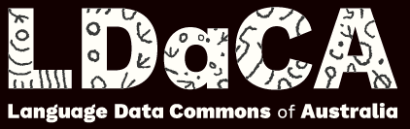


Vulgarity in spoken interaction across selected varieties of English Martin Schweinberger m.schweinberger@uq.edu.au materials and slides available at www.martinschweinberger.de
This research was partially funded by the Language Data Commons of Australia (LDaCA). Language Data Commons of Australia (LDaCA) (DOI: 10.3565/kq2v-9g52) is a co-investment partnership with the Australian Research Data Commons (ARDC) through the HASS and Indigenous Research Data Commons. The ARDC is enabled by the Australian Government’s National Collaborative Research Infrastructure Strategy (NCRIS). In addition, this research was partially funded by the Centre for Digital Cultures and Societies at the University of Queensland.

Slide 2
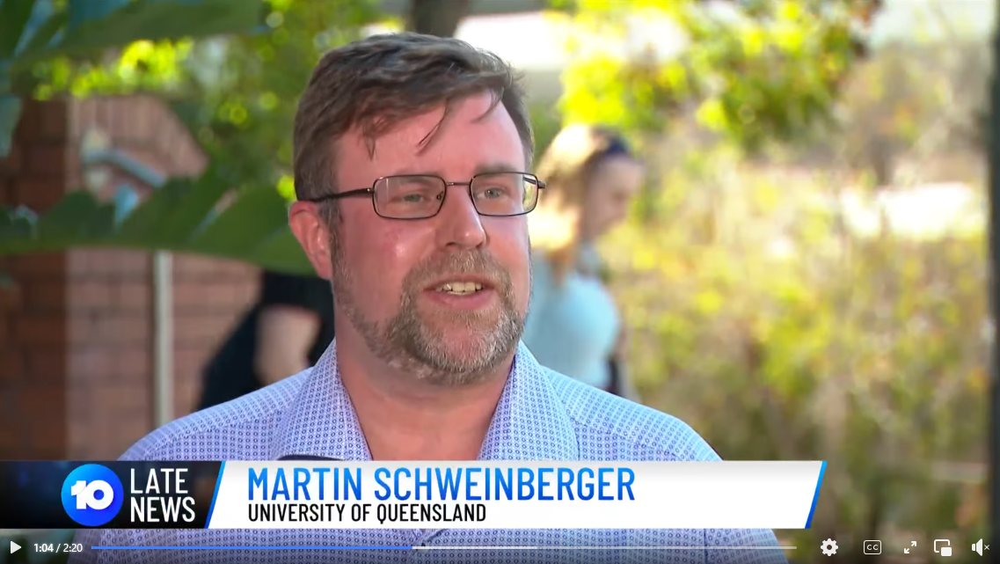
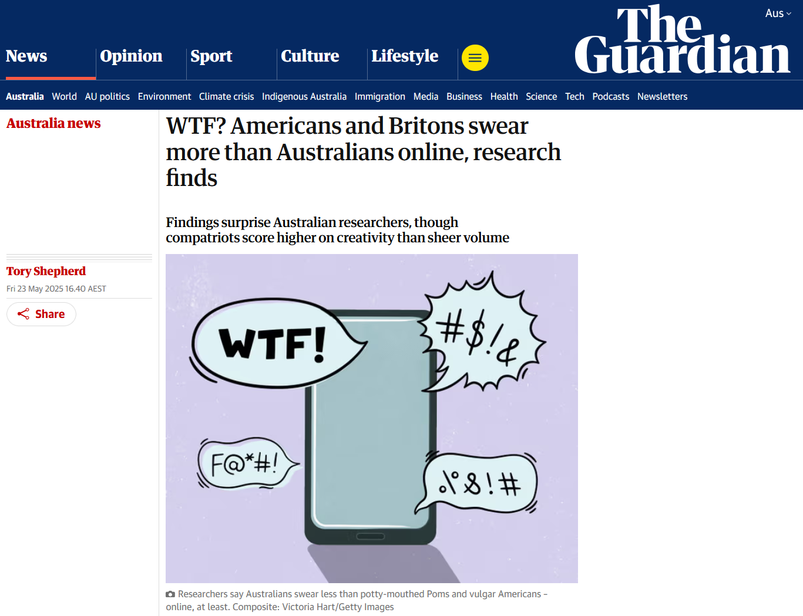
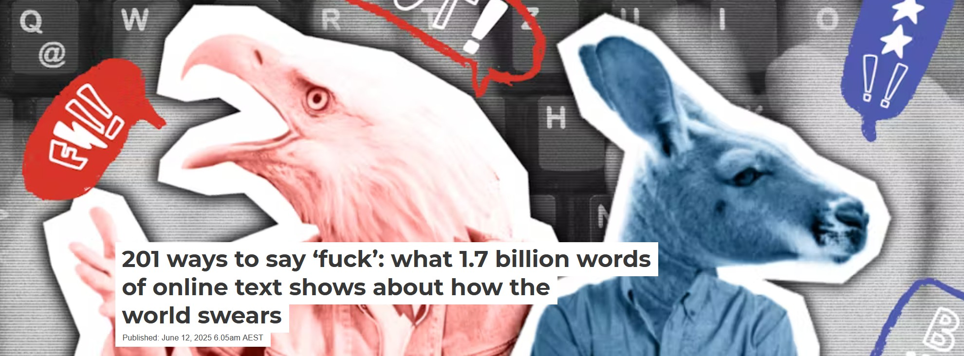
Background
In 2021, together with colleagues from UQ, The Queensland University of Technology, and the University of Eastern Finland, we applied for funding for a project called F%$# Twitter from the UQ Centre for Digital Cultures and Societies.
The results of this project have led to several presentations at international conferences and a Lingua Special Issue Bad Language and Vulgarity Online and in Public Discourse (Eds. Martin Schweinberger, Paula Rautionaho, & Kate Burridge)
Schweinberger & Burridge (2025) Vulgarity in online discourse around the English-speaking world went viral…
Features in the national afternoon and evening news in Australia
Over 70 newspaper articles including The Guardian, CNN, The Conversation, The Washington Times, etc.
Several live radio interviews (I alone appeared on 5 ABC radio shows)

Slide 3
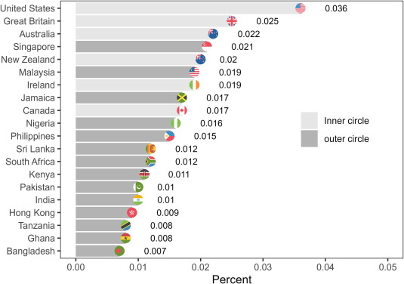
Background
Public interest particularly in the ranking of the use of vulgarity across English-speaking regions (although that was not the main focus of our paper)
Most common question we received:
What would results be
if you looked at face-to-face interaction?!

Slide 4
Functions of Swearing/Vulgarity
Social functions
Indexing Identity/Group Membership: can signal in-group solidarity, shared norms, or cultural/regional identity (Beers Fägersten, 2012)
Establishing|Challenging Social Hierarchies: can assert dominance, express resistance, or subvert social norms (Dynel, 2012; Jay, 2009)
Expressing Emotion & Intensity: used as an emotional intensifier and stress relief (Stephens, Atkins, & Kingston, 2009; Wajnryb, 2005).
Managing Social Distance & Politeness: may reduce social distance or enhance authenticity in informal settings (Culpeper, 2011; Kádár & Haugh, 2013)
Linguistic functions
Lexical Creativity & Innovation: Swearing often involves creative word formation, euphemisms, and taboo-avoidance strategies (Allan & Burridge, 2006; Ljung, 2011).
Pragmatic & Discourse Marking: serves as a discourse strategy to mark stance, topic shifts, or emphasis (Dewaele, 2016; Holmes, 2013)
Sociolinguistic Variation: varies by age, gender, class, and region, making it a rich domain for sociolinguistic study (McEnery & Xiao, 2004; Schweinberger, 2018; Stapleton, 2003)
Language Norms and Taboo: reveals how societies construct and negotiate linguistic taboos (Burridge, 2006; Pinker, 2007).

Slide 5
Research questions and hypotheses
Relevant findings from prior research
online, speakers/users from inner circle varieties and espcially speakers from the US use most vulgarity (Laitinen, Rautionaho, Fatemi, & Halonen, 2025; Schweinberger & Burridge, 2025; Schweinberger, Laitinen, Haugh, Rautionaho, Fatemi, Hames, & Takahashi, n.d.; Schweinberger, Haugh, Laitinen, Fatemi, Hames, Rautionaho, & Takahashi, n.d.).
Younger speakers and young males in particular exhibit higher rates of vulgarity compared with older speakers or female speakers (Schweinberger, 2018)
Hypotheses
Based on the use of vulgarity in spoken discourse in public settings (advertisement ads and outbursts of former Prime Miniters on televsion), we assumed that
Australians would exhibit higher frequencies of vulgarity in face-to-face conversations while the use of vulgarity among US speakers would be lower.
Inner circle varieties exhibit a tendency for higher use fo vulgarity compared to outer circle varieties.

Slide 6

Data and Data Processing
International Corpus of English (ICE)
Spoken sections of ICE Australia, Canada, East Africa (Kenya & Tanzania), Great Britain, Hong Kong, Ireland, India, Jamaica, New Zealand, Philippines, Sri Lanka, Singapore, and the Santa Barbraa Corpus of Spoken American English
Data Processing
All in R version 4.4.2 (R Core Team, 2024) via RStudio (Posit team, 2025)
Split into untterances
Extracted speaker reference and cleaned utterance
Added speaker information and determined the number of tokens in each utterance
Concordancing of vulgar elements using a list of regular expressions (same as Schweinberger & Burridge, 2025)
Tabullation and visualisation

Slide 7
Methodology
Data Extraction
To extract vulgar elements we used the same list of regular expressions as Schweinberger and Burrdige (2025).
Started with terms listed in online content modertation, previous research, and what the OED considers „vulgar“. Then manually checked the lists and enhanced them using regular expressions to be able to find vulgarity with non-normalised spellings and other variants (plurals, progressive forms, etc.).
Statistical Methods
Frequency tabulation (normalised by N tokens)
Adjusted Corrected Type-Token Ratios (aCTTR) to investigate variability and creativity in use: the higher the aCTTR, the more different variants the speaker form a region are using.
Conditional Inference Trees (CIT) to check for differences along social categories (dependent variable: speaker uses or vulgar element vs does not use a vulgar element).

Slide 8
Data
 | private dialogue |  |  | public dialogue |  |  | unscripted monologue |  |  | scripted monologue
Region | Vulgar Tokens | Tokens | Percent | Vulgar Tokens | Tokens | Percent | Vulgar Tokens | Tokens | Percent | Vulgar Tokens | Tokens | Percent
Australia | 146 | 206,544 | 0.071 | 19 | 163,595 | 0.012 | 23 | 147,533 | 0.016 | 22 | 109,371 | 0.02
Canada | 72 | 271,984 | 0.026 | 24 | 297,391 | 0.008 | 10 | 181,750 | 0.006 | 18 | 298,530 | 0.006
Great Britain | 126 | 261,576 | 0.048 | 11 | 192,483 | 0.006 | 12 | 294,119 | 0.004 | 3 | 174,120 | 0.002
Hong Kong | 74 | 485,383 | 0.015 | 17 | 293,478 | 0.006 | 8 | 257,041 | 0.003 | 15 | 257,831 | 0.006
India | 16 | 237,108 | 0.007 | 2 | 195,321 | 0.001 | 4 | 164,214 | 0.002 | 7 | 153,340 | 0.005
Ireland | 196 | 205,032 | 0.096 | 4 | 169,785 | 0.002 | 13 | 158,834 | 0.008 | 6 | 108,709 | 0.006
Jamaica | 30 | 236,258 | 0.013 | 8 | 191,304 | 0.004 | 39 | 221,205 | 0.018 | 5 | 137,777 | 0.004
Kenya | 3 | 63,073 | 0.005 | 9 | 151,371 | 0.006 |  |  |  | 6 | 122,646 | 0.005
New Zealand | 246 | 225,457 | 0.109 | 9 | 183,930 | 0.005 | 14 | 171,280 | 0.008 | 9 | 128,076 | 0.007
Philippines | 28 | 204,346 | 0.014 | 2 | 162,356 | 0.001 | 2 | 215,569 | 0.001 | 4 | 184,170 | 0.002
Singapore | 82 | 226,537 | 0.036 | 9 | 181,943 | 0.005 | 3 | 147,228 | 0.002 | 13 | 120,700 | 0.011
Sri Lanka | 108 | 222,615 | 0.049 | 16 | 177,260 | 0.009 | 4 | 156,676 | 0.003 | 7 | 113,641 | 0.006
Tanzania | 1 | 8,625 | 0.012 | 16 | 436,249 | 0.004 |  |  |  | 8 | 102,479 | 0.008
United States | 80 | 221,827 | 0.036
Total | 1,208 | 3,076,365 | 0.039 | 146 | 2,796,466 | 0.005 | 132 | 2,115,449 | 0.006 | 123 | 2,011,390 | 0.006

Slide 9
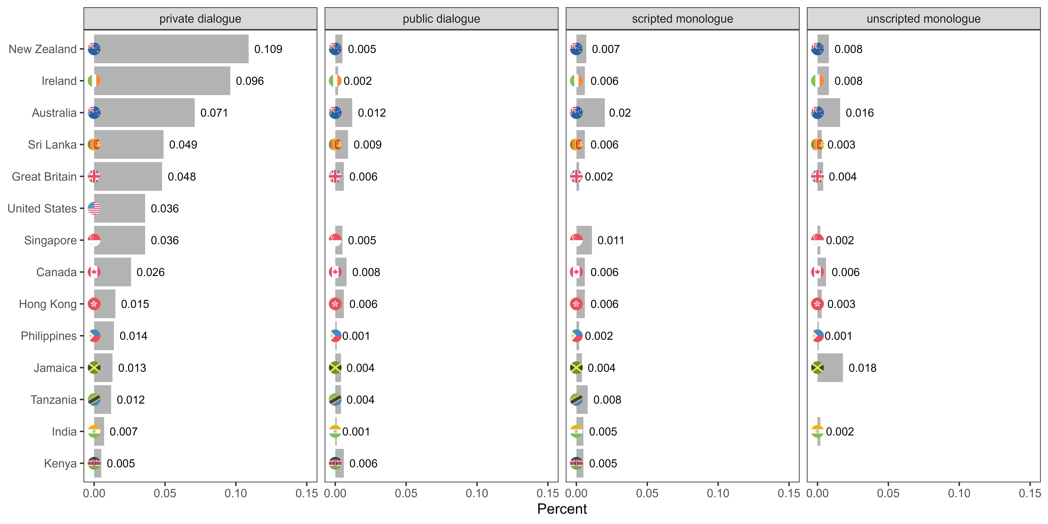

Slide 10
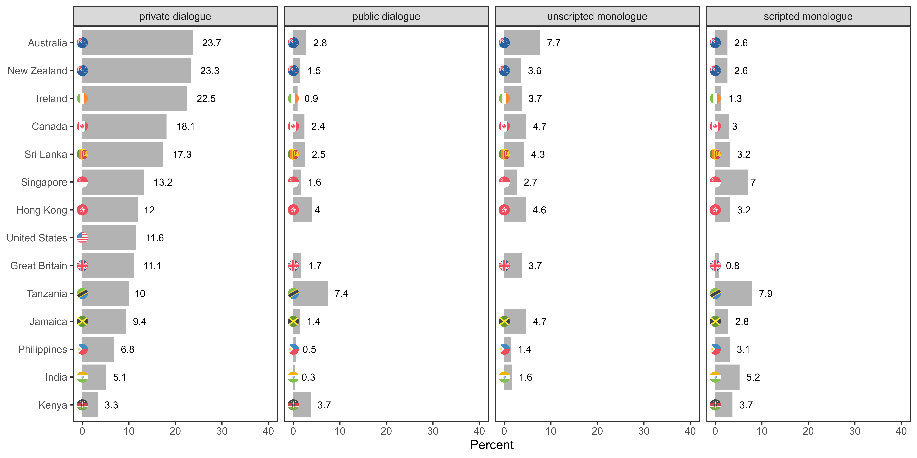

Slide 11
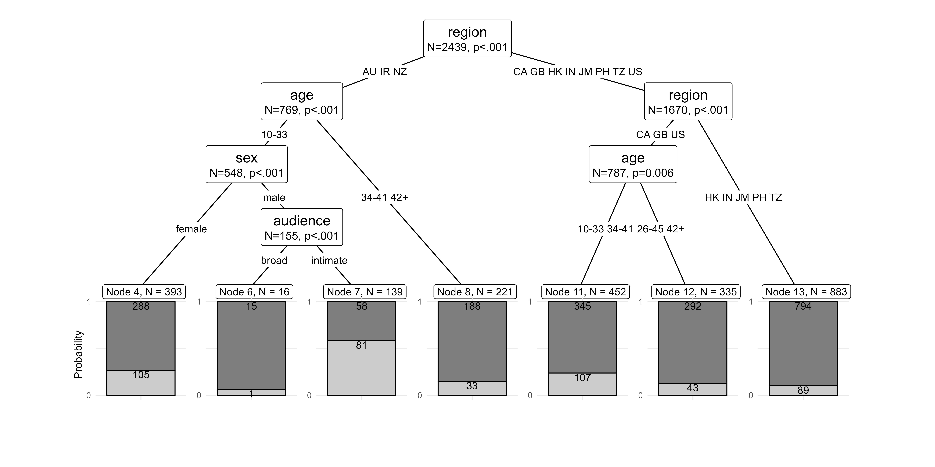

Slide 12
Key Findings
Vulgarity is notably more frequent in informal private dialogues than in public-stage talk or monologues intended for broader audiences.
Speakers from inner circle varieties use more vulgarity in face-to-face conversations than speakers from outer circle varieties.
Unlike online discourse, US speakers are less prominent in face-to-face vulgarity use.
In contrast, nativised post-colonial varieties (Ireland, New Zealand, Australia) show higher frequencies of vulgar expressions.
Australians have the highest share of speakers who use vulgarity in face-to-face settings.
Inner circle varieties also show greater creativity in swearing, indicated by a higher variability of vulgar forms.
Prior research regarding sociolinguistic constraints are supported and expanded: young speakers use more vulgarity. Young women use vulgarity regardless of audience size, young men use vulgarity significantly more in intimate settings rather than with a broad audience.

Slide 13
Problems
ICE corpora related
Despite being intended for cross-cultural comparisons – are quite heterogeneous and inconsistent (structure, transcription convention, coverage, sociodemographic information, etc.).
Focus of ICE on educated speakers – very little data from working class speakers.
Data quite “old” by now…
General
“True” behavior hard to capture – speakers are still aware that they are recorded.
How representative are the ICE components?

Slide 14
References
Allan, K., & Burridge, K. (2006). Forbidden Words: Taboo and the Censoring of Language. Cambridge University Press.
Beers Fägersten, K. (2012). Who’s Swearing Now? The Social Aspects of Conversational Swearing. Cambridge Scholars Publishing.
Burridge, K. (2006). Taboo words and the polite language. English Today, 22(1), 3–9.
Culpeper, J. (2011). Impoliteness: Using Language to Cause Offence. Cambridge University Press.
Dewaele, J.-M. (2016). Self-reported use and perception of swear words across languages by multilinguals. Intercultural Pragmatics, 13(3), 343–369.
Dynel, M. (2012). Swearing methodologically: The (im)politeness of expletives in anonymous commentaries on YouTube. Journal of English Studies, 10, 25–50.
Holmes, J. (2013). "Discourse markers." In R. F. Simonsen & P. Mæhlum (Eds.), Pragmatics of Society (pp. 343–364). De Gruyter Mouton.
Jay, T. (2009). The utility and ubiquity of taboo words. Perspectives on Psychological Science, 4(2), 153–161. https://doi.org/10.1111/j.1745-6924.2009.01115.x
Kádár, D. Z., & Haugh, M. (2013). Understanding Politeness. Cambridge University Press.
Laitinen, M., Rautionaho, P., Fatemi, M., & Halonen, M. (2025). Do we swear more with friends or with acquaintances? F#ck in social networks. Lingua, 320, 103931. https://doi.org/10.1016/j.lingua.2025.103931
Ljung, M. (2011). Swearing: A Cross-Cultural Linguistic Study. Palgrave Macmillan.
McEnery, T., & Xiao, R. (2004). Swearing in Modern British English: The Case of Fuck in the BNC. Language and Literature, 13(3), 235–268.
Pinker, S. (2007). The Stuff of Thought: Language as a Window into Human Nature. Viking.
Posit team (2025). RStudio: Integrated Development Environment for R. Posit Software, PBC, Boston, MA. url: http://www.posit.co/.
R Core Team (2024). R: A Language and Environment for Statistical Computing. R Foundation for Statistical Computing, Vienna, Austria. url: https://www.R-project.org.
Schweinberger, Martin (2018). Swearing in Irish English – A corpus-based quantitative analysis of the sociolinguistics of swearing. Lingua 209: 1-20. https://doi.org/10.1016/j.lingua.2018.03.008
Schweinberger, Martin and Kate Burridge. 2025. Vulgarity in Online Discourse around the English-Speaking World. Lingua, 321: 103946. https://doi.org/10.1016/j.lingua.2025.103946
Schweinberger, M., Laitinen, M., Haugh, M., Rautionaho, P., Fatemi, M., Hames, S., & Takahashi, M. (n.d.). F%$# Twitter: A corpus-based analysis of vulgar language on Twitter [Manuscript submitted for publication]. Corpora.
Schweinberger, M., Haugh, M., Laitinen, M., Fatemi, M., Hames, S., Rautionaho, P., & Takahashi, M. (n.d.). Swearing online: Exploring dimensions of variability in born-digital data [Manuscript submitted for publication]. Digital Scholarship in the Humanities.
Stapleton, K. (2003). Gender and swearing: A community practice. Women and Language, 26(2), 22–33.
Stephens, R., Atkins, J., & Kingston, A. (2009). Swearing as a response to pain. NeuroReport, 20(12), 1056–1060. https://doi.org/10.1097/WNR.0b013e32832e64b1
Wajnryb, R. (2005). Expletive Deleted: A Good Look at Bad Language. Free Press.

Slide 15
Thank you very ... much!

Slide 16
Vulgarity in spoken interaction across selected varieties of English Martin Schweinberger m.schweinberger@uq.edu.au materials and slides available at www.martinschweinberger.de
This research was partially funded by the Language Data Commons of Australia (LDaCA). Language Data Commons of Australia (LDaCA) (DOI: 10.3565/kq2v-9g52) is a co-investment partnership with the Australian Research Data Commons (ARDC) through the HASS and Indigenous Research Data Commons. The ARDC is enabled by the Australian Government’s National Collaborative Research Infrastructure Strategy (NCRIS). In addition, this research was partially funded by the Centre for Digital Cultures and Societies at the University of Queensland.

Slide 17
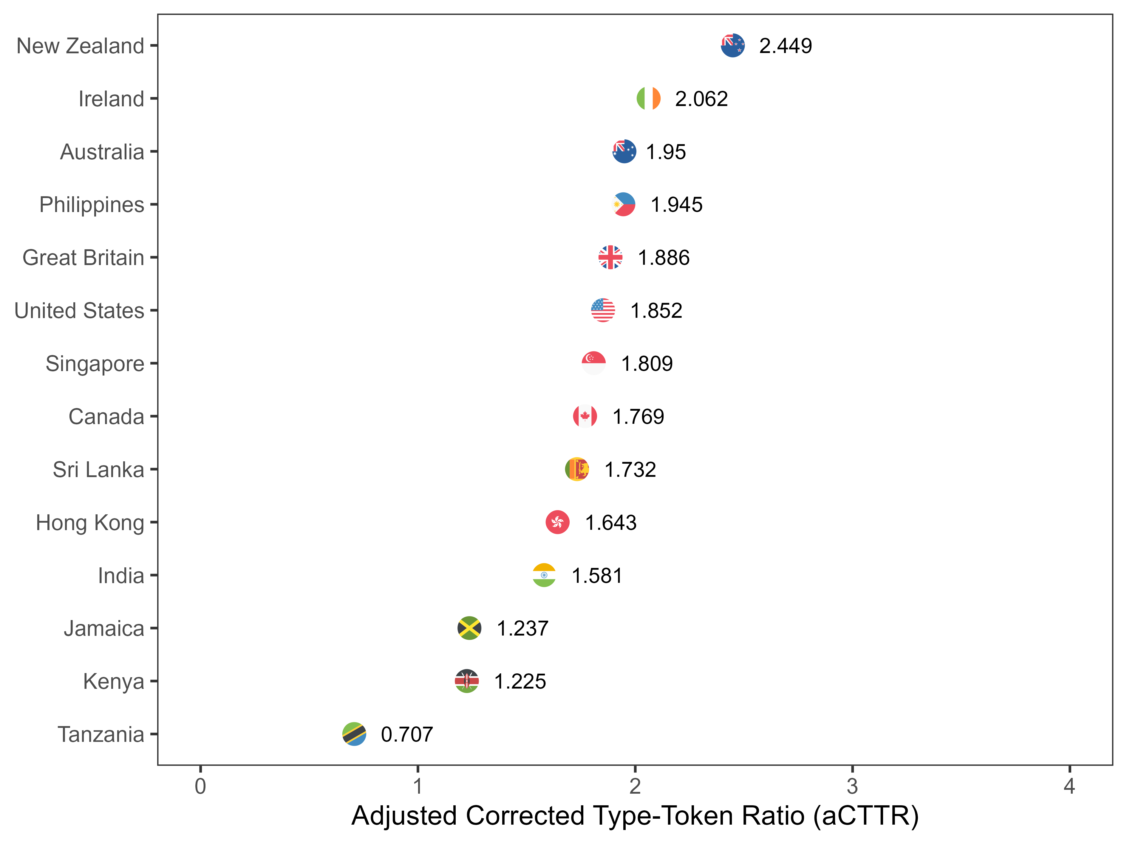

Slide 18
