Slide 1

Word Embeddings: How AI Learns Word Meanings Linguistics II – Aufbaumodul 1
Dr Martin Schweinberger

Slide 2
Activity 1: Semantic Similarity
YOUR TASK (Time: 2 minutes )
You will now receive word cards with 8 English words.
Your task is to position yourselves in the room so that semantically similar words are close to each other.
Once you have arranged yourselves, discuss:
What criteria are you using to arrange the words?
What makes these words similar or different?

Slide 3
Activity 2: Text Analysis
YOUR TASK (Think → Pair → Share)
I will show a text on the next slide.
Read the text and check which words co-occur with our terms from Activity 1.
Form pairs and discuss how these context words are related to “meaning”.
Share your observations and ideas with the group.

Slide 4
Activity 2: Text Analysis
The king ruled the kingdom with wisdom. The queen supported diplomatic relations with neighbouring countries. Meanwhile, the doctor examined patients at the hospital, while the nurse administered medications. The engineer designed the new bridge, and the teacher prepared lessons for the students.
Which verbs and nouns co-occur with our terms?
How could this be used to determine similarity?

Slide 5
Activity 2: Text Analysis
The king ruled the kingdom with wisdom. The queen supported diplomatic relations with neighbouring countries. Meanwhile, the doctor examined patients at the hospital, while the nurse administered medications. The engineer designed the new bridge, and the teacher prepared lessons for the students.
Which verbs and nouns co-occur with our terms? (collocations!)
How could this be used to determine similarity?

Slide 6
From Collocations to Word Embeddings
Have a look at the table which shows co-occurrence frequencies of words in the British National Corpus (a large collection of texts deemed representative of British English).
What word is missing?
How did you determine which word is missing?
 | cut | walk | eat | drink | pet
cat | 1 | 18 | 12 | 3 | 40
??? | 1 | 25 | 10 | 4 | 55
knife | 35 | 0 | 15 | 5 | 0
table | 12 | 1 | 40 | 35 | 0
pig | 20 | 3 | 45 | 10 | 0

Slide 7
From Collocations to Word Embeddings
Word embeddings are based on a linguistic theory (distributional semantics) proposed by J. R. Firth in the 1950s: “You shall know a word by the company it keeps.”
What does this mean?
Distributional semantics: The meaning of a word emerges from the contexts in which it appears.
AI systems analyze billions of sentences and learn which words appear in similar contexts. This information is stored in strings of numbers (called word vectors or word embeddings).
The fascinating part is that these word embeddings encode meaning (semantics) and can even represent analogies: the relationship king → queen is similar to the relationship man → woman.

Slide 8
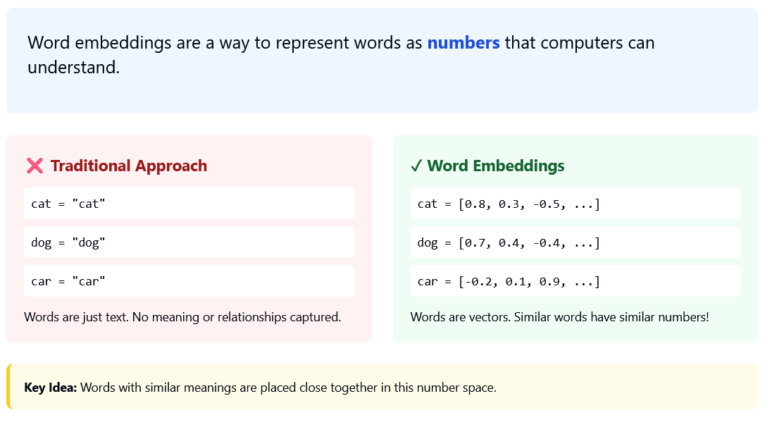
What are word embeddings?

Slide 9
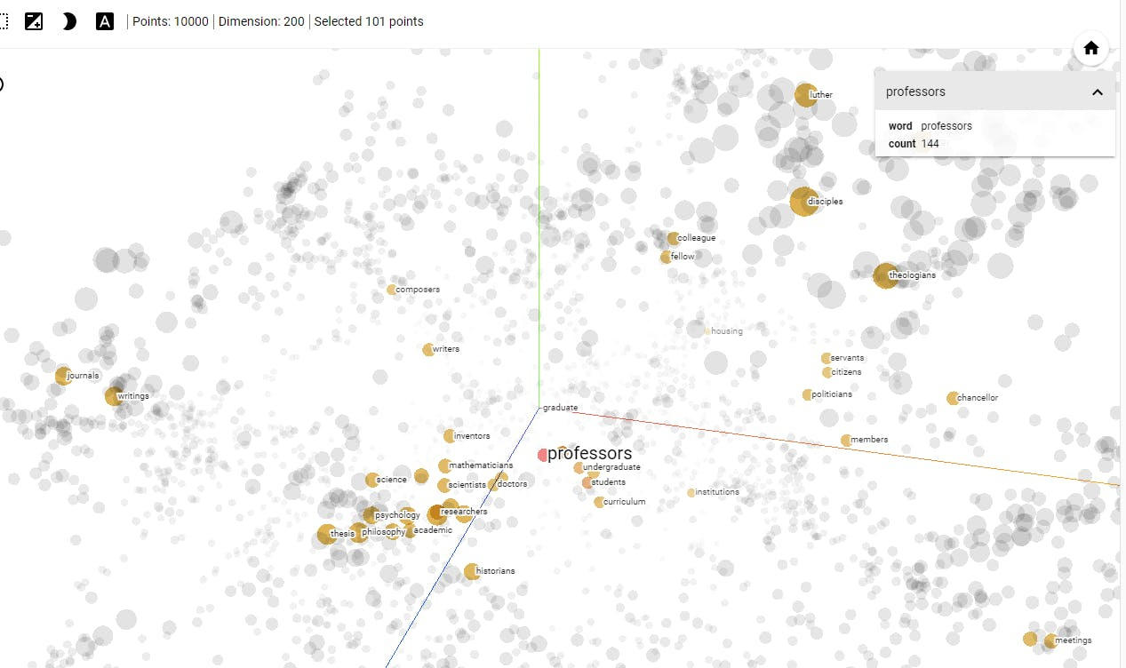
Spatial/Visual Representation of Word Embeddings

Slide 10
Activity 3: Word Embeddings in ESL/EFL
YOUR TASK (Time: 2 minutes )
As English teachers, you will be working with AI tools—whether in lesson planning or when students use them.
What do our insights into word embeddings mean for you as future teachers?
Form pairs and think about:
How could semantic relationships be taught to students?
Could word embeddings be used as a tool for vocabulary learning?
How can we explain that AI does not understand “real” meaning, but rather patterns?

Slide 11
Wrap Up
Word embeddings are numeric representations of words.
The numbers represent co-occurrence (distributional semantics, Firth)
Doctor: often co-occurs with hospital, patient, examination, medical.
Teacher often co-occurs with classroom, student, lesson, education.
Because doctor and teacher are both professions and occur in similar syntactic structures, they are located relatively close to each other in embedding space—but closer to their respective semantic fields.

Slide 12
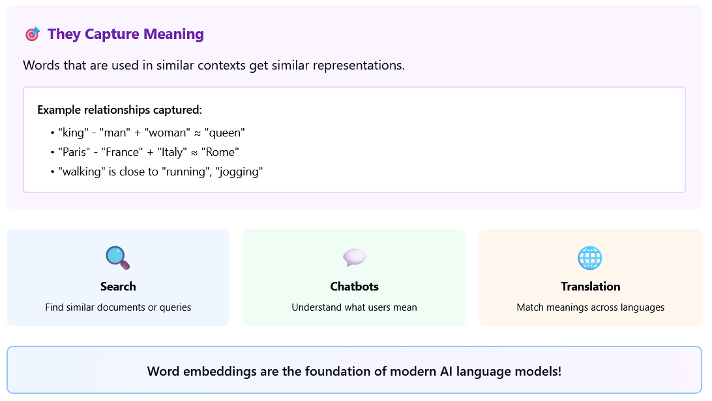
Wrap Up

Slide 13
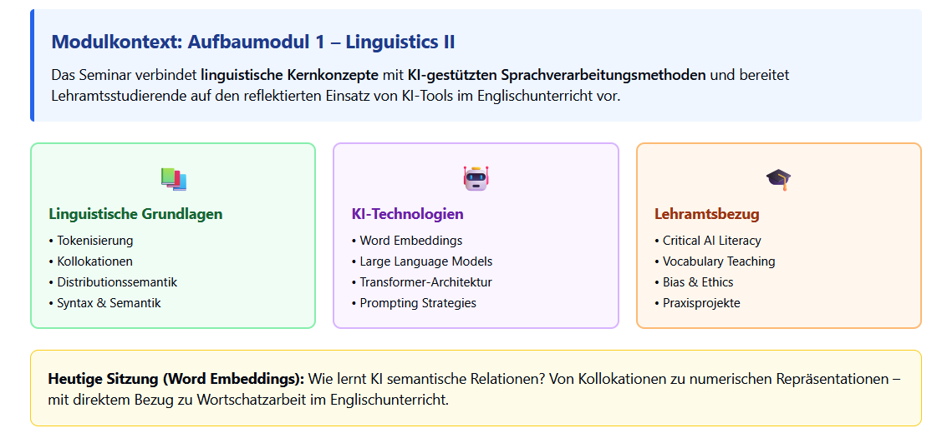
Einbettung in Gesamtkonzeption

Slide 14
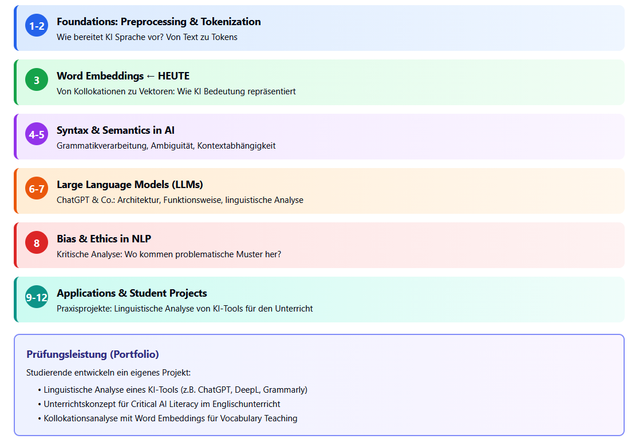
Seminarstruktur & Progression Von linguistischen Grundlagen zu kritischer KI-Analyse

