Slide 1
Local Geography
Educator

Slide 2
Goal
Create an application capable of teaching local geography of any place in the world.
  Examples of local geography:
    Cities, villages
    City districts
    Streets
    Parks
    Water bodies of any sort
    Schools
    Restaurants

Slide 3
Demo

Slide 4
Design decisions

Slide 5
Design decisions
How to create an educational application?
  Need to consider human factors regarding learning.
  Needs to be entertaining.
  Needs to be challenging.
Great attention on design decisions.

Slide 6
Design decisions:
Targeted audience
  Anyone with an interest in becoming more knowledgeable in local geography.
Broad audience.
Simplicity favored over complex functionality.

Slide 7
Design decisions:
Educational aspects
Many associations for preserved memories.
Repetition when needed.
Stimulation to stay focused.
Support after errors and mistakes.

Slide 8
Design decisions:
Potential user considerations
Discussed design decisions.
Important: Minimize risk of user getting stuck in the exercise progression.
Conclusion:
  Lightweight, quiz-based levels.
  Subsequent reminders.

Slide 9
Design decisions:
Existing application analysis
Exists multiple similar applications.
Seterra, World Geography, Duolingo...
What are their strengths/ weaknesses?

Slide 10
Design decisions:
Existing application analysis
Five crucial aspects for a quiz based application with an educational purpose:
  Motivation – why continue?
  Questions – difficulty/ design.
  Support after errors/ mistakes.
  Stimulation through a timer.
  Appearance also very important.

Slide 11
Design decisions:
Scenario analysis
Newly-moved-in student wants to learn city better.
Older person plans to move to a new village in Portugal.
Taxi driver who needs better local knowledge because of his job.
Sailer who plans to explore the islands in the archipelago of Stockholm.

Slide 12
Design decisions:
Functional requirements (selection)
Construct an exercise from a size-limited area anywhere in the world.
Let user take a level quiz which takes the user to next level if finished with satisfactory result.
At certain times, require the user to take a reminder quiz.
Integrate follow-up quizzes.
Include a stimulator (a timer ticking down).
Support Name-it, Place-it and Pair-it questions.
Integrate tapping practice.

Slide 13
Design decisions:
Non-functional requirements
Educational in local geography.
Promote learning about big and important geographic objects before less significant objects.
Swift, stimulating, lightweight quizzes.
Guiding user towards correct answer when incorrect answer is given.
Let user know that he/she is making progress towards a goal.
Prevent user from forget any previously seen geographic objects.

Slide 14
Design

Slide 15
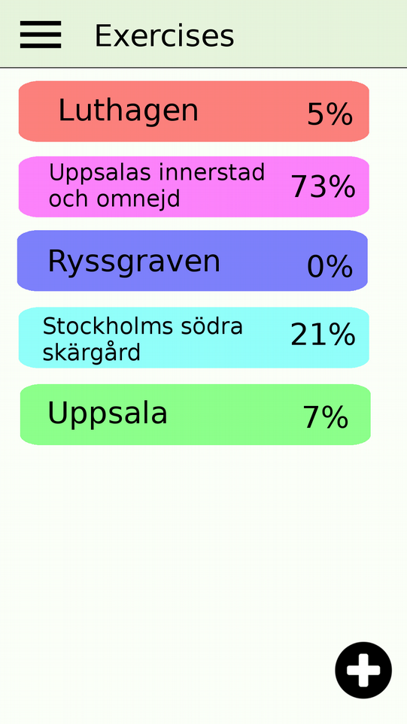
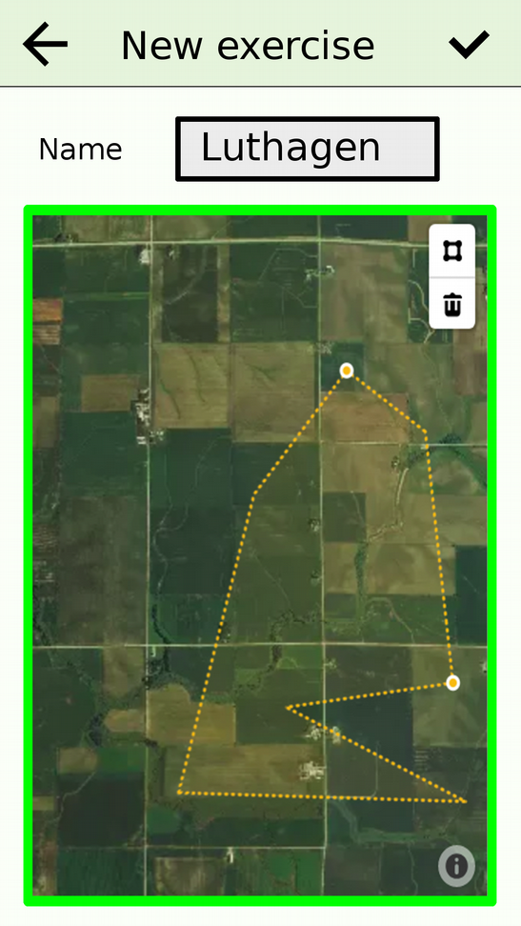
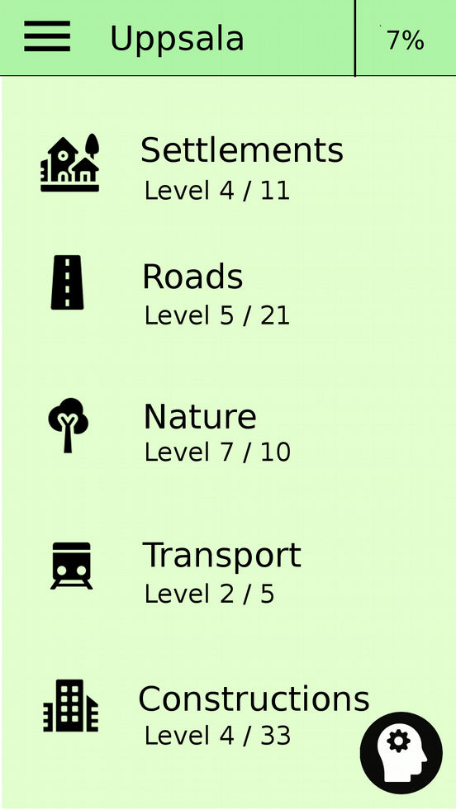
Select exercise/ create new/ enter

Slide 16
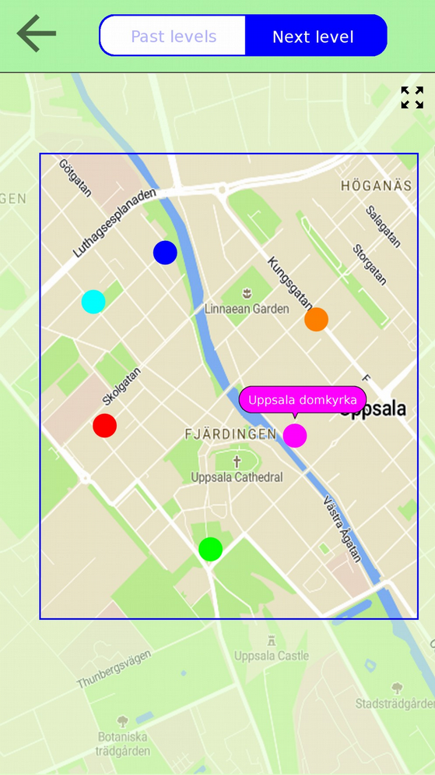
Tapping practice

Slide 17
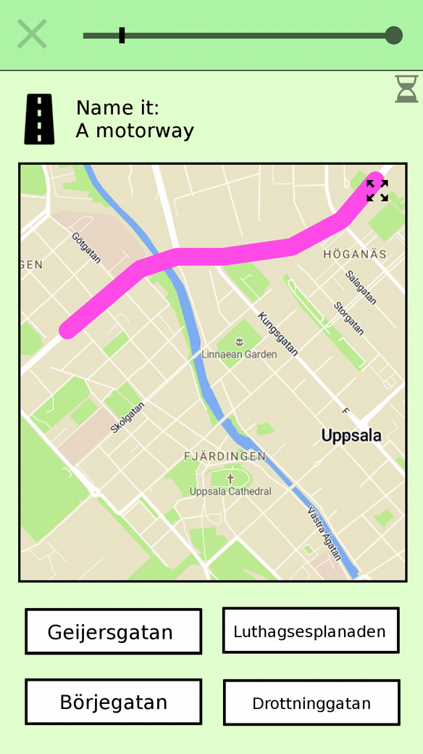
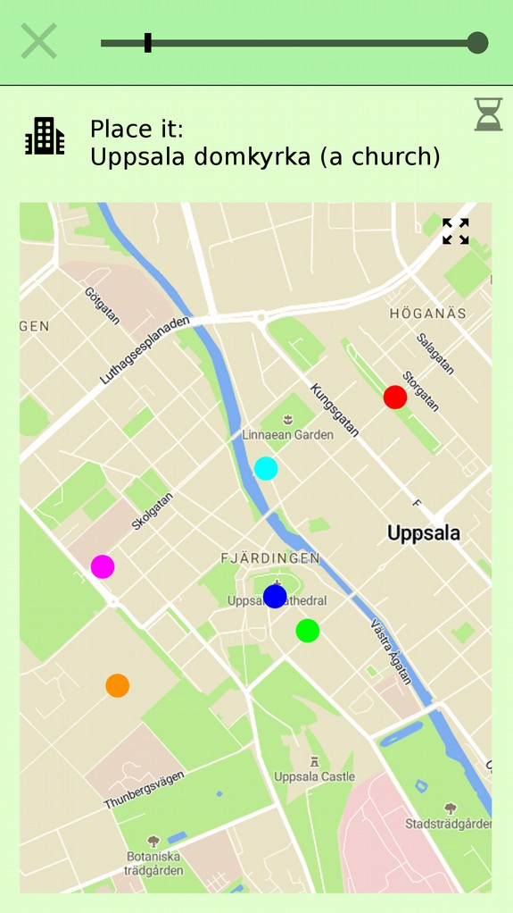
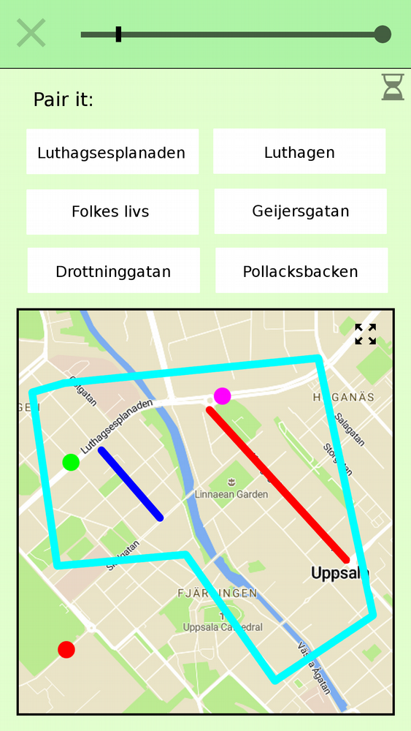
Quiz

Slide 18
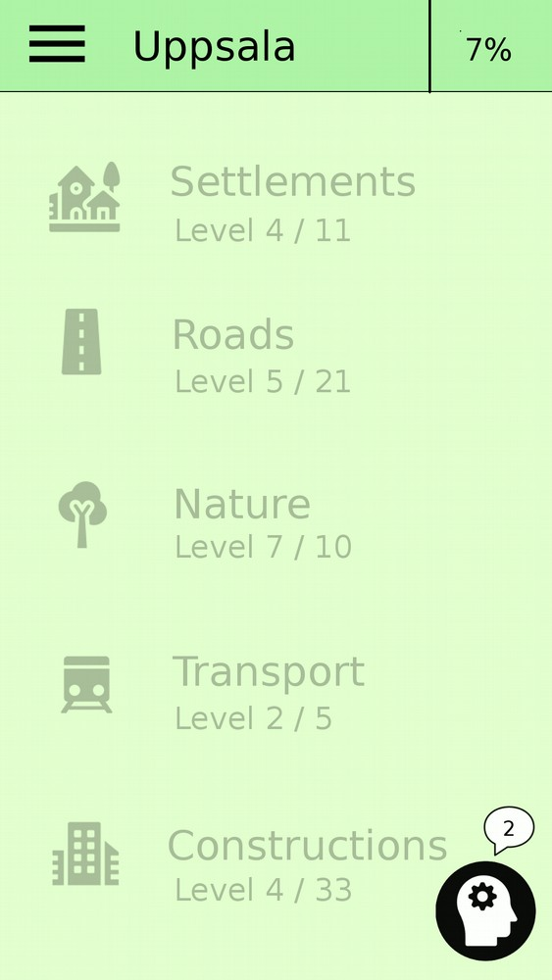
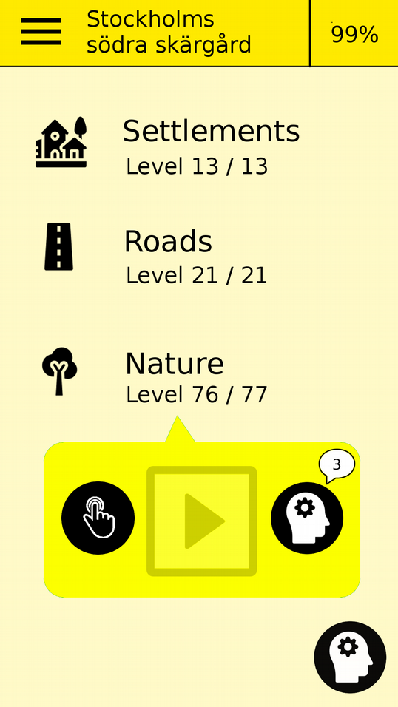
Required reminders

Slide 19
Implementation

Slide 20
Implementation
Android mobile phones and tablets
Java for logic
XML for layouts
Android studios IDE

Slide 21
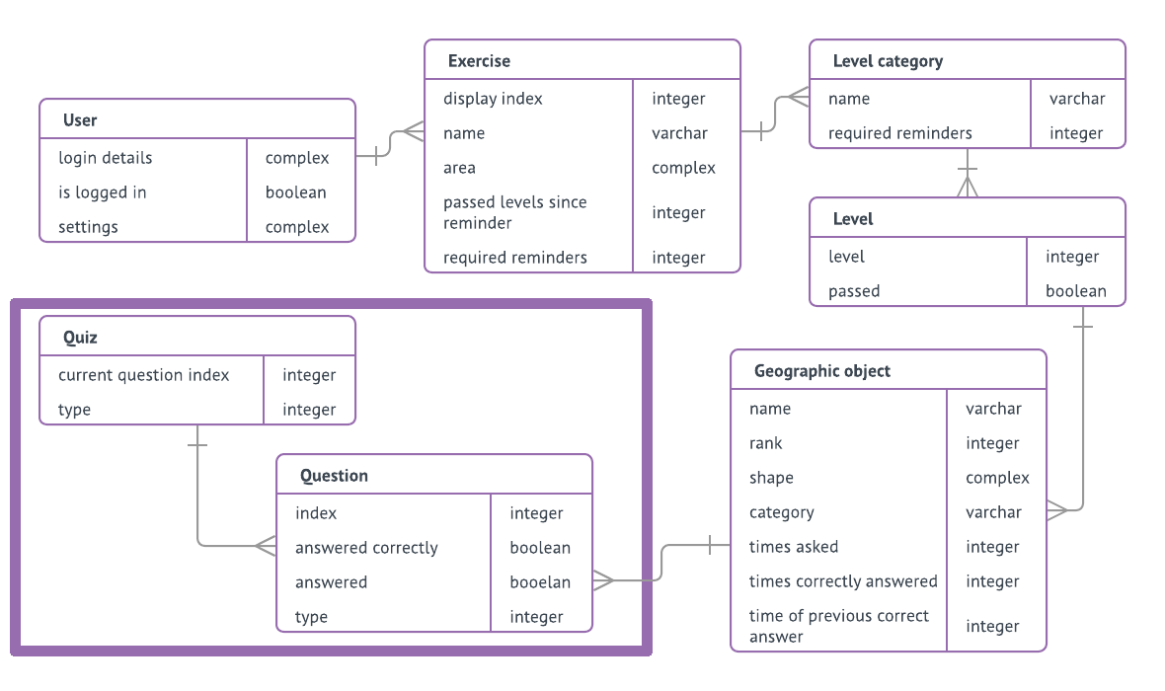
Implementation:
Data model

Slide 22
Implementation:
Data model

Slide 23
Implementation:
Data model
Implemented in Android using an SQLite database

Slide 24
Implementation:
Fetching data
Need: detailed geographic data with world coverage.
Provider: OpenStreetMap + Overpass API
Provides: xml-data of geographic elements.
Element:
  Coordinates (node/ way/ relation)
  Tags (key=value)

Slide 25
Implementation:
Incoming data → Build instructions
Small amount of data in main memory.
Incoming line of XML.
Scanned with regular expressions.
  Beginning of new element?
  Coordinates?
  Tags?
Build instructions: coordinates + tags.

Slide 26
Implementation:
Build instructions → geographic object
Convert tags to a super-category and a sub-category.
  Problem: varying quality of tags (OSM a collaborative project).
  Solution: Map each popular tag to its relevant category.
    Popular tags? TagInfo.
Importance-ranking from:
  Number of tags.
  Number of edits.
  Geographic size (length/ area).

Slide 27
Implementation:
Merge geographic objects
OSM-data contains incomplete elements (road-segments etc).
Solution:
  Extract groups of objects with same names.
  Attempt merge of objects in each group.
  Merge possible if objects are close enough.
  Two objects → One object with multiple shapes.

Slide 28
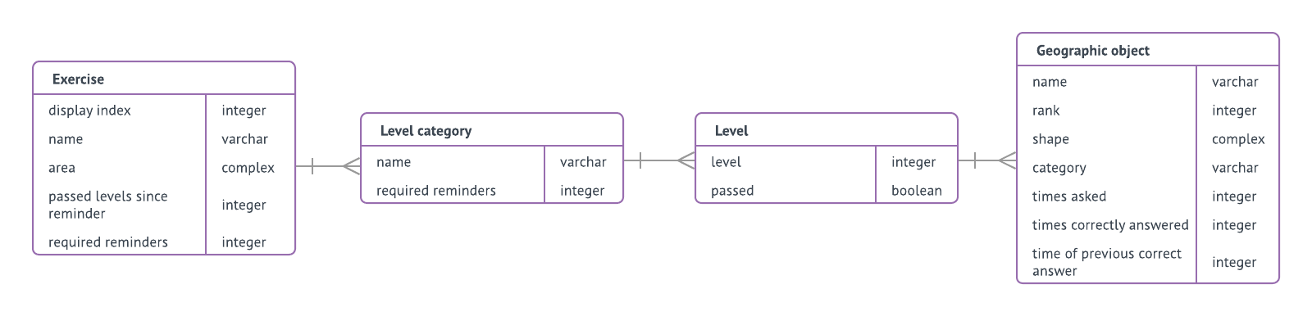
Implementation:
Geographic objects → complete exercise data
Geographic objects are grouped into levels.
Levels are group into level-categories.
Level-categories assigned to a new exercise.
Exercise assigned to a user.

Slide 29
Implementation:
Quiz run
Construct a Quiz-object (with Questions) before each quiz.
Remove Quiz-object from db when quiz done.
Resume a quiz if application started and a Quiz-object exists in db.
Gather stats about answers during a quiz:
  For smart reminder-selections.
  For smart alternatives-selection.

Slide 30
Implementation:
Integrated maps
Mapbox Maps API for Android.
Functionality for e.g.
  Displaying highly customizable integrated maps.
  Adding clickable markers and polygons to the map.
  Hiding/ showing text-labels.

Slide 31
Evaluation

Slide 32
Evaluation
Implementation corresponds well with intended design.
Application tested by two users:
  Both able to create an exercise and start practicing.
  Time provided for a question too little?
    Make it adapt to the user?
Used it myself.

Slide 33
Future work
Back up data on a server.
Optimize performance during exercise creation.
Predefined exercise areas.
Exercise and progress-sharing.

Slide 34
The names of local places tell a story about this areas’ history
...and the names help creating and preserving memories from these places

