Slide 1
Local Geography
Educator

Slide 2
Goal
Create an application capable of teaching local geography of any place in the world.
  Examples of local geography:
    Cities, villages
    City districts
    Streets
    Parks
    Water bodies of any sort
    Schools
    Restaurants
Notes:
Name and location.

Slide 3
Demo
Notes:
Create new exercise:
- Allowed zoom
- Allowed shape
- Allowed name
Laddar:
- Fetch all elements from OpenStreetMap DB
- Process these
- Time depends on area
The new exercise:
Tapping
Run a level: Stimulation, Educational support...
Other exercise:
Tapping: past levels
Reminders
Reorder / Delete / About

Slide 4
Design decisions

Slide 5
Design decisions
How to create an educational application?
  Need to consider human factors regarding learning.
  Needs to be entertaining.
  Needs to be challenging.
Great attention on design decisions.
Notes:
No so easy to achieve..
Now I’m gonna describe reasoning behind design decisions

Slide 6
Design decisions:
Targeted audience
  Anyone with an interest in becoming more knowledgeable in local geography.
Broad audience.
Simplicity favored over complex functionality.
Notes:
Customary to define..
- Not possible to satisfy everyone.
- Simplicity, for inexperienced.
- Flexibility of the application to adjust: open up for different speed of progression through the exercise.

Slide 7
Design decisions:
Educational aspects
Many associations to preserve memories.
Repetition when needed.
Stimulation to stay focused.
Support after errors and mistakes.
Notes:
Consider human factors.
- Support: Don’t ignore mistakes.

Slide 8
Design decisions:
Potential user considerations
Discussed design decisions.
Important: Minimize risk of user getting stuck in the exercise progression.
Conclusion:
  Lightweight, quiz-based levels.
  Subsequent reminders.
Notes:
Before major design decisions.

Slide 9
Design decisions:
Existing application analysis
Exists multiple similar applications.
Seterra, World Geography, Duolingo...
What are their strengths/ weaknesses?
Notes:
Similar but different focus (global, regional vs local)

Slide 10
Design decisions:
Existing application analysis
Five crucial aspects for a quiz based application with an educational purpose:
  Motivation – why continue?
  Questions – difficulty/ design.
  Support after errors/ mistakes.
  Stimulation through a timer.
  Appearance also very important.
Notes:
Offered insights; what to do/ not to do.

Slide 11
Design decisions:
Scenario analysis
Newly-moved-in student wants to learn city better.
Older person plans to move to a new village in Portugal.
Taxi driver who needs better local knowledge because of his job.
Sailer who plans to explore the islands in the archipelago of Stockholm.
Notes:
Visualize potential users, describe needs and expectations.
A selecting here..
- Student busy during daytime.
- Older person needs familiar/ simple concepts.
- Taxi driver/ bus driver etc, needs to answer customers about directions and time estimates.

Slide 12
Design decisions:
Functional requirements (selection)
Construct an exercise from a size-limited area anywhere in the world.
Let user take a level quiz which takes the user to next level if finished with satisfactory result.
At certain times, require the user to take a reminder quiz.
Integrate follow-up quizzes.
Include a stimulator (a timer ticking down).
Support Name-it, Place-it and Pair-it questions.
Integrate tapping practice.
Notes:
The application should be able to...

Slide 13
Design decisions:
Non-functional requirements
Educational in local geography.
Promote learning about big and important geographic objects before less significant objects.
Swift, stimulating, lightweight quizzes.
Guide user towards correct answer when incorrect answer is given.
Let user know that he/she is making progress towards a goal.
Prevent user from forget any previously seen geographic objects.
Notes:
The application should be...

Slide 14
Design
Notes:
Mock-ups of how I intended the application to be.
Supports functional/ non-functional requirements..
Images made with Gimp.

Slide 15
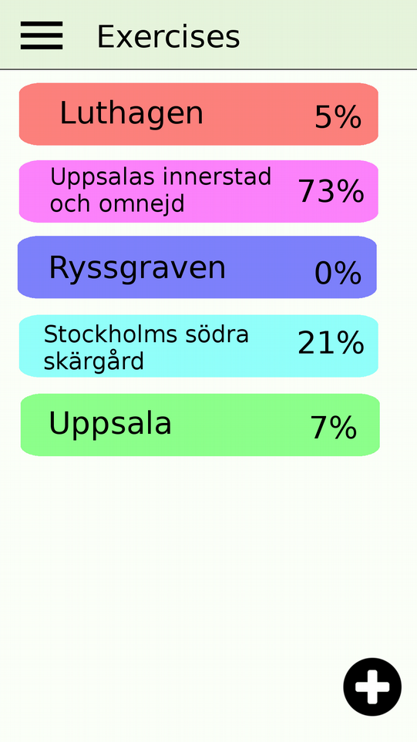
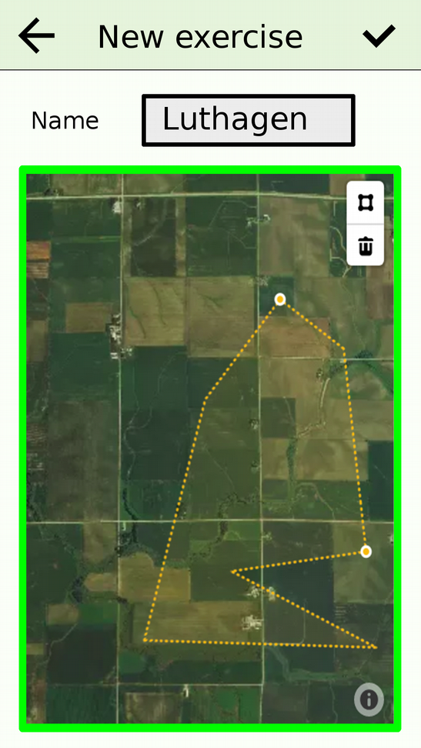
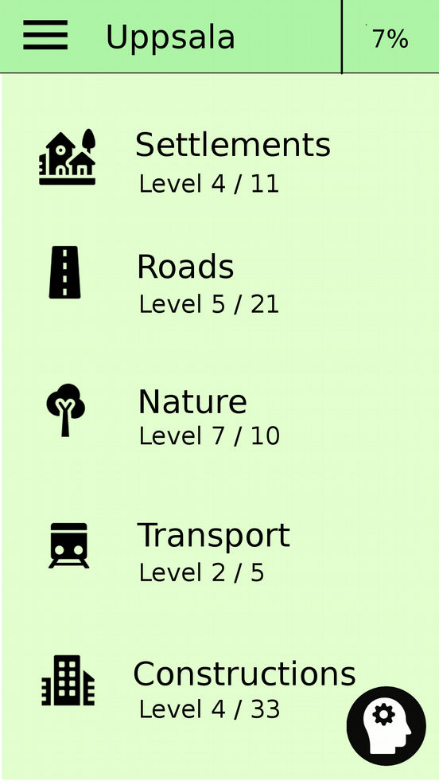
Select exercise/ create new/ enter
Notes:
Different exercise-colors, just for appearance.

Slide 16
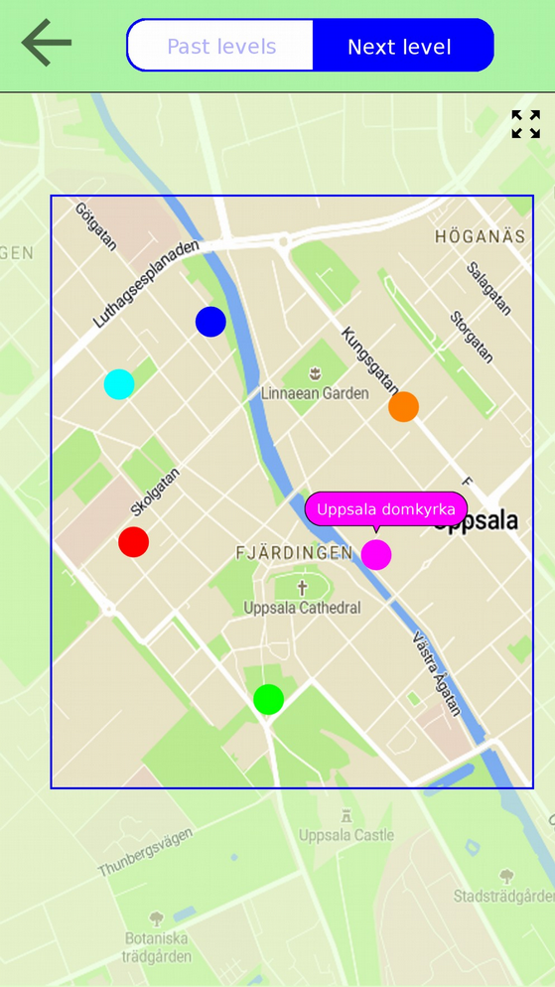
Tapping practice

Slide 17
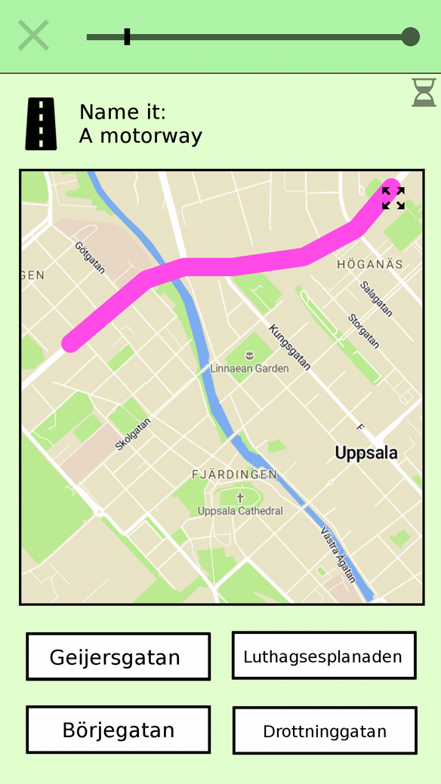
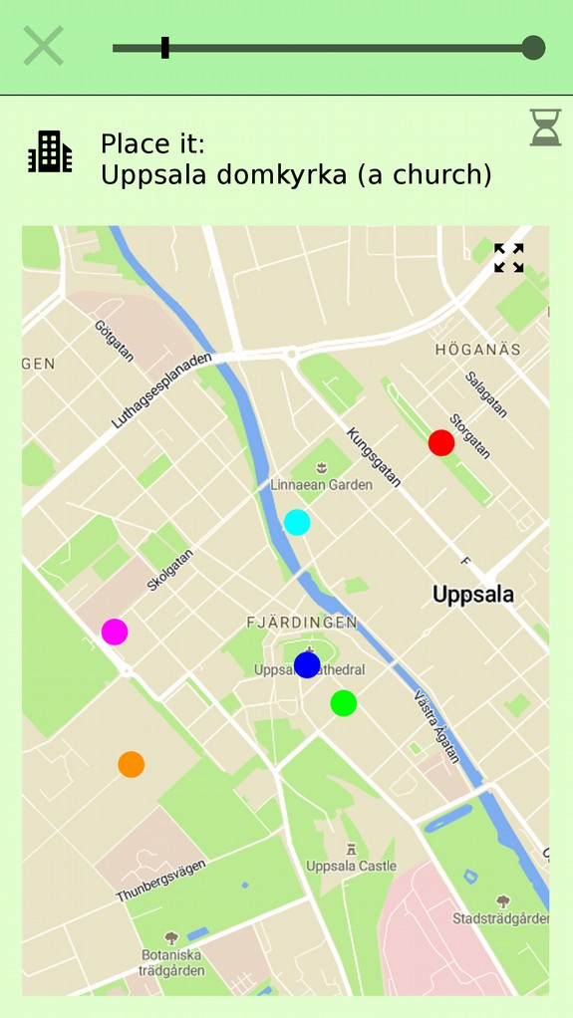
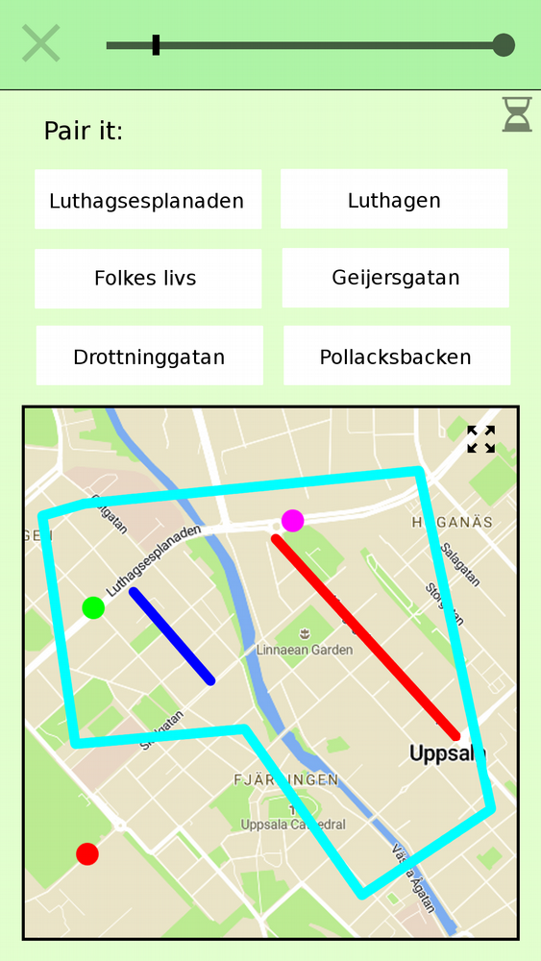
Quiz

Slide 18
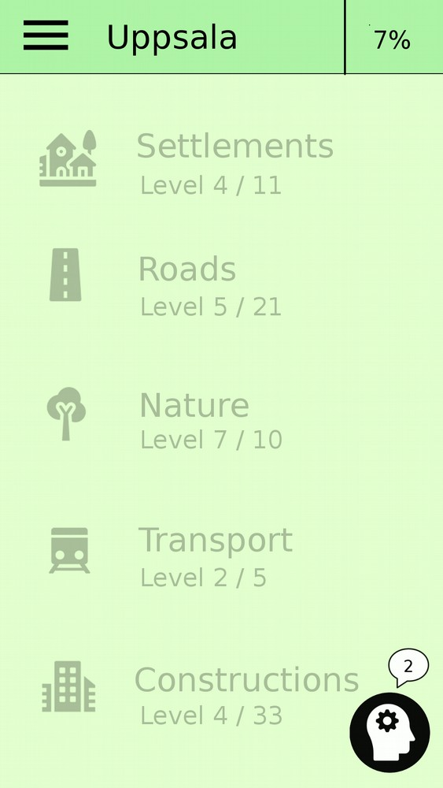
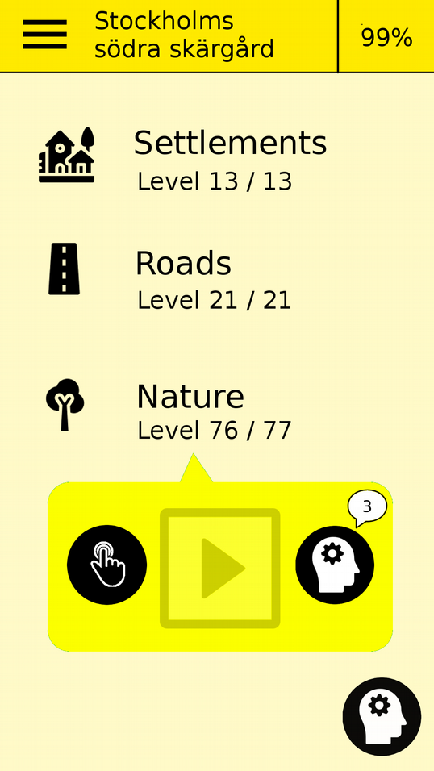
Required reminders
Notes:
Required exercise-reminder vs level-category.
Disabled until completed..
When 100% - do occasional reminders.

Slide 19
Implementation
Notes:
How was this implemented?

Slide 20
Implementation
Android mobile phones (and tablets)
Java for logic
XML for layouts
Android studio IDE
What data is needed?

Slide 21
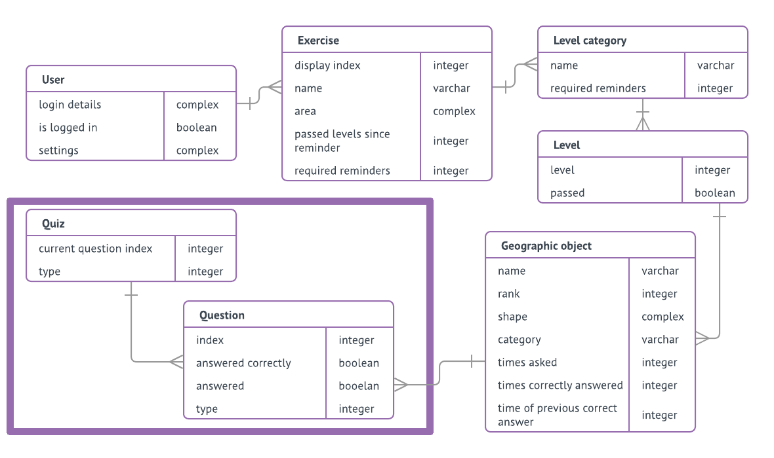
Implementation:
Data model
Notes:
What data is needed?
To structure the data..

Slide 22
Implementation:
Data model
Notes:
The heart of the model.
Category: During a quiz, narrow
(vs. Quiz-category, broad)).
Shape: Coordinates.
Rank: Importance-ranking (highway vs pathway).
- High rank: Presented early.
Stats..: Gathered during a quiz.
- For example, For selecting objects for reminder-quizzes.

Slide 23
Implementation:
Data model
Implemented in Android using an SQLite database.
Notes:
Implemented using SQLite db.
An SQLite engine is available on every Android devices, for storing complex data locally.

Slide 24
Implementation:
Required data
Need: detailed geographic data with world coverage.
Provider: OpenStreetMap + Overpass API
Provides: xml-data of geographic elements inside a limited area.
Notes:
Decided to use OpenStreetMap.
A collaborative project for creating maps of the world.
Extensive coverage which is updated by an active community.
Exists different APIs for extracting data, e.g Overpass.
Node: single point.
Way: set of nodes.
Relations: Set of nodes, ways, relations.

Slide 25
Implementation:
Exercise construction
Incoming lines of xml →
Build instructions →
Geographic object
Put geographic object in db.
Complete set of geographic objects →
Exercise-related entities.
Small amount of data in main memory.

Slide 26
Implementation:
Incoming data → Build instructions
Incoming line of XML.
Scanned with regular expressions.
  Beginning of new element?
  Coordinates?
  Tags?
Build instructions: coordinates + tags.

Slide 27
Implementation:
Build instructions → geographic object
Convert tags to a super-category and a sub-category.
  Problem: varying quality of tags (OSM a collaborative project).
  Solution: Map each popular tag to its relevant category.
    Popular tags? TagInfo.
Importance-ranking from:
  Number of tags.
  Number of edits.
  Geographic size (length/ area).
Notes:
Tags (key, value)
Super-category corresponds to Quiz-category (Settlement/Roads/Nature/Transport/Constructions)
Sub-category to more narrow Geographic object-cat.
Example: building=yes -> Constructions.

Slide 28
Implementation:
Merge geographic objects
OSM-data contains incomplete elements (road-segments etc).
Solution:
  Extract groups of objects with same names.
  Attempt merge of objects in each group.
  Merge possible if objects are close enough.
  Two objects → One object with multiple shapes.

Slide 29
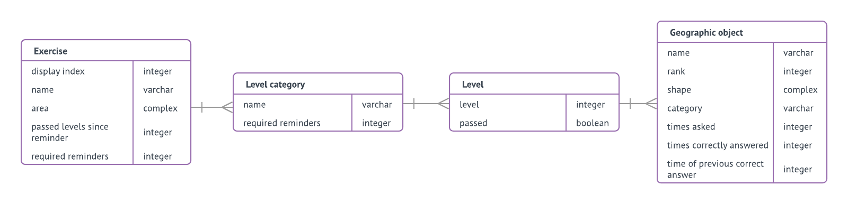
Implementation:
Geographic objects → complete exercise data
Geographic objects are grouped into levels.
Levels are group into level-categories.
Level-categories assigned to a new exercise.
Exercise assigned to a user.
Notes:
… exercise creation part of the implementation is complete.

Slide 30
Implementation:
Quiz run
Construct a Quiz-object (with Questions) before each quiz.
Gather stats about answers during a quiz:
  For smart reminder-selections.
  For smart alternatives-selection.
Notes:
Something else that needed to be implemented: The quiz run.

Slide 31
Implementation:
Integrated maps
Mapbox Maps API for Android.
Functionality for e.g.
  Displaying highly customizable integrated maps.
  Adding clickable markers and polylines to the map.
  Hiding/ showing text-labels.

Slide 32
Finally...

Slide 33
Future work
Back up data on a server.
Some known bugs exists.
Simplify exercise creation.
Text-labels during a quiz.

Slide 34
Evaluation
Implementation corresponds well with intended design.
Application tested by two users:
  Both able to create an exercise and start practicing.
  Too little time for answering questions?
Used it myself.
Notes:
I was able to learn local geography.
Did find it entertaining.
I’m happy to have reached my initial goal.

Slide 35
The names of local places tell a story about this areas’ history
...and the names help creating and preserving memories from these places
Notes:
Thanks for listening.

