Slide 1
OAK SPECIALIST HOSPITAL
Healing with Love, Trust, and Next-Gen Digital Innovation
A Digital Transformation Pitch & Assessment
Presenter: Website Redesign Team
Date: Tuesday, 26 May 2026

Slide 2
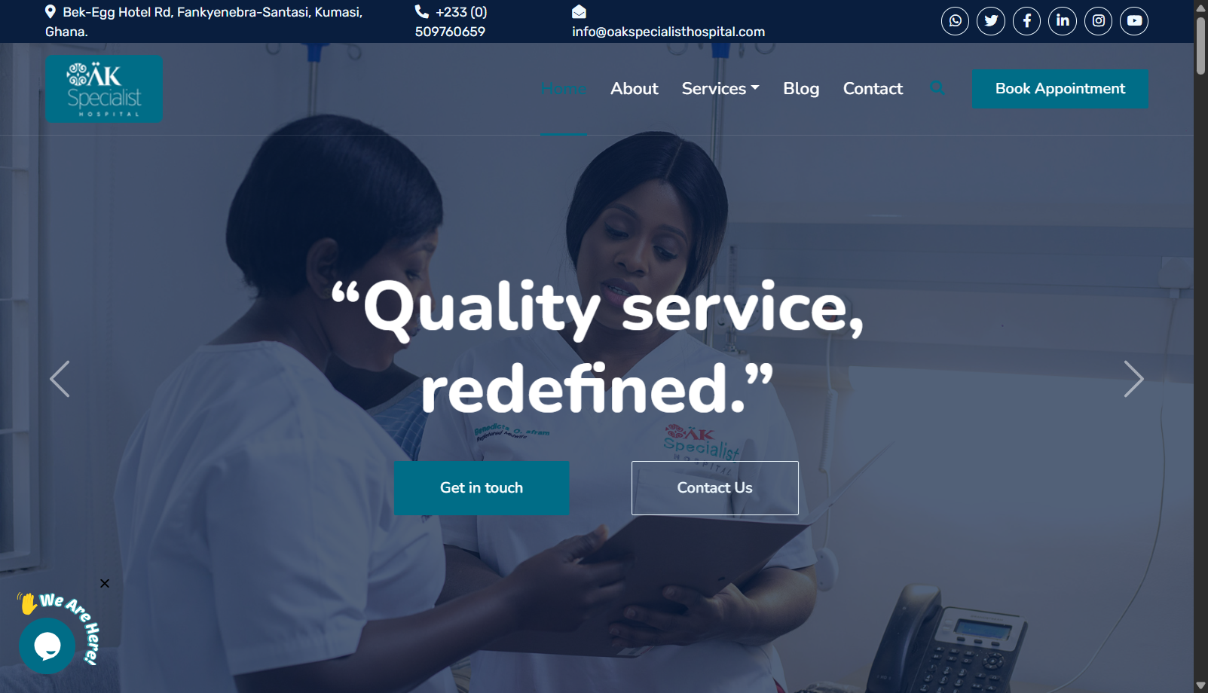
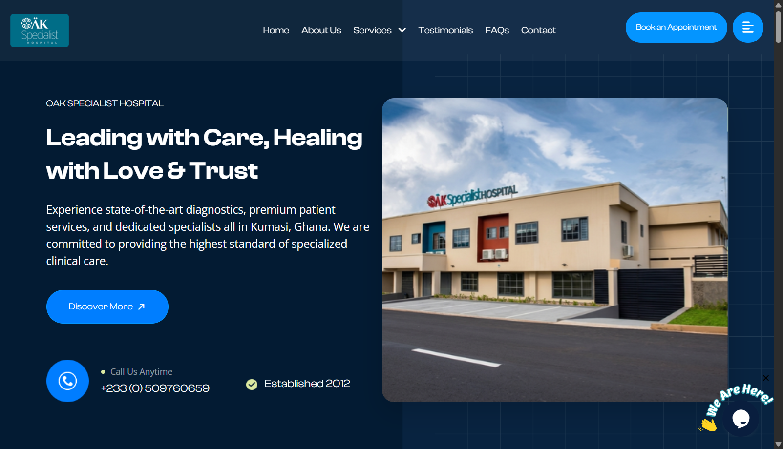
Modernized Visual Brand & Experience
Old Live Website (Static & Dated)
Redesigned Interface (Modern & Animated)
• Outdated template with higher patient cognitive load.
• Lack of engaging visual storytelling or brand narrative.
• Premium custom typography (Clash Display) & micro-animations.
• Custom cursor interactions, loader, and visual structure.

Slide 3
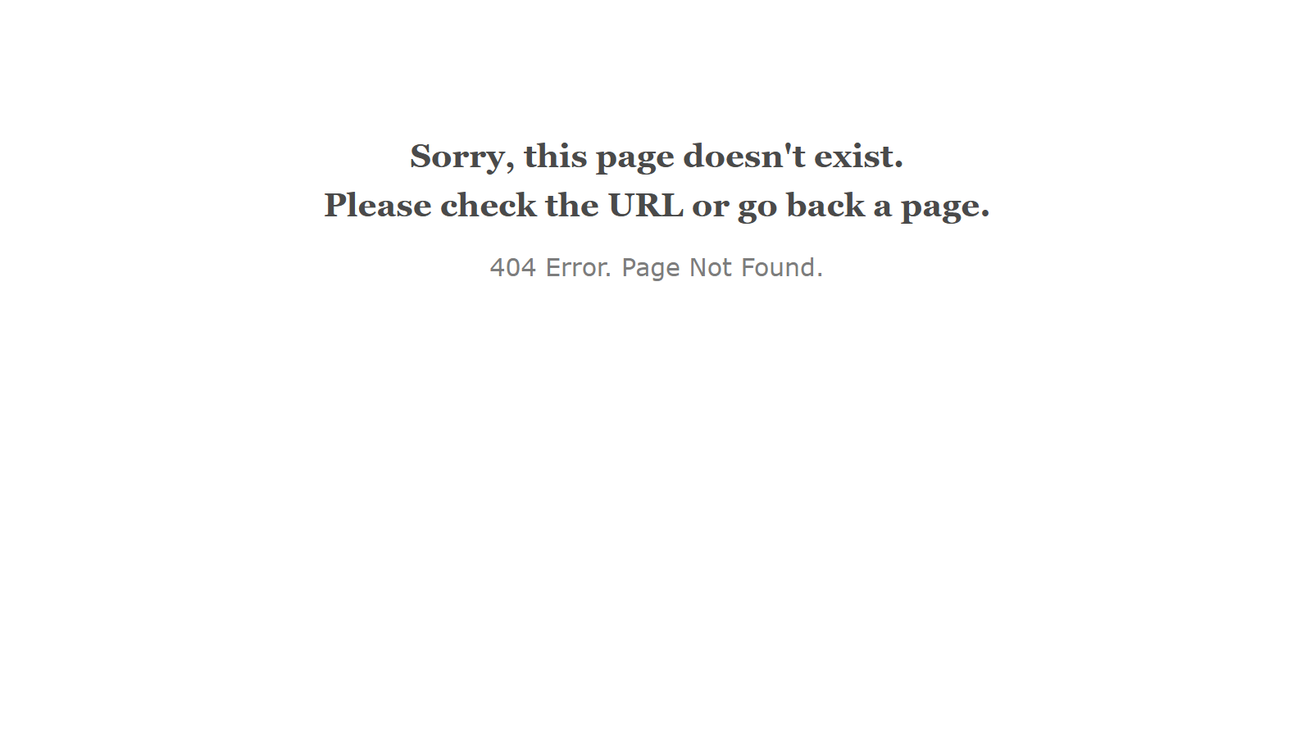
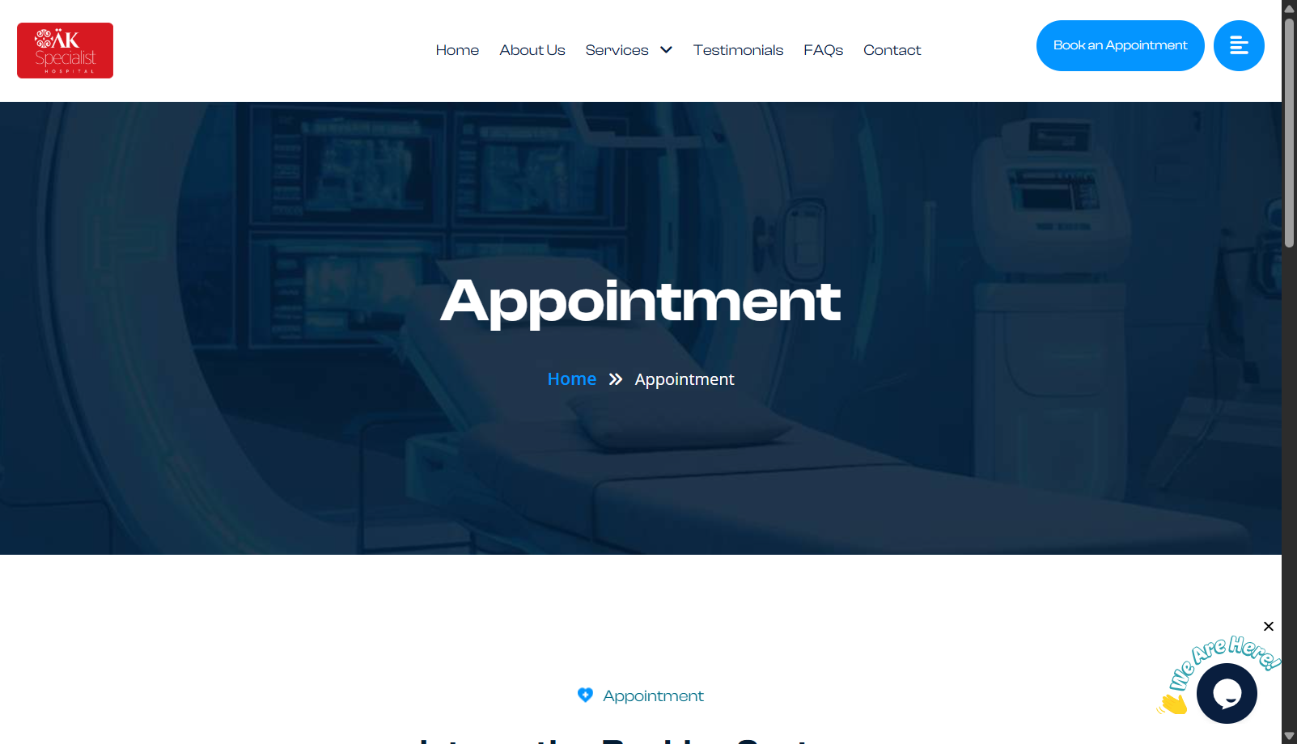
Interactive Scheduling vs. Static Forms
Old Patient Inquiry Page (High Friction)
Interactive 5-Step Booking Wizard
• Basic contact/inquiry form requires administrative sorting.
• Delay in booking confirmations leading to patient drop-off.
• Multi-step guided wizard for Virtual or In-Person visits.
• Links live Google Calendar schedules & yields printable receipts.

Slide 4
Instant Reassurance: Zenoph SMS & Helpdesk
Automated SMS Alerts (Ghana Gateway)
24/7 Digital Patient Channels
Our backend is fully integrated with Ghana's leading SMS gateway, Zenoph Notify, dispatching instant notifications to schedule and reassure patients:
• Tawk.to Live Chat Widget: Real-time patient queries and clinical support embedded directly on the homepage.
• Formspree Support: Direct, spam-filtered email notifications routed directly from the contact form to the clinic inbox.
Virtual Consultation SMS Alert Example:
"Hello Ama, your Virtual consultation (Fertility & IVF) with Dr. Osei Agyemang at Oak Specialist Hospital has been scheduled for Tue, May 26 at 9:00 AM. Google Meet invite sent to your email. Tel: +233509760659"
In-Person Consultation SMS Alert Example:
"Hello Ama, your In-Person consultation (OB/GYN) with Dr. Ama Nkrumah at Oak Specialist Hospital has been scheduled for Tue, May 26 at 10:00 AM. Location: Bek-Egg Hotel Rd, Santasi. Map: https://maps.google.com/?q=Oak+Specialist+Hospital+Kumasi"
SMS & CHAT
ACTIVE

Slide 5
Why Our Redesigned Platform Wins
Core Strengths of Our Solution
Widescreen Technical Optimization
1. Working Prototype Ready:
Not a simple static mockup—a fully coded, responsive website ready to deploy on your local Apache (XAMPP) server.
2. Localized Automation in Ghana:
Fully functional Zenoph Notify PHP SDK backend integration for automatic booking SMS confirmations.
3. Telehealth Widescreen Support:
Instant automated Google Meet video meeting link creation for remote patient care.
• High-Performance Code: Optimized for rapid mobile loading on standard cellular networks in Ghana.
• Built-in SEO Schema: Direct Google indexing for competitive medical search terms ("IVF Kumasi", "Maternity Clinic Santasi").
"First-class medical clinics deserve a first-class digital presence. Our redesign directly transforms patient impressions into immediate operational clinical bookings."

