Slide 1

Final Project Overview
Name: Home apps about car infotainment system
Author: Trinh Van Thang
Funix code: FX04527
Email:ThangTVFX04527@funix.com.vn
Hanoi 2/92021

Slide 2
Contents
I: Software Requirement Specification document
Introduction
Software Requirement Specification
II: Design document
1) UX Design
2) Architecture Design
3) Flow chart design
III: Test Document
IV: Demo

Slide 3
I: Software Requirement Specification document
1. Introduction
1.1: Objective
- The objective of the document is supplying a full and exact description for requirement Home
Applciation
1.2: Scope
- This document defines requirements for developing Home application of FUNiX
1.3: Audience
- FUNiX, Developer, Tester

Slide 4
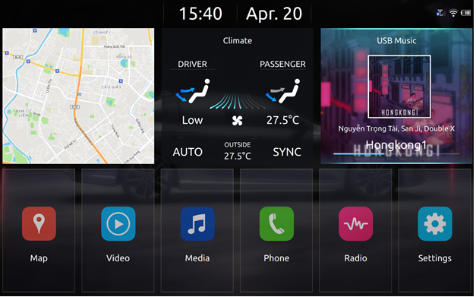
2. Software Requirement Specification

Slide 5
- Home_SRS_01: Provide layout in Home Application
- Home_SRS_02: Application Menu Area
- Home_SRS_03: Widgets Area
- Home_SRS_04: Status Bar Area
- Home_SRS_05: Description of interaction on home screen
Detail: SRS_FX04527_ThangTV_v1_1.pdf

Slide 6
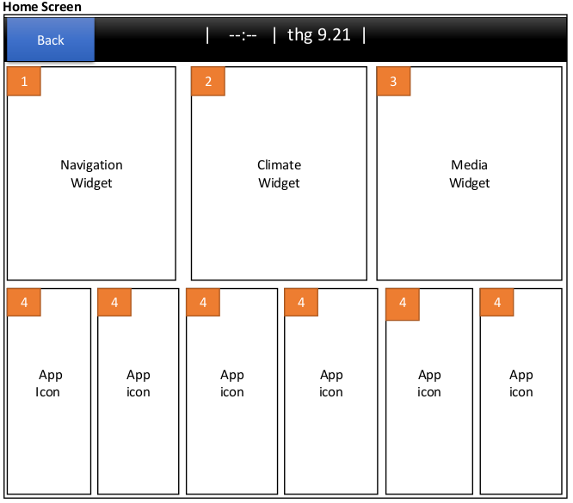
II: Design document
1 UX design
1.1 Common spec

Slide 7
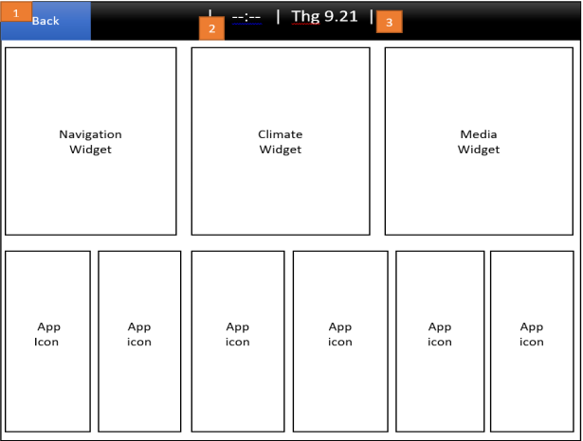
1.2 Status bar

Slide 8
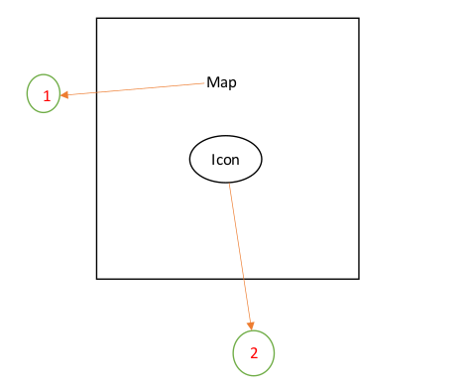
1.2 Widget
Map widget

Slide 9
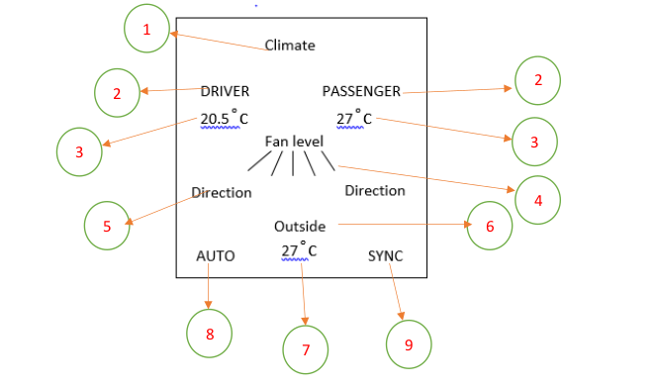
Climate widget

Slide 10
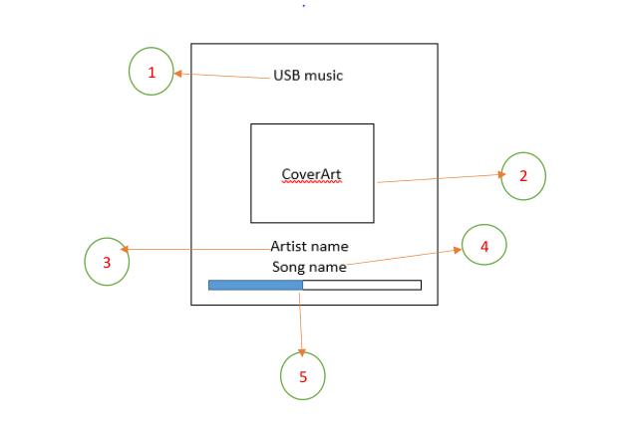
Media widget

Slide 11
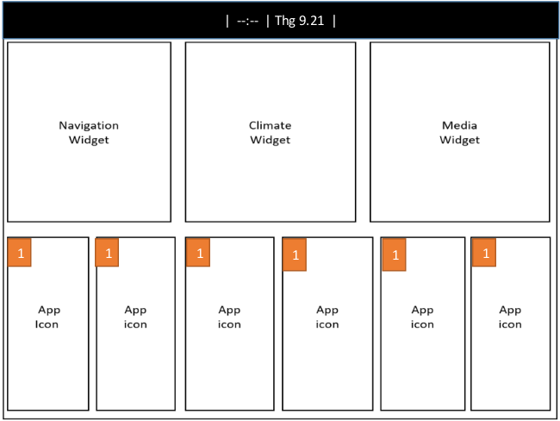
1.3 List App

Slide 12
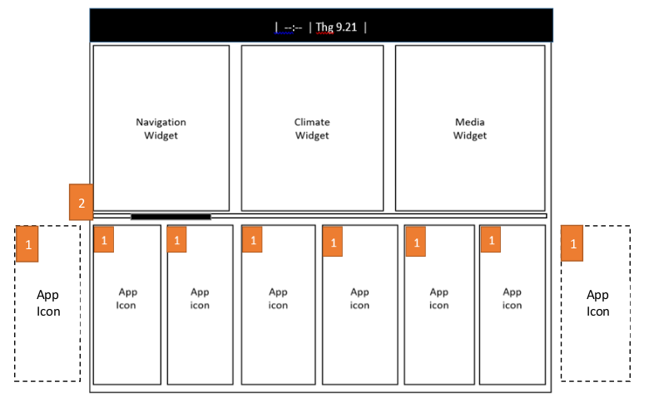

Slide 13
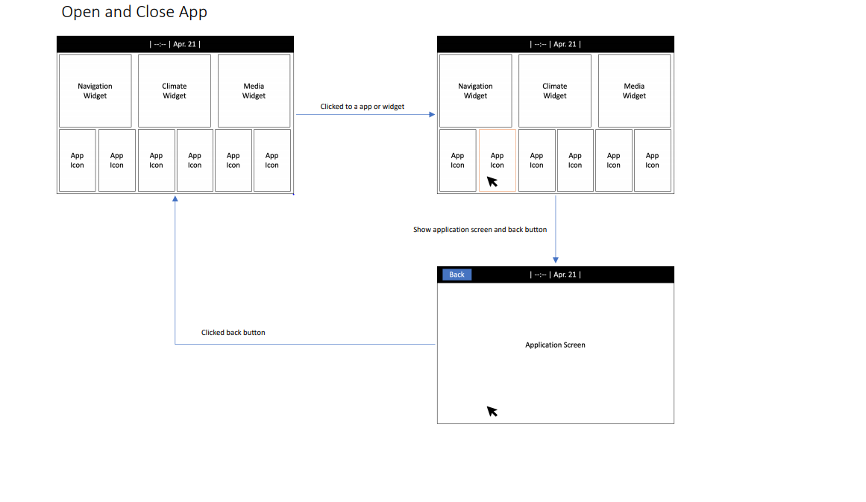
1.4 Flow Spec

Slide 14
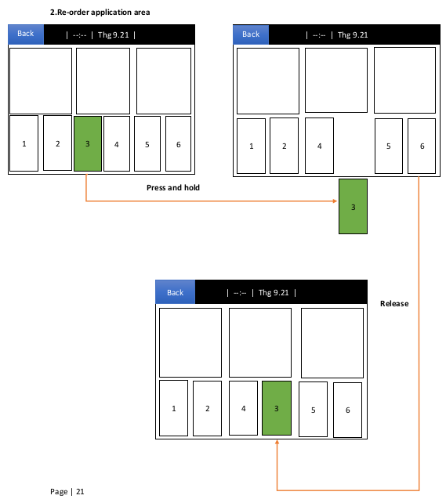
Re-order application

Slide 15
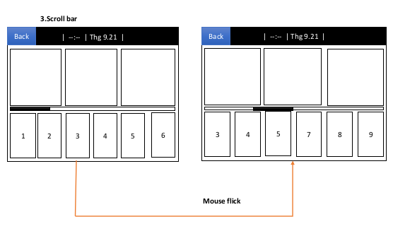
Scroll bar

Slide 16
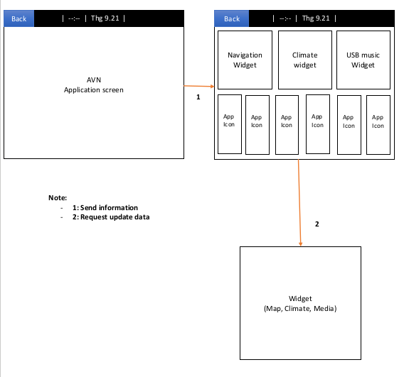
Update data

Slide 17
3.Architecture Design
AppHome
communicate
Simulator for climate service
View(QML)
Model (c++)
Climate
Services
Dbus
Controller (C++)

Slide 18
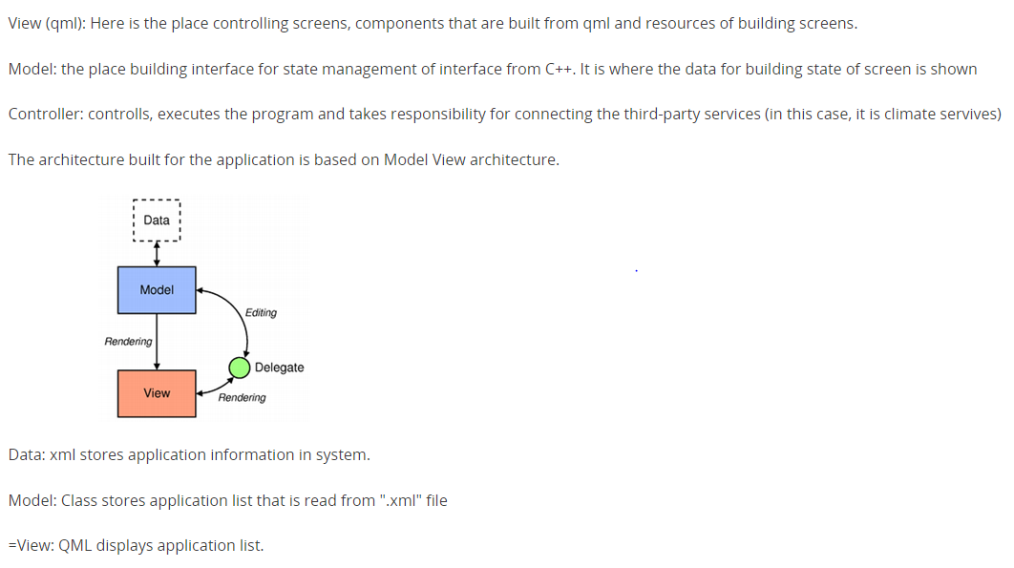

Slide 19
4.Flow chart design
4.1 Class diagram
The Package to be design by singleton pattern.

Slide 20
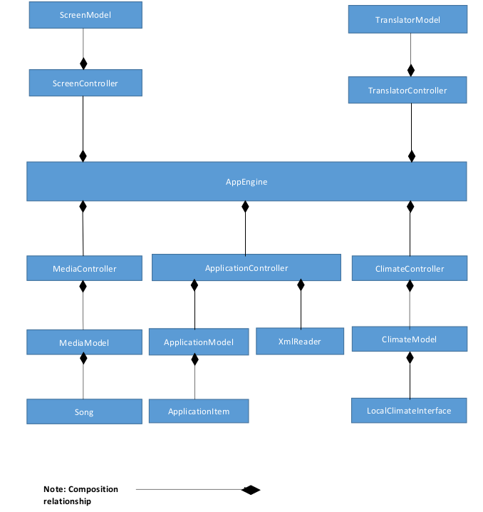

Slide 21
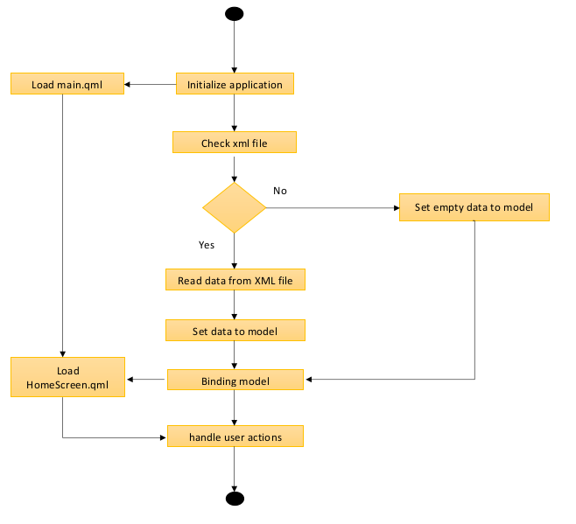
4.2 flow initialize home application

Slide 22
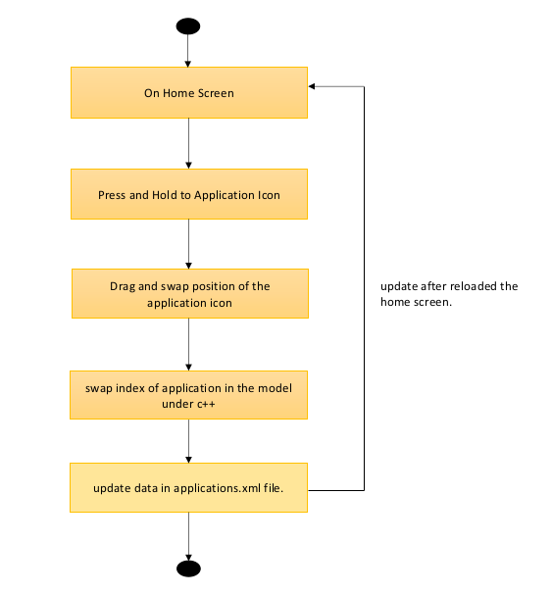
Re-order application

Slide 23
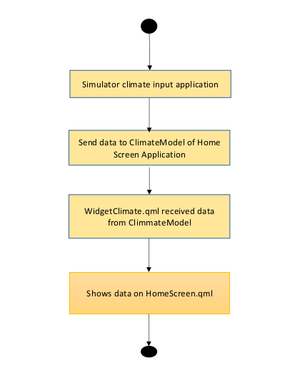
Send data to Climate Widget

Slide 24
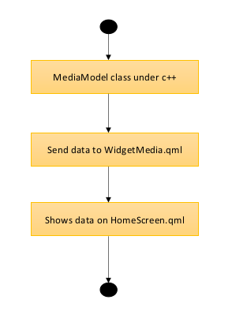
Send data to Music Widget

Slide 25
III:Test
Environment:
OS : ubuntu 18.04 LTS
QT creator version : 5.15
Location: Vietnam
Detail: Test_FX04527_ThangTV_V1_1.pdf
IV: Demo

