Slide 1
COMP3013 Tutorial01
2025 Fall

Slide 2
Outline
Design Process
  Conceptual-design -> ER diagram
  Logical-design -> logical view
  Relational Schema Optimization -> redundancies minimized
  Physical-design -> implementation
Entity Sets
  Entity: A “thing” or “object” in the real world; how to describe? -> attributes
Attributes
  Attributes for different purposes can be different
  Attribute value, domain
  Key: the set of special attribute(s), can uniquely identify the entities
  Basic ER Features
Relationship Sets
Basic SQL

Slide 3
Basic ER Features
Design Process
Entity Sets
Attributes
Relationship Sets
In ER diagrams,
  rectangles represent entity sets;
  ellipses represent attributes;
  keys are underlined; and
  lines link attributes to entity sets.
For example, the student entity set is modeled as follows.
id
name
students
year
major
GPA

Slide 4
Multi-valued Attribute
Design Process
Entity Sets
Attributes
Relationship Sets
Suppose that we also want to model students’ phone number.
It is possible that one student may have multiple phone numbers.
Thus, the phone number of a student is a multi-valued attribute, denoted by double ellipses.
id
name
phone
students
year
major
GPA

Slide 5
Example
Design Process
Entity Sets
Attributes
Relationship Sets
For more examples, instructors, courses, and books are modeled in the same way.
id
name
course_name
ISBN
credits
phone
instructors
course
books
title
major
course_code
title
author
salary

Slide 6
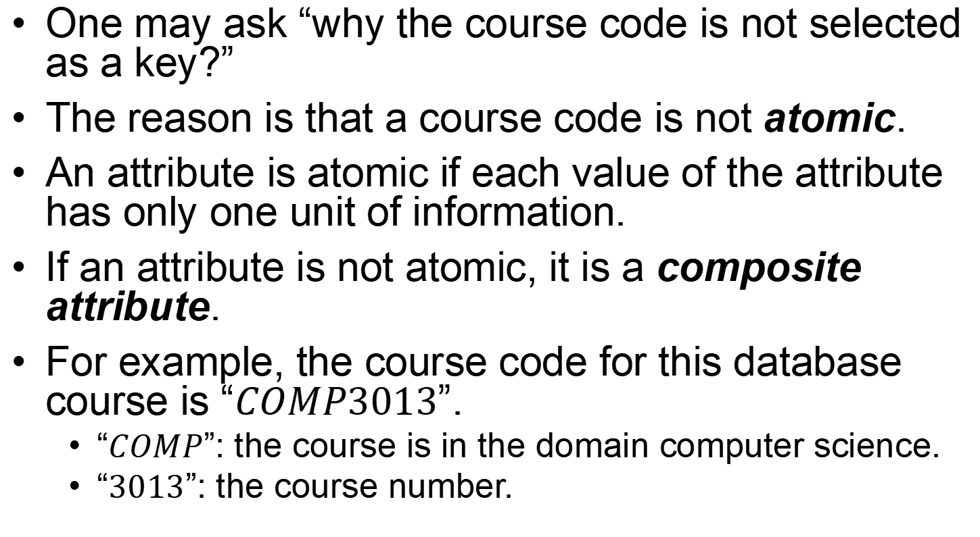
Composite Attribute
Design Process
Entity Sets
Attributes
Relationship Sets
One may ask “why the course code is not selected as a key?”
The reason is that a course code is not atomic.
An attribute is atomic if each value of the attribute has only one unit of information.
If an attribute is not atomic, it is a composite attribute.
For example, the course code for this database course is “$COMP3013$”.
  “$COMP$”: the course is in the domain computer science.
  “$3013$”: the course number.

Slide 7
Composite Attribute
Design Process
Entity Sets
Attributes
Relationship Sets
Thus, the attribute course code is decomposed into offering unit and course number.
course_name
credits
course
course_code
domain
course_number

Slide 8
Outline
Design Process
  Conceptual-design -> ER diagram
  Logical-design -> logical view
  Relational Schema Optimization -> redundancies minimized
  Physical-design -> implementation
Entity Sets
  Entity: A “thing” or “object” in the real world; how to describe? -> attributes
Attributes
  Attributes for different purposes can be different
  Attribute value, domain
  Key: the set of special attribute(s), can uniquely identify the entities
  Basic ER Features
Relationship Sets
Basic SQL

Slide 9
Relationship Set
Design Process
Entity Sets
Attributes
Relationship Sets
In ER diagrams, a relationship set is denoted by a diamond.
The previous example “students borrow books” can be modeled as
id
name
ISBN
phone
students
borrow
books
year
major
title
author
GPA

Slide 10
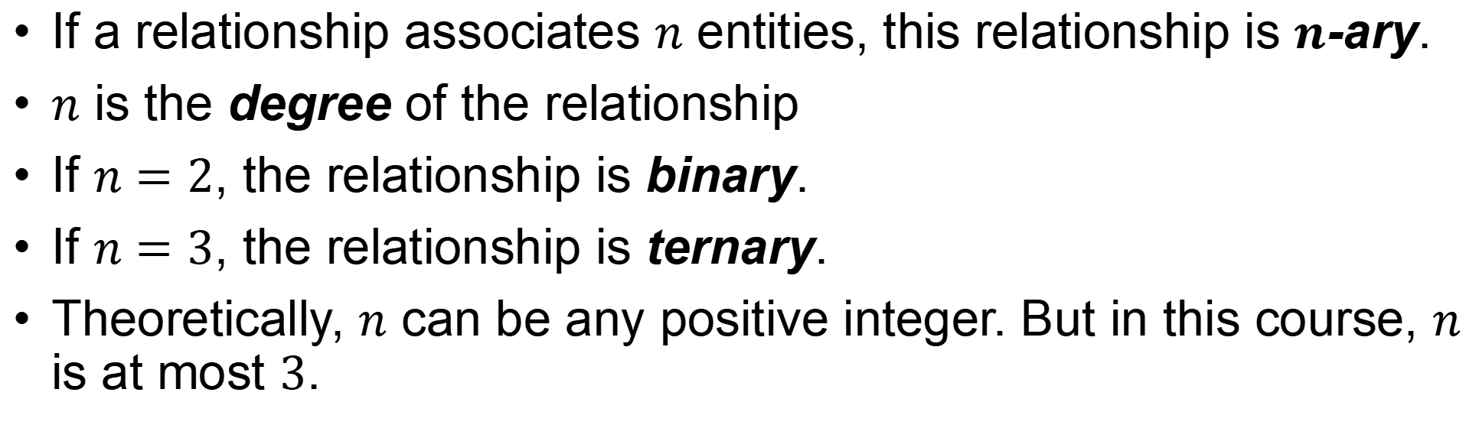
Multi-ary Relationship
Design Process
Entity Sets
Attributes
Relationship Sets
If a relationship associates $n$ entities, this relationship is $n$-ary.
$n$ is the degree of the relationship
If $n=2$, the relationship is binary.
If $n=3$, the relationship is ternary.
Theoretically, $n$ can be any positive integer. But in this course, $n$ is at most $3$.

Slide 11
Multi-ary Relationship
Design Process
Entity Sets
Attributes
Relationship Sets
For the following example, a ternary relationship is reasonable.
This example models that some students are enrolled in some courses which are instructed by some teachers.
id
name
course_name
credits
phone
students
enroll
course
id
name
course_code
year
major
GPA
domain
phone
instructors
course_number
title
major
salary

Slide 12
Outline
Design Process
  Conceptual-design -> ER diagram
  Logical-design -> logical view
  Relational Schema Optimization -> redundancies minimized
  Physical-design -> implementation
Entity Sets
  Entity: A “thing” or “object” in the real world; how to describe? -> attributes
Attributes
  Attributes for different purposes can be different
  Attribute value, domain
  Key: the set of special attribute(s), can uniquely identify the entities
  Basic ER Features
Relationship Sets
Basic SQL

Slide 13
Roles
Design Process
Entity Sets
Attributes
Relationship Sets
Sometimes multiple entities of the same type can participate a same relationship.
Suppose we want to express “some courses are the prerequisite of some other courses”.
For example, before taking the database course, one must pass the C program course.
To model this example, ER diagram allows an entity set to link with a relationship set multiple times.
Roles are written in text,
to express how the entities
are participating the
relationship.
course_name
credits
successor
course
pre_req
predecessor
course_code
domain
course_number

Slide 14
Outline
Design Process
  Conceptual-design -> ER diagram
  Logical-design -> logical view
  Relational Schema Optimization -> redundancies minimized
  Physical-design -> implementation
Entity Sets
  Entity: A “thing” or “object” in the real world; how to describe? -> attributes
Attributes
  Attributes for different purposes can be different
  Attribute value, domain
  Key: the set of special attribute(s), can uniquely identify the entities
  Basic ER Features
Relationship Sets
Basic SQL

Slide 15
Attributes for Relationship Sets
Design Process
Entity Sets
Attributes
Relationship Sets
Sometimes people are also interested in some information about relationships.
In the “students borrow books” example, we also want to know when the book is borrowed, when the book is returned, and how long the book is kept by the student.
This information does not belong to students or books. It is about the association.
Thus, in this case, the relationship set can also have some attributes.
date_of_borrow
date_of_return
id
name
ISBN
phone
students
borrow
books
year
major
author
GPA
duration
title

Slide 16
Derived Attributes
Design Process
Entity Sets
Attributes
Relationship Sets
In the previous example, the attribute duration is in a dashed ellipse because it is a derived attribute.
If one knows the date of borrow and the date of return, then the duration can be calculated from the two values.

Slide 17
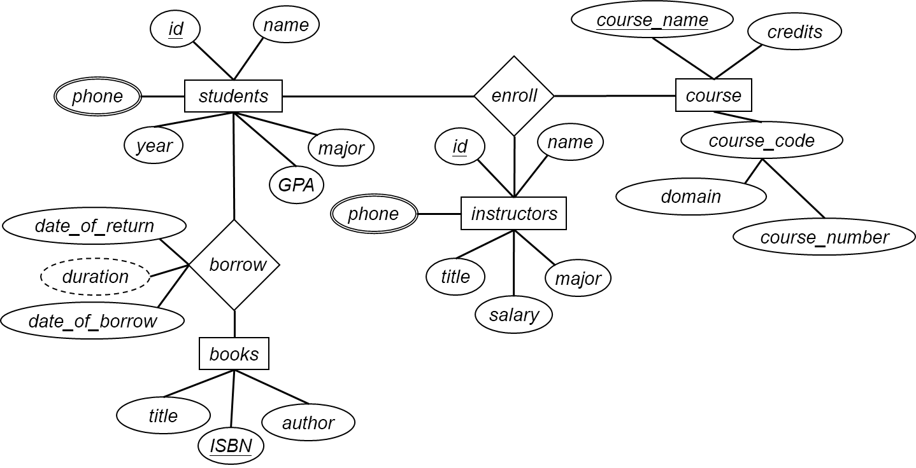
Example
Design Process
Entity Sets
Attributes
Relationship Sets
Summarizing the examples.
Sometimes designers have to reallocate the positions of some components of the ER diagram to make it beautiful.

Slide 18
How did you do for the class exercise? (Q&A)
Based on the ER diagram on the previous page, model the following features.
  Programs, which have program codes, program names, and the division that each program belongs to.
  Students have majors.
  Instructors work for some programs.
  Every program has a program director, who is also an instructor.
  Courses are offered by programs.

Slide 19
Outline
Design Process
  Conceptual-design -> ER diagram
  Logical-design -> logical view
  Relational Schema Optimization -> redundancies minimized
  Physical-design -> implementation
Entity Sets
  Entity: A “thing” or “object” in the real world; how to describe? -> attributes
Attributes
  Attributes for different purposes can be different
  Attribute value, domain
  Key: the set of special attribute(s), can uniquely identify the entities
  Basic ER Features
Relationship Sets
Basic SQL

Slide 20
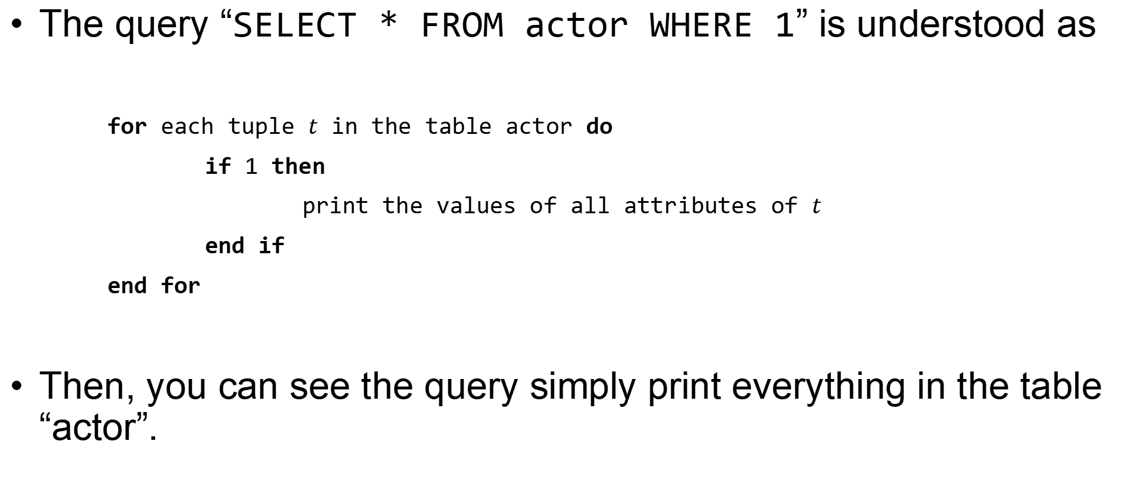
Basic Query
The query “SELECT * FROM actor WHERE 1” is understood as
for each tuple $t$ in the table actor do
if 1 then
print the values of all attributes of $t$
end if
end for
Then, you can see the query simply print everything in the table “actor”.

Slide 21
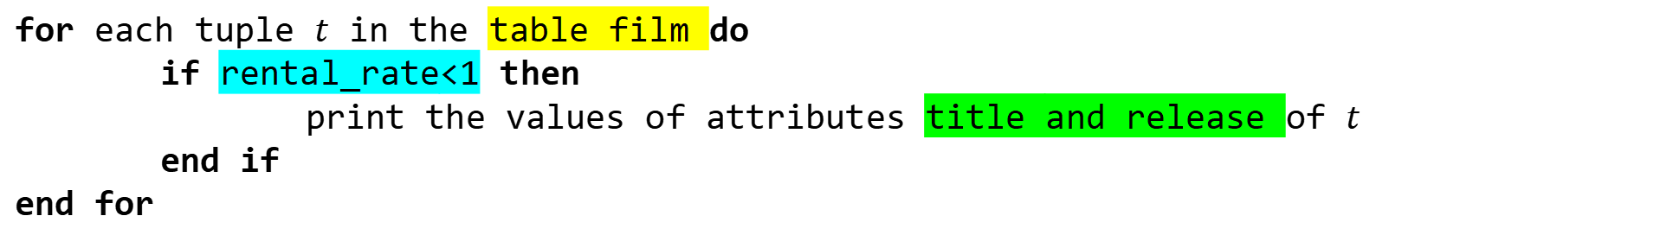
Basic Query
Let’s see another example.
SELECT title,release_year FROM film WHERE rental_rate<1
Please try to tell the meaning of this query.
And execute it in the system to check the outcome.
for each tuple $t$ in the table film do
if rental_rate<1 then
print the values of attributes title and release of $t$
end if
end for

Slide 22
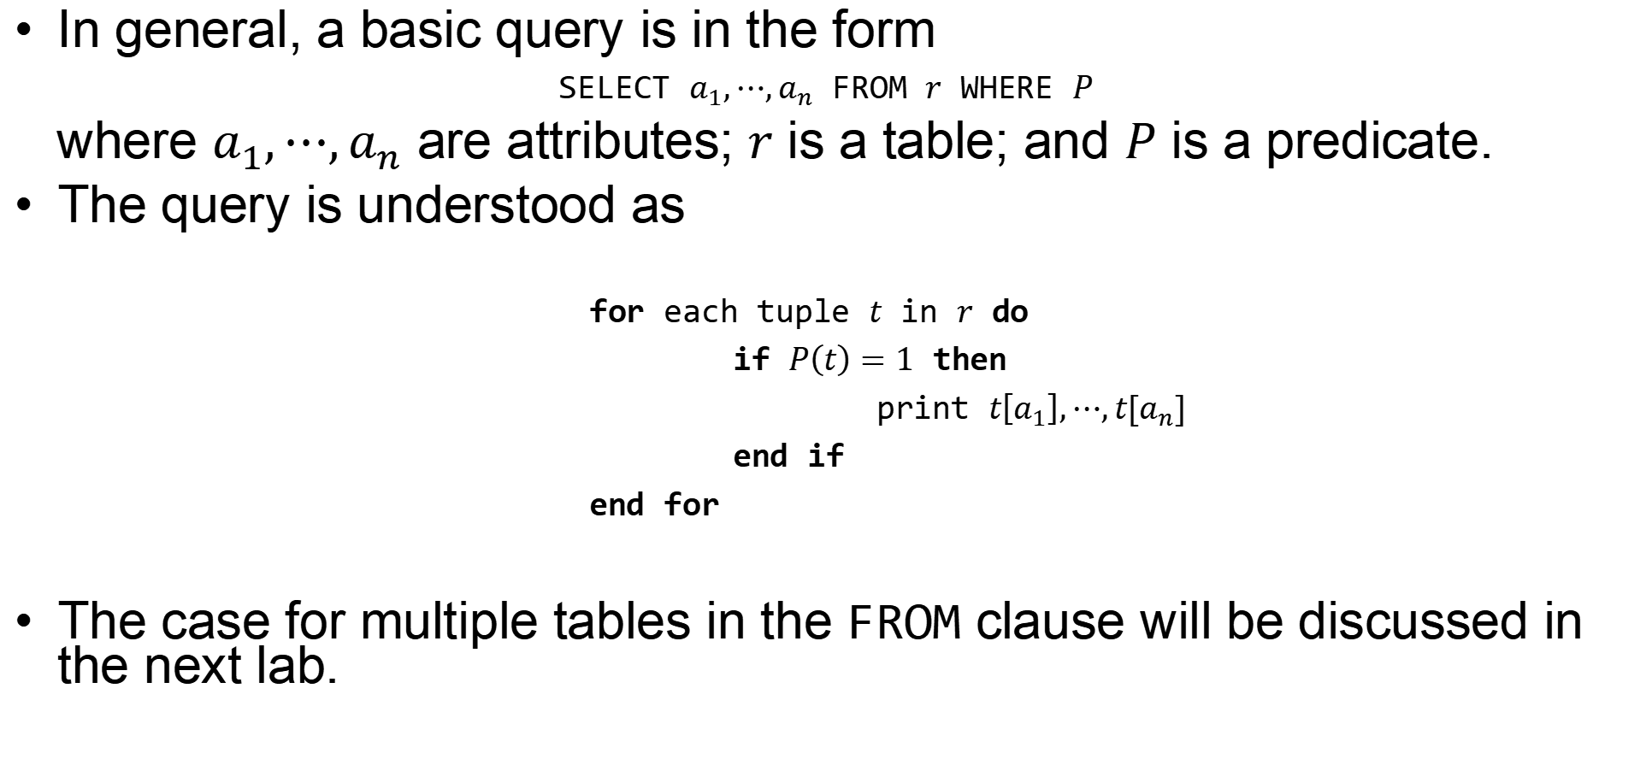
Basic Query
In general, a basic query is in the form
SELECT $a_{1},⋯,a_{n}$ FROM $r$ WHERE $P$
where $a_{1},⋯,a_{n}$ are attributes; $r$ is a table; and $P$ is a predicate.
The query is understood as
for each tuple $t$ in $r$ do
if $P\left(t\right)=1$ then
print $t\left[a_{1}\right],⋯,t[a_{n}]$
end if
end for
The case for multiple tables in the FROM clause will be discussed in the next lab.

Slide 23
Example
To write a good query, you need to pay attention to three things.
  Which table is used?
  What is the predicate?
  What are the attributes in the result?
For example, “Find the category ID for Sci-Fi movies”.
  Table: category
  Predicate: Sci-Fi movies
  Attribute: category ID
Thus, the query is
SELECT category_id FROM category WHERE name="Sci-Fi"
For this example, you need to know “Sci-Fi movies” is the attribute “name” of the category.

Slide 24
Exercises
To write a good query, you need to pay attention to three things.
  Which table is used?
  What is the predicate?
  What are the attributes in the result?
Find the information of actors whose first name is Russell.
Find the information of actors whose first name is Russell and last name is Close.
Find the email of customers whose first name is Harry and active is 0.
Find the full name of the actor whose id is 99.
Find the title and special features of the films whose replacement cost is lower than 20 and rental rate is higher than 4.0.
Find the customer id of the customers who have made a payment on 2005-05-25 but the amount does not exceed 3.

