Slide 1
Lecture 07
exercise

Slide 2
Exercise 1
Construct an ER diagram for a car-insurance company. The model includes
  each customer is described by a unique id, a name, and an address;
  each car is described by a unique vehicle identification number, the manufacturer, and the year of production;
  each accident is described by a unique report number, the date and the location when the accident happens;
  each customer owns one or more cars;
  every car is owned by at exactly one customer;
  each accident is only responsible to the owner of the car, no matter who drives;
  it is possible that multiple cars involve in a same accident and the amount of insurance claim for different cars are different.
List all assumptions that you make.
And convert your ER diagram to a logical design.

Slide 3
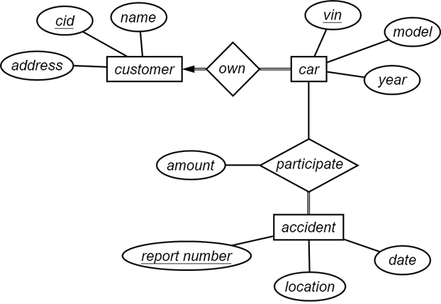
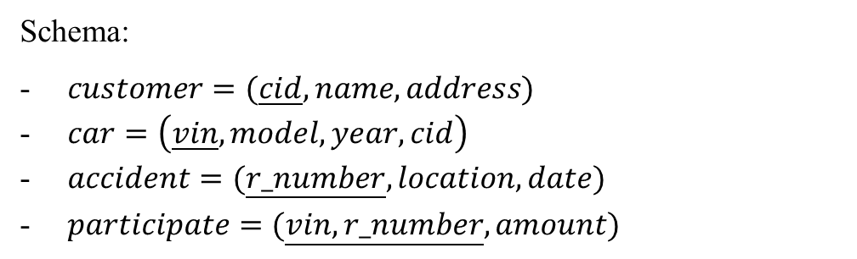
Assumptions
• The insurance company is not interested in those persons who are not customers, even they are hit by a car in an accident.
• Every accident is associated with at least one driver and one car.
Schema:
$customer=(\underline{cid},name,address)$
$car=\left(\underline{vin},model,year,cid\right)$
$accident=(\underline{r_number},location,date)$
$participate=(\underline{vin,r_number},amount)$

Slide 4
Exercise 2
Construct an ER diagram for a hospital with a set of patients and a set of medical doctors, which models
  each patient has a unique id, a name, and an insurance;
  each doctor has a unique id, a name, and the specialization;
  each test has a unique id, a name, the date, the time, and the result of the test;
  every patient is cared by one or multiple doctor;
  every test is performed by one or multiple doctor;
  every test is done for exactly one patient.
List all assumptions that you make.
And convert your ER diagram to a logical design.

Slide 5
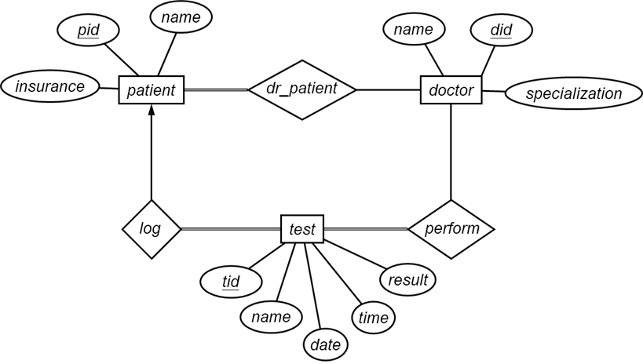
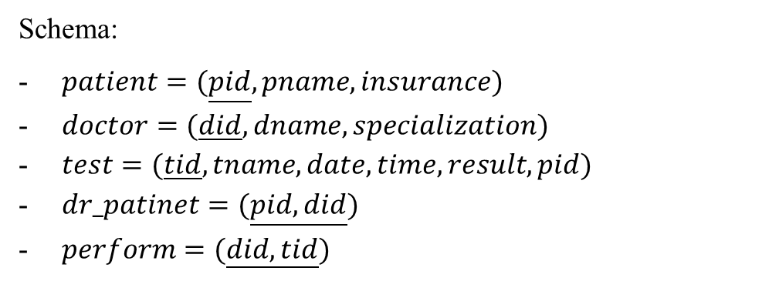
Schema:
$patient=(\underline{pid},pname,insurance)$
$doctor=(\underline{did},dname,specialization)$
$test=(\underline{tid},tname,date,time,result,pid)$
$dr_patinet=(\underline{pid,did})$
$perform=(\underline{did,tid})$

Slide 6
Exercise 3
Create an ER diagram for a recording company with the following requirements:
  Each musician has an unique SSN, a name, an address, and a phone number.
  Each instrument has a name (e.g., guitar) and a musical key (e.g., C).
  Each album that has a title, a copyright date, a format (e.g., CD), and an album identifier.
  Each song has a title and an author.
  Musicians may play many instruments, and an instrument may be played by many musicians.
  Each album has a number of songs on it, but no song may appear on more than one album.
  Each song is performed by one or more musicians, and a musician may perform a number of songs.
  Each album has exactly one musician who acts as its producer. A musician can of course produce several albums.

Slide 7
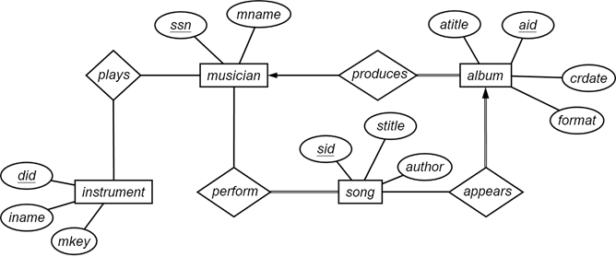
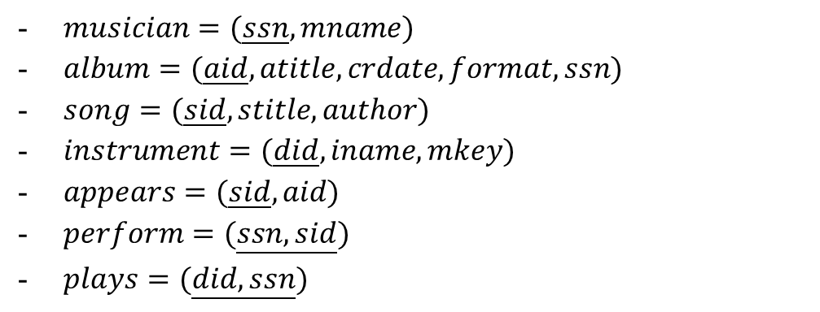
$musician=(\underline{ssn},mname)$
$album=(\underline{aid},atitle,crdate,format,ssn)$
$song=(\underline{sid},stitle,author)$
$instrument=(\underline{did},iname,mkey)$
$appears=(\underline{sid},aid)$
$perform=(\underline{ssn,sid})$
$plays=(\underline{did,ssn})$

Slide 8
Lab 07 review.

Slide 9
Data Modification
In the last lab, we have created new tables for UIC database.
Check “UIC definition.txt” for the sample code and compare it with your query. If you have any question, please ask your instructor or TA.
In this lab, we will insert, delete, and update data.
Note:
Usually, database users are only allowed to change data (table rows), which is covered by this lab.
Table columns are related to the logical design and managed by database managers.
To change the logical design, you need ALTER TABLE (last lab).

Slide 10
Insert
To insert a record for a program:
  Program code: 1001
  Program name: Computer Science
  Division: Science and Technology
  Director: NULL (unknown)
INSERT INTO programs (p_code, p_name, division, director_id)
VALUES (1001, 'Computer Science', 'Science and Technology', NULL);
The schema of the table is to remind users the data types, which can be omitted.
Currently, the instructor table is empty. So, the program director is unknown.

Slide 11
Example
Insert the information of a new instructor,
  ID: 20001
  NAME: S.T. Kwok
  Title: Professor
  Salary: 100000
  Program: Computer Science
INSERT INTO instructor (id, i_name, title, salary, p_code)
VALUES (20001, 'S.T. Kwok', 'Professor', 10000, 1001);

Slide 12
Example
Try to insert
  Course:
  Name: Introduction to Biology, Credits: 3,
  Domain: ENVS, Course Number: 2001
  Instructor:
  ID: 20002, Name: S.H. Zee, Title: Professor,
  Salary: 100000, Program: Environmental Science
  Program:
  ID: 1002, Name: Environmental Science,
  Division: Science and Technology, Program director: Unknown
Why the instructor cannot be inserted before the program?
CREATE TABLE instructor(
id INT,
i_name VARCHAR(20) NOT NULL,
title VARCHAR(20) NOT NULL,
salary INT NOT NULL,
p_code INT NOT NULL,
PRIMARY KEY(id)
);
ALTER TABLE instructor ADD FOREIGN KEY (p_code) REFERENCES program(p_code);

Slide 13
Insert
Sometimes we can insert data constructed from other tables.
Suppose we want to express that the program Environmental Science offers the course Introduction to Biology.
INSERT INTO offer
SELECT p_code,c_name
FROM programs,course
WHERE p_name='Environmental Science'
AND c_name = 'Introduction to Biology '
SELECT…FROM…WHERE… constructs the tuples which are inserted to “offer”.

Slide 14
Update
Suppose Prof. S.T. Kwok becomes the new program director for Computer Science. We need to update the table.
UPDATE programs
SET director_id = (SELECT id FROM instructors WHERE i_name=‘S.T. Kwok‘) 注意空格
WHERE p_name = 'Computer Science'
UPDATE: the keyword to update a table, followed by the table name.
SET: the keyword to update a specific column, followed by an assignment operation.
(…): a subquery to find the person id of S.T. Kwok.
WHERE: only update the rows which satisfy the condition in the WHERE clause.
A subquery is a query inside another query. More about this will be in the next lab.

Slide 15
Delete
Suppose Prof. S.T. Kwok has retired. All his information should be removed from the system.
DELETE FROM instructors WHERE i_name='S.T. Kwok'
Every row which satisfies the condition will be removed. Thus, be careful.
The system shows an error when the query is executed. The reason is same as the example on page 5.
Thus, change the program director for Computer Science to NULL first. Then, remove Prof. S.T. Kwok.
UPDATE program
SET director_id = NULL
WHERE p_name = 'Computer Science'
DELETE FROM instructor WHERE i_name='S.T.Kwok'

Slide 16
Exercises
Implement the logical design in MySQL
Insert all data in the package
To insert multiple rows into one table at a time, try
INSERT INTO table VALUES (t1),(t2),…

Slide 17
INSERT INTO program VALUES
(1001,'Computer Science','Science and Technology',NULL),
(1002,'Environmental Science','Science and Technology',NULL),
(1003,'Statistic','Science and Technology',NULL),
(1004,'Media Arts and Design','Culture and Creativity',NULL);
INSERT INTO instructor VALUES
(20002,'S.H. Zee','Professor',100000,1002),
(20003,'Eva','Professor',80000,1003),
(20004,'Howard','Lecturer',20000,1003),
(20005,'Stephen','Associate Professor',60000,1001),
(20006,'Paul','Lecturer',10000,1004),
(20007,'Kevin','Professor',80000,1004);

Slide 18
INSERT INTO course VALUES
('Introduction to Biology’, 3, 'ENVS', 2001),
('Software Development Workshop', 1, 'COMP', 3023),
('Foundations of C Programming', 3, 'GCIT’, 1013),
('Advanced Statistics', 3, 'STAT’, 2003),
('Photography', 3, 'MAD', 3003);
INSERT INTO section VALUES
('Introduction to Biology', 1001, '16F', 'C-303', 'Mon. 13:00-16:00', 20002),
('Software Development Workshop', 1001, '17S', 'D-102', 'Tue. 9:00-12:00', 20005),
('Foundations of C Programming', 1001, '17S', 'D-403', 'Tue. 14:00-17:00', 20005),
('Foundations of C Programming', 1002, '17S', 'D-402', 'Wed. 9:00-12:00', 20003),
('Advanced Statistics', 1001, '16F', 'B-302', 'Thu. 13:00-16:00', 20004),
('Photography', 1001, '16F', 'E-102', 'Fri. 13:00-16:00', 20006),
('Photography', 1001, '17F', 'E-104', 'Fri. 9:00-12:00', 20007);

Slide 19
INSERT INTO offer VALUES
(1001, 'Software Development Workshop'),
(1001, 'Foundations of C Programming'),
(1002, 'Introduction to Biology'),
(1003, 'Advanced Statistics'),
(1004, 'Photography');
INSERT INTO student VALUES
(30001, 'Alice', 3, 3.54, 1003),
(30002, 'Bob', 2, 1.36, 1002),
(30003, 'Charlie', 4, 3.14, 1004),
(30004, 'Dave', 2, 3.25, 1001),
(30005, 'Elfrid', 1, 2.94, 1003),
(30006, 'Frank', 1, 3.08, 1004),
(30007, 'Goppa', 2, 3.61, 1001),
(30008, 'Hynuza', 3, 3.72, 1002);

Slide 20
INSERT INTO enroll VALUES
(30001, 'Advanced Statistics’, 1001, '16F', 'A-'),
(30001, 'Foundations of C Programming’, 1002, '17S', 'A-'),
(30002, 'Introduction to Biology’, 1001, '16F', 'F'),
(30003, 'Photography’, 1001, '16F', 'B+'),
(30004, 'Software Development Workshop’, 1001, '17S', 'A-'),
(30005, 'Foundations of C Programming’, 1001, '17S', 'C+'),
(30006, 'Photography’, 1001, '17F', 'B'),
(30007, 'Foundations of C Programming’, 1001, '17S', 'A'),
(30008, 'Introduction to Biology’, 1001, '16F', 'A-');

Slide 21
INSERT INTO contact VALUES
(20002, 13123456789),
(20003, 13165498742),
(20004, 13124521698),
(20005, 13147821652),
(20006, 13152486123),
(20007, 13152168426),
(30001, 13548562132),
(30002, 13521654897),
(30003, 13526489762),
(30004, 13524879653),
(30005, 13564892136),
(30006, 13546892131),
(30007, 13516498554),
(30008, 13579652321);

Slide 22
INSERT INTO book VALUES
(9781579550088, 'A New Kind of Science', 'Stephen Wolfram'),
(9780923891579, 'Introduction to Metamathematics’, 'Stephen Cole Kleene');
INSERT INTO borrow VALUES
(30001, 9781579550088, '2016-03-24', '2016-03-01'),
(30002, 9781579550088, '2015-10-08', '2015-09-25'),
(30003, 9780923891579, '2014-11-12', '2014-11-22'),
(20004, 9781579550088, '2013-06-02', '2013-09-02');

Slide 23
UPDATE program
SET director_id = 20005
WHERE p_code = 1001;
UPDATE program
SET director_id = 20002
WHERE p_code = 1002;
UPDATE program
SET director_id = 20003
WHERE p_code = 1003;
UPDATE program
SET director_id = 20007
WHERE p_code = 1004;

Slide 24
Exercises
The student whose GPA is below 1.7 will be disqualified from the college. Find such students and remove their information from the database.
DELETE FROM enroll WHERE id=(SELECT id FROM student WHERE gpa<1.7);
DELETE FROM contact WHERE id=(SELECT id FROM student WHERE gpa<1.7);
DELETE FROM student WHERE gpa<1.7;
Because:
ALTER TABLE enroll ADD FOREIGN KEY (id) REFERENCES student(id);

