Slide 1
Lecture 08
review

Slide 2
Lecture 8 Relational Database Design
Purpose & First Normal Form
Good Design
Atomic
Dependencies
BCNF
3rdNF
MVDs
Design Process
Features of Good Relational Design
Atomic Domains and First Normal Form

Slide 3
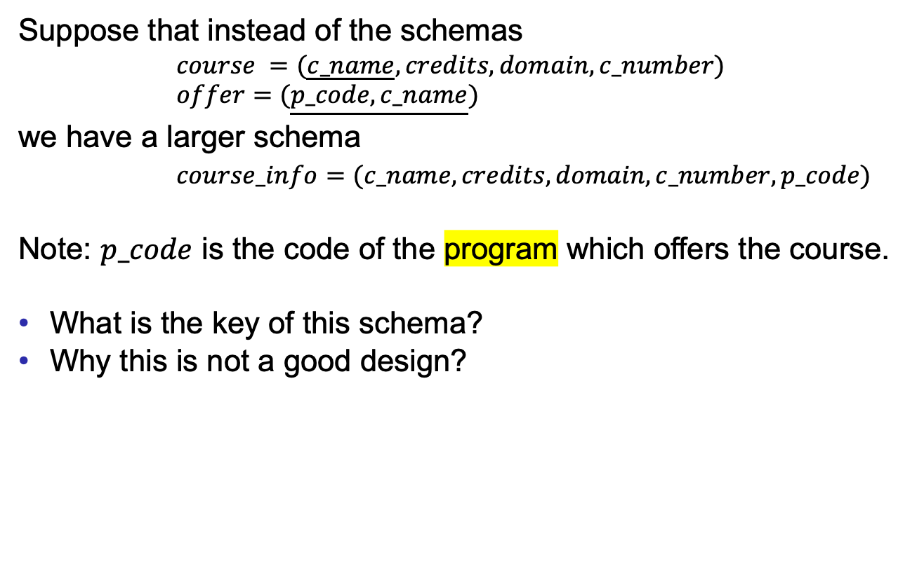
Larger Schemas?
Good Design
Atomic
Dependencies
BCNF
3rdNF
MVDs
Design Process
Suppose that instead of the schemas
$course =(\underline{c_name},credits,domain,c_number)$
$offer=(\underline{p_code,c_name})$
we have a larger schema
$course_info=(c_name,credits,domain,c_number,p_code)$
Note: $p_code$ is the code of the program which offers the course.
What is the key of this schema?
Why this is not a good design?

Slide 4
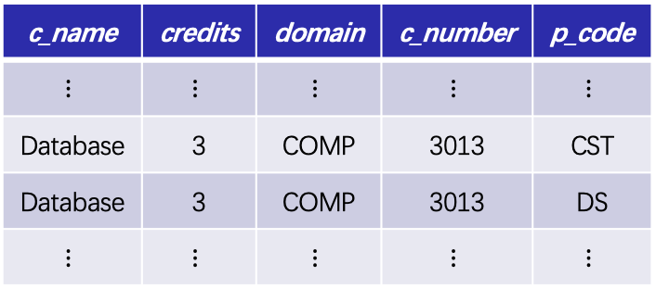
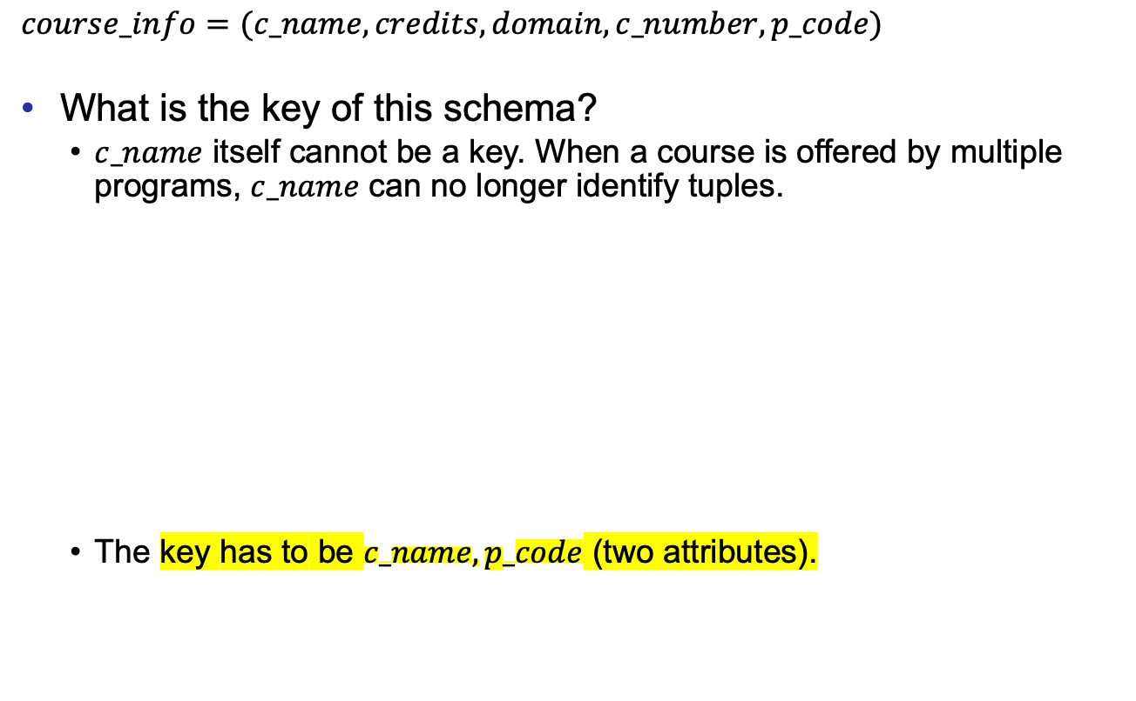
Larger Schemas?
Good Design
Atomic
Dependencies
BCNF
3rdNF
MVDs
Design Process
$course_info=(c_name,credits,domain,c_number,p_code)$
What is the key of this schema?
  $c_name$ itself cannot be a key. When a course is offered by multiple programs, $c_name$ can no longer identify tuples.
  The key has to be $c_name,p_code$ (two attributes).
c_name | credits | domain | c_number | p_code
$$⋮$$ | $$⋮$$ | $$⋮$$ | $$⋮$$ | $$⋮$$
Database | 3 | COMP | 3013 | CST
Database | 3 | COMP | 3013 | DS
$$⋮$$ | $$⋮$$ | $$⋮$$ | $$⋮$$ | $$⋮$$

Slide 5
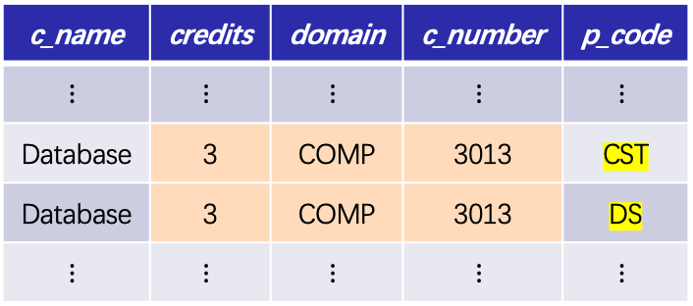

Larger Schemas?
Good Design
Atomic
Dependencies
BCNF
3rdNF
MVDs
Design Process
$course_info=(c_name,credits,domain,c_number,p_code)$
Why this is not a good design?
  From the example, we see redundancy occurs.
  The reason is that $credits,domain,c_number$ are decided by the course, but not by the program which offers the course.
c_name | credits | domain | c_number | p_code
$$⋮$$ | $$⋮$$ | $$⋮$$ | $$⋮$$ | $$⋮$$
Database | 3 | COMP | 3013 | CST
Database | 3 | COMP | 3013 | DS
$$⋮$$ | $$⋮$$ | $$⋮$$ | $$⋮$$ | $$⋮$$

Slide 6
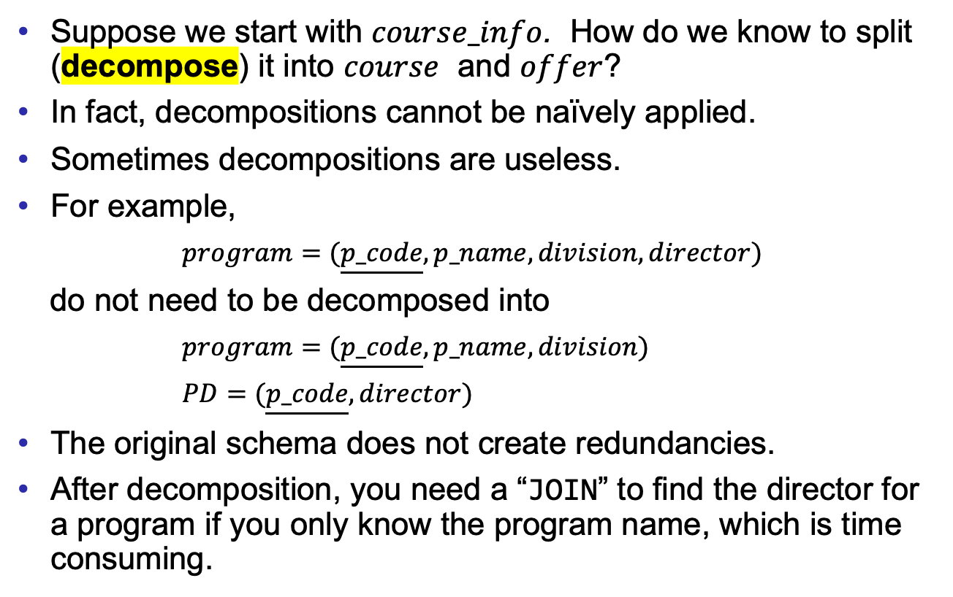
What About Smaller Schemas?
Good Design
Atomic
Dependencies
BCNF
3rdNF
MVDs
Design Process
Suppose we start with $course_info$. How do we know to split (decompose) it into $course$ and $offer$?
In fact, decompositions cannot be naïvely applied.
Sometimes decompositions are useless.
For example,
$program=(\underline{p_code},p_name,division,director)$
do not need to be decomposed into
$program=(\underline{p_code},p_name,division)$
$PD=(\underline{p_code},director)$
The original schema does not create redundancies.
After decomposition, you need a “JOIN” to find the director for a program if you only know the program name, which is time consuming.

Slide 7

What About Smaller Schemas?
Good Design
Atomic
Dependencies
BCNF
3rdNF
MVDs
Design Process
Sometimes naïve decompositions create inconsistency.
For example,
$student=(\underline{id},s_name,year,gpa,major)$
is decomposed into (pay attention to the keys)
$stu=(\underline{id},s_name)$
$stuinfo=(\underline{s_name,year,gpa,major})$
id | s_name | year | gpa | major
⋮ | ⋮ | ⋮ | ⋮
1001000654 | Dave | 5 | 2.01 | TESL
1701026104 | Dave | 1 | 3.41 | CST
⋮ | ⋮ | ⋮ | ⋮
id | s_name
⋮ | ⋮
1001000654 | Dave
1701026104 | Dave
⋮ | ⋮
s_name | year | gpa | major
⋮ | ⋮ | ⋮
Dave | 5 | 2.01 | TESL
Dave | 1 | 3.41 | CST
⋮ | ⋮ | ⋮

Slide 8

What About Smaller Schemas?
Good Design
Atomic
Dependencies
BCNF
3rdNF
MVDs
Design Process
Suppose we want to find the major of the student by IDs, we have to join $stu$ and $stu_info$. This creates some fake data.
id | s_name
⋮ | ⋮
1001000654 | Dave
1701026104 | Dave
⋮ | ⋮
s_name | year | gpa | major
⋮ | ⋮ | ⋮
Dave | 5 | 2.01 | TESL
Dave | 1 | 3.41 | CST
⋮ | ⋮ | ⋮
JOIN
id | s_name | year | gpa | major
⋮ | ⋮ | ⋮ | ⋮
1001000654 | Dave | 5 | 2.01 | TESL
1001000654 | Dave | 5 | 2.01 | CST
1701026104 | Dave | 1 | 3.41 | TESL
1701026104 | Dave | 1 | 3.41 | CST
⋮ | ⋮ | ⋮ | ⋮

Slide 9
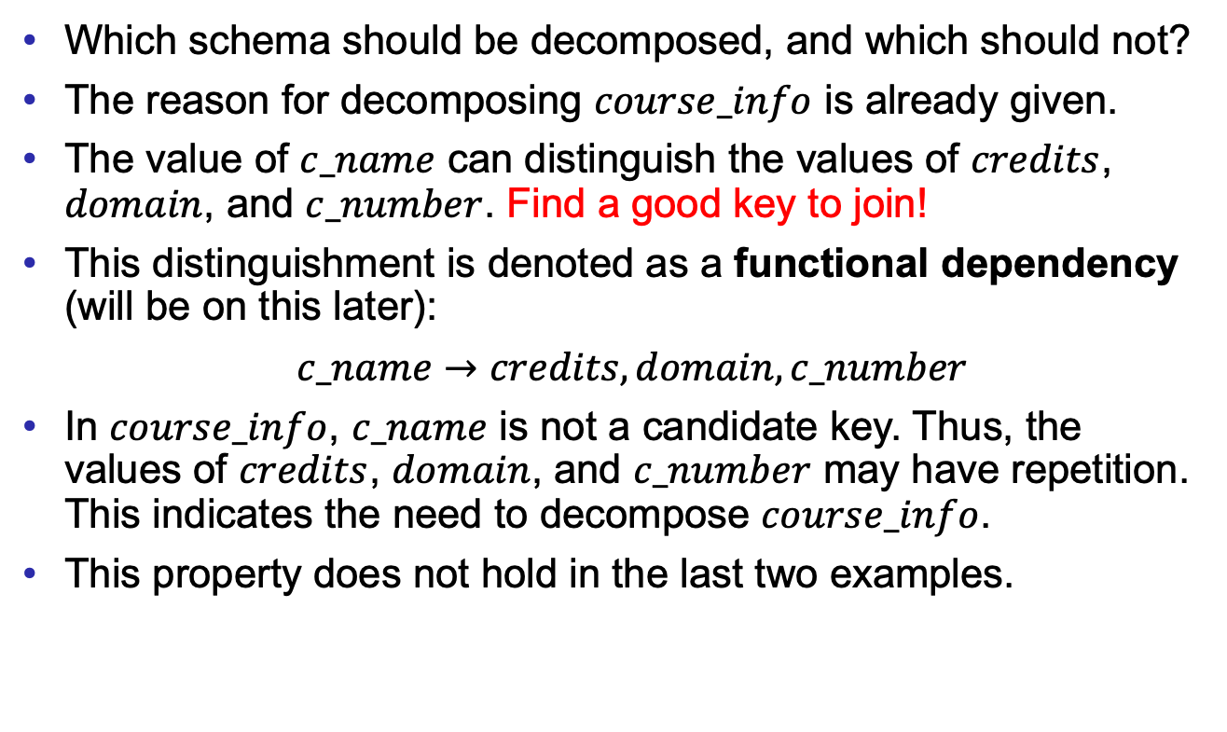
What About Smaller Schemas?
Good Design
Atomic
Dependencies
BCNF
3rdNF
MVDs
Design Process
Which schema should be decomposed, and which should not?
The reason for decomposing $course_info$ is already given.
The value of $c_name$ can distinguish the values of $credits$, $domain$, and $c_number$. Find a good key to join!
This distinguishment is denoted as a functional dependency (will be on this later):
$c_name→credits,domain,c_number$
In $course_info$, $c_name$ is not a candidate key. Thus, the values of $credits$, $domain$, and $c_number$ may have repetition. This indicates the need to decompose $course_info$.
This property does not hold in the last two examples.

Slide 10
First Normal Form
Good Design
Atomic
Dependencies
BCNF
3rdNF
MVDs
Design Process
A domain is atomic if its elements are considered to be indivisible units.
  Examples of non-atomic domains:
    Set of names, composite attributes
    Identification numbers like CS101, that can be broken up into parts.
A relational schema R is in first normal form if the domains of all attributes of R are atomic.
Non-atomic values complicate storage and encourage redundant (repeated) storage of data.

Slide 11
First Normal Form
Good Design
Atomic
Dependencies
BCNF
3rdNF
MVDs
Design Process
Atomicity is actually a property of how the elements of the domain are used.
Example: Strings would normally be considered indivisible.
Suppose that students are given roll numbers which are strings of the form CS0012 or EE1127.
If the first two characters are extracted to find the department, the domain of roll numbers is not atomic.
Doing so is a bad idea: leads to the encoding of information in application program rather than in the database.
Database users have to know the encoding before developing applications.

Slide 12
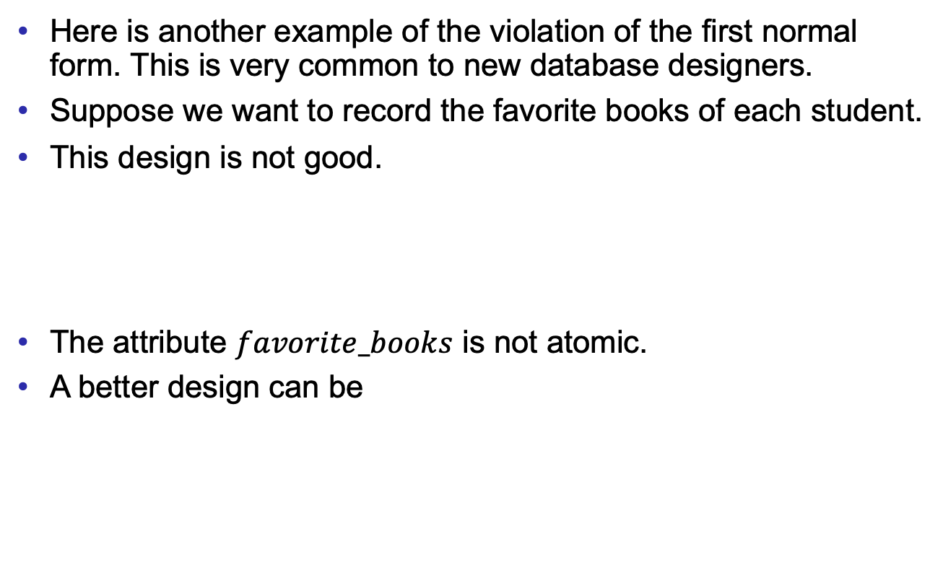
First Normal Form
Good Design
Atomic
Dependencies
BCNF
3rdNF
MVDs
Design Process
Here is another example of the violation of the first normal form. This is very common to new database designers.
Suppose we want to record the favorite books of each student.
This design is not good.
The attribute $favorite_books$ is not atomic.
A better design can be
id | s_name | favorite _books
1001000654 | Dave | Three body, MacBeth, Database
1701026104 | Steven | Three Body
⋮ | ⋮ | ⋮
a more common example：
name
Alan Turing
id | s_name | favorite _book
1001000654 | Dave | Three body
1001000654 | Dave | MacBeth
1001000654 | Dave | Database
1701026104 | Steven | Three Body
⋮ | ⋮ | ⋮
first name | last name
Alan | Turing

Slide 13
Lab 08 review.

Slide 14
NULL
The domain of each data type contains a special value – NULL.
NULL means the value is unknown or does not exist.
NULL values can participate
  calculations in the arithmetic expressions,
  aggregation functions,
  comparisons, and
  predicates (logical test) in the WHERE clause.

Slide 15
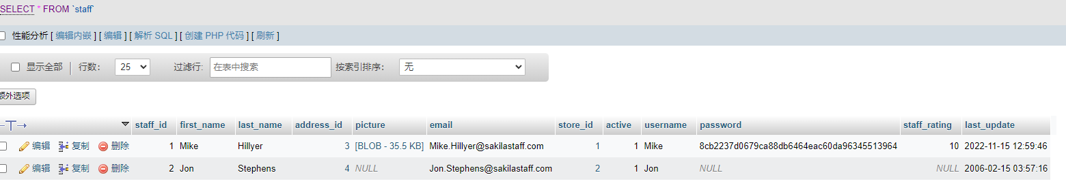
To get the examples for NULL values work
ALTER TABLE staff ADD staff_rating INT AFTER password; UPDATE staff SET staff_rating=10 WHERE staff_id=1;

Slide 16
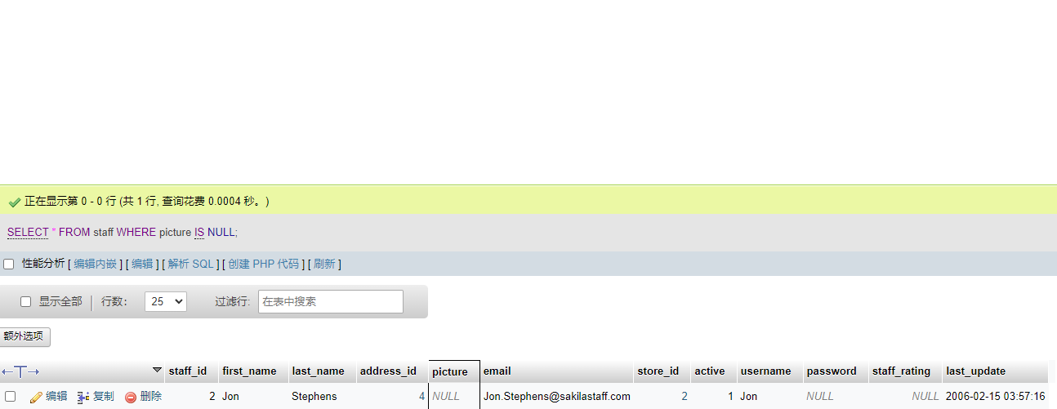
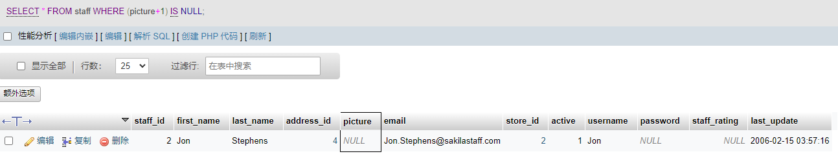
Arithmetic and Atomic Predicate
To check whether a value of an attribute is NULL (atomic predicate)
WHERE attribute IS NULL
For example,
SELECT * FROM staff WHERE picture IS NULL
Any arithmetic expression which has NULL values is evaluated as NULL.
For example, this query is same as the above.
SELECT * FROM staff WHERE (picture+1) IS NULL

Slide 17
Aggregation
Different aggregation functions treat NULL values differently.
If NULL values and non-NULL values are mixed,
  all aggregation functions ignore NULL values.
If the group only consists of NULL values,
  count returns 0;
  other aggregation functions return NULL.
Try the follow queries and see the outcome. One staff has rating NULL.
SELECT COUNT(staff_rating) FROM staff
SELECT MIN(staff_rating) FROM staff
SELECT staff_id,COUNT(staff_rating) FROM staff GROUP BY staff_id
SELECT staff_id,MIN(staff_rating) FROM staff GROUP BY staff_id

Slide 18
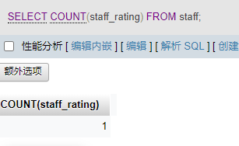
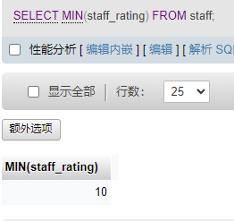
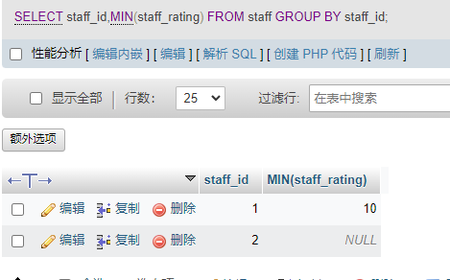
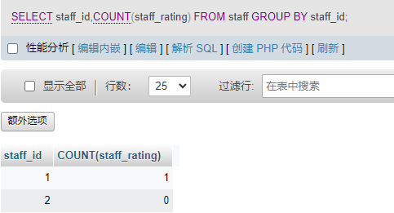

Slide 19
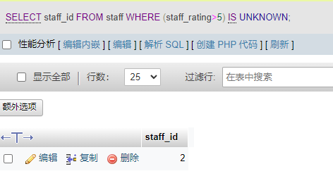
Comparison and Compound Predicates
The logic with NULL values has three constants:
TRUE, FALSE, and UNKNOWN
A comparison with NULL values is evaluated as UNKNOWN.
To check whether a logical constant is UNKNOWN, use IS UNKNOWN.
For example, try the query and check the outcome.
SELECT staff_id FROM staff WHERE (staff_rating>5) IS UNKNOWN

Slide 20
Comparison and Compound Predicates
In the compound predicates, (with logical connectives: AND, OR, and NOT)
  OR: (unknown OR true) = true
  (unknown OR false) = unknown
  (unknown OR unknown) = unknown
  AND: (true AND unknown) = unknown
  (false AND unknown) = false
  (unknown AND unknown) = unknown
  NOT: (NOT unknown) = unknown
If a logical test in WHERE is eventually equal to UNKNOWN, the result of the test is treated as FALSE.

Slide 21
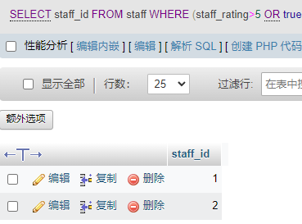
Example
Try the examples and explain the outcomes.
SELECT staff_id FROM staff WHERE (staff_rating>5 OR true);
(unknown OR true) = true, so include staff_id=2

Slide 22
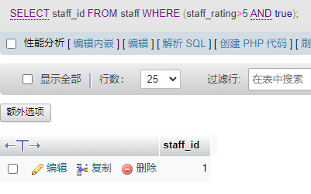
Example
Try the examples and explain the outcomes.
SELECT staff_id FROM staff WHERE (staff_rating>5 AND true);
(true AND unknown) = unknown ;
If a logical test in WHERE is eventually equal to UNKNOWN, the result of the test is treated as FALSE;
so, staff_id = 2 will not be included

Slide 23
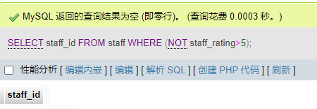
Example
Try the examples and explain the outcomes.
SELECT staff_id FROM staff WHERE (NOT staff_rating>5);
(NOT unknown) = unknown;
If a logical test in WHERE is eventually equal to UNKNOWN, the result of the test is treated as FALSE;
so, staff_id = 2 will not be included

Slide 24
Subquery
A subquery is a query (SELECT…FROM…WHERE) inside another query.
Subqueries can be in all of SELECT, FROM, and WHERE clauses.
This lab introduces subqueries in the FROM clause.
In the FROM clause, users need to indicate some tables.
A “SELECT…FROM…WHERE…” query returns a temporary table. (The type is matched.)

Slide 25
Subquery
For example, find the id of the actors who have played some films of rating “PG-13”.
SELECT actor_id
FROM film_actor NATURAL JOIN (
SELECT film_id
FROM film
WHERE rating = 'PG-13'
) AS temp
The keyword AS renames the temporary table returned by the subquery as ‘temp’.

Slide 26
Subquery
The previous example can also be done without a subquery.
What is the difference between these two approaches?
Which one is more efficient? Ans: left one. Without joining all attributes in table `film`.
(Think about the procedure when queries are executed by the system, about optimization.)
Query 1:
SELECT actor_id
FROM film_actor NATURAL JOIN (
SELECT film_id
FROM film
WHERE rating = 'PG-13'
) AS temp
Query 2:
SELECT actor_id
FROM film_actor JOIN film
USING(film_id)
WHERE rating='PG-13'

Slide 27
Example
Find the name of the customers who live in China.
SELECT first_name, last_name
FROM customer, (
SELECT address_id
FROM address, (
SELECT city_id
FROM city, (
SELECT country_id
FROM country
WHERE country='China') AS T1
WHERE city.country_id = T1.country_id) AS T2
WHERE address.city_id = T2.city_id) AS T3
WHERE customer.address_id = T3.address_id
The structure is like an onion.
those
customers
addresses in
those cities
cities in China

Slide 28
Exercises
You must use subqueries for the following questions. Try your best to use as many subqueries as you can.
Find the films (title) played by Zero Cage.
Find the films (title) rented by George Linton.
Find the customers (name) who have rented some action (category) films.
Find the id of the films which have the lowest rental rate.
Find the actors who have played a same film with Bolger (the last name of an actor).
Count the number of customers who have not rented any film. You have to use OUTER JOIN, aggregation, and subqueries.

Slide 29
Exercises
Find the films (title) played by Zero Cage.
SELECT title
FROM film,(
SELECT film_id
FROM film_actor,(
SELECT actor_id
FROM actor
WHERE first_name='Zero' AND last_name='Cage'
) AS act
WHERE film_actor.actor_id = act.actor_id) AS fa
WHERE film.film_id = fa.film_id;

Slide 30
Exercises
2. Find the films (title) rented by George Linton.
SELECT film.title
FROM film,(
SELECT film_id
FROM inventory,(
SELECT inventory_id
FROM rental,(
SELECT customer_id
FROM customer
WHERE customer.first_name='George' AND customer.last_name='Linton') AS C
WHERE rental.customer_id = C.customer_id) AS R
WHERE inventory.inventory_id = R.inventory_id) AS I
WHERE film.film_id = I.film_id;

Slide 31
Exercises
3. Find the customers (name) who have rented some action (category) films.
SELECT customer.first_name,customer.last_name
FROM customer, (
SELECT customer_id
FROM rental, (
SELECT inventory_id
FROM inventory, (
SELECT film_id
FROM film_category, (
SELECT category_id
FROM category
WHERE category.name='action') AS Action
WHERE film_category.category_id = Action.category_id) AS Fc
WHERE inventory.film_id = Fc.film_id) AS I
WHERE rental.inventory_id = I.inventory_id) AS R
WHERE customer.customer_id = R.customer_id;

Slide 32
Exercises
4. Find the id of the films which have the lowest rental rate.
SELECT film_id
FROM film, (
SELECT MIN(rental_rate) AS min_rate
FROM film) AS temp
WHERE rental_rate = min_rate;

Slide 33
Exercises
5. Find the actors who have played a same film with Bolger (the last name of an actor).
SELECT actor.first_name,actor.last_name
FROM actor, (
SELECT actor_id
  FROM film_actor, (
  SELECT film_id
  FROM film_actor, (
  SELECT actor_id
  FROM actor
  WHERE actor.last_name = "Bolger ") AS A
  WHERE film_actor.actor_id = A.actor_id) AS Fa1
  WHERE film_actor.film_id = Fa1.film_id) AS Fa2
WHERE actor.actor_id = Fa2.actor_id;

Slide 34
Exercises
6. Count the number of customers who have not rented any film. You have to use OUTER JOIN, aggregation, and subqueries.
SELECT COUNT(customer_id)
FROM (
SELECT customer_id
FROM customer LEFT OUTER JOIN rental USING (customer_id)
WHERE rental_id IS NULL) AS temp;
customer
Customer_id | …
1 | …
2 | …
rental
Customer_id | Rental_id
1 | NULL

