Slide 1
FenceGAN update

Slide 2
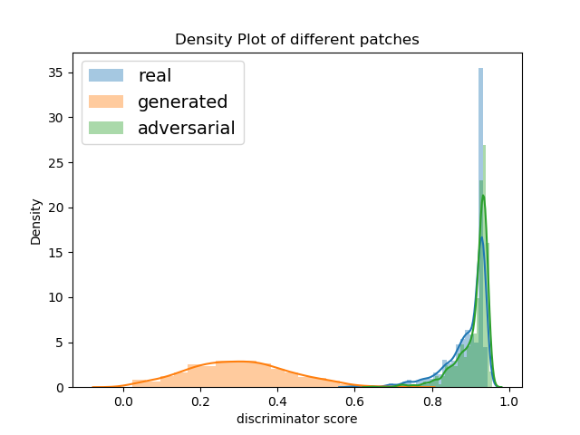
In June
FenceGAN(Dense)
On 5*5 patches
6500 iterations

Slide 3
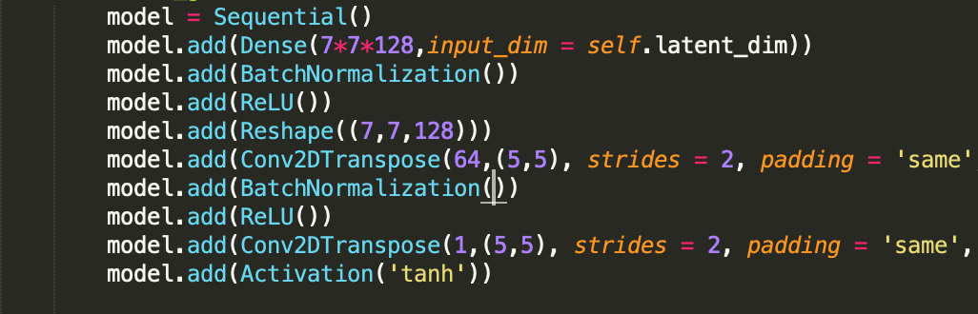
DCFenceGAN on full image
Generator Architecture

Slide 4
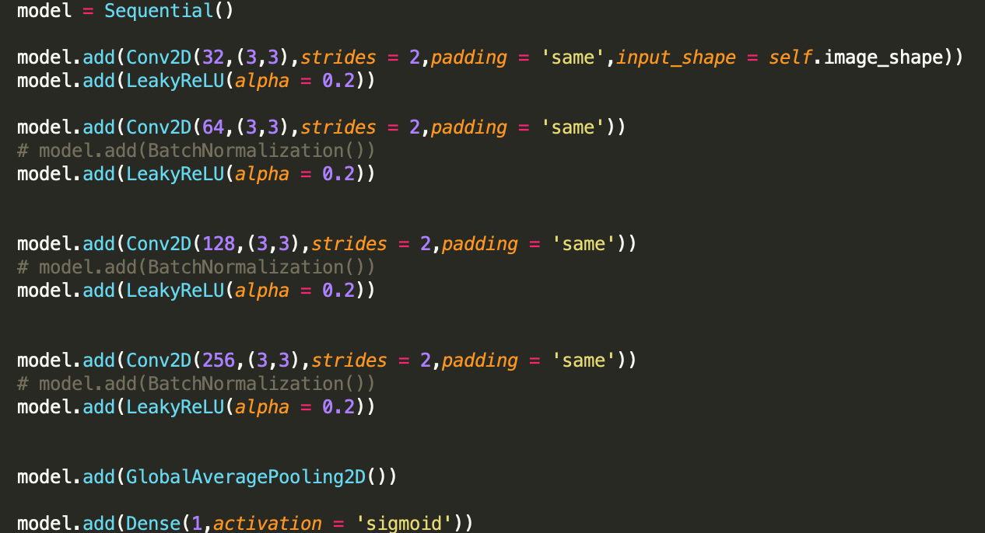
DCFenceGAN on full image
Discriminator Architecture

Slide 5
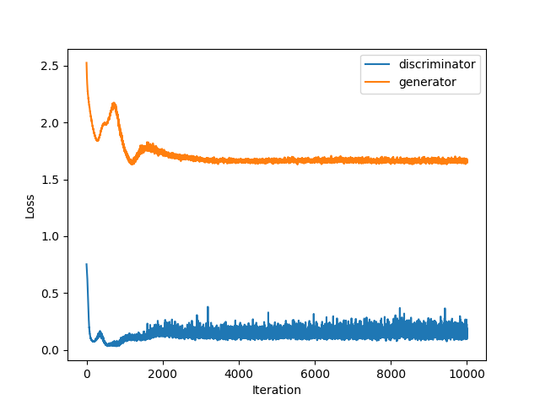
DCFenceGAN on full image
Workflow
G_lr = D_lr = 0.00002
batch size 64
gamma = 0.1
Beta = 15
BatchNorm for G only
10000 iterations

Slide 6
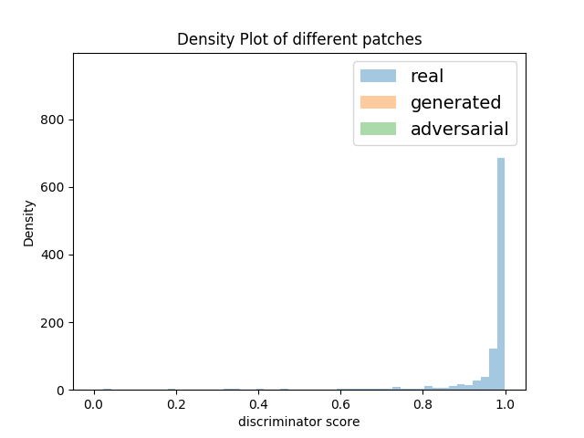
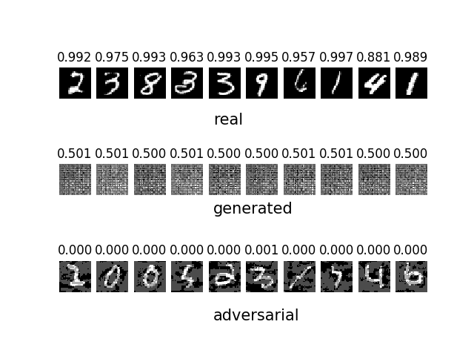
Results - fgsm

Slide 7
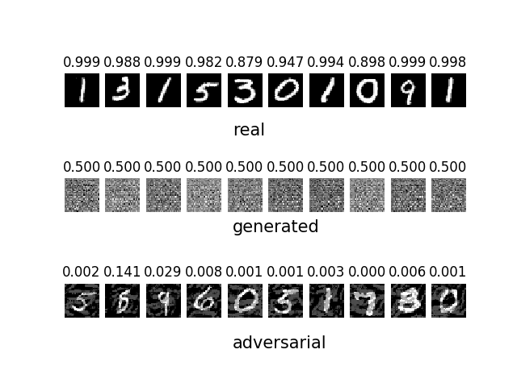
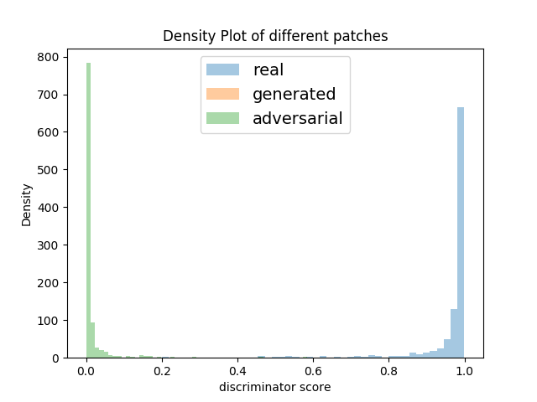
igsm

Slide 8
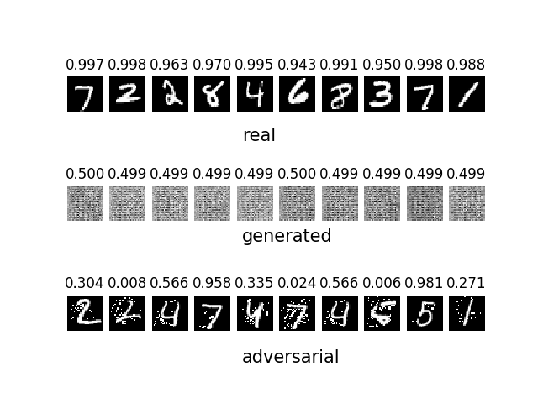
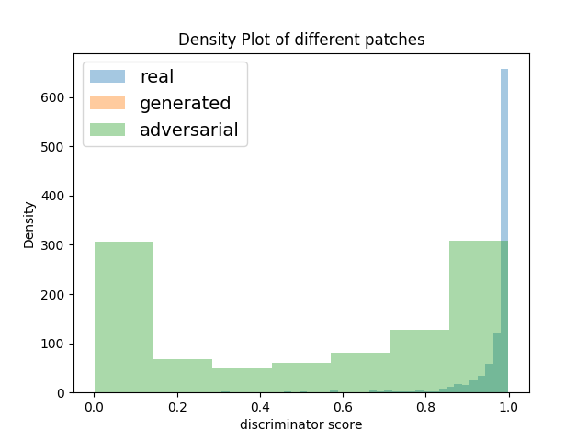
jsma

Slide 9
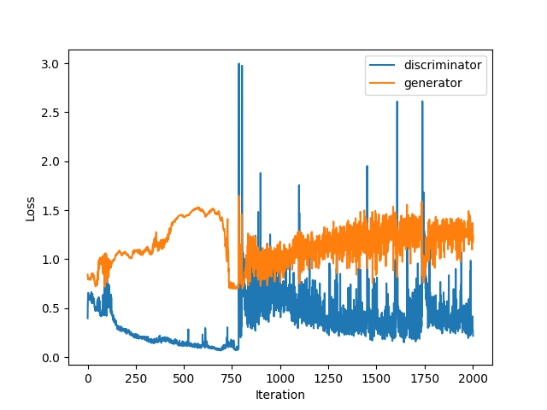
Interesting phenomenon
Jumping loss

Slide 10
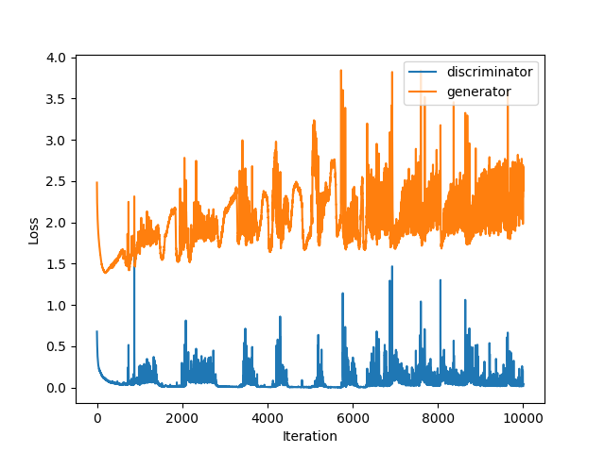
Interesting phenomenon
Periodic shift in image quality

