Slide 1

EOS
the next step in smart-contracts?
Presented by

Slide 2


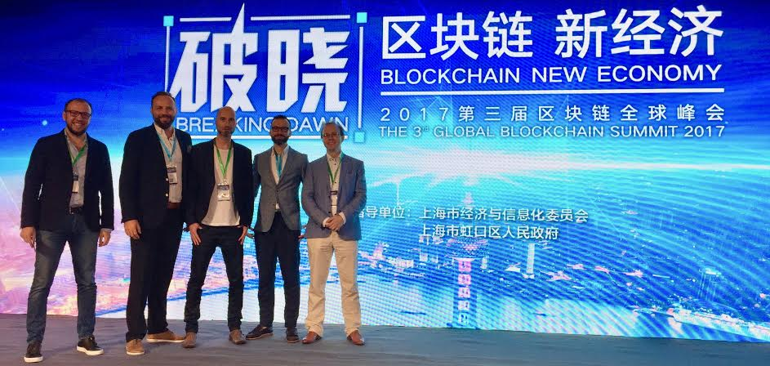

Slide 3
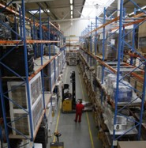
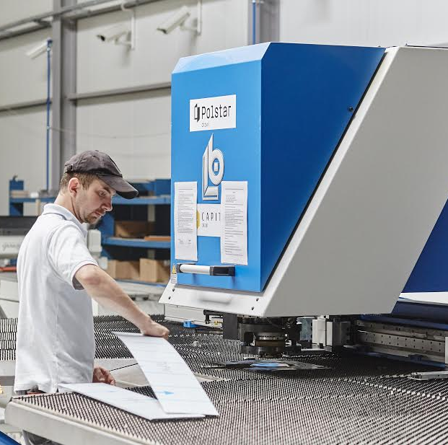
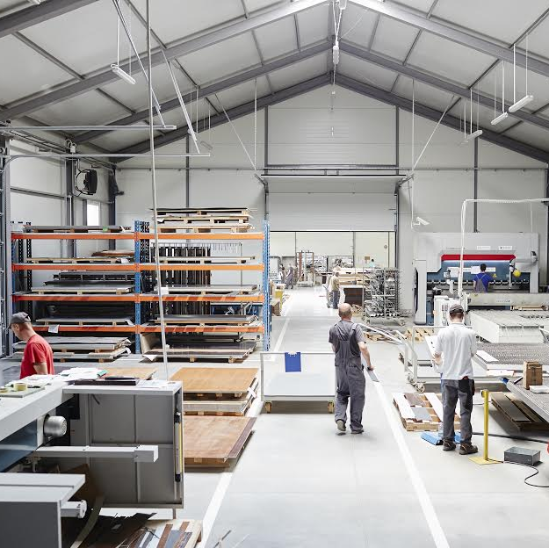
Our background in conventional business

Slide 4
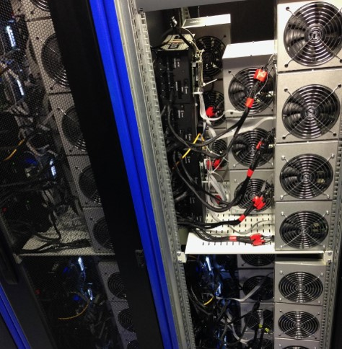
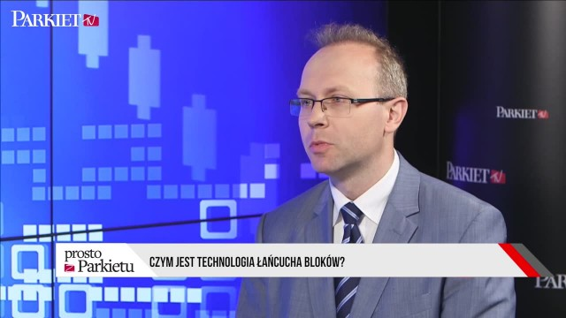
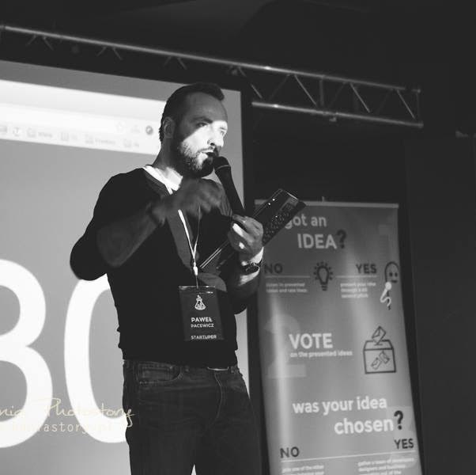
Our background IN the BLOCKCHaIN SPACE

Slide 5
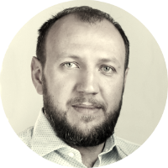

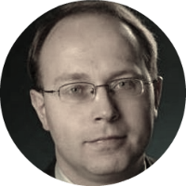




Slide 6
EOS
the next step in smart-contracts?
Presented by

Slide 7
Disclaimer
We are NOT in any way associated with block.one, the company developing EOS code. We are just part of the emerging EOS community.
We have no interest in you buying EOS tokens, and this certainly should not be treated as financial advice.
Our goal is to encourage you to take interest in the concept and possibly consider building businesses on top of EOS.

Slide 8
What do decentralized apps require?
Cheap to run
Free for the users
Easily accessible
No fancy cryptographic stuff
Bug recovery
Upgradability
Account recovery
Privacy protection
Access to other blockchains

Slide 9
WHAT’S NEEDED Vs. WHAT’s Available
BTC: 4 trxn/sec
ETH: 15-30 trxn/sec
BTC: 4 bln USD/year (12 mln USD/day)
ETH: 2 bln USD/year (6 mln USD/day)

Slide 10
What Scaling solutions ARE vailable?
Moving transactions off-chain: state channels
Lightening Network in Bitcoin
Raiden in Ethereum
Splitting the problem into smaller chunks:
Sub-domains within one blockchain (Ethereum’s sharding)
A hierachy of blockchains (Ethereum’s Plasma)

Slide 11
What is EOS?
EOS is a general-purpose smart-contract platform, just like Ethereum.

Slide 12
EOS is the blockchain for building commercial scale decentralized applications that are indistinguishable from centralized alternatives.
Daniel Larimer, CTO of block.one

Slide 13
HOW DOES EOS WORK?
Applications
Operating System
Computer

Slide 14
What are eos main features?
?
?
?
?
?
?

Slide 15
#1 Processing power
EOS MAIN FEATURES
On day one: 50,000 trxns per second or more.

Slide 16
#1 Processing power
EOS MAIN FEATURES
Sequential processing technology borrowed from LMAX exchange
Parallel processing for horizontal scaling
Consensus over events instead of consensus over state
No need to count CPU operations

Slide 17
#2 Built-in governance
EOS MAIN FEATURES
Consensus mechanism: Delegated Proof of Stake
Block producers able to freeze & fix broken apps
Built-in governance mechanisms:
Constitution encoded in the blockchain (legally binding)
Arbitration for resolving disputes
Shareholders voting on important decisions

Slide 18
#3 infrastructure for apps
EOS MAIN FEATURES
Common/low-level features & services embedded in the blockchain: account permissions, account recovery, scheduling, authentication, inter-app communication, biometric 2nd factor validation
Integrated storage solution based on IPFS

Slide 19
#4 No transaction fees
EOS MAIN FEATURES
EOS token is never consumed, no concept of gas
If you own 1% of the tokens, you own 1% of the network
You can own blockchain resources or rent them

Slide 20
#5 Upgradeable apps & multiple VMs
EOS MAIN FEATURES
Publish source code, not assembly
Upgradable smart-contracts
Multiple virtual machines

Slide 21
#6 Asynchronous communication
EOS MAIN FEATURES
Everything is based on messages
Cross-blockchain communication becomes possible

Slide 22
What are eos main features?
Processing power
Built-in governance
Infrastructure for apps
No transaction fees
Upgradeable apps & multiple VMs
Asynchronous communication

Slide 23
EOS BackGround
Top-down
Bottom-up
Attempt to generalize something that you have not figured out how to build yet.
Figure out how to build something first and then start generalizing it.

Slide 24
top four most used blockchains
BitShares usage: 4.0 trxns/sec capacity utilized: <1%
Steem usage: 7.8 trxns/sec capacity utilized: <1%

Slide 25
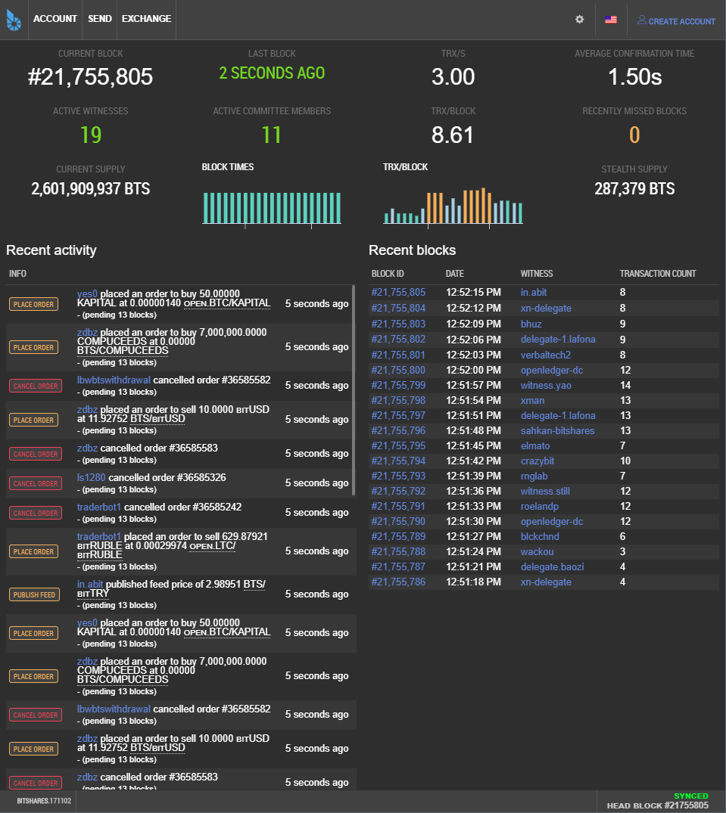
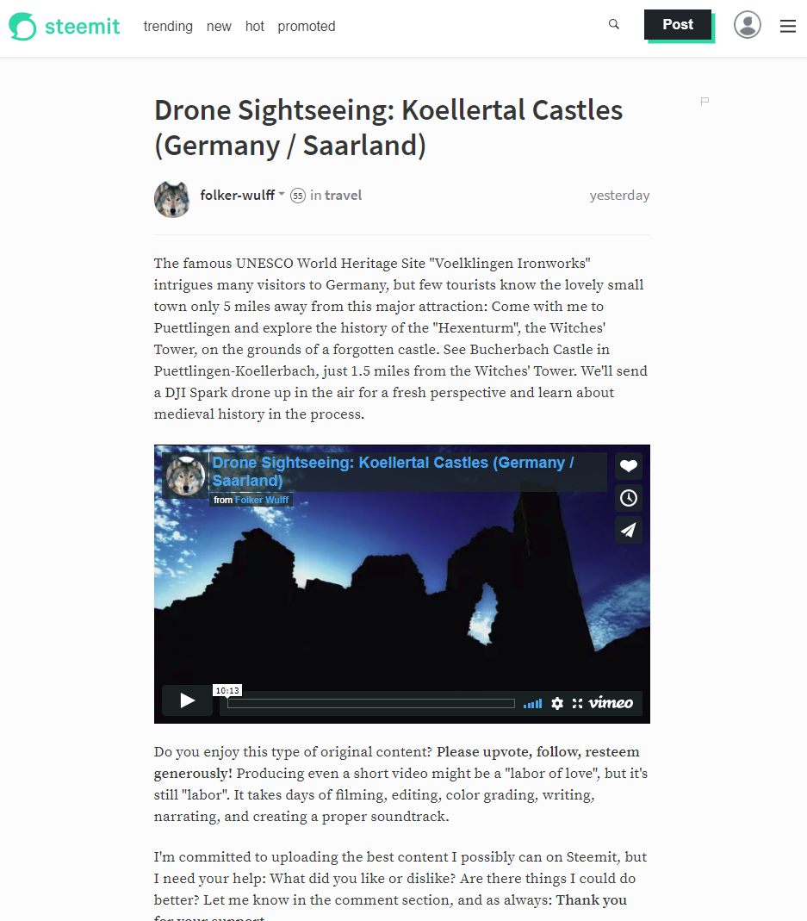
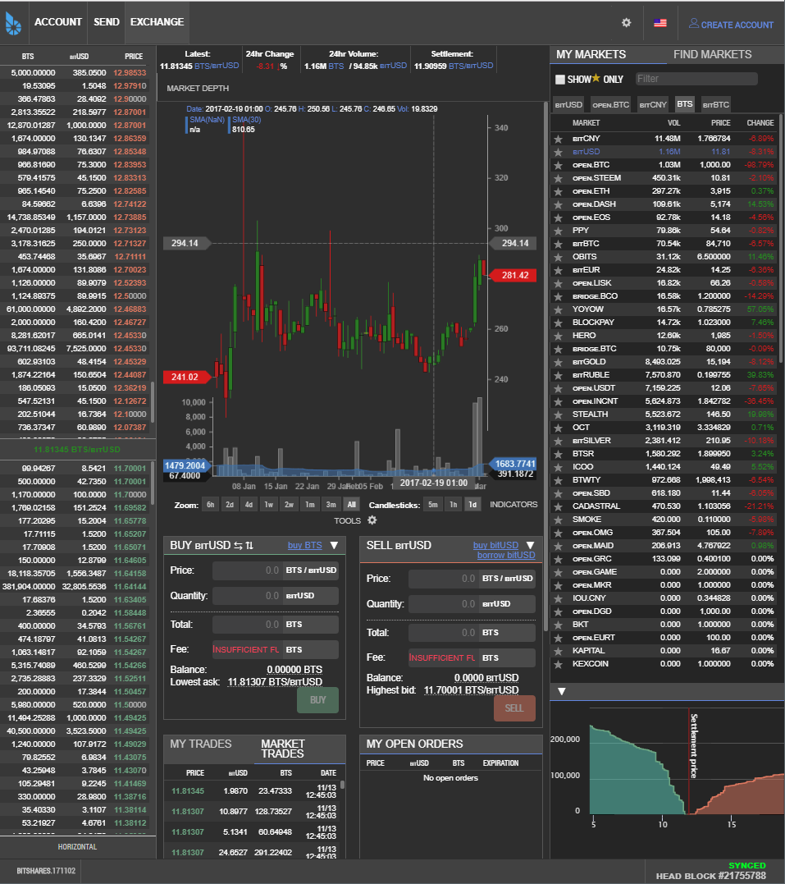
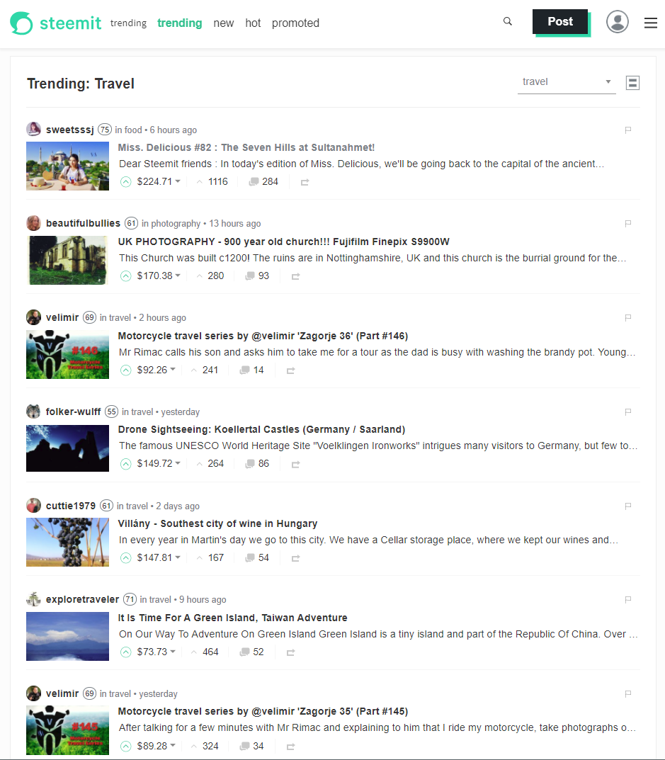
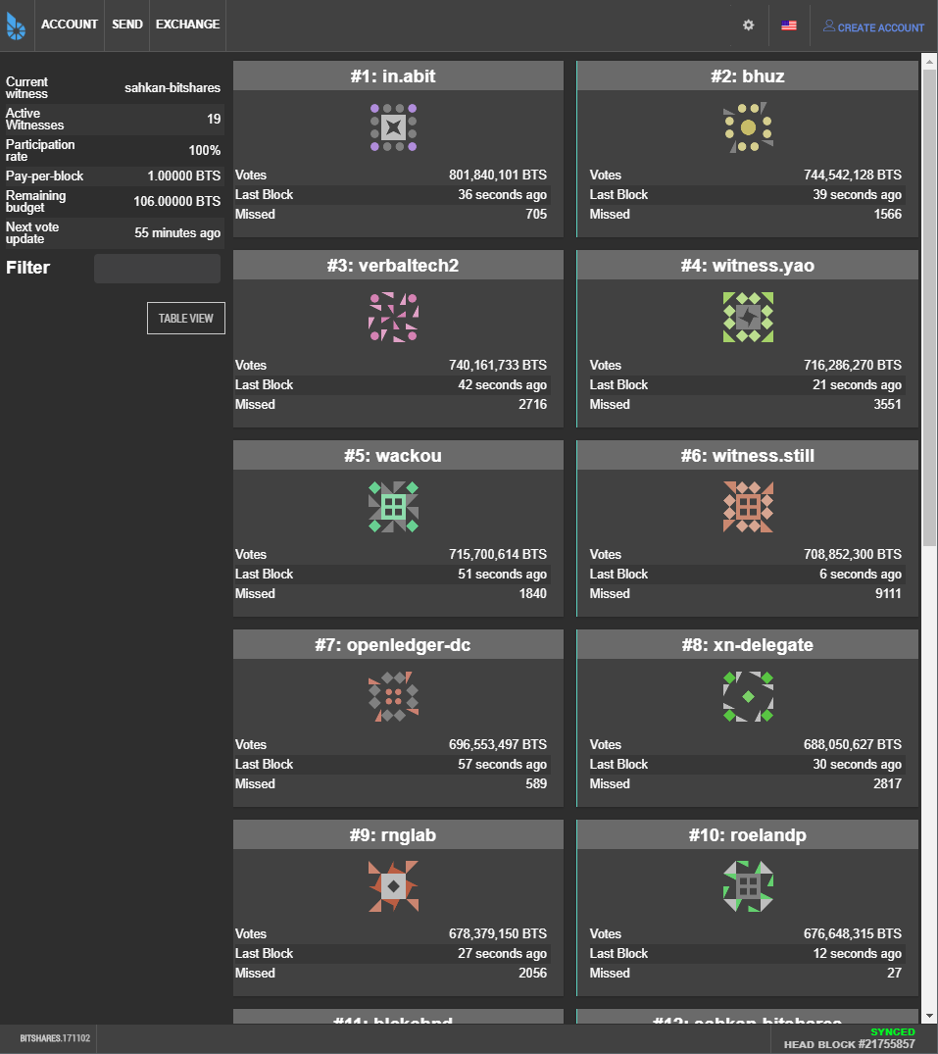
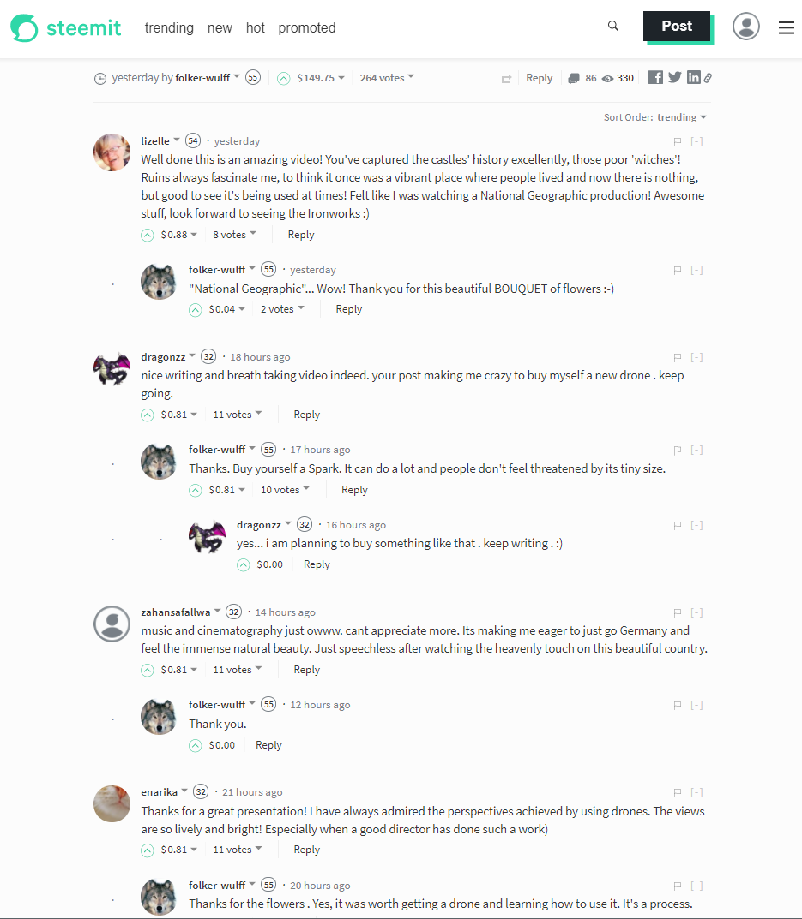
Source: bitshares.org & steemit.com

Slide 26
Delegated proof of stake (DPOS) HOW decentralized IS IT?
Purpose of decentralization: To make the system resilient against dishonest players on the inside and against attempts to shut it down from the outside.
Measure of decentralization: (1) How many unique entities are involved in producing 80% of the blocks? (2) How resilient the system is to an attempt to attack it?

Slide 27
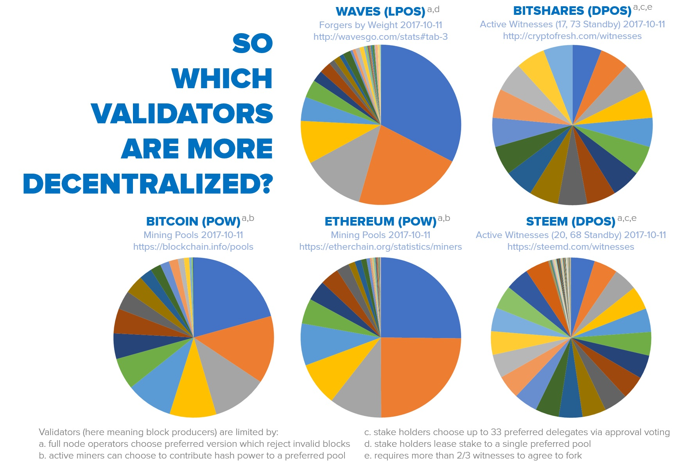
Delegated proof of stake (DPOS) HOW decentralized IS IT?
Source: senzheng on reddit.com

Slide 28
Delegated proof of stake (DPOS) HOW resilient IS IT?
Very easy to replace non-performing block producers
When in trouble, the system degrades in a graceful, detectable manner that is trivial to recover from
Continues to function even when a majority of producers fail, or a large minority of producers go rouge

Slide 29
What are the strong points?
Very efficient team implementing a concept proved in practice
Web Assembly as a virtual machine
Strong financial backing: Brock Pierce & Bo Shen (Fenbushi Capital)
Commitment to spend 1 bln USD to boost the ecosystem

Slide 30
EOS is the most well-funded project in history and we plan to soon announce a program for up to one billion USD of capital for EOS projects.
Brendan Blumer, CEO of block.one

Slide 31
What are the weak points?
Almost non-existent ecosystem
Track-record of poor documentation
C++ has a very steep learning curve
Not live yet

Slide 32
EOS roadmap
Project started in Q1 2017
MVP stage called EOS Dawn 1.0
January 2018 all major functionalities deployed
Q1 & Q2 2018 devoted to testing and building development tools & docs
The EOS blockchain goes live in June 2018, most probably with the parallel processing feature already enabled
December 2017 EOS Dawn 2.0 public testnet

Slide 33


EOS VS. decentralized apps requirements
Ethereum |  | EOS
 | Cheap to run
 | Free for the users
? | Easily accessible
? | No fancy cryptographic stuff
 | Account recovery
? | Privacy protection | ?
 | Access to other blockchains
 | Upgradability
 | Bug recovery

Slide 34
summary
Revolution or evolution?
Extremely business oriented
Can other systems copy EOS solutions?

Slide 35
BLOCKCHAIN Evolution
Payment system (Bitcoin)
Smart-contract system (Ethereum)
Operating system for decentralized applications (EOS)

Slide 36
About Tokenika
Focus on blockchain-based fundraising and digital asset management solutions, e.g. Neufund, Melonport, Iconomi
Software house for building dApps (both on EOS and Ethereum)
Aiming to be elected as one of the 20 block producers for EOS

Slide 37
What DO we need?
Not looking for funding, looking for ways to spend money
Looking for good ideas that can be converted into dApps
Hiring developers with background in C++ and/or Ethereum smart-contracts

Slide 38
Thank you
EOS - official website
www.eos.io
Any questions?
Presented by
www.tokenika.io contact@tokenika.io
facebook.com/groups/Tokenika facebook.com/groups/EOSPolska

