Slide 1

EOS
the next step in smart-contracts?
Presented by

Slide 2
Disclaimer
We are in no formal way associated with block.one, the company developing EOS code. We are just part of the emerging EOS community.
We have no interest in you buying EOS tokens, and this certainly should not be treated as financial advice. Our goal is to encourage you to take interest in the concept and possibly consider building businesses on top of EOS.

Slide 3
content
Our background
Quick survey
Major problems facing the crypto-space
Introduction to EOS
About Tokenika

Slide 4
Our background
Strongly based in real-life businesses: manufacturing industry, real-estate, university education & public agencies
We are blockchain veterans: Bitcoin, MaidSafe, BitShares, Ethereum, Steem & EOS
We actively participate in the blockchain space: FinTech Week in London & Blockchain Summit in Shanghai

Slide 5
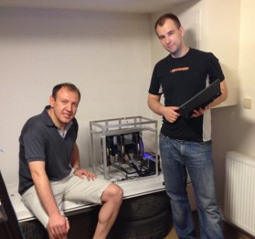
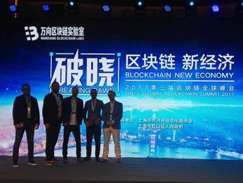

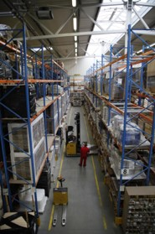
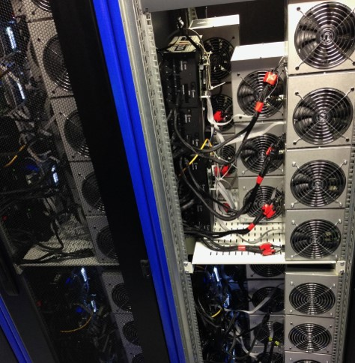
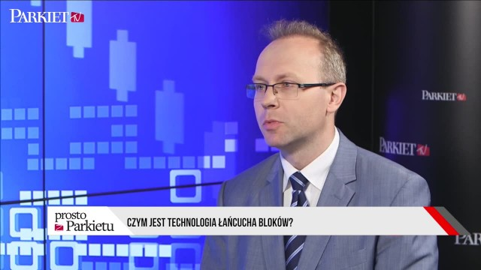
Our background

Slide 6
QUICK SURVEY - State of the blockchain 2017
How much in USD does BTC mining cost per day? What about ETH?
What is BTC average transaction fee? What about ETH?
How many transactions per second does Facebook require? What about Visa/MasterCard?
How many transactions per second is BTC able to process? What about ETH?

Slide 7
QUICK SURVEY - ResultS
How much in USD does BTC mining cost per day? What about ETH?
BTC: 12 mln USD/day (4 bln USD/year)
ETH: 6 mln USD/day (2 bln USD/year) Total raised by all ICOs so far: 3 bln USD
What is BTC average transaction fee? What about ETH?
BTC: 3 USD
ETH: 0.30 USD

Slide 8
QUICK SURVEY - ResultS
How many transactions per second does Facebook require? What about Visa/MasterCard?
Facebook: 50,000 trxn/sec Visa/MasterCard: 20,000 trxn/sec
How many transactions per second is BTC able to process? What about ETH?
BTC: 4 trxn/sec
ETH: 30 trxn/sec

Slide 9
WHAT’s POSSIBLE VS. WHAT’S NEEDED
Current blockchain solutions: extremely expensive and extremly inefficient.

Slide 10
Major problems facing the crypto-space
Scalability
Transaction fees
Private key security
Blockchain governance
Smart-contracts running amok
High cost of app development
Bad user experience
No bridges between blockchains

Slide 11
#1 Scalability
MAJOR PROBLEMS
What is high-performance?
Huge gap between what we can do and what we need to be able to do
Second layer solutions:
State channels: Lightening Network / Raiden
Spliting into subchains: Ethereum’s sharding & Plasma
But none is any good if you need very fast sequential processing

Slide 12
#2 High & unpredictable transaction fees
MAJOR PROBLEMS
No economic viability at the current level of transaction fees
Even if fees become low, they are still unpredictable
Sometimes you need no fees at all (e.g. social media)

Slide 13
#3 Private key security
MAJOR PROBLEMS
Increasing number of unsophisticated users
Losing not only money: also identity & reputation
Is this vulnerability an inherent blockchain feature?

Slide 14
#4 Blockchain governance
MAJOR PROBLEMS
Decentralized decision making:
business-as-usual situations
emergency situations
Value systems cannot be encoded, blockchain is not a self-contained entity
Different value systems = different people expect different outcomes

Slide 15
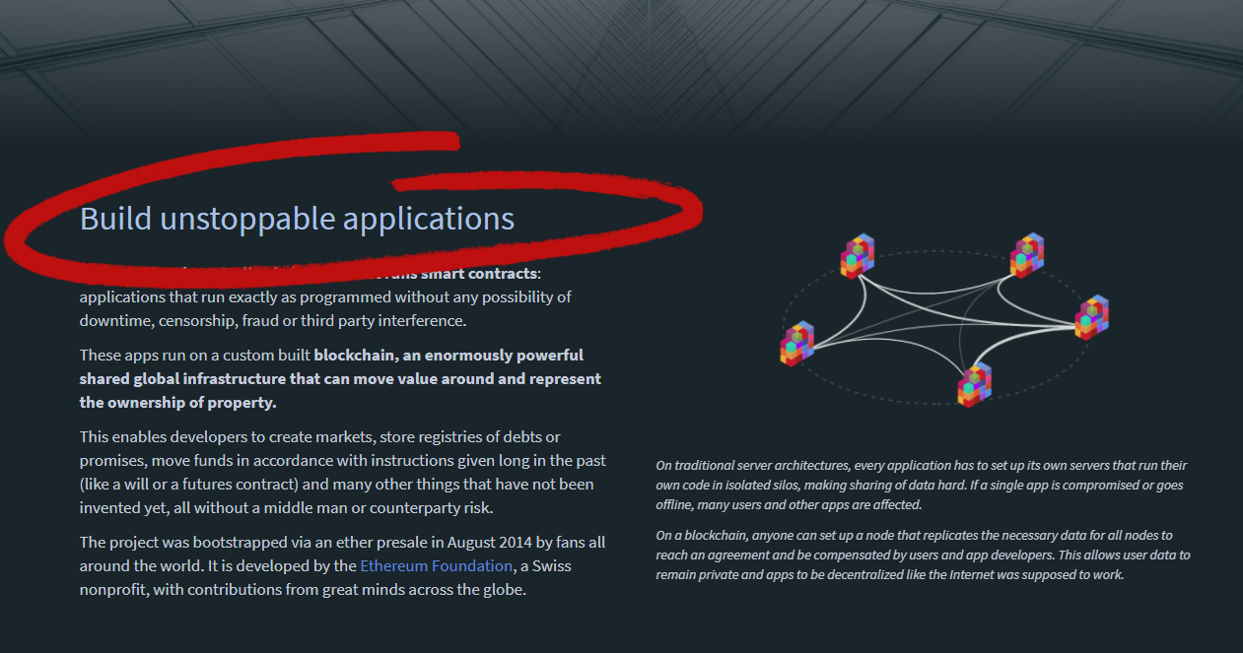
#5 Smart-contracts running amok
MAJOR PROBLEMS
Formal verification is hard & never fully reliable
Smart-contracts running out-of-control not part of Ethereum business model

Slide 16
#6 High cost of app development
MAJOR PROBLEMS
Nothing is coming to market
Devs stuck on low-level stuff
Complex things attempted in inefficient scripting environment
Generic solutions built with smart-contracts will be expensive to use

Slide 17
#7 Bad user experience
MAJOR PROBLEMS
UX way below centralized apps
Blockchain-based apps need to be indistinguishable from conventional apps
Responsive front-end requires proper back-end infrastructure
Devs still stuck on low-level stuff

Slide 18
#8 No bridges between blockchains
MAJOR PROBLEMS
Blockchains operate in their own silos
(Almost) impossible to move value across blockchains
Potential solutions are several years away (e.g. Polkadot, Cosmos)
They’ll require asynchronous communication

Slide 19
Major problems facing the crypto-space
Scalability
Transaction fees
Private key security
Blockchain governance
Smart-contracts running amok
High cost of app development
Bad user experience
No bridges between blockchains

Slide 20
What is EOS?
EOS is a general-purpose smart-contract platform, just like Ethereum.

Slide 21
What is EOS?
EOS is a holistic approach to high-performance general-purpose consensus.

Slide 22
EOS is the blockchain for building commercial scale decentralized applications that are indistinguishable from centralized alternatives.
Daniel Larimer, CTO of block.one

Slide 23
WHAT is a decentrzlized app?
Decentralized Uber
Decentralized exchange
Decentralized prediction market
Decentralized investment fund

Slide 24
What do decentralized apps require?
Scalable and cheap to run
Free for the users
Easily accessible
No fancy cryptographic stuff
Upgradeable
Bug recovery

Slide 25
HOW DOES EOS WORK?
EOS acts an operating system for running decentralized applications.

Slide 26
HOW DOES EOS WORK?
Applications
Operating System
Computer

Slide 27
BLOCKCHAIN Evolution
Payment system (Bitcoin)
Smart-contract system (Ethereum)
Operating system for decentralized applications (EOS)

Slide 28
What features make EOS unique?
Processing power
Wide context
Infrastructure for apps
No transaction fees
Publish source code, not assembly

Slide 29
#1 Processing poweR
UNIQUE FEATURES
Blocks produced exactly every 3 seconds (or even 500 ms)
Consensus over events (or messages) instead of consensus over state
Seqential processing technology borrowed from LMAX exchange which processes millions of transactions on a single thread
Parallel processing via separation of authentication from action
No concept of gas

Slide 30
#2 wide context
UNIQUE FEATURES
Errors in smart-contracts & conflicts between people are unavoidable
Built-in governance mechanisms:
Constitution encoded in the blockchain (legally binding)
Arbitration for resolving disputes
Shareholders voting on important decisions (e.g. self-funded community benefit apps)
Block producers able to freeze & fix broken apps
Designed with the needs of serious businesses in mind

Slide 31
#3 infrastructure for apps
UNIQUE FEATURES
Common/low-level features & services embedded in the blockchain: account permissions, account recovery, scheduling, authentication, inter-app communication, biometric 2nd factor validation
Private databases on smart-contract level
Integrated storage solution based on IPFS, free to use
App devs only need to write code for what's unique for their application

Slide 32
#4 No transaction fees
UNIQUE FEATURES
EOS token is never consumed, no concept of gas
Spam protection achieved via rate limiting
If you own 1% of the tokens, you own 1% of the network
You can own blockchain resources or rent them on pay-as-you-go basis
Monetization strategy is the application choice, not the platform it's running on

Slide 33
#5 Publish source code, not assembly
UNIQUE FEATURES
Source code is sacred, as it captures human intentions
Source code can be recompiled in the future
Opens up EOS for multiple virtual machines
Upgradable smart-contracts become possible

Slide 34
What features make EOS unique?
Processing power
Wide context
Infrastructure for apps
No transaction fees
Publish source code, not assembly

Slide 35
CONCRETE VS. ABSTRACT
Attempt to generalize something that you have not figured out how to build yet.
Figure out how to build something first and then start generalizing it.

Slide 36
top four most used blockchains
BitShares 4.0 trxns/sec
Steem 7.8 trxns/sec

Slide 37
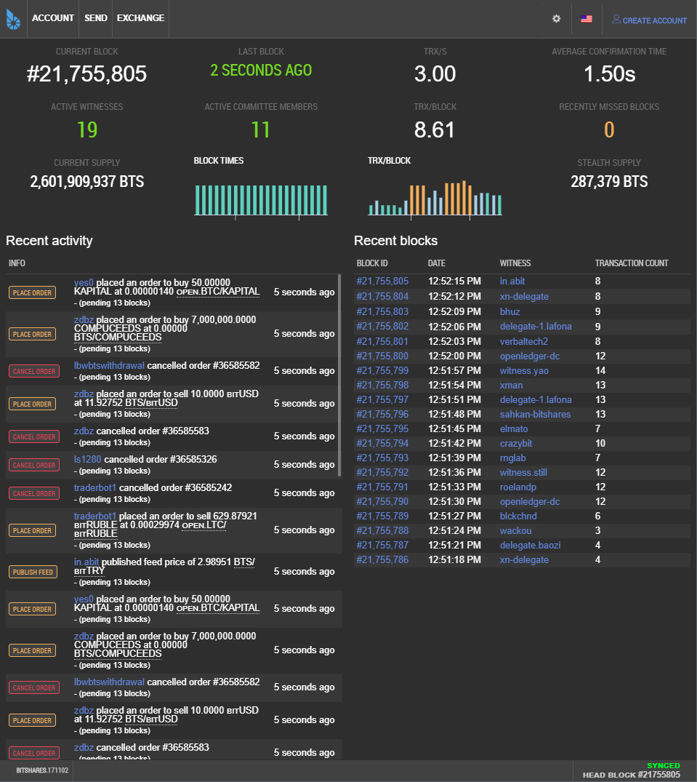
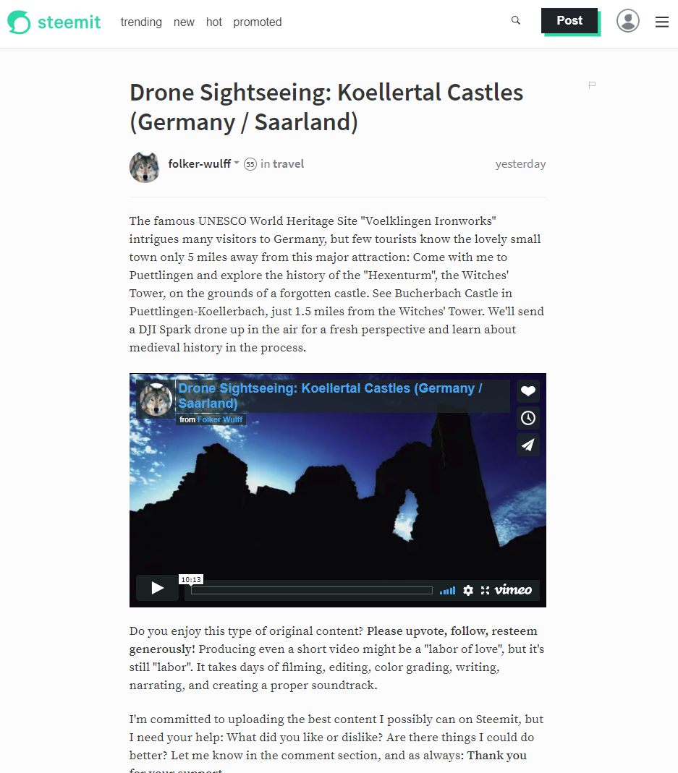
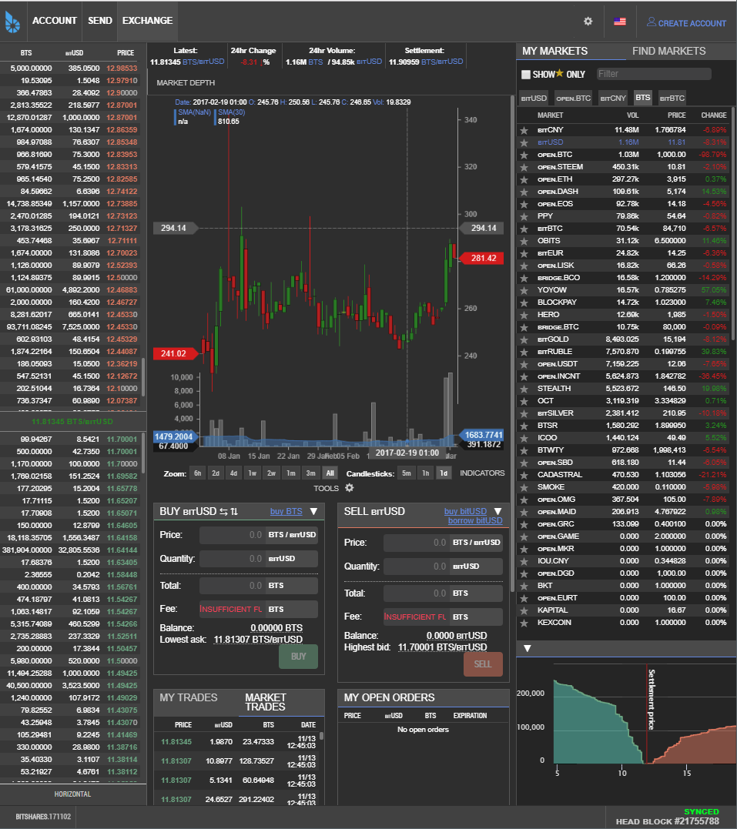
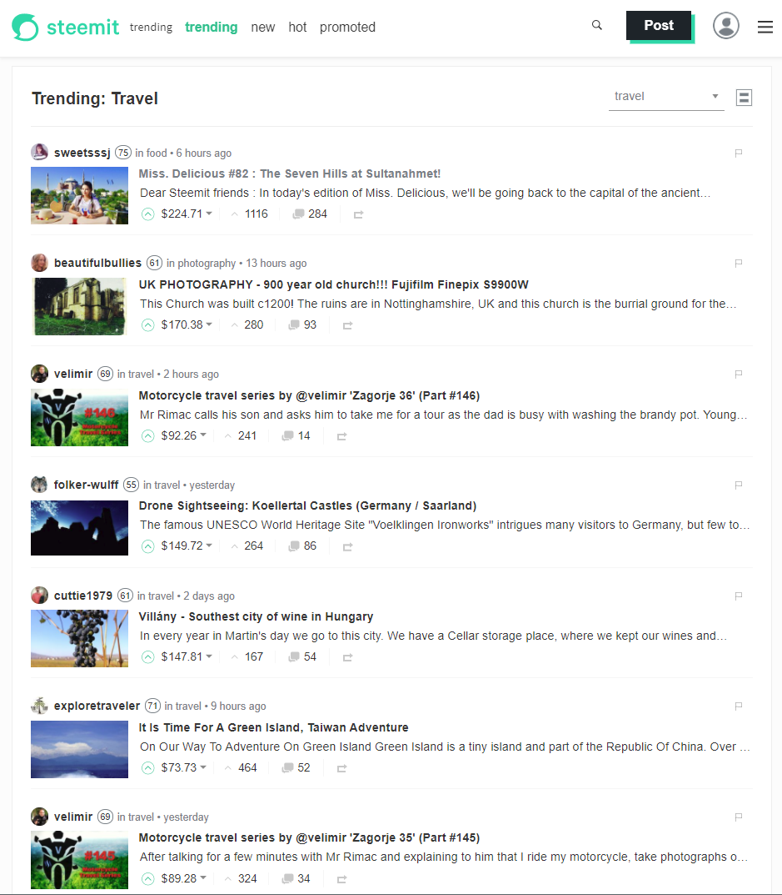
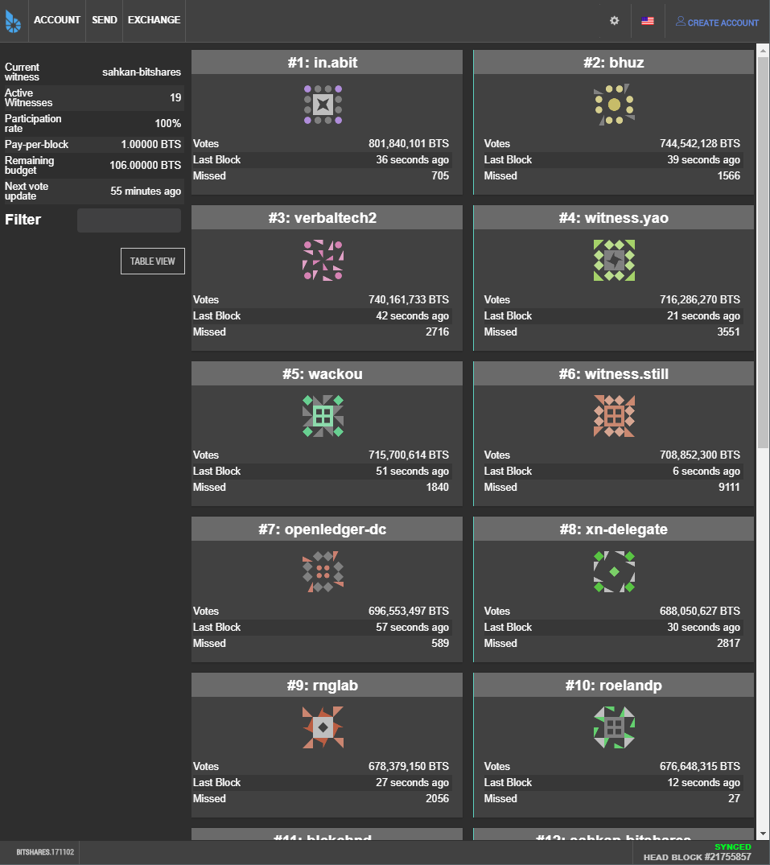
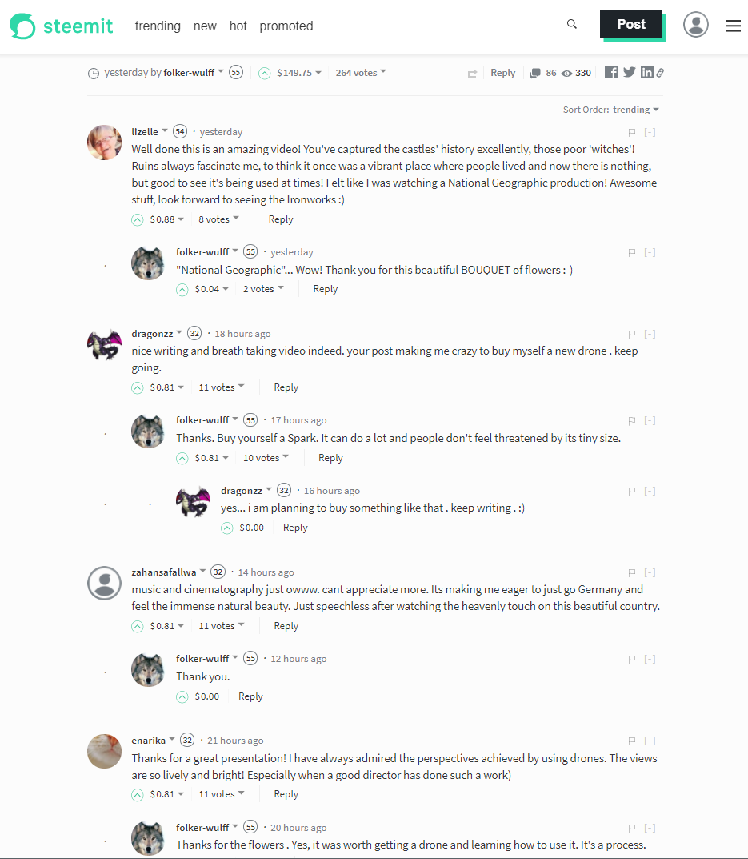

Slide 38
DPOS – Delegated proof of stake
Elected block producers (a.k.a. witnesses)
Powered by reputation: hard to earn, easy to lose
Confirms transactions with 99.9% certainty in an average of just 1.5 sec
Efficient decision making, yet ultimate power always rests with the shareholders

Slide 39
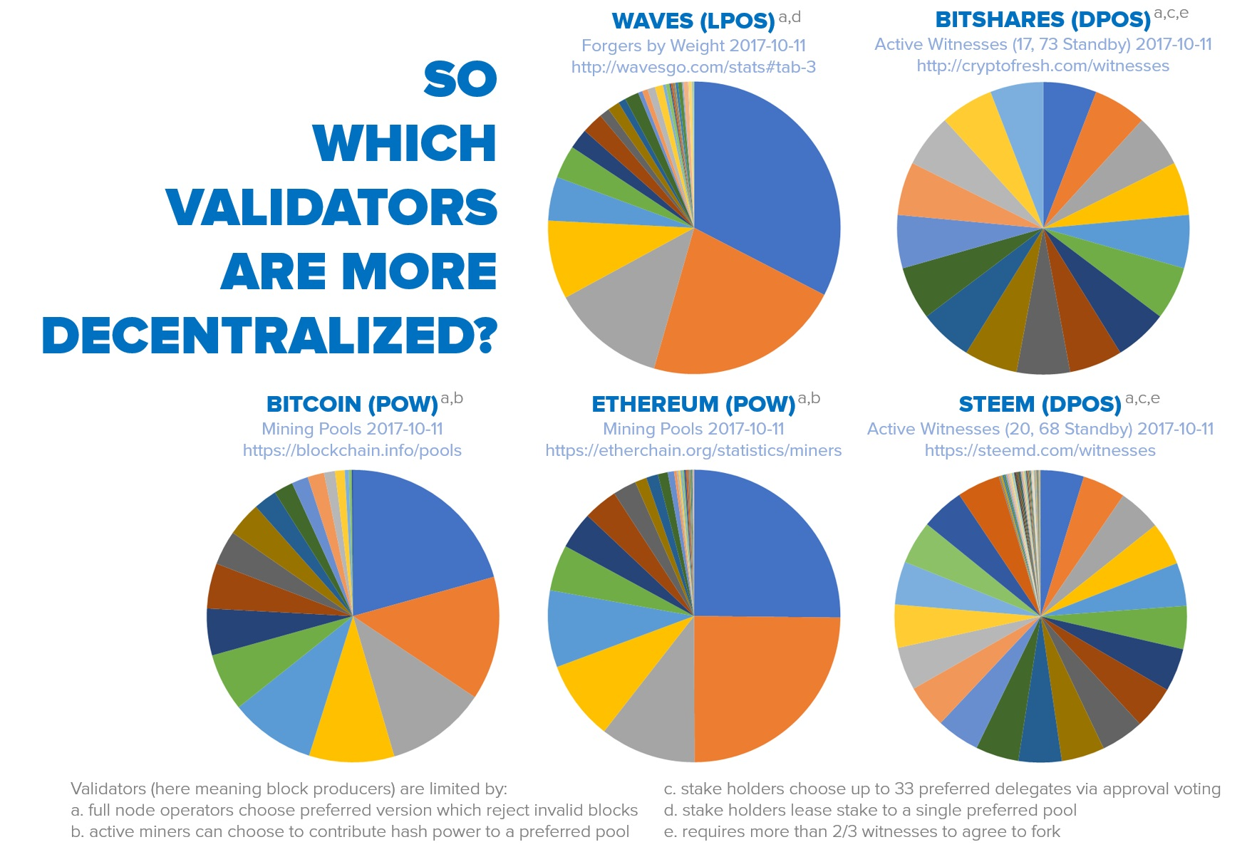
DPOS – HOW decentralized IS IT?

Slide 40
DPOS – HOW resilient IS IT?
Someone with even 50% of the active voting power is unable to select even a single producer on their own
When in trouble, the system degrades in a graceful, detectable manner that is trivial to recover from
Continues to function even when a majority of producers fail, or a large minority of producers go rouge

Slide 41
What are the strong points?
Concept proved in practice
Web Assembly as a virtual machine
Strong financial backing: Brock Pierce & Bo Shen (Fenbushi Capital)
Commitment to spend 1 bln USD to boost the ecosystem

Slide 42
EOS is the most well funded project in history and we plan to soon announce a program for up to one billion USD of capital for EOS projects.
Brendan Blumer, CEO of block.one

Slide 43
What are the weak points?
Low awareness and quite a lot of negative (undeserved?) perception
Almost non-existent ecosystem and very few developers
C++ has a very steep learning curve
Not live yet

Slide 44
EOS roadmap
Project started in Q1 2017
MVP stage called EOS Dawn 1.0
January 2018 all major functionalities deployed
Q1 & Q2 2018 devoted to testing and building development tools & docs
The EOS blockchain goes live in June 2018, most probably with the parallel processing feature already enabled
December 2017 public testnet

Slide 45
Major problems - revisited
Scalability
Enormous processing power: both sequential & parallel
Transaction fees
No transaction fees
Private key security
Account recovery & 2nd factor authentication built-in
Blockchain governance
Implemented via reputation-based consensus mechanism
Smart-contracts running amok
Block producers able to freeze & fix broken apps
High cost of app development
All common features built-in, entire back-end infrastructure supplied
Bad user experience
Back-end support for responsive front-end & web toolkit for UI
No bridges between blockchains
Asynchronous communication built-in

Slide 46
EOS Wrap-up
Most important: the way EOS is going to operate
Incremental improvement to stuff that's already been proven to work
Extremely business oriented
Can other systems copy EOS solutions?

Slide 47
About Tokenika
Focus on blockchain-based fundraising and digital asset management solutions, e.g. Neufund, Melonport, Iconomi
Software house dedicated to building dApps (both on EOS and ETH)
Aiming to be elected as one of the 20 block producers for EOS

Slide 48
What DO we need?
Not looking for funding, looking for ways to spend money
Looking for good ideas that can be converted into dApps
Hiring developers with background in C++ and/or ETH smart-contracts

Slide 49
Thank you
EOS - official website
www.eos.io
Any questions?
Presented by
www.tokenika.io contact@tokenika.io

Slide 50
QUICK SURVEY - ANSWERS
Which are the top four most used blockchains currently in production?

Slide 51
top four most used blockchains

Slide 52
#6 Asynchronous communication
UNIQUE FEATURES
Asynchronous communication from the start
Internal communication with local applications, as well as external communication with other blockchains
Private enterprise chains can communicate with a public chain

Slide 53
EOS VS. decentralized apps REQUIREMENTS
Scalable and cheap to run
Free for the users
Easily accessible
No fancy cryptographic stuff
Upgradeable
Bug recovery

Slide 54
#5 Smart-contracts running amok
MAJOR PROBLEMS

Slide 55
Our background

