Slide 1

EOS
The next step after ethereum?
Presented by

Slide 2
Disclaimer
We are in no formal way associated with block.one, the company developing EOS code. We are just part of the emerging EOS community.
We have no interest in you buying EOS tokens, and this certainly should not be treated as financial advice. Our goal is to encourage you to take interest in the concept and possibly consider building businesses on top of EOS.

Slide 3
content
Our background
Quick survey
What do decentralized applications require?
Major problems facing the crypto-space
Introduction to EOS
About Tokenika

Slide 4
Our background
Manufacturing industry, real-estate, education and public agencies
We are blockchain veterans
started with Bitcoin
Ethereum, BitShares, Steem and now EOS
We actively participate in the blockchain space
FinTech Week in London & Blockchain Summit in Shanghai
Ethereum, Iota, Factom, Gnosis & EOS

Slide 5
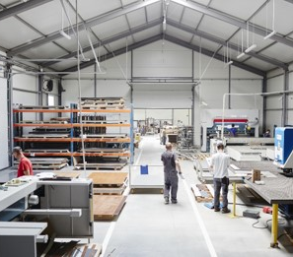
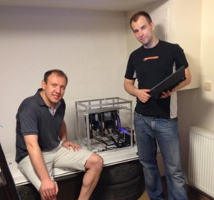
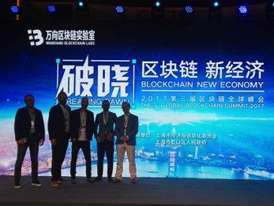
Our background

Slide 6
QUICK SURVEY - State of the blockchain 2017
How much are we spending on BTC mining per day? What about ETH?
What is BTC average transaction fee? What about ETH?
How many transactions per second does Facebook require? What about Visa/MasterCard?
How many transactions per second is BTC able to process? What about ETH?

Slide 7
QUICK SURVEY - ANSWERS
How much are we spending on BTC mining per day? What about ETH?
BTC: 12 mln USD/day (4 bln USD/year)
ETH: 6 mln USD/day (2 bln USD/year) Total raised by all ICOs so far: 3 bln USD
What is BTC average transaction fee? What about ETH?
BTC: 3 USD
ETH: 0.30 USD

Slide 8
QUICK SURVEY - ANSWERS
How many transactions per second does Facebook require? What about Visa/MasterCard?
Facebook: 50,000 trxn/sec Visa/MasterCard: 20,000 trxn/sec
How many transactions per second is BTC able to process? What about ETH?
BTC: 4 trxn/sec
ETH: 30 trxn/sec

Slide 9
WHAT’s POSSIBLE VS. WHAT’S NEEDED

Slide 10
What do decentralized apps require?
Scalable and cheap to run
Free for the users
Easily accessable
No fancy cryptographic stuff
Upgradeable
Bug recovery

Slide 11
Major problems facing the crypto-space
Scalability
Transaction fees
Private key security
Blockchain governance
Smart-contracts running amok
High cost of app development
Bad user experience
No bridges between blockchains

Slide 12
#1 Scalability
MAJOR PROBLEMS
What is high-performance?
Huge gap between what we can do and what we need to be able to do
Second layer of transaction processing:
Lightening Network for Bitcoin
Raiden for Ethereum
Ethereum’s Plasma - inherently less secure

Slide 13
#2 High & unpredictable transaction fees
MAJOR PROBLEMS
No economic viability at the current level of transaction fees
Even if they become low, they are still unpredictable
Sometimes you need no fees at all

Slide 14
#3 Private key security
MAJOR PROBLEMS
Increasing number of unsophisticated users
Not only money: also identity & reputation
Inherent feature?

Slide 15
#4 Blockchain governance
MAJOR PROBLEMS
Decentralized decision making:
business-as-usual situations
emergency situations
Different value systems = different expected outcomes

Slide 16
#5 Smart-contracts running amok
MAJOR PROBLEMS
Formal verification is hard
Ethereum : „Build unstoppable applications”

Slide 17
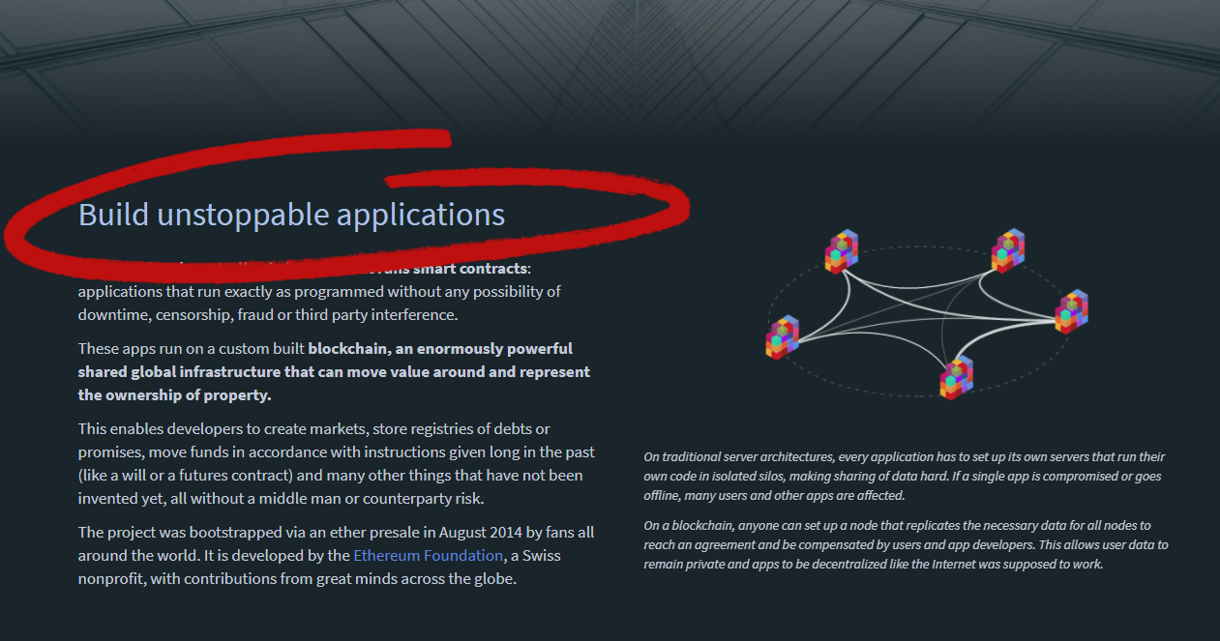
#5 Smart-contracts running amok
MAJOR PROBLEMS

Slide 18
#5 Smart-contracts running amok
MAJOR PROBLEMS
Formal verification is hard
Ethereum : „Build unstoppable applications”
Smart-contracts running amok not handled by Ethereum

Slide 19
#6 High cost of app development
MAJOR PROBLEMS
Nothing is coming to market
Devs stuck on low-level stuff
Complex things attempted in inefficient scripting environment
Generic solutions built with smart-contracts will be expensive to use

Slide 20
#7 Bad user experience
MAJOR PROBLEMS
Way below centralized apps
Responsive front-end requires proper back-end
Entire infrastructure around blockchain is needed

Slide 21
#8 No bridges between blockchains
MAJOR PROBLEMS
Impossible to move value across blockchains
Precondition: asynchronous communication
Potential solutions are several years away (e.g. Polkadot)

Slide 22
Major problems - recap
Scalability
Transaction fees
Private key security
Blockchain governance
Smart-contracts running amok
High cost of app development
Bad user experience
No bridges between blockchains

Slide 23
What is EOS?
EOS is a general-purpose smart-contract platform, just like Ethereum.

Slide 24
What is EOS?
EOS is a holistic approach to high-performance general-purpose consensus.

Slide 25
EOS is the blockchain for building commercial scale decentralized applications that are indistinguishable from centralized alternatives.
Daniel Larimer, CTO of block.one

Slide 26
BLOCKCHAIN Evolution
payment system (Bitcoin)
smart-contract system (Ethereum)
operating system for decentralized applications (EOS?)
EOS is an operating system for building decentralized applications.

Slide 27
top four most used blockchains

Slide 28
What features make EOS unique when compared to Ethereum?
Processing power
Much wider context
Blockchain governance built-in
Complete operating system
No transaction fees
Asynchronous communication
Publish source code, not assembly

Slide 29
#1 Processing power On The primary layer
UNIQUE FEATURES
Fixed number of block producers
Blocks produced exactly every 3 seconds (or even 500 ms)
Consensus over events (or messages) instead of consensus over state
Parallel processing
No concept of gas
End result: at least 50,000 txns/sec on day one.

Slide 30
#2 Much wider context
UNIQUE FEATURES
Errors in smart-contracts & conflicts are unavoidable
Built-in governance mechanisms:
constitution encoded in the blockchain (legally binding)
arbitration for resolving disputes (legally binding)
stakeholders voting on important decisions
Freeze & fix broken apps
Designed with the needs of serious businesses in mind

Slide 31
#3 Blockchain governance built-in
UNIQUE FEATURES
Elected block producers (a.k.a. witnesses)
Efficient decision making
Powered by reputation: hard to earn, easy to lose
Ultimate power always rests with the shareholders
Self-funded community benefit apps

Slide 32
#4 Complete operating system
UNIQUE FEATURES
Low-level features and services embedded in the blockchain: account permissions, account recovery, scheduling, authentication, inter-app communication, biometric 2nd factor validation
Private databases for every contract
Integrated storage solution based on IPFS, free to use
App devs only need to write code for what's unique for their application

Slide 33
#5 No transaction fees
UNIQUE FEATURES
EOS token is never consumed, no concept of gas
If you own 1% of the tokens, you own 1% of the network
You can own blockchain resources OR rent them

Slide 34
#6 Asynchronous communication
UNIQUE FEATURES
Asynchronous communication from the start
Internal communication with local applications, as well as external communication with other blockchains
Private enterprise chains can communicate with a public chain

Slide 35
#7 Publish source code, not assembly
UNIQUE FEATURES
Source code is sacred, as it captures intentions
Source code can be recompiled in the future
Opens EOS up for multiple virtual machines and upgradable smart-contracts

Slide 36
Unique features - RECAP
Processing power
Much wider context
Blockchain governance built-in
Complete operating system
No transaction fees
Asynchronous communication
Publish source code, not assembly

Slide 37
What are the strong points?
Small yet very efficient & experienced team
Concept proved in practice
Rare mix of the top talents, entrepreneurial skills, and strong financial backing
Web Assembly as a virtual machine
DPOS - the most decentralized & resilient consensus system out there
Commitment to spend 1 bln USD to boost the ecosystem

Slide 38
EOS is the most well funded project in history and we plan to soon announce a program for up to one billion USD of capital for EOS projects.
Brendan Blumer, CEO of block.one

Slide 39
DPOS – Delegated proof of stake
Objectively the most decentralized & resilient system in existence

Slide 40
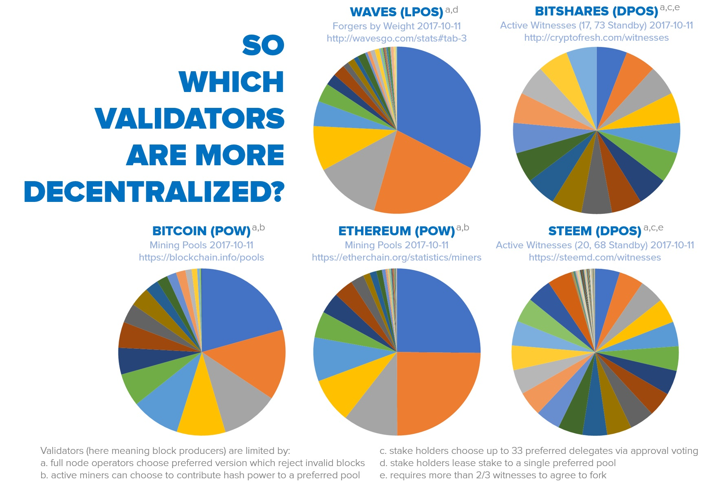
DPOS – Delegated proof of stake

Slide 41
DPOS – Delegated proof of stake
Objectively the most decentralized & resilient system in existence
Confirms transactions with 99.9% certainty in an average of just 1.5 sec
When in trouble, degrades in a graceful, detectable manner that is trivial to recover from
Continues to function even when a majority of producers fail, or a large minority of producers go rouge

Slide 42
What are the weak points?
Low awareness and quite a lot of negative (undeserved?) perception
Almost non-existent ecosystem and very few developers
C++ has a very steep learning curve
Not live yet

Slide 43
EOS roadmap
Project started in Q1 2017
MVP stage called EOS Dawn 1.0
January 2018 all major functionalities deployed
Q1 & Q2 2018 devoted to testing and building development tools & docs
The EOS blockchain goes live in June 2018, most probably with the parallel processing feature already enabled
December 2017 public testnet

Slide 44
EOS Wrap-up
Most important: the way EOS is going to operate
Scalable, flexible & usable
Extremely business oriented
Incremental improvement to stuff that's already been proven to work

Slide 45
EOS VS. decentralized apps REQUIREMENTS
Scalable and cheap to run
Free for the users
Easily accessable
No fancy cryptographic stuff
Upgradeable
Bug recovery

Slide 46
Major problems - revisited
Scalability
Processing power & separation of authentication from action
Transaction fees
No transaction fees
Private key security
Operating system (account recovery)
Blockchain governance
Reputation-based consensus mechanism
Smart-contracts running amok
Freeze & fix broken apps
High cost of app development
Operating system (low-level features built-in)
Bad user experience
Back-end support for responsive front-end & web toolkit for UI
No bridges between blockchains
Asynchronous communication

Slide 47
About Tokenika
Focus on blockchain-based fundraising and digital asset management solutions, e.g. Neufund, Melonport, Iconomi
Software house dedicated to building dApps (both on EOS and ETH)
Aiming to be elected as one of the 20 block producers for EOS

Slide 48
What we need?
Not looking for funding, looking for ways to spend money
Looking for good ideas that can be converted into dApps
Hiring developers with background in C++ and/or ETH smart-contracts

Slide 49
Thank you
Any questions?
Presented by
www.tokenika.io contact@tokenika.io

Slide 50
QUICK SURVEY - ANSWERS
Which are the top four most used blockchains currently in production?

