Slide 1

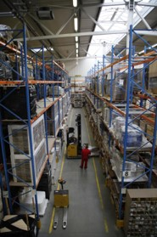
Our background in conventional business
Manufacturing industry, real-estate, FX trading, university education

Slide 2
Our background IN THE Blockchain SPACE
We are blockchain long-term investors: Bitcoin, Ethereum, Polkadot, MaidSafe, BitShares, Steem & EOS
We actively participate in blockchain events: FinTech Week in London & Blockchain Summit in Shanghai

Slide 3
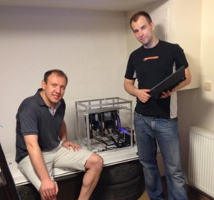
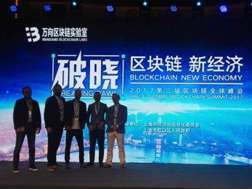
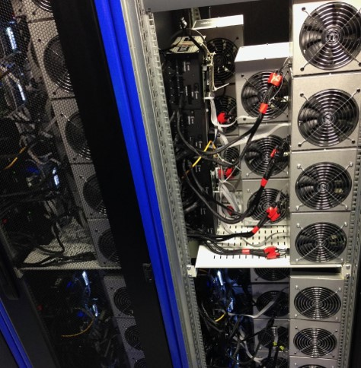
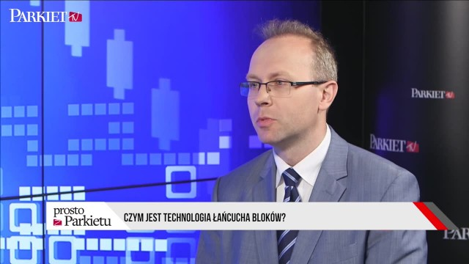
Our background IN THE BLOCKCHaIN SPACE

Slide 4
QUICK SURVEY - State of the blockchain 2017
What is the average transaction fee for a Bitcoin transfer? What about Ethereum?
How many transactions per second does Facebook require? What about payment systems like Visa/MasterCard?
How many transactions per second is Bitcoin able to process? What about Ethereum?

Slide 5
QUICK SURVEY - ResultS
What is the average transaction fee for a Bitcoin transfer? What about Ethereum?
BTC: 4 USD ETH: 0.30 USD

Slide 6
QUICK SURVEY - ResultS
How many transactions per second does Facebook require? What about payment systems like Visa/MasterCard?
Facebook: 50,000 trxn/sec Visa/MasterCard: 20,000 trxn/sec

Slide 7
QUICK SURVEY - ResultS
How many transactions per second is Bitcoin able to process? What about Ethereum?
BTC: 4 trxn/sec ETH: 30 trxn/sec

Slide 8

EOS
the next step in smart-contracts?
Presented by

Slide 9
Disclaimer
We are in no formal way associated with block.one, the company developing EOS code. We are just part of the emerging EOS community.
We have no interest in you buying EOS tokens, and this certainly should not be treated as financial advice. Our goal is to encourage you to take interest in the concept and possibly consider building businesses on top of EOS.
Notes:
We’ll be talking about a blockchain system called EOS.
This disclaimer basically says that we are NOT part of block.one, the company which has created EOS. We’re a separate entity.
However, this event has been coordinated with them, so hopefully we'll be talking sense.

Slide 10
content
Problems in the crypto-space
EOS concept & features
EOS background
EOS strong & weak points
EOS vs. problems
Blockchain evolution

Slide 11
Smart-contract vs. decentralized App
Smart-contract: a piece of interactive code hosted on a blockchain
Decentralized application:
An internet-based app which is constructed in such a way that it doesn't need any owner or administrator
Has its own blockchain or it’s made of a bunch of smart-contracts working together
Has a user interface and an economic model

Slide 12
Major problems facing the crypto-space
Notes:
OK, so before we talk about EOS, we’re going to briefly describe what we consider to be the main problems facing the crypto-space.

Slide 13
Major problems facing the crypto-space
Scalability
Notes:
If we want to host real-life businesses on the blockchain we need high performance. And what is high performance?

Slide 14
WHAT’S NEEDED Vs. WHAT’s Available
BTC: 4 trxn/sec
ETH: 15-30 trxn/sec
BTC: 4 bln USD/year (12 mln USD/day)
ETH: 2 bln USD/year (6 mln USD/day)
Notes:
>You need about 20k transactions per second just to do Visa & MasterCard, not to mention all the other payment systems out there.
>Facebook does 50k likes per second, not including all the posts and voting and other actions.
>And for currency trading, it's sometimes a hundred thousand transactions per second, just for one currency pair.
So, imagine putting all of these on a single platform, so they can inter-operate. Well, that would require millions of transactions per second. This is a massive scale.
>And what can the blockchain currently offer? Bitcoin does 4 transactions per second. Ethereum – something between 15 and 30.
>And those two systems are extremely expensive to run. Bitcoin and Ethereum shareholders are spending something like 6 billion USD a year just to be able to process less than 35 transactions per second.
In case of Bitcoin, this gives us the cost of 50 USD per one transaction. This is really mad.

Slide 15
Scaling solutions Available
Moving transactions off-chain: state channels
Lightening Network in Bitcoin
Raiden in Ethereum
Splitting the problem into smaller chunks:
Sub-domains within one blockchain (Ethereum’s sharding)
Hierachy of sub-chains (Ethereum’s Plasma)
Notes:
You might say it's just a matter of time before scaling solutions are introduced. But actually, there are only two ways to go:
>You can go off-chain, which is basically the idea behind state channels. Will it work? Who knows. But even if it does, it only solves the problem for basic payments, and does nothing for anything more complex than that.
>Or you can go into creating sub-domains within one blockchain or a hierarchy of sub-blockchains. This helps a bit, if you want to run a lot of small apps within the same ecosystem. But if you want to compete with big businesses like Facebook, Uber or eBay, or if you're into currency trading - this solves nothing. For those apps you need enormous processing power on a single blockchain and oftentimes on a single CPU thread.

Slide 16
Major problems facing the crypto-space
Scalability
Transaction fees
Notes:
Right now transaction fees are absurdly high.

Slide 17
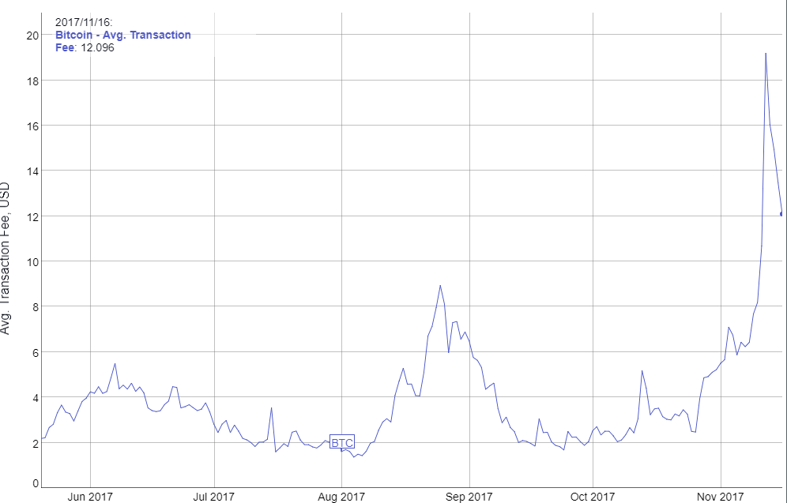
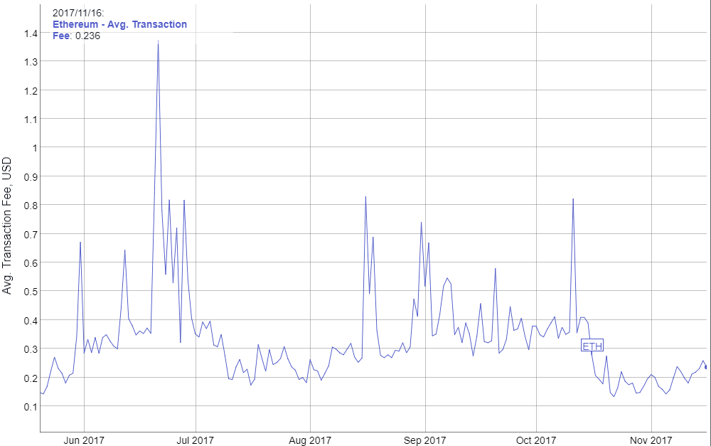
Average transaction fee
Bitcoin
Ethereum
6-month average: 4 USD/trxn
6-month average: 0.30 USD/trxn
Source: bitinfocharts.com
Notes:
On average you pay 4 USD for a Bitcoin transfer and 30 cents for moving funds on Ethereum, and this will only get worse once Ethereum hits its capacity limits.
No business can survive this.
Even if we introduce a second layer of transaction processing and the fees do get lower, they will still be unpredictable. If you’re on thin margins, any unexpected rise in transaction fees can kill your business overnight.

Slide 18
Major problems facing the crypto-space
Scalability
Transaction fees
Private key security
Notes:
People get hacked. And people lose their passwords. There will be more and more unsophisticated users entering the space and they cannot be expected to perfectly protect their private keys.
And if you're hacked on a blockchain app similar to eBay, you lose not only your money, but also you lose your identity and reputation.

Slide 19
Major problems facing the crypto-space
Scalability
Transaction fees
Private key security
Blockchain governance
Notes:
Blockchain governance is basically about what you do when you have a disaster similar to the infamous DAO incident, which happened last year. Or how you solve the block size issue in Bitcoin, where you have two camps of shareholders wanting to follow a different business strategy.
A blockchain, like any other enterprise, needs to make decisions, in order to survive in a changing environment. If this process fails, we end up with a fork, which usually hurts everyone involved.

Slide 20
Major problems facing the crypto-space
Scalability
Transaction fees
Private key security
Blockchain governance
Smart-contracts running amok
Notes:
One way to tackle this problem is trying to prevent it from happening in the first place. Which means one thing: formal verification of the code before it is deployed.
However, formal verification of a Turing complete programming language is really hard. And it just minimizes the risk, it does not eliminate it completely. Software development is an imperfect art, so no matter how much effort you put into checking the code, there will always be a black swan event waiting to happen.

Slide 21
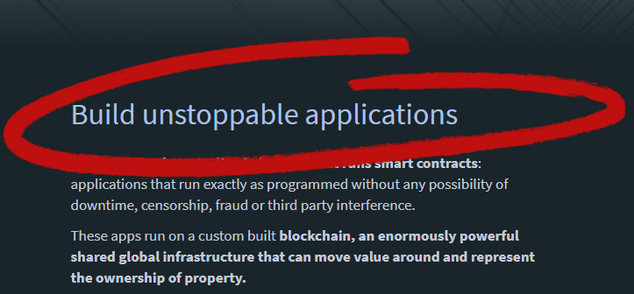
BUILD UNSTOPPAbLE APPS
Source: ethreum.org
Notes:
As we can see from this screen-shot, smart-contract platforms do NOT consider this issue to be part of their business model. So, when things go wrong, you, as a business, are on your own.

Slide 22
Major problems facing the crypto-space
Scalability
Transaction fees
Private key security
Blockchain governance
Smart-contracts running amok
High difficulty of app development
Notes:
Where are we today? We have the decentralized computer and a bunch of people trying to build applications on top of it. But actually nothing is coming to market. All we have are just prototypes. Why is that?
It’s mostly because developers don't get to spend their time on building business logic and user interfaces. Instead, they are stuck on figuring out the low-level stuff, things like data storage and inter-app communication.
And because everything is being implemented in the app layer, it's being done within relatively inefficient scripting environment. Which makes it really hard.
Furthermore, even if generic solutions eventually emerge this way, they will be expensive to use - it will cost gas each time your app needs to access them.

Slide 23
Major problems facing the crypto-space
Scalability
Transaction fees
Private key security
Blockchain governance
Smart-contracts running amok
High difficulty of app development
Inter-blockchain communication
Notes:
Right now blockchains are quite lonely creatures - they live in their own silos, separated from each other.
Even apps on similar blockchains cannot talk to each other: a smart-contract on Ethereum is unable to communicate with a smart-contract living on Ethereum Classic, even though technically they are identical platforms.

Slide 24
What do decentralized apps require?
Scalable and cheap to run
Free for the users
Easily accessible
No fancy cryptographic stuff
Upgradability & bug recovery
Rich dev ecosystem
Privacy protection
Notes:
OK, so we've painted this scary picture of blockchain space facing really big problems.
Now, what would be needed to overcome those problems? Let’s take a moment to consider what decentralized apps need, if they want to be successful:
>Your app needs to be scalable and cheap to run. That's pretty obvious. You need to be able to scale in order to have enough users to recover your initial costs.
>You need to have access to freemium models or different monetization strategies. If you want to charge your users that’s fine, but it should be the application choice, not the platform it's running on.
>Your app needs to be available via mobile phones & web interfaces, so that users don't have to download & install anything.
>Sometimes your users will need privacy: if you build a financial app, your users will expect confidentiality.
>Your users need account names, no public keys, no fancy cryptographic stuff. And they need a procedure for account recovery, in case they are hacked or just lose their password.
>And you, as a business owner, probably need a rich development environment: lots of programming tools, and access to experienced developers.
>Your app needs to be upgradeable. You need to be able to improve it to keep your business afloat. And finally, your app needs bug recovery, something that's often overlooked in this space.

Slide 25
What is EOS?
EOS is a general-purpose smart-contract platform, just like Ethereum.

Slide 26
EOS is the blockchain for building commercial scale decentralized applications that are indistinguishable from centralized alternatives.
Daniel Larimer, CTO of block.one

Slide 27
HOW DOES EOS WORK?
Applications
Operating System
Computer

Slide 28
What features make EOS unique?

Slide 29
#1 Processing power
EOS UNIQUE FEATURES
On day one: 50,000 trxns per second or more.

Slide 30
#1 Processing power
EOS UNIQUE FEATURES
Sequential processing technology borrowed from LMAX exchange
Parallel processing for horizontal scaling
No need to count CPU operations
Consensus over events instead of consensus over state

Slide 31
#2 Built-in governance
EOS UNIQUE FEATURES
Consensus mechanism: Delegated Proof of Stake
Block producers able to freeze & fix broken apps
Built-in governance mechanisms:
Constitution encoded in the blockchain (legally binding)
Arbitration for resolving disputes
Shareholders voting on important decisions
EOS as a decentralized app

Slide 32
#3 infrastructure for apps
EOS UNIQUE FEATURES
Common/low-level features & services embedded in the blockchain: account permissions, account recovery, scheduling, authentication, inter-app communication, biometric 2nd factor validation
Private databases on smart-contract level
Integrated storage solution based on IPFS, free to use

Slide 33
#4 No transaction fees
EOS UNIQUE FEATURES
EOS token is never consumed, no concept of gas
If you own 1% of the tokens, you own 1% of the network
You can own blockchain resources or rent them on pay-as-you-go basis
Monetization strategy is the application choice, not the platform it's running on

Slide 34
#5 Publish source code, not assembly
EOS UNIQUE FEATURES
Source code is sacred, as it captures human intentions
Source code can be recompiled in the future
Opens EOS up for multiple virtual machines
Upgradable smart-contracts become possible

Slide 35
#6 Asynchronous communication
EOS UNIQUE FEATURES
Everything is based on messages
Cross-blockchain communication becomes possible

Slide 36
What features make EOS unique?
Processing power
Built-in governance
Infrastructure for apps
No transaction fees
Publish source code, not assembly
Asynchronous communication

Slide 37
EOS BackGround
Top-down
Bottom-up
Attempt to generalize something that you have not figured out how to build yet.
Figure out how to build something first and then start generalizing it.

Slide 38
top four most used blockchains
BitShares usage: 4.0 trxns/sec capacity utilized: <1%
Steem usage: 7.8 trxns/sec capacity utilized: <1%

Slide 39
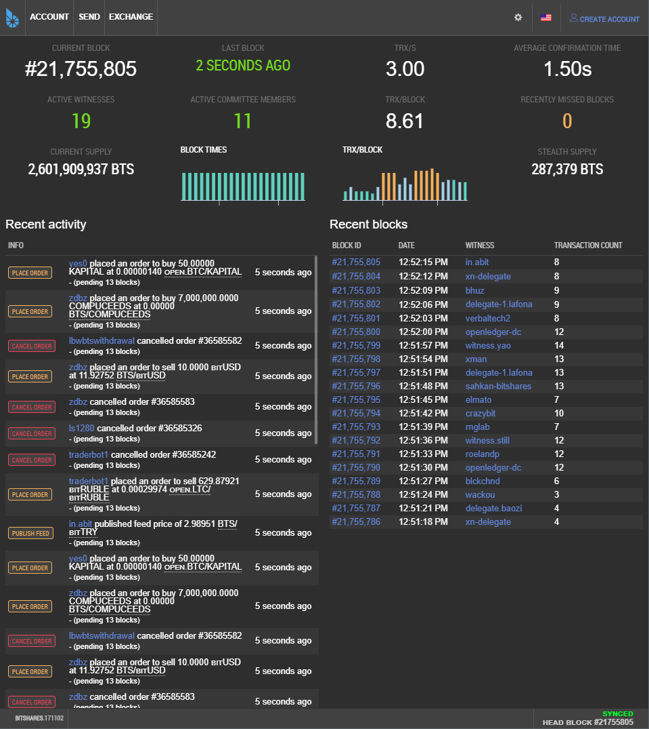
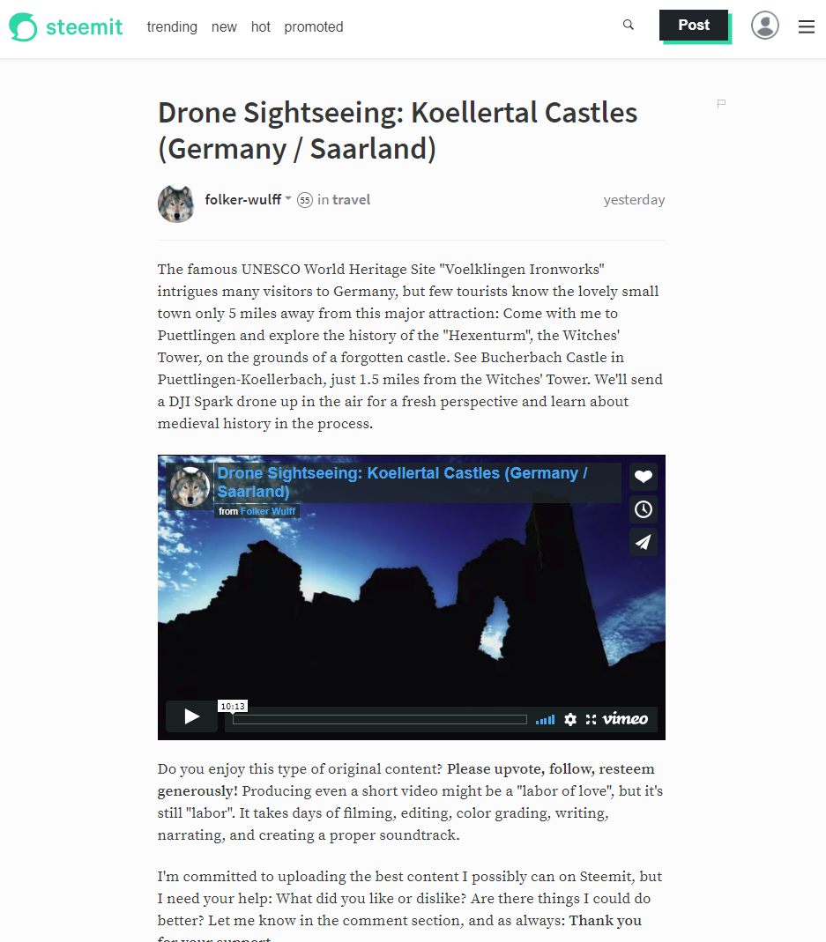
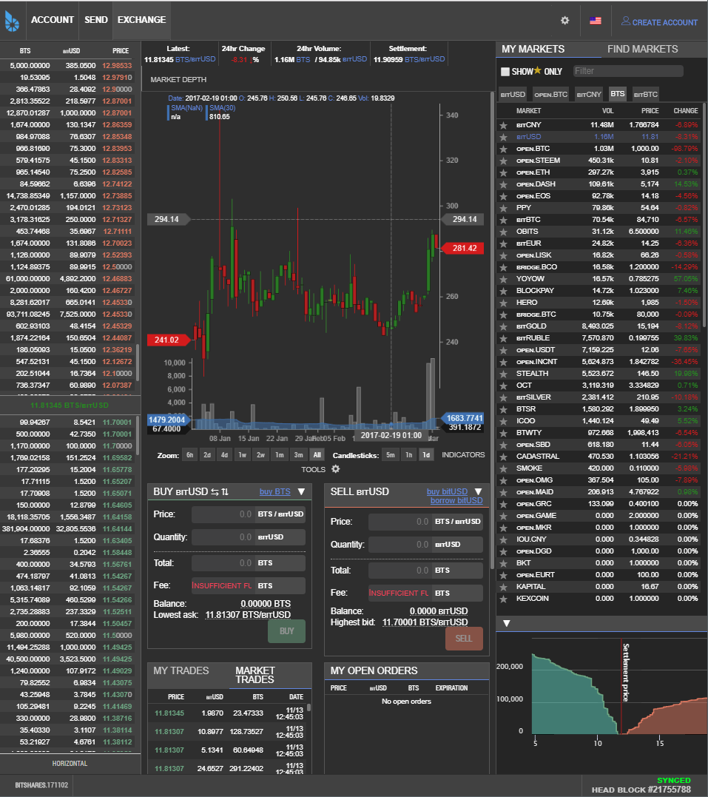
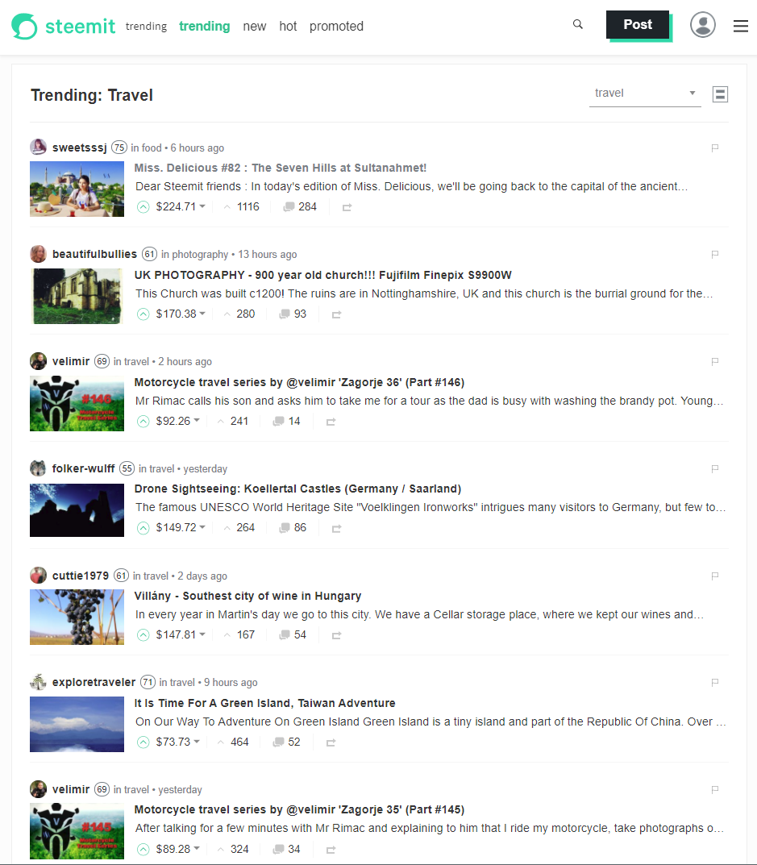
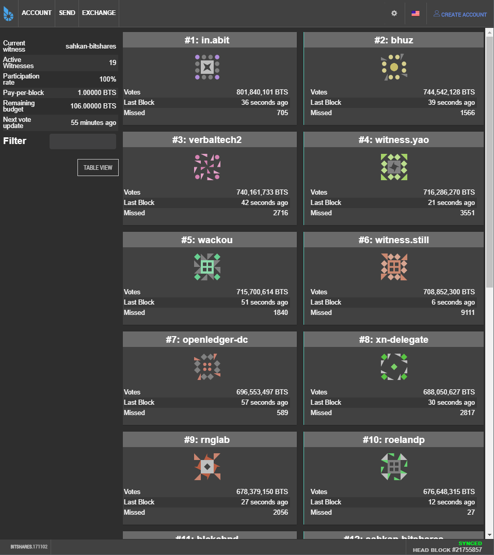
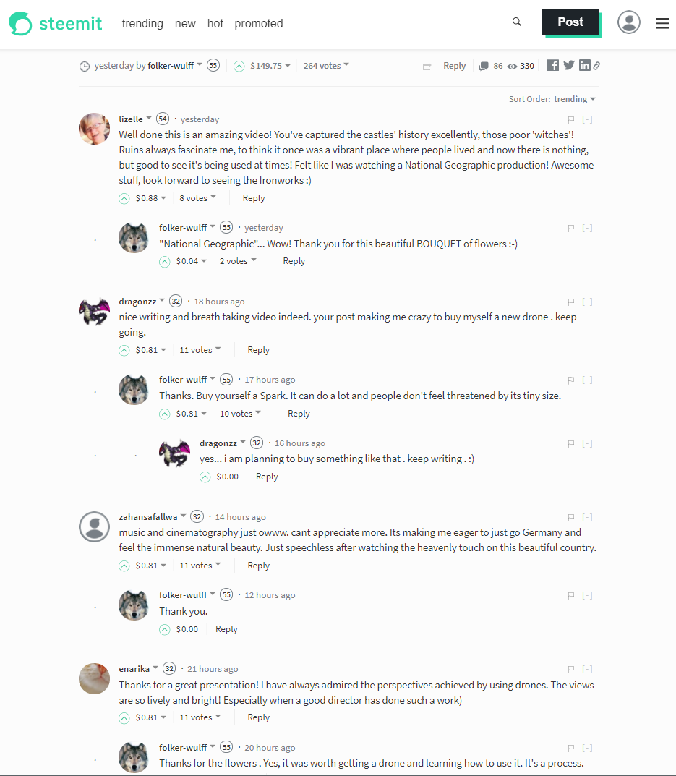
Source: bitshares.org & steemit.com

Slide 40
What are the strong points?
Very efficient team implementing a concept proved in practice
Web Assembly as a virtual machine
Strong financial backing: Brock Pierce & Bo Shen (Fenbushi Capital)
Commitment to spend 1 bln USD to boost the ecosystem

Slide 41
EOS is the most well-funded project in history and we plan to soon announce a program for up to one billion USD of capital for EOS projects.
Brendan Blumer, CEO of block.one

Slide 42
What are the weak points?
Negative (but undeserved) perception about DPOS

Slide 43
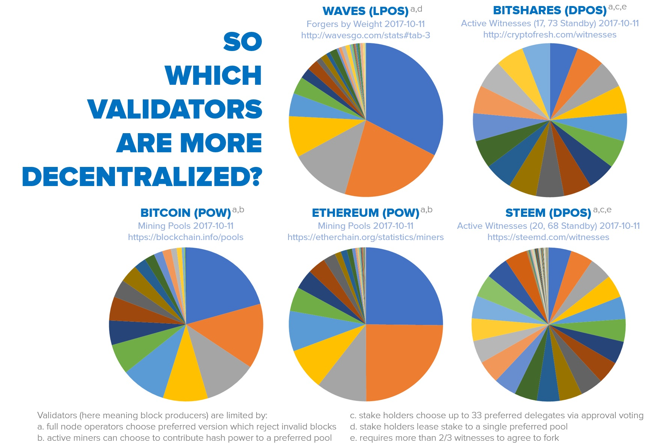
DPOS – HOW decentralized IS IT?
Source: senzheng on reddit.com

Slide 44
What are the weak points?
Negative (but undeserved) perception about DPOS
Almost non-existent ecosystem and very few developers
Track-record of poor documentation
C++ has a very steep learning curve
Not live yet

Slide 45
EOS roadmap
Project started in Q1 2017
MVP stage called EOS Dawn 1.0
January 2018 all major functionalities deployed
Q1 & Q2 2018 devoted to testing and building development tools & docs
The EOS blockchain goes live in June 2018, most probably with the parallel processing feature already enabled
December 2017 public testnet

Slide 46


EOS VS. decentralized apps requirements
 | Ethereum | EOS
Scalable and cheap to run
Free for the users
Easily accessible | ?
Privacy protection | ? | ?
No fancy cryptographic stuff
Rich dev ecosystem |  | ?
Upgradability & bug recovery

Slide 47
EOS VS. Major problems IN THE Crypto-space
Scalability
Enormous processing power: both sequential & parallel
Transaction fees
No transaction fees
Private key security
Account recovery & 2nd factor authentication built-in
Blockchain governance
Implemented via reputation-based consensus mechanism
Smart-contracts running amok
Block producers able to freeze & fix broken apps
High cost of app development
All common features built-in, entire back-end infrastructure supplied
Inter-blockchain communication
Asynchronous messaging built-in

Slide 48
summary
Most important: the way EOS is going to operate
Incremental improvement to stuff that's already been proven to work
Extremely business oriented
Can other systems copy EOS solutions?

Slide 49
BLOCKCHAIN Evolution
Payment system (Bitcoin)
Smart-contract system (Ethereum)
Operating system for decentralized applications (EOS)

Slide 50
About Tokenika
Focus on blockchain-based fundraising and digital asset management solutions, e.g. Neufund, Melonport, Iconomi
Software house for building dApps (both on EOS and Ethereum)
Aiming to be elected as one of the 20 block producers for EOS

Slide 51
What DO we need?
Not looking for funding, looking for ways to spend money
Looking for good ideas that can be converted into dApps
Hiring developers with background in C++ and/or Ethereum smart-contracts

Slide 52
Thank you
EOS - official website
www.eos.io
Any questions?
Presented by
www.tokenika.io contact@tokenika.io

