Slide 1


Our background in conventional business
Manufacturing industry, real-estate, FX trading, university education

Slide 2
Our background IN THE Blockchain SPACE
We are blockchain long-term investors: Bitcoin, Ethereum, Polkadot, MaidSafe, BitShares, Steem & EOS
We actively participate in blockchain events: FinTech Week in London & Blockchain Summit in Shanghai

Slide 3
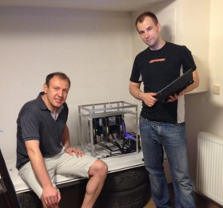
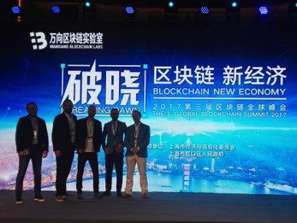
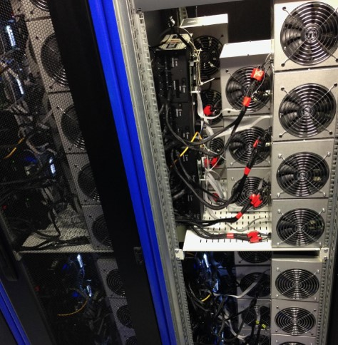
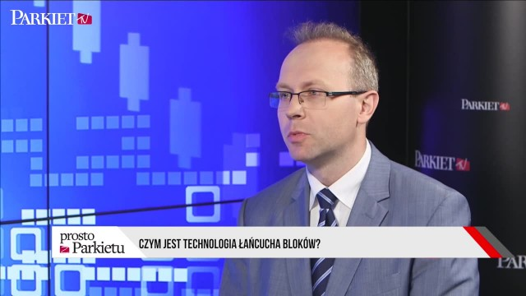
Our background IN THE BLOCKCHaIN SPACE

Slide 4
QUICK SURVEY - State of the blockchain 2017
What is the average transaction fee for a Bitcoin transfer? What about Ethereum?
How many transactions per second does Facebook require? What about payment systems like Visa/MasterCard?
How many transactions per second is Bitcoin able to process? What about Ethereum?

Slide 5
QUICK SURVEY - ResultS
What is the average transaction fee for a Bitcoin transfer? What about Ethereum?
BTC: 4 USD ETH: 0.30 USD

Slide 6
QUICK SURVEY - ResultS
How many transactions per second does Facebook require? What about payment systems like Visa/MasterCard?
Facebook: 50,000 trxn/sec Visa/MasterCard: 20,000 trxn/sec

Slide 7
QUICK SURVEY - ResultS
How many transactions per second is Bitcoin able to process? What about Ethereum?
BTC: 4 trxn/sec ETH: 30 trxn/sec

Slide 8

EOS
the next step in smart-contracts?
Presented by

Slide 9
Disclaimer
We are in no formal way associated with block.one, the company developing EOS code. We are just part of the emerging EOS community.
We have no interest in you buying EOS tokens, and this certainly should not be treated as financial advice. Our goal is to encourage you to take interest in the concept and possibly consider building businesses on top of EOS.

Slide 10
content
Problems in the crypto-space
EOS concept & features
EOS background
EOS strong & weak points
EOS vs. problems
Blockchain evolution

Slide 11
Smart-contract vs. decentralized App
Smart-contract: a piece of interactive code hosted on a blockchain
Decentralized application:
An internet-based app which is constructed in such a way that it doesn't need any owner or administrator
Has its own blockchain or it’s made of a bunch of smart-contracts working together
Has a user interface and an economic model

Slide 12
Major problems facing the crypto-space

Slide 13
Major problems facing the crypto-space
Scalability

Slide 14
WHAT’S NEEDED Vs. WHAT’s Available
BTC: 4 trxn/sec
ETH: 15-30 trxn/sec
BTC: 4 bln USD/year (12 mln USD/day)
ETH: 2 bln USD/year (6 mln USD/day)

Slide 15
Scaling solutions Available
Moving transactions off-chain: state channels
Lightening Network in Bitcoin
Raiden in Ethereum
Dividing the problem into sub-chains:
Ethereum’s sharding
Ethereum’s Plasma

Slide 16
Major problems facing the crypto-space
Scalability
Transaction fees

Slide 17
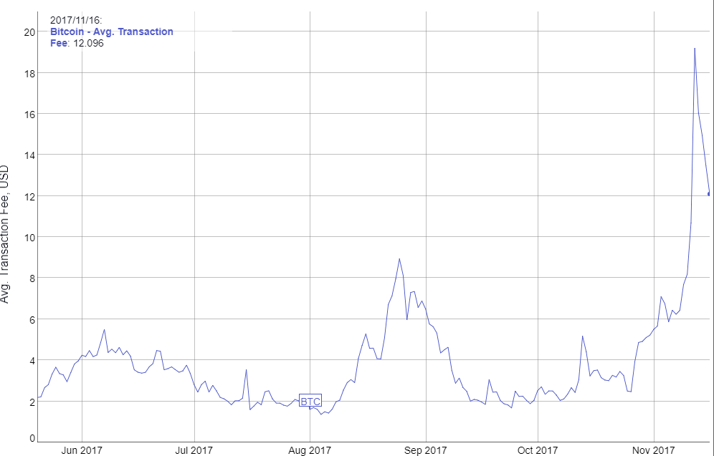
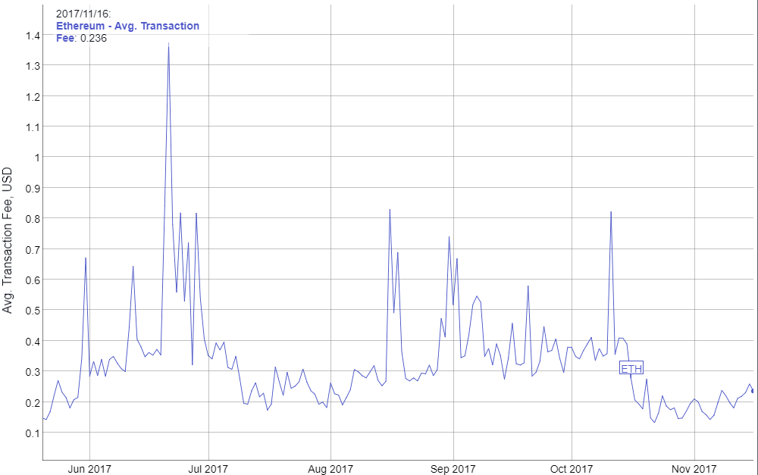
Average transaction fee
Bitcoin
Ethereum
6-month average: 4 USD/trxn
6-month average: 0.30 USD/trxn
Source: bitinfocharts.com

Slide 18
Major problems facing the crypto-space
Scalability
Transaction fees
Private key security

Slide 19
Major problems facing the crypto-space
Scalability
Transaction fees
Private key security
Blockchain governance

Slide 20
Major problems facing the crypto-space
Scalability
Transaction fees
Private key security
Blockchain governance
Smart-contracts running amok

Slide 21
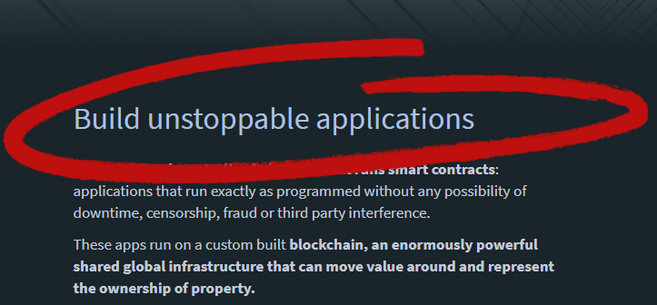
BUILD UNSTOPPAbLE APPS
Source: ethreum.org

Slide 22
Major problems facing the crypto-space
Scalability
Transaction fees
Private key security
Blockchain governance
Smart-contracts running amok
High difficulty of app development

Slide 23
Major problems facing the crypto-space
Scalability
Transaction fees
Private key security
Blockchain governance
Smart-contracts running amok
High difficulty of app development
Inter-blockchain communication

Slide 24
What do decentralized apps require?
Scalable and cheap to run
Free for the users
Easily accessible
No fancy cryptographic stuff
Upgradability & bug recovery
Rich dev ecosystem
Privacy protection

Slide 25
What is EOS?
EOS is a general-purpose smart-contract platform, just like Ethereum.

Slide 26
EOS is the blockchain for building commercial scale decentralized applications that are indistinguishable from centralized alternatives.
Daniel Larimer, CTO of block.one

Slide 27
HOW DOES EOS WORK?
Applications
Operating System
Computer

Slide 28
What features make EOS unique?
Processing power
Built-in governance
Infrastructure for apps
No transaction fees
Publish source code, not assembly
Asynchronous communication

Slide 29
#1 Processing power
UNIQUE FEATURES
On day one: 50,000 trxns per second or more.

Slide 30
#1 Processing power
UNIQUE FEATURES
Sequential processing technology borrowed from LMAX exchange
Parallel processing for horizontal scaling
No concept of gas
Consensus over events instead of consensus over state

Slide 31
#2 Built-in governance
UNIQUE FEATURES
Consensus mechanism: Delegated Proof of Stake
Block producers able to freeze & fix broken apps
Built-in governance mechanisms:
Constitution encoded in the blockchain (legally binding)
Arbitration for resolving disputes
Shareholders voting on important decisions
EOS as a decentralized app

Slide 32
#3 infrastructure for apps
UNIQUE FEATURES
Common/low-level features & services embedded in the blockchain: account permissions, account recovery, scheduling, authentication, inter-app communication, biometric 2nd factor validation
Private databases on smart-contract level
Integrated storage solution based on IPFS, free to use

Slide 33
#4 No transaction fees
UNIQUE FEATURES
EOS token is never consumed, no concept of gas
Spam protection achieved via rate limiting
If you own 1% of the tokens, you own 1% of the network
You can own blockchain resources or rent them on pay-as-you-go basis
Monetization strategy is the application choice, not the platform it's running on

Slide 34
#5 Publish source code, not assembly
UNIQUE FEATURES
Source code is sacred, as it captures human intentions
Source code can be recompiled in the future
Opens EOS up for multiple virtual machines
Upgradable smart-contracts become possible

Slide 35
#6 Asynchronous communication
UNIQUE FEATURES
Everything is based on messages
Cross-blockchain communication becomes possible

Slide 36
What features make EOS unique?
Processing power
Built-in governance
Infrastructure for apps
No transaction fees
Publish source code, not assembly
Asynchronous communication

Slide 37
EOS BackGround
Top-down
Bottom-up
Attempt to generalize something that you have not figured out how to build yet.
Figure out how to build something first and then start generalizing it.

Slide 38
top four most used blockchains
BitShares usage: 4.0 trxns/sec capacity utilized: <1%
Steem usage: 7.8 trxns/sec capacity utilized: <1%

Slide 39
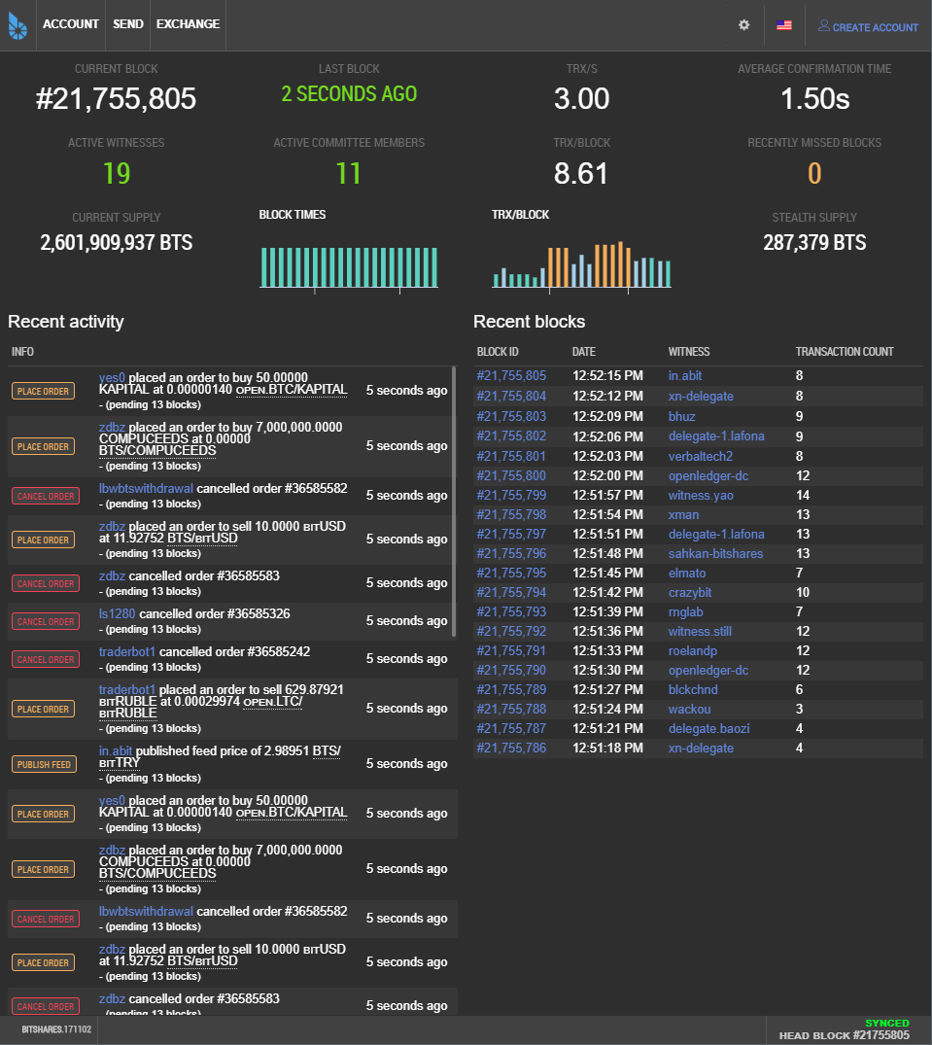
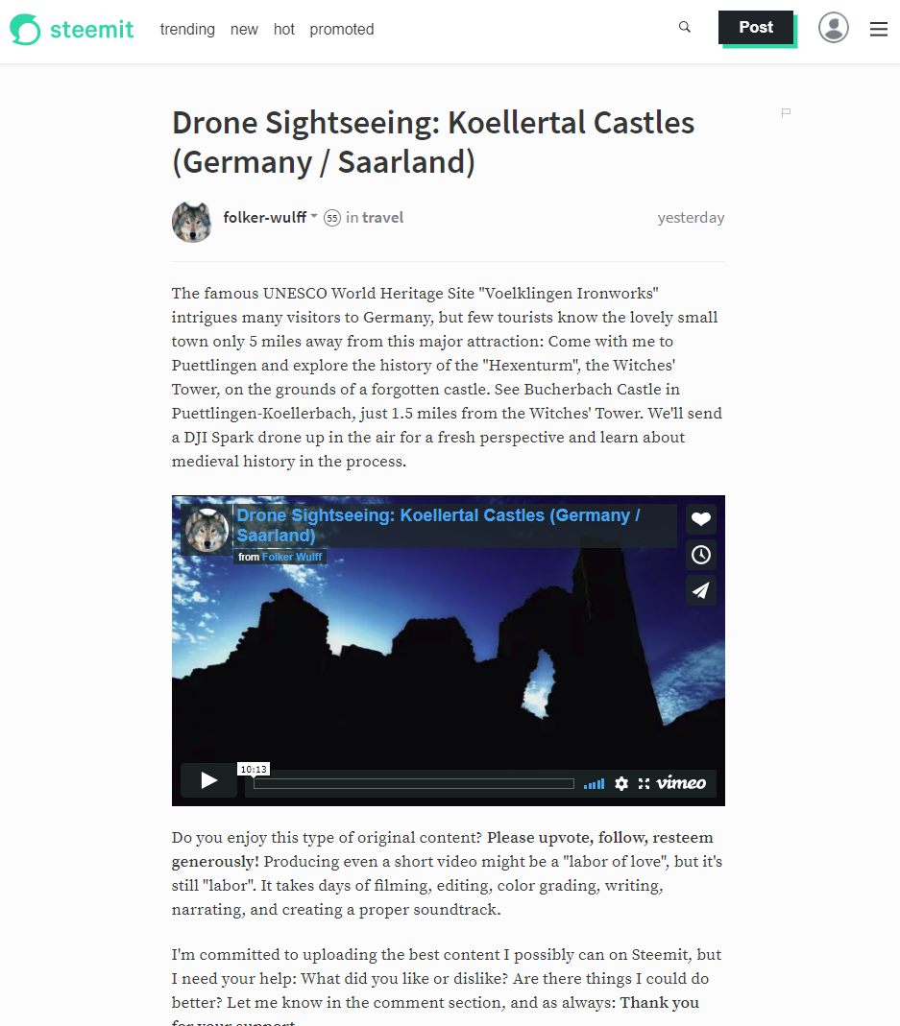
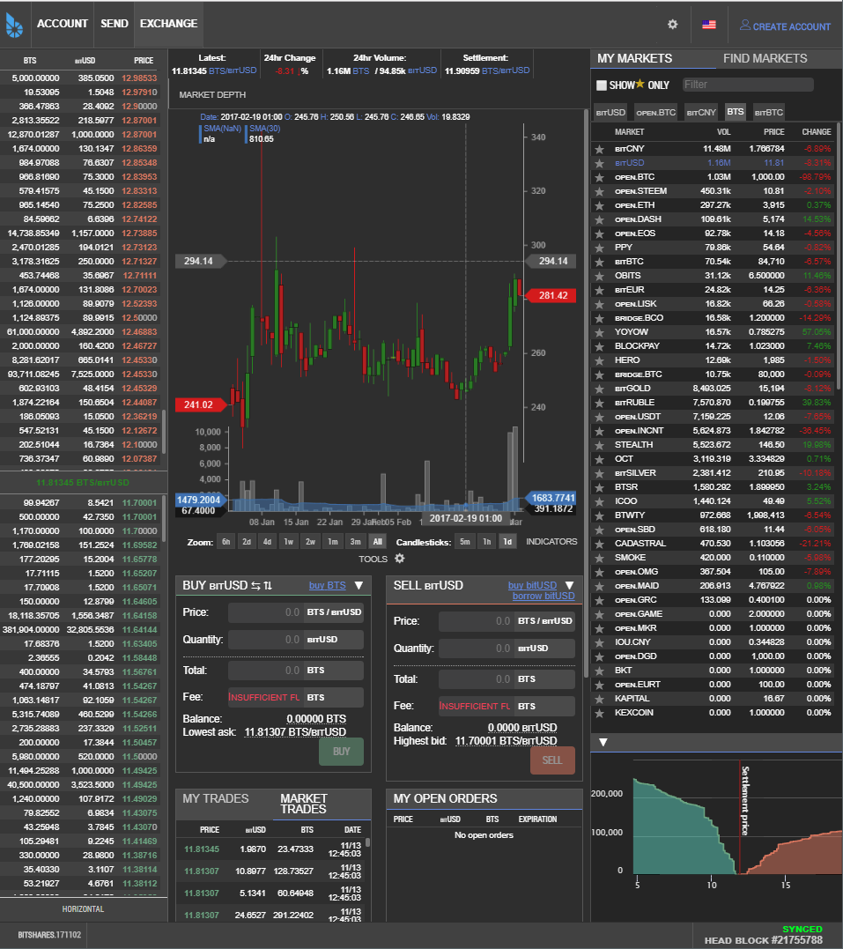
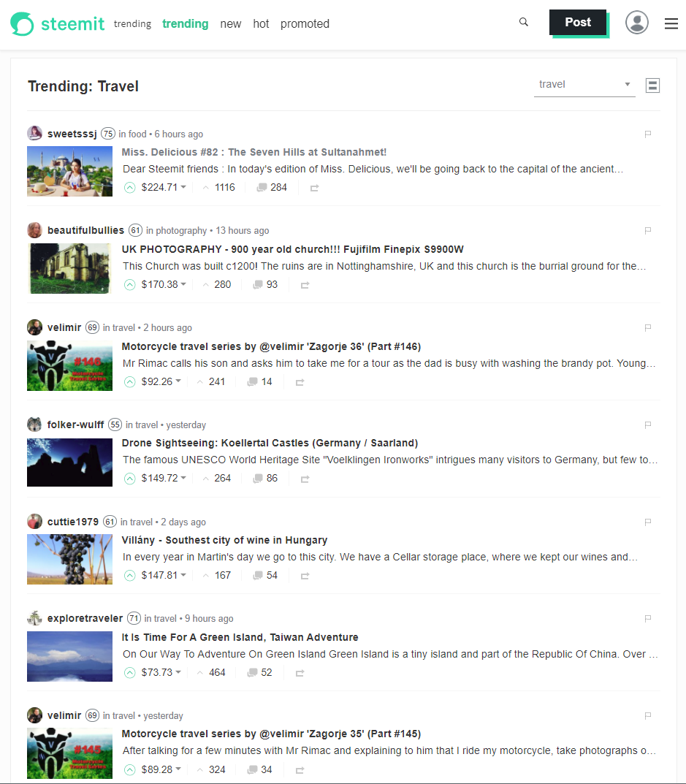
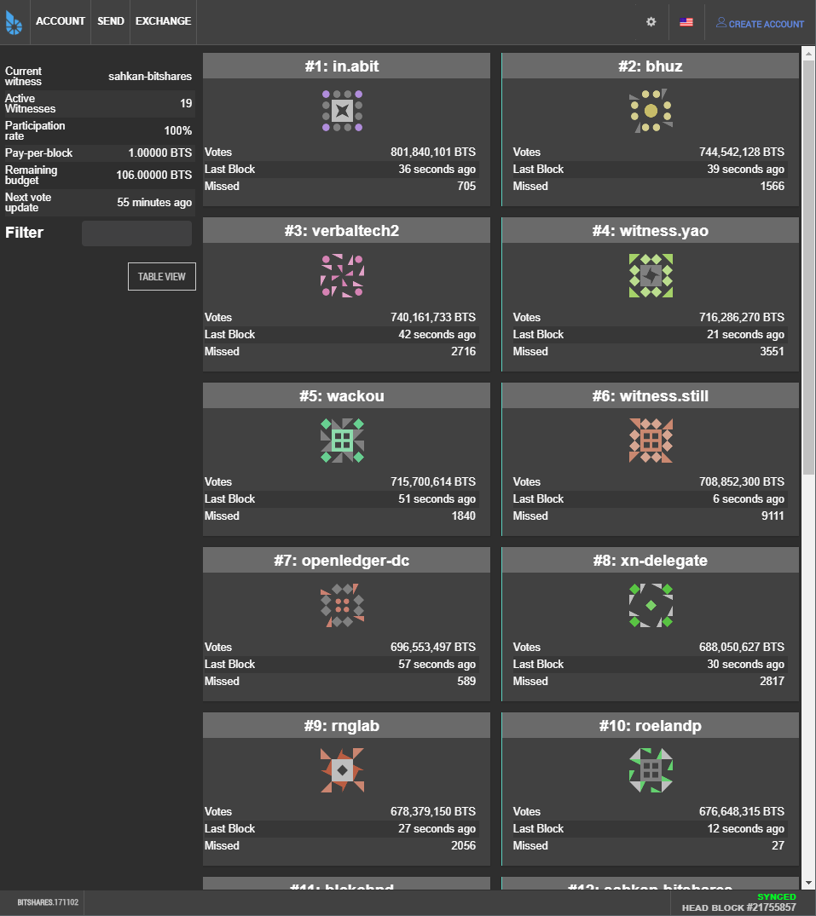
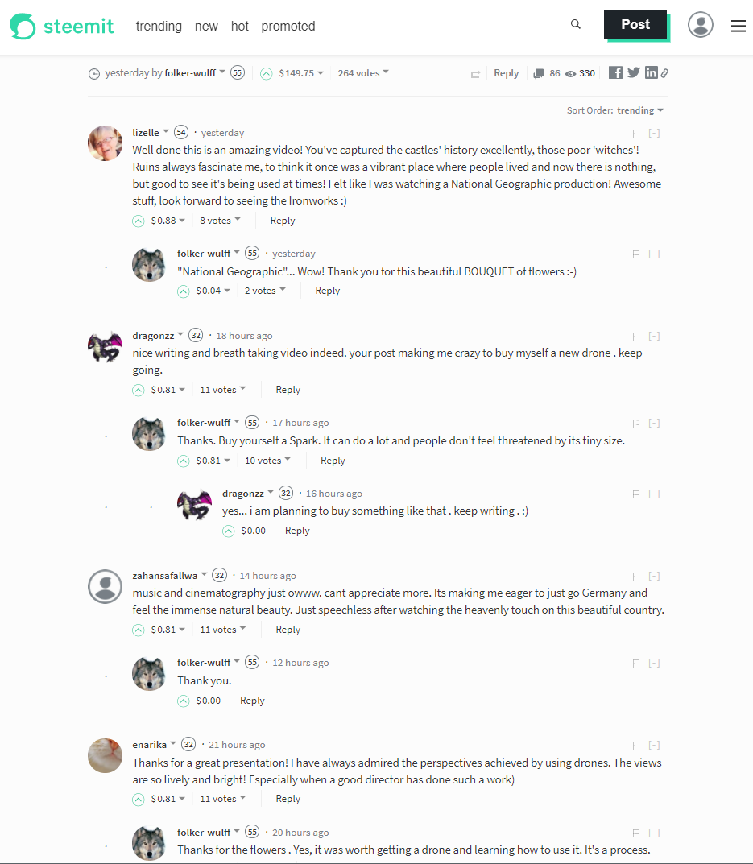
Source: bitshares.org & steemit.com

Slide 40
What are the strong points?
Very efficient team implementing a concept proved in practice
Web Assembly as a virtual machine
Strong financial backing: Brock Pierce & Bo Shen (Fenbushi Capital)
Commitment to spend 1 bln USD to boost the ecosystem

Slide 41
EOS is the most well-funded project in history and we plan to soon announce a program for up to one billion USD of capital for EOS projects.
Brendan Blumer, CEO of block.one

Slide 42
What are the weak points?
Negative (but undeserved) perception about DPOS

Slide 43
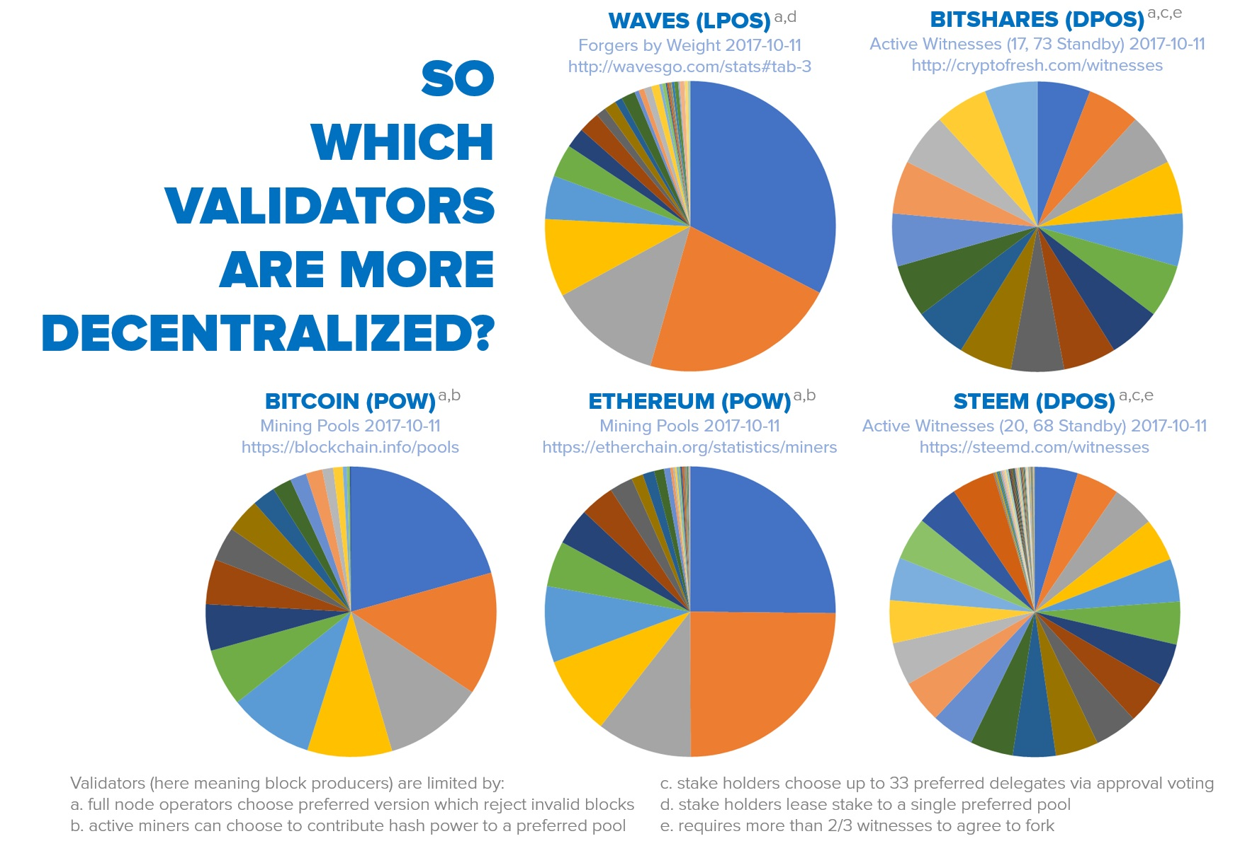
DPOS – HOW decentralized IS IT?
Source: senzheng on reddit.com

Slide 44
What are the weak points?
Negative (but undeserved) perception about DPOS
Almost non-existent ecosystem and very few developers
Track-record of poor documentation
C++ has a very steep learning curve
Not live yet

Slide 45
EOS roadmap
Project started in Q1 2017
MVP stage called EOS Dawn 1.0
January 2018 all major functionalities deployed
Q1 & Q2 2018 devoted to testing and building development tools & docs
The EOS blockchain goes live in June 2018, most probably with the parallel processing feature already enabled
December 2017 public testnet

Slide 46


EOS VS. decentralized apps requirements
 | Ethereum | EOS
Scalable and cheap to run
Free for the users
Easily accessible | ?
Privacy protection | ? | ?
No fancy cryptographic stuff
Rich dev ecosystem |  | ?
Upgradability & bug recovery

Slide 47
EOS VS. Major problems IN THE Crypto-space
Scalability
Enormous processing power: both sequential & parallel
Transaction fees
No transaction fees
Private key security
Account recovery & 2nd factor authentication built-in
Blockchain governance
Implemented via reputation-based consensus mechanism
Smart-contracts running amok
Block producers able to freeze & fix broken apps
High cost of app development
All common features built-in, entire back-end infrastructure supplied
Inter-blockchain communication
Asynchronous messaging built-in

Slide 48
summary
Most important: the way EOS is going to operate
Incremental improvement to stuff that's already been proven to work
Extremely business oriented
Can other systems copy EOS solutions?

Slide 49
BLOCKCHAIN Evolution
Payment system (Bitcoin)
Smart-contract system (Ethereum)
Operating system for decentralized applications (EOS)

Slide 50
About Tokenika
Focus on blockchain-based fundraising and digital asset management solutions, e.g. Neufund, Melonport, Iconomi
Software house for building dApps (both on EOS and Ethereum)
Aiming to be elected as one of the 20 block producers for EOS

Slide 51
What DO we need?
Not looking for funding, looking for ways to spend money
Looking for good ideas that can be converted into dApps
Hiring developers with background in C++ and/or Ethereum smart-contracts

Slide 52
Thank you
EOS - official website
www.eos.io
Any questions?
Presented by
www.tokenika.io contact@tokenika.io

