Slide 1
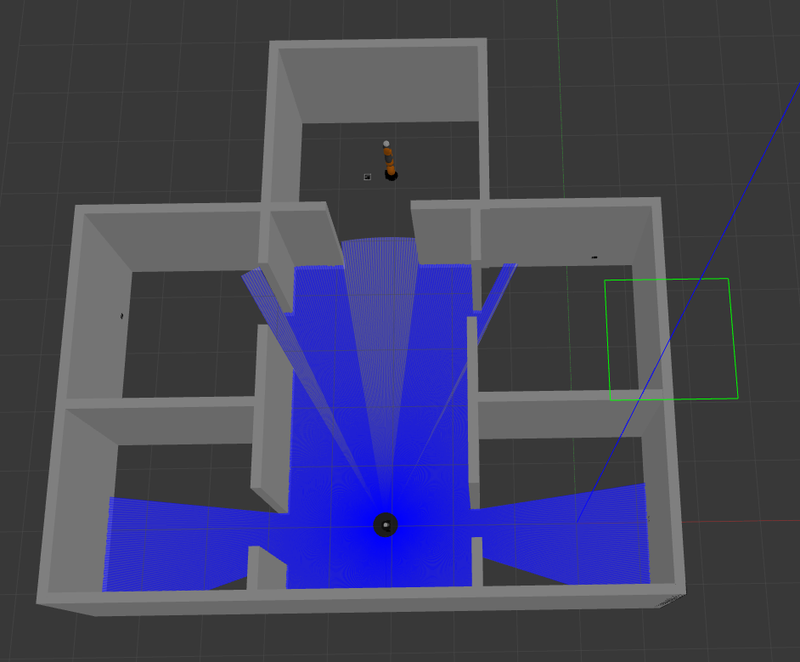
ROBOTICS LAB TECHNICAL PROJECT
Multi-Robot System
with Turtlebot3_Burger and Kuka_Iiwa
Martina Annicelli P38000065

Slide 2
INTRODUCTION
The behaviour of this multi-robot system could be implemented in several applications, from industrial to social fields, so the intent was to choose an example but making it very easy to be changed and adapted to different cases.
The main goal was for the project to be:
Modular
Generic
Easy to understand from a potential user point of view
Anyway, in order to make a practical example, the presentation will be set in an industrial environment.

Slide 3
PRESENTATION OF THE PROJECT
Packages and Folders;
Robots and World in Gazebo;
Sensors chosen for the robots;
Creation of the map offline;
Marker Detection;
Final additions to the main launch file;
Turtlebot3: Move and Search;
Kuka: Inverse Kinematic Control;
Client/Server approach;
Results and Conclusions;
Possible improvements.

Slide 4

Packages and folders
aruco_ros: external package, provided by Pal Robotics. This one was useful to implement the «all_aruco.launch» launch file.
kuka:_iiwa_support: external package, taken from our lessons. From this one I generated the urdf of the Kuka Iiwa and used the meshes and the controllers in the file .yaml
turtlebot3_description: external package, provided by ROBOTIS. From this one I also used the turtlebot3-burger xacro file and meshes.
rl_exam: my package. Here are stored all the launch files, the configuration of the world in Gazebo and the one in Rviz, as well as all the nodes that are called to make the simulation work and lastly the models of the fiducial markers.

Slide 5
Robots and World in Gazebo
STEP 1: I created the world in the Gazebo editor and saved it in the ‘world’ folder in my package.
STEP 2: I prepared two separate launch files to spawn the robots.
STEP 3: In the main launch file, ‘spawn_robots_and_world’, I included both launch files using two different namespaces.
STEP 4: In this launch file I also added the Rviz node for the visualization part, but before saving the Rviz configuration I created the map offline.

Slide 6
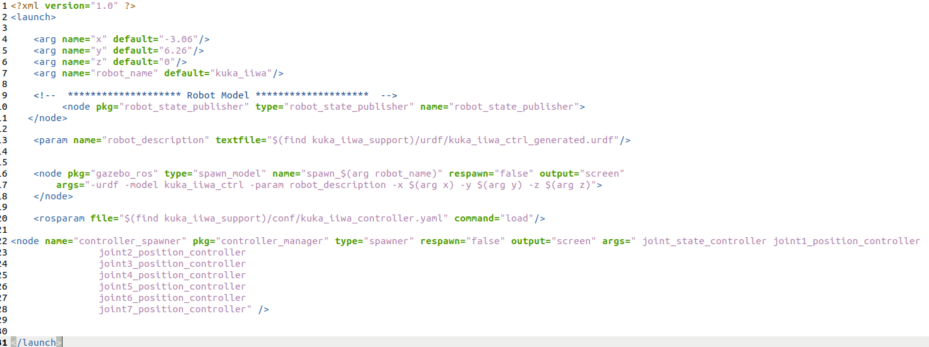
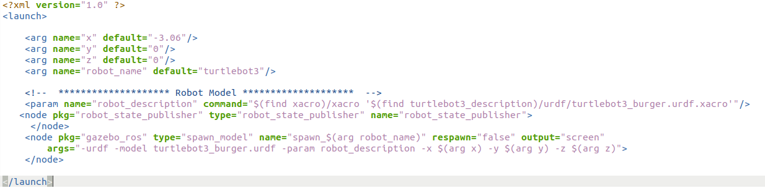
Robots and World in Gazebo

Slide 7
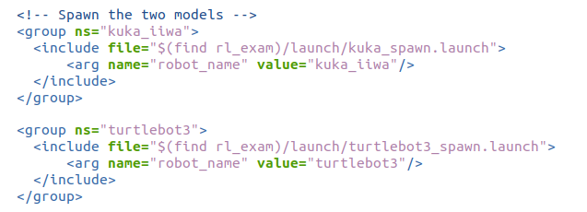
Robots and World in Gazebo
The two different namespaces are mandatory in order to not create conflicts between the two robot_state_publisher and to differentiate the sensors and the topics with which the robots have to deal.

Slide 8
Sensors chosen for the robots
The next step should be the creation of the map of my Gazebo world in Rviz and save it. To do this I have to implement some sensors on my robot, so I choose first to handle the sensors on both robots.
In the perspective of the purpose of the project, turtlebot must have a lidar, in order to be able to detect obstacles and measure the distance from them.
Moreover, another sensor that is needed is the camera sensor, because turtlebot must detect markers in each room.
Instead, as regard the Kuka Iiwa, its job is to search for a marker on the ground, so a camera is needed. I will explain later the decision on this vision sensor for the Kuka Iiwa because I made some consideration on the basis of the results.
In the following two slides there is the implementation of the sensor in the turtlebot3_burger xacro file and then in the kuka_iiwa urdf file.

Slide 9
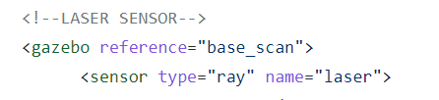
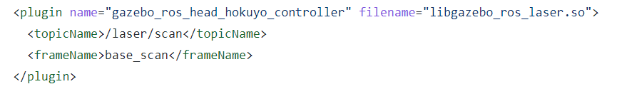

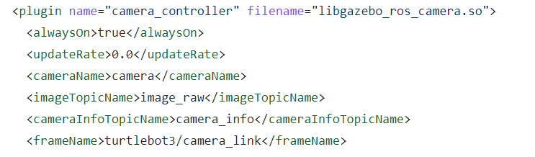
Sensors chosen for the robots
Turtlebot3_burger

Slide 10
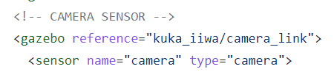
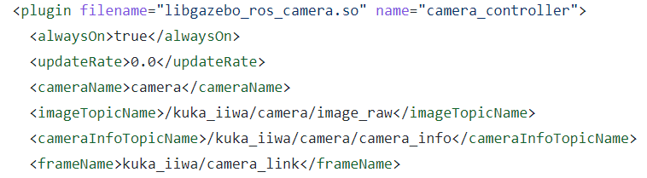
Sensors chosen for the robots
Kuka_iiwa
In the urdf there is also another ‘commented’ sensor that will be explained later.

Slide 11
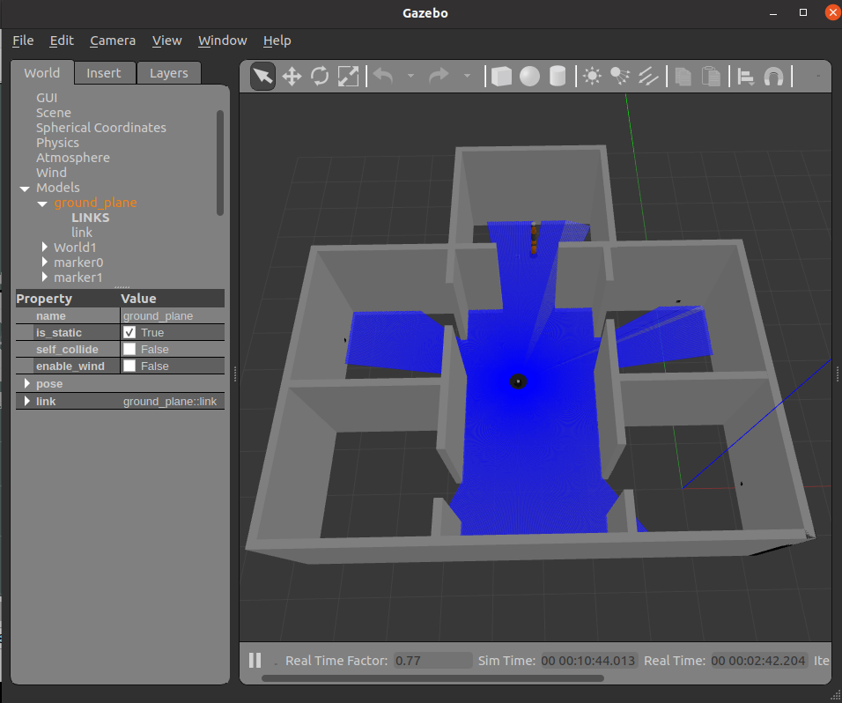
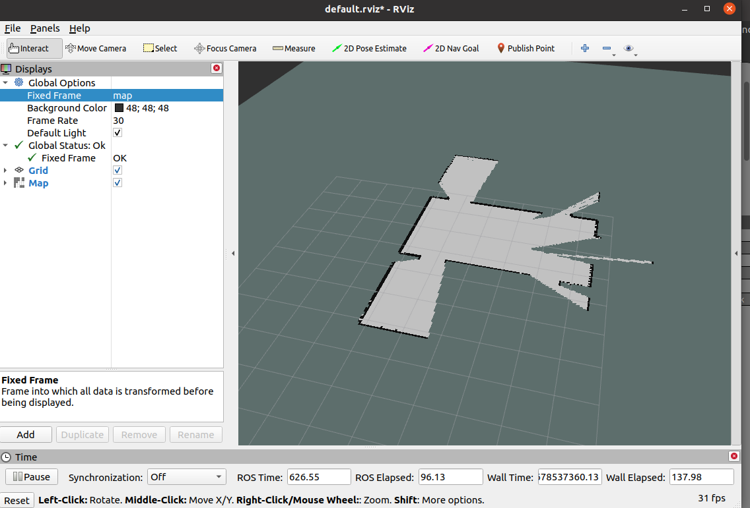
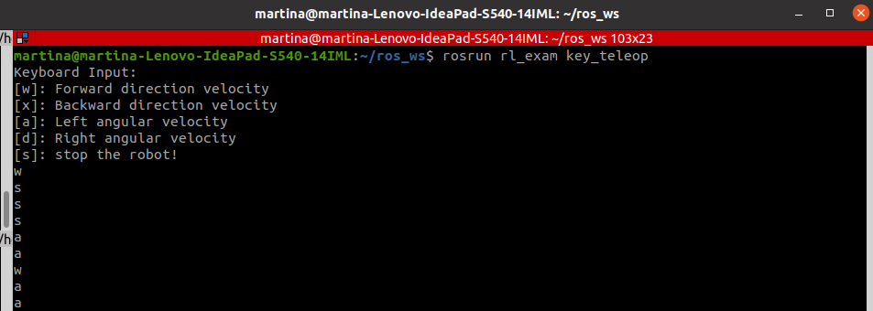
Creation of the map offline
Now that the sensors are implemented it is possible to create the map offline. In particular, I implemented the SLAM with Gmapping and the Key_Teleop node.

Slide 12
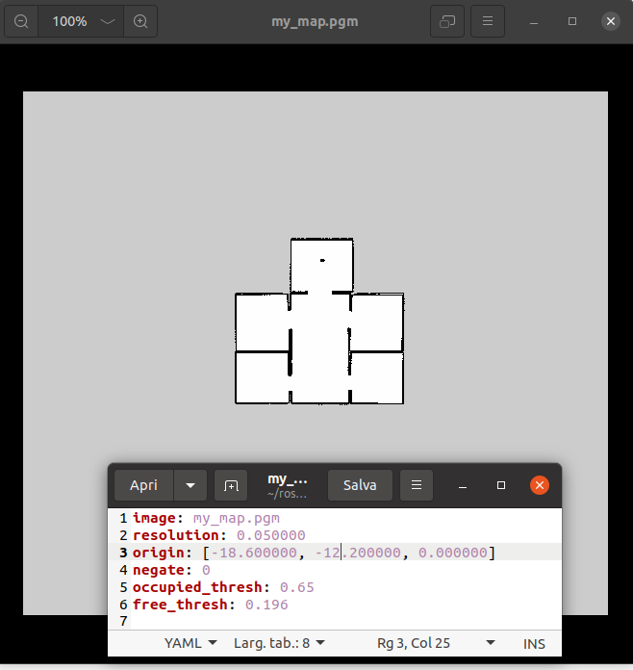
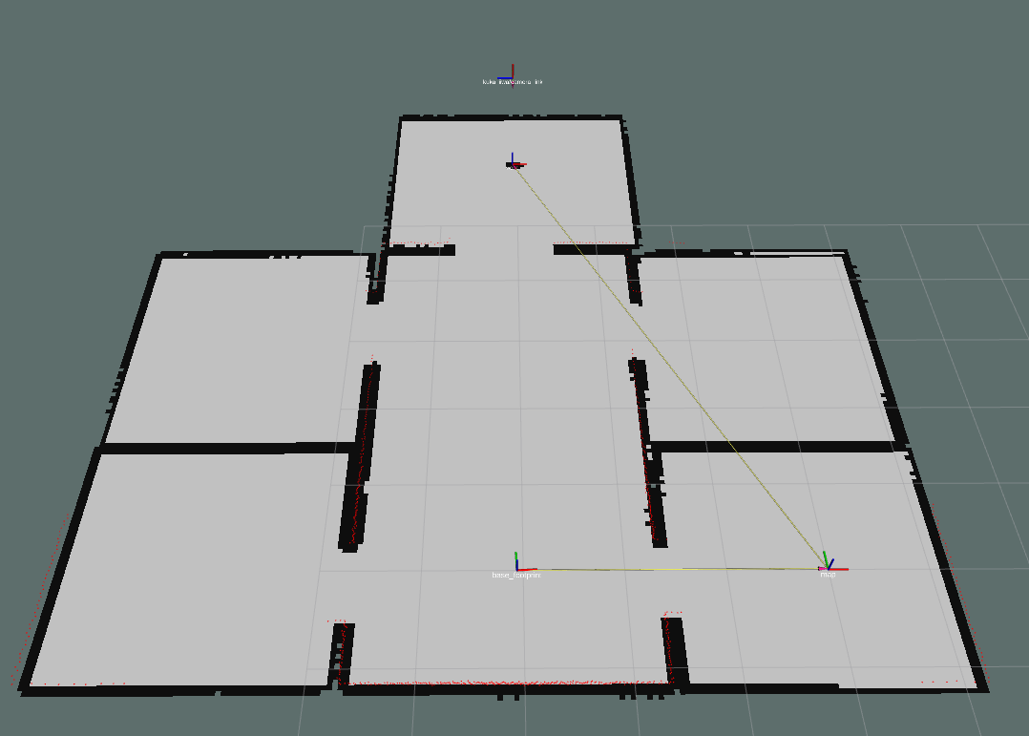
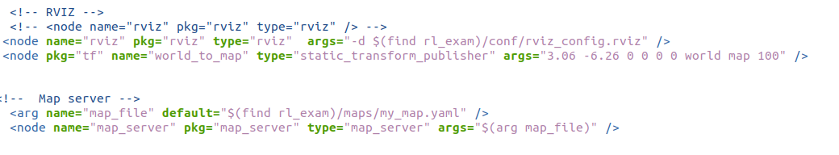
Creation of the map offline
At the end of the navigation I saved the map with the map-server package.
At this point I can also save the configuration in Rviz in the folder ‘conf’. This map will be added also in the launch file.

Slide 13
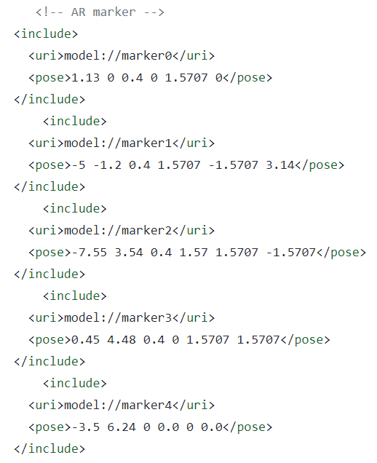

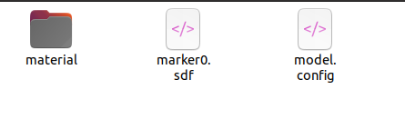
Marker Detection
Before starting the main controllers, the first step was to add the marker models to the world. These markers were created with an aruco marker generator found online.
I saved the models of the markers in a folder called ‘models’.
The sdf file was modified in order to adapt to each marker.
I placed four markers on the walls, one in each room in different positions, and a marker on the ground in the room where the Kuka is placed.

Slide 14
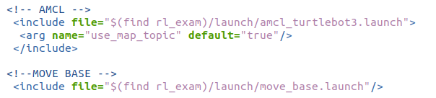
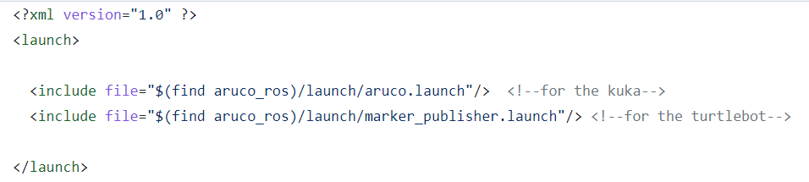
Final additions to the main launch file
Knowing the tasks that the robots must exploit, before starting to write the controllers I decided to refine the ‘spawn_robot_and_world’ file in order to add all the other nodes that are necessary to make the robots do their functions.
For example, turtlebot must move in a known environment so I needed to implement the navigation stack:
As regard the detection of the markers part, I used two different launch files from the aruco_ros package. In particular, the node ‘simple_single’ deals with Kuka Iiwa, and the node ‘aruco_marker_publisher’ with Turtlebot. Then I start both nodes with one launch file, ‘all_aruco.launch’:

Slide 15




Turtlebot3: Move and Search
Now, all is set to start the implementation of the two controllers. I divided them into two nodes, one handles the turtlebot3_burger’s tasks and the other one the kuka_iiwa’s.
The node dealing with turtlebot is called ‘move_and_search.cpp’ and of course is placed in the ‘src’ folder of my package.
STEP 1: Taking input from user.
STEP 2: Move to rooms.
STEP 3: Search desired oject.
STEP 4: Reach goal.
Publishers and Subscribers
Used to check id
In function rotate()

Slide 16
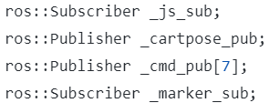
USING KDL
Kuka: Inverse Kinematic Control
The node dealing with kuka iiwa is called ‘kuka_invkin_ctrl.cpp’. I used the file provided during the lessons, studied it and modified it in order to adapt to the project. Here, I will focus only on my contribution to the code.
STEP 1: Adapt the code to my robot model.
STEP 2: Start from desired pose and search marker.
STEP 3: Approach the centre of marker.
Publishers and Subscribers

Slide 17
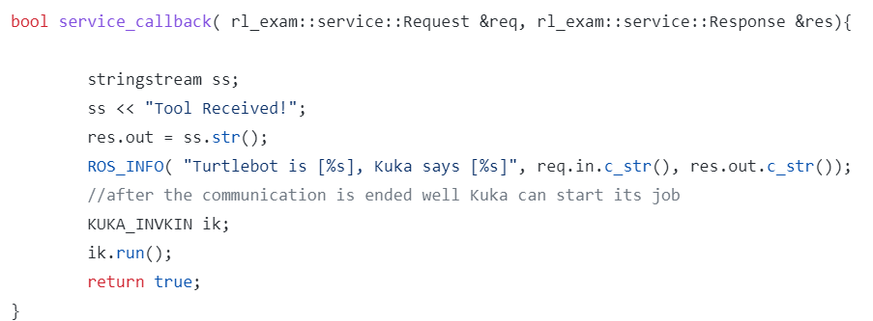
Client/Server approach
After running the two nodes separately and doing all the possible trials, I implemented the communication between them, imagining that the node kuka_iiwa_kdl acts as a server waiting for the client, search_obj, to send an information. In order to do this I added the folder ‘srv’ to my package and properly modified the Cmakelist.txt
Server

Slide 18
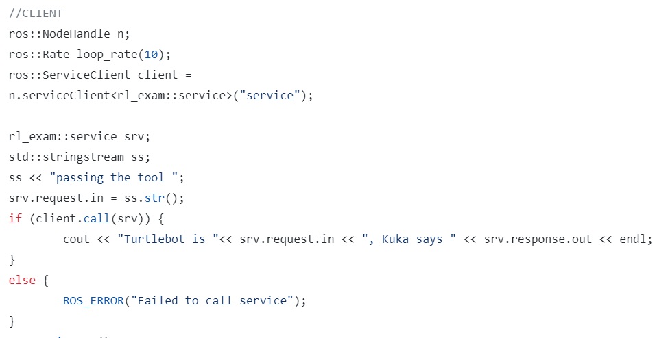
Client/Server approach
Client
Implemented in the move(float x_des, float y_des, float w_des) after the turtlebot reached the goal position and stops.

Slide 19
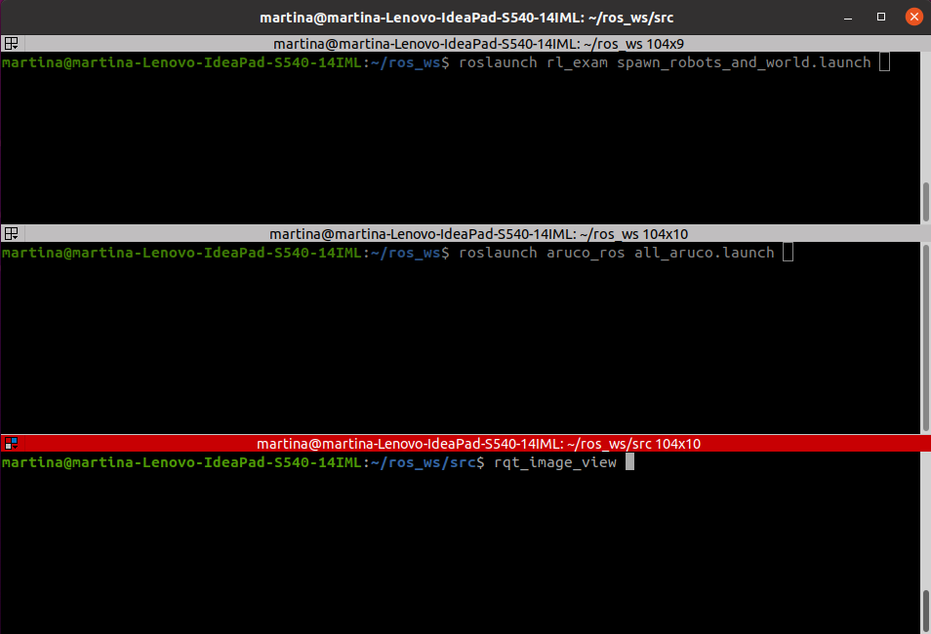
Results and Conclusions
STEP 1: Launch all the files necessary to set the world, to prepare the nodes for the detection and the visualization.

Slide 20
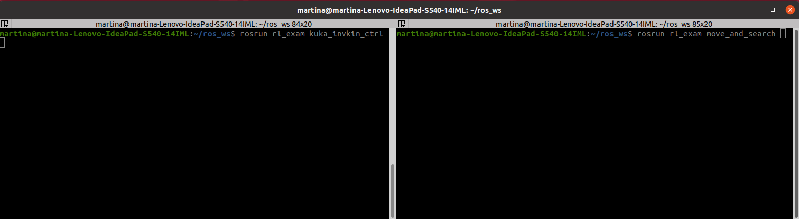
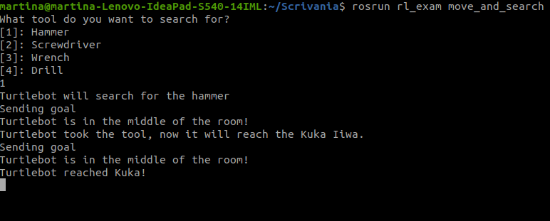
Results and Conclusions
STEP 2: Run first the server node, and then the client one.
The following is an example of the output of the turtlebot task.

Slide 21
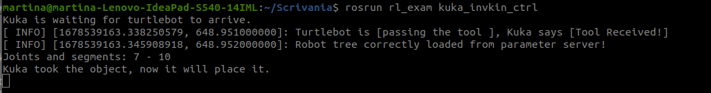
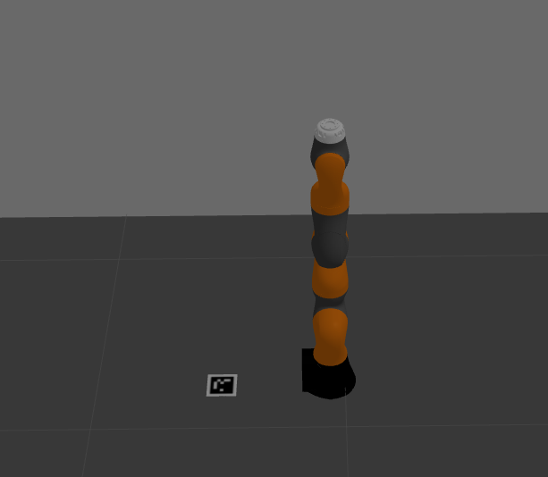
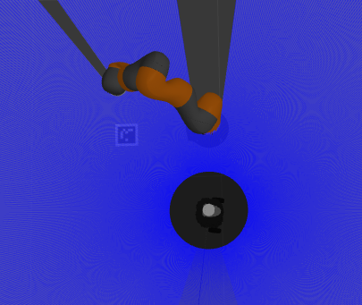
Results and Conclusions
STEP 3: The server output stops at the first raw until turtlebot finishes its tasks. Then the communication happens.
BEFORE
AFTER

Slide 22
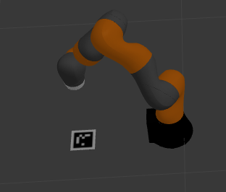
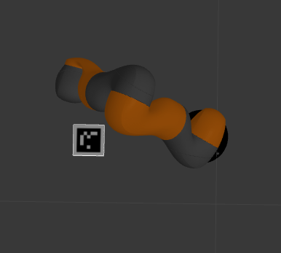
Possible improvements
As we can see here, there is an error in the final pose of the end effector that is not in the center of the marker! I tried several configurations moving the marker and obtained the same error. This is caused from the incorrect position of the frame detected by the camera. Kuka will center the origin of the frame detected.

Slide 23
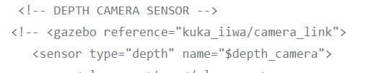
Possible improvements
I thought the problem could be the camera sensor, because even changing the parameters and the configuration of the marker the error still persisted.
That’s why I considered the possibility of using a depth camera.
Final observation
Using this sensor, the frame is detected right in the center of the marker, but the kuka couldn’t perform the kinematic inversion due to the configuration of the depth camera that has a larger ray of vision and should probabily be better calibrated accordingly to the task. So I choose to keep the old camera sensor and the error.
A good solution can be finding a trade-off between the results obtained with the depth camera and the camera sensor and do other trials to make the kinematic inversion work.
Last reminder: move the «all_aruco.launch» file in my own package for further precision.

Slide 24
THANK YOU
FOR YOUR ATTENTION

