Slide 1
The Wumpus World
by MiMaCh System – Course of Intelligent Systems a.a. 2021/2022
Notes:
Hi Everyone! This is our presentation for the fifth homework about logical agent and the wumpus world.

Slide 2




Contents
Wumpus World
Description
PEAS Description
Environment Properties
Logic and Knowledge
Logical Agents
Fundamentals and Background
Logical Formalisms
A Graphic Model
ASP Program
MiniZinc Program
Conclusion
Our Models
Further Improvement
Notes:
Here is a brief list of the contents that we want to show in the presentation.
First there will be a description of the wumpus world, the environment and the agents involved.
Then we will see the main concepts about logic, knowledge and inference and some other background about probability statistics
We will discuss about our implementations and our formalisms implemented
And at the end we will discuss our models and some possible improvements

Slide 3


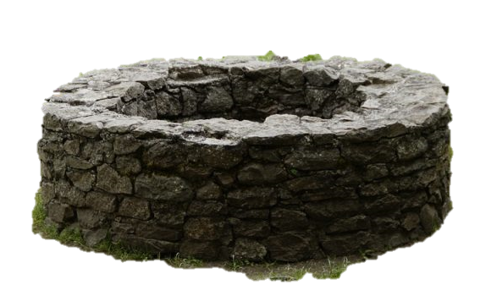
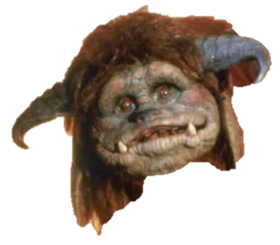


Wumpus World - Description
The Wumpus world is a simple world example to illustrate the importance of a knowledge-based agent.
It was inspired by a video game Hunt the Wumpus by Gregory Yob in 1973.
The Wumpus World is a cave composed by 16 rooms connected with passageways.
The cave has a room with a beast called Wumpus who eats anyone in the room. (Note: the Wumpus is static)
Other rooms can contain a bottomless Pit.
Notes:
Let’s start with a quick description of the wumpus World.
The Wumpus world is a simple world example to illustrate the worth of a knowledge-based agent and to represent knowledge representation.

Slide 4
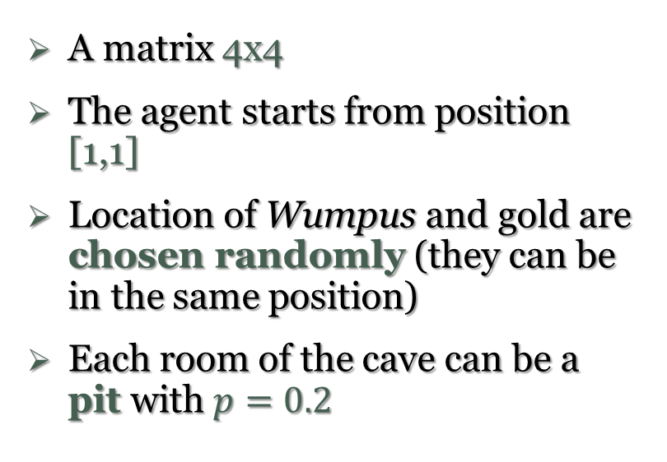
Wumpus World - PEAS Description
Performance Measure:
Environment:
+1000 points if the agent takes the gold
-1000 points if the agent dies (eaten by the Wumpus or falling into a pit)
-1 for each action
-10 for using its arrow
A matrix 4x4
The agent starts from position [1,1]
Location of Wumpus and gold are chosen randomly (they can be in the same position)
Each room of the cave can be a pit with $p=0.2$
Notes:
What about a PEAS (Performance measure, Environment, Actuators, Sensors) Description.
First af all let’s see the performance measure. So its better to find a minimum path, move in less cells as possible.

Slide 5
Wumpus World - PEAS Description
Actuators:
Sensors:
Goal:
Turn Left
Turn Right
Move
Grab
Release
Shoot
The agent will perceive:
Stench
Breeze
Glitter
Bump
When the Wumpus is shot, its horrible scream can be perceived everywhere.
The game ends if:
The agent dies
Came out of the cave with gold
Notes:
What our agent can do?
The agent will perceive the stench if he is in the room adjacent to the Wumpus. (Not diagonally).
The agent will perceive breeze if he is in the room directly adjacent to the Pit.
The agent will perceive the glitter in the room where the gold is present.
The agent will perceive the bump if he walks into a wall.
When the Wumpus is shot, it emits a horrible scream which can be perceived anywhere in the cave.
These percepts can be represented as five element list, in which we will have different indicators for each sensor.
Example if agent perceives stench, breeze, but no glitter, no bump, and no scream then it can be represented as: [Stench, Breeze, None, None, None].

Slide 6
Wumpus World - Environment Properties
Deterministc
Static
Descrete
Single-Agent
Partially Observable
Sequential
Wumpus World
The Wumpus world properties:
Partially Observable: the agent has a local perception.
Deterministic: the result and outcome of the world are already known.
Sequential: the order is important.
Static: Wumpus and Pits are not moving.
Discrete: the environment is discrete.
Single-Agent: there is only one agent and Wumpus is not considered as an agent.
Notes:
As shown during the last lecture these are the characteristics of the Wumpus World’s Environment.
The Wumpus world Properties:
Partially observable: The Wumpus world is partially observable because the agent can only perceive the close environment such as an adjacent room.
Deterministic: It is deterministic, as the result and outcome of the world are already known.
Sequential: The order is important, so it is sequential.
Static: It is static as Wumpus and Pits are not moving.
Discrete: The environment is discrete.
One agent: The environment is a single agent as we have one agent only and Wumpus is not considered as an agent.

Slide 7
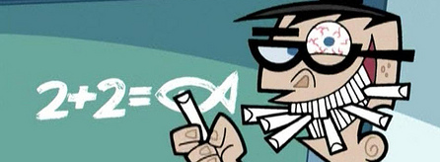
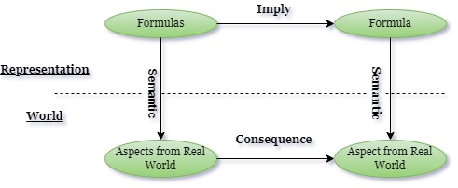
Logic and Knowledge - Logical Agents
Knowledge-based agents use their knowledge about the world to generate good decisions.
Knowledge is represented as a set of sentences in a formal language. The language defines the truth value of a formula given a specific world.
A Logical Agent is composed by a knowledge base and an inferential procedures.
Notes:
Knowledge-based agents use their knowledge about the world to generate good decisions.
Knowledge is representd as a set of senteces in a formal language.
These sentences are stored in a knowledge base.
So A Logical Agent is composed by a knowledge base and an inferential procedures
It’s important to underline the fact that formulas are meaningful if we consider the interpretation and the models of our world. This schema summariez how a knowledge representation works.
It’s important because in our arithmetic world 2+2 is equal to 4 but in a magic world of the The Fairly OddParents “due fantagenitori” 2+2 is equal to a fish.

Slide 8
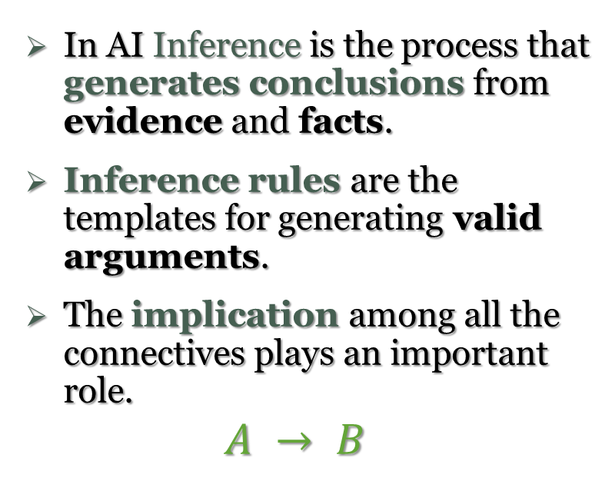
Logic and Knowledge - Fundamentals and Background
In AI Inference is the process that generates conclusions from evidence and facts.
Inference rules are the templates for generating valid arguments.
The implication among all the connectives plays an important role.
$$A → B$$
There are different types of Inference rules.
They are used in AI to derive proofs (a sequence of «actions» to reach the goal).
Propositional Logic and First-Order Logic are the core of Logical Agents.
Basis for ASP and CSP.
Notes:
In artificial intelligence, we need intelligent computers which can create new logic from old logic or by evidence, so generating the conclusions from evidence and facts is termed as Inference.
In AI Inference is the process that generates conclusions from evidence and facts. So it is possible to create new logic from old logic or by evidence.
Inference rules are the templates for generating valid arguments.
The implication among all the connectives plays an important role. Implication: It is one of the logical connectives which can be represented as P → Q. It is a Boolean expression.
There are different types of Inference rules. Such as Modus Pones or Modus Tollens
These rules are used in AI to derive proofs the proof is a sequence of the conclusion that leads to the desired goal.
Propositional Logic and First-Order Logic are the core of Logical Agents and AI but we studied these arguments in some other courses so we will not talk about that. But it is important to know that this is the base of important paradigms like Answet Set Programming and Constraint Statisfaction Problems.

Slide 9
Logical Formalisms
Flow Chart
ASP Program
MiniZinc Program
Notes:
Let’s quick describes our formalisms implementation. We build 3 different implementations.

Slide 10
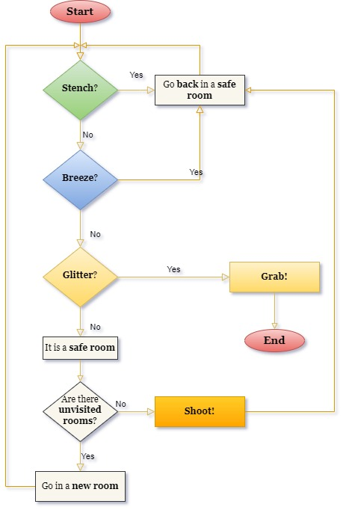
Logical Formalism - A Graphic Model
Flow Chart
A flowchart is a diagram that describes a process, system or algorithm
Simple and easy to understand
There is a specific set of flowchart symbols (see more here)
Notes:
First we start with a graphic model as our first logical formalism. We want to start with a simple flow chart to show the different choices and situations of our agent.
We want to underline that we want to keep the flowchart very simple and easy to understand, otherwise it could be possibile to implement a more complex diagram that analyzes every possible step done by the agent. Here we want to focus on what an agent can do at each singole step.

Slide 11
Logical Formalism - ASP Program
Answer Set Programming
Notes:
Let’s take another approach and another logical formalism, strictly linked to the basis of First-Order Logic.

Slide 12
Logical Formalism - ASP Program
ASP Implementation

Slide 13
Logical Formalism - MiniZinc Program
Constraint Satisfaction Problems
Many real-life problems of AI and OR can be formulated as a Constraint Satisfaction Problem (CSP)
CSP is a powerful tool for knowledge representation
MiniZinc is a free and open-source constraint modeling language.
Use MiniZinc to model constraint satisfaction and optimization problems
Notes:
Many real-life problems of AI and OR can be formulated as a Constraint Satisfaction Problem (CSP)
Infact many problems are problems of satisfiability and in Prop logic and FOL we have the concepts of validity, sat, unsat ecc. so the CSP for example require to verify if the constrints are satisfied by some variables assignment.
So CSP is a really powerfull tool for know.Repr.
We used MiniZinc to implement a CS Problem for the wumpus world which is an open source modeling language. It is possible to model both CSP and optimization problems.

Slide 14
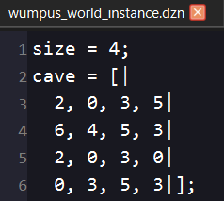
Logical Formalism - MiniZinc Program
MiniZinc Implementation
Data File
Elements = {Ok=0, Stench=2, Breeze=3, Glitter=4, Pit=5, Wumpus=6};
We assume that the input instance is correct and there is only one Wumpus and only one room with the Gold

Slide 15
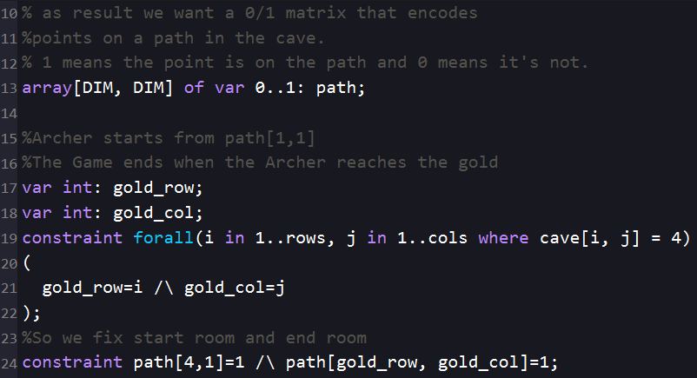
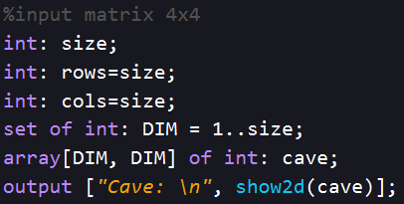
Logical Formalism - MiniZinc Program
MiniZinc Implementation
Model File

Slide 16
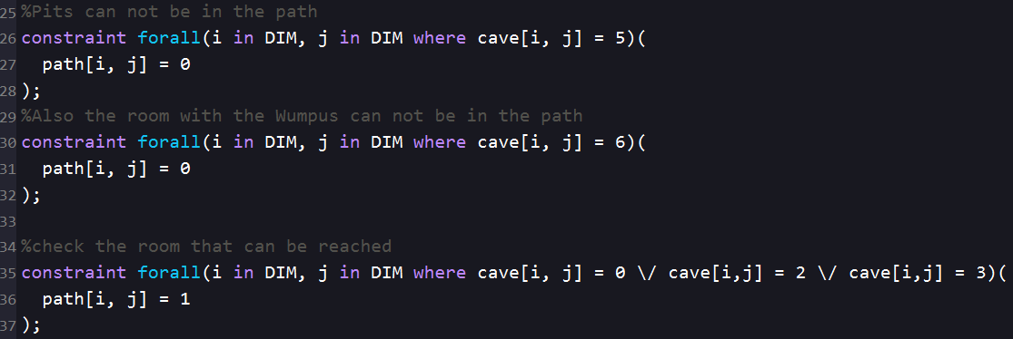
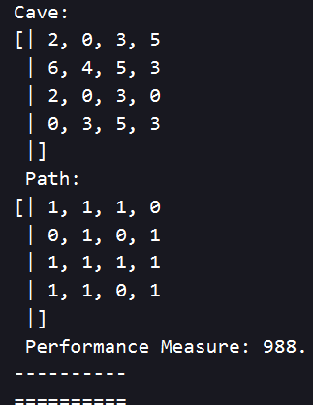
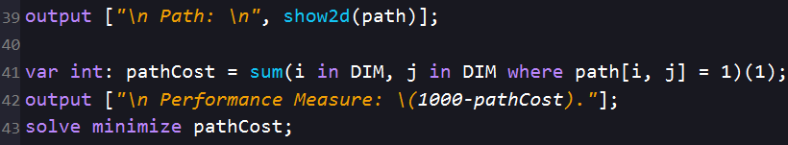
Logical Formalism - MiniZinc Program
Model File

Slide 17
Resources
Text Book: Intelligenza Artificiale. Un Approccio Moderno. Stuart J Russell, Peter Norvig. Pearson, 2021.
Online Sources: javatpoint.com logical agents for wumpus world diagrams.net what is a flowchart
ASP Programming:
CSP Programming and MiniZinc: Constraint Satisfaction Problems minizinc.org
Notes:
Here there some useful link, out git repository and other utilities about codingame and mean-max bot

Slide 18
Thanks for your attention
MiMaCh System
Canonaco Martina [231874]
Morello Michele [223953]
Passarelli Chiara [223971]

