Slide 1
Modeling: Some Concrete Cases
By MiMaCh System – Course of Intelligent Systems – a.a. 2021/2022
Notes:
Componente chiave di questi algoritmi: funzione euristica h(n) = costo stimato del cammino più conveniente dal nodo n a un nodo obiettivo.

Slide 2
Contents
Introduction
The world of two coins
The world of a robot
The world of mean-max game
Conclusion

Slide 3
Introduction
What is Modeling?
Why is it important?
Generally, the process of representing a real-world object or phenomenon.
The representation, often mathematical, of a process, concept, or operation of a system, often implemented by a computer program.
It is important to model a problem or the input of a problem in order to find an easy way to understand and solve it.
Model the whole universe to understand it.
Basic of ontological foundations of cognitive and communicative processes, knowledge engineering, conceptual modeling and software engineering.

Slide 4
The world of two coins
Description:
Purposes:
Formal definition:
Two coin with two sides
C1 = {T} {H}
C2 = {T} {H}
Toss both the coins one or more time
Win 10$ each turn if the following purposes occur.
Never two tails
At least one tail
Consider both the purposes (in conjunction)
The set of all the possible outcomes without {T, T}
The set of all the possible outcomes with at least a T
Conjunction of the first two

Slide 5
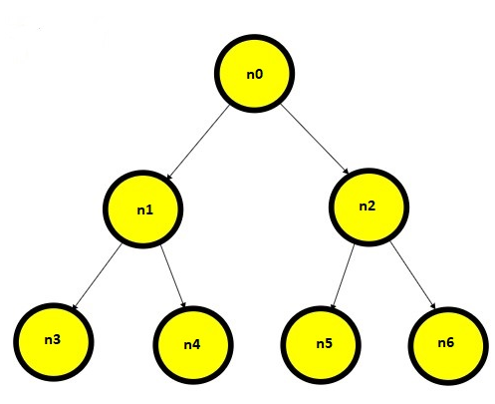
The world of two coins
Structure and Modelization:
Model the outcomes as a Tree
The binary tree explores every possible outcomes:
n0 = no coins tossed
n1 = head for the first coin
n2 = tail for the first coin
n3 = head after head
n4 = tail after head
n5 = head after tail
n6 = tail after tail

Slide 6
The world of two coins
Structure and Modelization:
Model the outcomes as a Tree
Focus on the first purpose:
Never two tail
n3={H,H}; n4={H,T}; n5={T,H};
Focus on the second purpose:
At least one tail
n4={H,T}; n5={T,H}; n6={T,T};
Focus on the third purpose:
First purpose AND second purpose
n4={H,T}; n5={T,H};
H T
H T H T
Φ: n4 ∧ n5
T1: n4
T2: n5
n4 and n5 are models

Slide 7
The world of a robot
Description:
Purpose:
Formal definition:
There is a robot in a room
The robot wants to exit avoiding obstacles
Reach the exit
Find a «safe» path from the initial position of the robot to the position of the exit.

Slide 8





The world of a robot
The map is a 2-D array of size NxM. In this case there are 4 rows and 5 columns.
Each object is in a cell with position (i, j).
Three kind of objects:
The Robot (Dynamic)
k Bombs (Static)
1 single Exit (Static)
Given the objects and an ID that identifies them in the matrix, knowing their position, it will be easy to construct a path using an algorithm that allows the robot to reach the exit cell without die by reaching the cell with bombs.
0,0 | 0,1 | 0,2 | 0,3 | 0,4
1,0 | 1,1 | 1,2 | 1,3 | 1,4
2,0 | 2,1 | 2,2 | 2,3 | 2,4
3,0 | 3,1 | 3,2 | 3,3 | 3,4

Slide 9
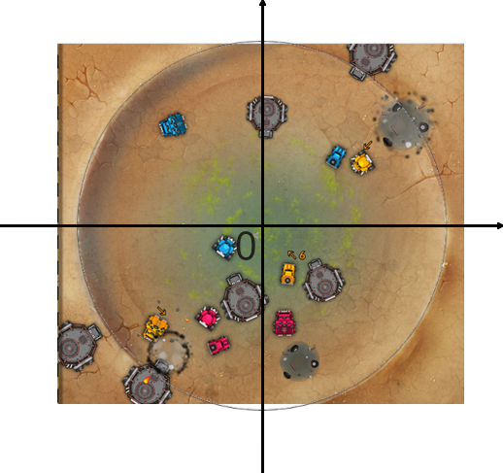
The world of «Mean-Max» Game
Description:
The map:
Model the “mean-max” game as a circular map in a Cartesian plane, with the center equal to C(0,0) and radius r=6000.
Water Town is the core of the game and it is in the center of the map and has a radius of 3000.
The Entities:
Map each object in the map as an Entity.
There are different types of players and autonomous objects:
Reapers
Destroyers
Doofs
Tankers
Wrecks
Every Entity has some attributes and properties

Slide 10
The world of «Mean-Max» Game
The Moves:
Purpose:
Formal definition:
As players we can:
Move to a position (X, Y) with a THROTTLE >=0 and <= 300
Use a SKILL in position (X, Y)
Reaper’s Skill = Tar Pool
Destroyer’s Skill = Nitro Grenade
Doof’s Skill = Oil Pool
WAIT
Win the play by gathering more water than the other players.
Have an higher «score» then the other reapers.

Slide 11
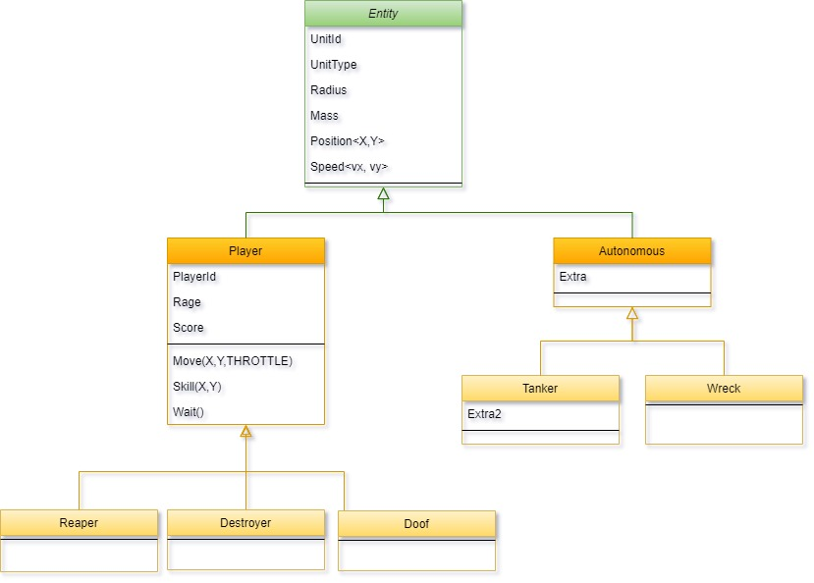
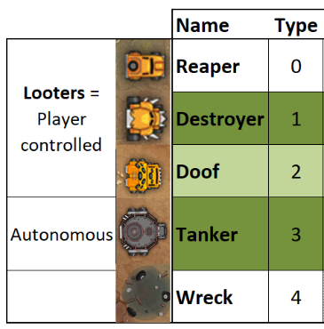
The world of «Mean-Max» Game – Class Diagram

Slide 12
Resources
Text Book (Mainly Chapter 10): Intelligenza Artificiale. Un Approccio Moderno. Stuart J Russell, Peter Norvig. Pearson, 2021.
Modeling definitions: dictionary.com
Mean-Max Game: codingame.com
Class Diagram UML: visual-paradigm.com

Slide 13
THANKS FOR YOUR ATTENTION
MiMaCh System
Canonaco Martina [231874]
Morello Michele [223953]
Passarelli Chiara [223971]

