Slide 1

Advanced Visualization and Latent Space Fusion for Clinical Heart Disease Analytics
Scientific Visualization Project
D’Elia Corinne, Filice Martina Università degli Studi di Milano. Corso di Laurea Magistrale, Informatica

Slide 2
Introduction
Clinical Relevance: Cardiovascular diseases demand early, robust, and interpretable screening.
Parameter Integration: Convergence of stable demographic profiles with dynamic stress-test biomarkers.
Visual Analytics & XAI: Prioritizing data transparency and structural validation over black-box opacity

Slide 3
Dataset Structure
Data Cleansing: Raw input volume of 1,025 records; elimination of 723 exact duplicates.
Data Leakage Prevention: Clean cohort of 303 unique patients to prevent model overfitting.
Class Balance: Optimal equilibrium achieved (139 Class 0 vs 164 Class 1 cases).
Multi-View Partitioning:
  View 1 (Clinical/Demographic): age, trestbps, chol.
  View 2 (Diagnostic/Stress Test): thalach, oldpeak.

Slide 4
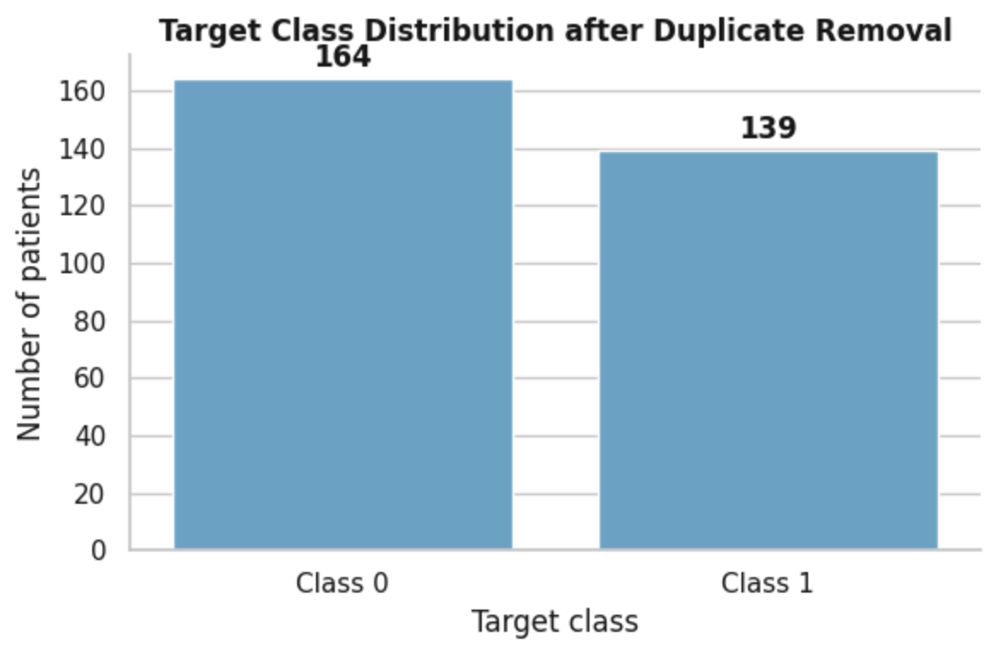
Target Class Distribution & Balance Assessment
Cohort Structure: 303 unique patients after duplicate removal (164 Class 0, 139 Class 1).
Class Balance: Near-balanced distribution (~54,1% vs 45,9%).
Methodological Advantage: Prevents skewness, ensuring stable predictive performance without synthetic oversampling.

Slide 5
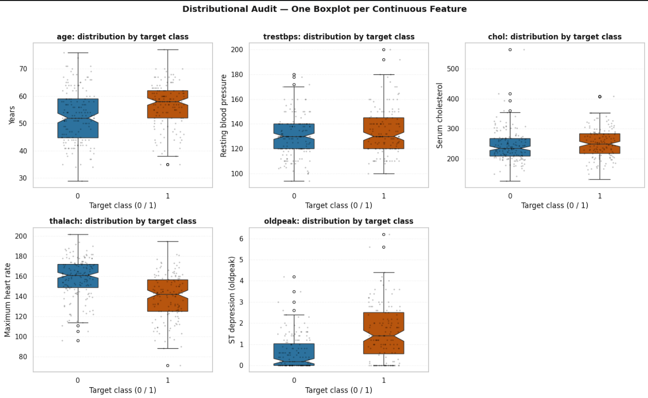
Outlier Boundary Definition & Detection
Geometric Isolation: Application of the Interquartile Range (IQR) method and notched confidence intervals to define normality boundaries, identify statistical outliers, and visually test the significance of median differences
Physiological Extremes: Parameters (chol, trestbps, oldpeak) exhibit valid physiological tails rather than measurement errors.
Clinical Strategy: Retention of distributional outliers in the workflow; they represent critical high-risk phenotypes for models to account for

Slide 6
Feature Scaling
Standardization and preprocessing pipeline:
  Need for Scaling: Prevents features with larger magnitudes (e.g., chol > 400 vs oldpeak 2-6) from dominating Euclidean distances.
  Applied Pipeline: Z-score normalization (StandardScaler) centering mean at 0 and variance at 1 for fairness in PCA and K-Means

Slide 7
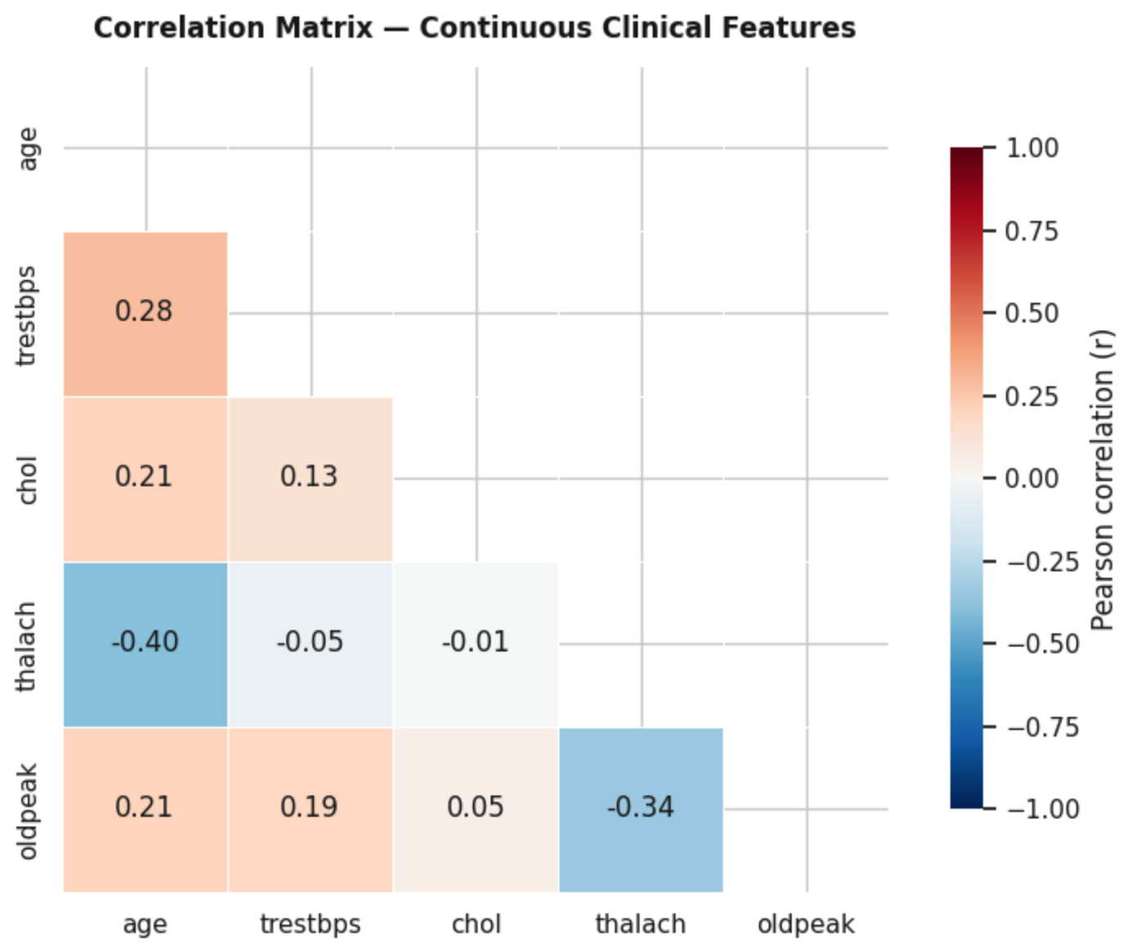

Feature Interaction Space
Continuous Feature Interplay: Pearson correlation mapping restricted to core continuous clinical parameters (age, trestbps, chol, thalach, oldpeak).
Key Patterns:
  Chronotropic Decline: Inverse correlation between age and thalach ($r=−0.40$)
  Cardiovascular Aging: Positive links between age and trestbps ($r=0.28$) / chol ($r=0.21$)
  Stress-Test Interaction: Inverse relationship between thalach and oldpeak ($r=−0.34$).
Analytical Value: Maps internal collinearity, ensuring geometric stability for latent space decomposition.

Slide 8
Non-Linearity Hypothesis
Limits of Linear Analysis: Bivariate matrices analyze isolated pairs; actual cardiovascular risk involves complex multivariate interactions.
Geometric Solution: Dimensional reduction maps 303 patients into a multidimensional architecture via orthogonal projection (PCA) to compress global variance

Slide 9
PCA Setup
PCA Methodology: Applied on the 5 standardized continuous features (age, trestbps, chol, thalach, oldpeak); scaling ensures computational fairness against magnitude distortion.
Decision Objectives: Maximize explained variance for dimensional reduction; project patient behavior onto PC1 and PC2 to isolate latent dataset structure

Slide 10
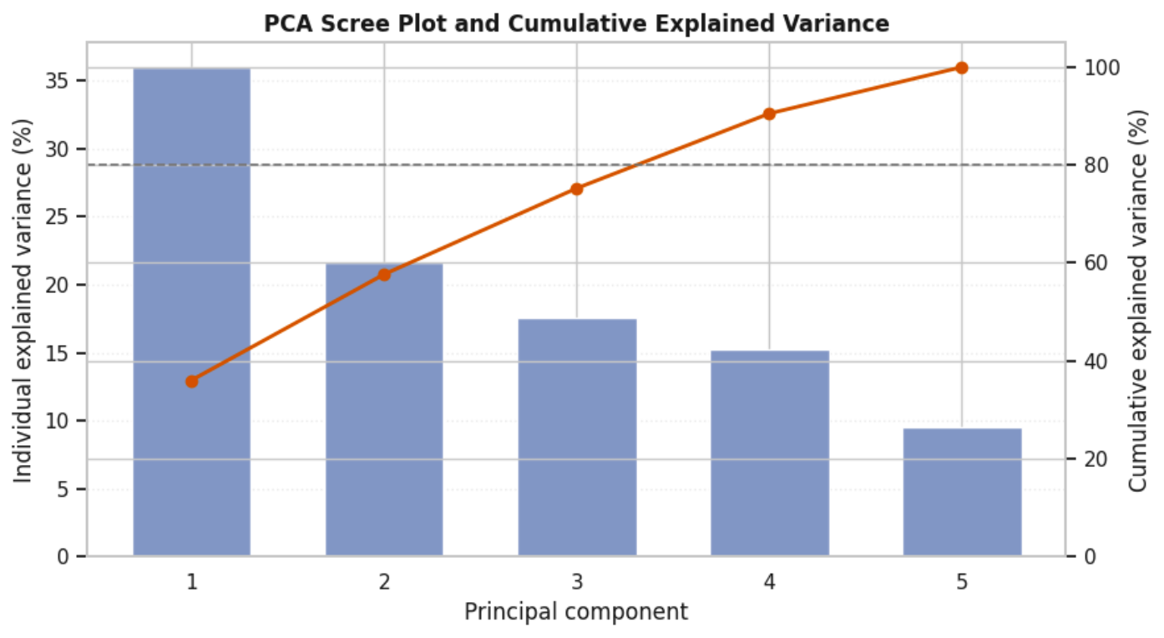
PCA Global Scree Plot & Cumulative Variance
Global Spatial Decomposition: PCA applied to the 5 core continuous features (age, trestbps, chol, thalach, oldpeak) to quantify information compression.
Cumulative Curve: Variance captured across 5 components; PC1 alone explains over 35% of total variance reflecting primary physiological axes.
Critical Threshold Intercept: The 80% reference threshold is crossed between the 3rd and 4th principal components, preserving variability while eliminating noise

Slide 11
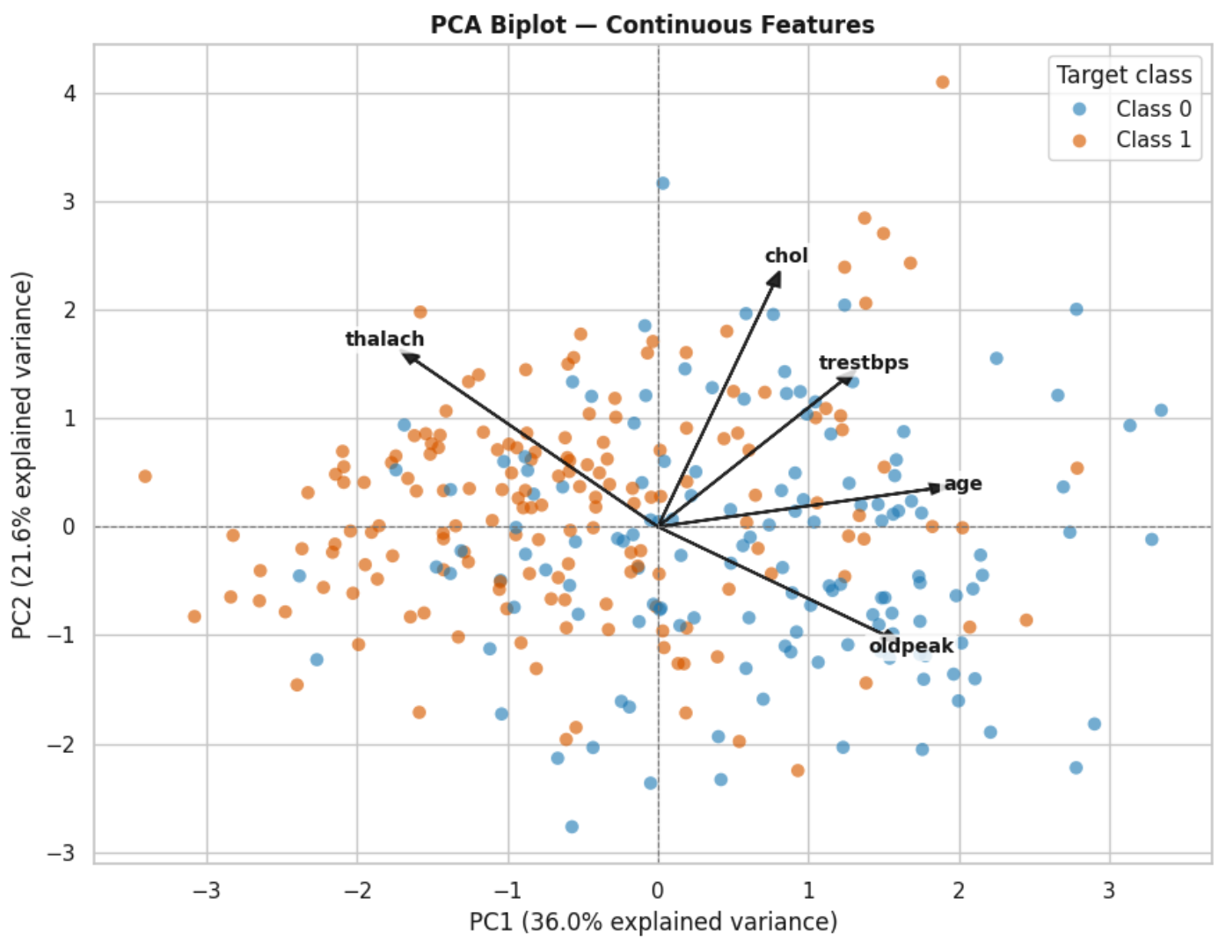
PCA Biplot Representation
Multidimensional Space: Simultaneous projection of patient profiles and feature vectors onto PC1 and PC2, capturing a total variance of 57.6% (PC1: 36.0%, PC2: 21.6%).
Vector Interpretations (Loadings): Arrow orientation and length express the strength and direction of the 5 continuous variables (age, trestbps, chol, thalach, oldpeak).
Hemodynamic and Risk Drivers:
  thalach orients toward the negative half-plane of PC1.
  age, trestbps, and chol project toward positive values.
  oldpeak extends toward the lower-right quadrant.
Clinical Cohort Separation: Spatial polarization clearly distinguishes Class 0 (blue) and Class 1 (orange) across the latent space.
Structural Dynamics: Biomarkers naturally drive geometric variance and alignment without requiring supervised classification

Slide 12
Geometric Interpretation
Feature Loadings (Clinical Bias): Arrow directions indicate biological bias, with vectors like oldpeak and age acting as direct cardiovascular risk drivers.
Vector Magnitude (Contribution to Variance): Arrow length expresses statistical significance, where longer vectors signify biomarkers contributing most to PC1 and PC2.
Decision Boundary (Intrinsic Latent Structure): 2D spatial bias demonstrates that separation between Class 0 and Class 1 patients stems entirely from natural data variance without algorithmic supervision

Slide 13
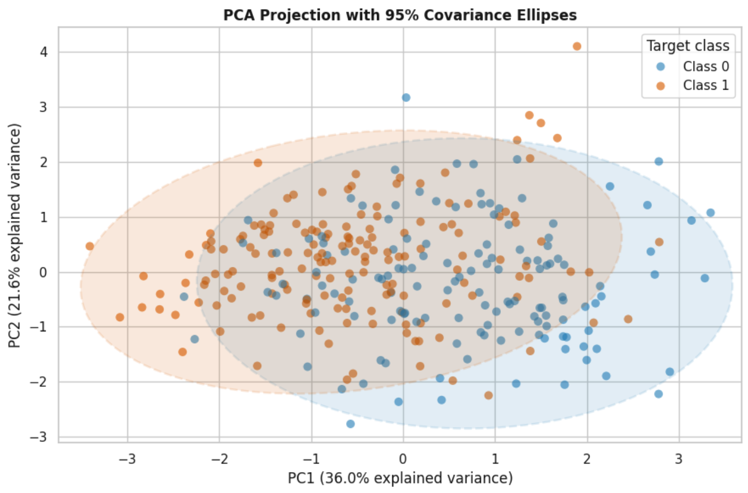
Variance Explained
2D Latent Space Projection: Visualization of patient distribution on the Cartesian plane defined by the first two Principal Components (PC1 and PC2) from standardized continuous features.
Quantification of Information: PC1 captures 36.0% and PC2 captures 21.6% of total variance, summarizing 57.6% of the original signal.
Cohort Segregation & Enclosure: Spatial polarization reinforced by 95% covariance ellipses; Class 0 (blue) clusters in the positive half-plane of PC1, while Class 1 (orange) concentrates toward negative coordinates.

Slide 14
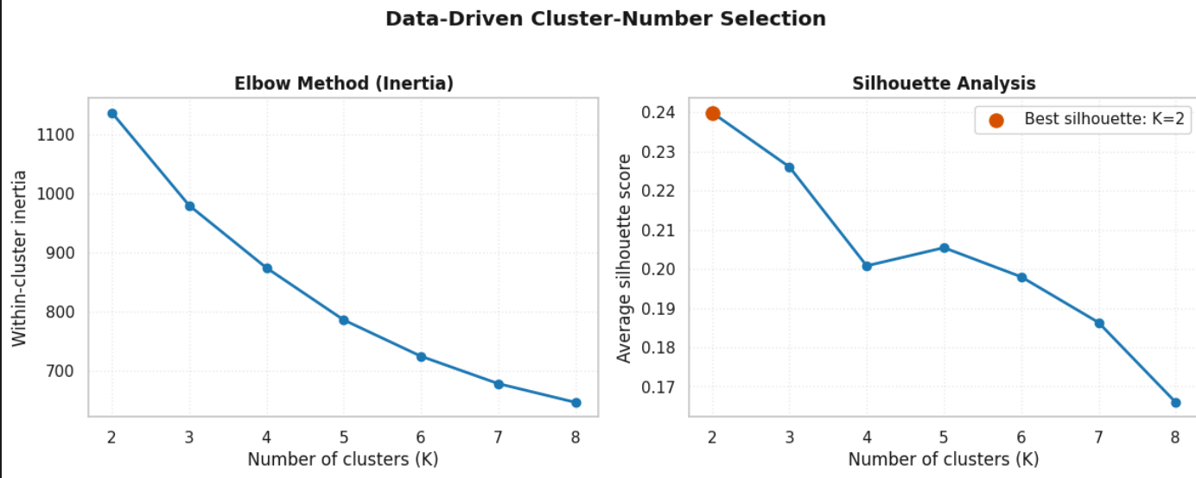

Data-Driven Selection of the Number of Patient Clusters
Cluster Number Optimization: Rigorous data-driven strategy to select the optimal number of patient clusters ($K$), avoiding arbitrary assignments.
Geometric Inspection (Elbow Method): Within-Cluster Inertia plot guides the identification of structural stability points as clusters increase from 2 to 8.
Statistical Validation (Silhouette Analysis): Confirms that $K=2$ maximizes internal cohesion and separation, recording a peak score of 0.24

Slide 15
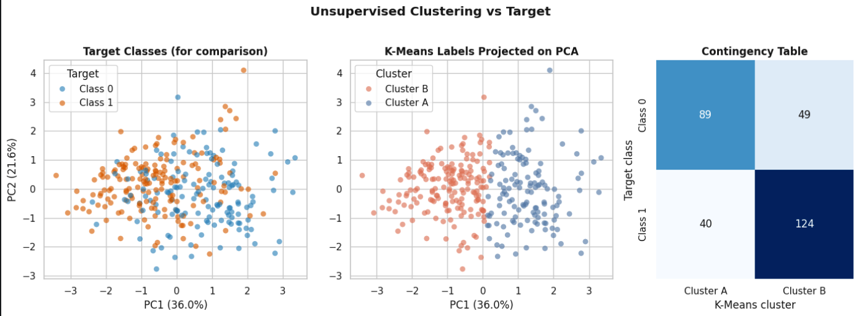

Unsupervised Clustering Strategy
Blind Methodology (K-Means): Partitions latent space ($K=2$) into two cohorts based solely on geometric distances without diagnosis labels.
Structural Comparison & Ground Truth: Maps target classes to show overlapping distributions of healthy and pathological patients within the coordinate space.
Contingency Matrix Alignment: Cross-references true target classes with unsupervised clusters (e.g., 124 in Cluster B for Class 1, 89 in Cluster A for Class 0) to illustrate structural agreement

Slide 16
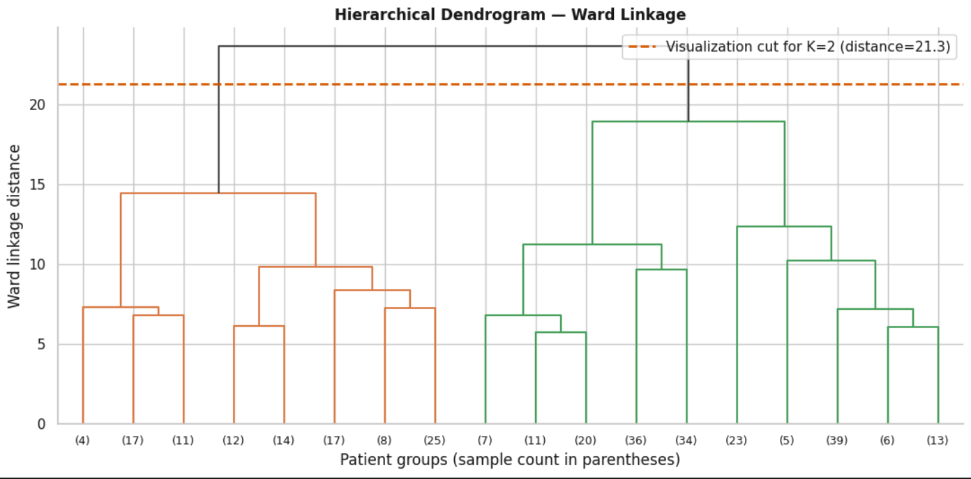

Hierarchical Dendrogram of Heart-Disease Patient Profiles
Ward's Linkage Methodology: Aggregates clusters progressively to minimize the increase in internal variance at each merging step.
Cut-off Threshold Definition: Insertion of the orange dashed line at height 21.3 intercepts the two main branches, providing independent validation of population bipartition ($K=2$).
Structure of Sub-Subpopulations:
  Orange Macro-Branch (Left): Identifies the first main branch based on multivariate similarity.
  Green Macro-Branch (Right): Identifies the second main branch with further hierarchical stratification (sample sizes shown in parentheses)

Slide 17
Comparative Evaluation
Clinical-Mathematical Alignment:
  "Blind" Clustering: K-Means segmented the cohort based exclusively on latent space geometric distances without conditioning labels.
  Phenotype Reconstruction: Clusters spontaneously capture the true biological separation of the dataset
Interpretation of Extracted Cohorts:
  Cluster A Profile: Captures physiological phenotypes with favorable hemodynamic profiles under stress.
  Cluster B Profile: Isolates high-risk pathological profiles sensitive to markers of myocardial distress (oldpeak).

Slide 18
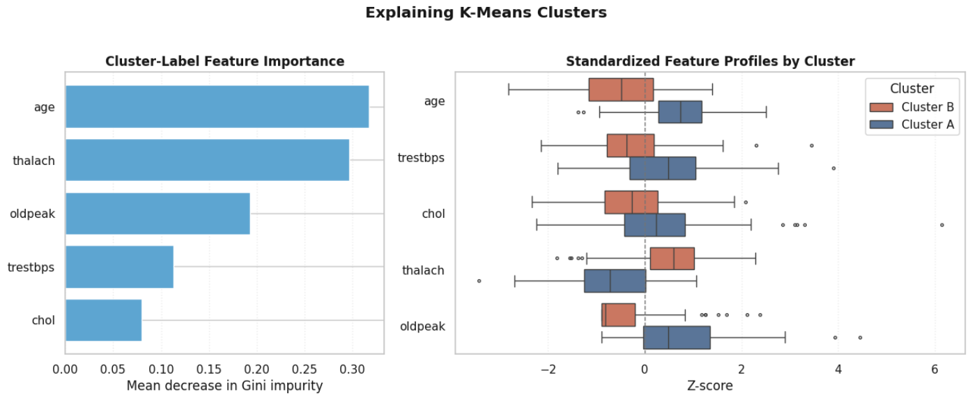
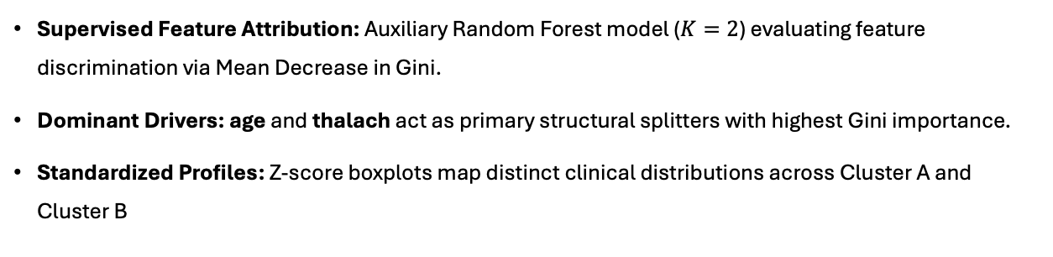
Distribution of Top Feature Drivers across K-Means Clusters
Supervised Feature Attribution: Auxiliary Random Forest model ($K=2$) evaluating feature discrimination via Mean Decrease in Gini.
Dominant Drivers: age and thalach act as primary structural splitters with highest Gini importance.
Standardized Profiles: Z-score boxplots map distinct clinical distributions across Cluster A and Cluster B

Slide 19
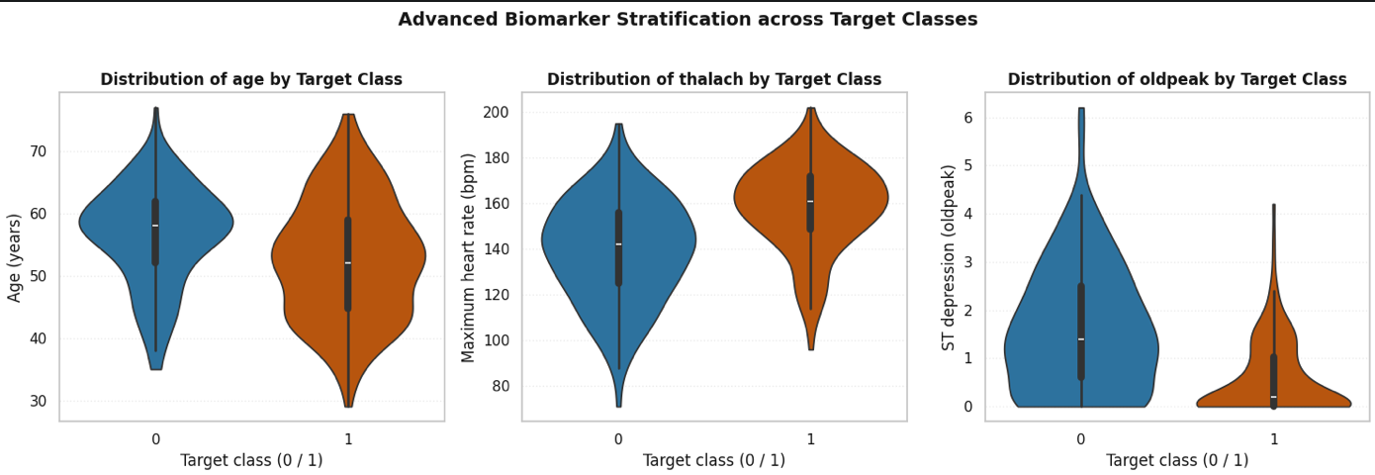
Statistical Biomarker Discrimination
Biomarker Stratification (Violin Plots): Density variations map how continuous metrics differentiate patient groups across target classes.
Hemodynamic Separation: Pathological patients exhibit a wider thalach spread and pronounced oldpeak ST-depression as a primary risk indicator.
Demographic Profile: Pathological cohorts concentrate more heavily in slightly older age brackets

Slide 20
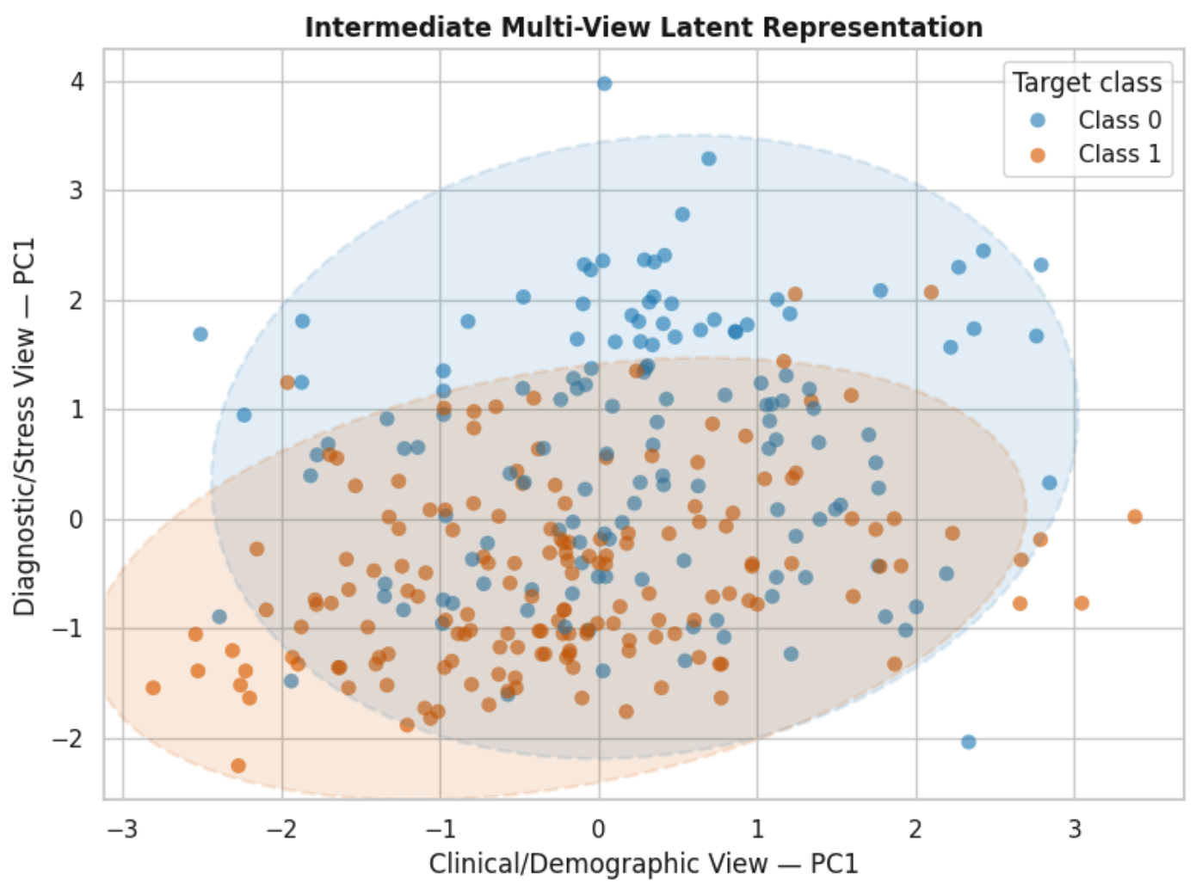
Multi-View Medical Framework
Independent View Decomposition: Separates View 1 (Clinical/Demographic: age, trestbps, chol) from View 2 (Diagnostic/Stress Test: thalach, oldpeak) to prevent cross-source noise.
Late Data Fusion Pipeline: Independent PCA maximizes local variance per view; a shared 2D fusion plane highlights cohort separation; purified multi-view representations feed robust downstream classifiers

Slide 21
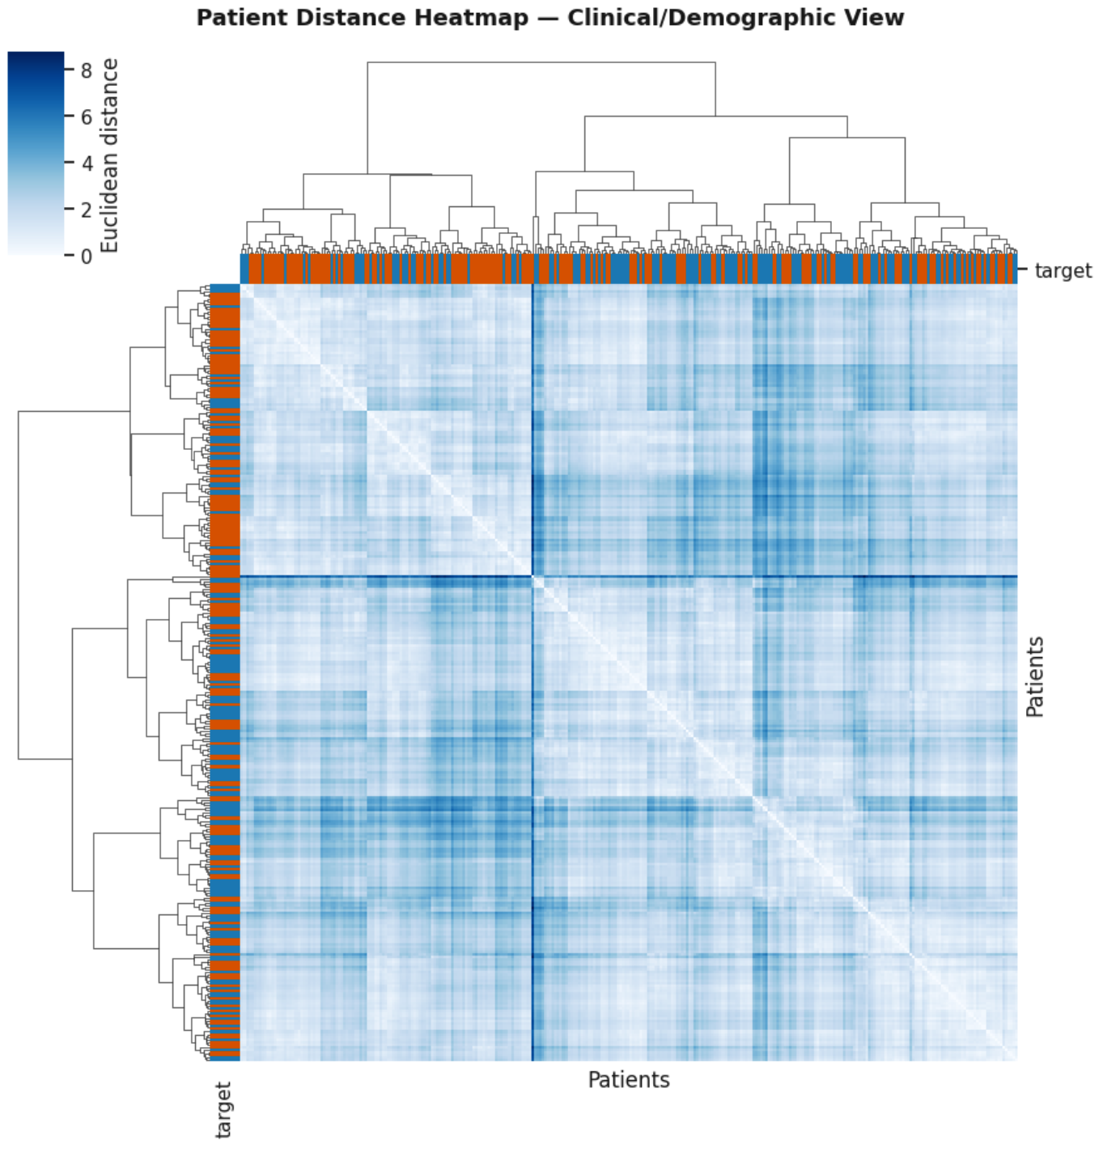
Patient Distance Heatmap
Spatial Similarity Mapping: Euclidean distances quantify geometric similarity within the Clinical-Demographic View; light/dark blue tones denote profile similarity/dissimilarity.
Block Structures & Anomalies: Ward hierarchical clustering reveals diagonal blocks of comparable patient profiles; side color bars verify alignment between clinical similarities and actual disease status

Slide 22
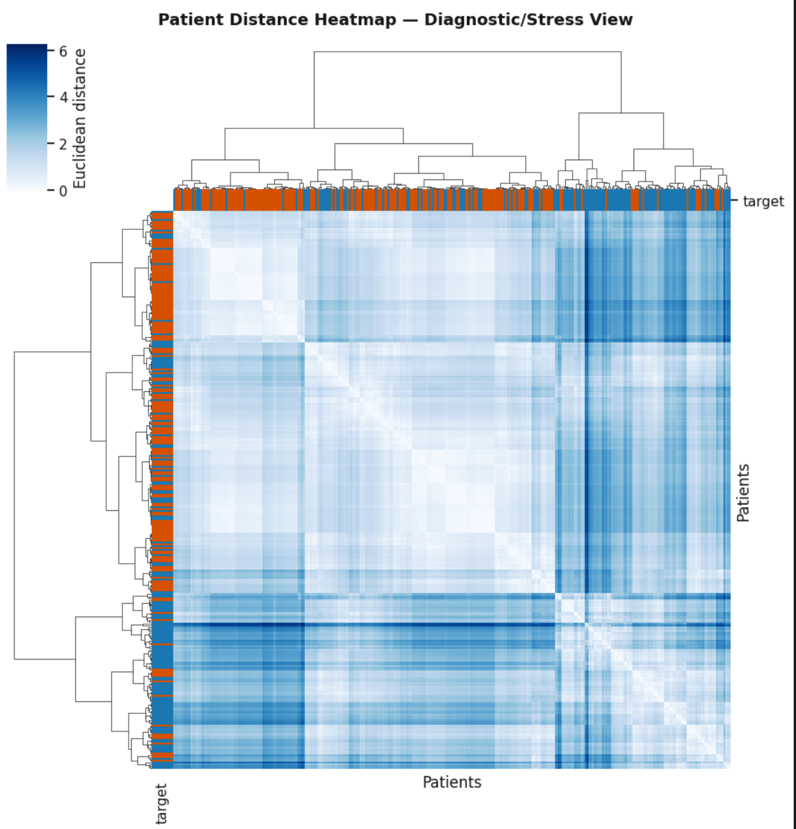
Patient Distance Heatmap (Diagnostic View)
Hemodynamic Isolation: Euclidean distances based solely on the Diagnostic/Stress-Test View (thalach, oldpeak).
Checkerboard Macro-Blocks: Highlights cohorts with nearly identical chronotropic responses under stress.
Acute Signal Sensitivity: Sharp color contrast clearly polarizes pathological phenotypes with a high separation gradient.
Framework Validation: Proves the stress test contains a self-contained diagnostic signal free of demographic noise, ready for Late Fusion

Slide 23
Late Fusion Insight
Staged Architecture (Late Fusion): Extracts independent representations per view instead of early data fusion; integrates only in the common latent space to prevent noise propagation.
Latent Pathology Detection: Identifies patients appearing normal clinically who reveal clear pathological evidence solely in the diagnostic/stress test view

Slide 24
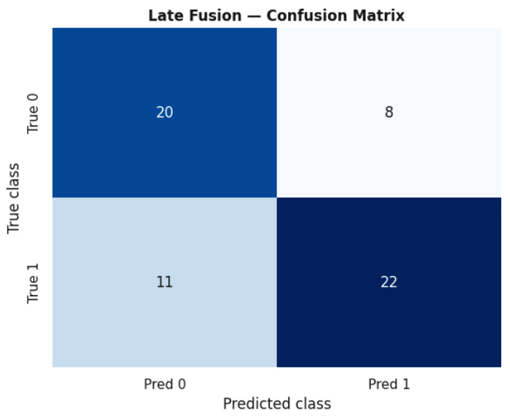
Supervised Performance: Random Forest Confusion Matrix
Test Set Performance: 20/28 correct for Class 0 (8 FPs); 22/33 correct for Class 1 (11 FNs).
Predictive Efficacy: High sensitivity in successfully isolating true pathological instances.
Supervised Validation: Confirms the robust predictive power of the multi-view feature space and Random Forest architecture.

Slide 25
Statistical Density Cohorts
Clinical Anomaly Detection: Boxplots identify critical cases with extreme clinical values, such as cholesterol (chol) > 381 mg/dL and blood pressure (trestbps) > 181 mmHg.
Methodological Rigor (Data Preservation): Fully preserves all 303 original records, recognizing that extreme medical anomalies represent severe pathological phenotypes rather than statistical noise.
Implications for Latent Space: Maintaining the complete distribution is essential for PCA and clustering algorithms to accurately map geometric transitions between healthy profiles and acute pathologies.

Slide 26
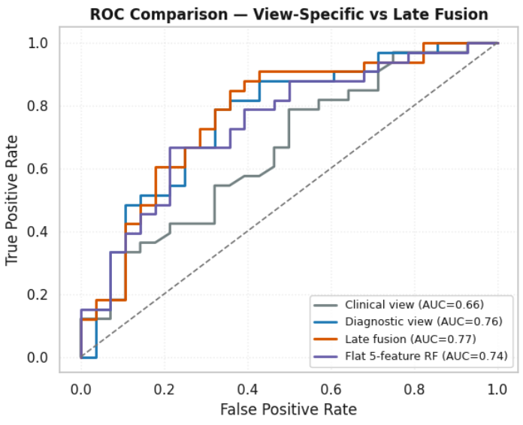

Supervised Diagnostics: ROC Curve Performance
Discriminant Power Validation: ROC curve analysis on an independent test set confirms the effectiveness of Random Forest in distinguishing between the two target classes.
Quantification (AUC = 0.77 for Late Fusion): AUC scores certify statistical robustness and discriminative power, with Late Fusion achieving the highest performance (0.77), followed by the Diagnostic view (0.76), Flat 5-feature RF (0.74), and Clinical view (0.66).
Trajectory Analysis: The progressive rise of the curves above the random classifier line demonstrates a favorable balance between a high True Positive Rate and a controlled false alarm rate.
Effectiveness of Multi-View Architecture: The clear separation from the diagonal random line ($\text{AUC}=0.50$) mathematically validates the contribution and superiority of the multi-view predictive framework

Slide 27
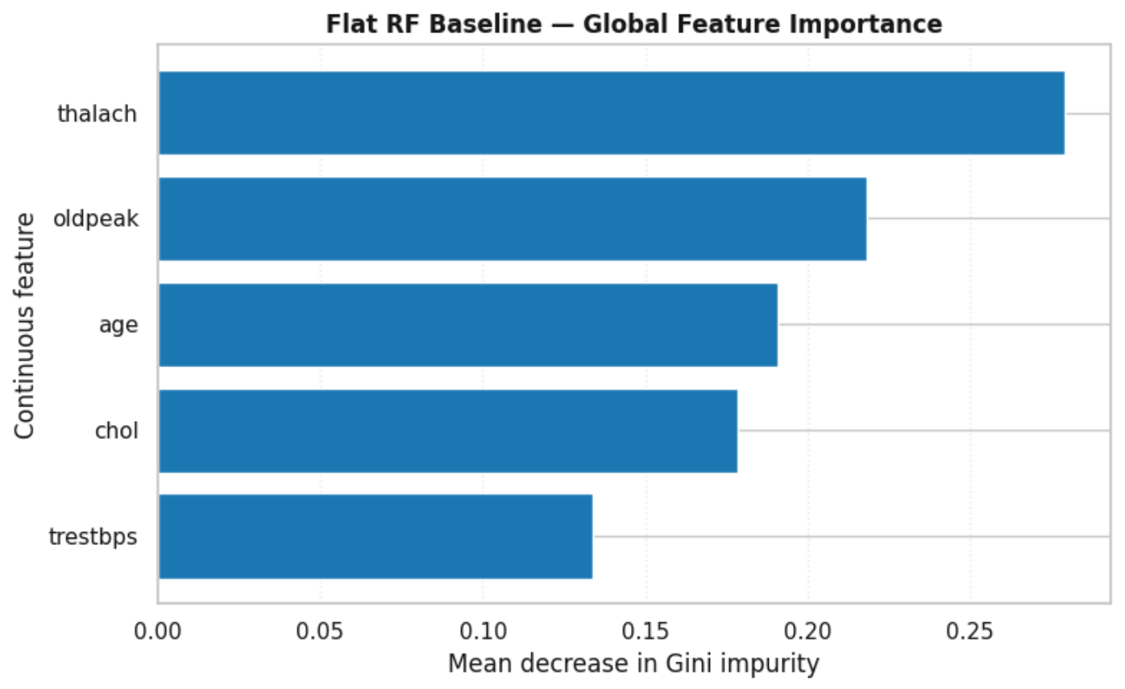
Global Explainability: Computational Weight of Clinical Features
Algorithmic Transparency (XAI): Application of the Mean Decrease in Gini Impurity to quantify the statistical impact of each continuous feature on the model's decision stability.
Top Diagnostic Drivers:
  thalach & oldpeak (Dominant): Ranked as primary ensemble drivers, confirming that maximum heart rate under stress and ST-depression hold the highest relative statistical importance in determining cardiac risk.
  age (Fundamental): Follows closely, demonstrating that the model effectively balances demographic background with clinical metrics.
Intermediate & Secondary Contribution:
  chol & trestbps: Serum cholesterol and resting blood pressure provide the secondary physiological context necessary to refine decision boundaries, though with lower relative Gini importance compared to primary functional and demographic indicators

Slide 28
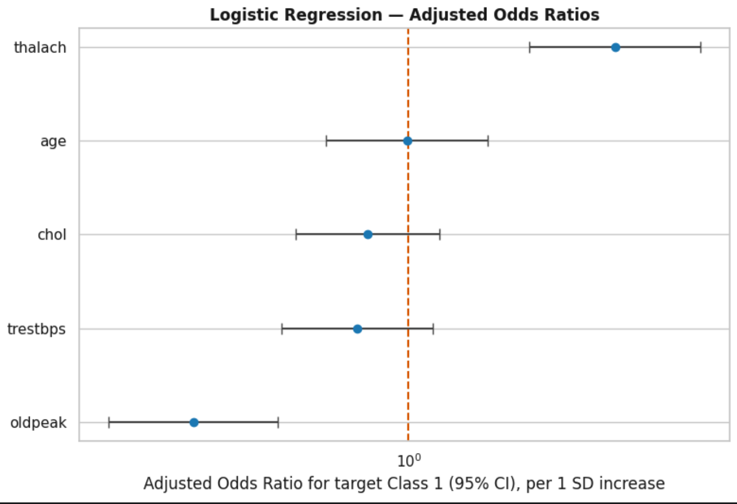

Adjusted Odds Ratios (Forest Plot)
Methodological Approach: Implementation of a multivariable logistic regression on standardized continuous features (age, trestbps, chol, thalach, oldpeak) to extract adjusted Odds Ratios (ORs) and 95% confidence intervals, quantifying net association with cardiac disease risk.
Feature Associations (Odds Ratios relative to Nullity Line at $OR=1.0$):
  thalach (Positive Association): Positioned to the right of the nullity line ($OR>1$), reflecting its strong predictive relationship within the multivariable space.
  age (Neutral Association): Centered near the nullity line ($OR≈1$), indicating balanced net effects when adjusted for other hemodynamic parameters.
  chol, trestbps, & oldpeak (Inverse Associations in Model): Positioned to the left of the unit line ($OR<1$) under multivariable adjustment, highlighting conditional interactions in the logistic regression equation.
Statistical Significance: Error bars represent 95% confidence intervals, illustrating precision and estimation uncertainty for each continuous clinical feature

Slide 29
Conclusions & Future Work
Data Integrity: Validation of a robust, complete, and balanced dataset, ensuring a solid basis for clinical inference.
Unsupervised Learning: The synergy between PCA and K-Means enabled the autonomous extraction of pathological patterns, confirming the geometric relevance of biomarkers.
Multi-View Framework: The Late Fusion approach demonstrated diagnostic superiority, isolating specific hemodynamic signals from baseline demographic noise.
Future Vision: The project demonstrates the value of Visual Analytics integrated with Artificial Intelligence, paving the way towards transparent and interpretable predictive medicine (XAI).

