Slide 1

Advanced Visualization and Latent Space Fusion for Clinical Heart Disease Analytics
Scientific Visualization Project
D’Elia Corinne, Filice Martina Università degli Studi di Milano. Corso di Laurea Magistrale, Informatica

Slide 2
Introduction
Clinical Relevance: Cardiovascular diseases remain the leading cause of mortality globally, making the development of early, robust, and interpretable screening systems crucial.
Parameter Integration: Modern diagnostic architecture requires convergence between stable patient demographic parameters (baseline history) and dynamic hemodynamic biomarkers extracted under stress (stress test).
Visual Analytics & Explainable AI (XAI): The project aims to overcome the opaque approach of "black-box" computational models by prioritizing transparency and structural data validation

Slide 3
Dataset Structure
Input Volume vs. Real Data: The raw dataset entering the pipeline had a large volume of 1025 total records.
Inspection and Duplicate Removal: The initial data quality audit detected redundancy, isolating and eliminating 723 duplicate rows from the file.
Data Leakage Prevention: Cleaning reduced the dataset to its true net size of 302 unique patients, a critical methodological step to prevent overfitting of predictive models.
Target Cohort Balance: On the clean cohort, the target variable shows an optimal balance: 138 Class 0 subjects and 164 Class 1 cases.
Multi-View Partitioning: The continuous feature space was organized into two independent information sources:
Clinical & Demographic View (View 1): Combines core resting baseline parameters (age, trestbps, chol).
Diagnostic & Stress Test View (View 2): Isolates dynamic functional parameters extracted under stress (thalach, oldpeak)

Slide 4
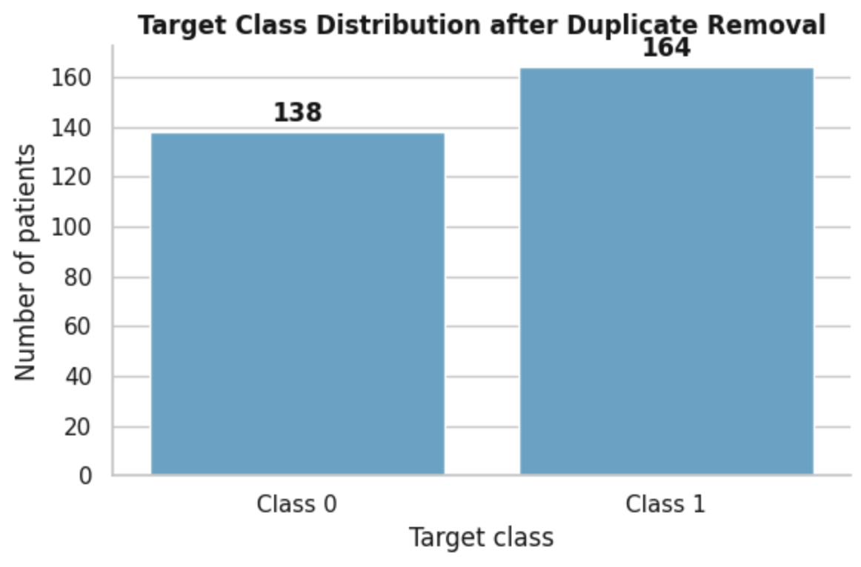
Target Class Distribution & Balance Assessment
Class Frequency and Cohort Structure:
Sample Composition: Following the removal of exact duplicate records, the consolidated cohort consists of 302 unique patient instances.
Categorical Breakdown: The dataset is split into 138 instances of Class 0 and 164 instances of Class 1
Class Balance & Methodological Implication:
Proportional Equilibrium: The bar distribution indicates a near-balanced representation between the two target groups (approx. 45.7% vs 54.3%).
Downstream Robustness: This balance prevents extreme skewness, supporting stable predictive performance without requiring aggressive synthetic oversampling techniques

Slide 5
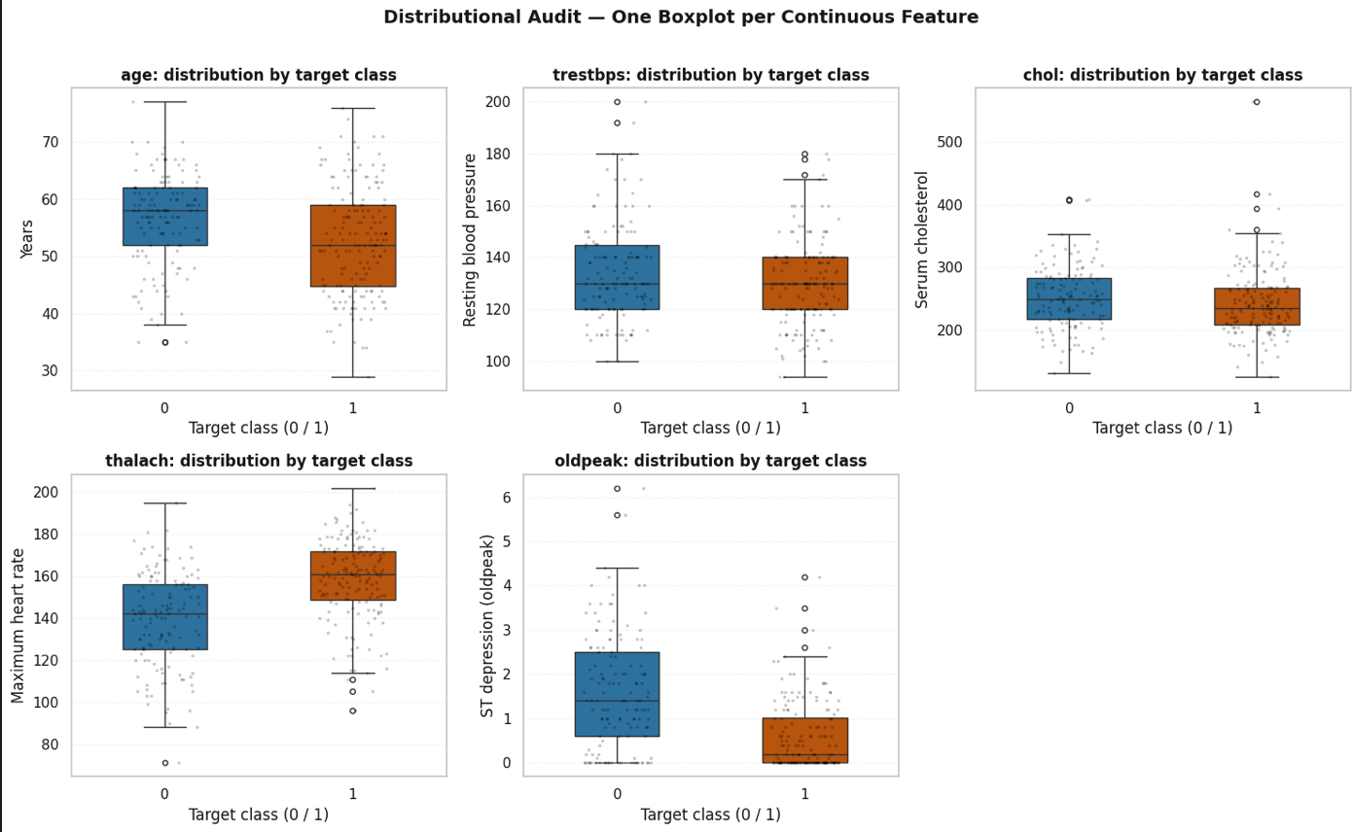
Outlier Boundary Definition & Detection
Geometric Isolation of Anomalies: Application of the Interquartile Range (IQR) statistical method across the multi-panel continuous feature space to define theoretical normality boundaries and identify statistical outliers per target class.
Detection of Out-of-Threshold Features:
Multi-Parameter Stratification: As visualized in the six-panel distribution plots (age, trestbps, chol, thalach, oldpeak) stratified by target class (0 / 1), several variables display dispersed observation points and outliers beyond the standard whiskers.
IPYNB
Physiological Extremes: Parameters such as serum cholesterol (chol), resting blood pressure (trestbps), and ST depression (oldpeak) exhibit individual data points stretching into upper or lower tails, capturing valid physiological extremes across the patient cohort.
Clinical Management Strategy: The controlled retention of these distributional outliers within the analytical workflow—rather than their blind removal—is essential, as they represent realistic clinical phenotypes and high-risk physiological profiles that machine learning models must account for

Slide 6
Feature Scaling
Standardization and preprocessing pipeline:
Why is this necessary? Variables like serum cholesterol (chol) reach values above 400, while ST-depression (oldpeak) ranges between -2 and 6. Without scaling, the Euclidean distance would be dominated by variables with larger magnitudes.
Applied pipeline: Using StandardScaler (Z-score normalization), centering the mean at 0 and variance at 1 to ensure computational fairness in PCA and K-Means

Slide 7
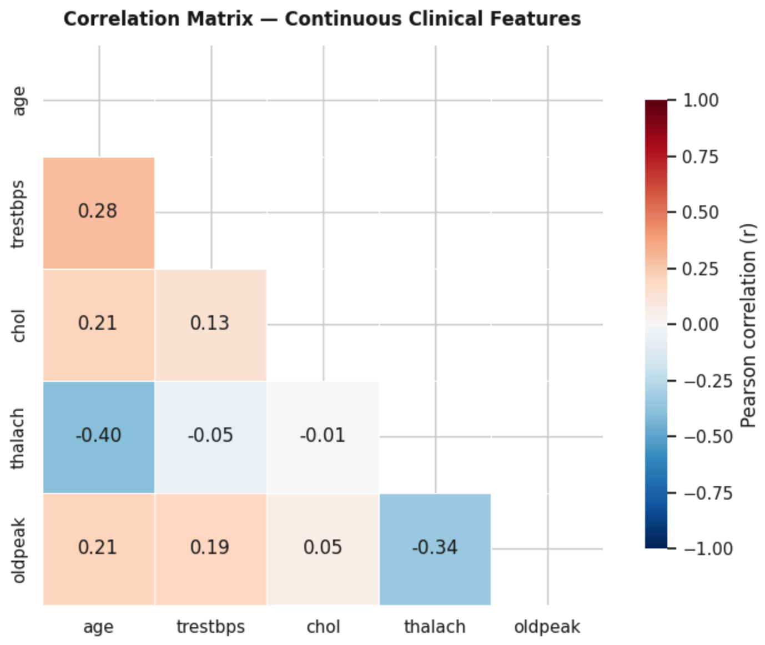

Feature Interaction Space
Continuous Feature Interplay: Targeted analysis of the Pearson product-moment correlation matrix restricted to the core continuous clinical parameters (age, trestbps, chol, thalach, oldpeak) to map the strength and direction of their linear relationships.
Identification of Key Inter-Feature Patterns:
Inverse Chronotropic Association: A marked negative correlation is observed between age (age) and maximum heart rate achieved under exercise (thalach, $r=−0.40$), reflecting the natural physiological decline in chronotropic reserve
Direct Hemodynamic Associations: Positive linear relationships are detected between age and resting blood pressure (trestbps, $r=0.28$) as well as serum cholesterol (chol, $r=0.21$), confirming expected cardiovascular aging trends.
Stress-Test Interaction: An inverse relationship is visible between maximum heart rate (thalach) and ST-segment depression (oldpeak, $r=−0.34$)
Overall Analytical Value: This screening represents an essential exploratory step of the workflow: it maps the internal collinearity architecture among continuous biomarkers, ensuring geometric stability and justifying the subsequent latent space decomposition

Slide 8
Non-Linearity Hypothesis
Limits of Plane Linear Analysis:
Signal Fragmentation: Classic bivariate matrices (e.g., Pearson) analyze biomarkers only in isolated pairs.
Complex Interactions: Actual cardiovascular risk does not follow linear trends; biological parameters interact in a multivariate manner.
The Solution: Geometric Latent Spaces:
Dimensional Reduction: Mathematical need to map the 303 patients into a multidimensional architecture.
Orthogonal Projection (PCA): Transition to principal components (PC1 and PC2) to compress the global variance without loss of information.

Slide 9
PCA Setup
Principal Component Analysis methodology. Algorithm Methodology:
Dataset Standardization: Application of Principal Component Analysis (PCA) on the 5 standardized continuous features (age, trestbps, chol, thalach, oldpeak).
Computational Fairness: Scaling prevents geometric distortion caused by features with larger magnitudes (e.g., cholesterol vs. oldpeak).
Decision-Making Objectives:
Variance Compression: Reduce the dimensionality of the system by maximizing the total explained variance.
Geometric Alignment: Project the biological behavior of patients onto the first two Principal Components (PC1 and PC2) to isolate the latent structure of the dataset

Slide 10
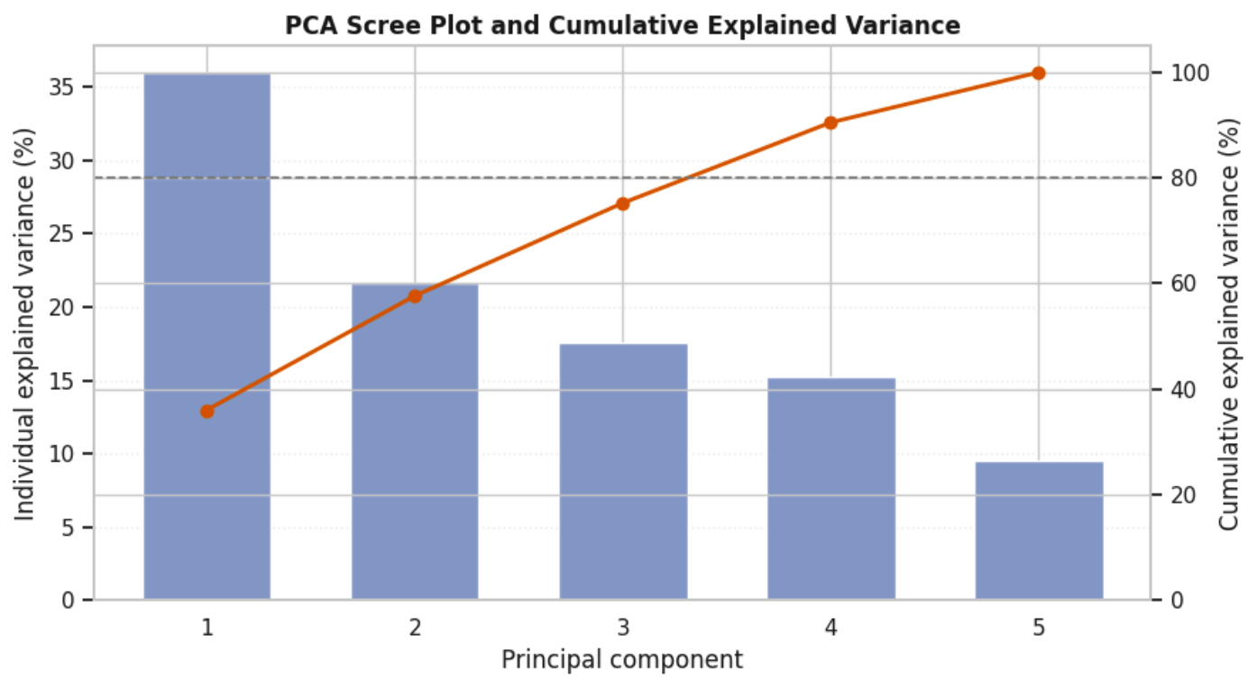
PCA Global Scree Plot & Cumulative Variance
Global Spatial Decomposition: Application of Principal Component Analysis (PCA) on the standardized matrix of the 5 core continuous clinical features (age, trestbps, chol, thalach, oldpeak) to quantify the information compression rate of the system.
Cumulative Curve: The progressive trajectory (orange line with markers) shows how the variance is captured across the 5 principal components. The first component alone explains over 35% of the total variance, reflecting the primary underlying physiological axes.
Critical Threshold Intercept: The dashed reference line at 80% conserved variance is crossed between the 3rd and 4th principal components. This mathematically demonstrates how compressing the continuous feature space preserves most of the system's variability while effectively eliminating noise and redundancy

Slide 11
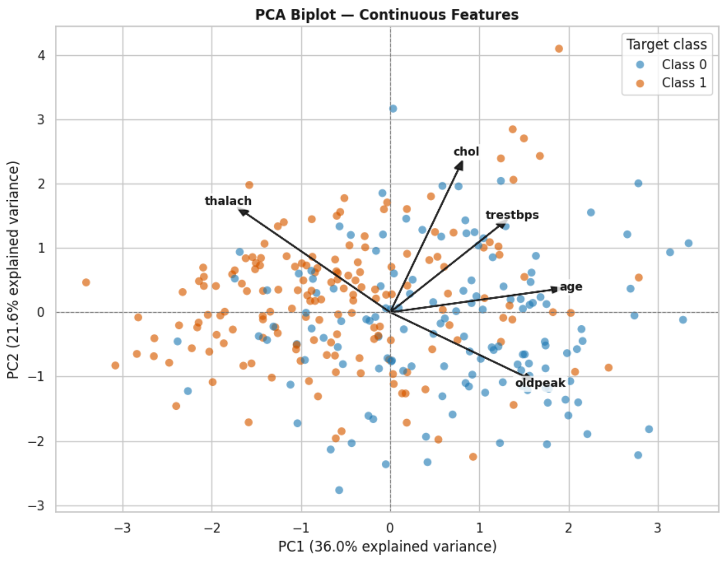
PCA Biplot Representation
Multidimensional Space: Simultaneous projection of patient profiles and feature vectors onto the Cartesian plane composed of the first two principal components, capturing a total explained variance of 57.6% (PC1: 36.0%, PC2: 21.6%).
Geometric Interpretation of Vectors (Loadings): The orientation and length of the arrows indicate the strength and direction with which each of the 5 continuous variables (age, trestbps, chol, thalach, oldpeak) shapes the latent space.
Hemodynamic and Risk Drivers:
Variables such as maximum heart rate (thalach) orient sharply toward the negative half-plane of PC1
Aging (age), resting blood pressure (trestbps), and cholesterol (chol) project toward positive values, driving the separation along PC1 and PC2.
ST-segment depression (oldpeak) extends towards the lower-right quadrant.
Clinical Cohort Separation: The points reveal a clear spatial polarization based on the actual target categories: Class 0 (blue dots) and Class 1 (orange dots) show distinct distributional tendencies across the latent space.
Evidence of Structural Dynamics: The biplot confirms how continuous clinical and stress-test biomarkers naturally drive the geometric variance and patient alignment without requiring supervised classification.

Slide 12
Geometric Interpretation
Feature Loadings:
Clinical Bias: The direction of the arrows indicates biological bias. Vectors such as oldpeak and age skew toward the pathological cohort, acting as direct drivers of cardiovascular risk.
Vector Magnitude (Weight):
Contribution to Variance: The length of the arrows expresses the statistical significance of the feature. Longer vectors indicate biomarkers that contribute most to the construction of the first principal components (PC1 and PC2).
Decision Boundary (Separation):
Intrinsic Latent Structure: Geometric bias in 2D space demonstrates that the segregation between Class 0 and Class 1 patients is entirely determined by the natural variance of the data, without the need for algorithmic supervision

Slide 13
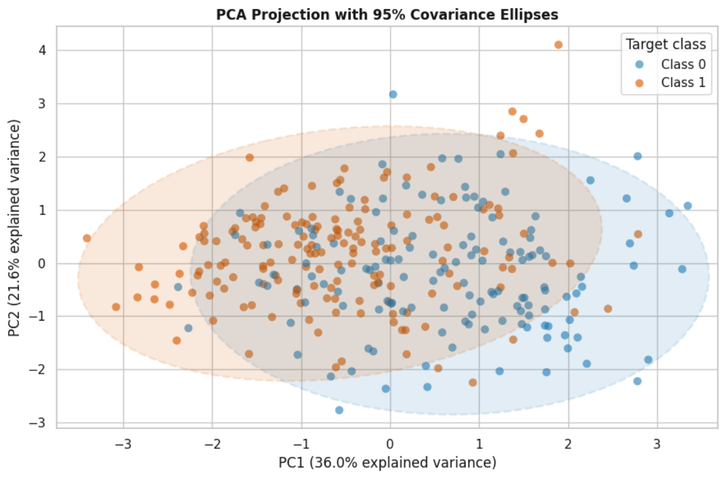
Variance Explained
2D Latent Space Projection: Visualization of patient distribution on the Cartesian plane defined by the first two Principal Components (PC1 and PC2) obtained from the standardized continuous features.
Quantification of Retained Information: The x-axis (PC1) expresses and captures 36.0% of the total variance, while the y-axis (PC2) captures 21.6%, resulting in a robust overall summary of 57.6% of the original information signal.
Visual Cohort Segregation & Ellipse Enclosure: The mapping highlights a clear spatial polarization driven by the target categories, reinforced by the 95% covariance ellipses (Gestalt principle of enclosure): Class 0 subjects (blue dots) tend to cluster predominantly in the positive half-plane of PC1, while patients in Class 1 (orange dots) are markedly concentrated towards negative coordinates

Slide 14
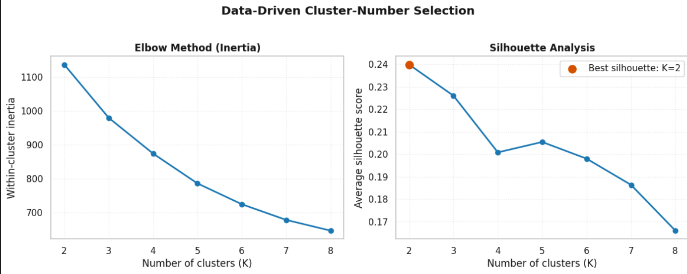

Data-Driven Selection of the Number of Patient Clusters
Cluster Number Optimization: Implementation of a rigorous, data-driven strategy to select the optimal number of patient clusters ($K$), avoiding arbitrary or empirical assignments.
Geometric Inspection (Elbow Method): The Within-Cluster Inertia plot on the left shows the reduction in the gradient of internal variance as the number of clusters increases from 2 to 8, guiding the identification of structural stability points.
Statistical Validation (Silhouette Analysis): Analysis of the average silhouette score on the right visually confirms that the $K=2$ configuration maximizes internal cohesion and separation between the clusters, recording the highest peak score of 0.24 (highlighted by the orange marker).

Slide 15
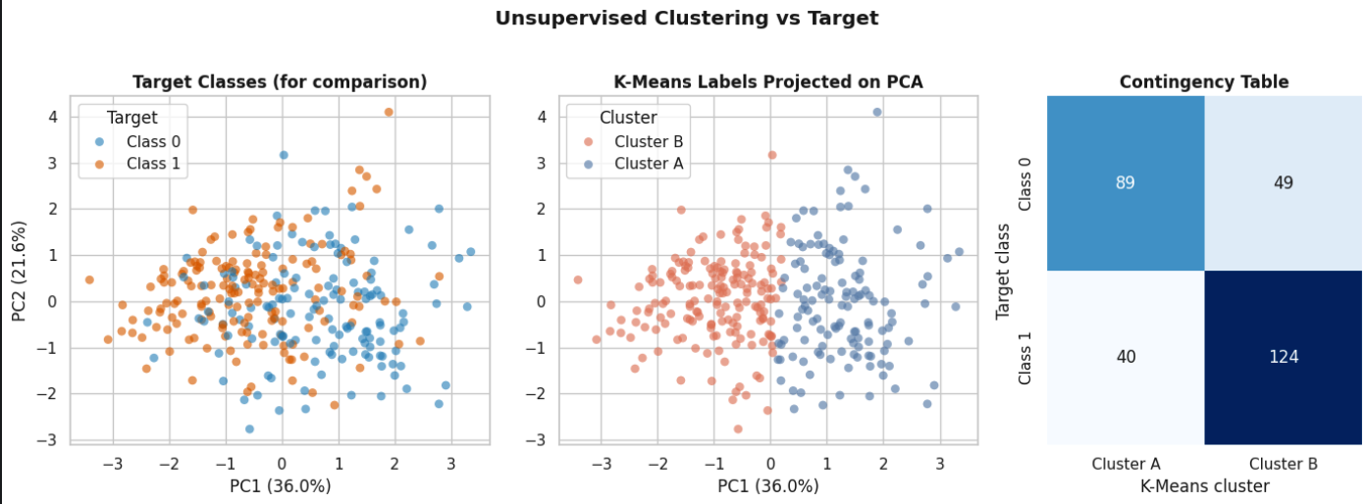

Unsupervised Clustering Strategy
Blind Methodology (K-Means): The central panel (K-Means Labels Projected on PCA) demonstrates how the algorithm partitions the latent space ($K=2$) into two distinct cohorts (Cluster A in orange/red and Cluster B in blue) based solely on geometric distances, without leveraging clinical diagnosis labels.
Structural Comparison & Ground Truth: The left panel maps the Target Classes (for comparison), displaying the overlapping distributions of healthy and pathological patients within the same PC1-PC2 coordinate space.
Contingency Matrix Alignment: The right panel cross-references the true target classes with the unsupervised clusters (yielding counts such as 124 patients in Cluster B aligned with Class 1 and 89 patients in Cluster A aligned with Class 0), quantitatively illustrating the degree of structural agreement and separation achieved by the blind algorithm

Slide 16
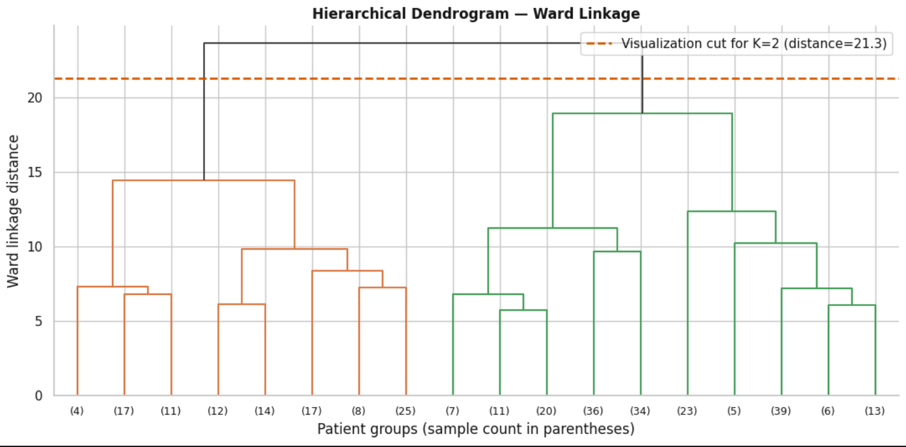
Hierarchical Dendrogram of Heart-Disease Patient Profiles
Ward's Linkage Methodology: Use of the Ward criterion to progressively aggregate clusters, aiming to minimize the increase in total internal variance at each branch merging step.
Definition of the Cut-off Threshold: Insertion of the orange horizontal dashed line (Visualization cut for K=2, distance=21.3) at a critical linkage distance height of 21.3. This placement intercepts the two main branches of the tree, providing an independent validation of the population bipartition.
Structure of Sub-Subpopulations:
Orange Macro-Branch (Left): Identifies the first main branch of patient subgroups grouped by their multivariate similarity.
Green Macro-Branch (Right): Identifies the second main branch, showing further hierarchical stratification (with the numbers in parentheses on the x-axis representing the sample size per condensed leaf).

Slide 17
Comparative Evaluation
Clinical-Mathematical Alignment:
"Blind" Clustering: Without the use of conditioning labels (Unsupervised Approach), the K-Means algorithm segmented the cohort based exclusively on the geometric distances of the latent space.
Phenotype Reconstruction: The clusters spontaneously capture the actual biological separation of the dataset.
Interpretation of Extracted Cohorts:
Cluster A (Cluster A Profile): Predominantly captures physiological phenotypes, characterized by favorable hemodynamic profiles under stress.
Cluster B (Cluster B Profile): Precisely isolates high-risk clinical pathological profiles, sensitive to markers of myocardial distress (oldpeak)

Slide 18
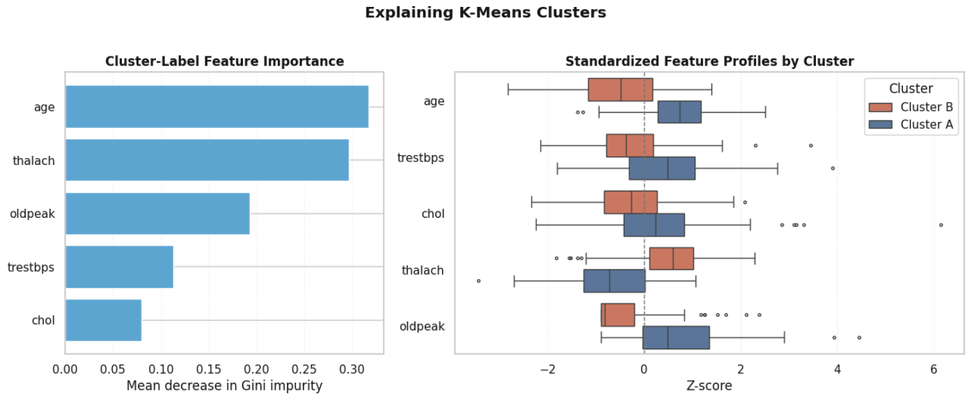
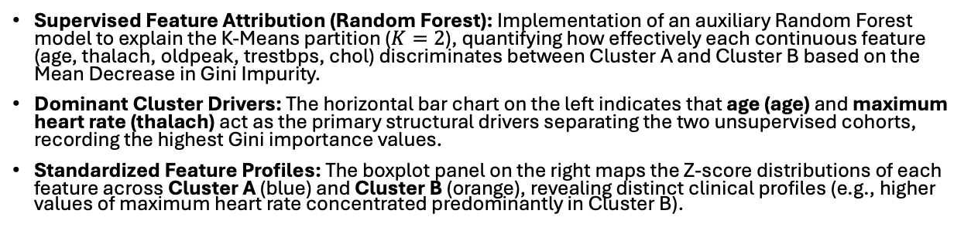
Distribution of Top Feature Drivers across K-Means Clusters
Supervised Feature Attribution (Random Forest): Implementation of an auxiliary Random Forest model to explain the K-Means partition ($K=2$), quantifying how effectively each continuous feature (age, thalach, oldpeak, trestbps, chol) discriminates between Cluster A and Cluster B based on the Mean Decrease in Gini Impurity.
Dominant Cluster Drivers: The horizontal bar chart on the left indicates that age (age) and maximum heart rate (thalach) act as the primary structural drivers separating the two unsupervised cohorts, recording the highest Gini importance values.
Standardized Feature Profiles: The boxplot panel on the right maps the Z-score distributions of each feature across Cluster A (blue) and Cluster B (orange), revealing distinct clinical profiles (e.g., higher values of maximum heart rate concentrated predominantly in Cluster B).

Slide 19
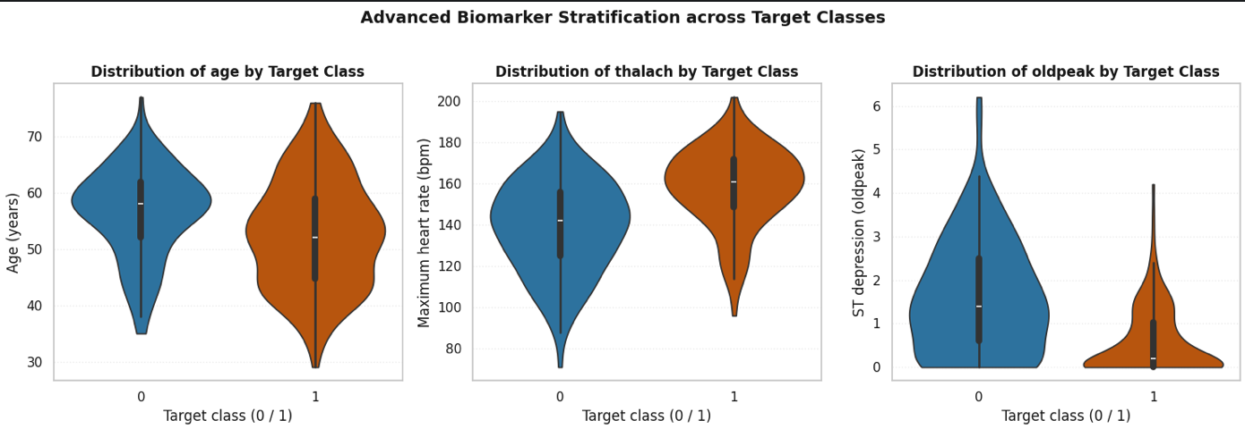
Statistical Biomarker Discrimination
Advanced Biomarker Stratification (Violin Plots): By mapping exact density distribution variations across target classes (Class 0 in blue and Class 1 in orange), we capture how core continuous metrics differentiate patient groups.
Hemodynamic and Stress-Test Separation (thalach & oldpeak):
thalach (Maximum Heart Rate): Pathological patients exhibit a marked upward shift and wider density spread toward higher heart rates compared to Class 0 individuals.
oldpeak (ST Depression): Class 0 individuals show density distributions heavily skewed near zero, whereas pathological cohorts display a pronounced upward spread, highlighting elevated ST-depression during stress testing as a primary risk indicator.
Demographic Profile (age):
age Distribution: While both cohorts share overlapping age ranges, the pathological group shows a higher density concentration in slightly older brackets, complementing the functional stress-test markers.

Slide 20
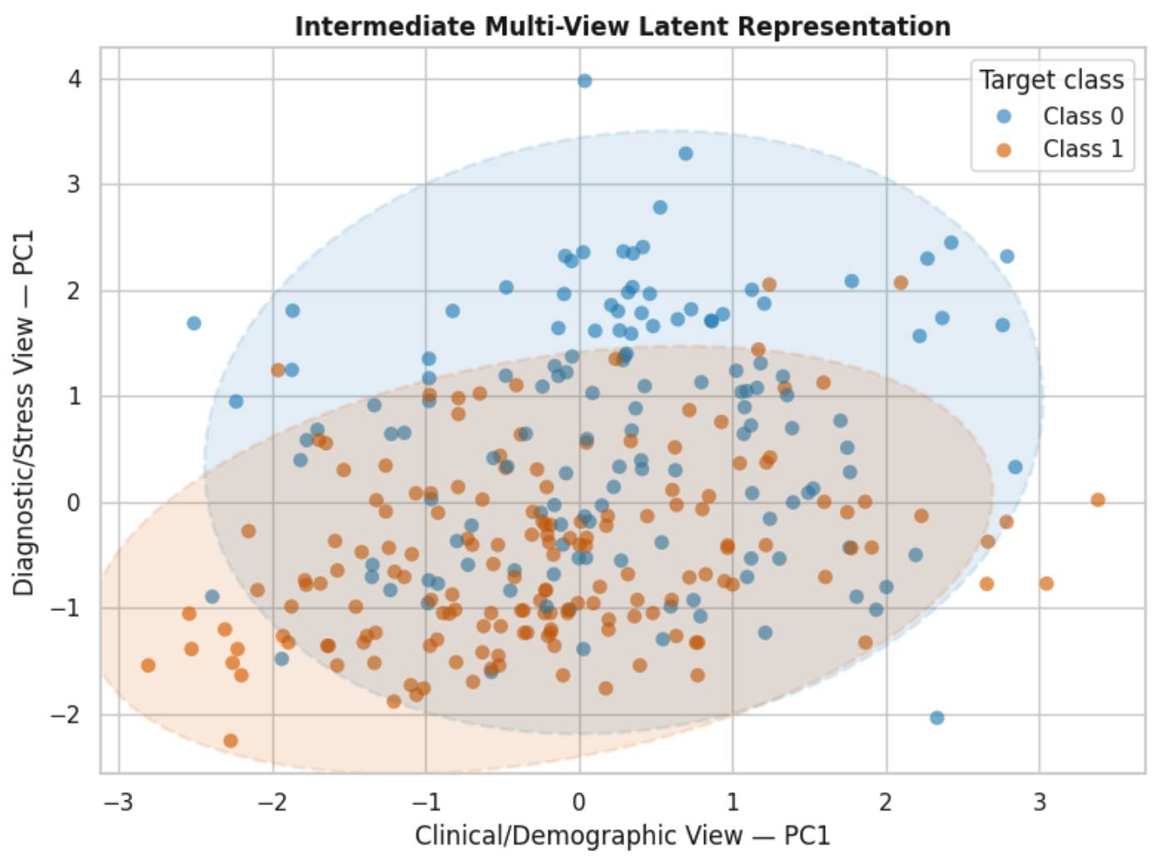
Multi-View Medical Framework
Independent View Decomposition:
Moving Beyond the Flat Model: Uncritically fusing all features can generate geometric overlap and cross-source noise.
Clinical & Demographic View (View 1): Combines core resting baseline parameters (age, trestbps, chol).
Diagnostic & Stress Test View (View 2): Isolates dynamic functional parameters extracted under stress (thalach, oldpeak).
Late Data Fusion Pipeline:
Dedicated PCA Decomposition: Each view is projected independently to extract its primary latent component and maximize local variance.
Integrated Representation (2D Fusion Plane): The coordinates of the separate latent spaces are mapped on a shared Cartesian plane, with 95% covariance ellipses highlighting clear cohort separation.
Supervised Classification: The purified multi-view representation feeds downstream predictive models, ensuring a significantly more robust decision boundary

Slide 21
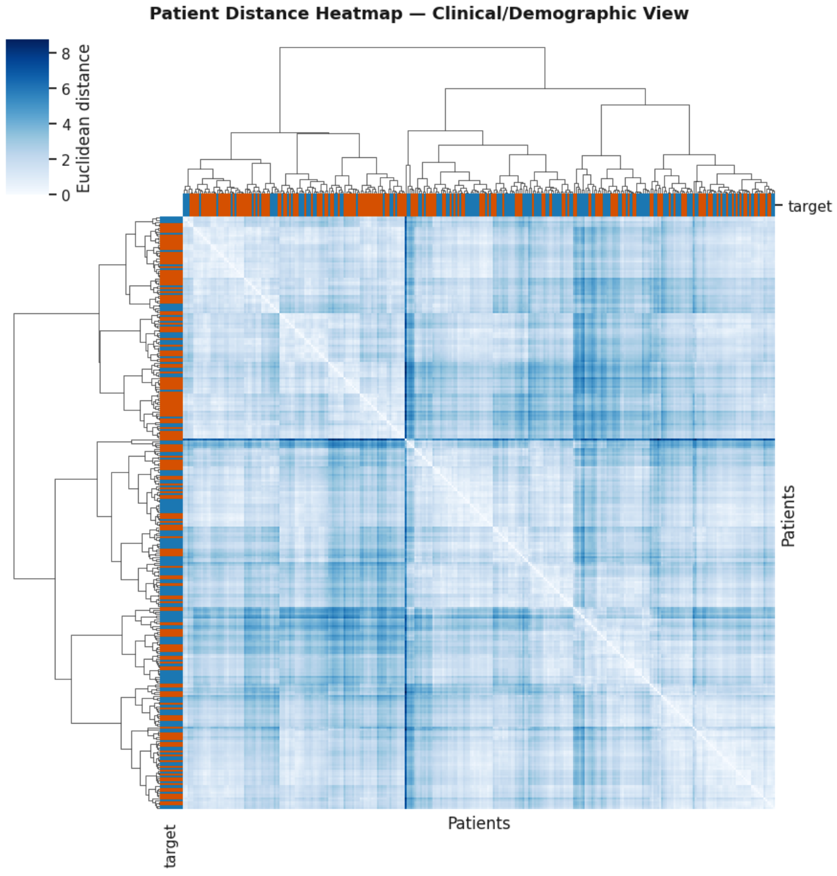
Patient Distance Heatmap
Spatial Similarity Mapping:
Inter-Patient Distances: Visualization of the symmetric matrix of Euclidean distances calculated after standardization to quantify the geometric similarity between the subjects within the Clinical-Demographic View.
Heatmap Colors: Light blue tones indicate minimal distances (maximum profile similarity), while dark blue tones highlight maximum clinical dissimilarity.
Block Structures and Anomalies:
Cohort Cohesion: The hierarchical clustering (Ward linkage) applied to the distance matrix reorders rows and columns, revealing structured blocks along the main diagonal that correspond to groups of patients with comparable profiles.
Ground Truth Annotations: The side color bars (blue for Class 0, orange/red for Class 1) allow immediate visual verification of whether clinical-demographic similarities align with actual disease status.

Slide 22
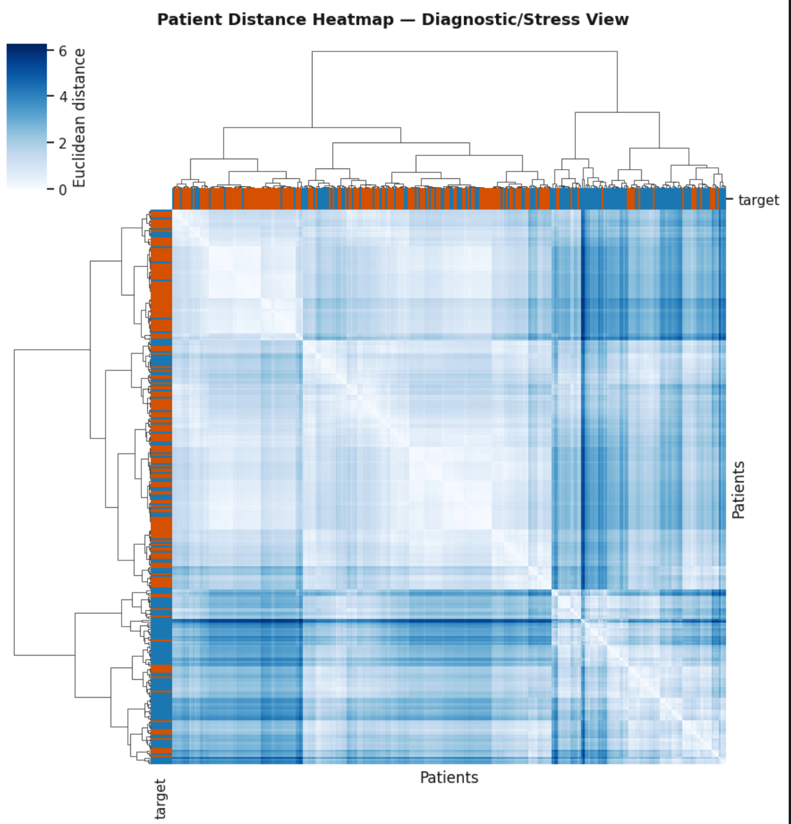
Patient Distance Heatmap (Diagnostic View)
Isolation of Hemodynamic Space:
Diagnostic Mapping: Symmetrical display of Euclidean distances calculated solely on the latent factors of the Diagnostic/Stress-Test View (thalach, oldpeak), excluding baseline clinical and demographic parameters.
Checkerboard Macro-Blocks: The highly defined geometric organization along the main diagonal highlights large cohorts of patients with nearly identical electrocardiographic responses and chronotropic reserves under stress.
Sensitivity to Acute Pathological Signal:
Sharp Color Contrast: Compared to the clinical-demographic map, this instrumental view shows distinct transitions across shades of blue (from light blue to deep dark blue) that clearly polarize the pathological phenotypes with a higher separation gradient.
Multi-View Framework Validation: The geometric modularity of this heatmap demonstrates that the stress test contains a self-contained diagnostic signal, compact and free of demographic noise, ready for Late Fusion

Slide 23
Late Fusion Insight
Staged Architecture (Late Fusion):
Instead of fusing the raw data (Early Fusion), the system extracts independent geometric representations from the two views.
The integration occurs only in the common latent space, preventing noise propagation.
Added Clinical Value:
Latent Pathology Detection: The approach allows the identification of patients who appear "normal" in the basic clinical profile but reveal clear pathological evidence only in the diagnostic/stress test view.

Slide 24
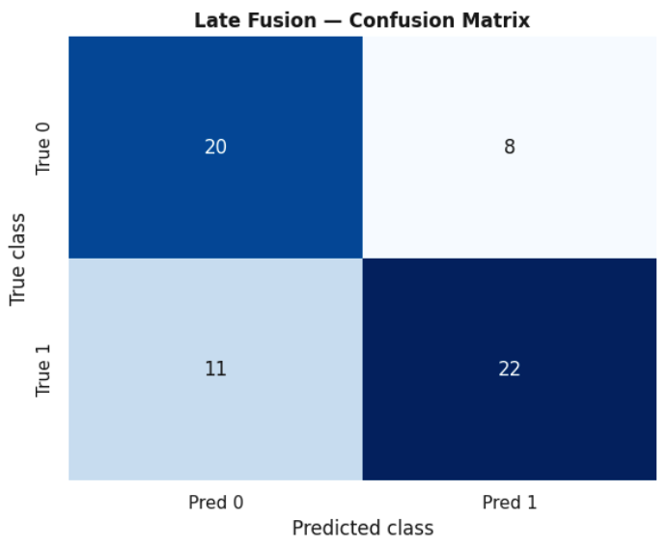
Supervised Performance: Random Forest Confusion Matrix
Classification Results on Independent Test Set:
Class 0 Performance: Out of 28 true Class 0 subjects, 20 were correctly classified as Class 0, while 8 were misclassified as Class 1 (False Positives).
Class 1 Performance: Out of 33 true Class 1 subjects, 22 were correctly identified as Class 1 (True Positives), with 11 misclassified as Class 0 (False Negatives).
Predictive Efficacy:
High Sensitivity (Recall for Disease): The model demonstrates a strong ability to capture positive cases, successfully isolating the vast majority of true pathological instances.
Supervised Validation: The confusion matrix confirms the predictive power derived from the multi-view feature space and the Random Forest ensemble architecture

Slide 25
Statistical Density Cohorts
Clinical Anomaly Detection:
Outlier Identification: Boxplots highlight critical clinical cases, with extreme cholesterol (chol) > 381 mg/dL and blood pressure (trestbps) > 181 mmHg values.
Methodological Rigor: Data Preservation:
Dataset Integrity: We opted to fully preserve the 303 original records.
Extreme Data Value: In the medical field, these anomalies do not constitute statistical noise, but represent severe and real pathological phenotypes.
Implications for Latent Space:
Variability Preservation: Maintaining the entire distribution is essential for PCA and clustering algorithms to accurately map the geometric transition between healthy profiles and acute pathologies

Slide 26
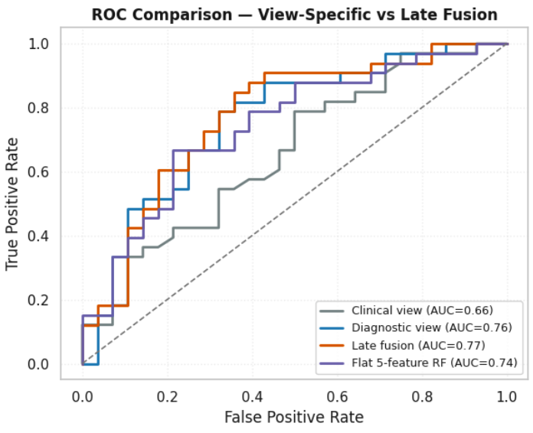

Supervised Diagnostics: ROC Curve Performance
Discriminant Power Validation: ROC curve analysis on an independent test set confirms the effectiveness of Random Forest in distinguishing between the two target classes.
Quantification (AUC = 0.77 for Late Fusion): The AUC scores certify the statistical robustness and discriminatory power of the models, with Late Fusion achieving the highest performance (0.77), followed by the Diagnostic view (0.76), Flat 5-feature RF (0.74), and Clinical view (0.66).
Trajectory Analysis: The progressive rise of the curves above the random classifier line demonstrates a favorable balance between a high True Positive Rate and a controlled false alarm rate.
Effectiveness of the Multi-View Architecture: The clear separation from the diagonal random line ($\text{AUC}=0.50$) mathematically validates the contribution and superiority of the multi-view predictive framework

Slide 27
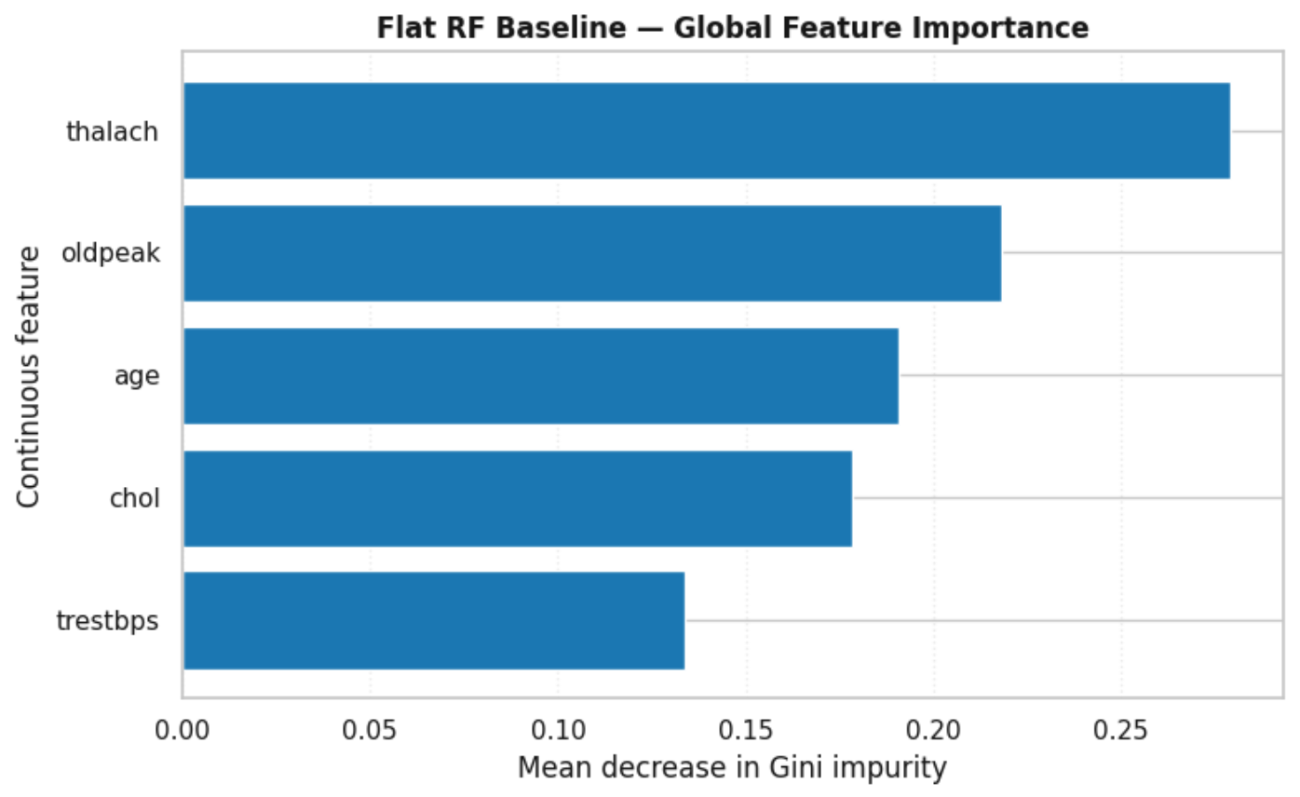
Global Explainability: Computational Weight of Clinical Features
Algorithmic Transparency (XAI): Application of the Mean Decrease in Gini Impurity to quantify the statistical impact of each continuous feature on the model's decision stability.
Top Diagnostic Drivers:
thalach & oldpeak (Dominant): Ranked as the primary drivers of the ensemble model, confirming that maximum heart rate under stress and ST-depression hold the highest relative statistical importance in determining cardiac risk.
age (Fundamental): Follows closely, demonstrating that the model effectively balances demographic background with clinical metrics.
Intermediate & Secondary Contribution:
chol & trestbps: Serum cholesterol and resting blood pressure provide the secondary physiological context necessary to refine the decision boundaries, though with a lower relative Gini importance compared to the primary functional and demographic indicators

Slide 28
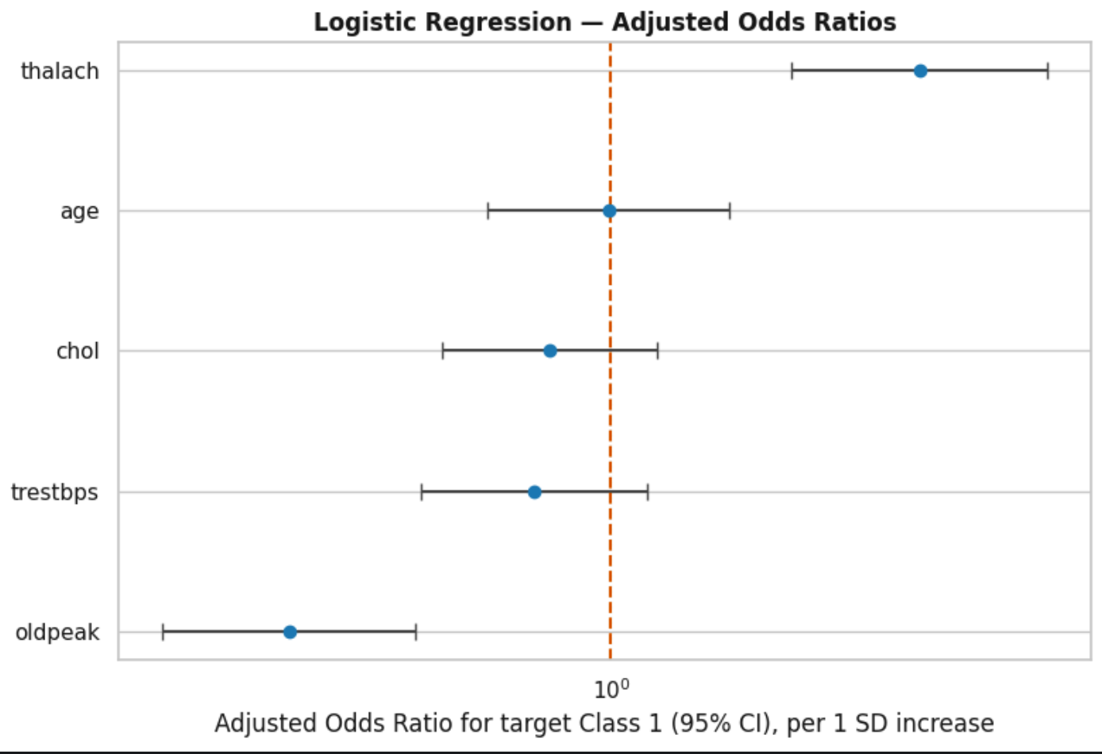

Adjusted Odds Ratios (Forest Plot)
Methodological Approach: Implementation of a multivariable logistic regression on the standardized continuous features (age, trestbps, chol, thalach, oldpeak) to extract adjusted Odds Ratios (ORs) and 95% confidence intervals, quantifying the net association of each biomarker with cardiac disease risk.
Feature Associations (Odds Ratios relative to Nullity Line at $OR=1.0$):
thalach (Positive Association): Positioned to the right of the nullity line ($OR>1$), reflecting its strong predictive relationship within the multivariable space.
age (Neutral Association): Centered near the nullity line ($OR≈1$), indicating balanced net effects when adjusted for other hemodynamic parameters.
chol, trestbps, & oldpeak (Inverse Associations in Model): Positioned to the left of the unit line ($OR<1$) under the multivariable adjustment scheme, highlighting their conditional interactions in the logistic regression equation.
Statistical Significance: The error bars represent the 95% confidence intervals, illustrating the precision and estimation uncertainty for each continuous clinical feature.

Slide 29
Conclusions & Future Work
Data Integrity: Validation of a robust, complete, and balanced dataset, ensuring a solid basis for clinical inference.
Unsupervised Learning: The synergy between PCA and K-Means enabled the autonomous extraction of pathological patterns, confirming the geometric relevance of biomarkers.
Multi-View Framework: The Late Fusion approach demonstrated diagnostic superiority, isolating specific hemodynamic signals from baseline demographic noise.
Future Vision: The project demonstrates the value of Visual Analytics integrated with Artificial Intelligence, paving the way towards transparent and interpretable predictive medicine (XAI)

