Slide 1
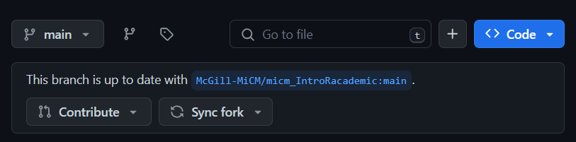
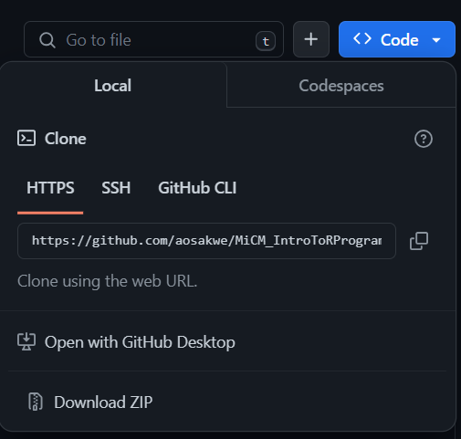
Download Workshop Materials
Go to https://github.com/QLS-MiCM/IntroToR

Slide 2
Intro to programming in R
Lead: Maximiliane Jousse
Facilitator: Sana Naderi
July 14, 2025
Materials adapted from Larisa M. Soto and Xiaoqi Xie

Slide 3

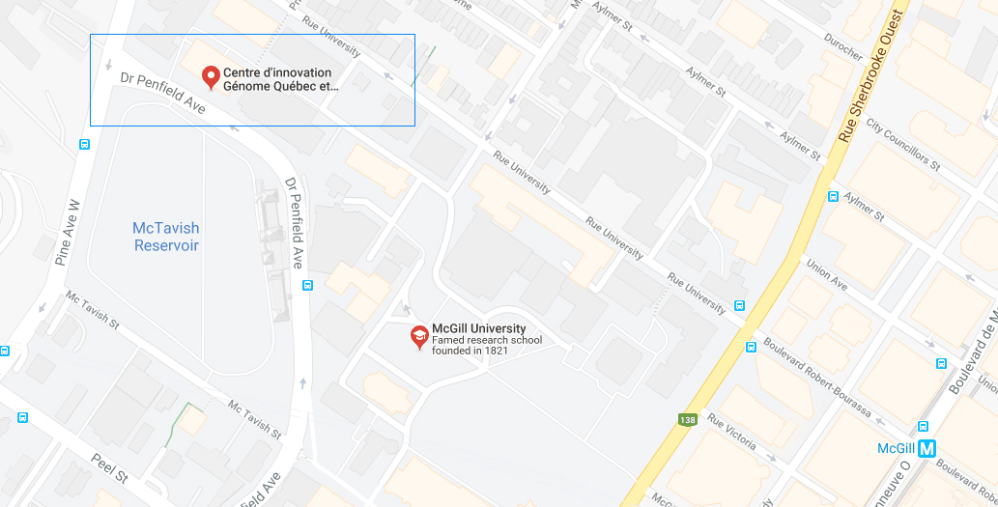

Mission statement: deliver quality workshops designed to help biomedical researchers develop the skills they need to succeed.
Location: 550 Sherbrooke West, Montreal, Quebec
Scan the QR code to sign up
for our mailing list
Contact: workshop-micm@mcgill.ca

Slide 4
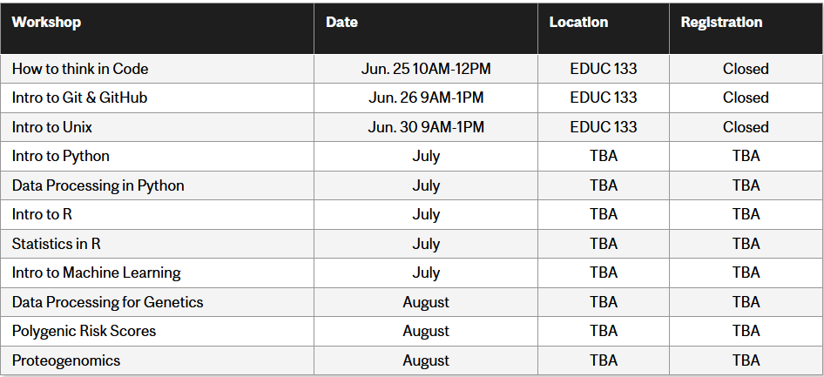
https://www.mcgill.ca/micm/training/workshops-series

Slide 5
Workshop outline Part 1
1
The
language
History
Foundation
Syntax
Logical ops
Help
Packages
2
Data
types
Vectors
Factors
Lists
Data Frames
Arrays
Hands on
3
Control
Structures
Functions
If statement
for loop
Hands on

Slide 6
Workshop outline Part 2
4
Basic data manipulation
Read & Write
Subset
Split
Join
Hands on
5
Advanced data
Manipulation
dplyr
tidyr
plyr
DataTable
Hands on
6
Generating
Outputs
Graphics
ggplot2
RMarkdown
Templates
7
Software development
Good coding practices
Documentation standards
Debugging

Slide 7
Workshop Components
Theory
Code Examples
Hands-on Activities

Slide 8
1. The R programming language
Learning objectives
Why Excel is not enough
What is R
What is an IDE
Basic Operations

Slide 9


Why not Excel?
Easy at first glance
Issues
  Hard to automate
  Hard to reproduce
  Inflexible
  Slow!

Slide 10
Statistical Programming Language
Integrated suite for data manipulation, analysis, and graphical visualization
Environment where statistical tests can be performed
Its functionality can be easily extended with packages
GNU project of free software
Users have the freedom to:
  Run the program
  View and modify the source code
  Redistribute copies and
  Distribute their modifications
https://www.r-project.org/about.html

Slide 11
R facts
Interpreted language
Object-oriented
No spaces allowed in variable names
Case sensitive
1-based indexing
Allows user-defined functions
Works with environments

Slide 12
R Files
Many types of files can contain R code
  .R ‘Script’
  .Rmd ‘R Notebook’
  .qmd ‘Quarto Notebook’
  .ipynb ‘Jupyter Notebook’
Scripts
  Automation & Portability
Notebooks
  Documentation
  Accessibility

Slide 13

R & RStudio
R & RStudio are different entities
R is the programming language
  The actual code we execute
  Developed at the University of Auckland
RStudio is an Integrated Development Environment (IDE)
  A GUI software to develop and execute R code
  Developed by Posit

Slide 14
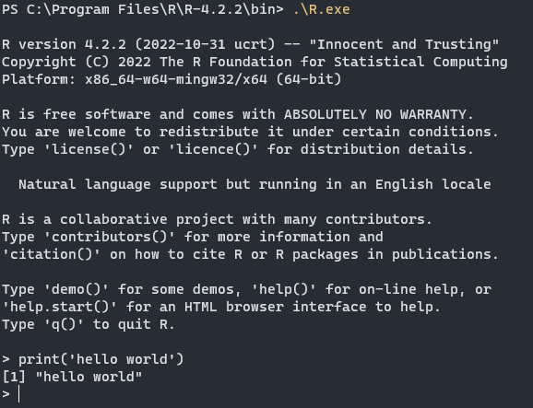

Slide 15
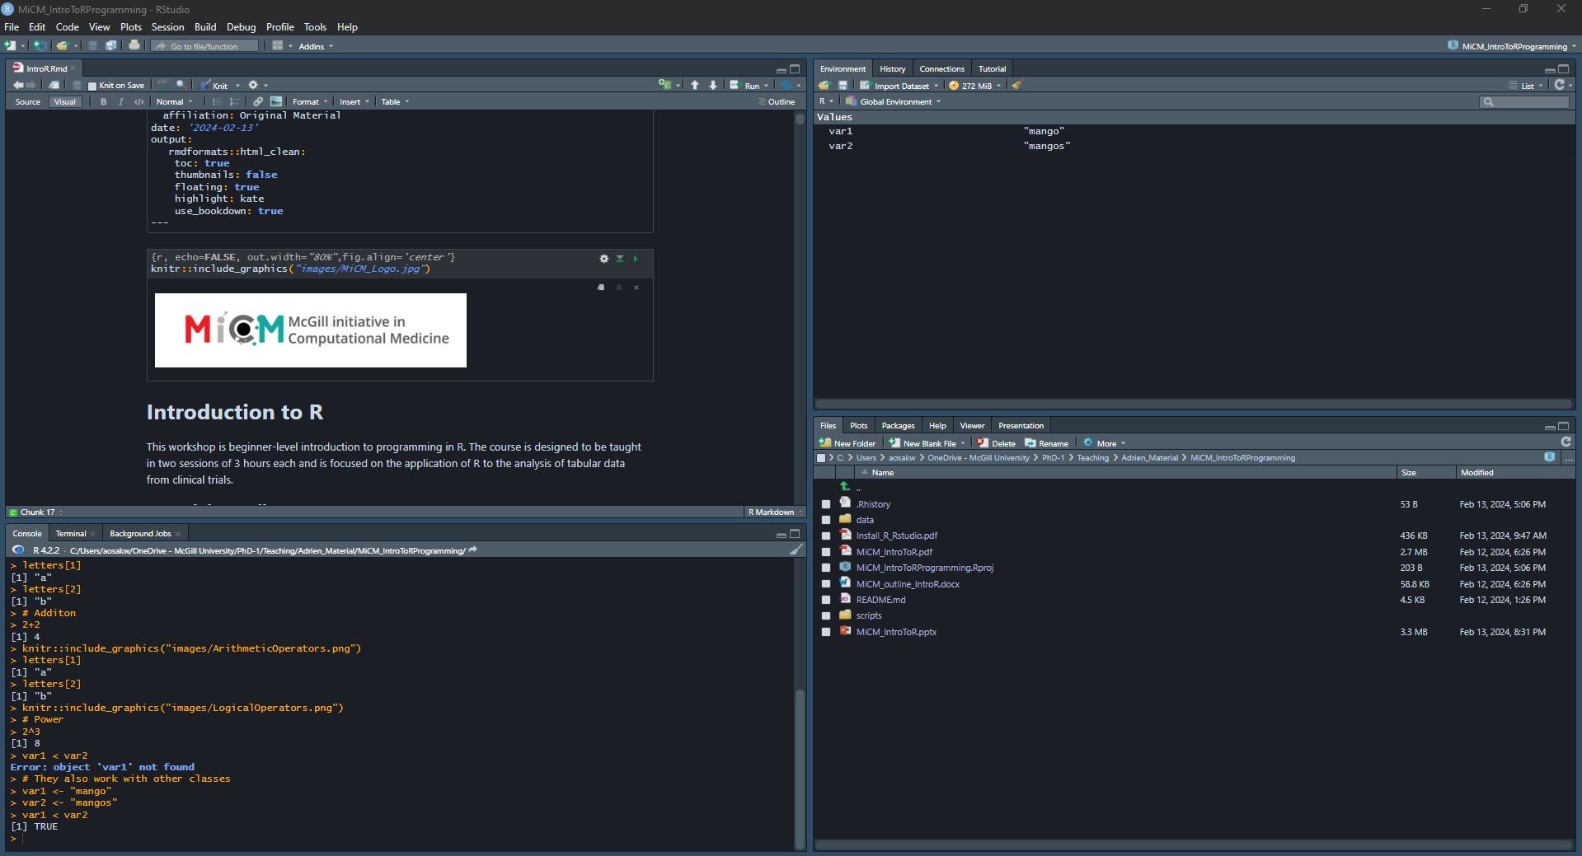
Source Pane
Environment Pane
Console Pane
Files/Plot/Help Pane

Slide 16
Data types and data structures
Learning objectives
Understand the differences between classes, objects and data types in R
Create objects of different types
Subset and index objects
Learn and use vectorized operations

Slide 17
Atomic Classes
Also called data types
Character | A,b,c,d,e,..
Numeric (real numbers) | 1.00,2.00,… Inf, NaN
Integer | 1L,2L,3L,4L,….
Complex | 2i
Logical (True/False) | TRUE,FALSE
Missing Value | NA

Slide 18
Arithmetic operators
Addition | +
Subtraction | -
Division | /
Power | ^
Scalar multiplication | *
Matrix multiplication | %*%

Slide 19
Syntax operators
Comment line | #
Assignation | <-
Access content | $
Equal | =

Slide 20
Logical operators
Equal | ==
Not equal | !=
Greater than | >
Greater than or equal to | >=
Less than | <
Less than or equal to | <=
contains | %in%
x AND y | x & y
x OR y | x | y
NOT x | !x

Slide 21
Objects
Also called data structures
Vector | Only elements of the same class
List | Elements of any class
Factor | Categorical data
Matrix | Elements of the same class in 2D
Data frame | Elements of multiple classes in 2D
NULL | Empty object

Slide 22
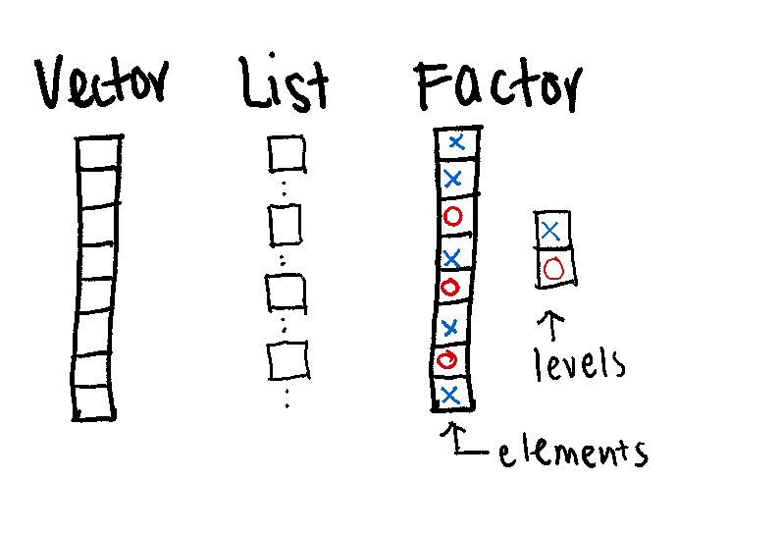
One dimension

Slide 23
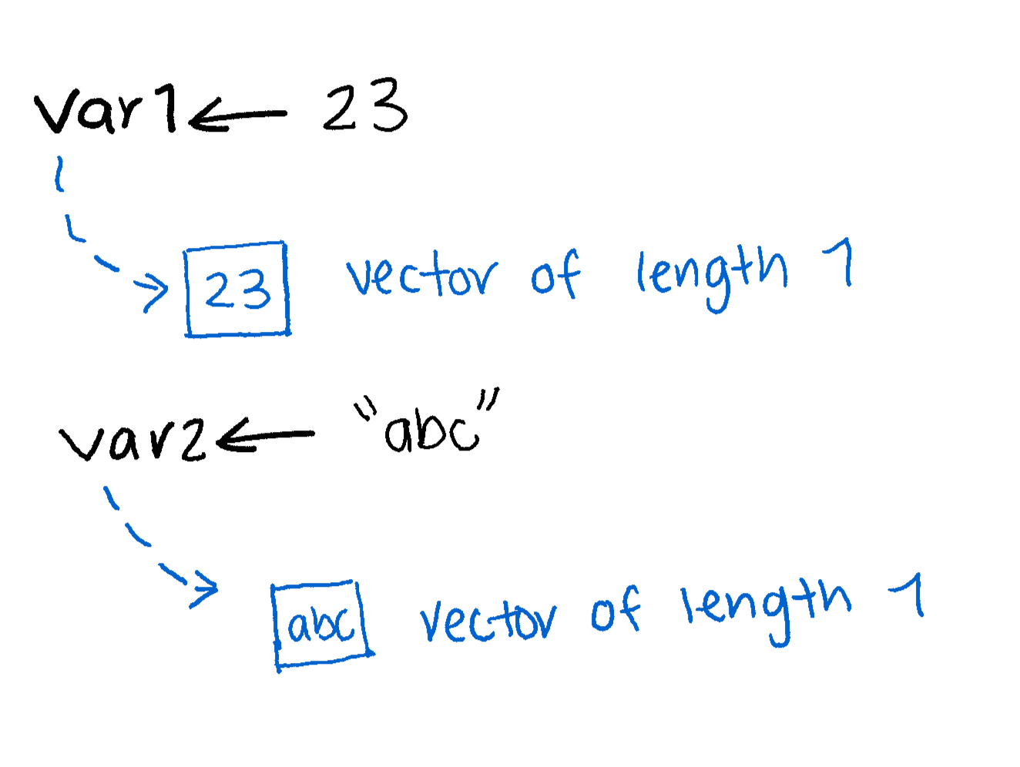
Vectors
Can only contain objects of the same class
Most basic type of R object
Variables are vectors

Slide 24
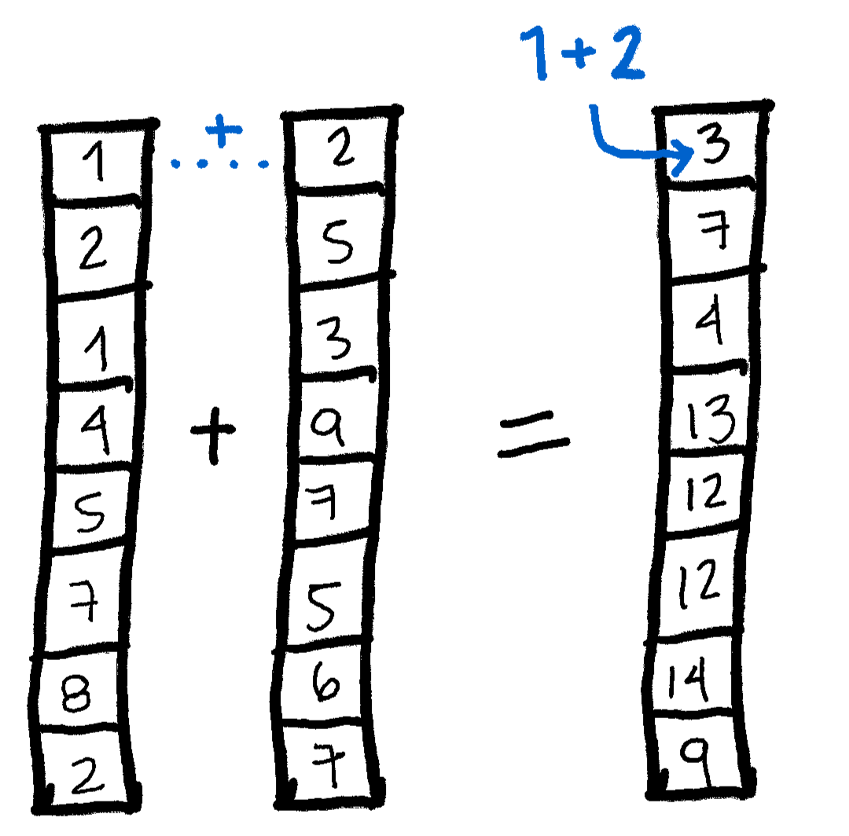
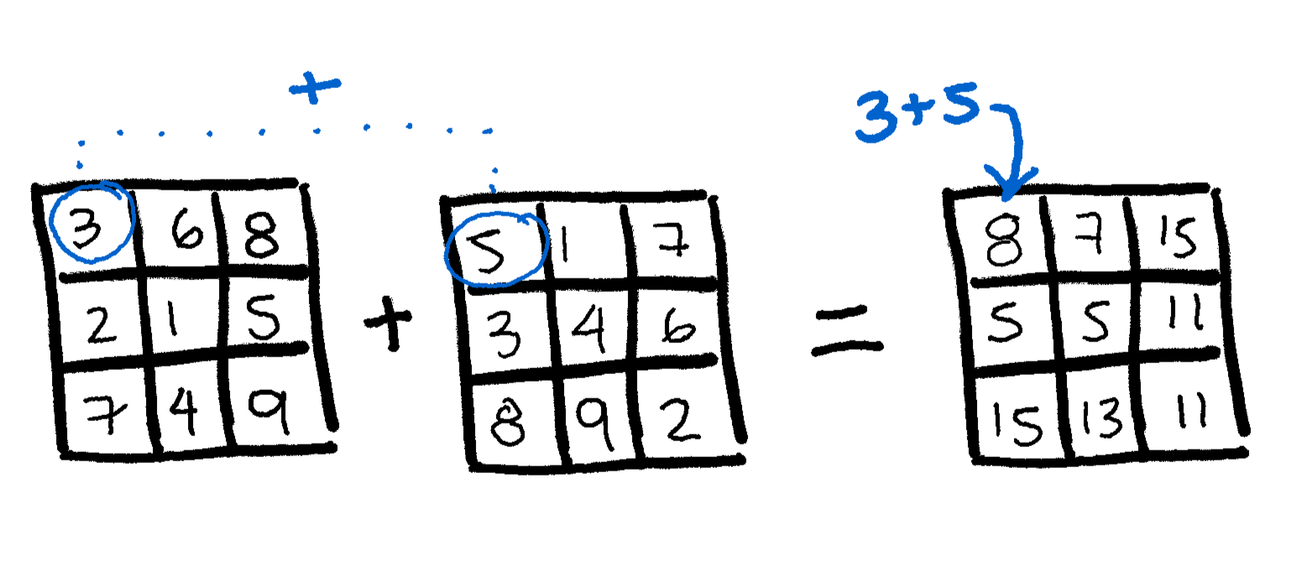
Vectorized operations

Slide 25
Factors
Useful for categorical data
Can have implicit order, if needed
Each element has a label or level
They are important in statistical modelling and plotting with ggplot
Some operations behave differently on factors

Slide 26
Lists
Can contain objects of multiple classes
Very important data type in R
Extremely powerful when combined with some built-in functions

Slide 27
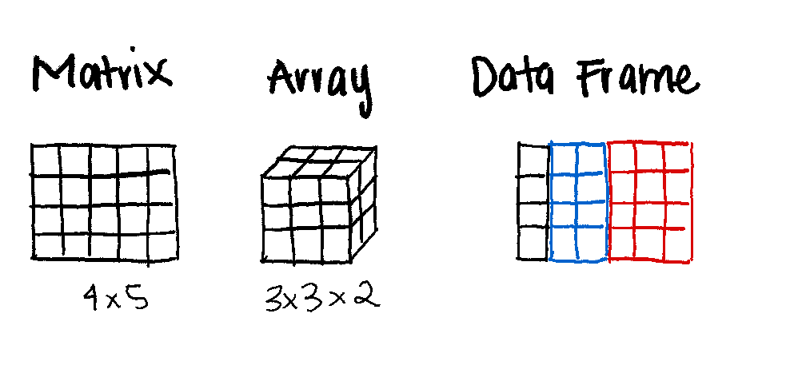
Multiple dimensions

Slide 28
Break

Slide 29
Control structures and functions
Learning objectives:
Understand the concept of environments in R
Create new functions
Implement conditional statements
Implement a for loop to iterate over a list of files

Slide 30
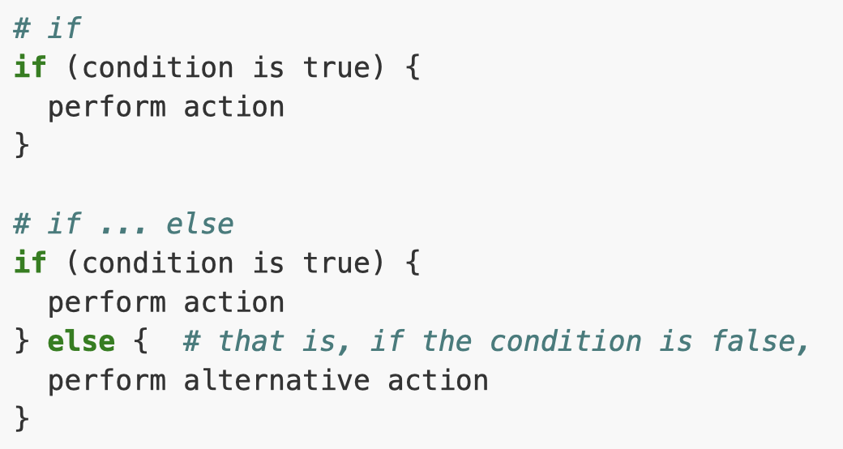
Conditional statements
When we want a set of actions to be executed only if certain conditions are met
https://swcarpentry.github.io/r-novice-gapminder/07-control-flow

Slide 31
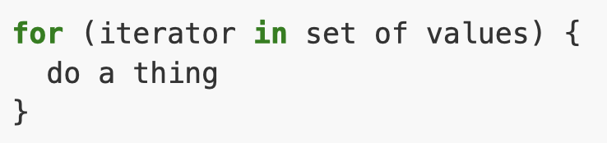
For loop
Repeat a set of operations a certain number of times
https://swcarpentry.github.io/r-novice-gapminder/07-control-flow

Slide 32

While loop
Repeat a set of operations until a condition is no longer met
https://swcarpentry.github.io/r-novice-gapminder/07-control-flow

Slide 33
What if base R is not enough?
Sometimes your analysis requires tools that are not available in base R
Two options:
  Create new functions
  Packages provide a way to incorporate methods and functions from

Slide 34
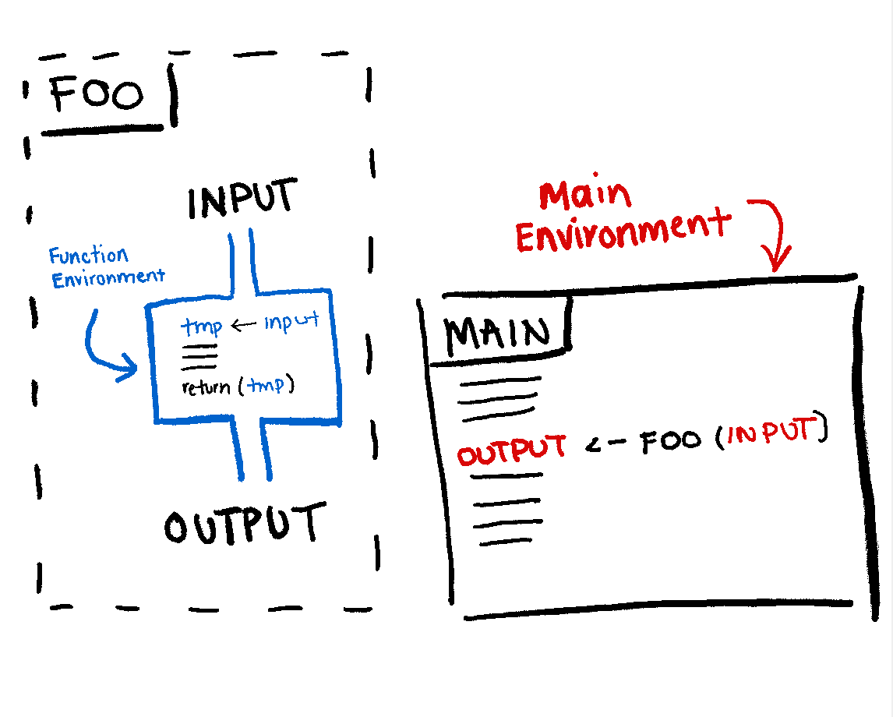
Functions and environments

Slide 35
Pass by value and scope
When we pass an object to a function, a copy of it is created internally
The changes made inside the function won’t modify the original object we passed to it
Any variables created inside the function will only exist during the function’s execution time

Slide 36
Packages
Packages are a way for users to share methods they have developed
Incorporate novel methods, datasets, or visualization tools
Downloaded from many places:
  Comprehensive R Archive Network (CRAN)
  Bioconductor
  GitHub, Bitbucket etc.

Slide 37


Slide 38
Basic data manipulation
Learning objectives:
Learn how to read/write data to/from files with different formats (.tsv, .csv)
Familiarize with basic operations of data frames
Index and subset data frames using base R functions
Manipulate specific data frame columns
Joining by columns and rows

Slide 40
Advanced data manipulation
Learning objectives:
Become familiar with the dplyr syntax
Create pipes with the operator %>%
Perform operations on data frames using dplyr and tidyr functions
Implement functions from other external packages

Slide 41
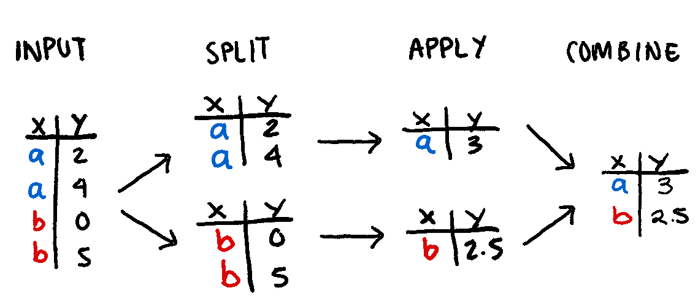
Split-Apply-Combine problem

Slide 42
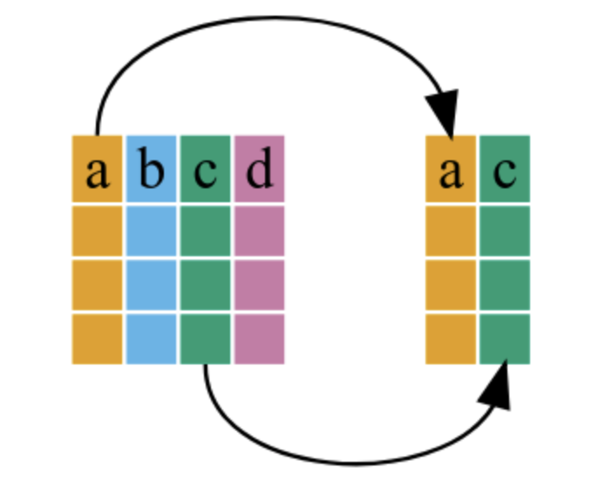
Select
https://swcarpentry.github.io/r-novice-gapminder/13-dplyr/index.html

Slide 43
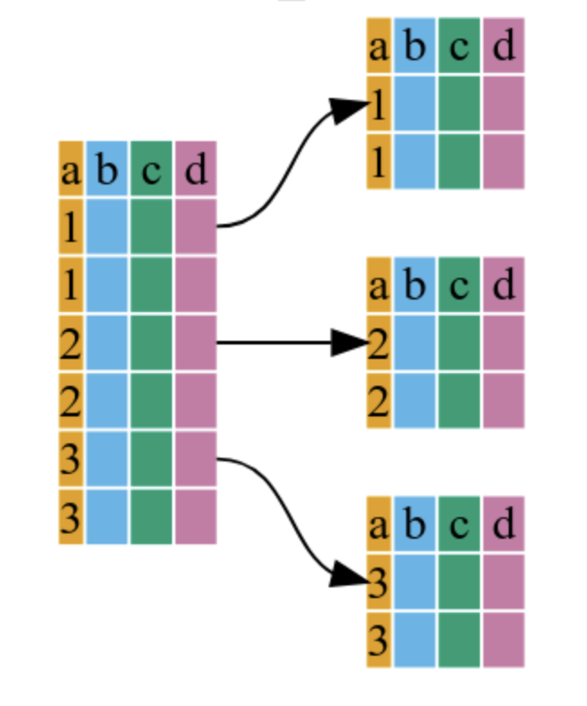
Group by
https://swcarpentry.github.io/r-novice-gapminder/13-dplyr/index.html

Slide 44
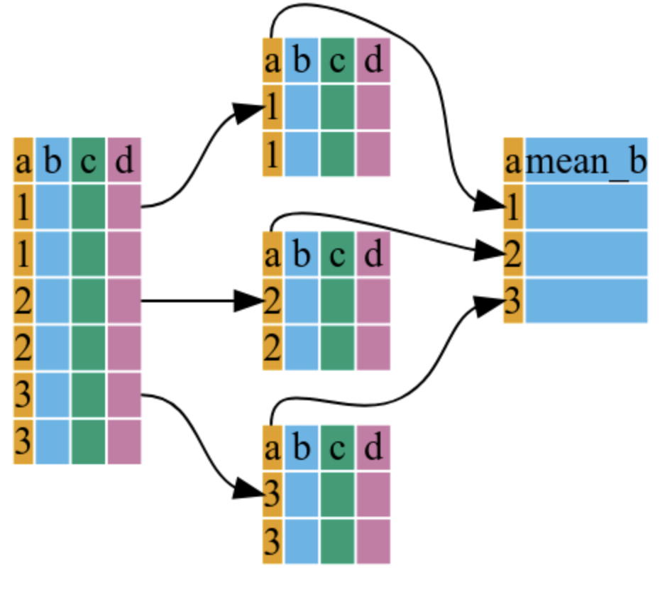
Summarize
https://swcarpentry.github.io/r-novice-gapminder/13-dplyr/index.html

Slide 45


Slide 46
Break

Slide 47
Generating visual outputs
Learning objectives:
Create basic plots using base R functions
Understand the connection between data frames and ggplot2
Create basic graphs with ggplot2
Use factors to customize graphics in ggplot2
Learn about RMarkdown syntax to create reports
Get familiar with existing RMarkdown templates

Slide 48
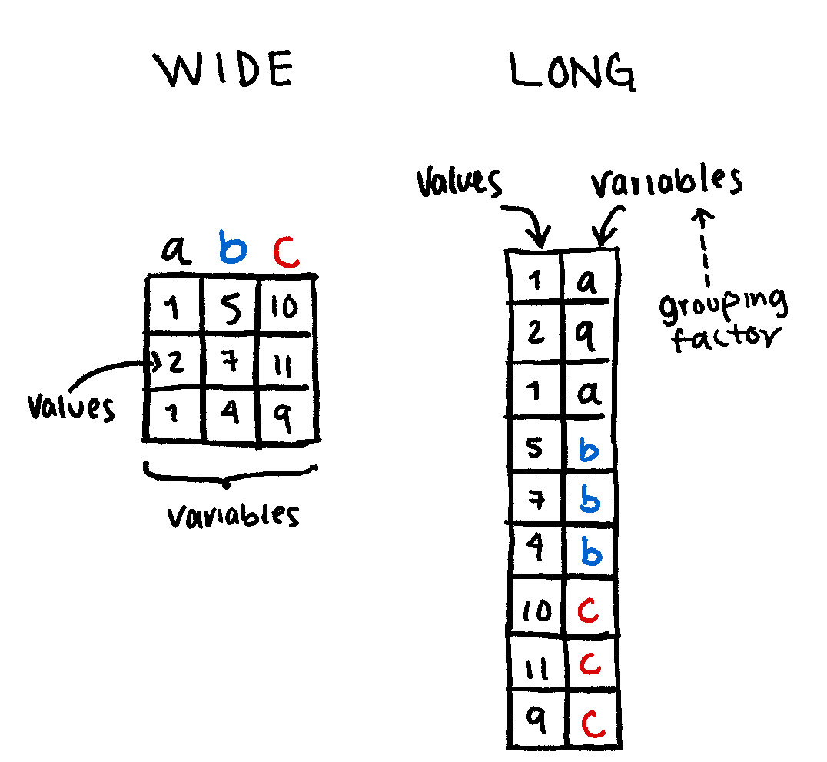
Formatting data for ggplot

Slide 50
Activity:
Analyzing a medical data set
Learning objectives:
Familiarize with a real-life use case of R
Apply the knowledge from previous modules to create an analysis pipeline

Slide 51
COVID testing dataset
Details
Data on testing for SARS-CoV2 from days 4-107 of the COVID pandemic in 2020. CHOP is a pediatric hospital in Philadelphia, Pennsylvania, USA. These data have been anonymized, time- shifted, and permuted.
Text taken from https://cran.r-project.org/web/packages/medicaldata/medicaldata.pdf

Slide 52
The dataset
Documentation
Part of the medicaldata package
https://htmlpreview.github.io/?https://github.com/higgi13425/medicaldata/blob/master/man/description_docs/covid_desc.html
https://htmlpreview.github.io/?https://github.com/higgi13425/medicaldata/blob/master/man/codebooks/covid_testing_codebook.html

Slide 53
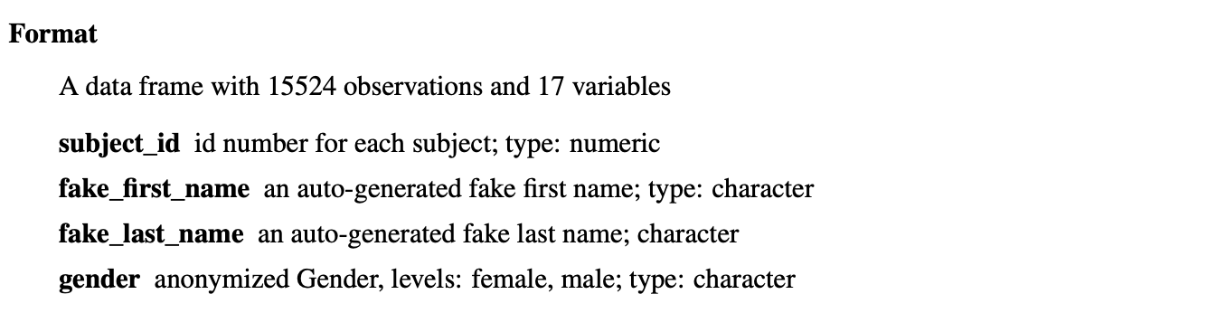
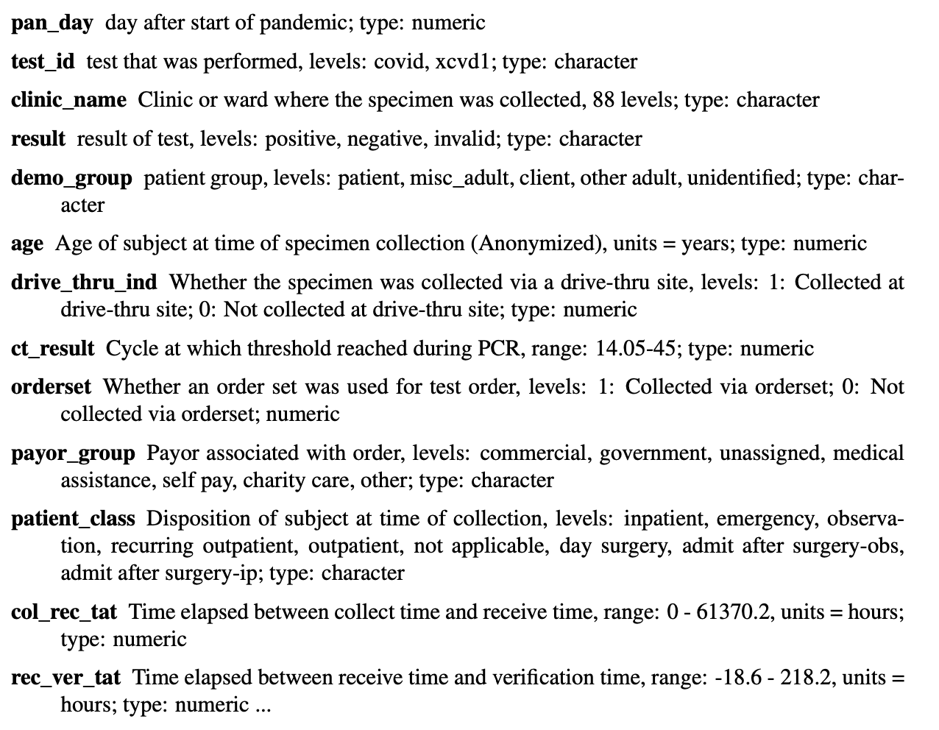

Slide 55
Software development concepts
Learning objectives:
Familiarize with general good coding practices
Learn about documentation standards
Things to avoid when programming in R
Learn how to debug and troubleshoot

Slide 56
What we learned today:
What is R
Basic syntax, data types
Data Manipulation and Visualization
Package Installation

Slide 57
What’s next?
Statistics in R Workshop (Part 2)
Data Wrangling
Regression
Statistical Analysis

Slide 58
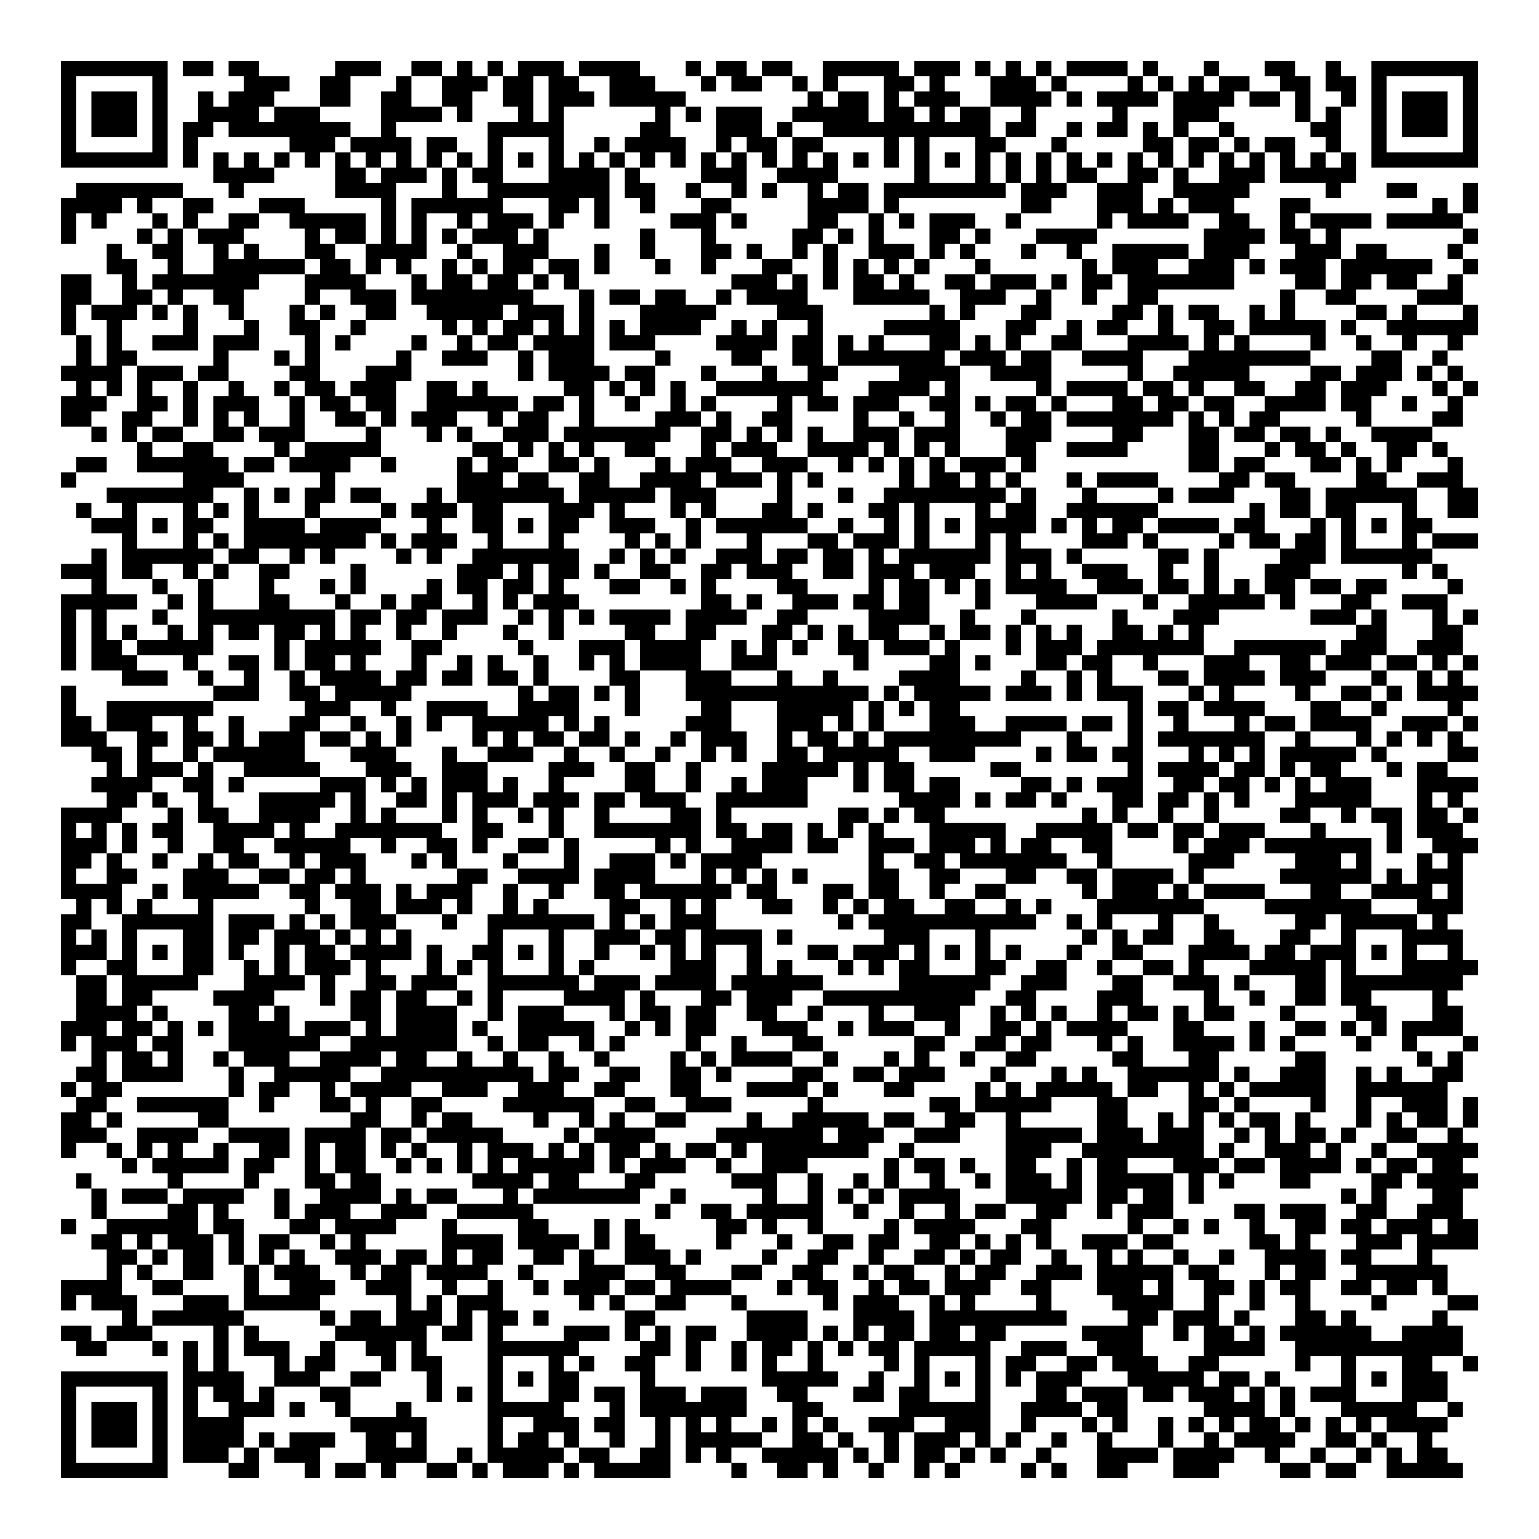


Thank you for attending!
1
2
3
  Scan the QR code to confirm you attended today’s workshop.
Fill out the feedback survey in the next 72h.
Get recognition for this workshop on your
co-curricular record.

Slide 59
Useful links
R software project
RStudio Cheatsheet
R ggplot2 Cheatsheet
R dplyr Cheatsheet
More resources

