Slide 1
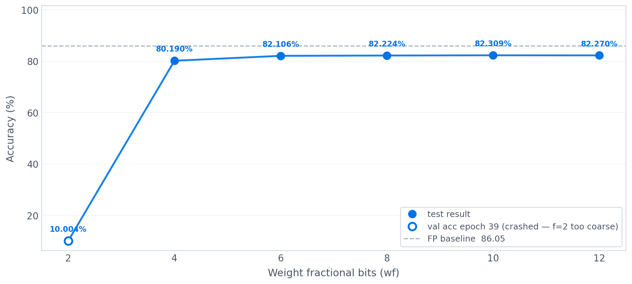
ParT weights compression — accuracy vs wf bits
Data compressed to 16 bits (f=11, i=4, k=1)

Slide 2
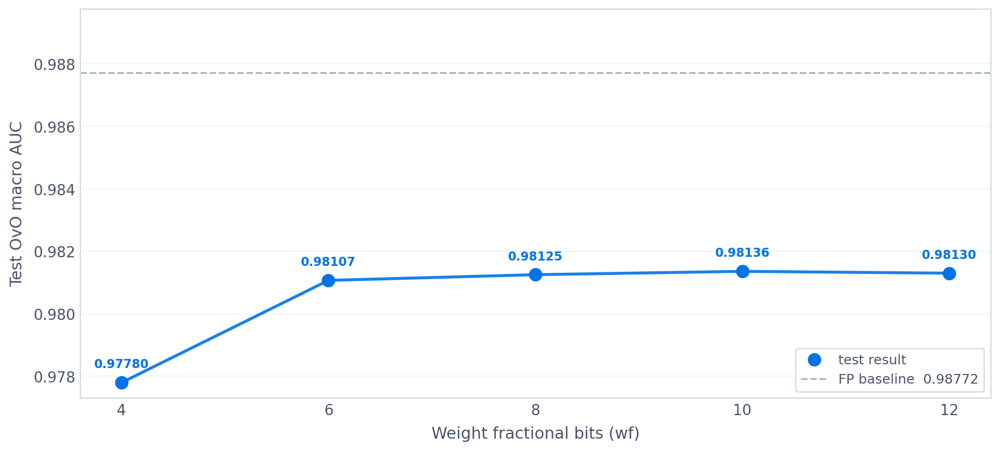
ParT weights compression — OvO AUC vs wf bits
Data compressed to 16 bits (f=11, i=4, k=1)

Slide 3
Overall scan metrics
Test accuracy · remaining weights · OvO macro AUC
 | Accuracy (%) | Remaining weights | OvO macro AUC
Full prec. | 86.051% | 100.00% | 0.98772
wf = 2 | 10.004% * | 0.00% | —
wf = 4 | 80.190% | 0.56% | 0.97780
wf = 6 | 82.106% | 1.06% | 0.98107
wf = 8 | 82.224% | 1.68% | 0.98125
wf = 10 | 82.309% | 2.07% | 0.98136
wf = 12 | 82.270% | 2.41% | 0.98130
* wf=2: training ran to epoch 39 but weights collapsed to 0% by epoch 3 (2-bit quantization too coarse); accuracy shown is 10% (random chance for 10 classes)

Slide 4
Per-class AUC (OvR)
Binary one-vs-rest AUC per jet class
FP baseline per-class AUC computed from pred.root
 | QCD | Hbb | Hcc | Hgg | H4q | Hqql | Zqq | Wqq | Tbqq | Tbl
Full prec. | 0.97825 | 0.99713 | 0.98790 | 0.98007 | 0.98880 | 0.99957 | 0.96695 | 0.98013 | 0.99854 | 0.99987
wf = 2 | — | — | — | — | — | — | — | — | — | —
wf = 4 | 0.96754 | 0.99088 | 0.96821 | 0.96842 | 0.97866 | 0.99857 | 0.94355 | 0.96737 | 0.99533 | 0.99944
wf = 6 | 0.97099 | 0.99302 | 0.97487 | 0.97175 | 0.98196 | 0.99899 | 0.95220 | 0.97089 | 0.99644 | 0.99959
wf = 8 | 0.97113 | 0.99309 | 0.97516 | 0.97180 | 0.98185 | 0.99902 | 0.95294 | 0.97146 | 0.99647 | 0.99961
wf = 10 | 0.97125 | 0.99316 | 0.97544 | 0.97203 | 0.98210 | 0.99903 | 0.95299 | 0.97150 | 0.99650 | 0.99961
wf = 12 | 0.97121 | 0.99310 | 0.97518 | 0.97186 | 0.98200 | 0.99903 | 0.95300 | 0.97151 | 0.99651 | 0.99960

Slide 5
QCD rejection rate
1 / FPR vs QCD at per-class signal efficiency target
Rejection = 1 / false positive rate, where FPR = fraction of QCD background jets passing the signal-score threshold at the given signal efficiency. Full prec. (FP) = full-precision uncompressed ParT model, evaluated on the 20M jet test set.
 | Hbb @50% | Hcc @50% | Hgg @50% | H4q @50% | Hqql @99% | Zqq @50% | Wqq @50% | Tbqq @50% | Tbl @99%
Full prec. | 10638.000 | 4149.000 | 123.000 | 1867.000 | 5420.000 | 402.000 | 543.000 | 32258.000 | 16260.000
wf = 2 | — | — | — | — | — | — | — | — | —
wf = 4 | 2624.672 | 383.215 | 38.040 | 276.091 | 159.261 | 56.865 | 46.404 | 2339.181 | 88.539
wf = 6 | 2985.075 | 520.291 | 45.367 | 339.559 | 296.868 | 59.457 | 112.290 | 3012.048 | 163.092
wf = 8 | 2628.121 | 487.805 | 46.059 | 335.233 | 293.513 | 64.779 | 105.180 | 3372.681 | 158.115
wf = 10 | 2789.400 | 542.005 | 45.574 | 342.407 | 284.779 | 65.744 | 102.422 | 2894.356 | 151.630
wf = 12 | 2762.431 | 498.008 | 45.339 | 334.169 | 275.368 | 66.622 | 97.106 | 3215.434 | 159.337

