Slide 1
The Network Stack (1)
L41 Lecture 5
Dr Robert N. M. Watson
2019-2020
Notes:
2016-2017: Ran about 55 minutes with moderate elaboration.
2017-2018: Ran about 50 minutes, but went too fast. Would be good to remove a slide or two.

Slide 2
This time: Introduction to Network Stacks
Rapid tour across hardware and software:
Networking and the sockets API
Network-stack design principles: 1980s vs. today
Memory flow across hardware and software
Network-stack construction and work flows
Recent network-stack research

Slide 3
Networking: A key OS function (1)
Communication between computer systems
Local-Area Networks (LANs)
Wide-Area Networks (WANs)
A network stack provides:
Sockets API and extensions
Interoperable, feature-rich, high-performance protocol implementations (e.g., IPv4, IPv6, ICMP, UDP, TCP, SCTP, 802.1, 802.11, …)
Security functions (e.g., cryptographic tunneling, firewalls...)
Device drivers for Network Interface Cards (NICs)
Monitoring and management interfaces (BPF, ioctl)
Plethora of support libraries (e.g., DNS)

Slide 4
Networking: A key OS function (2)
Dramatic changes over 30 years:
1980s: Early packet-switched networks, UDP+TCP/IP, Ethernet
1990s: Large-scale migration to IP; Ethernet VLANs
2000s: 1-Gigabit, then 10-Gigabit Ethernet; 802.11; GSM data
2010s: Deployment of IPv6; 40/100-Gbps Ethernet; 3G to 5G; ... billions → trillions of devices?
Vanishing technologies
UUCP, IPX/SPX, ATM, token ring, SLIP, ...

Slide 5
The Berkeley Sockets API (1983)
close()
read()
write()
...
accept()
bind()
connect()
getsockopt()
listen()
recv()
select()
send()
setsockopt()
socket()
...
The Design and Implementation of the 4.3BSD Operating System
(but APIs/code first appeared in 4.2BSD)
Now universal TCP/IP (POSIX, Windows)
Kernel-resident network stack serves networking applications via system calls
Reuses file-descriptor abstraction
Same API for local and distributed IPC
Simple, synchronous, copying semantics
Blocking/non-blocking I/O, select()
Multi-protocol (e.g., IPv4, IPv6, ISO, …)
TCP-focused but not TCP-specific
Cross-protocol abstractions and libraries
Protocol-specific implementations
“Portable” applications
Notes:
Easy to forget that this structure was not pre-ordained – why each design choice?

Slide 6
BSD network-stack principles (1980s-1990s)
Multi-protocol, packet-oriented network research framework:
Object-oriented: multiple protocols, socket types, but one API
Protocol-independent: streams vs. datagrams, sockets, socket buffers, socket addresses, network interfaces, routing table, packets
Protocol-specific: connection lists, address/routing specialization, routing, transport protocol itself – encapsulation, decapsulation, etc.
Packet-oriented:
Packets and packet queueing as fundamental primitives
Best effort: If there is a failure (overload, corruption), drop the packet
Work hard to maintain packet source ordering
Differentiate ‘receive’ from ‘deliver’ and ‘send’ from ‘transmit’
Heavy focus on TCP functionality and performance
Middle-node (forwarding), not just edge-node (I/O), functionality
High-performance packet capture: Berkeley Packet Filter (BPF)

Slide 7
FreeBSD network-stack principles (1990s-2010s)
All of the 1980s features and also …
Hardware:
Multi-processor scalability
NIC offload features (checksums, TSO/LRO, full TCP)
Multi-queue network cards with load balancing/flow direction
Performance to 10s or 100s of Gigabit/s
Wireless networking
Protocols:
Dual IPv4/IPv6
Pluggable congestion control, delay-based congestion control (BBR)
Security/privacy: firewalls, IPSec, ...
Software model:
Flexible memory model integrates with VM for zero-copy
Fine-grained locking and lockless algorithms (e.g., RCU)
Network-stack virtualisation
Userspace networking via netmap

Slide 8
Memory flow in hardware
Key idea: follow the memory
Historically, memory copying is avoided due to instruction count
Today, memory copying is avoided due to cache footprint
Recent Intel CPUs push and pull DMA via the LLC (“DDIO”)
If we differentiate ‘send’ and ‘transmit’, ‘receive’ vs. ‘deliver’, is this a good idea?
… it depends on the latency between DMA and processing

Slide 9
Memory flow in software
Socket API implies one software-driven copy to/from user memory
Historically, zero-copy VM tricks for socket API ineffective
Network buffers cycle through the slab allocator
Receive: allocate in NIC driver, free in socket layer
Transmit: allocate in socket layer, free in NIC driver
DMA performs second copy; can affect cache/memory bandwidth
NB: what if packet-buffer working set is larger than the cache?

Slide 10
The mbuf abstraction
Unit of work allocation and distribution throughout the stack
mbuf chains represent in-flight packets, streams, etc.
Operations: alloc, free, prepend, append, truncate, enqueue, dequeue
Internal or external data buffer (e.g., VM page)
Reflects bi-modal packet-size distribution (e.g., TCP ACKs vs data)
Similar structures in other OSes – e.g., skbuff in Linux

Slide 11
Send/receive paths in the network stack

Slide 12
Forwarding path in the network stack

Slide 13
Work dispatch: input path
Deferred dispatch: ithread → netisr thread → user thread
Direct dispatch: ithread → user thread
Pros: reduced latency, better cache locality, drop early on overload
Cons: reduced parallelism and work placement opportunities

Slide 14
Work dispatch: output path
Fewer deferred dispatch opportunities implemented
(Deferred dispatch on device-driver handoff in new iflib KPIs)
Gradual shift of work from software to hardware
Checksum calculation, segmentation, …

Slide 15
Work dispatch: TOE input path
Kernel provides socket buffers and resource allocation
Remainder, including state, retransmissions, etc., in NIC
But: two network stacks? Less flexible/updateable structure?
Better with an explicit HW/SW architecture – e.g., Microsoft Chimney

Slide 16
Netmap: a novel framework for fast packet I/O Luigi Rizzo, USENIX ATC 2012 (best paper).
Map NIC buffers directly into user process memory
Not the sockets API: Zero copy to/from application
System calls initiate DMA, block for NIC events
Packets can be reinjected into normal stack
Ships in FreeBSD; patch available for Linux
Userspace network stack can be specialised to task (e.g., packet forwarding)

Slide 17
Network stack specialisation for performance Ilias Marinos, Robert N. M. Watson, Mark Handley, SIGCOMM 2014, 2017.
30 years since the network-stack design developed
Massive changes in architecture, micro-architecture, memory…
Optimising compilers
Cache-centered CPUs
Multiprocessing, NUMA
DMA, multiqueue
10 Gigabit/s Ethernet
Performance lost to ‘generality’ throughout stack
Revisit fundamentals through clean-slate stack
Orders-of-magnitude performance gains

Slide 18
Break

Slide 19
The Network Stack (2)
L41 Lecture 6
Dr Robert N. M. Watson
2019-2020
Notes:
2016-2017: Ran about 55 minutes with moderate elaboration.
2017-2018: Ran about 50 minutes, but went too fast. Would be good to remove a slide or two.

Slide 20
The Network Stack (2)
The Transmission Control Protocol (TCP)
The TCP state machine
TCP congestion control
TCP implementations and performance
The evolving TCP stack
Labs 4 + 5 on TCP
Wrapping up the L41 lecture series

Slide 21
The Transmission Control Protocl (TCP)
September 1981 Transmission Control Protocol
Functional Specification
+---------+ ---------\ active OPEN
| CLOSED | \ -----------
+---------+<---------\ \ create TCB
| ^ \ \ snd SYN
passive OPEN | | CLOSE \ \
------------ | | ---------- \ \
create TCB | | delete TCB \ \
V | \ \
+---------+ CLOSE | \
| LISTEN | ---------- | |
+---------+ delete TCB | |
rcv SYN | | SEND | |
----------- | | ------- | V
+---------+ snd SYN,ACK / \ snd SYN +---------+
| |<----------------- ------------------>| |
| SYN | rcv SYN | SYN |
| RCVD |<-----------------------------------------------| SENT |
| | snd ACK | |
| |------------------ -------------------| |
+---------+ rcv ACK of SYN \ / rcv SYN,ACK +---------+
| -------------- | | -----------
| x | | snd ACK
| V V
| CLOSE +---------+
| ------- | ESTAB |
| snd FIN +---------+
| CLOSE | | rcv FIN
V ------- | | -------
+---------+ snd FIN / \ snd ACK +---------+
| FIN |<----------------- ------------------>| CLOSE |
| WAIT-1 |------------------ | WAIT |
+---------+ rcv FIN \ +---------+
| rcv ACK of FIN ------- | CLOSE |
| -------------- snd ACK | ------- |
V x V snd FIN V
+---------+ +---------+ +---------+
|FINWAIT-2| | CLOSING | | LAST-ACK|
+---------+ +---------+ +---------+
| rcv ACK of FIN | rcv ACK of FIN |
| rcv FIN -------------- | Timeout=2MSL -------------- |
| ------- x V ------------ x V
\ snd ACK +---------+delete TCB +---------+
------------------------>|TIME WAIT|------------------>| CLOSED |
+---------+ +---------+
TCP Connection State Diagram
Figure 6.
V. Cerf, K. Dalal, and C. Sunshine, Transmission Control Protocol (version 1), INWG General Note #72, December 1974.
In practice: J. Postel, Ed., Transmission Control Protocol: Protocol Specification, RFC 793, September, 1981.

Slide 22
TCP principles and properties
Network may delay, (reorder), drop, corrupt packets
TCP: Reliable, ordered, stream transport protocol over IP
Three-way handshake: SYN / SYN-ACK / ACK (mostly!)
Sequence numbers ACK’d
Round-Trip Time (RTT) measured to time out loss
Data retransmitted on loss
Flow control via advertised window size in ACKs
Congestion control (‘fairness’) detects congestion via loss (and, recently, via delay: BBR)

Slide 23
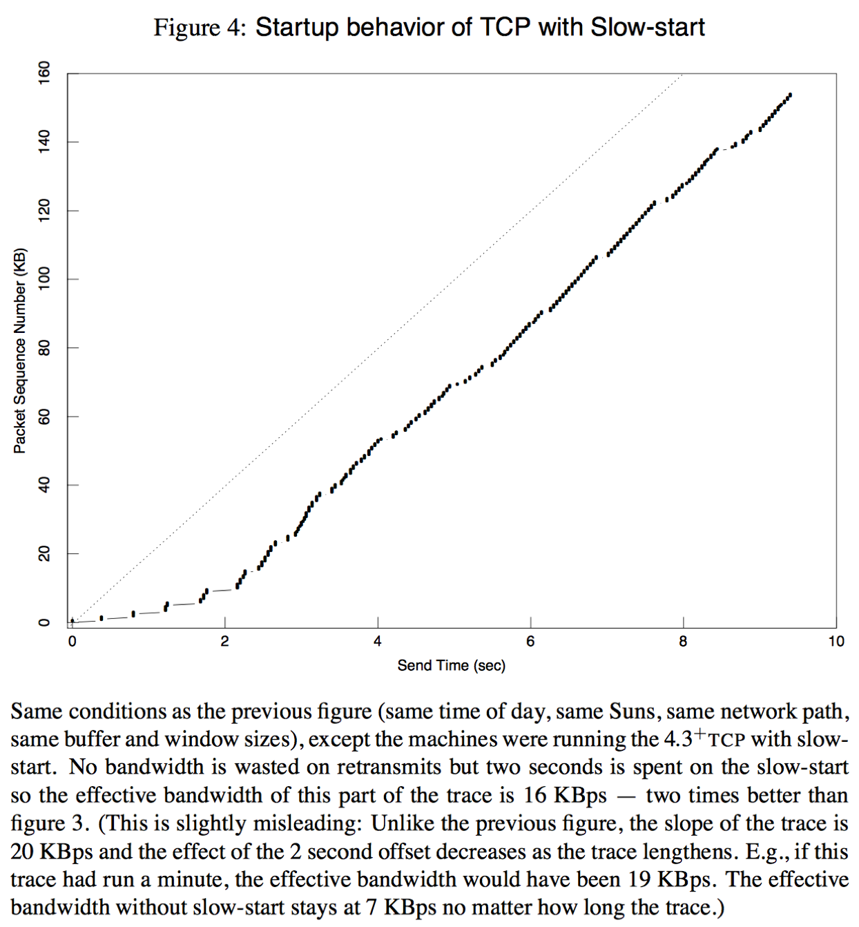
TCP congestion control and avoidance
1986 Internet CC collapse
32Kbps → 40bps
Van Jacobson, SIGCOMM 1988
Don’t send more data than the network can handle!
Conservation of packets via ACK clocking
Exponential retransmit timer, slow start, aggressive receiver ACK, and dynamic window sizing on congestion
ECN (RFC 3168), ABC (RFC 3465), Compound (Tan, et al, INFOCOM 2006), Cubic (Rhee and Xu, ACM OSR 2008), BBR (Cardwell, ACM Queue 2016)

Slide 24
TCP time/sequence graphs
Extracted from TCP packet traces (e.g., via tcpdump)
Visualize windows, congestion response, buffering, RTT, etc:
X: Time
Y: Sequence number
We can extract this data from the network stack directly using Dtrace
Allows correlation/plotting with respect to other variables / events

Slide 25
Evolving BSD/FreeBSD TCP implementation
Year | Version | Feature
1983 | 4.2BSD | BSD sockets, TCP/IP implementation
1986 | 4.3BSD | VJ/Karels congestion control
1999 | FreeBSD 3.1 | sendfile(2)
2000 | FreeBSD 4.2 | TCP accept filters
2001 | FreeBSD 4.4 | TCP ISN randomisation
2002 | FreeBSD 4.5 | TCP SYN cache/cookies
2003 | FreeBSD 5.0-5.1 | IPv6, TCP TIMEWAIT state reduction
2004 | FreeBSD 5.2-5.3 | TCP host cache, SACK, fine-grained locking
2008 | FreeBSD 6.3 | TCP LRO, TSO
2008 | FreeBSD 7.0 | T/TCP removed, socket-buffer autosizing
2009 | FreeBSD 7.1 | Read-write locking, full TCP offload (TOE)
2009 | FreeBSD 8.0 | TCP ECN
2012 | FreeBSD 9.0 | Pluggable TCP congestion control, connection groups
… changes continue to this day … BBR, RCU, pluggable TCP, …
Which changes have protocol-visible effects vs. only code?

Slide 26
Lect. 5 - Send/receive paths in the network stack

Slide 27
Data structures – sockets, control blocks

Slide 28
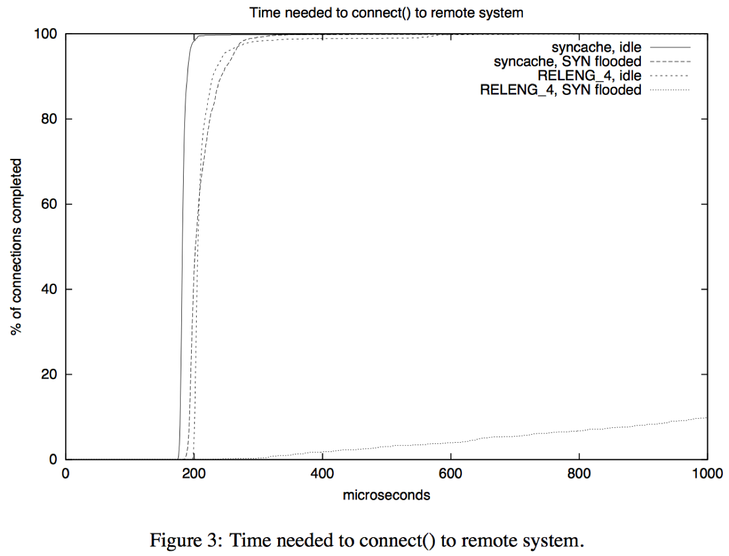
Denial of Service (DoS) – state minimisation
Yahoo!, Amazon, CNN taken down by SYN floods in February 2000
D. Borman: TCP SYN cache – minimise state for new connections
D. Bernstein: SYN cookies – eliminate state entirely – at a cost
J. Lemon: TCP TIMEWAIT reduction – minimise state during close
J. Lemon: TCP TIMEWAIT recycle – release state early under load

Slide 29
TCP connection lookup tables
Global list of connections for monitoring (e.g., netstat)
Connections are installed in a global hash table for lookup
Separate (similar) hash table for port-number allocations
Tables protected by global read-write lock as reads dominate
New packets are more frequent than new connections

Slide 30
Lect. 5 - Work dispatch: input path
Deferred dispatch: ithread → netisr thread → user thread
Direct dispatch: ithread → user thread
Pros: reduced latency, better cache locality, drop early on overload
Cons: reduced parallelism and work placement opportunities

Slide 31
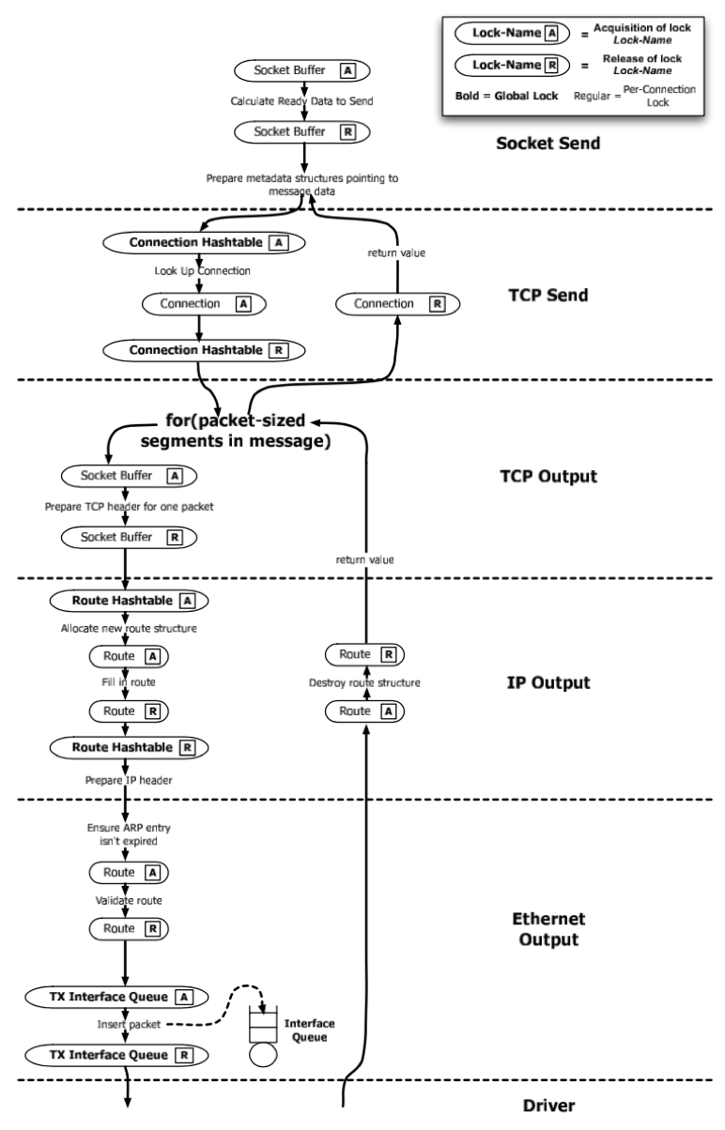
An Evaluation of Network Stack Parallelization Strategies in Modern Operating Systems Paul Willmann, Scott Rixner, and Alan L. Cox, USENIX ATC, 2006
Network bandwidth growth > CPU frequency growth
Locking overhead (space, contention) substantial
Getting ‘speedup’ is hard!
Evaluate different strategies for TCP processing parallelisation
Message-based parallelism
Connection-based parallelism (threads)
Connection-based parallelism (locks)
Coalescing locks over connections:
reduces overhead
increases parallelism

Slide 32
FreeBSD connection groups, RSS
Connection groups blend MsgP and ConnP-L models
PCBs assigned to group based on 4-tuple hash
Lookup requires group lock, not global lock
Global lock retained for 4–tuple reservation (e.g., setup, teardown)
Problem: have to look at TCP headers (cache lines) to place work!
Microsoft: NIC Receive-Side Scaling (RSS)
Multi-queue NICs deliver packets to queues using hash of 4-tuple
Align connection groups with RSS buckets / interrupt routing

Slide 33
Performance: dispatch model and locking
2010 8-core x86 multicore server
TCP LRO disabled (maximise PPS)
Configurations:
1 queue (no dispatch), 1 thread on 1 core
1 queue (SW dispatch), 8 threads on 8 cores
8 queues (HW dispatch), 8 threads on 8 cores
Userspace processes receiving bulk TCP
8 7 6 5 4 3 2 1 8 7 6 5 4 3 2 1 8 7 6 5 4 3 2 1

Slide 34
Architectural → micro-architectural + I/O optimisation
Hardware, software, protocol co-design causes change to optimisation approach over time:
Counting instructions → counting cache misses
Reducing lock contention → cache-line contention
Adding locking → identifying new parallelism
Work ordering, classification, and placement
Vertically integrated distribution and affinity
NIC offload of further protocol layers, crypto
DMA/cache interactions
Convergence of networking and storage technologies?

Slide 35
Labs 4 + 5: TCP
From abstract to concrete understanding of TCP
Use tools such as tcpdump and DUMMYNET
Explore effects of latency on TCP performance
Be sure to consider probe and simulation effects
Lab 4 – TCP state machine and latency
Measure the TCP state machine in practice
Experiment with artificially induced latency (DUMMYNET)
Lab 5 – TCP congestion control
Explore OS buffering strategies
Explore slow-start vs. steady state as latency changes
Explore OS and microarchitectural performance interactions

Slide 36
L41 lecture wrap-up
Goal: Deeper understanding of OS design and implementation
Evolving architectural and microarchitectural foundations
Evolving OS design principles
Evolving tradeoffs in OS design
Case study: The process model
Case study: Network-stack abstractions
Quick explorations of past and current research
Goal: Gain practical experience analysing OS behaviour
Goal: Develop scientific analysis and writing skills
Feel free to get in touch to learn more!

