Slide 1
L41: Lab 1- I/O
Lecturelet 1
Dr Robert Watson / Dr Graeme Jenkinson
2019-2020

Slide 2
L41: Lab 1 – I/0
Introduce our experimental environment:
BeagleBone Black
FreeBSD operating system + DTrace
I/O benchmark
Jupyter notebooks
Explore user-kernel interactions via syscalls and traps
Engage with POSIX I/O and its implications
Measure the probe effect

Slide 3
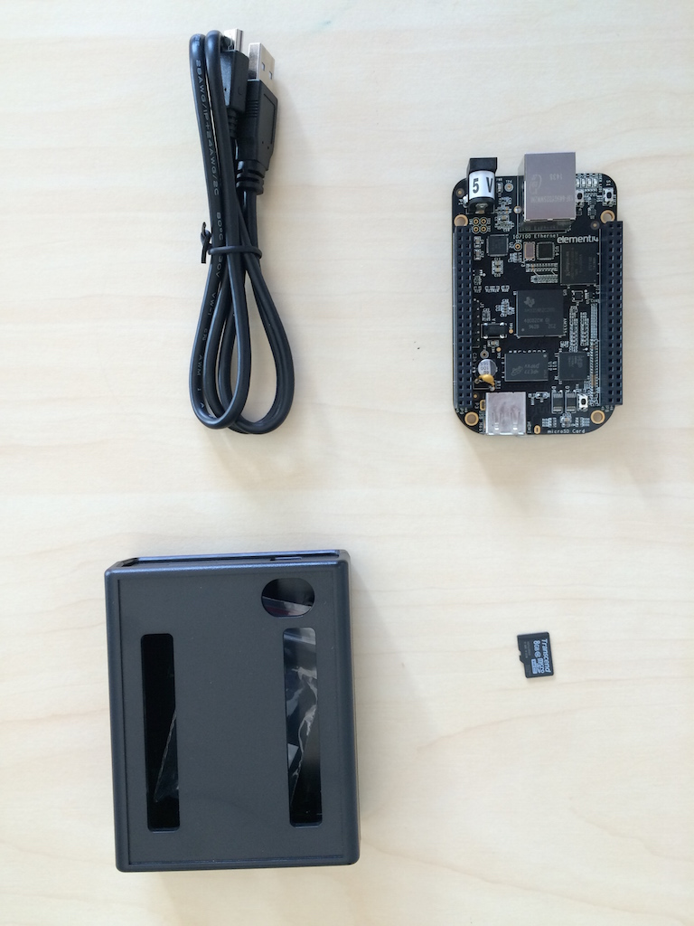
The platform
TI BeagleBone Black
1GHz ARM Cortex-A8 32-bit CPU
Superscalar pipeline, MMU, L1/L2 caches
FreeBSD operating system + DTrace
Bespoke “potted benchmarks”
Jupyter notebook measurement and analysis environment

Slide 4
DTrace scripts
Human-facing (C/AWK inspired) language
One or more {probe name, predicate, action} tuples
Expression limited to control side effects (e.g. no loops)
Specified on the command line or via a .d file
fbt::malloc:entry /execname == “csh”/ {trace(arg0);}
Probe name | Identifies the probe(s) to instrument; wildcards allowed; identifies the provider and a provider-specific probe name
Predicate | Filters cases where action will execute
Action | Describes tracing operations

Slide 5
Some kernel DTrace providers in FreeBSD
Provider | Description
callout_execute | Timer-driven callouts
dtmalloc | Kernel malloc()/free()
dtrace | DTrace script events (BEGIN, END)
fbt | Function Boundary Tracing
io | Block I/O
ip, udp, tcp, sctp | TCP/IP
lockstat | Locking
proc, sched | Kernel process/scheduling
profile | Profiling timers
syscall | System call entry/return
vfs | Virtual filesystem

Slide 6
Aggregations
Aggregation | Description
count() | Number of times called
sum() | Sum of arguments
avg() | Average of arguments
min() | Minimum of arguments
max() | Maximum of arguments
stddev() | Standard deviation of arguments
lquantize() | Linear frequency distribution (histogram)
llquantize() | Log-linear frequency distribution (histogram)
quantize() | Log frequency distribution (histogram)
Often we want summaries, not detailed traces. DTrace allows early, efficient reduction using aggregations
Scalable multicore implementations (i.e. commutative)
@variable = function()
printa(@variable) to print

Slide 7
Counting kernel read() system calls
$ ./io-static -q -r /data/iofile
$ dtrace –n 'syscall::read:entry /execname=="io-static"/ {@reads = count(); }'
Probe name | Trace the read() system call
Predicate | Limit actions to processes executing io-static
Action | Count the number of probe fires
dtrace: description 'syscall::read:entry ' matched 1 probe dtrace: buffer size lowered to 2m dtrace: aggregation size lowered to 2m
^C
1024

Slide 8
The benchmark
$ ./io-static
io-static -c|-r|-w [-Bdqsv] [-b blocksize] [-t totalsize] path
Modes (pick one):
-c 'create mode': create benchmark data file
-r 'read mode': read() benchmark
-w 'write mode': write() benchmark
Optional flags:
-B Run in bare mode: no preparatory activities
-d Set O_DIRECT flag to bypass buffer cache
-q Just run the benchmark, don't print stuff out
-s Call fsync() on the file descriptor when complete
-v Provide a verbose benchmark description
-b blocksize Specify a block size (default: 16384)
-t totalsize Specify total I/O size (default: 16777216)
Simple, bespoke I/O benchmark: read() or write()
Statically linked
Adjust buffer sizes, etc.
Various output modes

Slide 9
The benchmark (2)
Three operational modes
Create (-c) Create a new benchmark data file
Read (-r) Perform read()s against data file
Write (-w) Perform writes()s against data file
Adjust I/O parameters:
Block size (-b) Block size used for each I/O
Total size (-t) Total size across all I/Os
Direct (-d) Use direct I/O (bypass buffer cache)
Sync (-s) Perform fsync() after I/O loop
Bare (-b) Don’t synchronise cache (etc) on start (whole-program testing)
Output flags:
Quiet (-q) Suppress all output (whole-program tracing)
Verbose (-v) Verbose output (interactive testing)

Slide 10
The benchmark (3)
$ ./io-static -v -d -w /data/iofile
Benchmark configuration:
blocksize: 16384
totalsize: 16777216
blockcount: 1024
operation: write
path: /data/iofile
time: 58.502746875
280.06 KBytes/sec
Use verbose output (-v)
Bypass the buffer cache (-d)
Write (-w) to the previously created file /data/iofile
Use default buffer size (16K) and total I/O size (16M)

Slide 11
Probe effect
Probe effect - act of measuring disturbs system
Electronics - probes introduce additional capacitance, resistance or inductance
Software tracing - probes take time to execute
Don’t benchmark while running DTrace ...
... unless measuring probe effect
Be aware that traced applications may behave differently
E.g., more timer ticks will fire, I/O will “seem faster”
Zero when disabled
Definitely not zero

Slide 12
Jupyter notebooks
Unified environment for:
Executing benchmarks.
Instrumenting the behaviours and performance of benchmarks using DTrace.
Post-processing performance measurements.
Plotting performance measurements.
Performing statistically analysis on performance measurements.

Slide 13
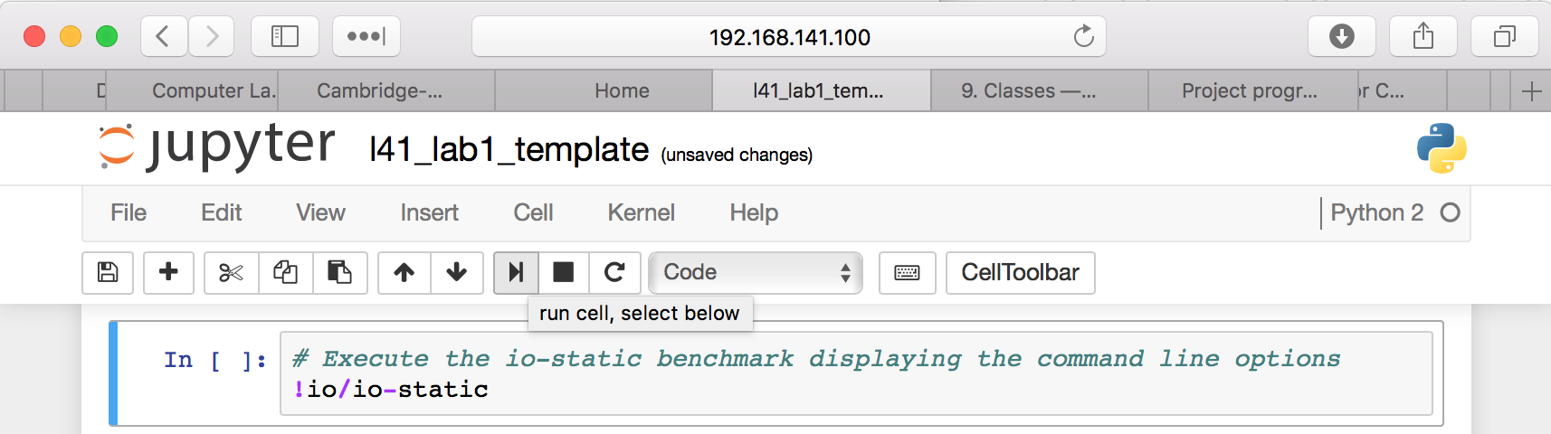
Jupyter notebooks (2)
Series of cells containing Python or cell “magics”.
Cell magics allow, for example, inline plotting of graphs or executing shell commands.
Raw data and plots can be saved to the BBB for inclusion in laboratory reports.
Details of experimental environment in lab setup handout.

Slide 14
Hypotheses
Larger I/O and IPC buffer sizes amortize system-call overheads
A purely architectural (SW) view dominates
HW platform is irrelevant
The DTrace probe effect is insignificant in real workloads

Slide 15
Experimental questions for the lab report
Experiments are with respect to a configuration reading from a fixed-size file through the buffer cache
Run the benchmark to gather initial measurements
Explore through system-call/trap tracing and profiling
Use various configurations (e.g., I/O on /dev/zero) to explore kernel code-path behaviour
Ensure that you directly consider the impact of the probe effect on your causal investigation

Slide 16
A few cautions
There are two kinds of people, those that have experienced data loss and those that haven’t experienced data loss YET.
The SD cards seem a bit fragile during power off – make sure that you shut down safely using the laboratory setup instructions.
We have spare imaged SD cards if you need them.
Backup key scripts and data files on your workstation
We may replace your SD cards for future labs.

Slide 17
A few other useful things
Feel free to work in pairs or groups in the lab:
Laboratory reports must be written separately.
You will likely want multiple SSH sessions open.
The kernel source code is in github: freebsd/freebsd.git (branch release/11.0.0).
Experiment on the command line:
Start with something simple – e.g., DTrace hello world.
Do not hesitate to ask for help.

