Slide 1
L41: Lab 3 Micro-architectural implications of IPC
Lecturelet 3
Dr Graeme Jenkinson
2019-2020

Slide 2
L41: Lab 3 - Micro-architectural implications of IPC
Hardware performance counters
Extending Lab2 from OS effects to architecture/micro-architecture
Gather further data for assessed Lab Report 2

Slide 3
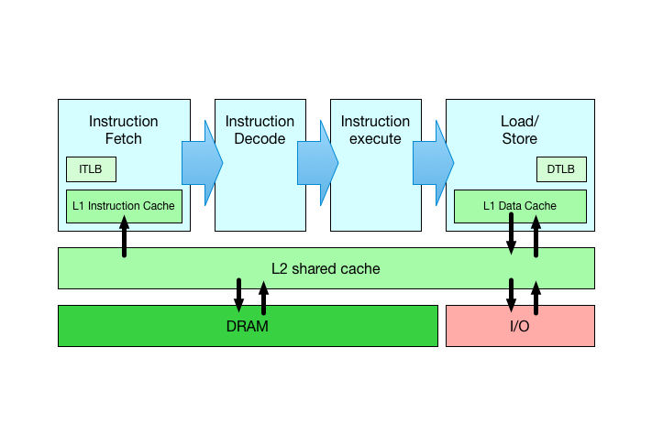
Sketch of ARM Cortex A8 memory hierarchy
Architectural refers to an ISA-level view of execution
Micro-architectural refers to behaviours below the ISA
This is a very, very rough sketch indeed!

Slide 4
Hardware performance counters (1/2)
Seems simple enough:
Source code compiles to instructions
Instructions are executed by the processor
But some instructions take longer than others:
Register-register operations generally single-cycle (or less)
Multiply and divide may depend on the specific numeric values
Floating point may take quite a while
Loads/stores cost different amounts depending on TLB/cache use

Slide 5
Hardware performance counters (2/2)
Optimisation is therefore not just about reducing instruction count
Optimisation must take into account micro-architectural effects
TLB/cache effects tricky as they vary with memory footprint
How can we tell when the cache overflows?
Hardware performance counters let us directly ask the processor about architectural and micro-architectural events
#instructions, #memory accesses, #cache misses, DRAM traffic...

Slide 6
The benchmark – now with PMC
root@l41-beaglebone data/ipc # ./ipc-static
ipc-static [-Bqsv] [-b buffersize] [-i pipe|local] [-t totalsize] mode
Modes (pick one - default 1thread):
1thread IPC within a single thread
2thread IPC between two threads in one process
2proc IPC between two threads in two different processes
Optional flags:
-B Run in bare mode: no preparatory activities
-i pipe|local Select pipe or socket for IPC (default: pipe)
-P l1d|l1i|l2|mem|tlb|axi Enable hardware performance counters
-q Just run the benchmark, don't print stuff out
-s Set send/receive socket-buffer sizes to buffersize
-v Provide a verbose benchmark description
-b buffersize Specify a buffer size (default: 131072)
-t totalsize Specify total I/O size (default: 16777216)
-P argument requests profiling of load/store instructions, L1 D-cache, L1 I-cache, L2 cache, I-TLB, D-TLB, and AXI traffic

Slide 7
Example: Profile memory instructions (1/3)
root@l41-beaglebone:/data/ipc # ./ipc-static -vP mem -b 1048576 -i local ^{2thread}
^{Benchmark configuration:}
^{buffersize: 1048576}
^{totalsize: 16777216}
^{blockcount: 16}
^{mode: 1thread}
^{ipctype: socket}
^{time: 0.084140708}
^{pmctype: mem}
^{INSTR_EXECUTED: 25463397}
^{CLOCK_CYCLES: 46233168}
CLOCK_CYCLES/INSTR_EXECUTED: 1.815672
^{MEM_READ: 8699699}
MEM_READ/INSTR_EXECUTED: 0.341655
MEM_READ/CLOCK_CYCLES: 0.188170
^{MEM_WRITE: 7815423}
MEM_WRITE/INSTR_EXECUTED: 0.306928
MEM_WRITE/CLOCK_CYCLES: 0.169044
^{194721.45 KBytes/sec}

Slide 8
Example: Profile memory instructions (2/3)
Benchmark run pushed 16M data through a socket using 1M buffers for reads and writes
Reasonable expectation of load and store memory footprints to be 16M ×2 + ε reflecting copies to and from kernel buffers
Memory reads: 8,699,699
Word size in ARMv7: 32bits
8,699,699 × 4 ≈ 32M
Sum of buffer accesses in user and kernel memory:

Slide 9
Example: Profile memory instructions (3/3)
Could now query L1, L2 caches
How many of those accesses are in each cache, and how does it affect performance?
How does L1,L2 cache miss rate relate to cycles/instruction?
How would DTrace profiling show changed behaviour as cycles/instruction goes up?

Slide 10
Experimental questions for the lab report
Experimental questions (2/2):
How does changing the IPC buffer size affect architectural and micro-architectural memory behaviour – and why?
Can we reach causal conclusions about the scalability of pipes vs. sockets from processor performance counters?
Remember to consider the hypotheses the experimental questions are exploring.
Ensure that you directly consider the impact of the probe effect on your causal investigation.

Slide 11
This lab session
Use this session to continue to build experience:
Ensure that you can use PMC to collect information about the memory subsystem: instructions, cache behaviour, AXI behaviour
Continue data collection for the Lab Report2
Identify inflection points where performance trends change as a result of architectural or micro-architectural thresholds
Remember to use data from both Lab 2 and Lab 3 to write the lab report.
Do ask us if you have any questions or need help.

