Slide 1
L41: Lab 4 The TCP State Machine
Lecturelet 4
Dr Robert Watson / Dr Graeme Jenkinson
2019-2020

Slide 2
L41: Lab 4 – The TCP State Machine
TCP and the TCP state machine
Setting the MTU, IPFW, and DUMMYNET
TCP mode for the IPC benchmark
DTrace probes of interest
Plotting the state machine with Graphviz
Experimental questions

Slide 3
Lecture 6: The Transmission Control Protocol (TCP)
September 1981 Transmission Control Protocol
Functional Specification
+---------+ ---------\ active OPEN
| CLOSED | \ -----------
+---------+<---------\ \ create TCB
| ^ \ \ snd SYN
passive OPEN | | CLOSE \ \
------------ | | ---------- \ \
create TCB | | delete TCB \ \
V | \ \
+---------+ CLOSE | \
| LISTEN | ---------- | |
+---------+ delete TCB | |
rcv SYN | | SEND | |
----------- | | ------- | V
+---------+ snd SYN,ACK / \ snd SYN +---------+
| |<----------------- ------------------>| |
| SYN | rcv SYN | SYN |
| RCVD |<-----------------------------------------------| SENT |
| | snd ACK | |
| |------------------ -------------------| |
+---------+ rcv ACK of SYN \ / rcv SYN,ACK +---------+
| -------------- | | -----------
| x | | snd ACK
| V V
| CLOSE +---------+
| ------- | ESTAB |
| snd FIN +---------+
| CLOSE | | rcv FIN
V ------- | | -------
+---------+ snd FIN / \ snd ACK +---------+
| FIN |<----------------- ------------------>| CLOSE |
| WAIT-1 |------------------ | WAIT |
+---------+ rcv FIN \ +---------+
| rcv ACK of FIN ------- | CLOSE |
| -------------- snd ACK | ------- |
V x V snd FIN V
+---------+ +---------+ +---------+
|FINWAIT-2| | CLOSING | | LAST-ACK|
+---------+ +---------+ +---------+
| rcv ACK of FIN | rcv ACK of FIN |
| rcv FIN -------------- | Timeout=2MSL -------------- |
| ------- x V ------------ x V
\ snd ACK +---------+delete TCB +---------+
------------------------>|TIME WAIT|------------------>| CLOSED |
+---------+ +---------+
TCP Connection State Diagram
Figure 6.
V. Cerf, K. Dalal, and C. Sunshine, Transmission Control Protocol (version1), INWG General Note#72, December 1974.
In practice: Jon Postel, Ed, Transmission Control Protocol: Protocol Specification, RFC 793, September, 1981.

Slide 4
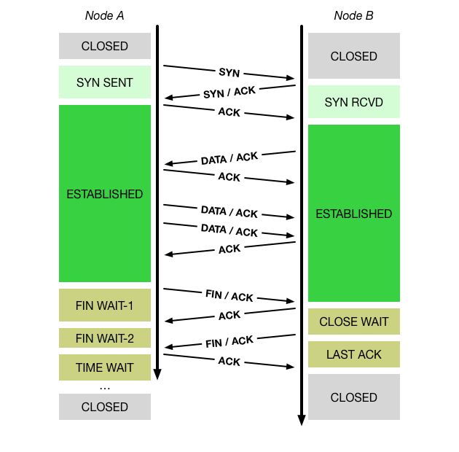
Lecture 6: TCP principles and properties
Network may delay, (reorder), drop, corrupt packets
TCP: Reliable, ordered, stream transport protocol over IP
Three-way handshake: SYN / SYN-ACK / ACK (mostly!)
Sequence numbers ACK’d; data retransmitted on loss
Round-Trip Time (RTT) measured to time out loss
Flow control via advertised window size in ACKs
Congestion control (‘fairness’) via packet loss and ECN

Slide 5
Loopback interface, IPFW, and DUMMYNET
Network-stack features to configure once per-boot:
Loopback interface
Simulated local network interface: packets “loop back”
Interface name lo0
Assigned IPv4 address 127.0.0.1
IPFW - IP firewall by Rizzo, et al.
Numbered rules classify packets and perform actions
Actions include accept, reject, inject into DUMMYNET ...
We will match lab flows using the TCP port number 10141
Configure (and reconfigure) for each experiment
DUMMYNET – link simulation tool by Rizzo, et al.
Widely used in network research
Impose simulated network conditions – delay, bandwidth, loss, ...

Slide 6
TCP in the IPC benchmark
root@beaglebone:/data/ipc # ./ipc-static ipc-static [-Bqsv] [-b buffersize] [-i pipe|local|tcp] [-p tcp_port] [-P l1d|l1i|l2|mem|tlb|axi] [-t totalsize] mode
Modes (pick one - default 1thread):
1thread IPC within a single thread
2thread IPC between two threads in one process
2proc IPC between two threads in two different processes
Optional flags:
-B Run in bare mode: no preparatory activities
-i pipe|local|tcp Select pipe, local sockets, or TCP (default: pipe)
-p tcp_port Set TCP port number (default: 10141)
-P l1d|l1i|l2|mem|tlb|axi Enable hardware performance counters
-q Just run the benchmark, don't print stuff out
-s Set send/receive socket-buffer sizes to buffersize
-v Provide a verbose benchmark description
-b buffersize Specify a buffer size (default: 131072)
-t totalsize Specify total I/O size (default: 16777216)
tcp IPC type
-p argument to set the port number

Slide 7
DTrace probes
Described in more detail in the lab assignment:
We are using implementation-specific probes (FBT) rather than portable TCP probes due to an issue with the FreeBSD/armv7 implementation of DTrace
The last (and most critical!) argument goes missing: a pointer to the TCP header! (only 4 argument regs..)
We will fix this someday .. but not today
fbt::syncache_add:entry | TCP segment installs new SYN-cache entry
fbt::syncache_expand:entry | TCP segment converts SYN-cache entry to full connection
fbt::tcp_do_segment:entry | TCP segment received post-SYN cache
fbt::tcp_state_change:entry | TCP state transition

Slide 8
pygraphviz (1/2)
Graphviz is open-source graph visualization software for drawing graphs specified in DOT language scripts
The DOT language describes three kinds of objects: graphs, nodes, and edges
Graph graph or digraph undirected or directed graph
Node syn-sent;
Edge "closed" ->"syn-sent";
Nodes and Edges can be assigned attributes changing, for example, their colour or shape:
Node syn-sent [color=blue];
Edge "closed" ->"syn-sent" [label="Active open", color=green];

Slide 9
Pygraphviz (2/2)
Programmatic interface for creating visualizations with Graphviz:
>>> import pygraphviz as pgv
>>> G = pgv.AGraph(strict=False, directed=True)
>>> G.add_node(’a’)
>>> G.add_edge(’b’,’c’)
>>> print(G)
digraph {
a;
b ->c;}
pygraphviz graphs can be viewed directly in a Juyter Notebook (see laboratory template)

Slide 10
Experimental questions for the lab report
Plot an effective (measured) TCP state-transition diagram for both directions of a flow
Label the state-transition diagram with causes – TCP headers, system calls, etc.
Compare the diagram with RFC 793
What observations can we make about state-machine transitions as latency increases?
Describe any apparent simulation or probe effects.
In the next lab, we will start a causal analysis of why latency affects bandwidth

Slide 11
This lab session
Setup IPFW, DUMMYNET, and loopback MTU (see notes).
Start with the analysis of the TCP state machine.
Do ask us if you have any questions or need help.
Remember to use data from both Lab 4 and Lab 5 to write the second assessed lab report.

