Slide 1
L41: Lab 5 TCP Latency and Bandwidth
Lecturelet 5
Dr Robert Watson / Dr Graeme Jenkinson
2019-2020

Slide 2
L41: Lab 5 – TCP Latency and Bandwidth
Lab 5 topic and questions
TCP congestion control
TCP Protocol Control Block (TCPCB)
ARM DTrace limitations

Slide 3
Lab 5 – TCP congestion control
This lab explores the behavior the TCP implementation and the bandwidth it achieves as latency is varied
How does TCP congestion control affect bandwidth at different latencies?
What are the impacts of specific implementation choices and policies, such as socket-buffer auto-sizing
As we are working over the loopback interface, we can instrument both ends of the TCP connection
Track packet-level headers on transmit and receive
Also track TCP-internal parameters such as whether TCP is in “slow start” or the steady state
And, of course, we care about the arising probe effect

Slide 4
Experimental questions for the lab report
Plot DUMMYNET-imposed latency on the X axis and effective bandwidth on the Y axis, considering both the case where the socket-buffer size is set versus allowing it to be auto-resized.
Is the relationship between round-trip latency and bandwidth linear?
How does socket-buffer auto-resizing help, hurt, or fail to affect performance as latency varies?
Plot a time-bandwidth graph comparing the effects of setting the socket-buffer size versus allowing it to be auto-resized by the stack. Stack additional graphs showing the sender last received advertised window and congestion window on the same X axis.
How does socket-buffer auto-resizing affect overall performance, as explained in terms of the effect of window sizes?
Be sure to describe any simulation or probe effects.

Slide 5
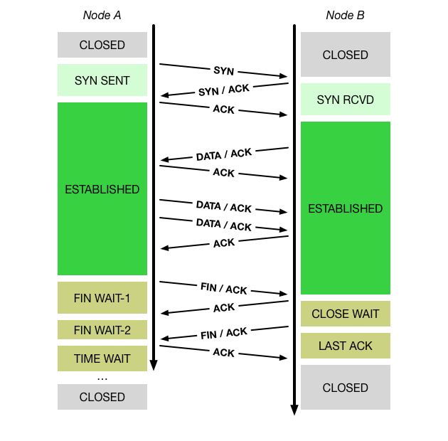
Lecture 6: TCP goals and properties
Network may delay, (reorder), drop, corrupt packets
TCP: Reliable, ordered, stream transport protocol over IP
Three-way handshake: SYN / SYN-ACK / ACK (mostly!)
Sequence numbers ACK’d; data retransmitted on loss
Round-Trip Time (RTT) measured to time out loss
Flow control via advertised window size in ACKs
Congestion control (‘fairness’) via packet loss and ECN

Slide 6
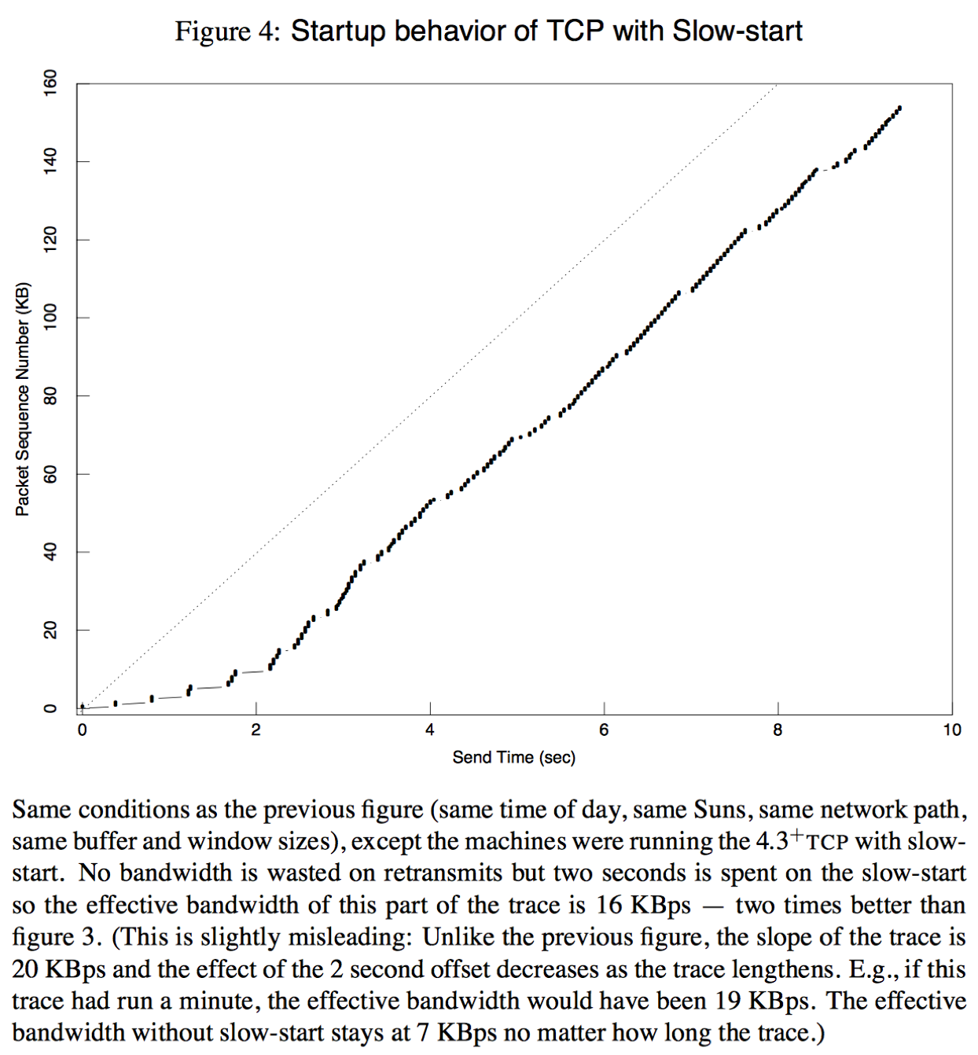
Lecture 6: TCP congestion control and avoidance
1986 Internet CC collapse
32Kbps → 40bps
Van Jacobson, SIGCOMM 1988
Don’t send more data than the network can handle!
Conservation of packets via ACK clocking
Exponential retransmit timer, slow start, aggressive receiver ACK, and dynamic window sizing on congestion
ECN (RFC 3168), ABC (RFC 3465), Compound (Tan, et al, INFOCOM 2006), Cubic (Rhee and Xu, ACM OSR 2008), BBR (Cardwell et al, ACM Queue 2016)

Slide 7
Lecture 6: Data structures – sockets, control blocks

Slide 8
tcpcb sender-side data-structure fields
In this lab, there are two parties with tcpcbs as we run:
The ‘client’ is receiving data
The ‘server’ is sending data ← Instrument CC send state here
For the purposes of classical TCP congestion control, only the sender retains congestion-control state
Described in more detail in the lab assignment:
snd_wnd Last received advertised flow-control window.
snd_cwnd Current calculated congestion-control window.
snd_ssthresh Current slow-start threshold:
if (snd_cwnd <= snd_ssthresh), then TCP is in slowstart; otherwise, it is in congestion avoidance
Instrument tcp_do_segment using DTrace to inspect TCP header fields and tcpcb state for only the server
Inspect port number to decide which way the packet is going
NB: Flush the TCP host cache between benchmark runs

Slide 9
ARM DTrace limitations (1/2)
In previous years, we had suggested that the TCP segment length can be computed as follows:
tdatalen = ntohs(((struct ip *)args[0]->m_data)->ip_len) - ((((struct ip *)args[0]->m_data)->ip_hl << 2) + (args[1]->th_off << 2));
However, a bug in ARM DTrace resulted in the indexing of the m_data field dereferencing NULL
The TCP segment length should instead by measured directly from the ip_length field in the struct ipinfo_t structure (accessible via args[2] in the tcp:::send probe)

Slide 10
ARM DTrace limitations (2/2)
FreeBSD’s DTrace implementation restricts the creation of trace buffer sizes that exceed a fixed percentage of the available kernel memory
Unfortunately, for small memory boards such as the BBB this is overly restrictive and prevents the allocation of trace buffers greater than 3MB:
#pragma D option bufsize=3M
#pragma D option bufresize=manual
When running the benchmark, it is acceptable to limit your experiment to a total buffer sizes that does not result in drops (exceeding space in the trace buffer)

Slide 11
This lab session
Ensure that you are able to properly extract both TCP header and tcpcb fields from the tcp_do_segment FBT probe.
Generate the data for a time–bandwidth graph.
Ask us if you have any questions or need help.

