Slide 1
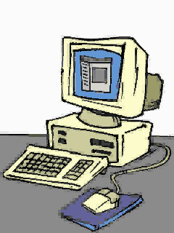


Why is Office 97 good in 2025
And why the heck did this get removed:

Slide 2
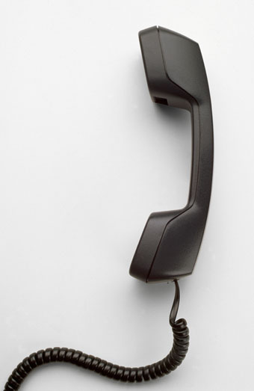

1. No spyware
If you got Office 97 from a credible source, it will make no unwanted network connections.

Slide 3
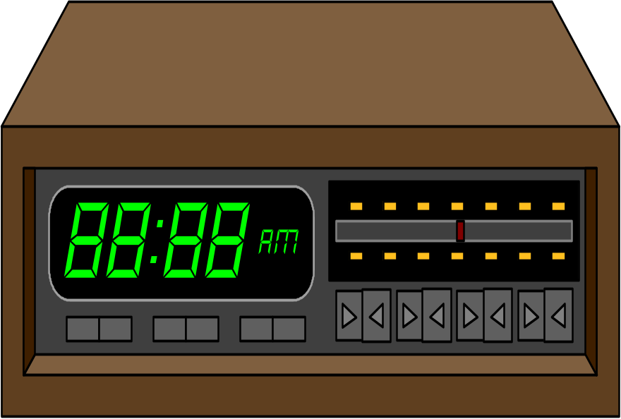

2. Once you get it, you own it
No one can take Office 97 from you via a subscription like they can with Office 365

Slide 4




3. Countless templates and insertables
Examples below:

Slide 5

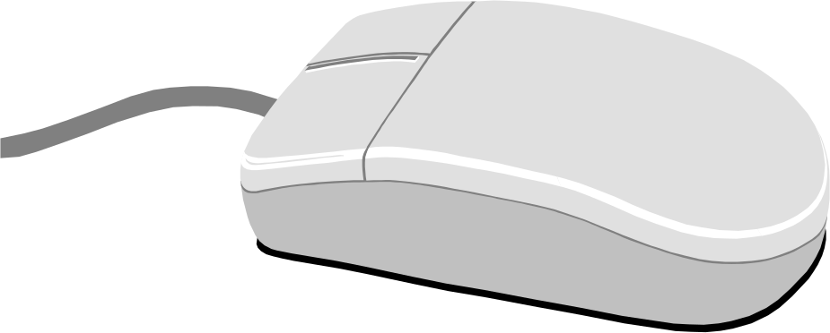
4. Easy to use
Has almost all of the useful functions from Office 365 easily accessible

Slide 6

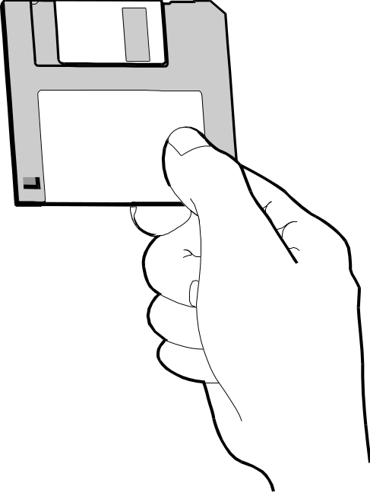
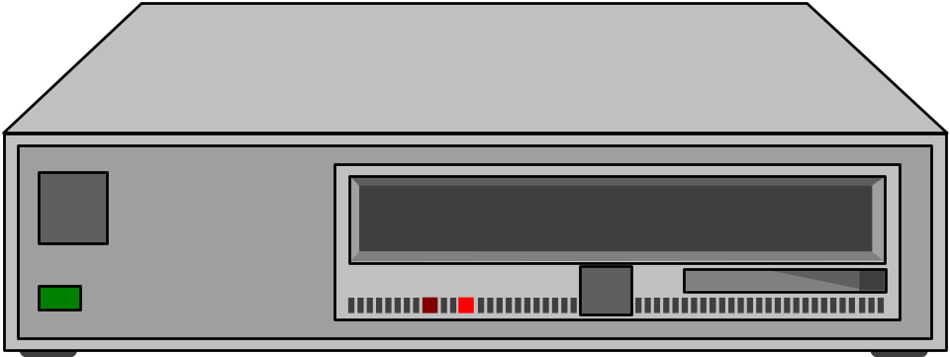
5. Small program and save sizes
Yet still looks nice...

Slide 7


6. It is free
Just download it from InternetArchive and start making what you want!

Slide 8

7. MS Copilot will not annoy you
Clippy just chills in the corner...

Slide 9

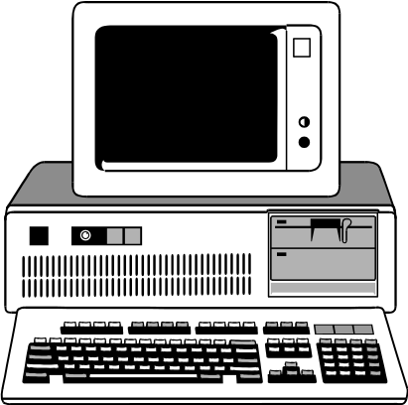


8. Big OS coverage
Works on Windows 95, 98, NT, 2000 and XP, which can be easily emulated even on a modern OS

Slide 10


9. Looks good even on modern OS
It just goes with the times when it comes to the look…

Slide 11
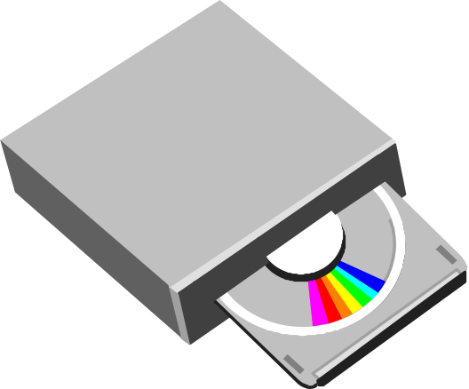


Summary
Office 97 is easy to use, looks good, supports a wide range of Windows versions, is powerful, compact, has no annoying features, will not spy on you and once you get it, you own it.

Slide 12

Thank you for your attention!!!

