Slide 1
IMDB Data Exploration
Preliminary Analysis Summary

Slide 2
Exploration Findings
Some genres show higher average ratings
Movies with more votes have more reliable ratings
Runtime varies significantly across movies

Slide 3
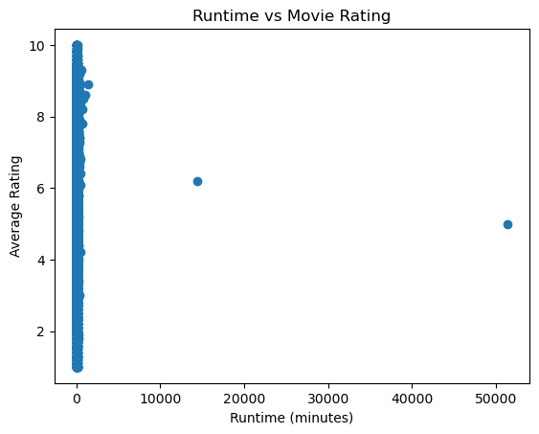
Business Question
Do movies with higher runtimes tend to receive higher ratings and more audience engagement?

Slide 4
Data Cleaning Considerations
Remove NULL values
Filter movies (year ≤ 2019)
Handle multiple genres (e.g., Action, Drama)
Ensure consistent data formats

Slide 5
Key Insight
There is no strong direct relationship between runtime and rating, suggesting other factors influence audience reception.

