Slide 1
WEEKLY EXECUTIVE READOUT
Credit Card
Weekly Performance
Report
Executive readout for monitoring revenue, interest income, transaction activity, and customer mix.
REVENUE
10.79M

Slide 2
REVENUE IS HEALTHY, BUT THE PORTFOLIO IS CONCENTRATED
REVENUE
INTEREST EARNED
10.79M
7.84M
BLUE CARDS
9.18M
LEADERSHIP IMPLICATION
Protect the Blue-card base while testing profitable migration into Silver, Gold, and Platinum.
About 85% of total revenue

Slide 3
WEEKLY KPI SCORECARD SHOULD ANCHOR EVERY LEADERSHIP REVIEW
ACTIVITY
CUSTOMER BASE
45M
10K
total transactions
customer count
CUSTOMER VIEW
CSS
576M
3.19
income represented
customer service experience
Metric | Current value | Weekly management use
Revenue | 10.79M | Track growth and target variance
Interest earned | 7.84M | Monitor monetization
Transactions | 45M | Monitor activity and utilization
Customer count | 10K | Monitor base size
CSS | 3.19 | Monitor customer service experience
Weekly controls: current week, prior week, week-over-week change, target variance, and exception flag. Gender mix is near-even: 5.46M male revenue versus 5.34M female revenue.

Slide 4
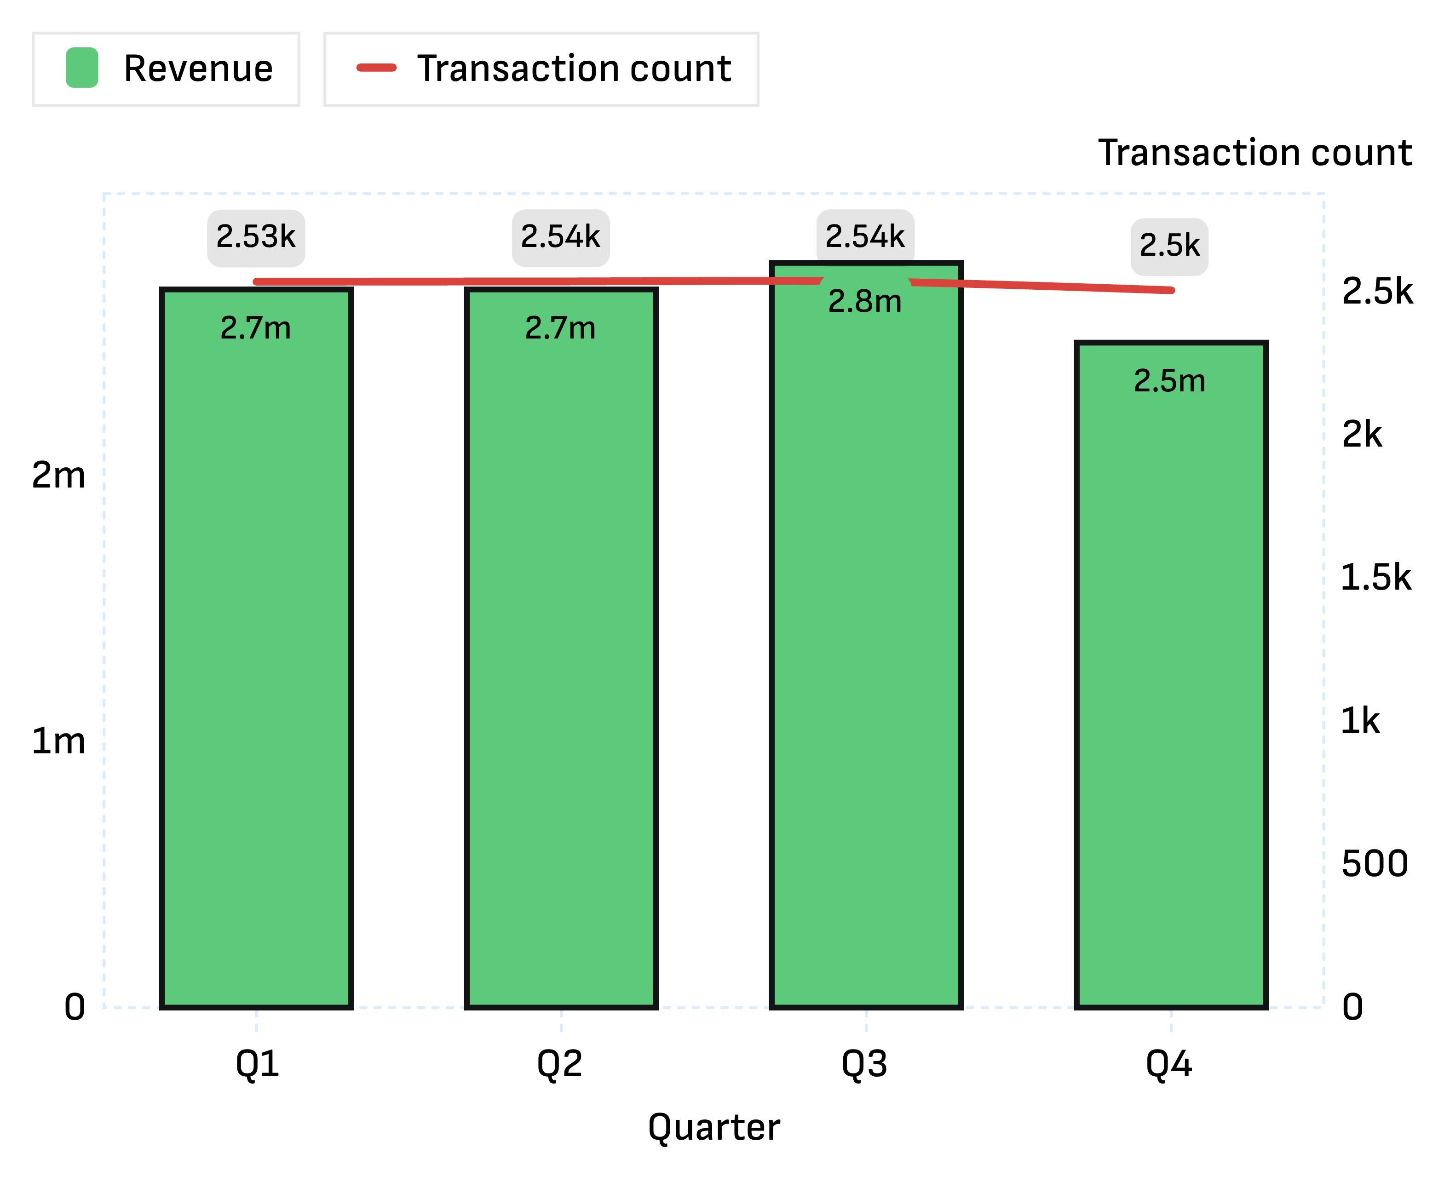
QUARTERLY REVENUE PEAKED IN Q3 BEFORE SOFTENING IN Q4
Revenue was 2.8M in Q3, 2.7M in Q2, 2.7M in Q1, and 2.5M in Q4; quarterly transaction counts stayed tightly grouped between 2,504 and 2,535.
1
SIGNAL
Revenue softened in Q4 while transaction volume remained broadly stable.

Slide 5
CUSTOMER VALUE IS STRONGEST IN MATURE, HIGHER-INCOME SEGMENTS
AGE
EDUCATION
40–45 LEADS
GRADUATES LEAD
2.3M female revenue and 2.5M male revenue.
2.1M female revenue and 2.3M male revenue.
GEOGRAPHY
SPEND CATEGORIES
STATE LEADERS
BILLS LEAD
California leads female state revenue at 1.4M; New York leads male state revenue at 1.3M.
2.8M, followed by Fuel at 1.8M and Grocery at 1.7M.
Use these segments for retention, cross-sell, and spend-category campaigns rather than treating the portfolio as one audience.

Slide 6
RECOMMENDED WEEKLY DASHBOARD ACTIONS
1
MONITOR
Revenue, interest earned, transactions, customer count, CSS, average transaction value, and week-over-week movement.
2
DIAGNOSE
Drill from quarter to week, card category, state, age band, income, job, education, and spend type.
3
PRIORITIZE
Defend Blue-card retention, improve premium-card penetration, and target high-value 40–45 and graduate segments.

