Slide 1
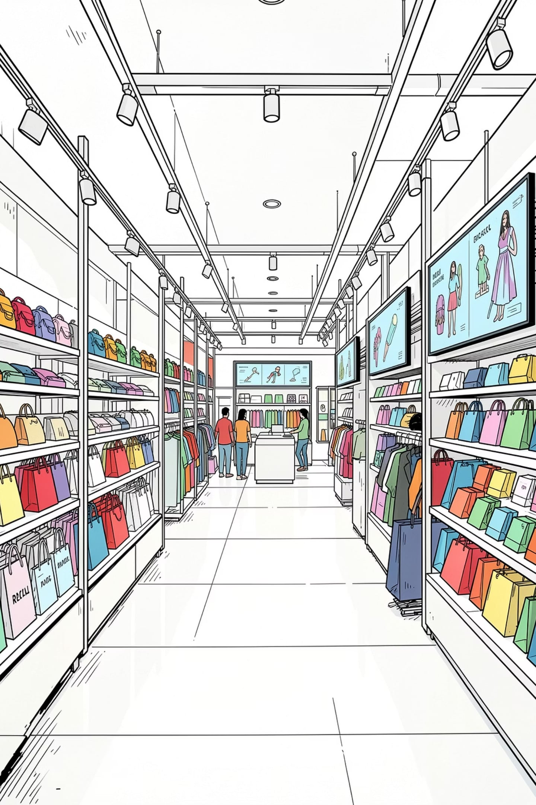
Retail Revenue Leakage Analysis
Despite sustained revenue growth over three years, a leading retail chain has experienced declining profitability — signaling hidden revenue leakage. This analysis uses Excel, Python, SQL, and Power BI to uncover the root causes and deliver actionable strategies.
DATA-DRIVEN INVESTIGATION
RETAIL ANALYTICS

Slide 2

The Core Problem
Revenue Trend
Profitability Trend
Sustained growth across multiple regions over three years
Consistent decline in overall profit despite rising sales
The Gap
Revenue leakage suspected across operations, discounts, shipping, and product performance

Slide 3




Data Model Overview
Four interconnected tables form the analytical foundation.
Fact Sales
Products
Central transactional table — quantities, pricing, discounts, costs, and profit margins per transaction.
Product details: name, category (Furniture, Office Supplies, Technology), and sub-category.
Customers
Stores
Customer profiles by segment: Consumer, Corporate, and Home Office.
Retail branch names and geographic regions for regional profitability analysis.

Slide 4
Exploratory Data Analysis
Python-based EDA examined seven key business areas to identify trends, patterns, and revenue leakage sources.
01
02
03
Revenue Analysis
Profitability Analysis
Product Performance
Overall sales performance and patterns
Revenue vs. operating profit relationship
High and low-performing products; focus on the top 7 lowest-profit products
04
05
06
Store Performance
Customer Segments
Shipping Analysis
Operating profit by branch to identify underperformers
Revenue and profit contribution by segment
Impact of shipping modes on profitability
07
Discount Analysis
Scatter plot revealed negative correlation between discount % and profit; discounts above ~15% likely generate losses

Slide 5

SQL & Power BI Analysis Pipeline
Python EDA
Cleaning and normalization
Three-Phase Analytics Pipeline
Power BI
SQL Server
Star schema, DAX, dashboards
Business queries and aggregations
Cleaned datasets from Python were exported to SQL Server Management Studio for business-focused analytical queries, then modeled in Power BI with a star schema and DAX measures to build interactive executive dashboards.

Slide 6
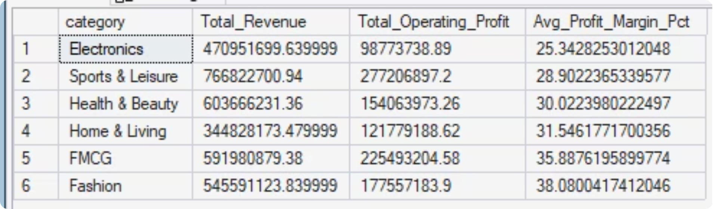
Key Findings: Products & Discounts
Underperforming Categories
Electronics and Sport & Leisure underperformed across all regions. Health & Body, Electronics, and Home & Living generate high sales but low profits.
Discount Impact
Discount bands of 11%–20% and above consistently generated low profit. Electronics has the highest discount rate yet still produces low profit — a clear leakage point.

Slide 7
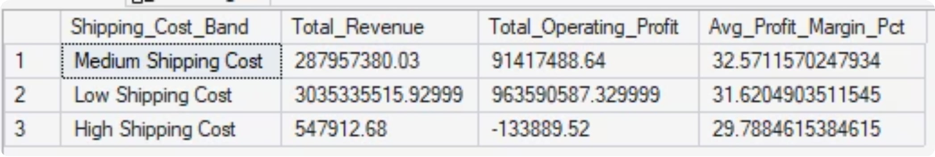

Key Findings: Shipping Costs
High Shipping Cost = Active Losses
Orders in the "High Shipping Cost" band (above ₦15,000) are actively losing money:
Shipping modes Second Class and Standard Class generated higher profits and should be prioritized.
Revenue Generated
Operating Profit
$547,912.68
−$133,889.52

Slide 8
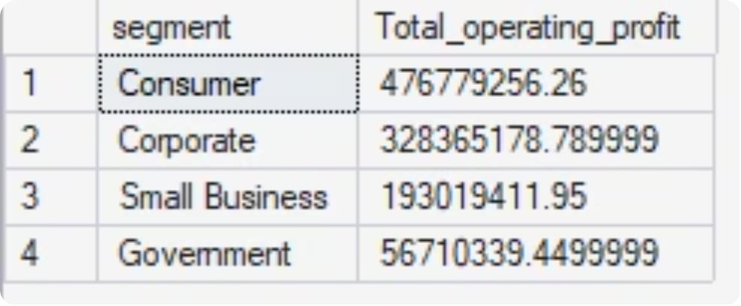
Key Findings: Customers & Regions
Customer Segments
Consumer segment customers are the most loyal and generate the highest profits across all segments.
Regional Leakage
The South (24.96% of revenue) and North (24.16% of revenue) contribute significant sales but generate disproportionately low profit — requiring immediate operational review.

Slide 9
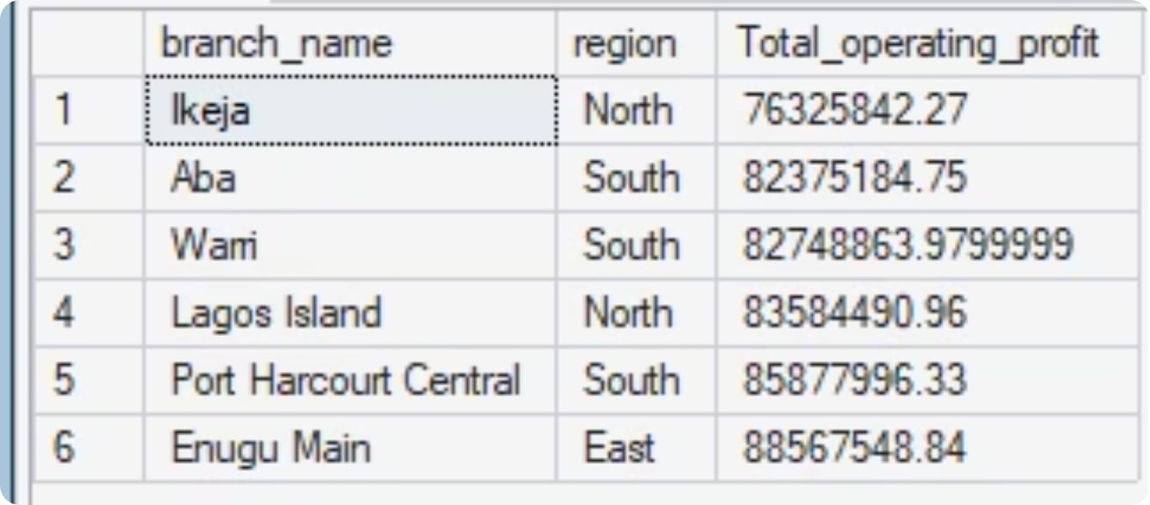
Key Findings: Stores & Sales Trends
Stores Requiring Attention
Ikeja and Aba branches show the weakest operating profit performance and need immediate operational intervention.
Sales Performance Over Time
Sales have grown year-over-year, confirming that the profitability decline is driven by operational inefficiencies — not falling demand.

Slide 10
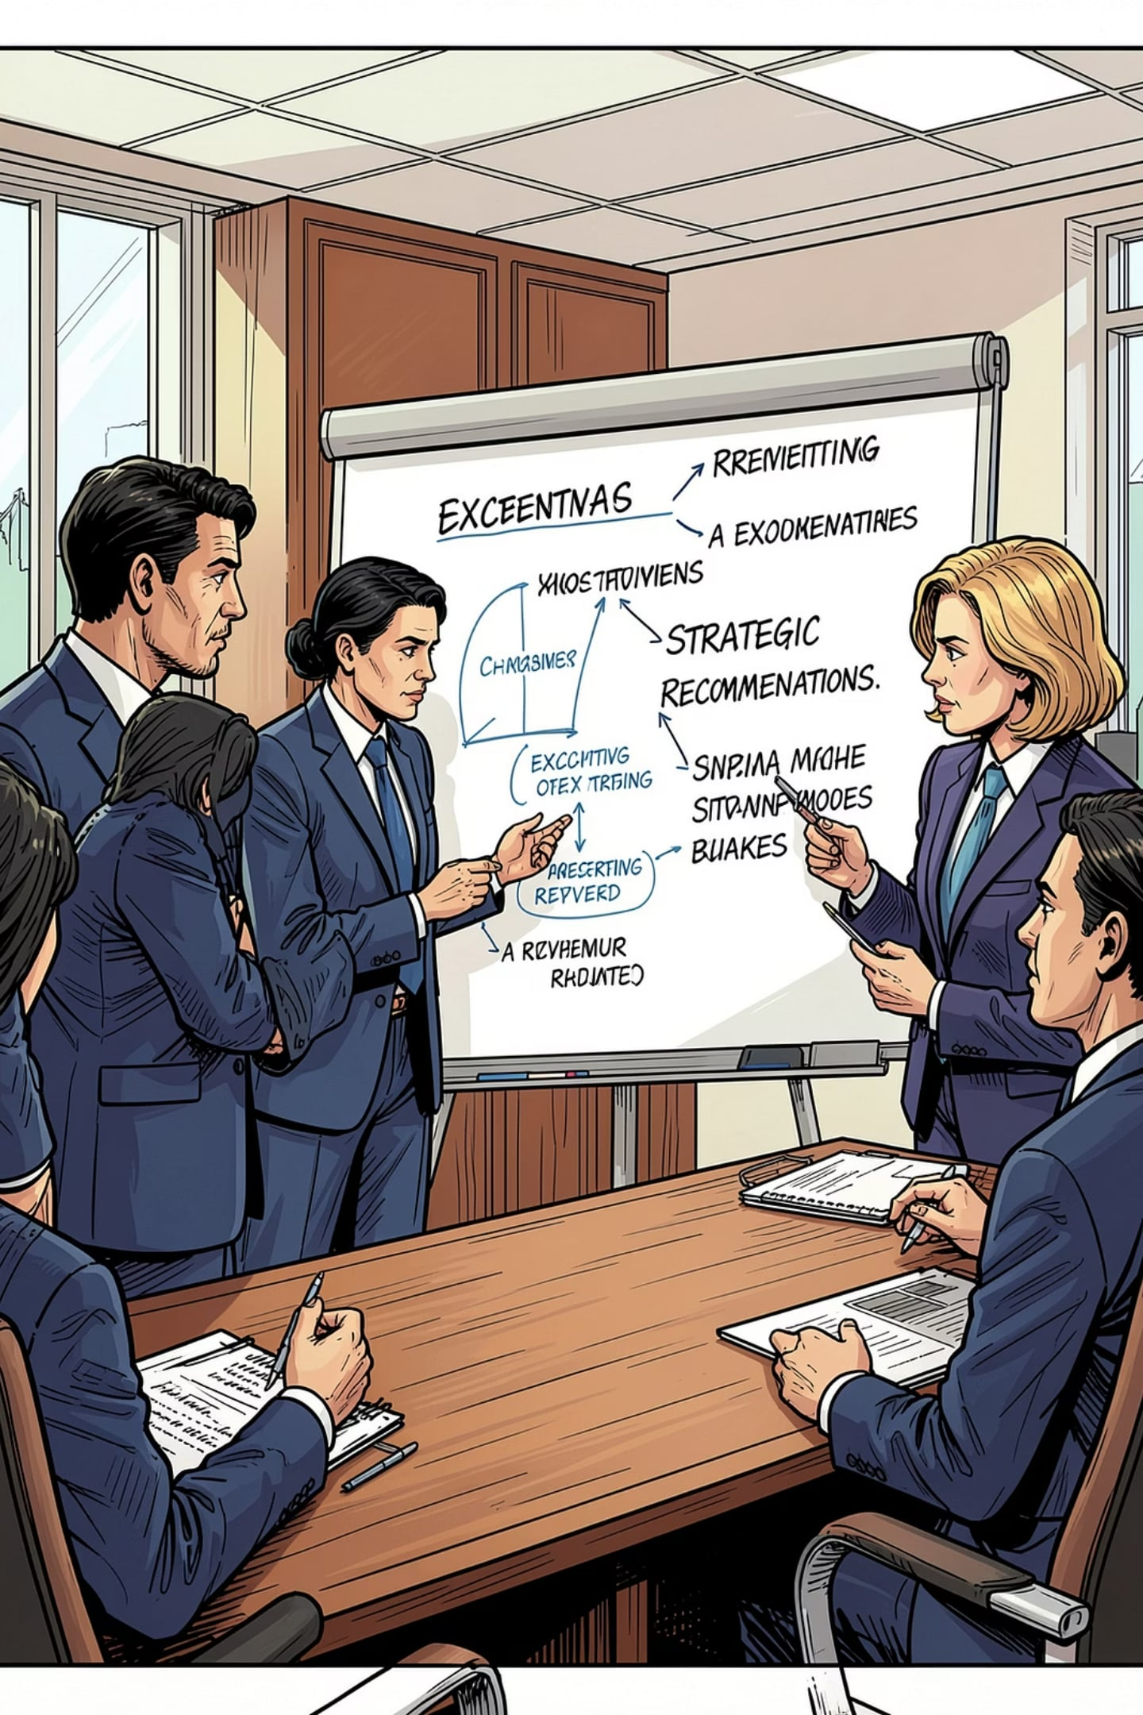


Recommendations
Cap Discounts at 15%
1
Eliminate discounts above 15%; reduce Electronics discounts specifically.
Optimize Shipping Modes
2
Prioritize Second Class and Standard Class shipping for better margins.
Focus on Low Performers
3
Direct attention to underperforming product categories and the Ikeja and Aba branches.
Investigate North & South Regions
4
Assess staff performance, delivery times, and customer satisfaction in these high-revenue, low-profit regions.

